Slide 1
Cluster extension 2017-2018, 2019-2020 Science
C. Philippe Escoubet
Project Scientist on behalf of
Cluster Science Working Team
13/10/2016

Slide 2
Cluster Science
Cluster science performance
Cluster confirmation that science objectives planned in 2017-2018 can be achieved
Cluster new science objectives for 2019-2020

Slide 3
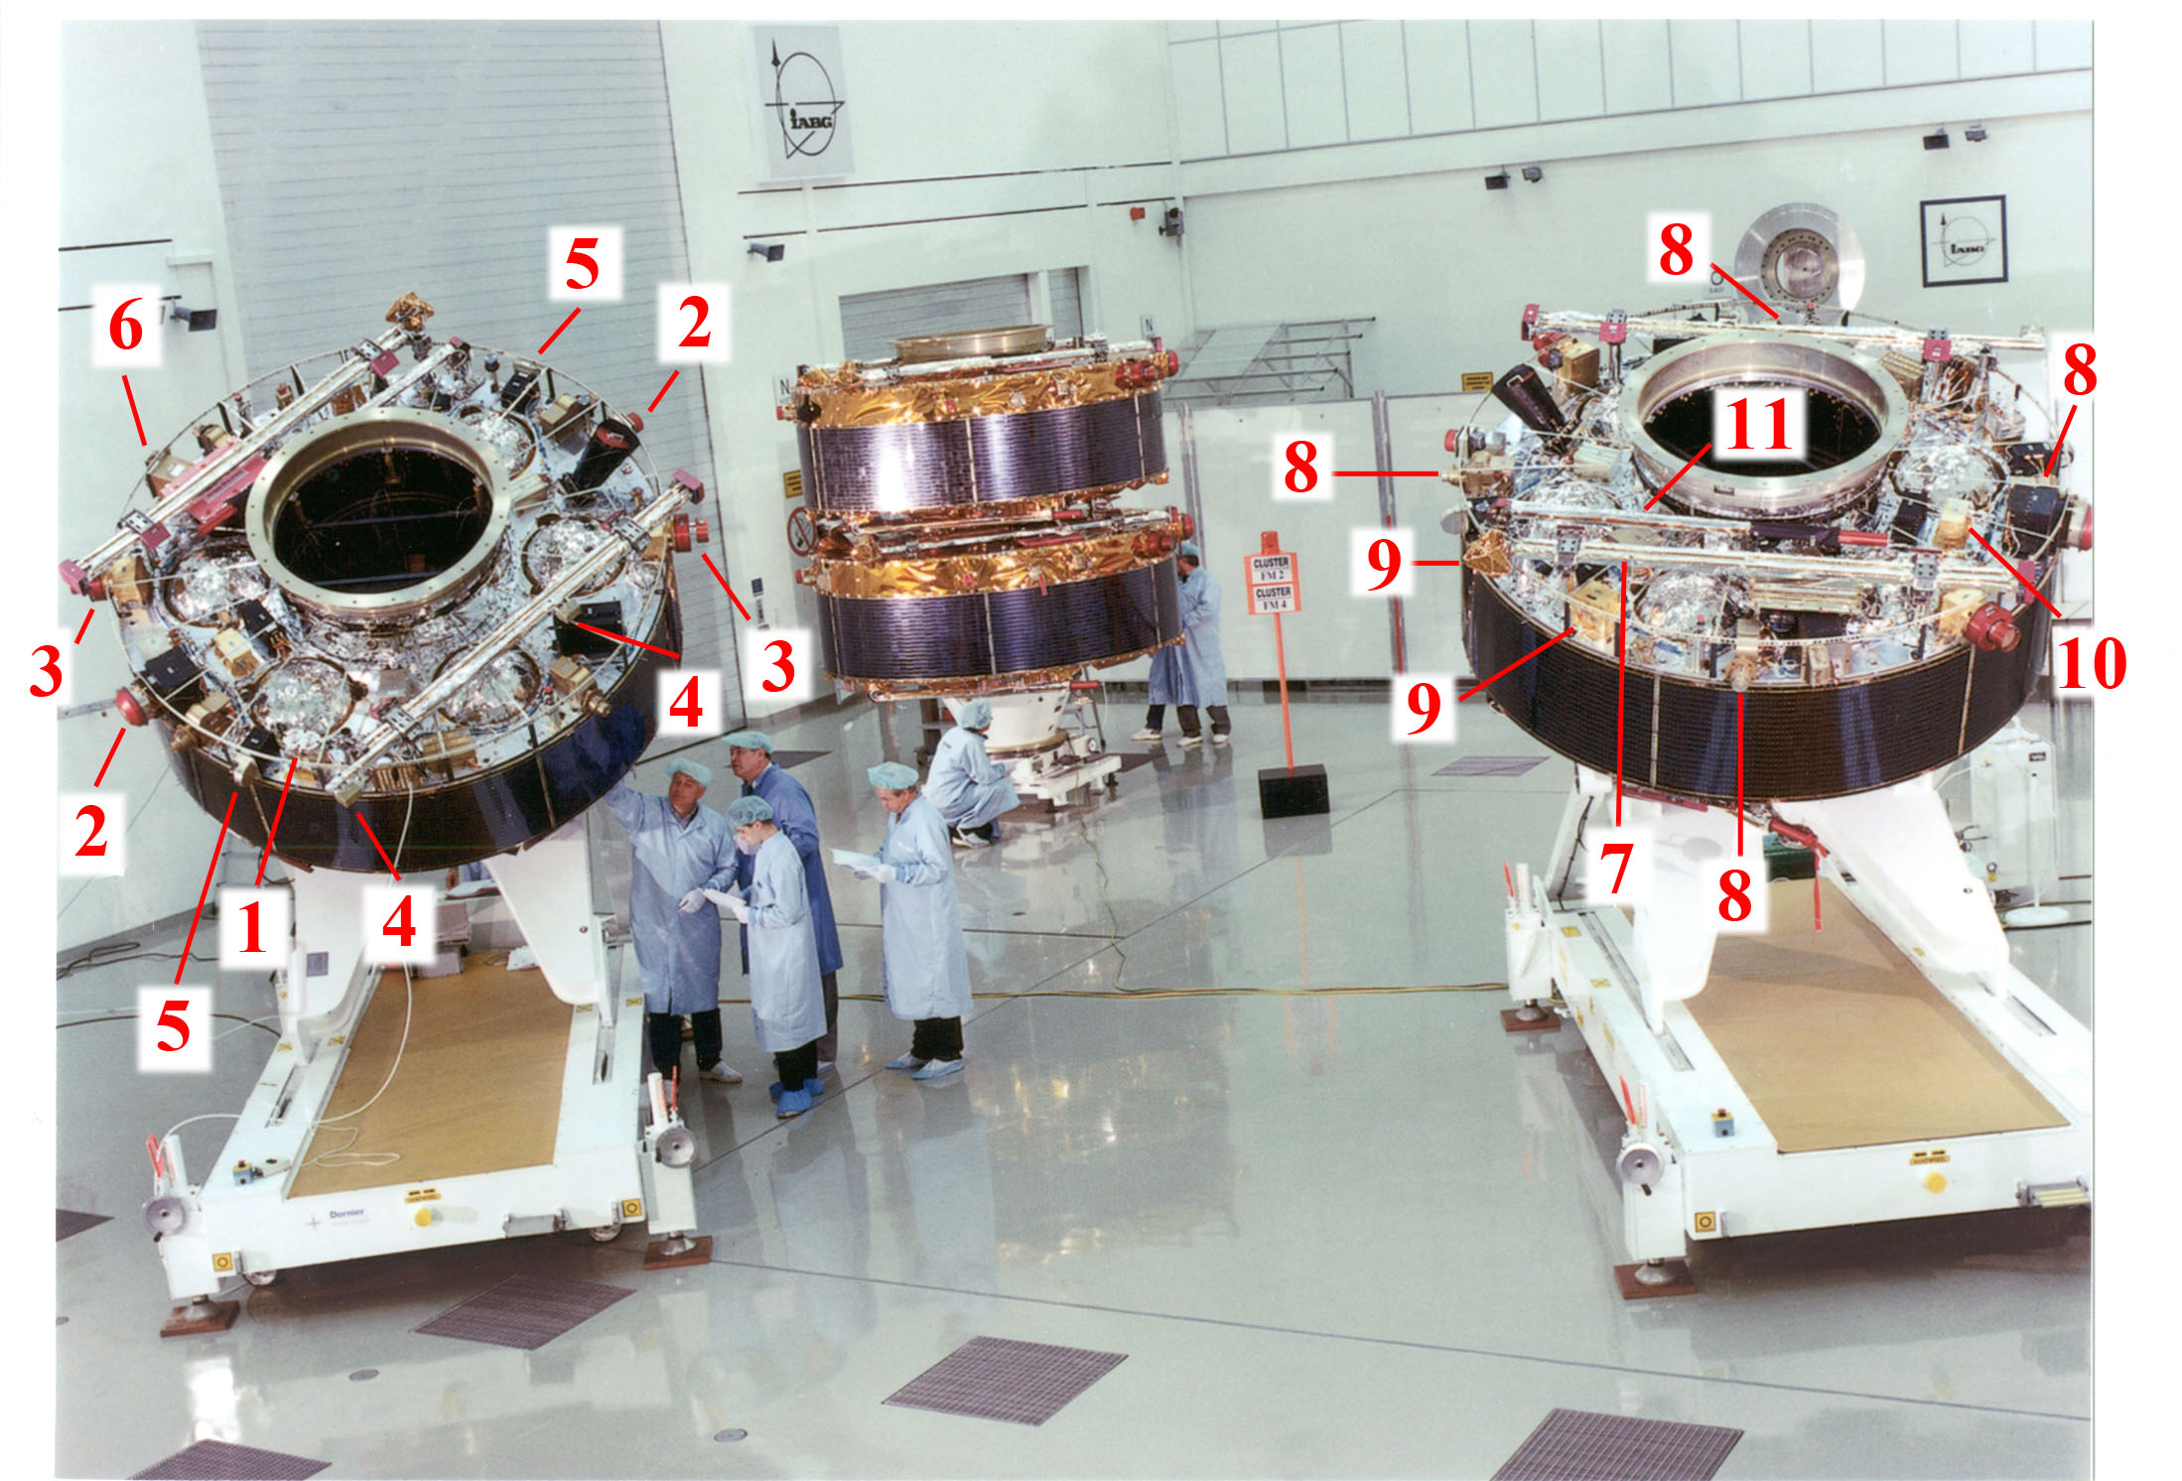
Cluster
Four identical spacecraft
44 instruments with 76 sensors
Measurements:
Ions, e- (2,5,6)
Magnetic field (4)
Electric field (3,8)
Electromagnetic waves (7,9,10,11)
Spacecraft potential control (1)

Slide 4
Cluster Science
Cluster science performance
Cluster confirmation that science objectives planned in 2017-2018 can be achieved
Cluster new science objectives for 2019-2020

Slide 5
Cluster refereed publications 1
August 2016

Slide 6
Cluster refereed publications 2
Journals
Nature/Science | 26
JGR | 818
GRL | 234
Annales Geophysicae | 516
Physics of Plasmas | 61
Physical Review Letters | 69
Astrophysical Journal (incl. Lett.) | 59
Others | 611
Total | 2394
Rest of the World
13%
USA
25%
China
12%
Europe
50%

Slide 7
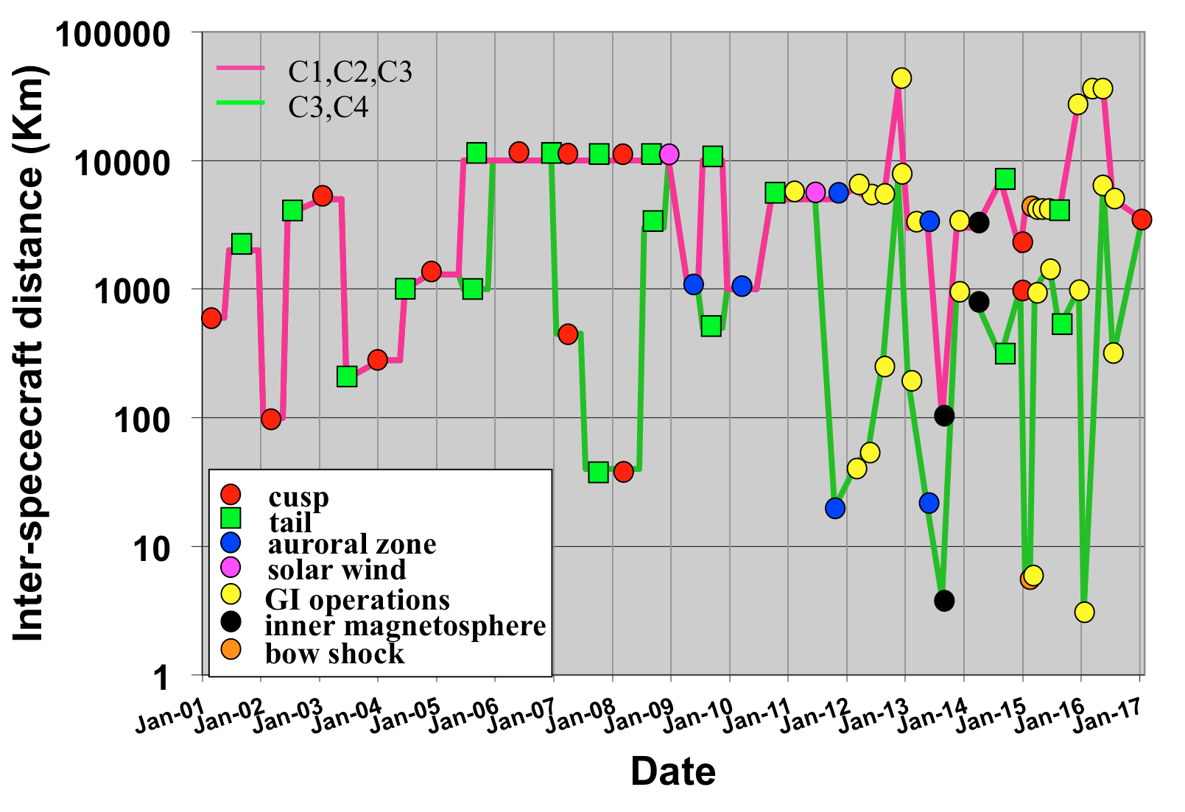
Cluster inter-spacecraft distances
41 constellation manoeuvres
2nd Guest Investigator (GI) operations completed
Large distances (27000 km) repeated in Spring 2016
Smallest distance achieved in 2016: 3 km
New tetrahedron in 2016-2017
3 km

Slide 8
Cluster Science
Cluster science performance
Cluster confirmation that science objectives planned in 2017-2018 can be achieved
Cluster new science objectives for 2019-2020

Slide 9
Scientific performance for 2017 and 2018
to characterise the jet braking region with Cluster at multi-scales
Orbit is as expected and instruments are working nominally (mission extension review)
to determine the extent of the polar cusp in longitude and investigate its dawn dusk asymmetries
Orbit is as expected and instruments are working nominally
to study the magnetosphere-ionosphere coupling together with Swarm with 60-90 deg. orbits
Cluster and Swarm working as expected. Swarm collaborations initiated. Swarm nominal mission up to May 2018 which is enough for investigation
to investigate the macro and micro physics scales of the magnetosphere simultaneously using THEMIS, Van Allen Probes and MMS constellation missions
THEMIS, Van Allen Probes collaborations initiated. MMS launched as planned in March 2015. THEMIS-Cluster workshop in Nov. 2016 (MMS invited but it was too early for them)
Notes:
Many teams in European labs working on both MMS and Cluster data.

Slide 10
Cluster Science
Cluster science performance
Cluster confirmation that science objectives planned in 2017-2018 can be achieved
Cluster new science objectives for 2019-2020

Slide 11
Cluster Science Objectives for 2019-2020
To characterise chorus waves at both low and high-latitude with 3km inter-spacecraft distance
To investigate bow shock/magnetosheath/magnetopause physics with local solar wind monitor
To investigate evolution of Kelvin–Helmholtz waves on the flank of the magnetosphere
To open a call for young scientists to perform Cluster science operations (spacecraft separation+instrument modes) for 3 months.

Slide 12
Cluster Science Objectives for 2019-2020
To characterise chorus waves at both low and high latitude with 3km inter-spacecraft distance
To investigate bow shock/magnetosheath/magnetopause physics with local solar wind monitor
to investigate evolution of Kelvin–Helmholtz waves on the flank of the magnetosphere
To open a call for young scientists to perform Cluster science operations (spacecraft separation+instrument modes) for 3 months.

Slide 13
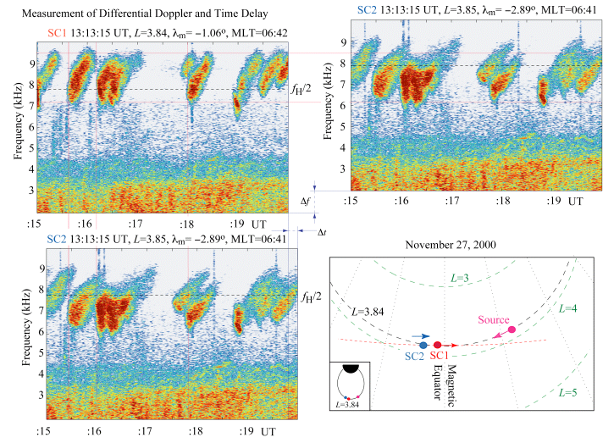

Chorus observations frequency shift
C1
Chorus are electromagnetic waves at audible frequencies naturally generated in space close to the magnetic equator or magnetic minimum.
Play an important role in the local acceleration of electrons to relativistic energies in the outer radiation belt.
C2
[Inan al., 2004]
Notes:
The first simultaneous measurements of discrete chorus emissions on multiple spacecraft, realized in the context of the Cluster mission, revealed a rather unexpected frequency difference of around 1 kHz between nearly identical discrete elements observed on different spacecraft [Gurnett et al., 2001]. This frequency difference is interpreted herein as a natural outcome of the dependence of the whistler-mode refractive index on the wave normal angle between the wave vector k and the static magnetic field B₀ and the rapid motion of highly localized source region(s) of chorus of 400 km to 1700 km in extent along the field line, but only less than 100 km transverse to the magnetic field, and moving at speeds of 20,000 km/s to 25,000 km/s. Wave packets emanating from the localized regions propagate to two spacecraft at different wave normal angles, and are observed at different frequencies due to the differential Doppler shift between the two spacecraft. These differences in frequency, as well as the different times of arrival of the similar emissions at the different spacecraft, provide a unique opportunity to estimate the source characteristics, using a model involving rapidly moving sources traveling at speeds comparable to the parallel resonant velocity of counterstreaming electrons moving along the Earth's magnetic field lines. We report the determination of chorus emission source region motion for two different cases observed during 2000-2001, where these differences in frequency were readily observable due to the relatively large separation of the Cluster spacecraft. We also report a case in 2002 where the spacecraft separations were smaller, so that these frequency differences were not as evident but nevertheless measurable. In general, our results provide the first experimental evidence that the sources that generate the discrete chorus emissions are in rapid motion.

Slide 14
Chorus observations frequency shift
C1
Chorus are electromagnetic waves at audible frequencies naturally generated in space close to the magnetic equator or magnetic minimum.
Play an important role in the local acceleration of electrons to relativistic energies in the outer radiation belt.
1 kHz
shift
C2
[Inan al., 2004]
Notes:
The first simultaneous measurements of discrete chorus emissions on multiple spacecraft, realized in the context of the Cluster mission, revealed a rather unexpected frequency difference of around 1 kHz between nearly identical discrete elements observed on different spacecraft [Gurnett et al., 2001]. This frequency difference is interpreted herein as a natural outcome of the dependence of the whistler-mode refractive index on the wave normal angle between the wave vector k and the static magnetic field B₀ and the rapid motion of highly localized source region(s) of chorus of 400 km to 1700 km in extent along the field line, but only less than 100 km transverse to the magnetic field, and moving at speeds of 20,000 km/s to 25,000 km/s. Wave packets emanating from the localized regions propagate to two spacecraft at different wave normal angles, and are observed at different frequencies due to the differential Doppler shift between the two spacecraft. These differences in frequency, as well as the different times of arrival of the similar emissions at the different spacecraft, provide a unique opportunity to estimate the source characteristics, using a model involving rapidly moving sources traveling at speeds comparable to the parallel resonant velocity of counterstreaming electrons moving along the Earth's magnetic field lines. We report the determination of chorus emission source region motion for two different cases observed during 2000-2001, where these differences in frequency were readily observable due to the relatively large separation of the Cluster spacecraft. We also report a case in 2002 where the spacecraft separations were smaller, so that these frequency differences were not as evident but nevertheless measurable. In general, our results provide the first experimental evidence that the sources that generate the discrete chorus emissions are in rapid motion.

Slide 15
Chorus observations frequency shift: under debate
Propagation vs B + high speed of source (Inan et al., 2004) or
Fixed source with frequency variations of directional emission pattern (Chum et al., 2007)
[Inan al., 2004]
Notes:
The first simultaneous measurements of discrete chorus emissions on multiple spacecraft, realized in the context of the Cluster mission, revealed a rather unexpected frequency difference of around 1 kHz between nearly identical discrete elements observed on different spacecraft [Gurnett et al., , 2001]. This frequency difference is interpreted herein as a natural outcome of the dependence of the whistler-mode refractive index on the wave normal angle between the wave vector k and the static magnetic field B₀ and the rapid motion of highly localized source region(s) of chorus of 400 km to 1700 km in extent along the field line, but only less than 100 km transverse to the magnetic field, and moving at speeds of 20,000 km/s to 25,000 km/s. Wave packets emanating from the localized regions propagate to two spacecraft at different wave normal angles, and are observed at different frequencies due to the differential Doppler shift between the two spacecraft. These differences in frequency, as well as the different times of arrival of the similar emissions at the different spacecraft, provide a unique opportunity to estimate the source characteristics, using a model involving rapidly moving sources traveling at speeds comparable to the parallel resonant velocity of counterstreaming electrons moving along the Earth's magnetic field lines. We report the determination of chorus emission source region motion for two different cases observed during 2000-2001, where these differences in frequency were readily observable due to the relatively large separation of the Cluster spacecraft. We also report a case in 2002 where the spacecraft separations were smaller, so that these frequency differences were not as evident but nevertheless measurable. In general, our results provide the first experimental evidence that the sources that generate the discrete chorus emissions are in rapid motion.

Slide 16
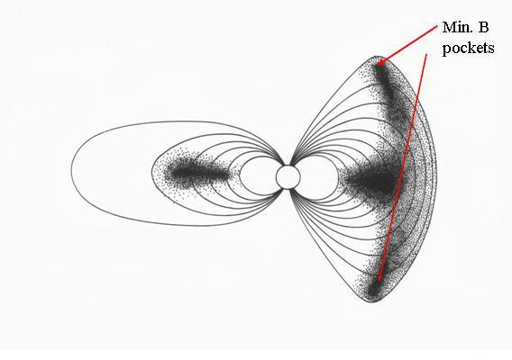
Chorus at high-latitude: local or remote generation
Chorus emissions at 3 km inter-spacecraft distance
High-latitude
Chorus
High-latitude chorus:
locally generated (Vaivads et al., 2007) or
propagating from equatorial region (Menietti et al., 2009)
Cluster: only mission able to study high-latitude chorus with polar orbit
Equatorial chorus
Tsurutani and Smith, JGR 1977

Slide 17
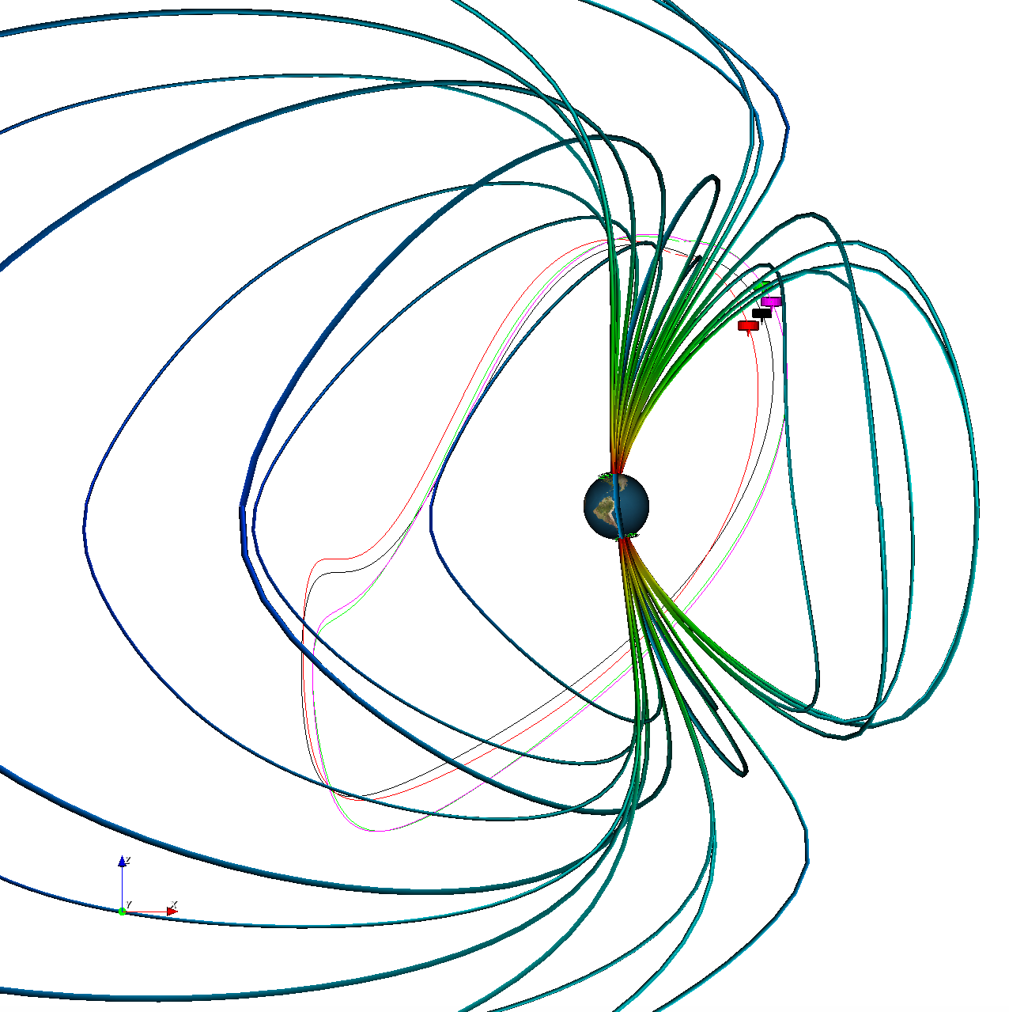
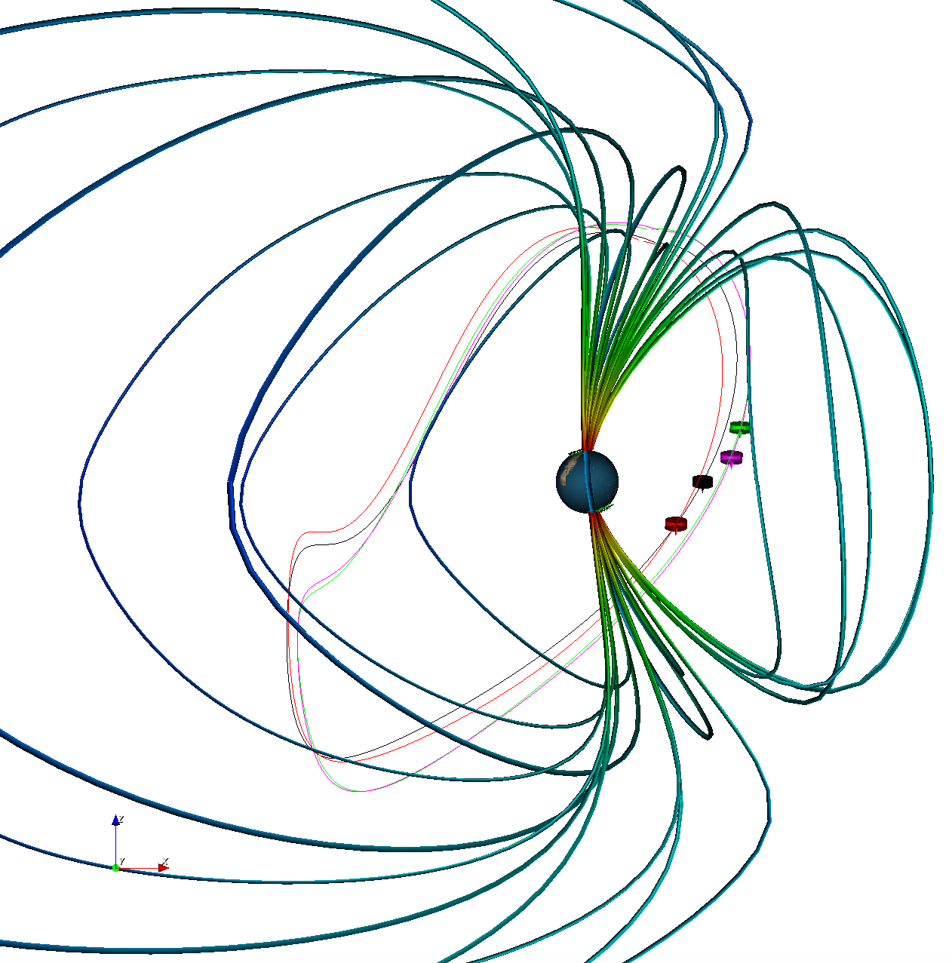
Low and high latitude chorus quasi-simultaneously in October 2019
Current chorus observations 2019
High latitude chorus
Low latitude chorus (3h later)
Cluster
Notes:
We may also think if laging one s/c by a few hours would allow to observe both low and high latitude at the same time. This could be combine with the large manoeuvre for local solar wind monitor

Slide 18
Low and high latitude chorus quasi-simultaneously in October 2019
Current chorus observations 2019: C1 drift by 3h
High latitude chorus
Low latitude chorus (3h later)
Cluster
Notes:
We may also think if laging one s/c by a few hours would allow to observe both low and high latitude at the same time. This could be combine with the large manoeuvre for local solar wind monitor

Slide 19
Cluster Science Objectives for 2019-2020
To characterise chorus waves at both low and high latitude with 3km inter-spacecraft distance
To investigate bow shock/magnetosheath/magnetopause physics with local solar wind monitor
to investigate evolution of Kelvin–Helmholtz waves on the flank of the magnetosphere
To open a call for young scientists to perform Cluster science operations (spacecraft separation+instrument modes) for 3 months.

Slide 20
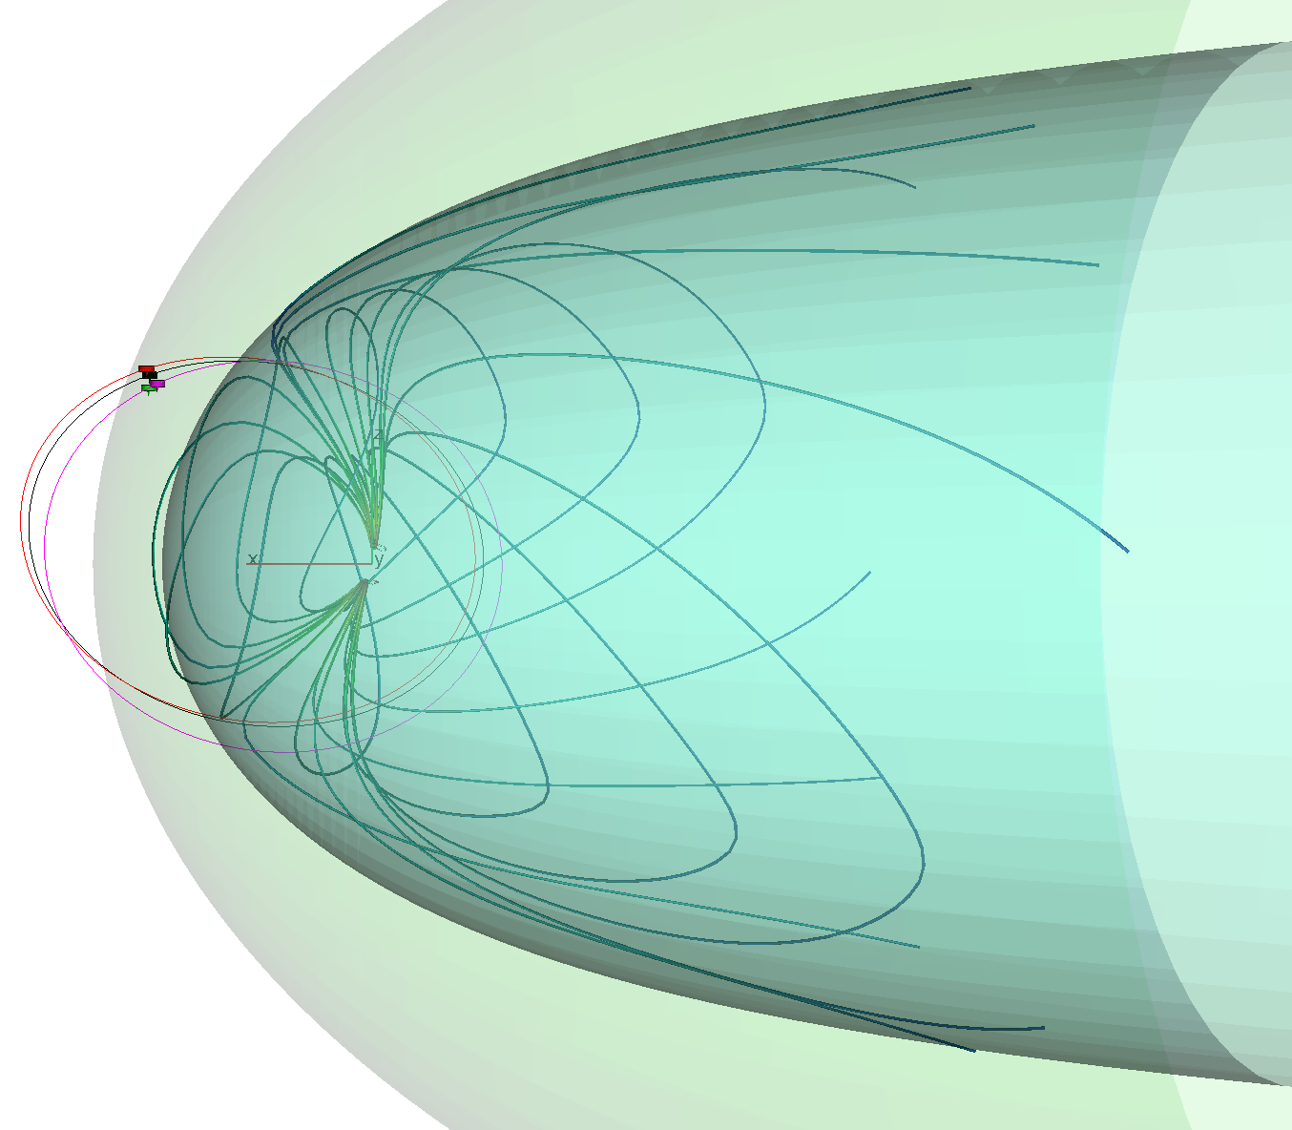

Cluster measurements of dayside plasma boundaries and structures
Bow
shock
Magnetopause
Cluster
Magnetosheath structures:
Hot flow anomalies
High-speed jets
Solar
wind
Sun

Slide 21
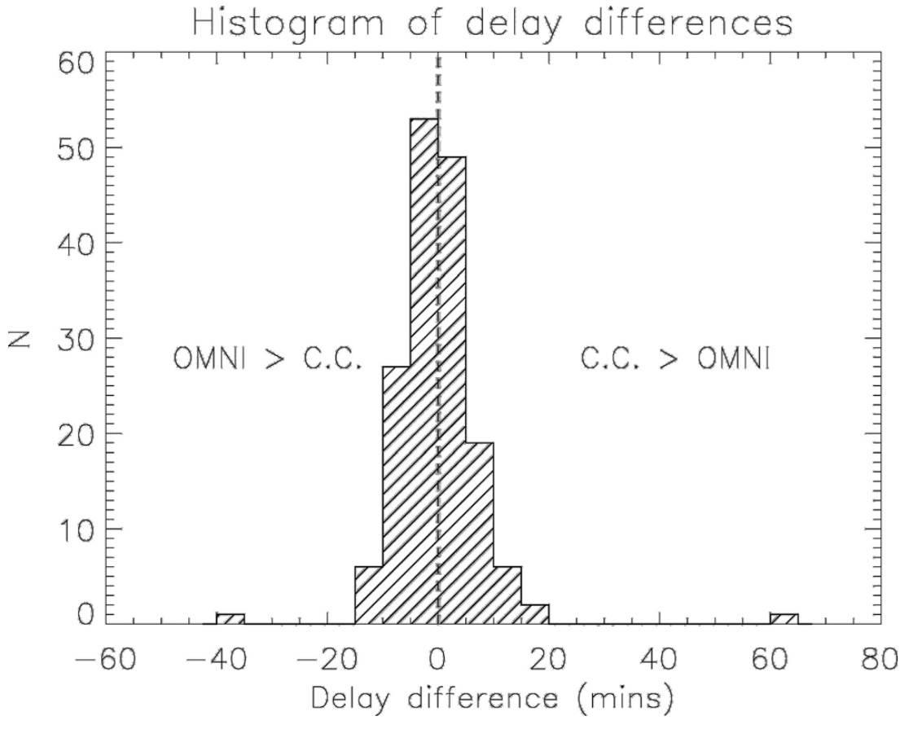
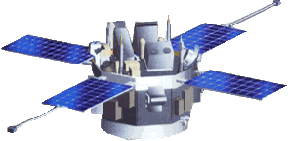
Solar wind “classical” L1 monitor
30min-1h30
Propagation time
ACE/SOHO/Wind
L1
Solar
wind
220 Re
10 Re
(Case and Wild, 2012)
=> L1 too far away for structures in dayside boundaries

Slide 22
C1 as “local” solar wind monitor: lag other s/c by 8h
Use one of the Cluster spacecraft as local solar wind monitor
Local solar wind monitor for extended period of time
Would take up 3-6 months to drift C1 to that position
C2,C3,C4
C1

Slide 23
Cluster Science Objectives for 2019-2020
To characterise chorus waves at both low and high latitude with 3km inter-spacecraft distance
To investigate bow shock/magnetosheath/magnetopause physics with local solar wind monitor
to investigate evolution of Kelvin–Helmholtz waves on the flank of the magnetosphere
To open a call for young scientists to perform Cluster science operations (spacecraft separation+instrument modes) for 3 months.

Slide 24
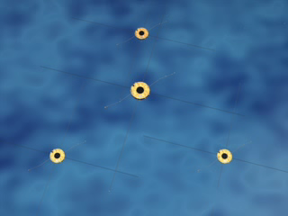
Kelvin-Helmholtz waves observed by Cluster
Kelvin-Helmholtz waves rolling-up
Vortex
Cluster
H. Hasegawa et al., 2004)
Notes:
Les vents solaires, plasma emis continuellement par le soleil, peut sous certaines condition creer de gigantesques vortex a la surface externe de la magnetosphere
C’est analoque au vent qui donne naissance aux vagues a la surface de l’ocean. Ce qu’on voit avec Cluster, grace a ses observations en 3D, c’est que les vagues s’enroulent sur elles memes pour creer des vortex.
C’est un processus tres important car il permettrai au particules du vent solaire d’entrer dans la magnetosphere. Les particules du vent solaire peuvent produires les aurores polaires mais aussi avoir des effets dramatiques sur la vie de tous les jours (communications, anomalies ou destructions satellites, lignes electriques en sur-tension dans les pays Nordqiues.

Slide 25
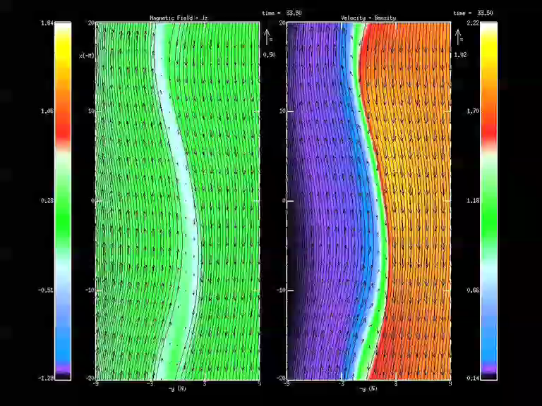
Ideal configuration of Cluster-MMS to study K-H waves evolution
Evolution of Cluster and MMS orbits approach them in 2019
Cluster and MMS will be skimming the magnetopause
MMS high resolution small scales and Cluster multi-scales
SWARM will investigate effect of K-H waves in the polar cap
=> evolution of K-H waves as they propagate downstream
=> reconnection inside vortex with 4 points measurements
MMS
(4 s/c)
Cluster
(4 s/c)
Sun
SWARM
(3 sc)
THEMIS
(3 s/c)
Notes:
MMS and Swarm not yet extended but likely to happen.

Slide 26
Cluster Science Objectives for 2019-2020
To characterise chorus waves at both low and high latitude with 3km inter-spacecraft distance
To investigate bow shock/magnetosheath/magnetopause physics with local solar wind monitor
to investigate evolution of Kelvin–Helmholtz waves on the flank of the magnetosphere
To open a call for young scientists to perform Cluster science operations (spacecraft separation+instrument modes) for 3 months.

Slide 27
Science Operations Planning by Young scientists 1/2
Train young European scientists: play the role as PI of an ESA space mission.
Create a network of young European space scientists (publish joint papers).
Science planning using fresh eyes and new ideas.
Outreach (web stories)

Slide 28
Science Operations Planning by Young scientists 2/2
AO for PhDs-PhDs+4 years
Cover 3 month Cluster planning (s/c config + instr. modes)
Young scientists invited to two SOWGs:
1st SOWG: 1 day training on mission+instruments + participation to SOWG
2nd SOWG: young scientists decides s/c config + instr.
Scientific proposal by young scientists: select 5-10 scientists and only the best proposal to be implemented

Slide 29
Why is Cluster unique?
Latest Tsyganenko model
Data used (Cluster in green) 1995-2012
Cluster
Geotail
Polar
THEMIS A,D,E
THEMIS B,C
[Tsyganenko 2014]
Polar orbit: Cluster
- Equatorial orbit: Geotail, THEMIS, Van Allen Probes, MMS
Constellation: ion scale tetrahedron and multi-scale (e-/ion, ion/fluid)
Most sensitive search coil magnetometer (turbulence)
Unique active plasma sounder (absolute local density)

Slide 30
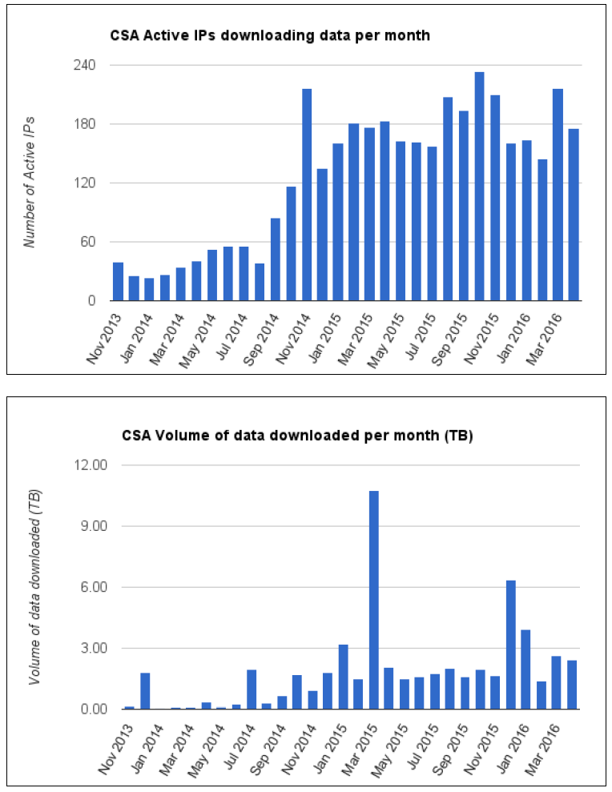
Cluster Science Archive
Contains all high-resolution data from Cluster instruments
Total number of users over 1900
Average monthly active IP number around 180
Average monthly download rate of 2 TB (10 TB peak)
Calibration effort:
2 cross-calibration meetings/year
1 annual review
first dedicated book on the Cluster archive was published in 2010 and consisted of more than 30 refereed papers (11632 chapters downloaded, 70% in 2014-2015)
Notes:
A call is done synchronously to the server

Slide 31
Summary and conclusion
Cluster continues to make discoveries and has a high scientific output thanks its unique orbit, the capabilities to change the spacecraft distances and the fast access to all data
Extension 2017-2018:
All four science objectives presented in 2014 can be achieved
Extension 2019-2020 new science objectives:
To characterise chorus waves at both low and high latitude with 3km inter-spacecraft distance
To investigate bow shock/magnetosheath/magnetopause physics with local solar wind monitor
to investigate evolution of Kelvin–Helmholtz waves on the flank of the magnetosphere
To open a call for young scientists to perform Cluster science operations (spacecraft separation + instrument modes) for 3 months.

