Slide 1
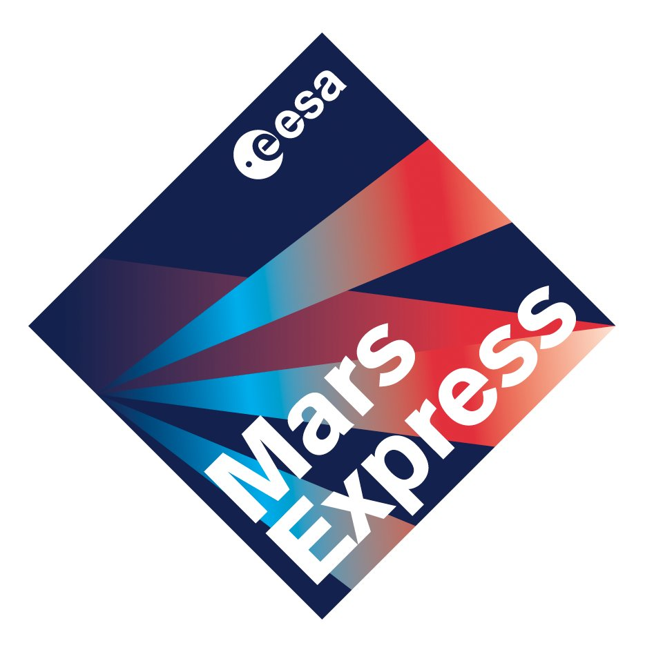

Fifteen Years of a
Mars-Orbiting Radar
Andy Kopf
Univ. of Iowa MARSIS Team Manager
UNI Department Colloquium
January 23, 2019

Slide 2
A brief outline
Mars, MARSIS, and Mars Express
Early MARSIS Results and Discoveries
A Layered Ionosphere – 2008 vs. 2017
Recent MARSIS Science Highlights
The Future of MARSIS and Mars Express

Slide 3
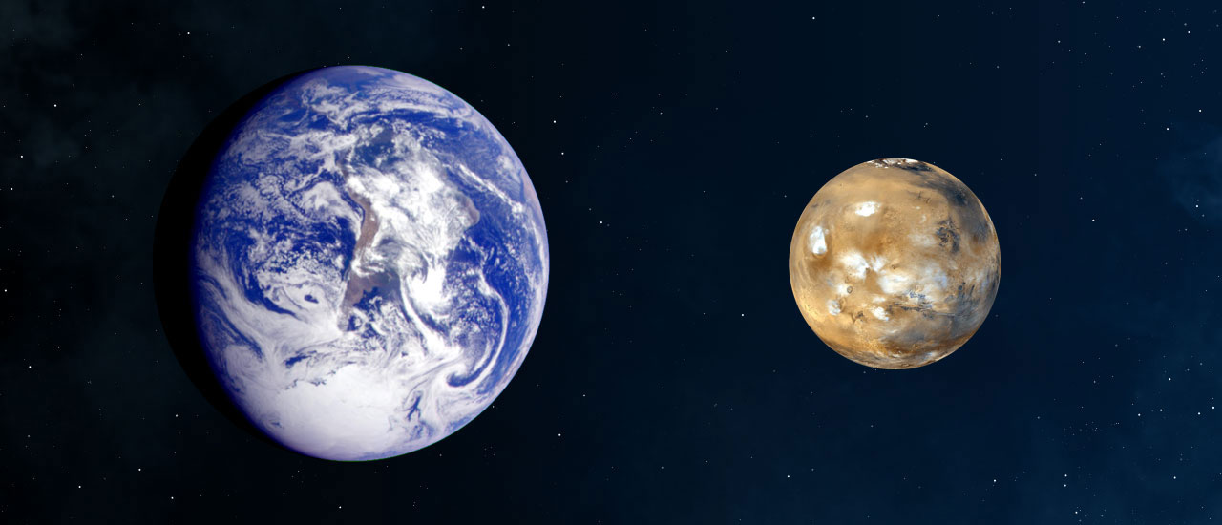
EARTH VS. MARS

Slide 4
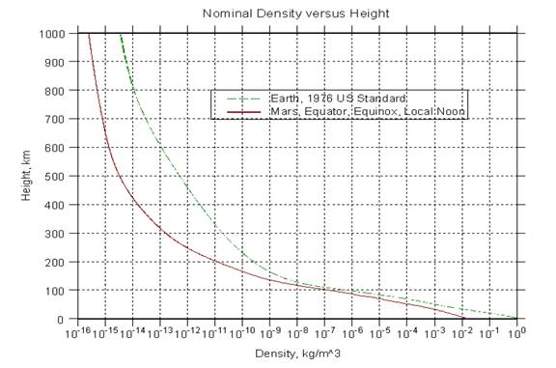
Atmospheric density

Slide 5
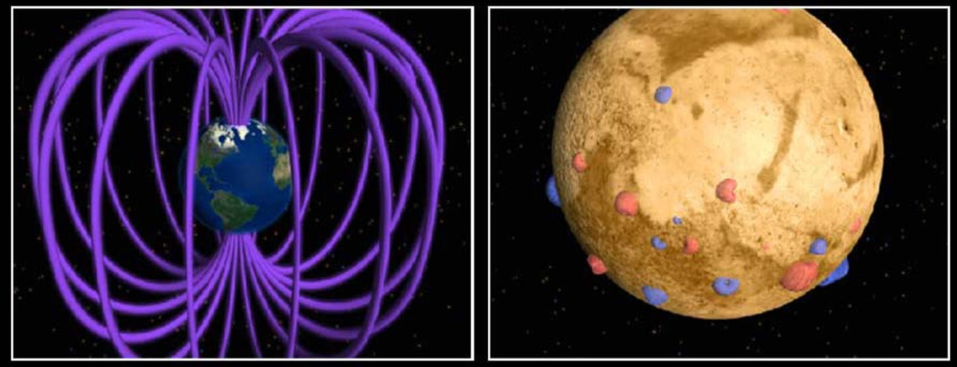
MAGNETIC FIELDS

Slide 6
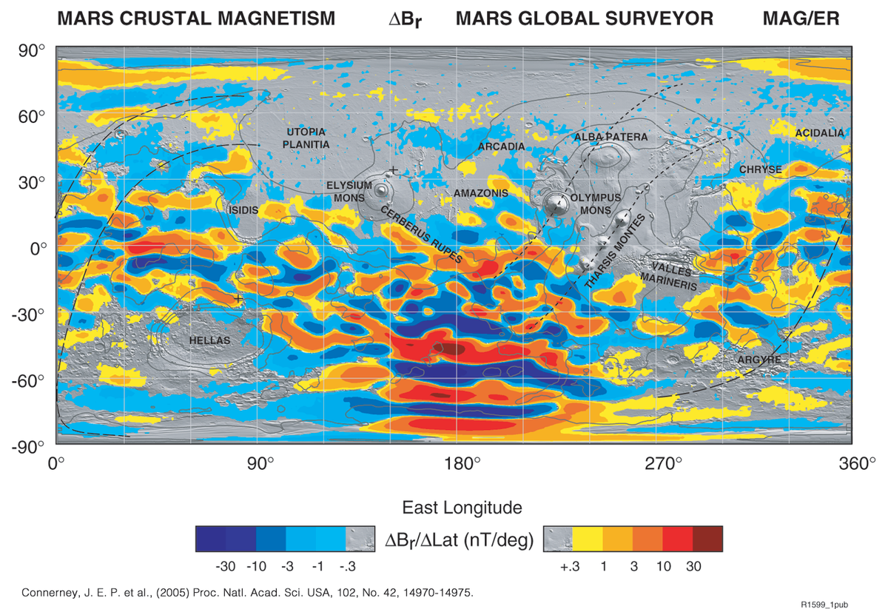
Crustal fields

Slide 7
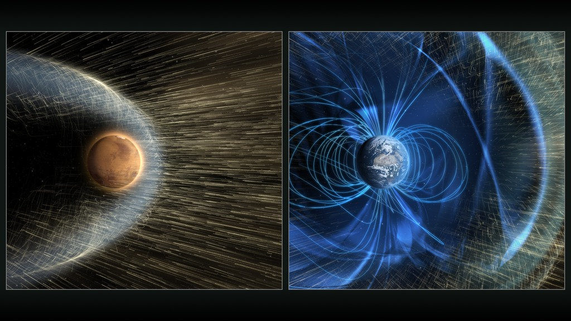
Solar wind interaction

Slide 8
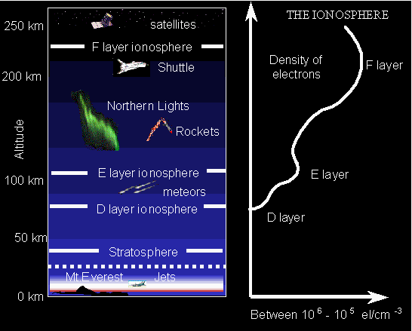
The ionosphere
Higher-altitude layer of the atmosphere with more direct interaction with outside influences
Ionized by solar radiation
Layer(s) of charged particles (plasma)
Influences radio propagation to distant places on the Earth

Slide 9
The Basics of Plasmas
What is ionospheric plasma?
  Charged particles – electrons, protons, and ions
  Same components as the atmosphere (Oxygen, Carbon Dioxide, etc.), but ionized
  Exhibits collective behavior, much like a fluid
  Ions created by solar photons (light) and electron collisions with neutrals
  Has a characteristic motional oscillation at the “plasma frequency”
    Directly related to density of the plasma
  Because of high altitude and ease of motion, can be stripped away by solar wind

Slide 10
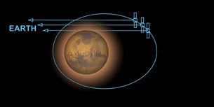
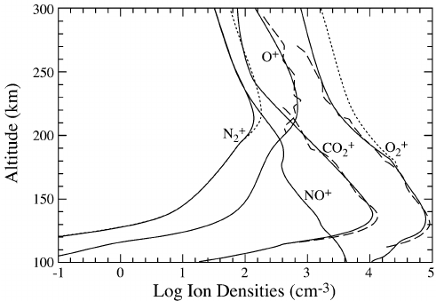
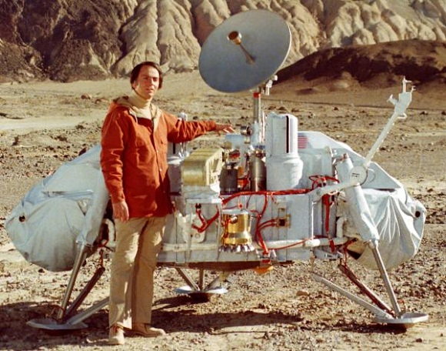
Early Studies at Mars

Slide 11
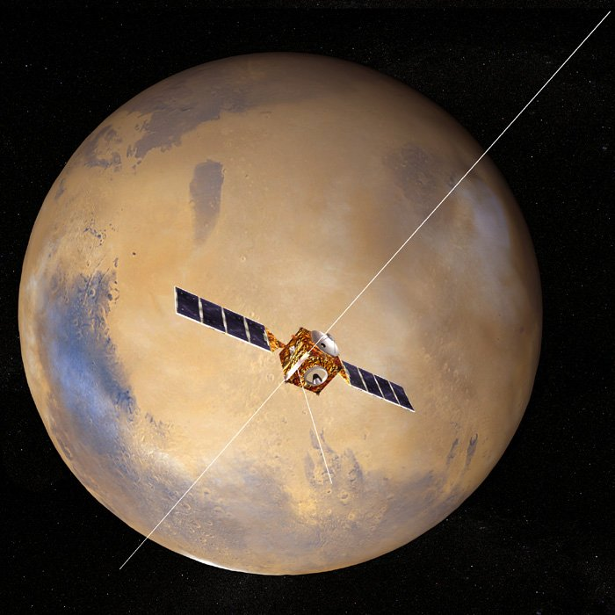
marsis
Mars Advanced Radar for Subsurface and Ionosphere Sounding
Twin 20-meter dipole antennae
7 meter monopole
Capable of operating in two main modes, one for ionospheric science (AIS), the other for subsurface radar sounding
  Operates in only one at a time

Slide 12
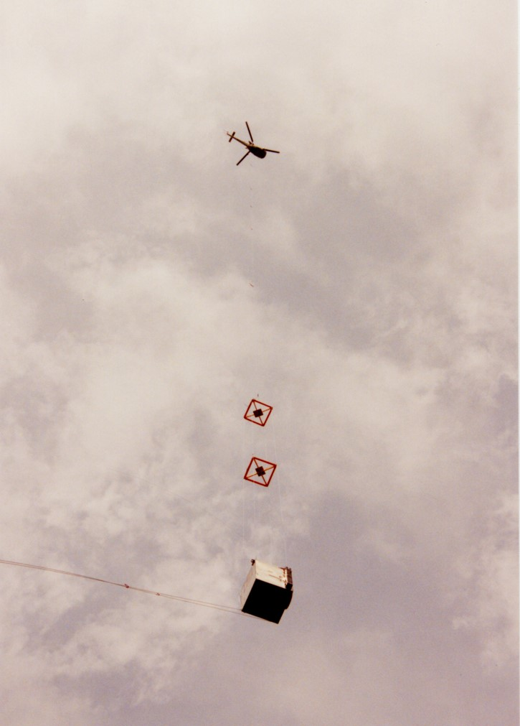
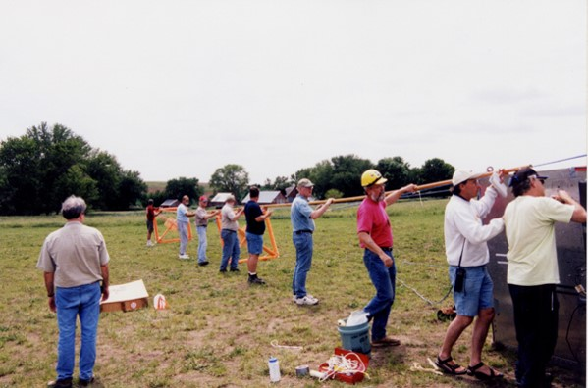
Testing MARSIS
Instrument was attached to a large box-shaped structure, lifted into the air by a helicopter
Tested by targeting the Rocky Mountains

Slide 13
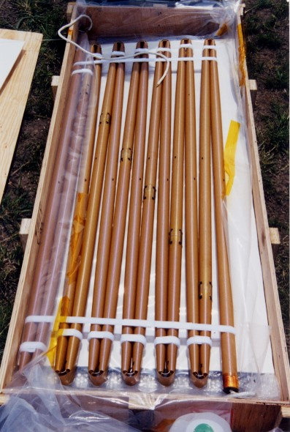
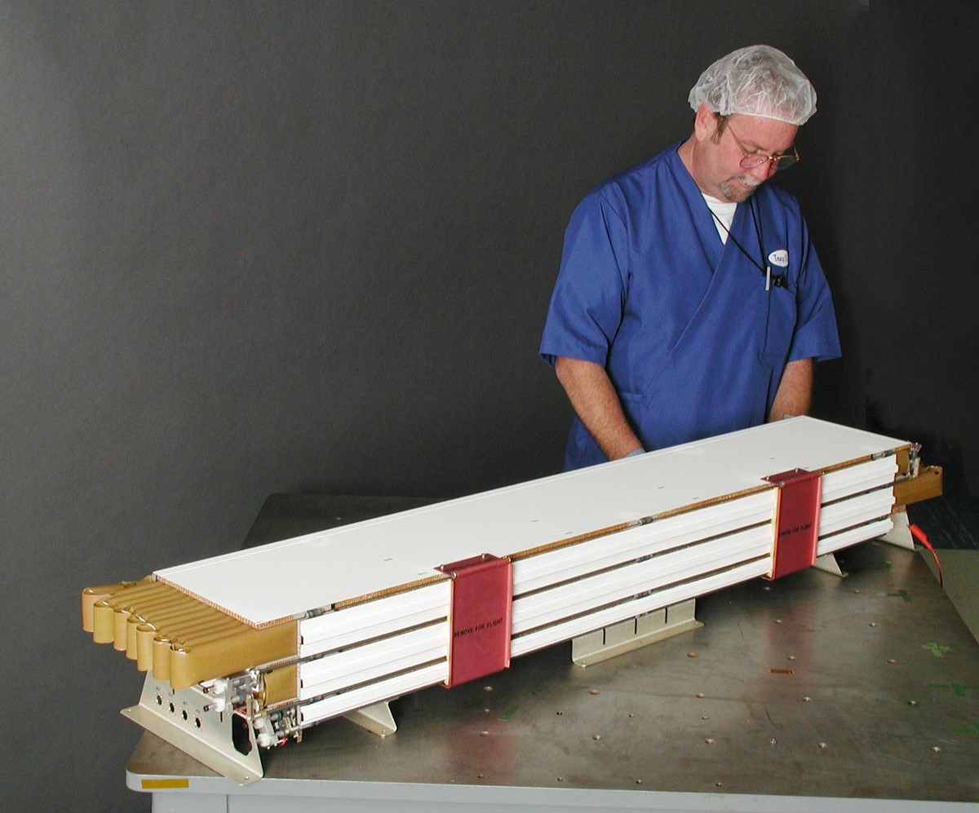
Making it fit

Slide 14
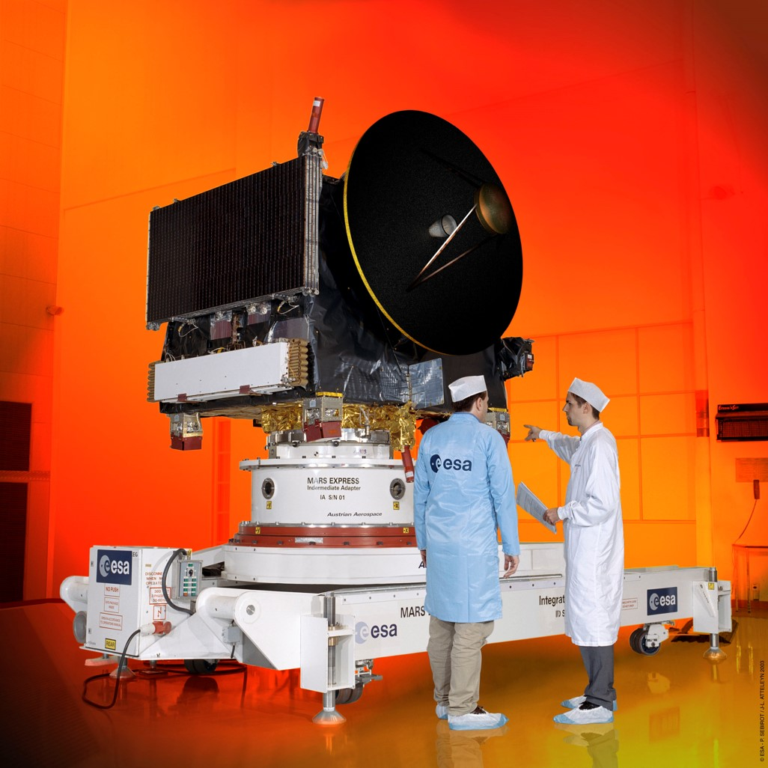
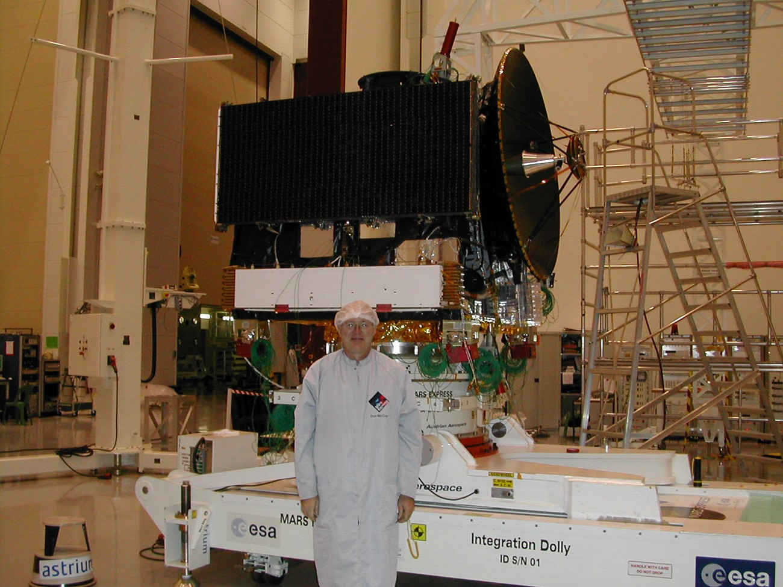
installation

Slide 15
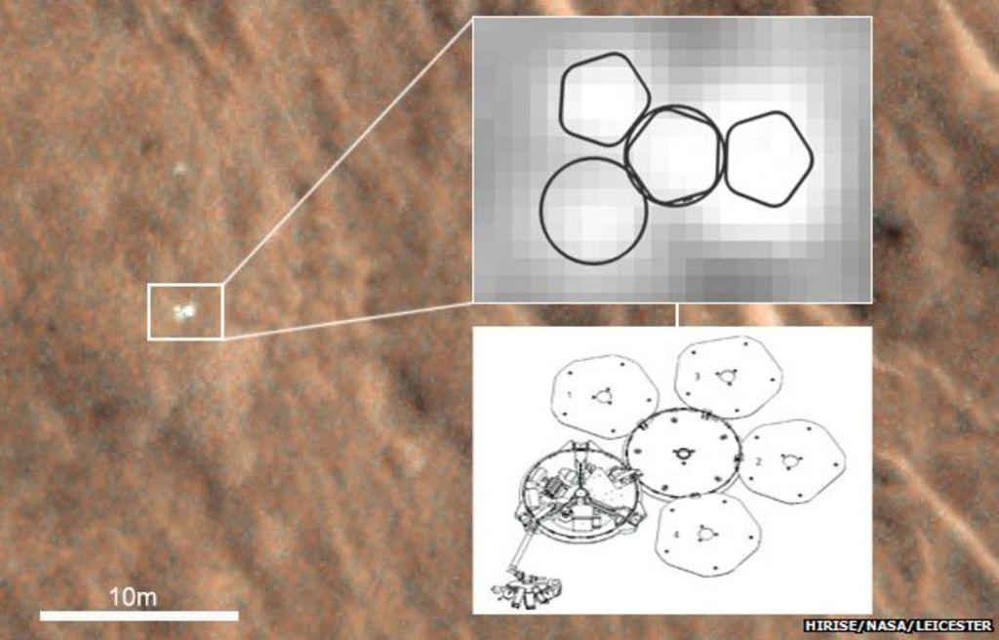
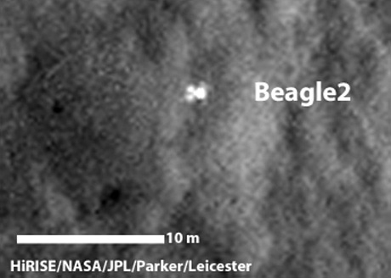
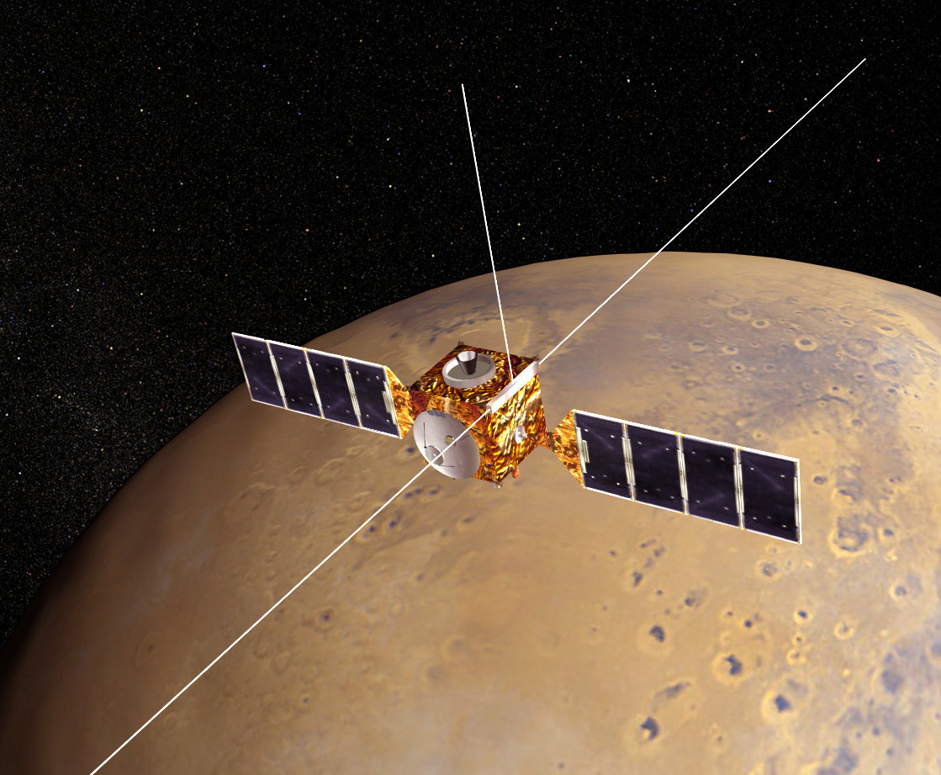
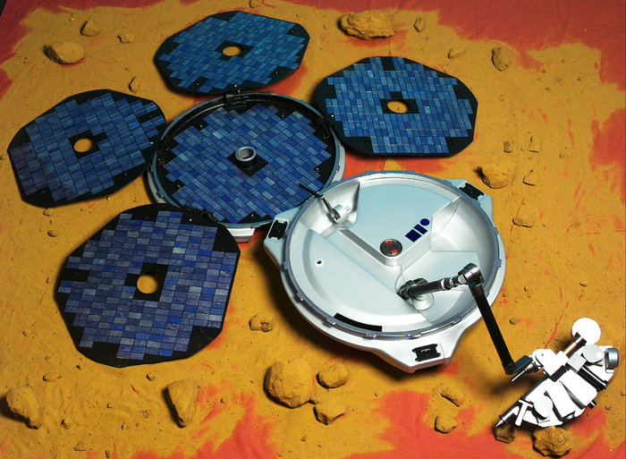
Mars express
Operated by European Space Agency with NASA collaboration
Launched: June 2, 2003
Mars Arrival: December 25, 2003
Carried Beagle 2 lander
  Landed but failed to communicate.
MARSIS Deployed: May 4 – June 10, 2005
MARSIS Science: July 2005 – Present

Slide 16
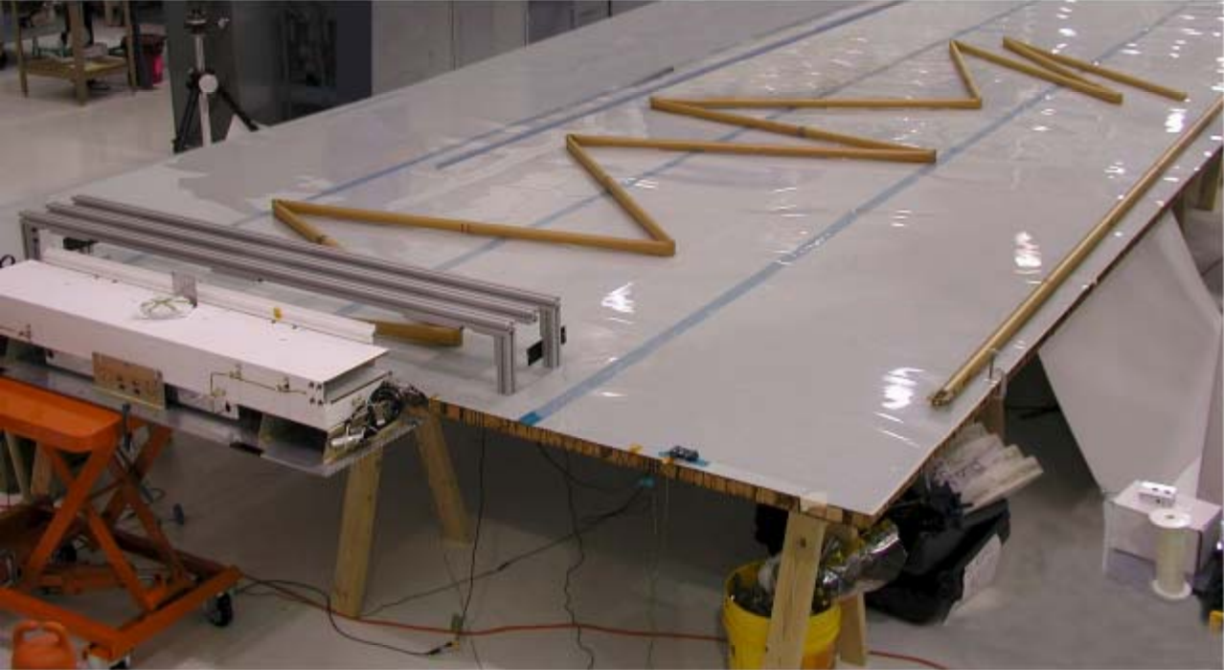
Deploying the antennae

Slide 17
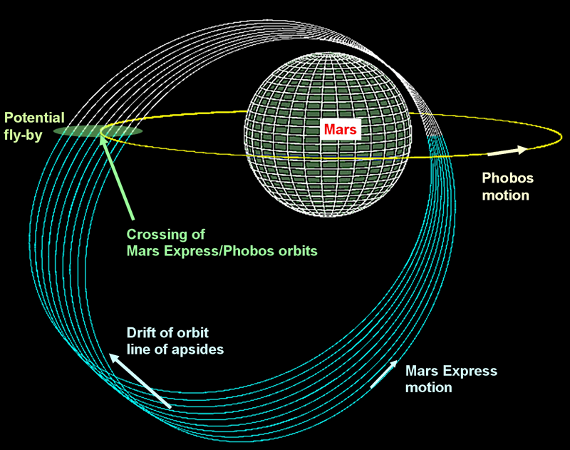
ORBIT PARAMETERS
Periareion – ~300 km
Apoareion – ~10000 km
Inclination – 86.3 degrees
Period – 7.5 hours
Orbit drifts gradually, to allow for better planetary coverage along with low-altitude passes of different regions

Slide 18
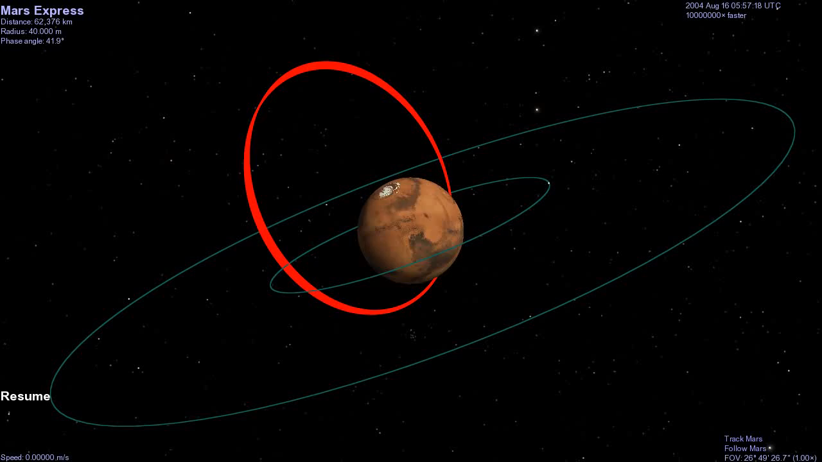
orbit

Slide 19
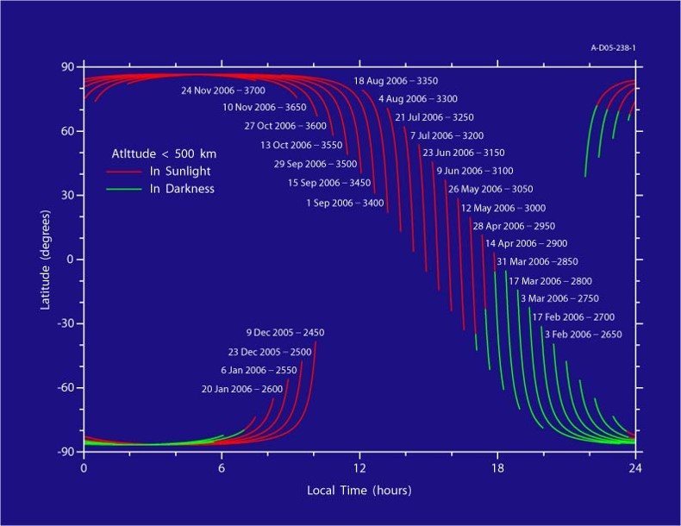
Why is precession good?

Slide 20
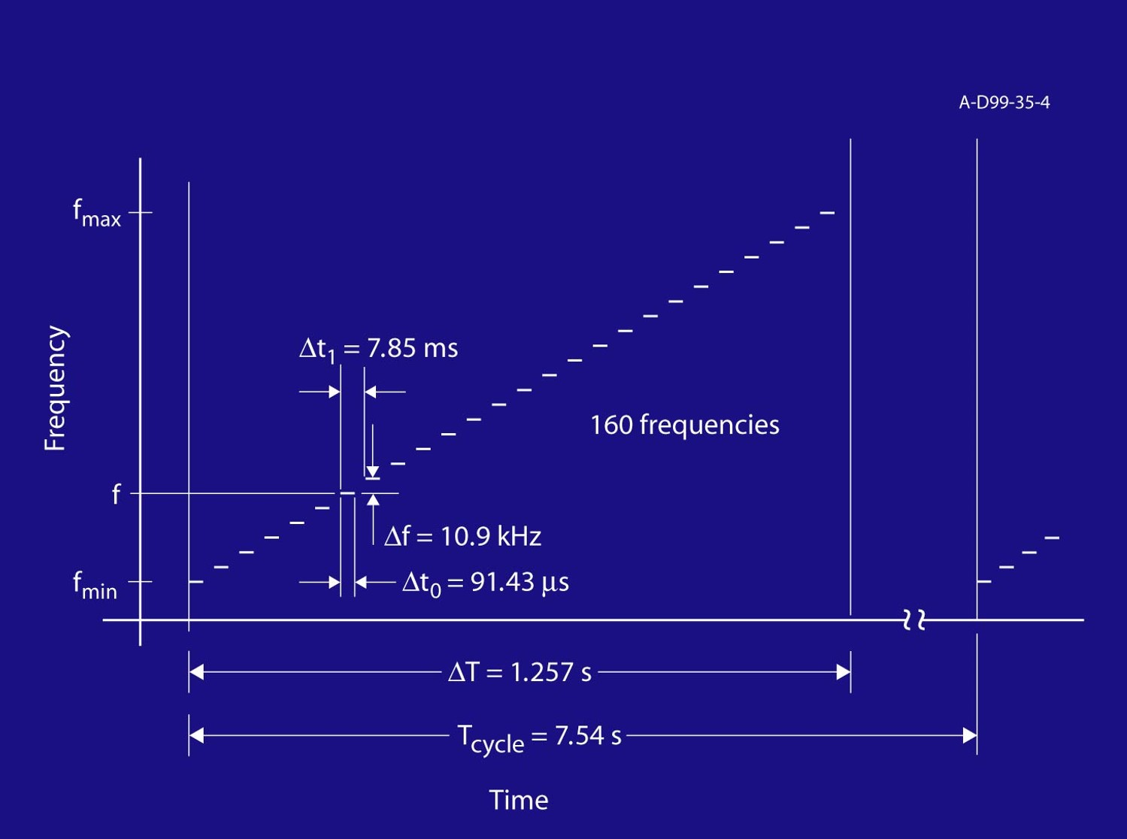
How marsis works
Studies ionosphere at 160 frequencies between 0.1 and 5.4 MHz
Observation cycle of 7.54 seconds
MARSIS can operate for about 45 minutes out of each orbit, when Mars Express is at altitudes low enough to get a response from the ionosphere

Slide 21
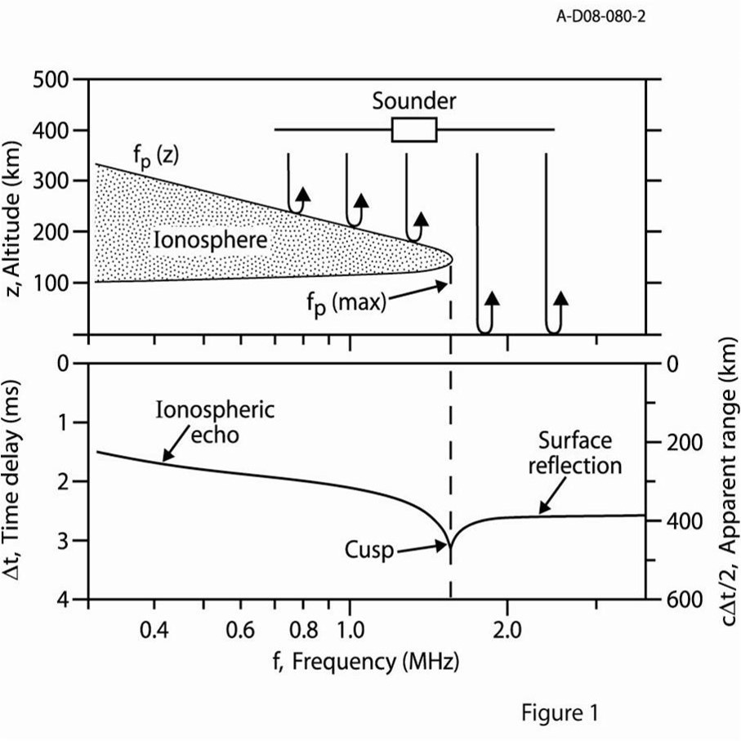

Sounding principles
MARSIS emits its “chirp”, and listens for the reflected echo from the ionosphere
Radio signal can propagate freely through space (and the ionosphere) at frequencies above the local plasma frequency
Reflection occurs when the pulse frequency equals the ionospheric plasma frequency. This gives the density (in cm⁻³), where:
Cusps appear at density profile maximums, since the group velocity approaches zero.

Slide 22
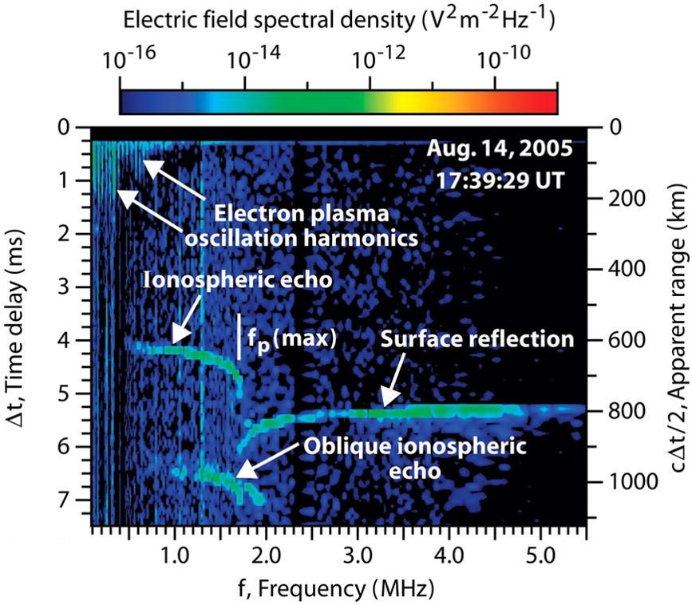
General observations
Ionospheric echo shows altitude profile of the ionosphere
Surface reflection can appear at frequencies above maximum plasma frequency of ionosphere
Other features, such as plasma harmonics, cyclotron harmonics, and oblique echoes are frequently present as well.

Slide 23
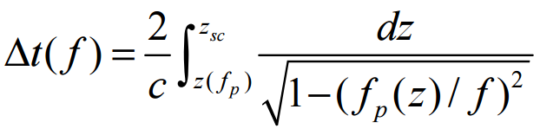
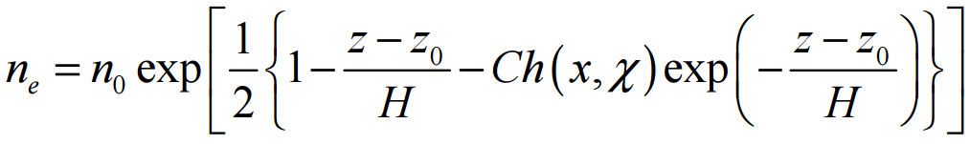
And then we do math…
The apparent range gives an estimate for the altitudes of the ionospheric reflection. However, to be accurate, we must correct for plasma dispersion.
Assuming vertical reflection from a horizontally stratified ionosphere, we find that the time delay (as a function of frequency) is:
This can then be inverted to give the frequency/density as a function of altitude:

Slide 24
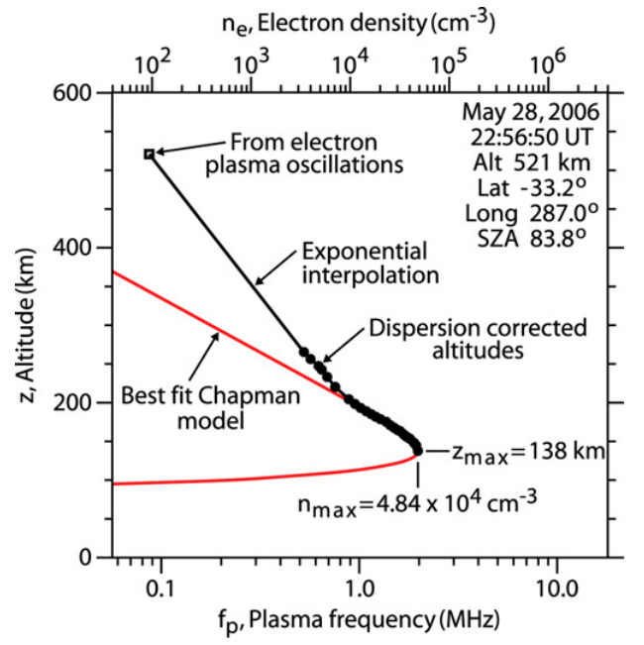
Fitting the ionosphere
Once the altitudes of the traced points have been corrected for dispersion, we can then fit the profile with a Chapman model function to obtain:
  Altitude of the density maximum
  Maximum density of the ionosphere
Both values, but especially the density, are dependent on the solar zenith angle

Slide 25
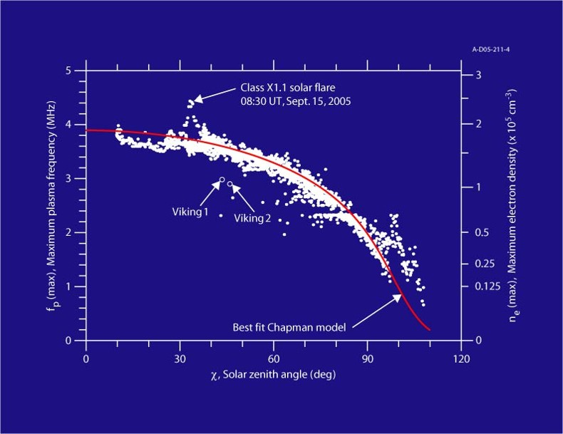
Solar zenith angle dependent

Slide 26
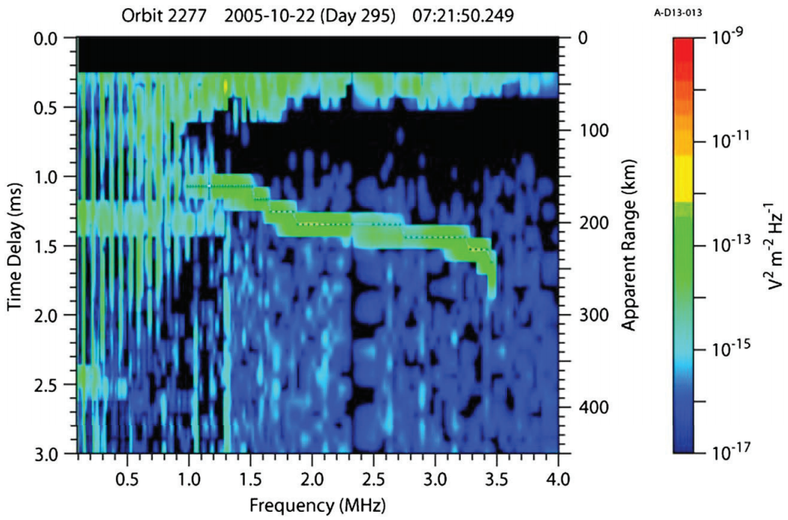
Plasma harmonics
MARSIS also sees harmonics occur as it steps up in frequency. These harmonics are associated with the local plasma frequency, and are seen to vary with altitude as the spacecraft orbits Mars.
These harmonics only appear in slower-moving (ionospheric) plasma. Once outside, the faster solar wind plasma is carried away too quickly for the echo to return to Mars Express.

Slide 27
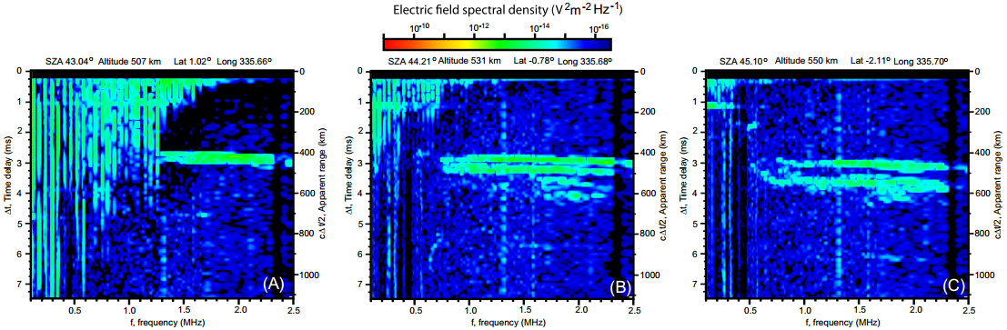
Flow boundary

Slide 28
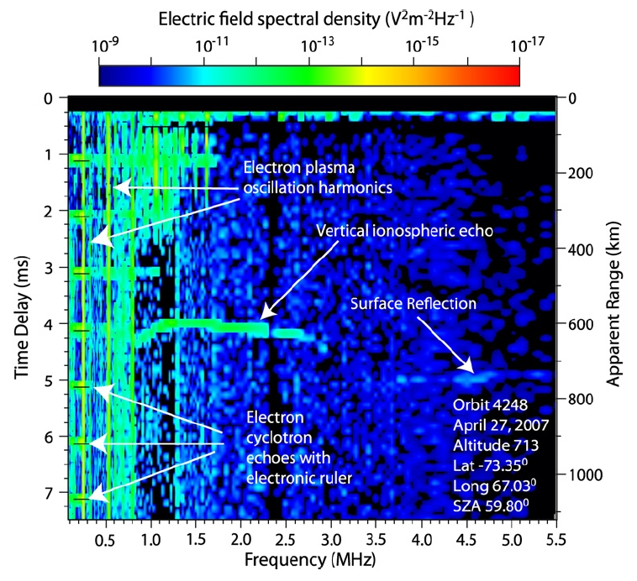
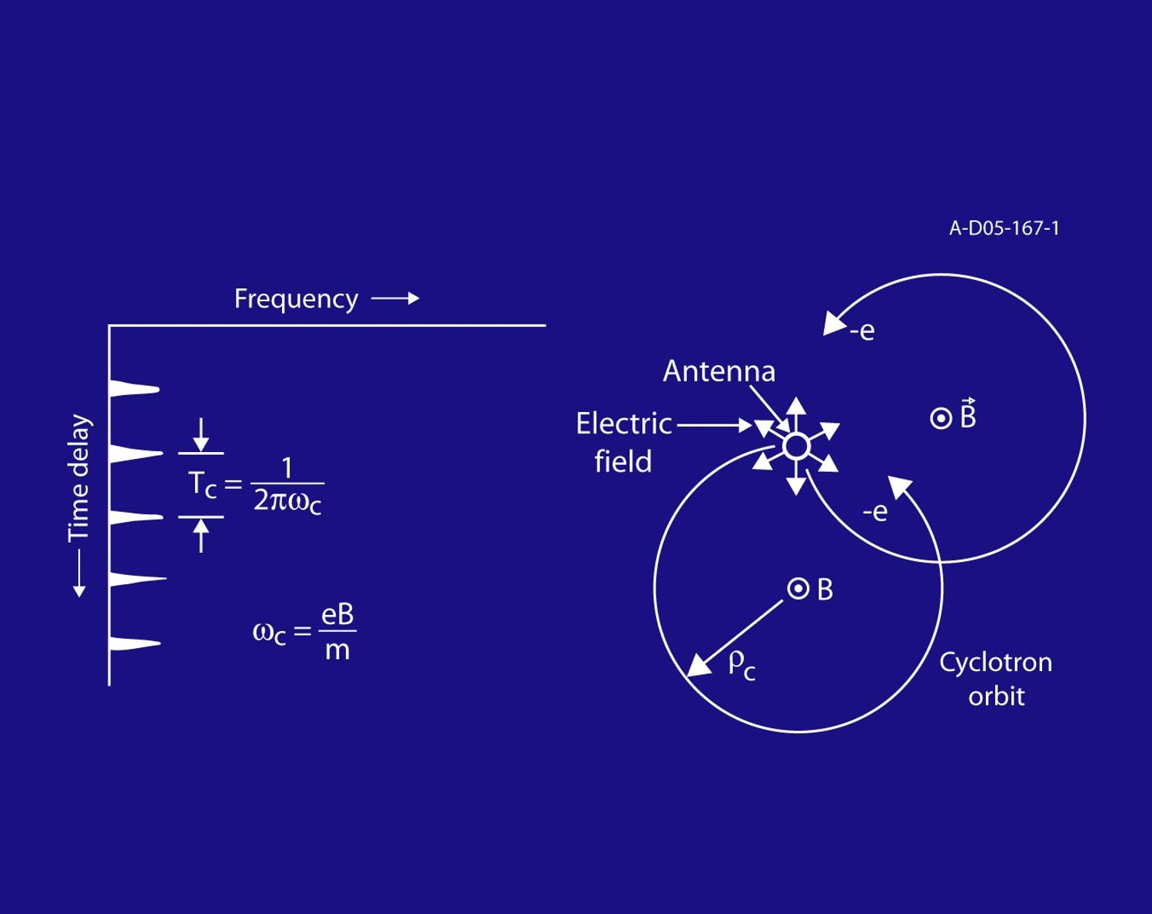
Cyclotron harmonics
Oscillation harmonics can also occur at regular time delay intervals. This has been interpreted as being harmonics of the cyclotron frequency

Slide 29
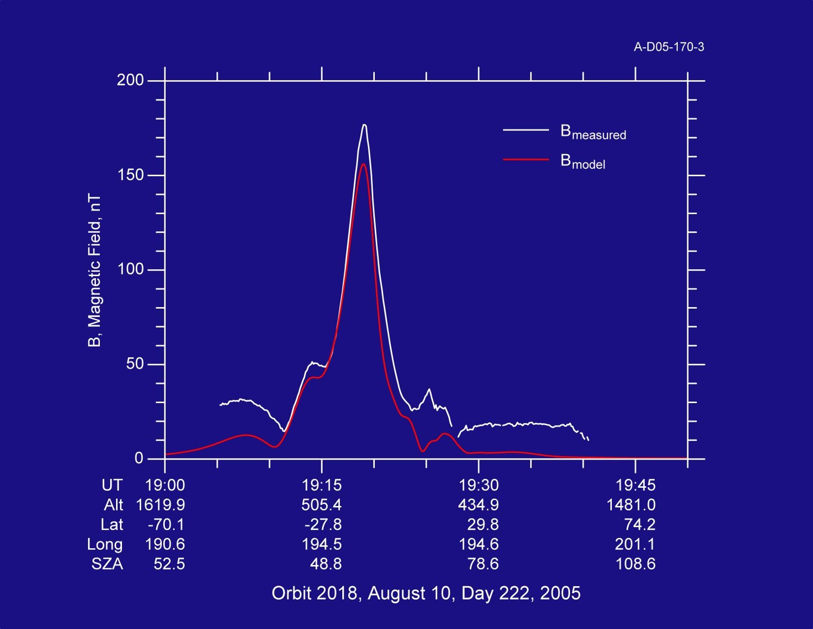
Mars express “magnetometer”

Slide 30
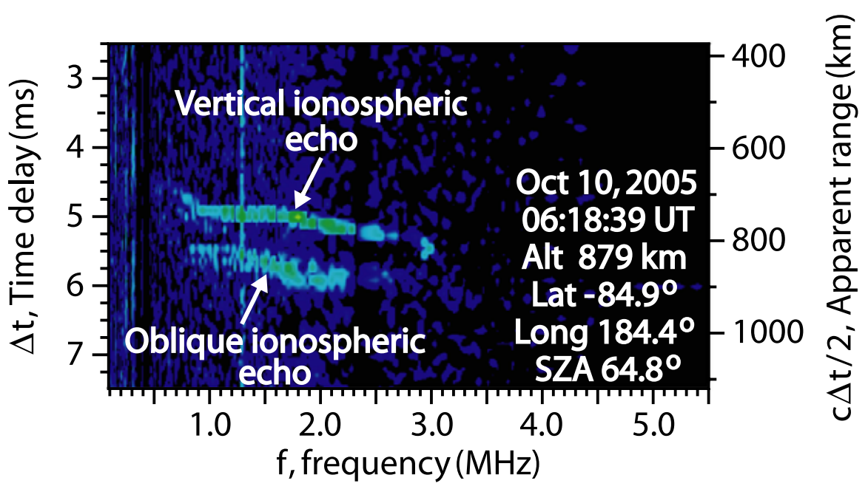
Oblique echoes
Sometimes, additional ionospheric echoes appear with longer time delays than the main echo
It is physically impossible for the echo to come from a second straight-down source

Slide 31
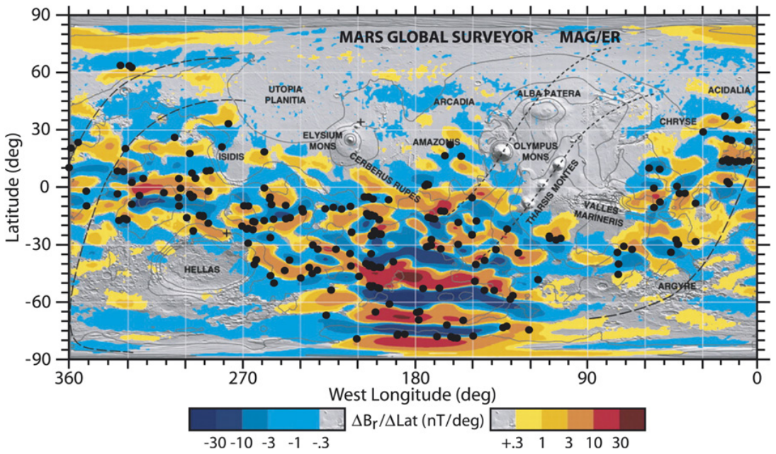
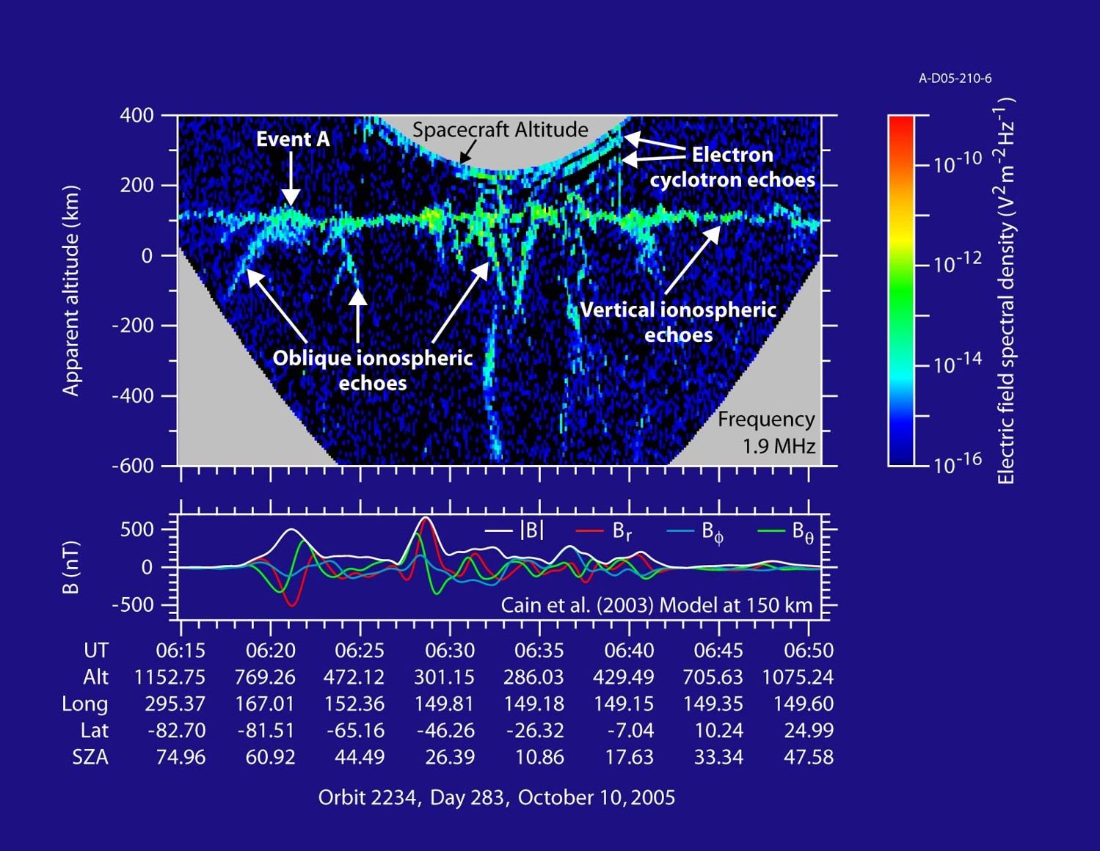
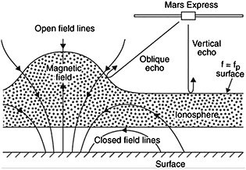
Oblique echoes

Slide 32
A Layered Ionosphere

Slide 33
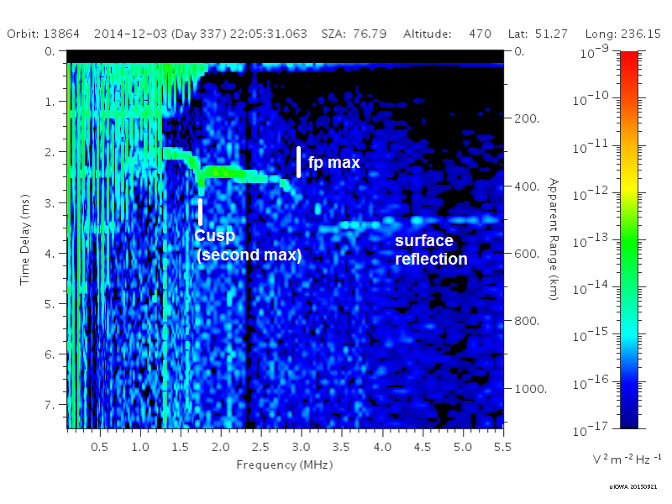
Transient Upper layers
An additional cusp is frequently observed at lower frequencies than the cusp of the main layer
This appearance of this feature implies the presence of an additional peak in the density profile at a lower density, and therefore at a higher altitude

Slide 34
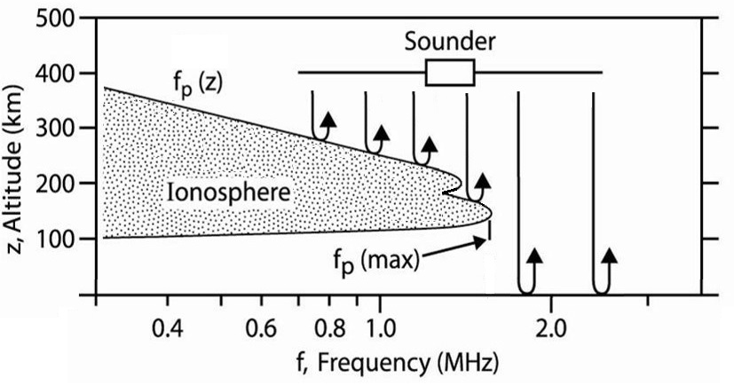
A Non-monotonic profile

Slide 35
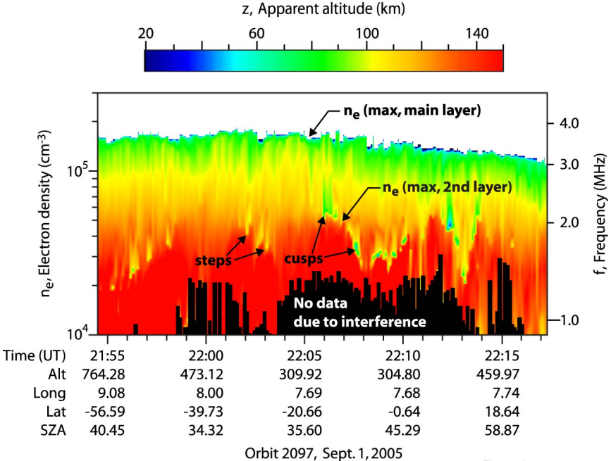
IDENTIFYING THE DISCONTINUITY

Slide 36
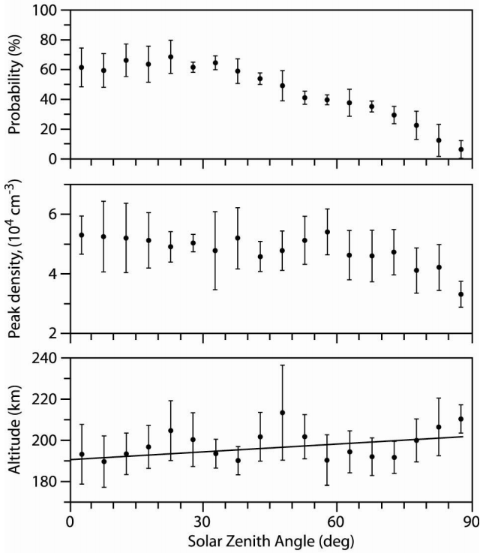
ORIGINAL STUDY (2008)
All data sets were from fall of 2005
These layers are highly transient – they are present roughly 50% of the time for most SZAs, and less near the terminator
Peak density is fairly consistent, but does also drop slightly at high SZAs. Consistently around 4-6 x 10⁴ cm⁻³
Altitude has an small upward trend with SZA, getting higher near the terminator, but always near 200 km

Slide 37
But why? – dead ends
Enhancement/Biteout in the particle density? – Mars Express doesn’t dip low enough into the ionosphere to directly pass through this region and measure.
MHD Waves from Solar Wind fluctuations? – Onboard instruments can give solar wind moments, but are orbit averages, not fast enough to use here.
Kelvin-Helmholtz Instability? – Effects would likely become more prominent toward the terminator, where these features are less-frequently observed.
Magnetic Reconnection and Transport? – No magnetometer on Mars Express.

Slide 38
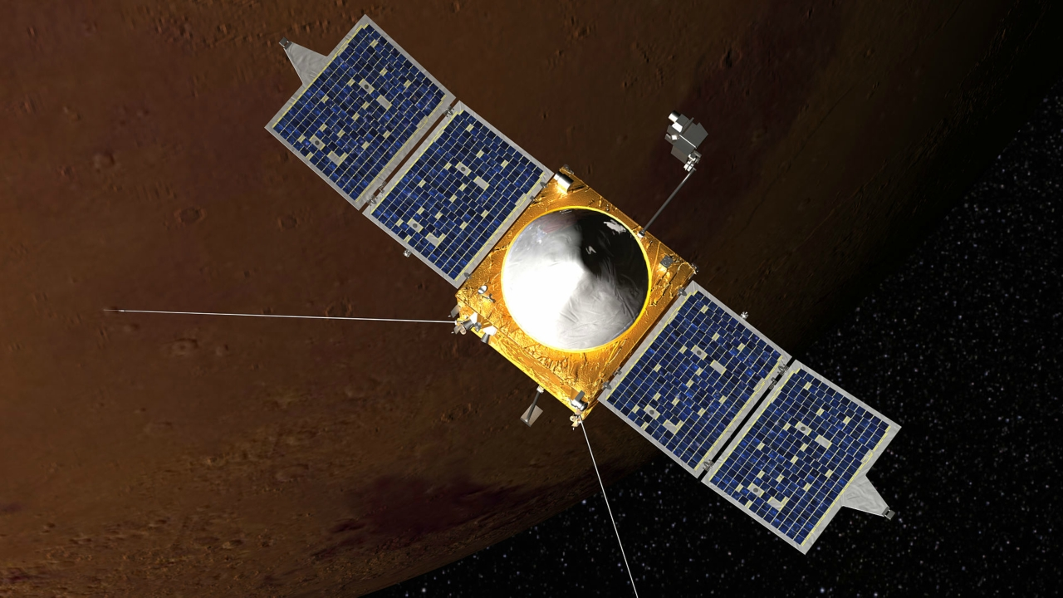
maven
Operated by NASA
Launched: November 18, 2013
Mars Arrival: September 22, 2014
Full Science Operations began in early November 2014
Diverse instrument suite, including some not found on Mars Express

Slide 39
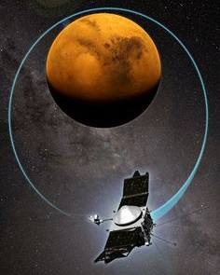
ORBIT PARAMETERS
Periareion – 150 km
Apoareion – 6200 km
Inclination – 75 degrees
Period – 4.5 hours
Orbit is occasionally adjusted to allow for week-long “Deep Dip” configuration that sends MAVEN down to near 125 km

Slide 40
Mars express vs. maven
MARS EXPRESS
MUCH longer duration in orbit, yielding many more data sets with which to work
Constant sounding while above this region gives large-scale spatial overview of these features
Can not determine inner workings due to higher altitude orbit
MAVEN
Flies directly through this region, giving direct measurement of properties, including vertical profile and depth
On-board instruments give particle counts, magnetic field measurements, and solar wind parameters
Only two chances per orbit, via quick pass-through, limits chances to observe

Slide 41
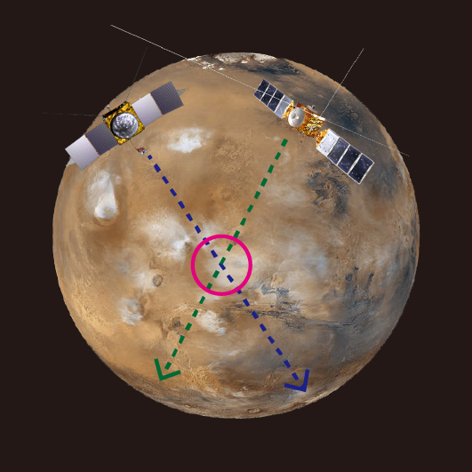
Crossing Orbits
Goal: Identify “crossing orbits”, where the spacecraft orbits intersect.
To limit the useable sets, the following basic conditions were applied:
  MAVEN must be in the ionosphere to study the region within a short time of intersect.
  The two spacecraft should reach this point within a few minutes of each other.
  The crossing point must be on the day side of the planet.
In the first three MAVEN data releases (thru 8/15), there were 41 candidate orbits.
  23 had no MARSIS ionospheric data (instrument off or in subsurface sounding mode)
  18 had MARSIS data but cross deep on the night side (no ionospheric signal)
  This leaves 0 useable orbits

Slide 42
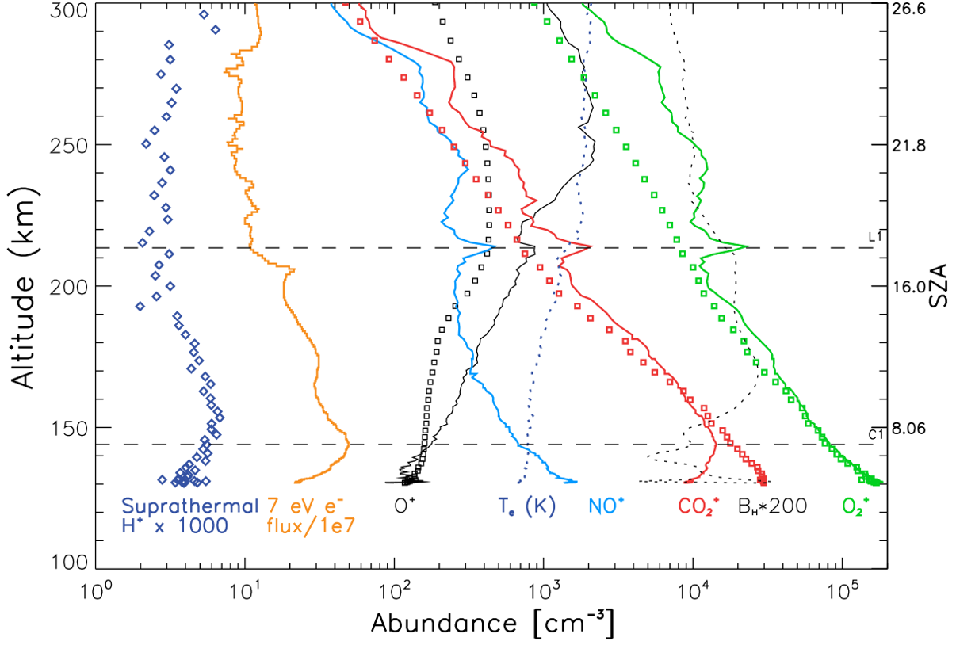
PARTICLE DATA (NGIMS)
From Bougher, et al
(2015)

Slide 43
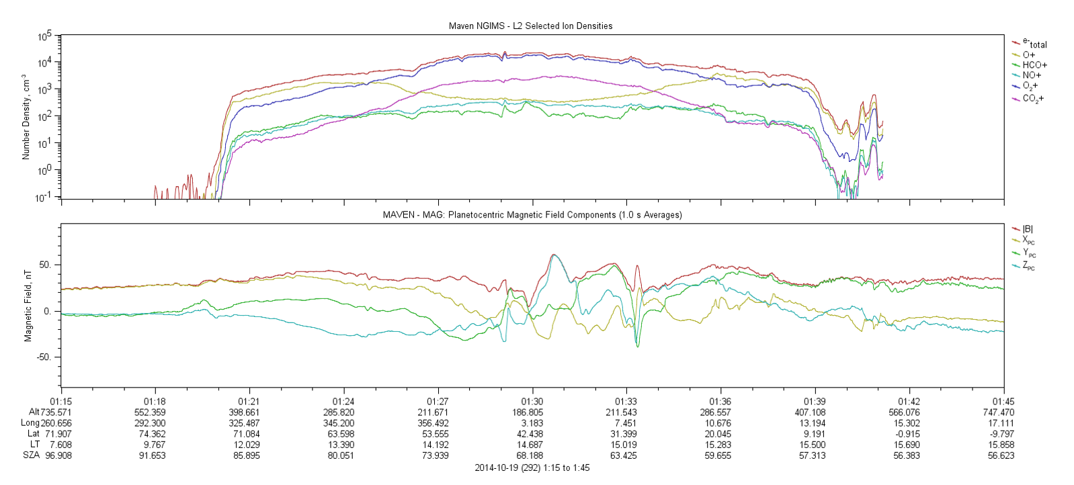
NGIMS & MAGNETOMETER DATA

Slide 44

A closer look
NGIMS instrument frequently shows a jump up in density by a factor of 2-3 in the region near 200 km in altitude.
Density jump is the result of nearly all ion components increasing in density.
Magnetometer almost always shows a kink in the magnetic field magnitude at the same place, and generally also has one or more field components flip direction at the same time.

Slide 45




Slide 46

The big dip

Slide 47


Slide 48



Slide 49


Topside layer –
Conjunction Observation
Feature jointly detected in Oct. 2015 crossing orbit!

Slide 50
RECENT MARSIS SCIENCE HIGHLIGHTS

Slide 51

“MARSIS Effect” in ASPERA
Another Mars Express experiment, ASPERA, sees isolated bursts in its Ion observations when MARSIS is operating at low frequency.
Frequency corresponds to MARSIS sounding frequency at the time
Believed to be ions in cycloton orbits around Mars Express, excited by MARSIS soundings

Slide 52

Comet layer
In late 2014, comet Siding Spring flew within 135,000 km of Mars at a velocity of 56 km/s. Due to the high speed, dust impacts had the potential to strongly ionize the upper atmosphere.
Generated a transient layer at 100 km, with density up to 2.6 x 10⁵ cm⁻³. This is the highest ever seen on the nightside.
Layer present on dayside as well, at a slightly lower density (1.8 x 10⁵ cm⁻³), but still larger than the main layer.
Lasted between 14 and 21 hours.

Slide 53


TRANSIENT IONOPAUSE – DENSITY GRADIENTS

Slide 54


Radar Detections of Martian IONOPAUSE
MARSIS radar is capable of directly seeing echoes from the ionopause boundary
Detections made at all dayside solar zenith angles
Normalized occurrence rate reveals tendency toward detections away from crustal field regions (right)
Preliminary figure from Feng Chu
Preliminary figure from Feng Chu

Slide 55

A Shock Hits Mars
Dual spacecraft observation using MARSIS and MAVEN instruments.
Shock first hit MAVEN, in the upstream solar wind, reached MEX a minute later, as MEX was in the ionosphere.
Shock created a very disturbed and diffuse ionosphere, along with sharp changes local to the spacecraft.
Figure from Harada et al., JGR, 2017

Slide 56

Shock WAVE Effects on Nightside
1
1. Disappearance of ground reflection
2. Increased peak electron densities
3. Enhancement in induced magnetic fields
2
3
Figure from Harada et al., GRL, 2018

Slide 57

Dust Storms and Lightning
In a follow-up to a previous study, we are analyzing possible lightning events detected by the MARSIS radar.
Several candidate events, but only one of these events has been seen in the vicinity of a dust storm.
No lightning events have been observed during the recent Mars dust storm this summer
Figure from Bruce Cantor, Malin Space, using MRO-MARCI

Slide 58


Water on Mars

Slide 59
The Future of MARSIS and Mars Express

Slide 60
The good, the Bad, The Ugly
THE GOOD
  MARSIS, after 13.5 years of use, has shown little to no degradation and is functioning just as it did the day it turned on.
THE BAD
  Mars Express isn’t so lucky. While most instruments are in good shape, a few components have started to fail, and a race is on to see which aspect kills the spacecraft first:
    Fuel: 6 kg ± 8 kg remaining
    Batteries: 40% of initial capacity
    Gyros: 3 of 6 are near failure, gyro-less mode implemented to slow decay
THE UGLY
  As with any mission, MEX has to continuously re-propose for funding. Up again this year for a three year extension, and money gets tougher to come by as new missions start.

Slide 61
Make Yourself New Again
If you want to stay relevant, you have to either:
  Do something nobody else can do
  Do something new that you’ve never done before
NOBODY ELSE: This spring, MAVEN’s orbit is rising, so we will be the only ones who can consistently see the ionospheric peak
NEW: High Resolution Sounding
  Instead of sounding 160 frequencies once, sound 40 four times. Or 10 sixteen times. Etc.
  Enables resolution of 0.3 seconds or less (current mode: 7.5 seconds)
  New scientific research on turbulence and small structure possible

Slide 62
SUMMARY
MARSIS has produced a wide range of scientific results, including some that were arguably not expected from the instrument
Opportunities for multi-spacecraft studies have opened up since the arrival of MAVEN in 2014
The instrument is still in great health with little to no degradation
Exciting new results still yet to come… stay tuned!

Slide 63


