Slide 1
Transient Layers in the Topside Ionosphere of Mars
Andrew J. Kopf
Master’s Thesis Defense
July 3, 2008

Slide 2
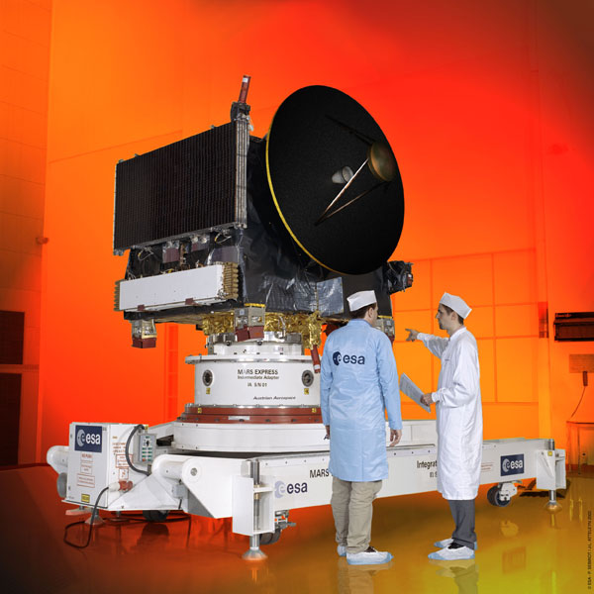
Mars Express
Named for its rapid and streamlined development
ESA probe launched by Soyuz 6/2/03
Entered orbit around Mars 12/25/03
Completes highly elliptical polar orbit in 6 hr, 43 min
Carries seven distinct instruments, one of which is MARSIS

Slide 3
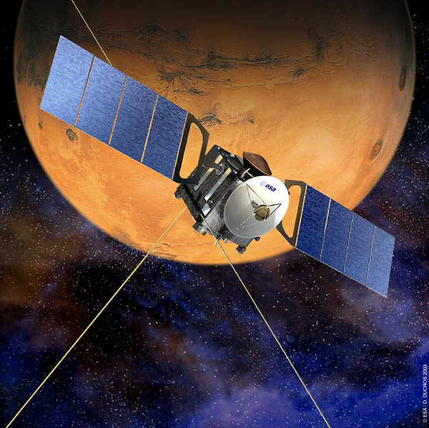
Mars Advanced Radar for Subsurface and Ionosphere Sounding
Two 20-m antennae act as a dipole: transmit radar pulse and receive reflected echo
Antennae deployed 5/10/05 and 6/14/05, began operating 7/4/05
Operates from 0.1 – 5.4 MHz for ionospheric sounding
Repeats transmit/receive cycle about every 7.543 seconds.
Sounding performed when below 1200 km in altitude, or for roughly 40 minutes per orbit
Complements radio occultation by providing better spatial resolution and full coverage of the planet

Slide 4
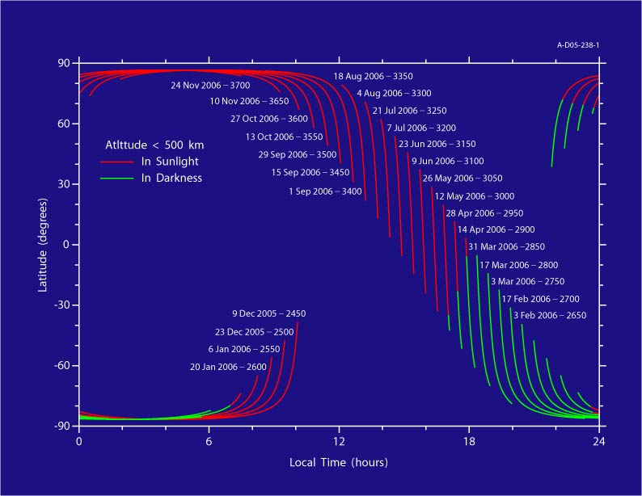
Orbit Evolution

Slide 5
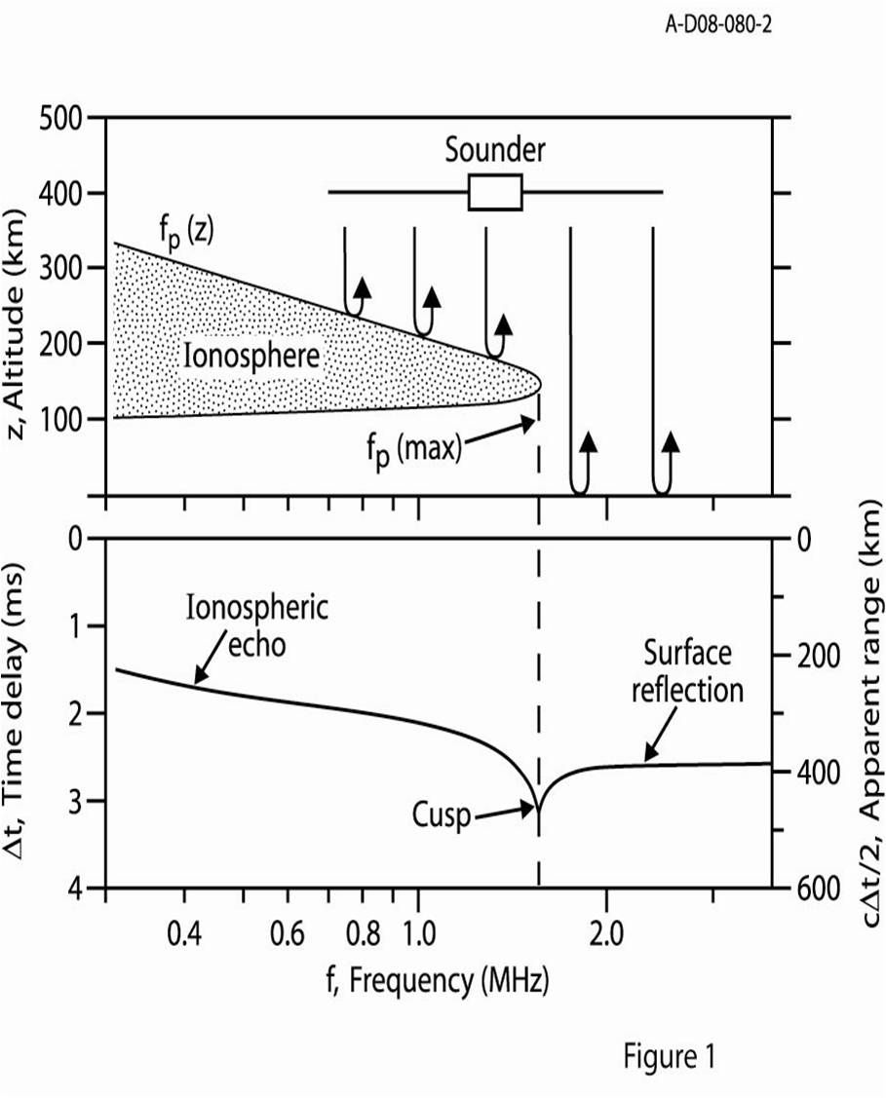
Sounding Principles
Radar pulse can not propagate at frequencies below plasma frequency
Reflection occurs when pulse frequency equals plasma frequency
Frequencies above max plasma frequency will reflect off surface
Cusps occur at density profile maximums

Slide 6
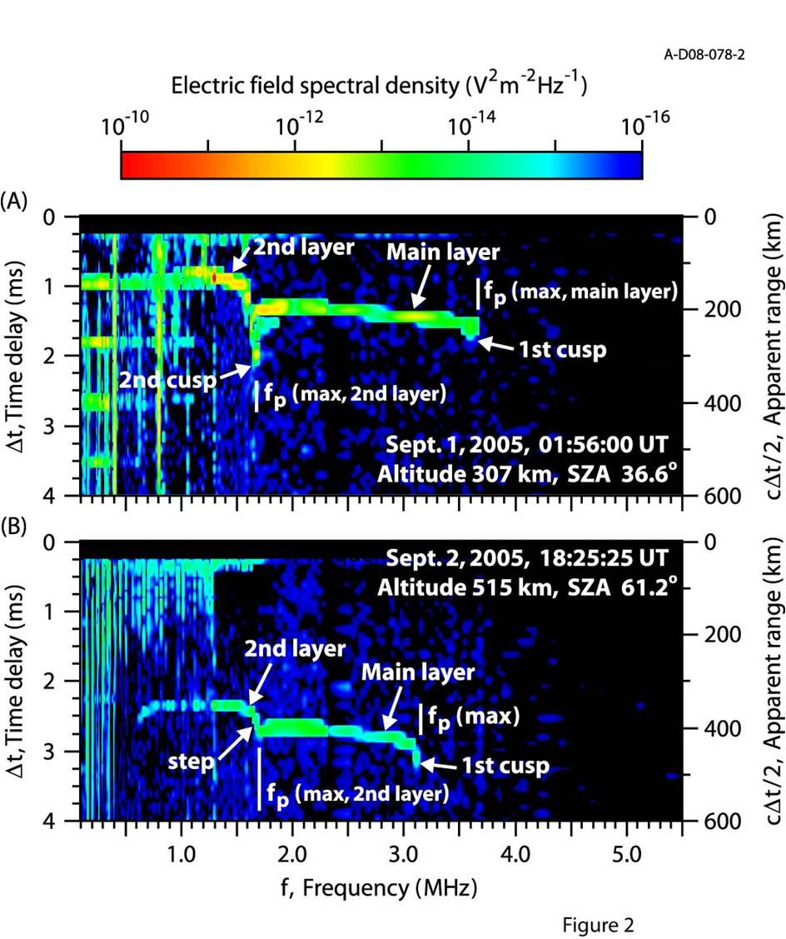
Cusps & Steps – The Second Layer
(A) shows a full second cusp, indicating peak in the density profile
(B) shows a “step” at a lower frequency, which occurs at an inflection point (dn/dz approaches but does not reach zero)
Both indicate presence of a second topside layer

Slide 7
Studying the Second Layer
1500 ionograms with second layer present were traced over the range between Aug. 5 – Sept. 5, 2005
  Tracing was performed in order to obtain a density profile
All analysis was done only on data sets where the spacecraft altitude was below 800 km
Detections were made at a wide range in latitude and longitude and over the full range of dayside SZA’s
Statistical count was kept of all the ionograms in the orbits to determine a probability of detection

Slide 8
Forming the Density Profile
By measuring the time delay Δt in receiving the echo, the range can be computed.
For vertical incidence on a horizontal ionosphere, the round trip delay time as a function of frequency is:
Since Δt(f) is known from the ionogram, we must invert this integral to obtain z(f_{p}).
Once this is known, we can obtain z(n_{e}) easily, since:

Slide 9
Fitting the Density Profile
Once the inversion was completed, we used a theoretical model for the density profile and adjusted the parameters to give the best fit.
The model we used for the main layer was the Chapman model, taken from his 1931 paper:
Ch(x,χ) is the Chapman grazing incidence function, which takes into account absorption of solar radiation by the atmosphere:

Slide 10
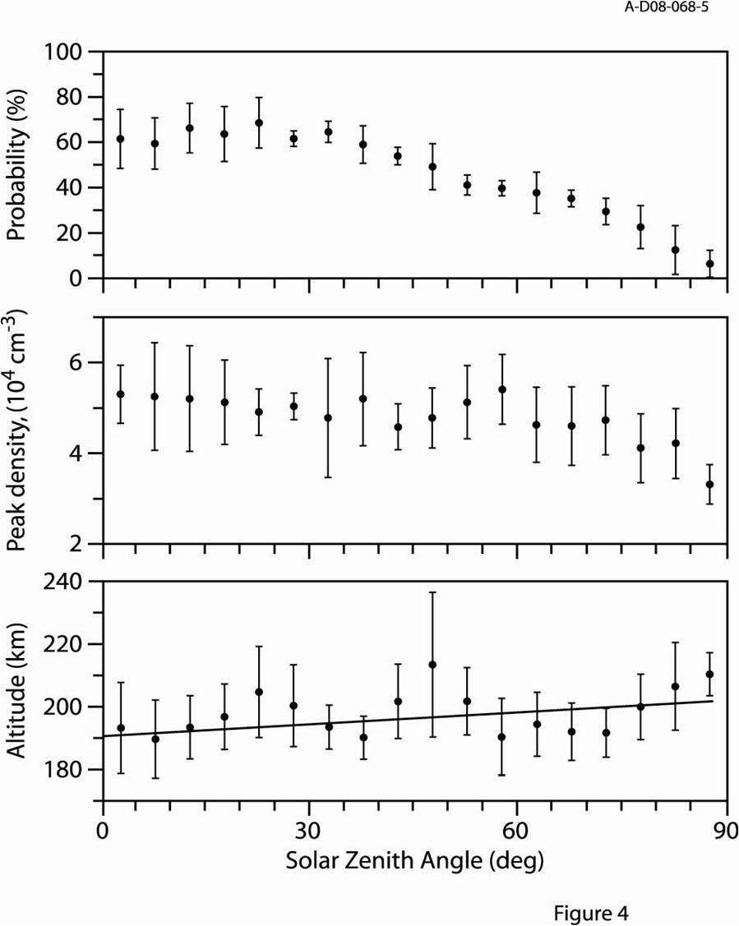
Properties of the Second Layer
Broad maximum in probability at ~60%, falls with increasing SZA
Peak density is roughly constant with slight downward trend with increasing SZA
Altitude of maximum shows slight tendency to increase with SZA

Slide 11
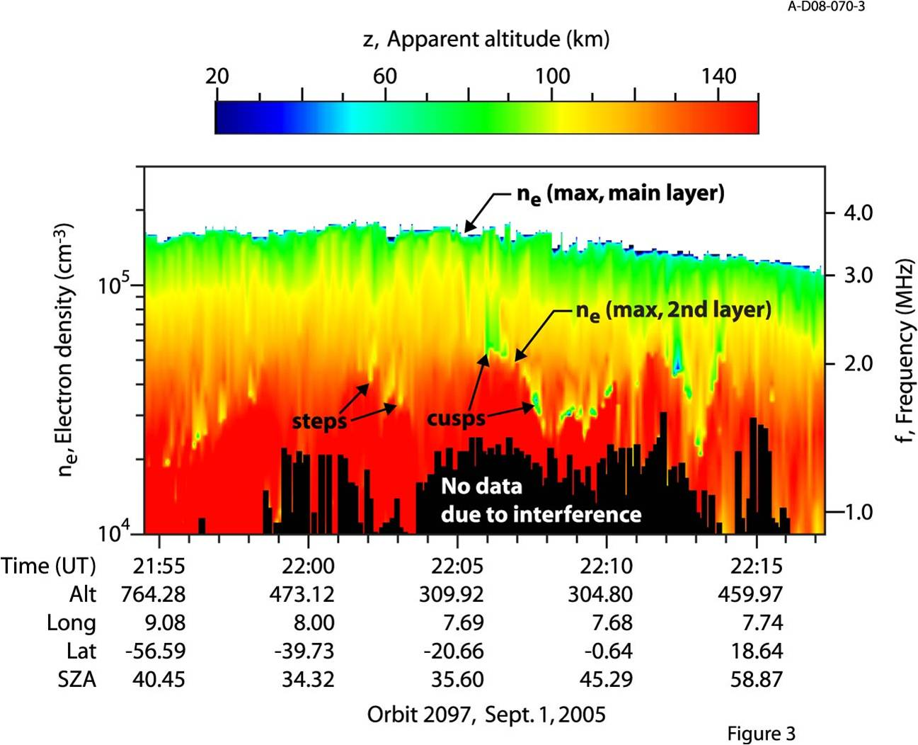
A Variable & Transient Second Layer
Full orbit 2097 traced, not just ionograms with second layer
Altitude and density of main layer constant, but 2nd layer varies
Second layer transient (comes and goes) with time scales corresponding to a few tens to several hundred km in spatial size

Slide 12
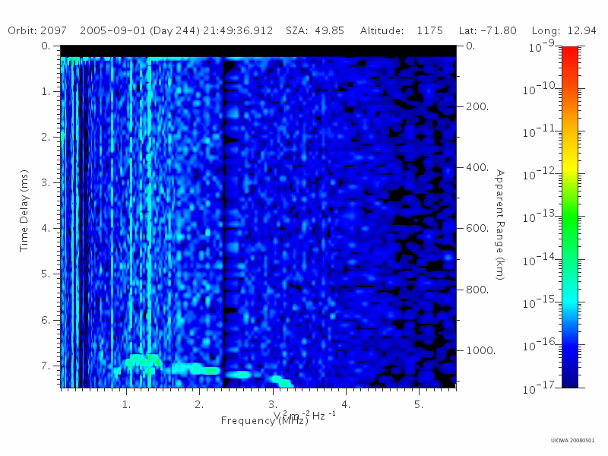

Slide 13
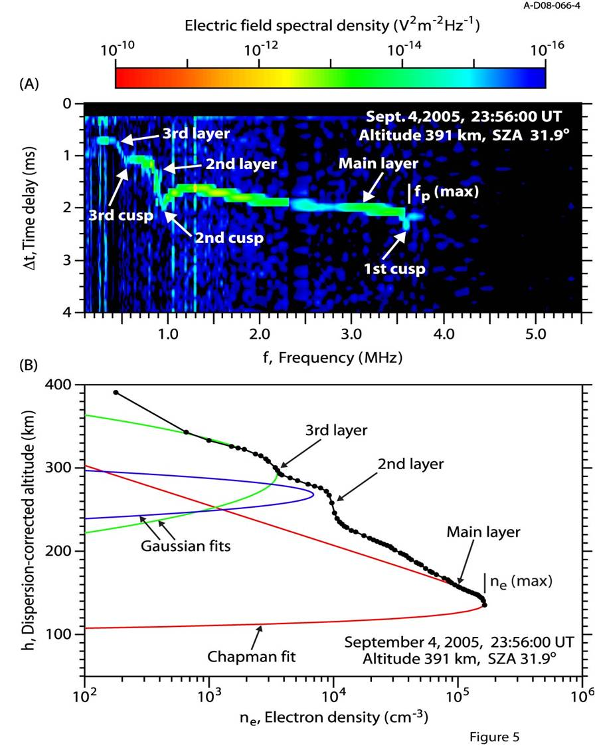
Detection of a Third Layer
(A) shows “step” of a third layer above rather well defined cusp of the second layer.
(B) is calculated density profile for (A), fit with three functions to show layer structure
Main layer consistent with previous results, gives us confidence in profile
Low interference allows for rare (~1%) detection of the third layer

Slide 14
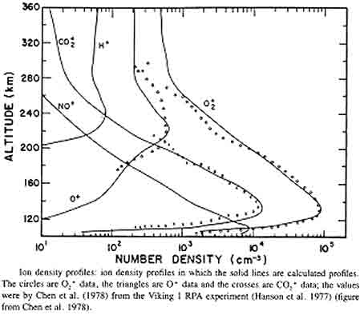
An O⁺ Layer?
Originally interpreted as a possible detection of the O⁺ known to be present at Mars
Indeed, peak of layer is in reasonable agreement with our detections
Problem #1: Density
Problem #2: Thickness
Problem #3: Transience
Ultimately, we need a dynamical mechanism

Slide 15
Fluctuations
Duru, et al. (2008) reported that at altitudes above 275 km the electron density is highly variable, with fluctuations greater than 25% at 300 km and increasing upward
A few theories exist for what could excite such fluctuations
  Wang & Nielson (2004) suggested that fluctuations in the solar wind ram pressure could excite large amplitude MHD waves in the upper ionosphere, especially near the subsolar point
  Several researchers have suggested that the velocity shear that exists between solar wind and ionosphere could give rise to Kelvin-Helmholtz instabilities

Slide 16
Fluctuation Comparison
 | MHD Waves | Kelvin-Helmholtz
Previously Observed at Mars? | Below | Above
Could Appear as Distinct Layer? | Yes | Yes
Agree with SZA Dependence? | Yes | No*
Large Enough Amplitudes | No* | Yes
* Believed to be accurate, but not conclusive

Slide 17
Erosive Processes
Eastwood, et al. (2008) suggested magnetic reconnection near the nose of the induced magnetosphere could lead to enhanced transport of ions out of ionosphere
Modolo, et al. (2005) showed the v x B electric field due to the bulk motion of the solar wind can cause plasma loss by accelerating ions up out of the ionosphere
Important to note that the higher cusps appear to be caused by an erosion in the upper levels of the main layer rather than an enhancement in the plasma density in the second layer
  See Figure 3, where apparent altitude of the second layer (red) is near constant, while apparent altitudes of upper levels of main layer (yellow or green) show sharp irregular decreases

Slide 18
Recall “Figure 3”

Slide 19
Summary
Two additional topside layers (2nd & 3rd layers) detected in the ionosphere of Mars by the MARSIS instrument
Study of 2nd layer reveals it is generally around 200 ± 20 km in altitude with a density near (2 to 7) x 10⁴ cm⁻³
2nd layer also highly transient, with fluctuations from tens of seconds to several minutes, corresponding to horizontal sizes of a few tens to several hundred km, and a clear dependence on SZA
Possible causes include:
  Fluctuations due to MHD waves or Kelvin-Helmholtz instabilities
  Ion loss (erosion) by magnetic reconnection or the solar wind’s v x B electric field

