Slide 1
AURORAL HISS AT SATURN – A MULTI-INSTRUMENT CASSINI STUDY
Andrew J. Kopf
Science & Sandwiches
August 17, 2009

Slide 2
Outline
Introduction to Auroral Hiss
Previous Work
Theory of Auroral Hiss
The Cassini Spacecraft
Auroral Hiss at Saturn
Goals of this Research

Slide 3
Introduction to Auroral Hiss
Whistler-mode plasma wave emission in high-latitude regions of magnetosphere
Discovered by ground-based instruments
First satellite observations in 1960s. Has since been detected on other planets.
Generated by beam of electrons
Saturn detections due to upward-propagating electrons along magnetic field lines
Believed to propagate near resonance cone around field-aligned currents
Characteristic funnel shape on spectrogram

Slide 4
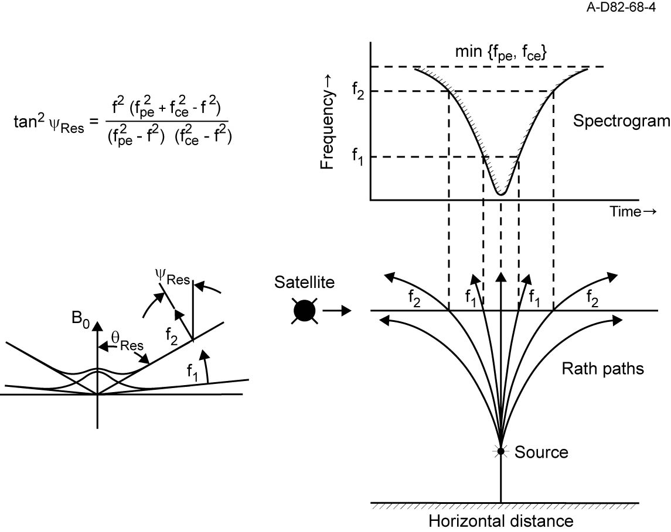
Resonance Cone Propagation

Slide 5
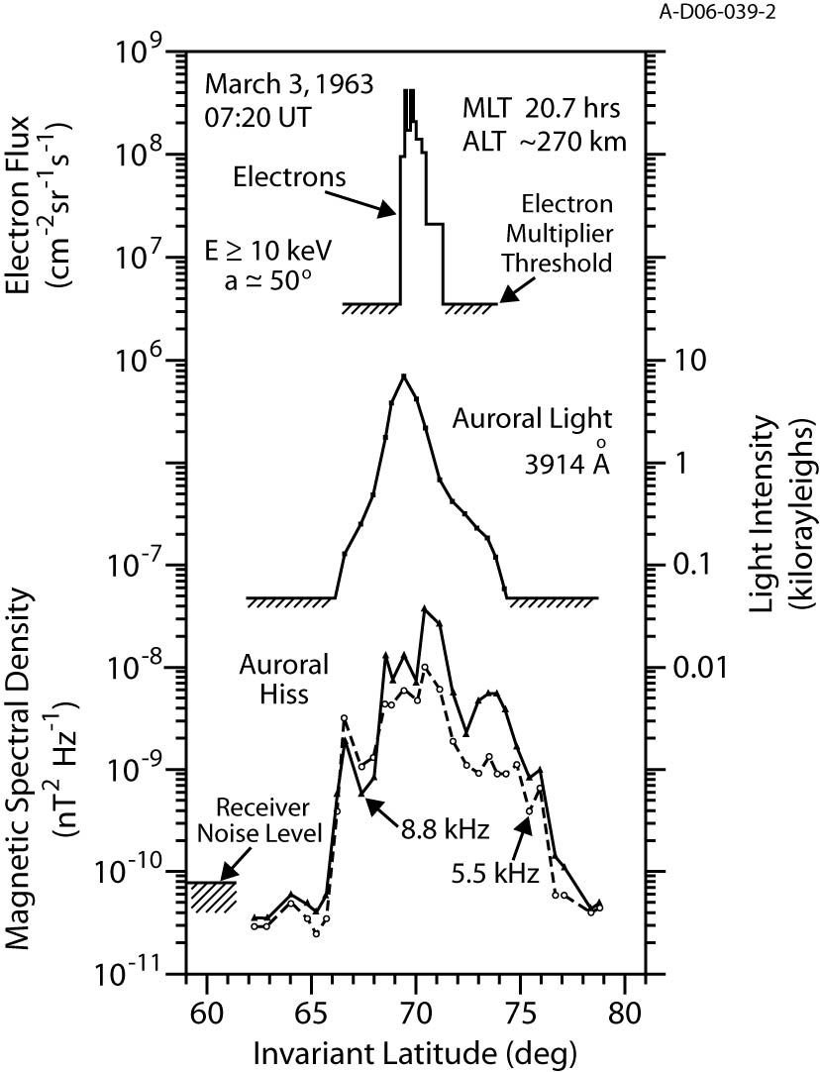
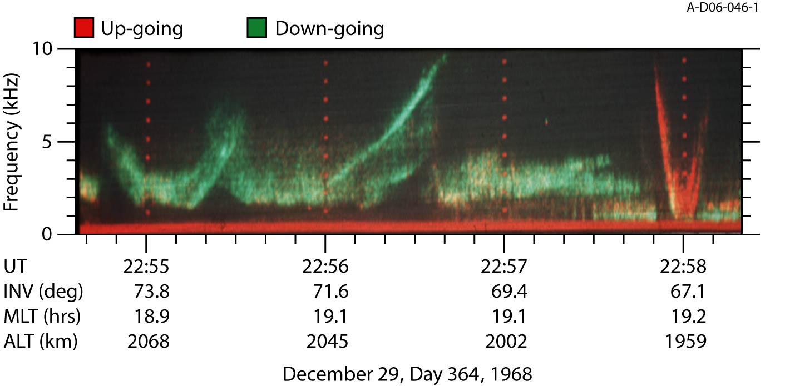
Injun 3 & Injun 5

Slide 6
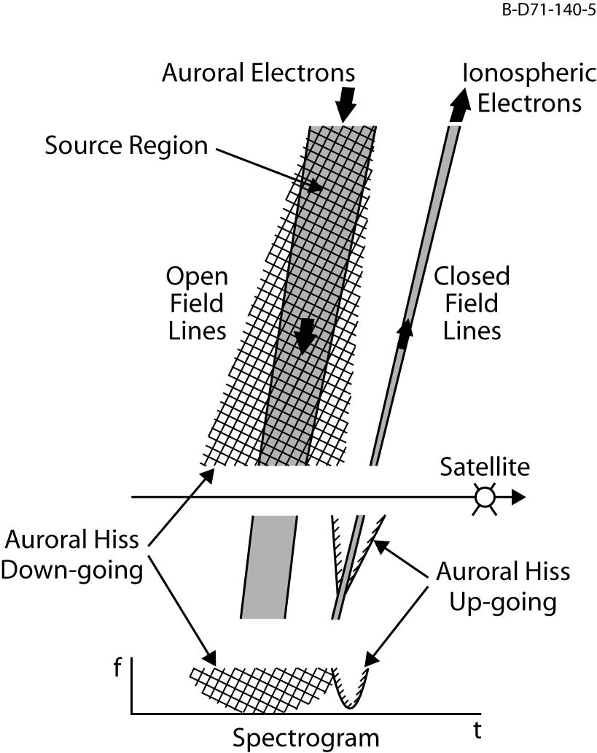

Slide 7
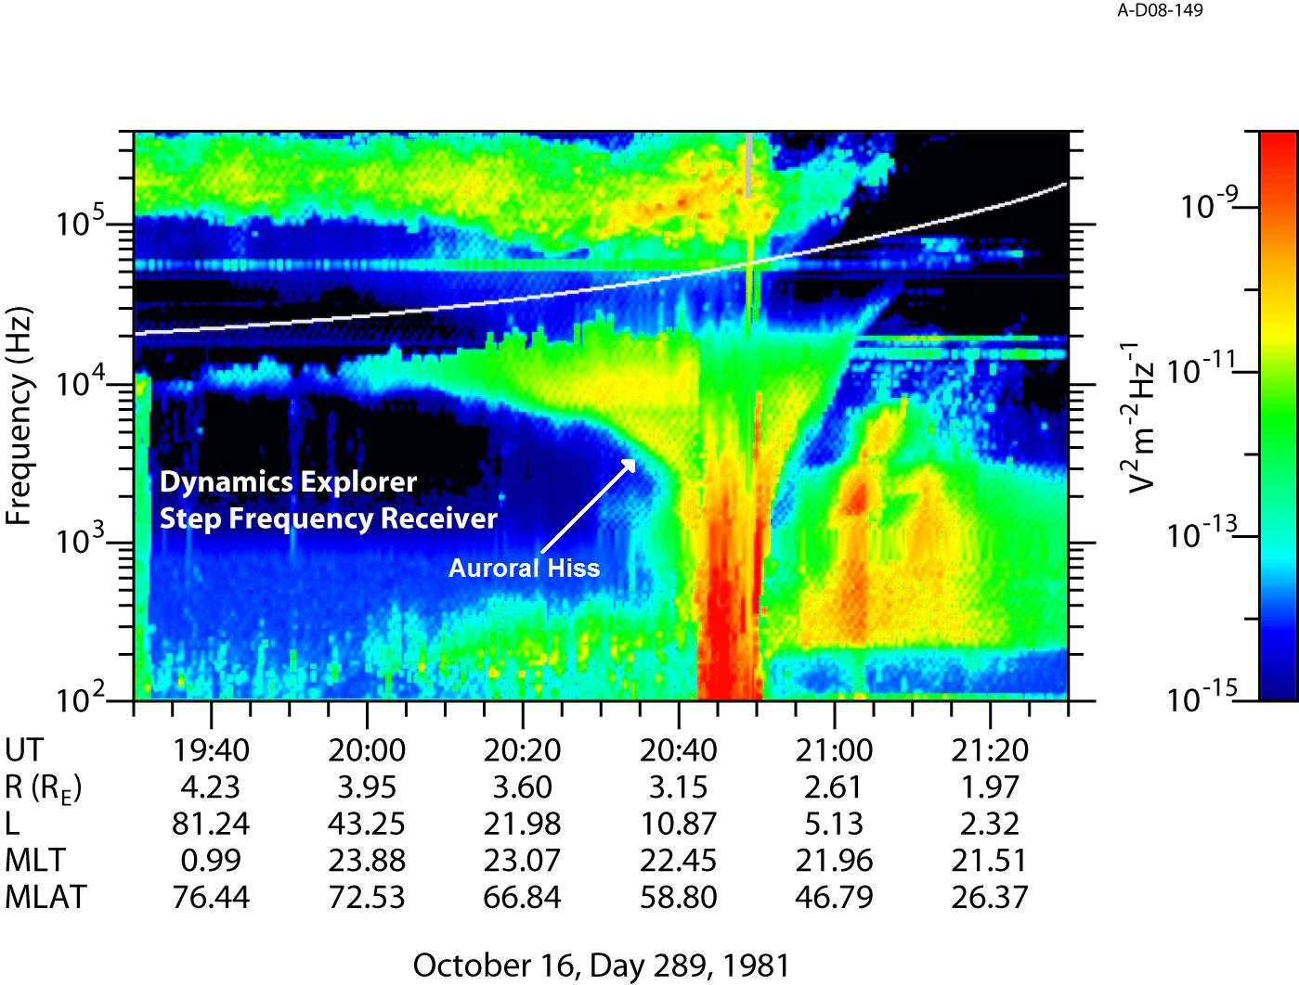
Dynamics Explorer

Slide 8
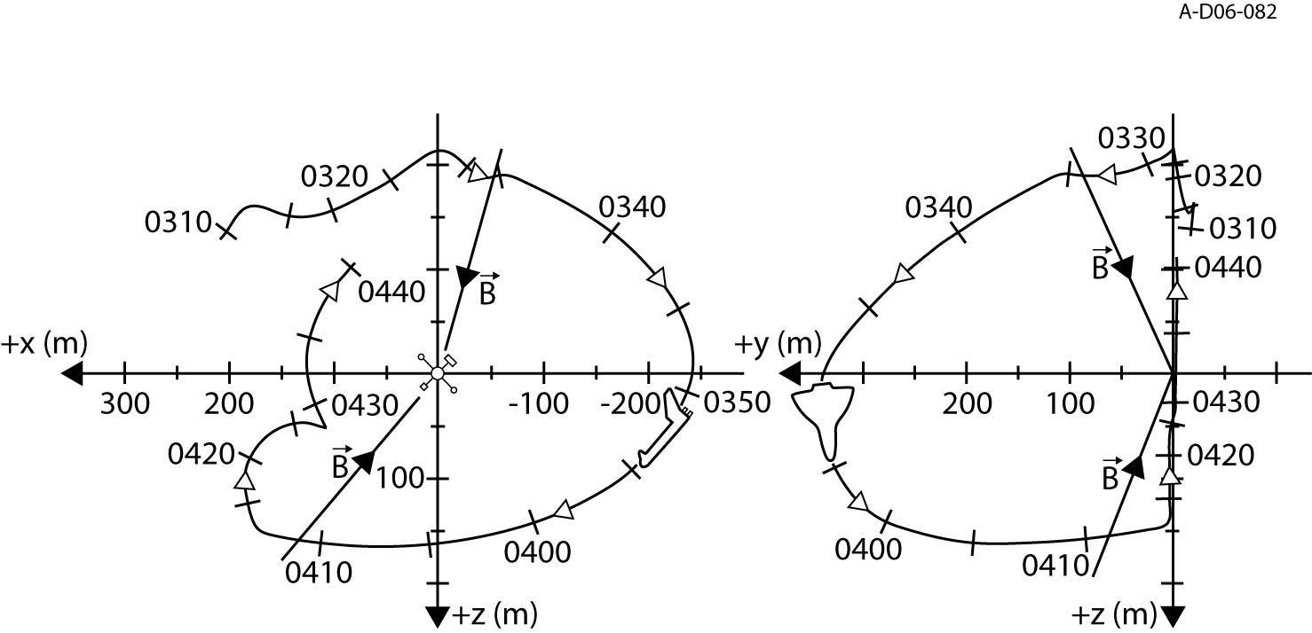
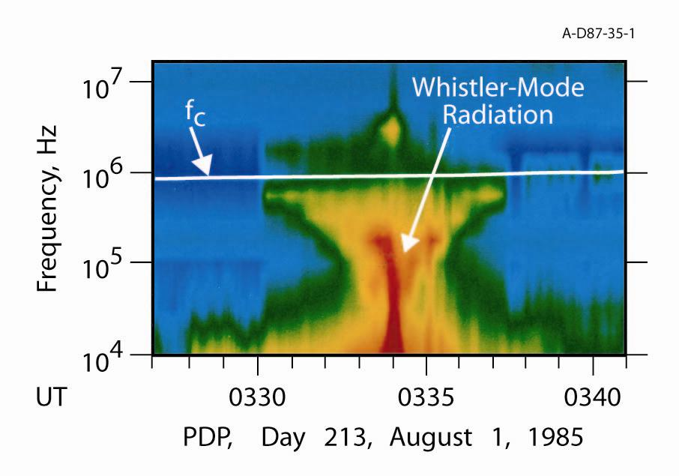
Challenger
PDP

Slide 9
FAST

Slide 10
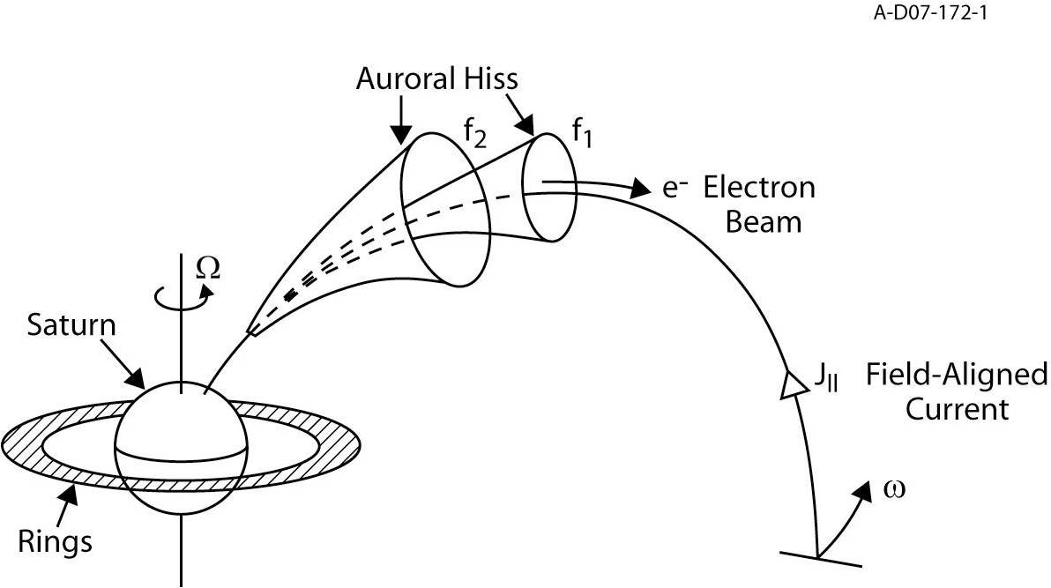
Theory of Auroral Hiss

Slide 11
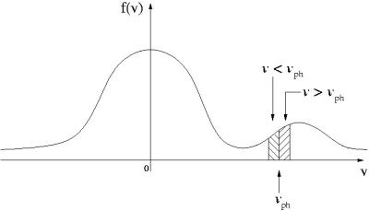
Generation - Exciting an Instability

Slide 12
Growth Rate & Ray Tracing
Growth Rate
  Complicated analytical calculation, solvable only in special, non-physical situations
  Numerical simulation (WHAMP)
Ray Tracing
  Haselgrove’s Equations
  Provides location of source region
  Requires magnetic field knowledge

Slide 13
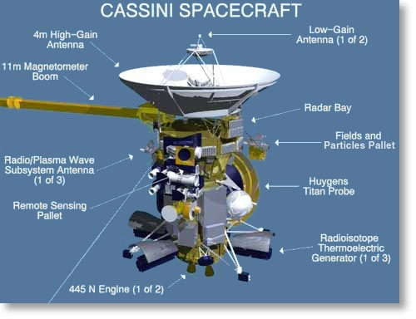
The Cassini Spacecraft
At Saturn since July 1, 2004
Key Instruments
  RPWS
  MAG
  MIMI
  CAPS

Slide 14
Auroral Hiss At Saturn
A comprehensive study of auroral hiss requires knowledge of the following:
  Location
  Periodicity
  Field-Aligned Currents
  Particle Beams

Slide 15
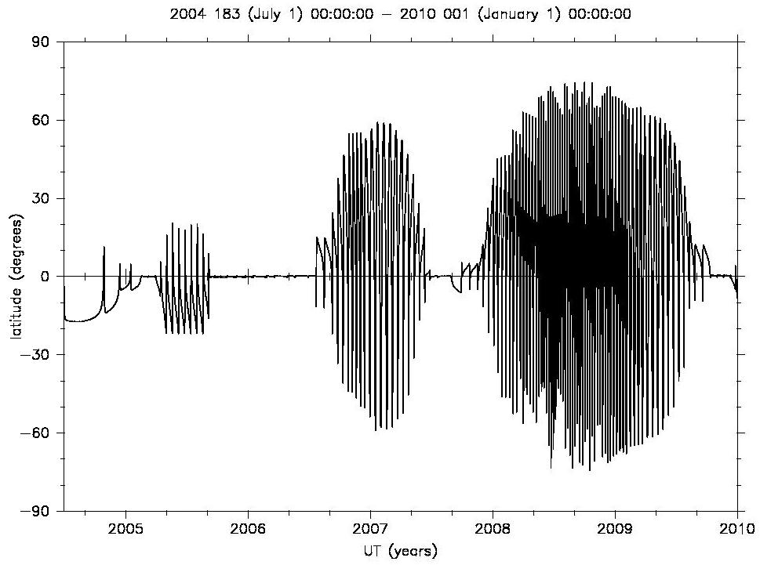
Orbital Trajectory

Slide 16
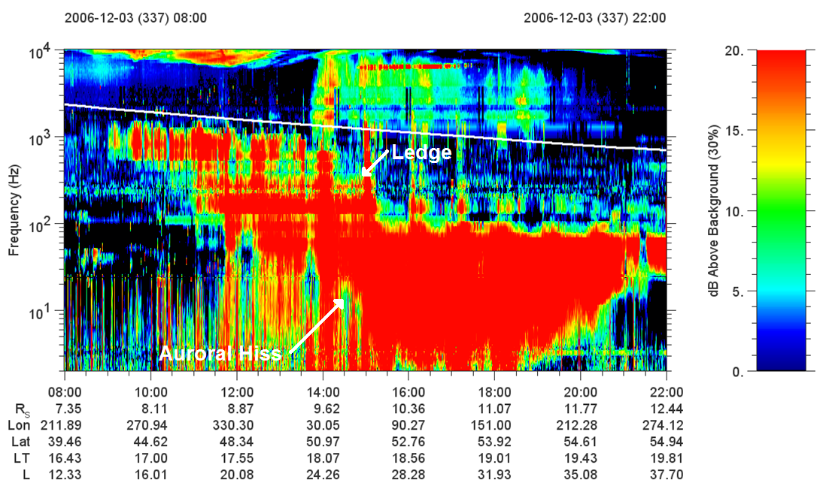
Cassini RPWS Spectrogram

Slide 17
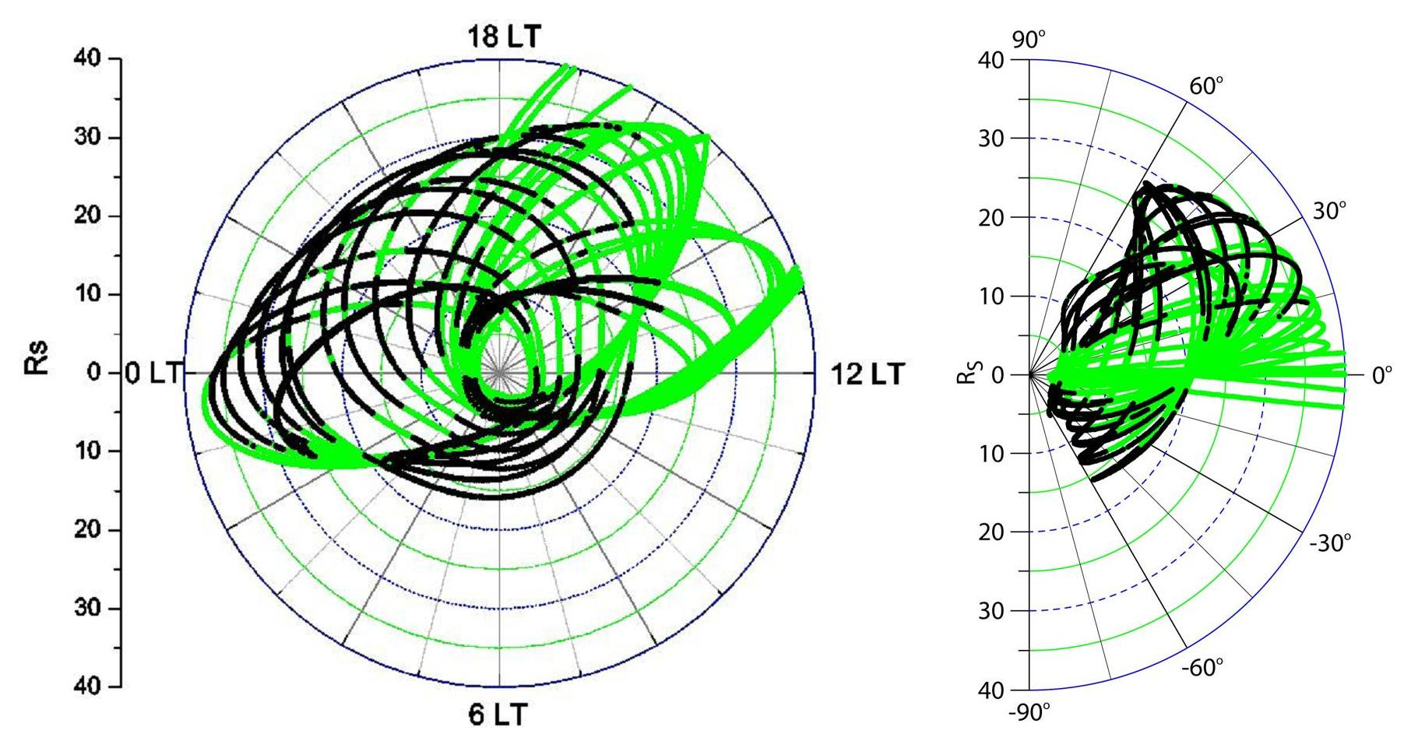
Location

Slide 18
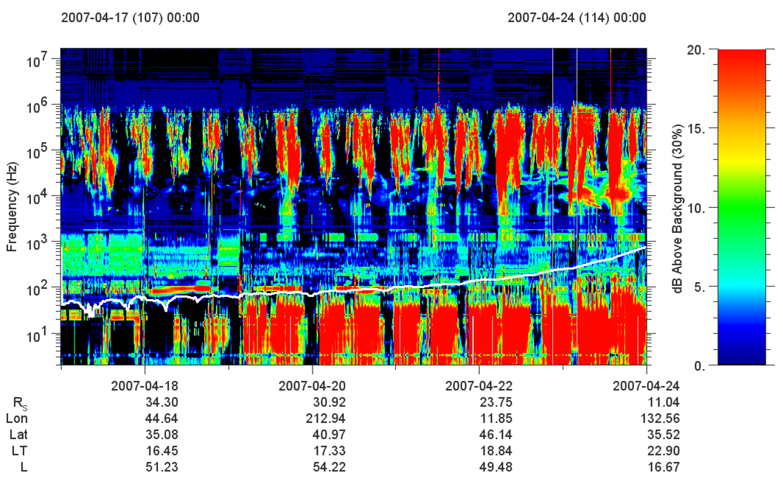
Periodicity

Slide 19
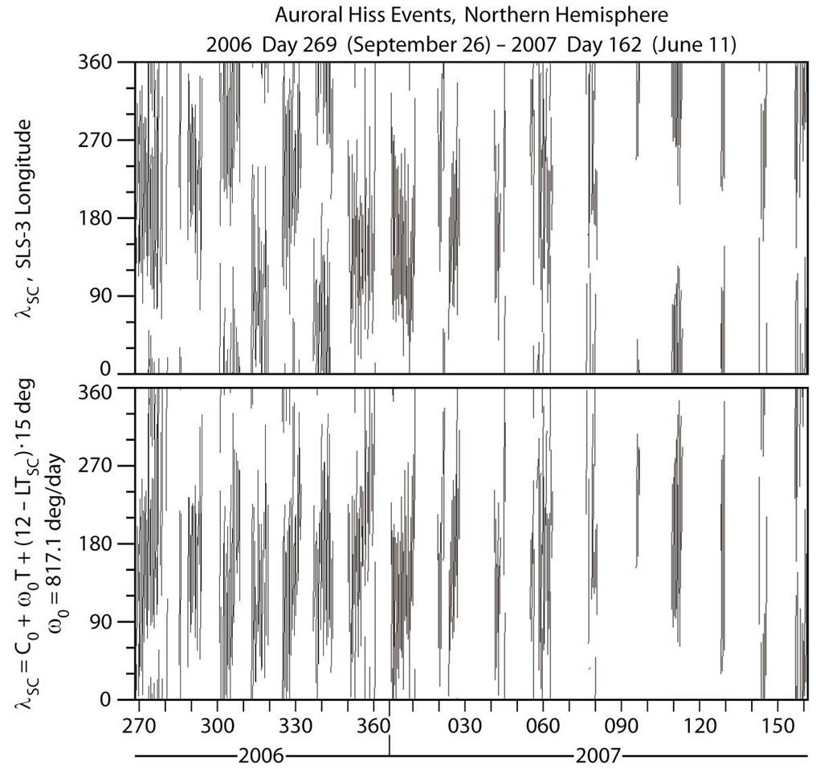
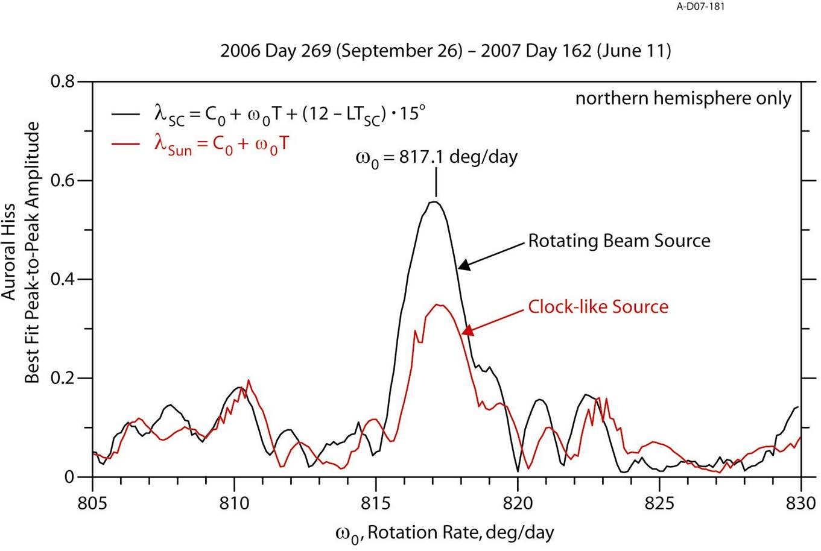
Periodicity Analysis

Slide 20
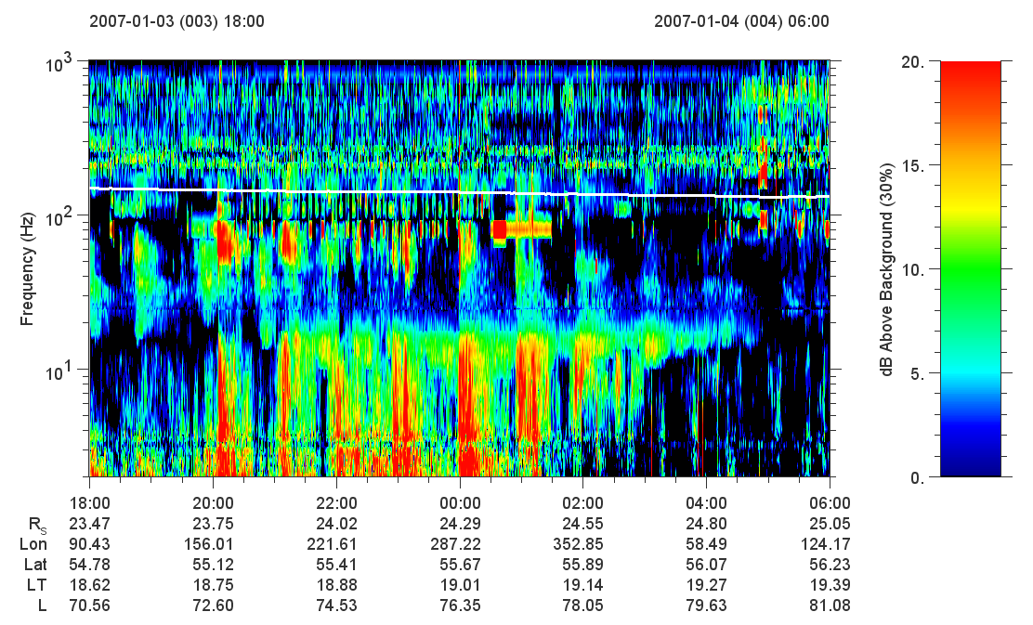
Burst Periodicity

Slide 21
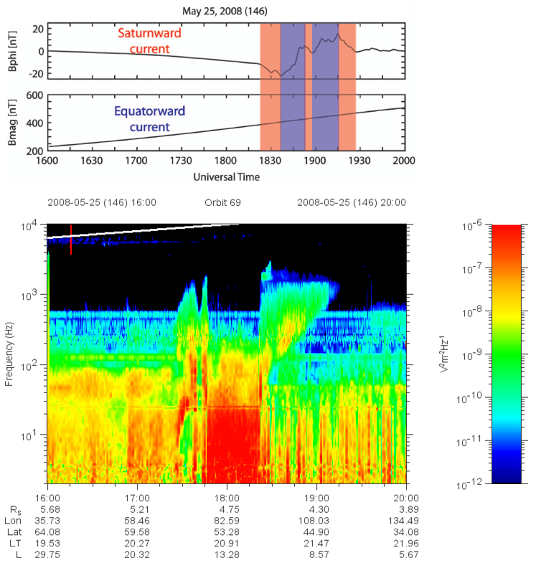
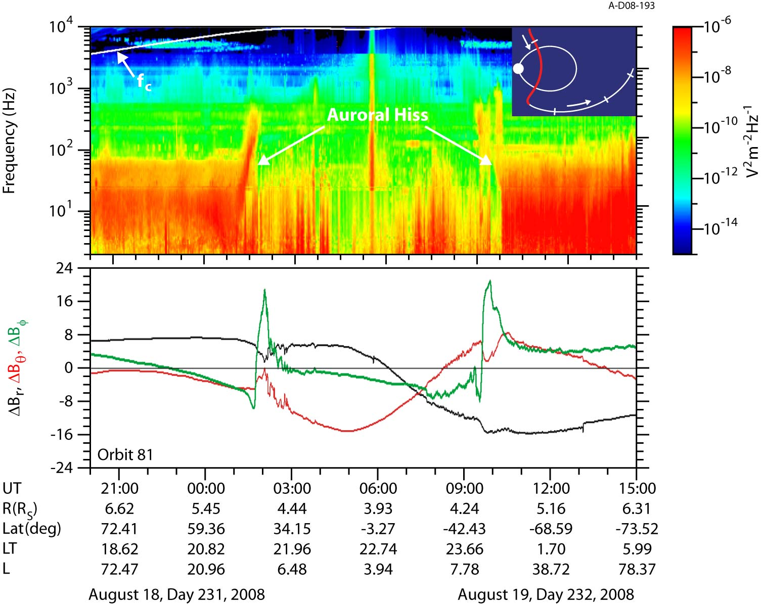
Field-Aligned Currents

Slide 22
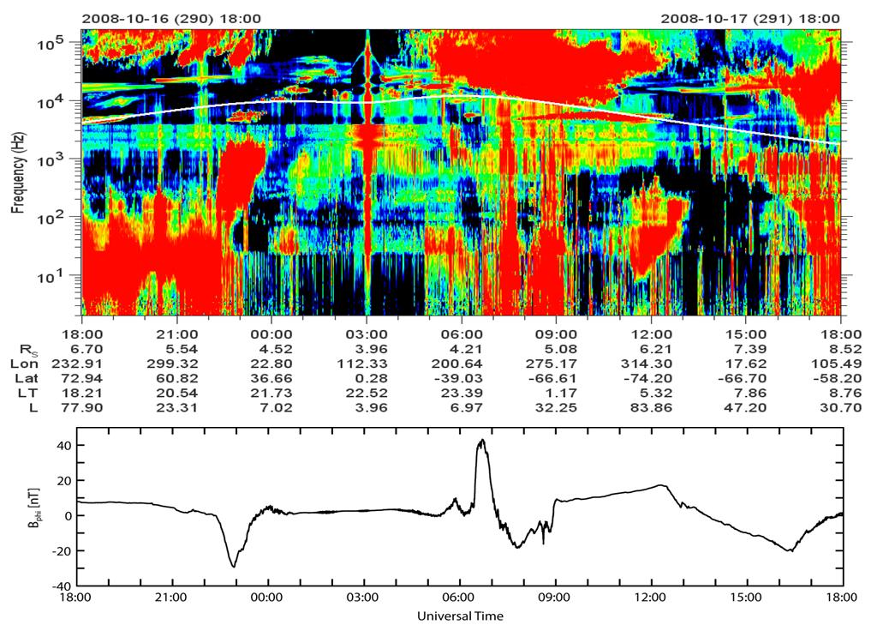
Electron Beams – The Ongoing Saga

Slide 23
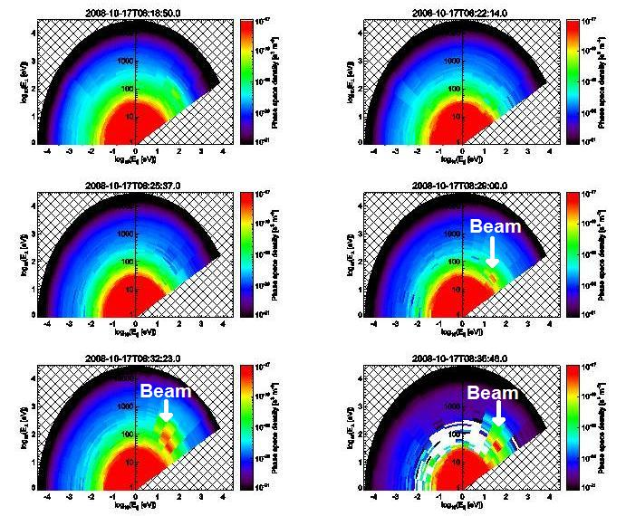
ELS Spectrograms

Slide 24
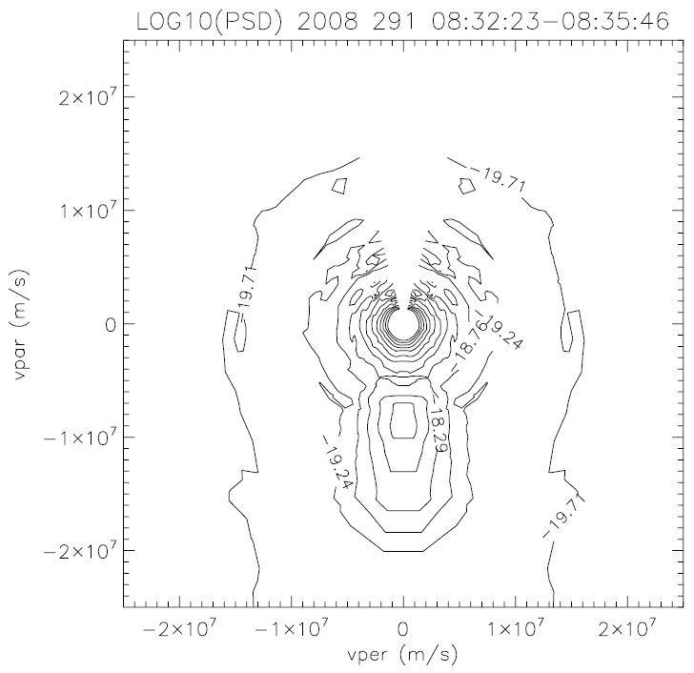
New
Contour
Plot

Slide 25
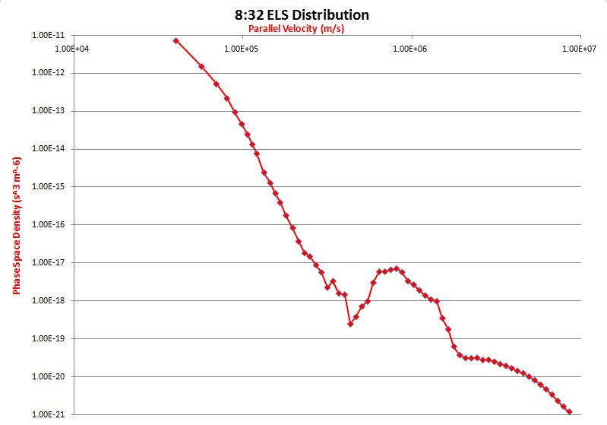
Parallel Velocity Distribution

Slide 26
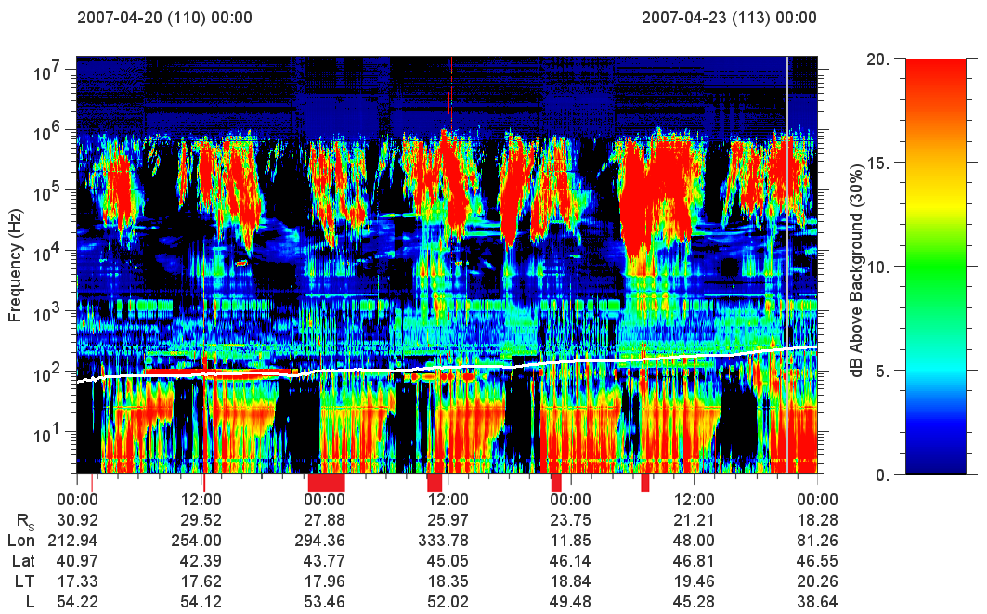
Ion Beams

Slide 27
Goals of this Research
Continue correlating field-aligned currents
Locate more examples of electron beams in CAPS-ELS data
Analytical & numerical growth rate analysis
Examine source region with ray tracing
  Perform both backwards (locate source region) and forwards (reproduce emission)
  Incorporate MAG models
Compare all aspects with Earth

