Slide 1
The Saturnian Auroral Hiss
Andrew Kopf
December 8, 2008

Slide 2
OUTLINE
Whistler Mode Emission
What is Auroral Hiss?
Auroral Hiss at Earth and Saturn
Periodic Nature
Field-Aligned Currents
Ray Tracing

Slide 3
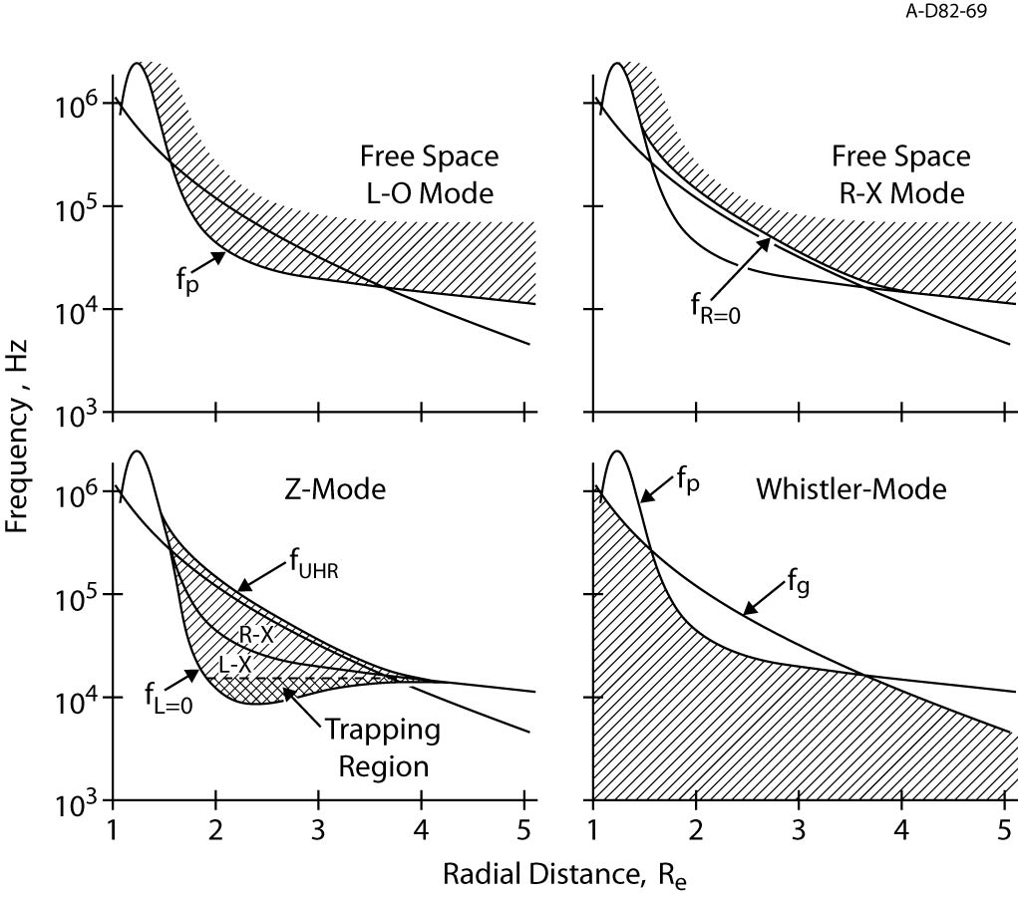

Slide 4
AURORAL HISS
Whistler-mode plasma wave emission in high-latitude regions of magnetosphere
First observed at Earth in 1960s. Has since been detected on other planets
Characteristic funnel shape on spectrogram
Saturn detections due to upward-propagating electrons along magnetic field lines
Believed to propagate near resonance cone around field-aligned currents

Slide 5
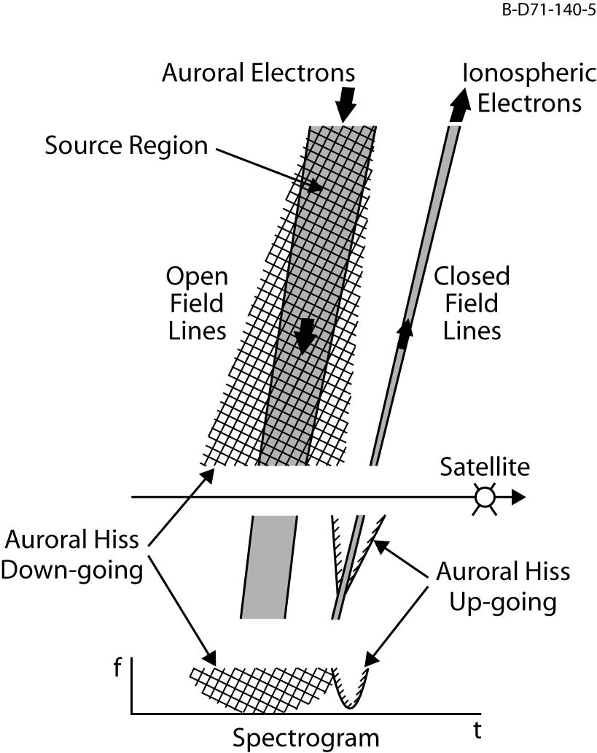

Slide 6
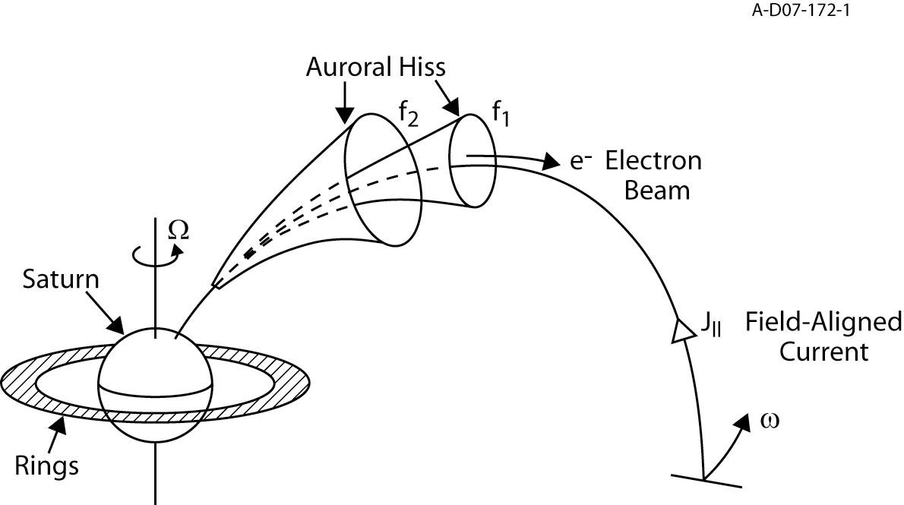
The Generation & Propagation of Auroral Hiss

Slide 7
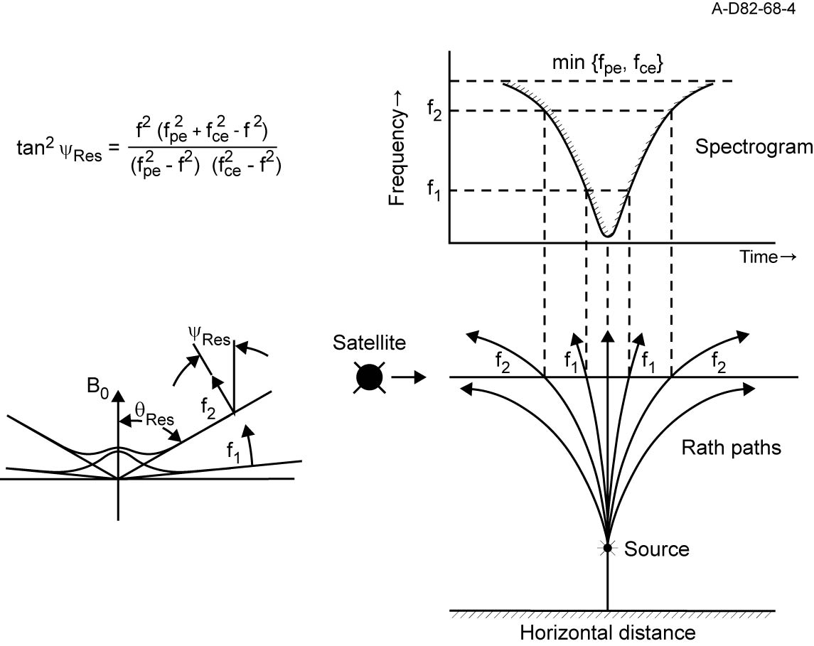

Slide 8
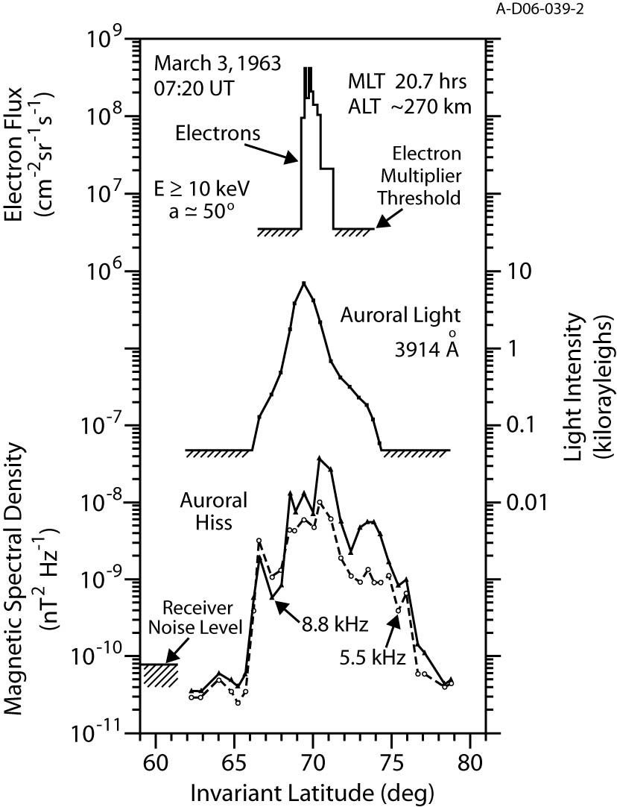

Slide 9
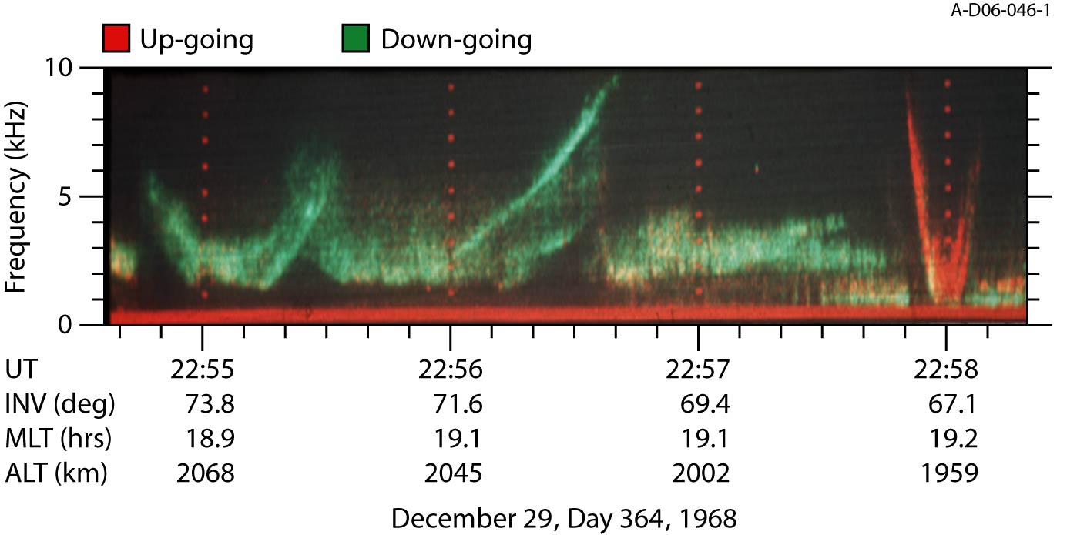

Slide 10
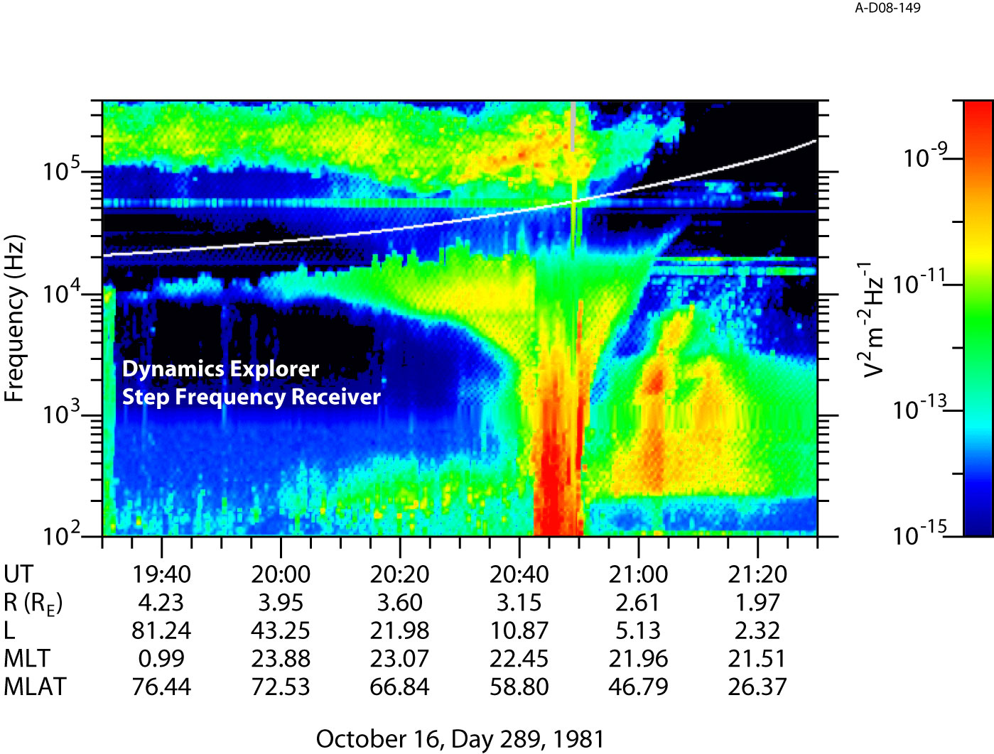

Slide 11
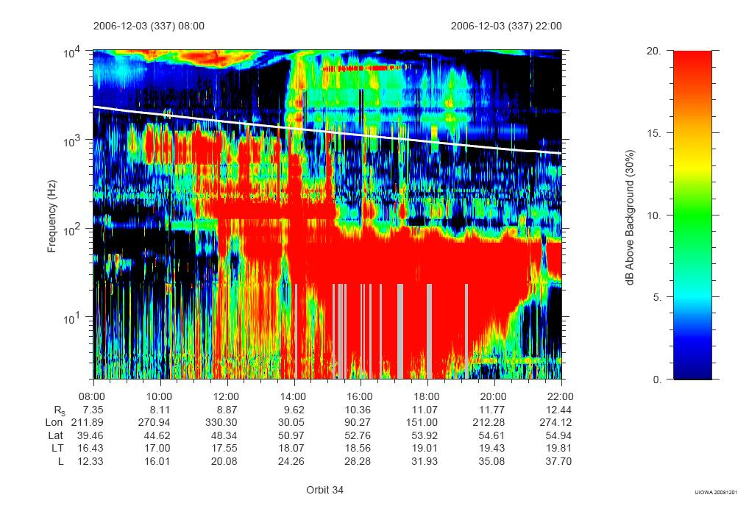

Slide 12
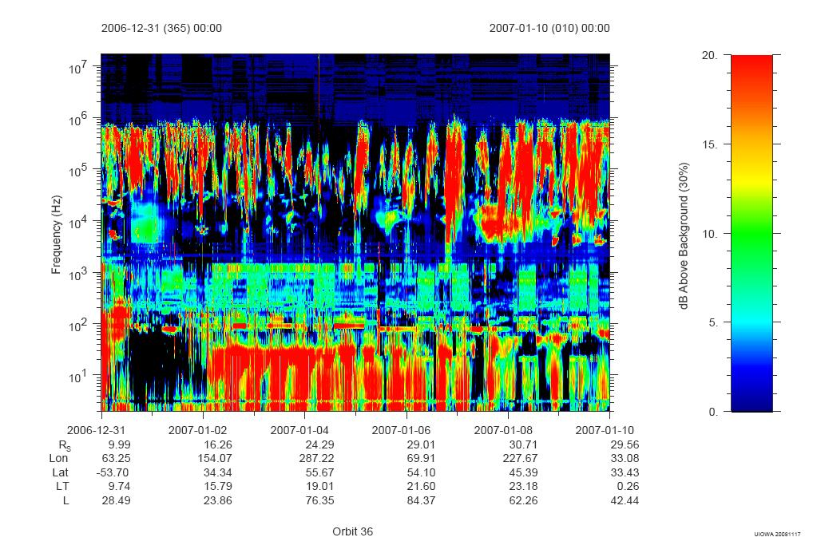

Slide 13
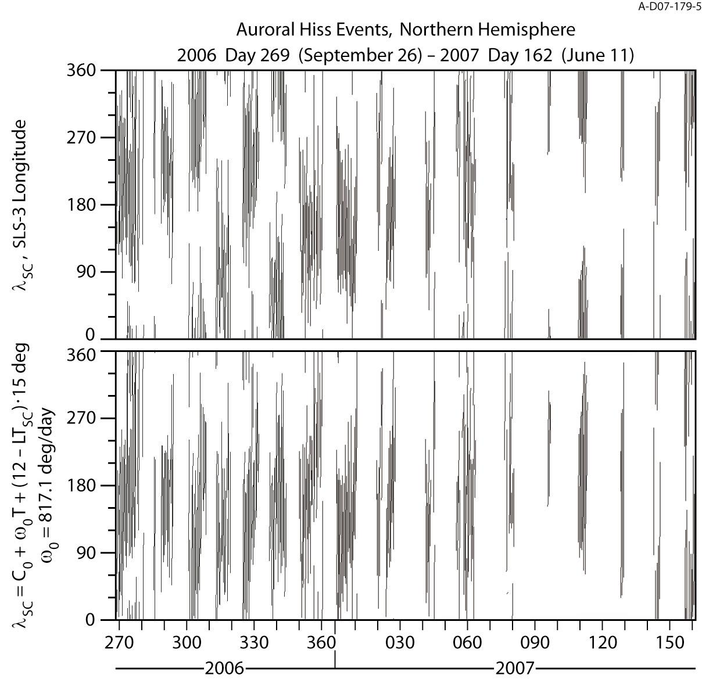
Periodicity

Slide 14
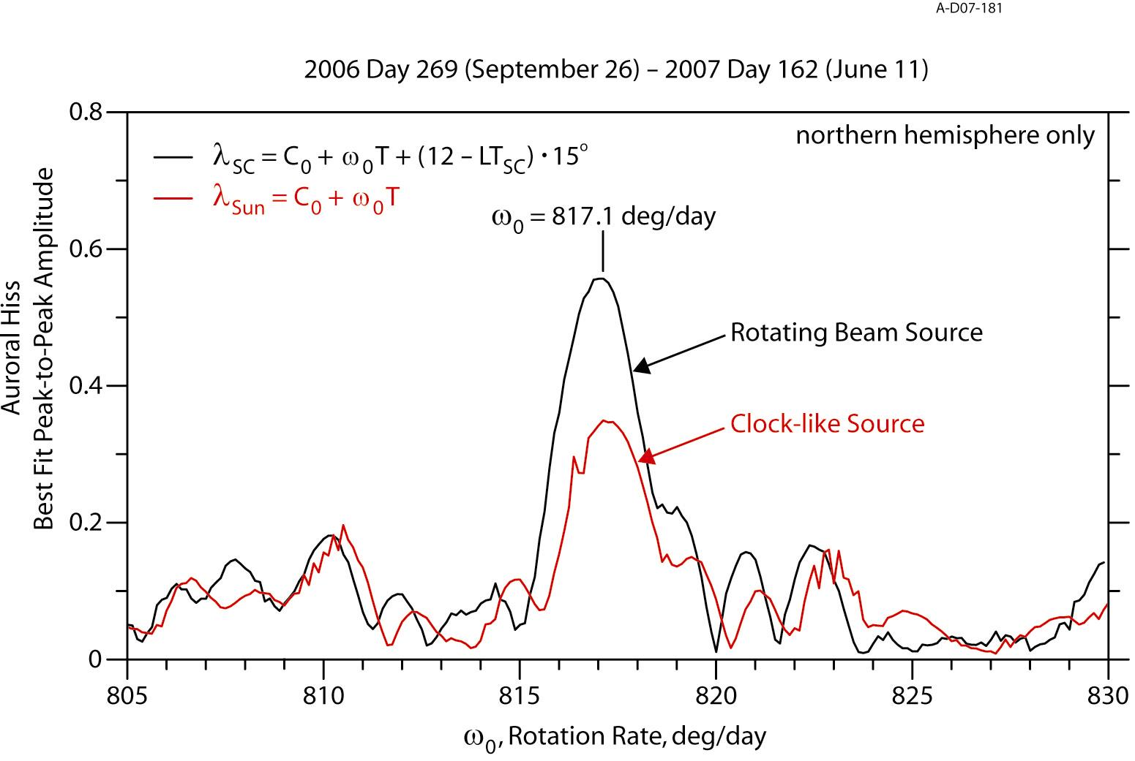
Modulation Spectrum

Slide 15
Testing the Theory

Slide 16
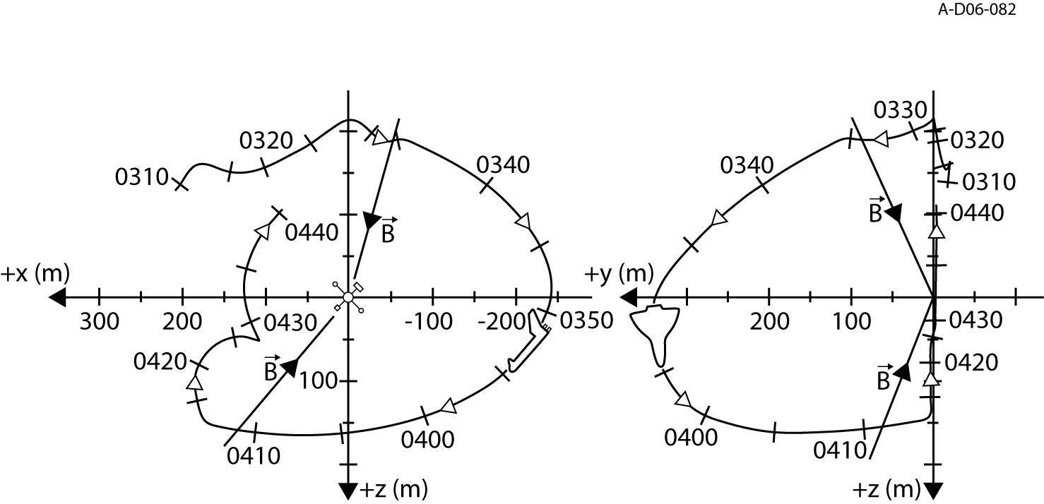
Shuttle Experiment

Slide 17
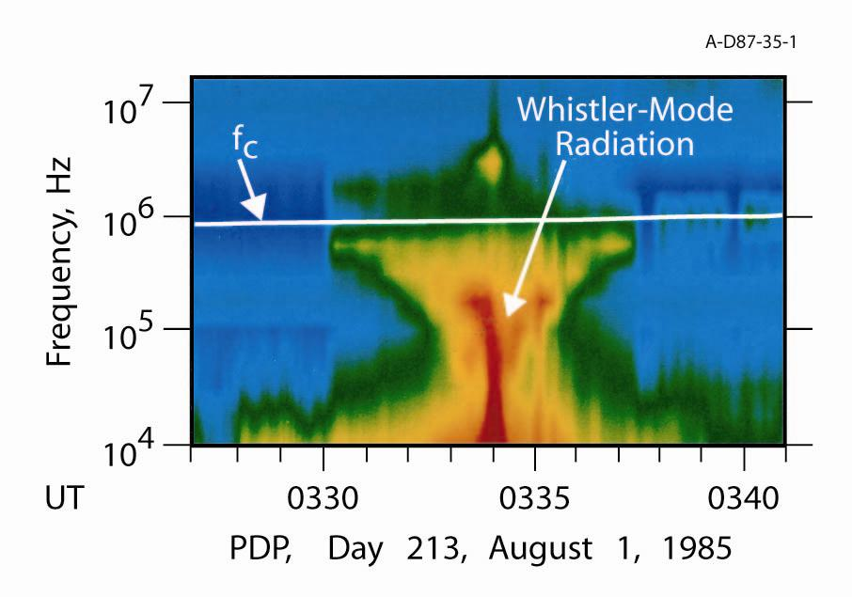

Slide 20
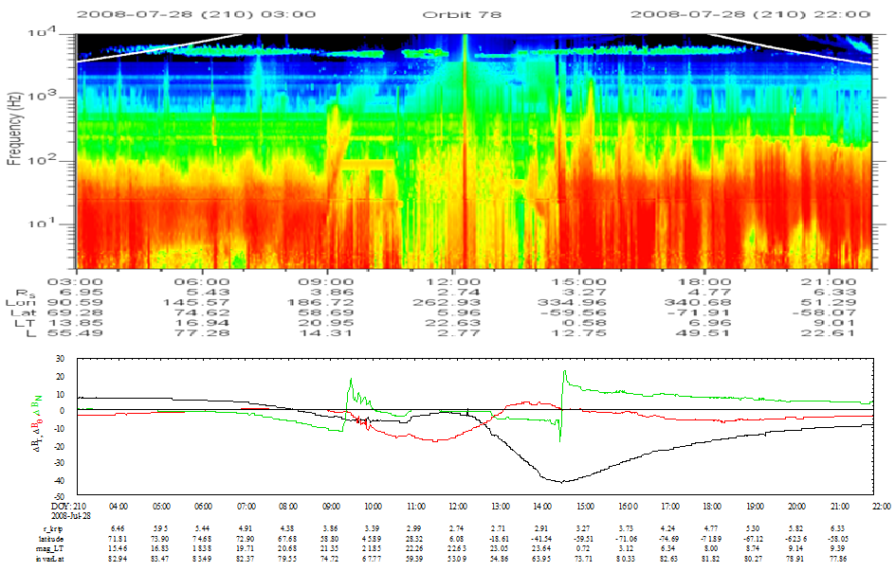

Slide 21
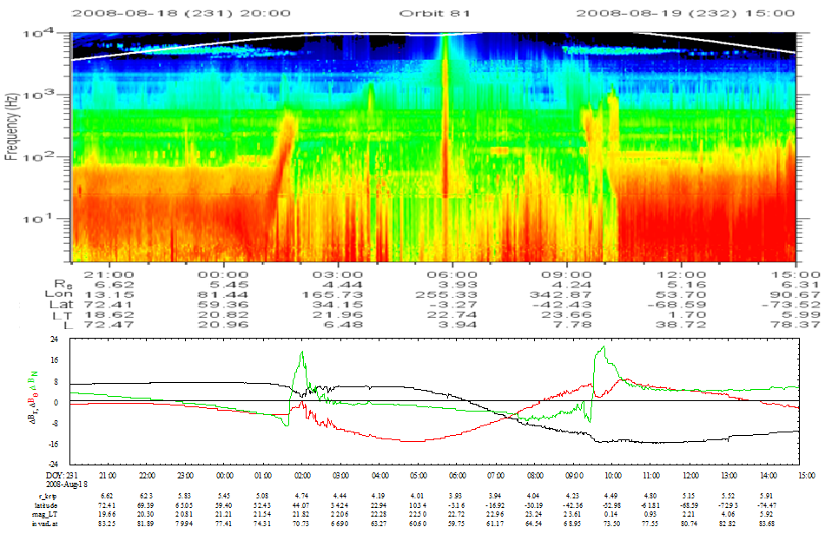

Slide 22
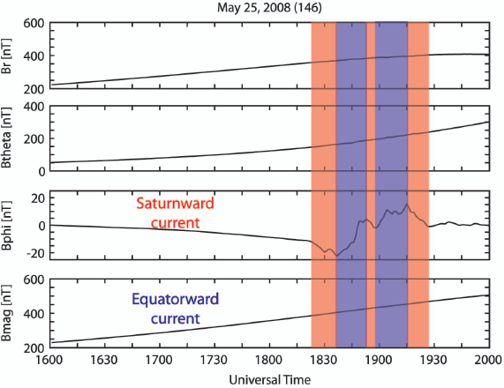
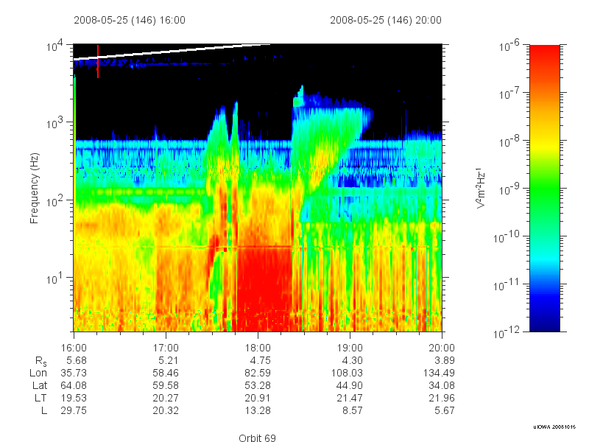

Slide 23
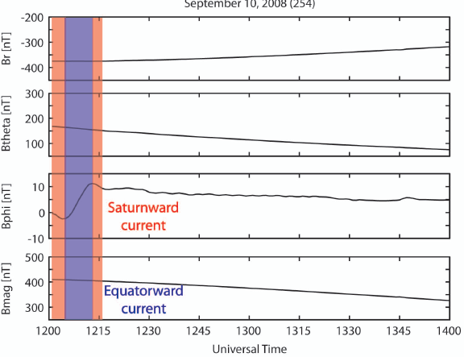
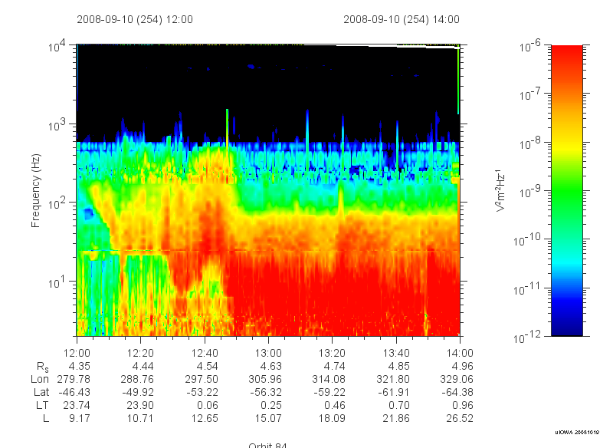

Slide 24
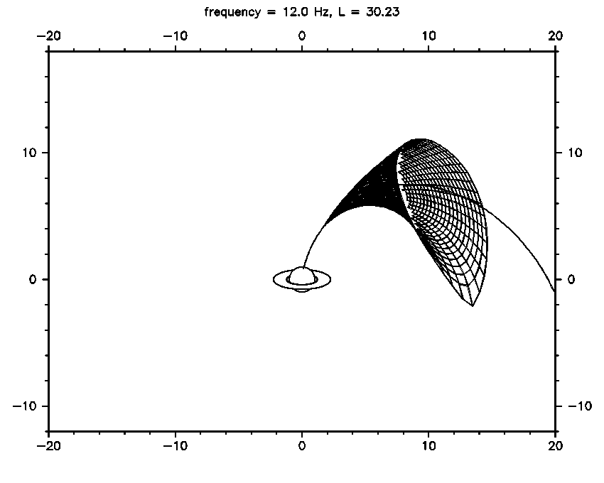

Slide 25
SUMMARY
Whistler mode auroral hiss events detected at Saturn, show similar features to those at Earth
Emission displays two periodicities
1 hour burst periodicity possibly due to ion conics
10.8 hour periodicity with properties of a rotating beam source
Field-aligned current structures commonly observed, but do not align with center of hiss
Ray tracing efforts underway to map emission back to a source region

