Slide 1
A Study of New Layers in the Topside Ionosphere of Mars Using MARSIS
Andrew J. Kopf
March 10, 2008

Slide 2
Presentation Outline
Introduction & Background
Mars Express
Ionospheric Sounding and MARSIS
The Ionogram and Analysis
Results from the main ionospheric layer
Electron Density Profiles
Oblique Ionospheric Echoes
Solar Zenith Angle Dependence
My focus: Upper layers
What are their properties?
What are they made of?
Where do they come from?
Why don’t we always see them?

Slide 3
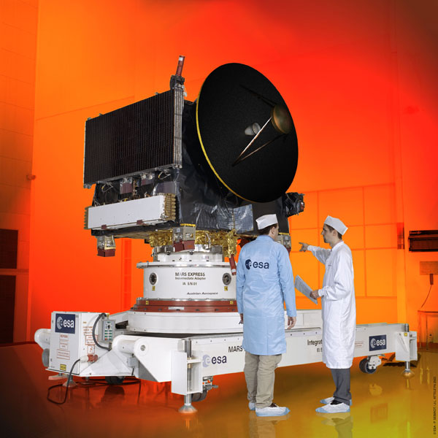
Mars Express
ESA probe launched by Soyuz 6/2/03
Entered orbit around Mars 12/25/03
MARSIS antennae deployed on 5/10/05 and 6/14/05
MARSIS began operating 7/4/05

Slide 4
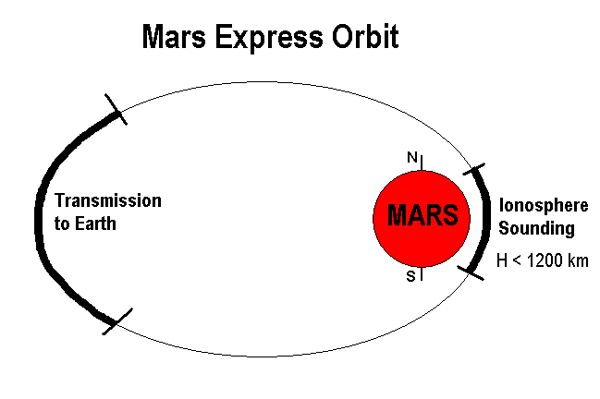
Mars Express Orbit
Periapsis = 275 km, Apoapsis = 10,100 km, Period = 6.75 hr

Slide 5
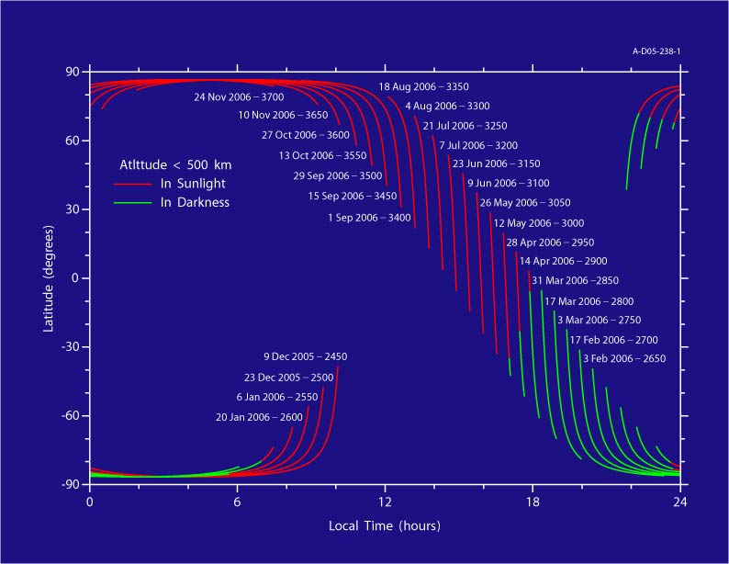
Orbit Evolution

Slide 6
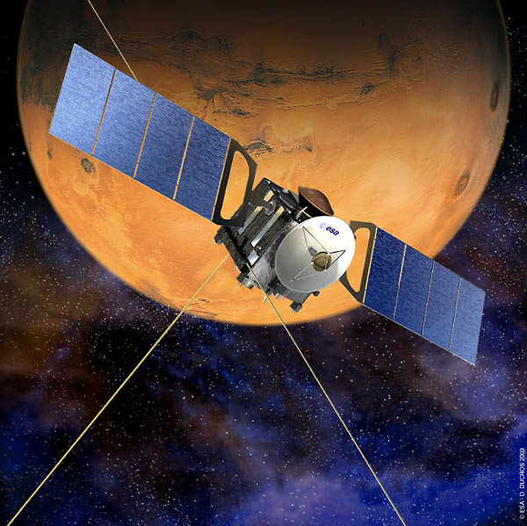
MARSIS
Mars Advanced Radar for Subsurface and Ionosphere Sounding
Two 20-m antennae act as a dipole: transmit radar “chirp” and receive reflected “echo”
Operates from 0.1 – 5.4 MHz for ionospheric sounding
Repeats transmit/receive cycle about every 7.543 seconds.
Each sounding pass lasts roughly 40 minutes
Complements radio occultation by providing better spatial resolution and full coverage of the planet

Slide 7
How Sounding Works
Ionospheric sounders transmit a short pulse at a fixed frequency f, and then detect any echoes that are reflected from the ionosphere
Reflection occurs because free-space EM-radiation can’t propagate at frequencies below the electron plasma frequency f_{p}:
For a horizontal ionosphere, reflection occurs at the point where f = f_{p}

Slide 8
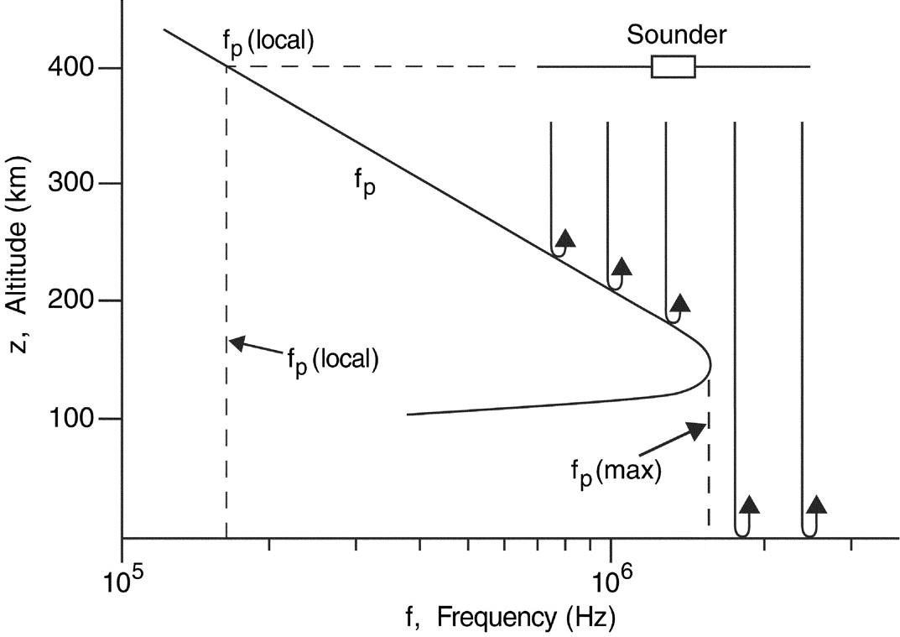
Sounding Diagram

Slide 9
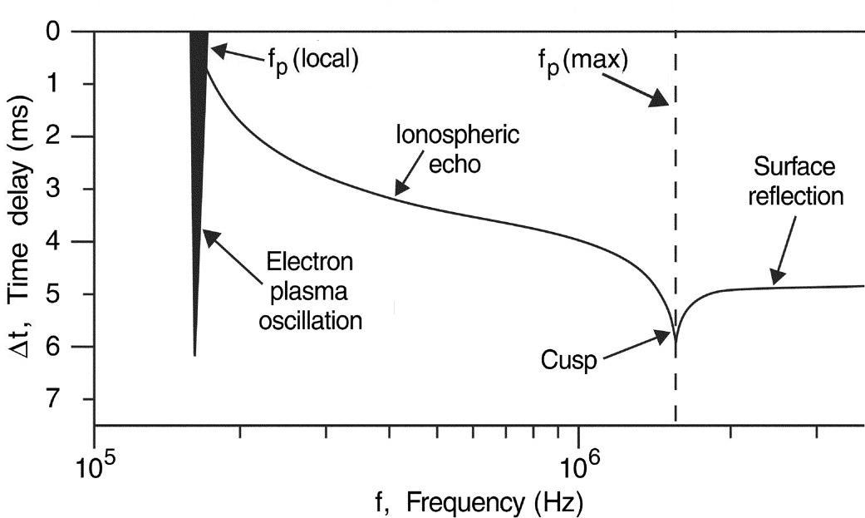
Idealized “Echo” Response

Slide 10
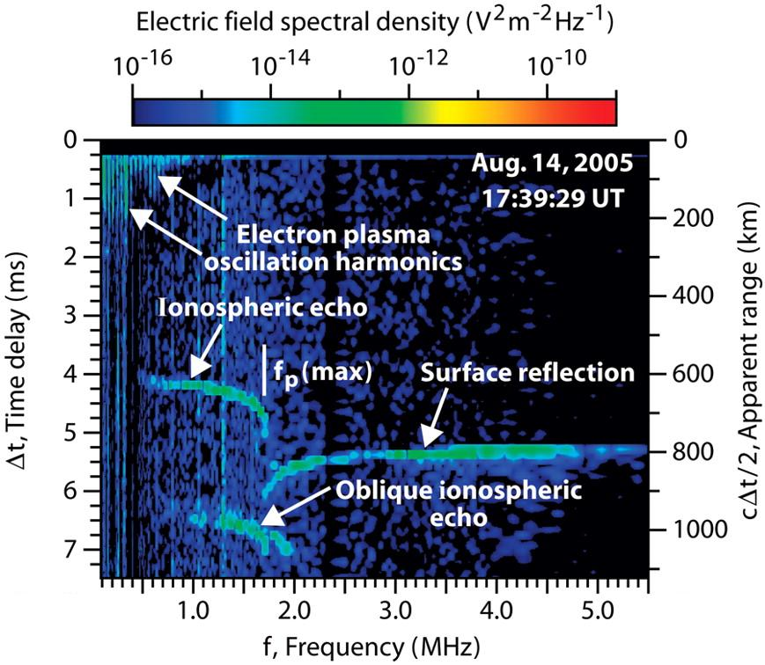

Slide 11
Using Time Delay
We want to form a density profile z(n_{e})
By measuring the time delay Δt in receiving the echo, the range can be computed
A free-space electromagnetic pulse will propagate through an unmagnetized plasma at the group velocity:
For vertical incidence on a horizontal ionosphere, the round trip delay time as a function of frequency is:

Slide 12
Inverting the integral
Since Δt(f) is known from the ionogram, we must invert this integral to obtain z(f_{p}).
The integral has the following solution:
where sin α = f_{p}(z)/f , sin α₀ = f_{p}(z_{sc})/f_{p}(max)
Once this is known, we can obtain z(n_{e})

Slide 13
Presentation Outline
Introduction & Background
Mars Express
Ionospheric Sounding and MARSIS
The Ionogram and Analysis
Results from the main ionospheric layer
Electron Density Profiles
Oblique Ionospheric Echoes
Solar Zenith Angle Dependence
My focus: Upper layers
What are their properties?
What are they made of?
Where do they come from?
Why don’t we always see them?

Slide 14
Fitting the profile
Once the inversion was completed, we used a theoretical model for the density profile and adjusted the parameters to give the best fit.
The model we used was the Chapman model, taken from his 1931 paper:
Ch(x,χ) is the Chapman grazing incidence function, which takes into account absorption of solar radiation by the atmosphere:

Slide 15
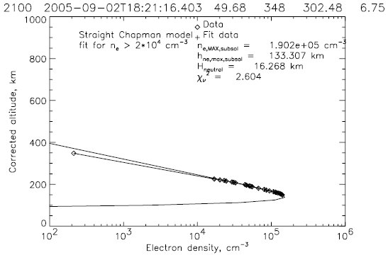
Chapman Fit

Slide 16
“Oblique Echoes”

Slide 17
Obliques on Ionogram

Slide 18
What Causes Oblique Echoes?
Reflection off upward bulge in the ionosphere
Open field lines connect to the solar wind, allowing it to heat lower levels of the ionosphere, thus increasing n_{e}

Slide 19
Where do we see them?
Apexes occur where the crustal field is nearly vertical

Slide 20
Solar Zenith Effects
The primary source that creates the ions that make up the ionosphere is solar photons
Photons ionize neutral molecules and atoms, creating ions and free electrons
Areas with direct sunlight (SZA ≈ 0) receive more photons than those with less direct illumination, and thus have:
Higher maximum electron densities
Higher maximum plasma frequencies

Slide 21
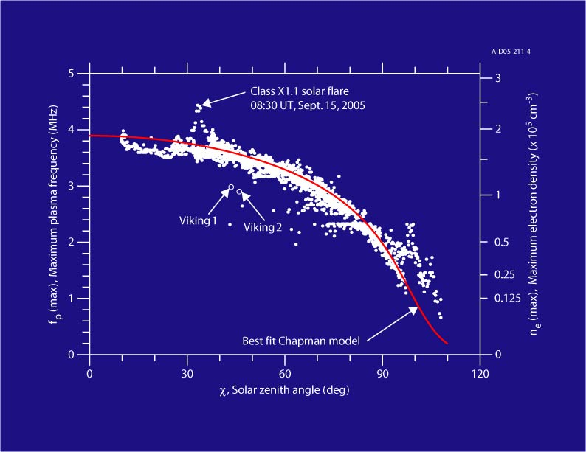
SZA Dependence

Slide 22
Presentation Outline
Introduction & Background
Mars Express
Ionospheric Sounding and MARSIS
The Ionogram and Analysis
Results from the main ionospheric layer
Electron Density Profiles
Oblique Ionospheric Echoes
Solar Zenith Angle Dependence
My focus: Upper layers
What are their properties?
What are they made of?
Where do they come from?
Why don’t we always see them?

Slide 24
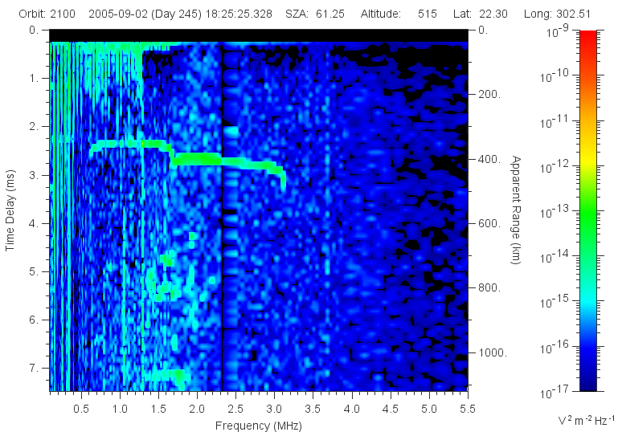
What? Another Cusp?

Slide 25
Analysis
As with the main layer, this feature was observed and traced on the ionogram
Inversion techniques same as before
Initially used Chapman model to analyze key characteristics. However, no scientific basis for this, so have also more recently fit some profiles with Gaussian functions
Altitude, Density, SZA, Latitude, and Longitude of each event were saved and plotted in graphing software

Slide 26
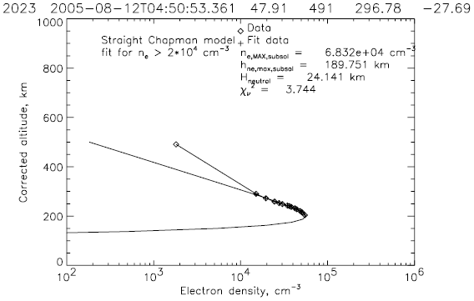
Density Profile

Slide 27
What are its Properties?
Altitude = 190-235 km (Mean 205 km)
Density = 4-6 x 10⁴ cm⁻³ (Mean 48,000 cm⁻³)
Compare to Main Layer: 130 km, 2 x 10⁵ cm⁻³
In addition, a few peculiar properties
SZA dependence, more prominent closer to zenith
Appears (infrequently) even with essentially no solar interaction, implying a natural Martian source in addition to solar interaction

Slide 28
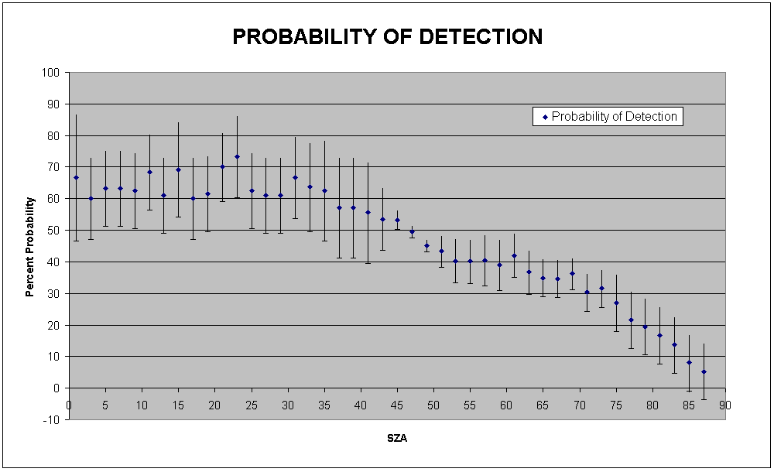
Solar Effect on Detection

Slide 29
SZA Dependence

Slide 30
Considered Explanations
Solar Effects
Variations in Solar Wind Flux
Sudden increase in ionization of O₂⁺ ions
Static Effects
Magnetic field effects
Magnetic Flux Ropes
O⁺ ions
Dynamical Effects
Kelvin-Helmholtz instabilities
Mass loading / Transport effects
Residue bumps from atmospheric outflow

Slide 31
Considered Explanations
Solar Effects
Variations in Solar Wind Flux (no time dependence)
Sudden increase in ionization of O₂⁺ ions (same)
Static Effects
Magnetic field effects
Magnetic Flux Ropes
O⁺ ions
Dynamical Effects
Kelvin-Helmholtz instabilities
Mass loading / Transport effects
Residue bumps from atmospheric outflow

Slide 32
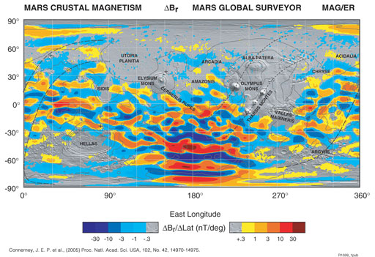
Crustal Magnetic Field

Slide 33
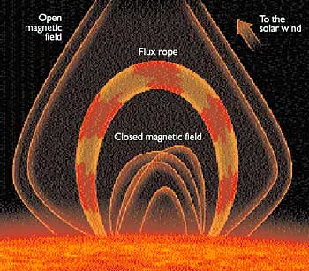
Flux Ropes

Slide 34
Considered Explanations
Solar Effects
Variations in Solar Wind Flux (no time dependence)
Sudden increase in ionization of O₂⁺ ions (same)
Static Effects
Magnetic field effects (doesn’t follow field)
Magnetic Flux Ropes (wrong location)
O⁺ ions
Dynamical Effects
Kelvin-Helmholtz instabilities
Mass loading & horizontal transport
Residue bumps from atmospheric outflow

Slide 35
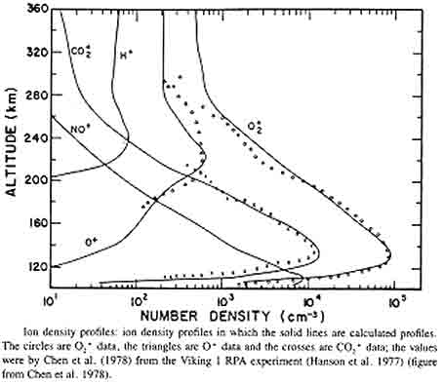
Ion Densities

Slide 36
Considered Explanations
Solar Effects
Variations in Solar Wind Flux (no time dependence)
Sudden increase in ionization of O₂⁺ ions (same)
Static Effects
Magnetic field effects (doesn’t follow field)
Magnetic Flux Ropes (wrong location)
O⁺ ions (density probably too low by itself)
Dynamical Effects
Kelvin-Helmholtz instabilities
Mass loading & horizontal transport
Residue bumps from atmospheric outflow

Slide 37

Kelvin-Helmholtz

Slide 38
Considered Explanations
Solar Effects
Variations in Solar Wind Flux (no time dependence)
Sudden increase in ionization of O₂⁺ ions (same)
Static Effects
Magnetic field effects (doesn’t follow field)
Magnetic Flux Ropes (wrong location)
O⁺ ions (density probably too low by itself)
Dynamical Effects
Kelvin-Helmholtz instabilities (no evidence at altitude)
Mass loading & horizontal transport
Residue bumps from atmospheric outflow

Slide 39
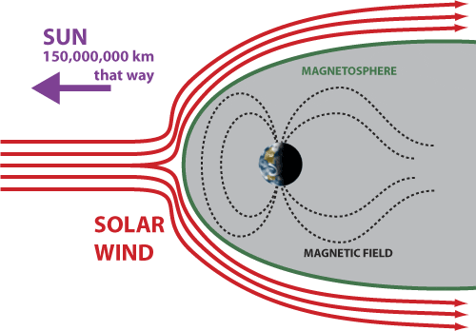
Transport?
Transition Altitude
Well established that transition from photochemical equilibrium to transport domination takes place near 200 km on the dayside of Mars
Change in mechanism could cause change in slope

Slide 40
Solar Effect on Detection

Slide 41
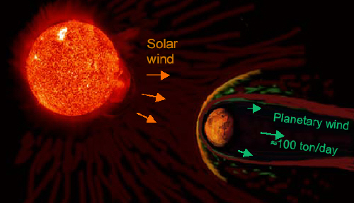
…HOWEVER…
Transport could still be a major contributing factor to creating this sudden change in density because of the lack of a global magnetic field

Slide 42
Considered Explanations
Solar Effects
Variations in Solar Wind Flux (no time dependence)
Sudden increase in ionization of O₂⁺ ions (same)
Static Effects
Magnetic field effects (doesn’t follow field)
Magnetic Flux Ropes (wrong location)
O⁺ ions (density probably too low by itself)
Dynamical Effects
Kelvin-Helmholtz instabilities (no evidence at altitude)
Mass loading & horizontal transport (SZA problems)
Residue bumps from atmospheric outflow

Slide 43
Recall “Ideal” Response

Slide 44
…The Second Cusp…

Slide 45
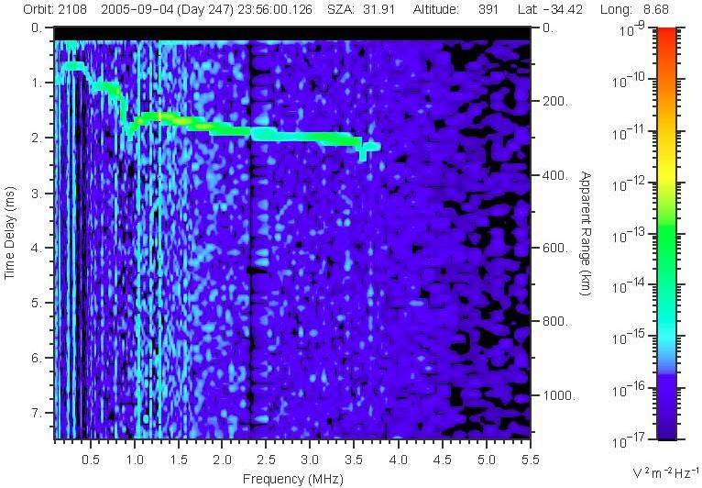
The Third Cusp

Slide 46
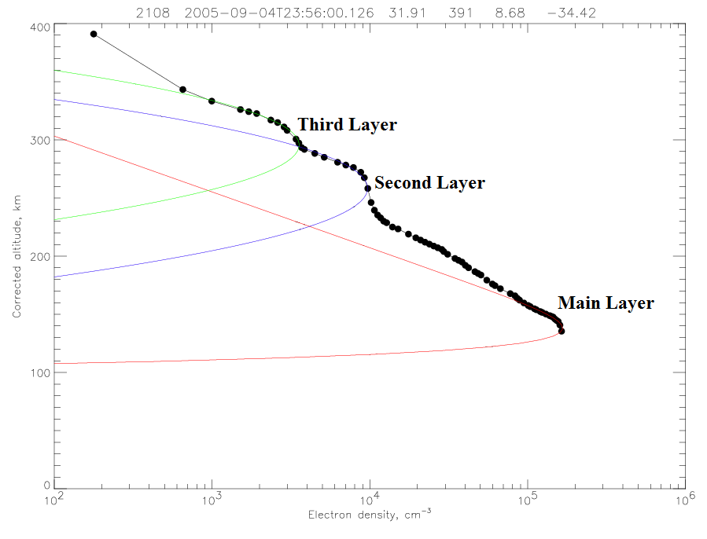
Gaussian Fitting

Slide 47
So what’s causing this cusp?
Could be a transport effect, and this does not face the same SZA problems the 2nd layer did. Altitude is also perhaps more probable for this scenario
Looking at the Hanson density profile, the next most populous ion is Hydrogen, the only ion whose density INCREASES with altitude
The solar wind is primarily Hydrogen ions. Combining this with Mars’ ionosphere could create a significant enough density to cause this cusp and corresponding step on the profile
Densities from Vikings would still imply that this explanation is inaccurate

Slide 48
Summary
Upper layer properties correlate well with theory and previous measurements of O⁺ ions, except that densities from limited previous measurements are too low
Ability to detect feature is a function of SZA, may correspond to a change in density
Alternate explanation of transport does not seem to be enough to explain the often drastic change in slope by itself, though may still be a key factor
Third layer detected, possibly due to either horizontal transport or Hydrogen ions, though sparse detection makes its study more difficult

