Slide 1



Understanding the Transient
Layers in the Ionosphere of Mars with Mars Express and MAVEN
A.J. Kopf, D.A. Gurnett, D.D. Morgan, and J.S. Halekas

Slide 2
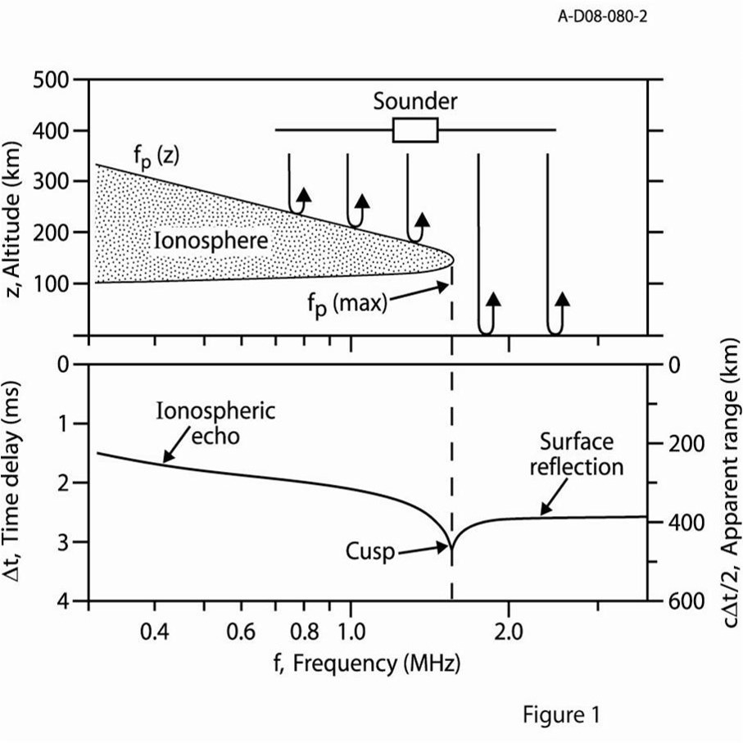
Sounding Principles
MARSIS ionospheric sounder aboard Mars Express studies the topside ionosphere
Emits multi-frequency “chirp”, listens for reflected echo
Reflection occurs when pulse frequency equals the plasma frequency
Cusps appear at density profile maximums

Slide 3
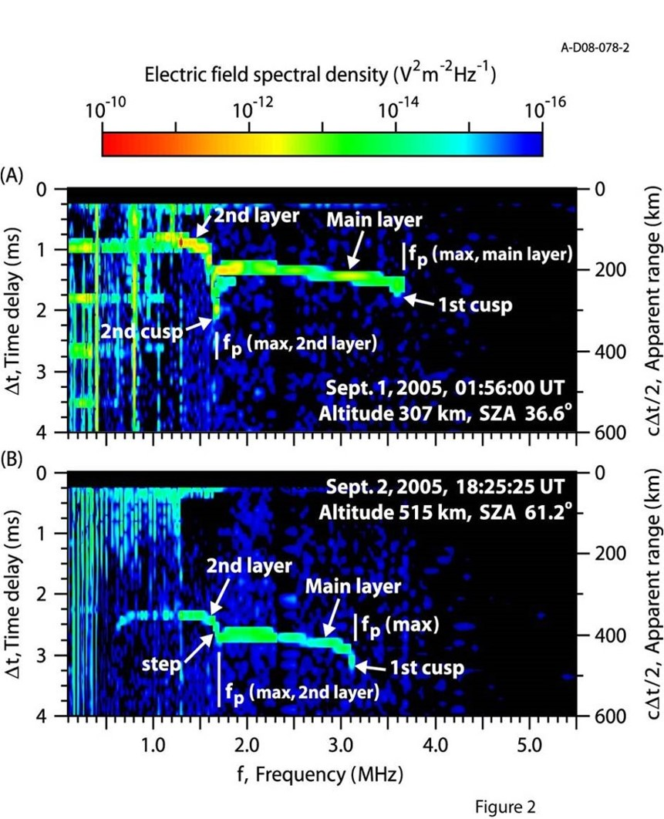
Structure in the Upper Ionosphere
MARSIS spectrograms often show additional cusps at frequencies well below the maximum plasma frequency of the ionosphere
This indicates additional density maximums at higher altitudes in the ionosphere
These features are spatially variable and transient in time

Slide 4
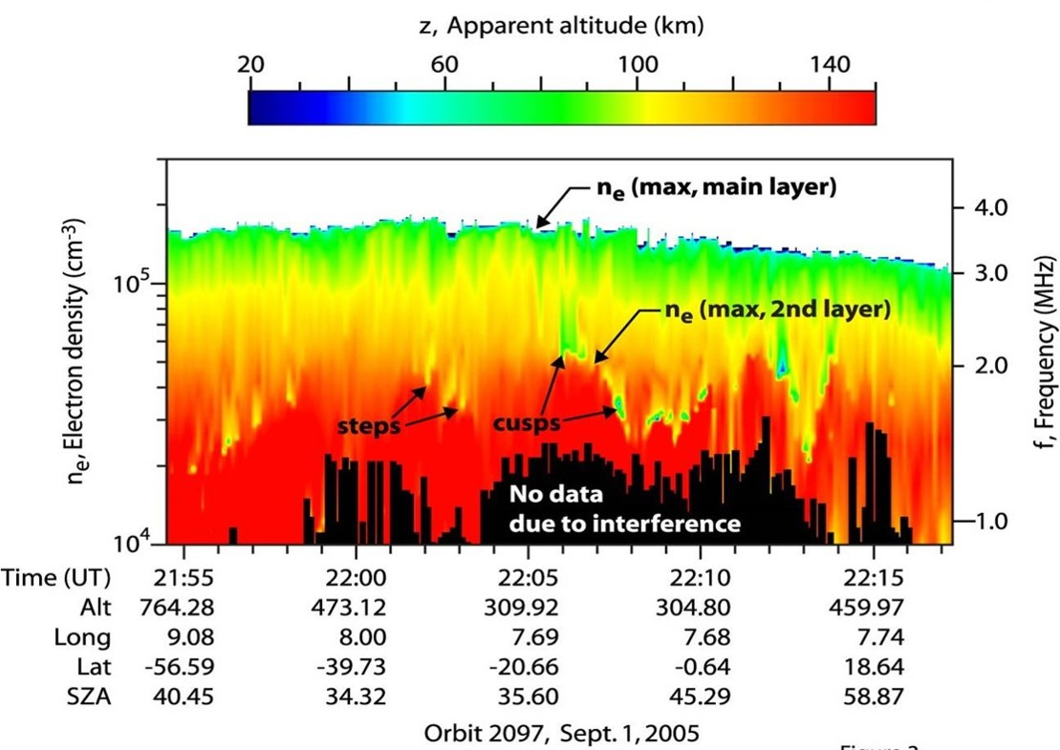
Variable and Transient
While the altitude and density of the main layer are roughly constant, those of this upper layer vary widely.
  Altitude of 180-220 km
Appearance is also highly transient, coming and going at irregular intervals, but still present up to about 50% of the time on the day side.

Slide 5

Enter MAVEN
Mars Express, with its higher orbit, is limited in its ability to analyze key characteristics of these features directly
MAVEN dips significantly lower into the ionosphere, and carries a few key instruments:
  SWIA – A solar wind analyzer than can determine densities, temperatures, and velocities
  NGIMS – A mass spectrometer that can determine ionospheric ion composition

Slide 6
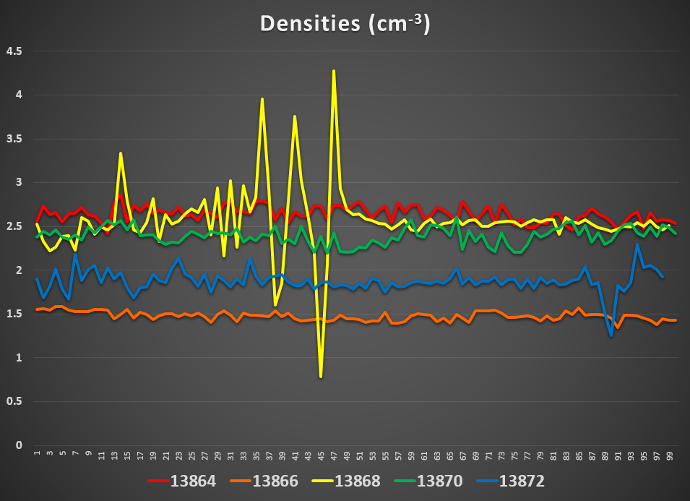
Solar Wind Study – Density

Slide 7
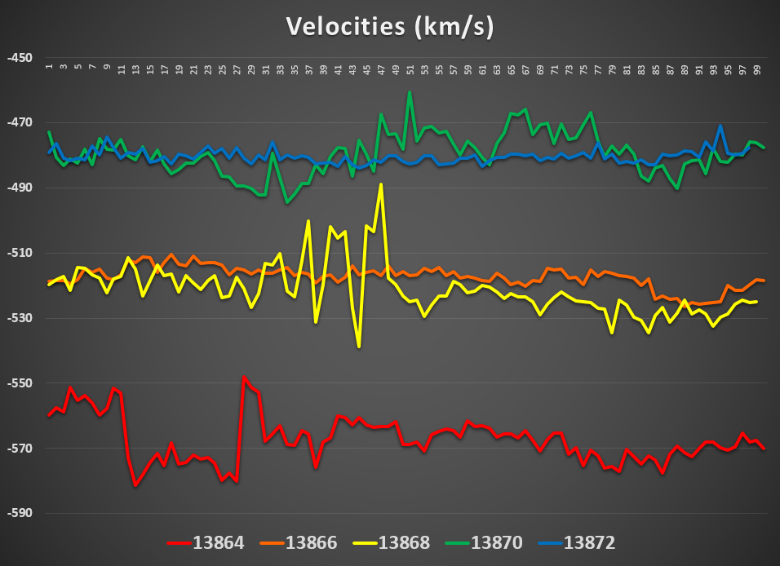
Solar Wind Study – Velocity

Slide 8
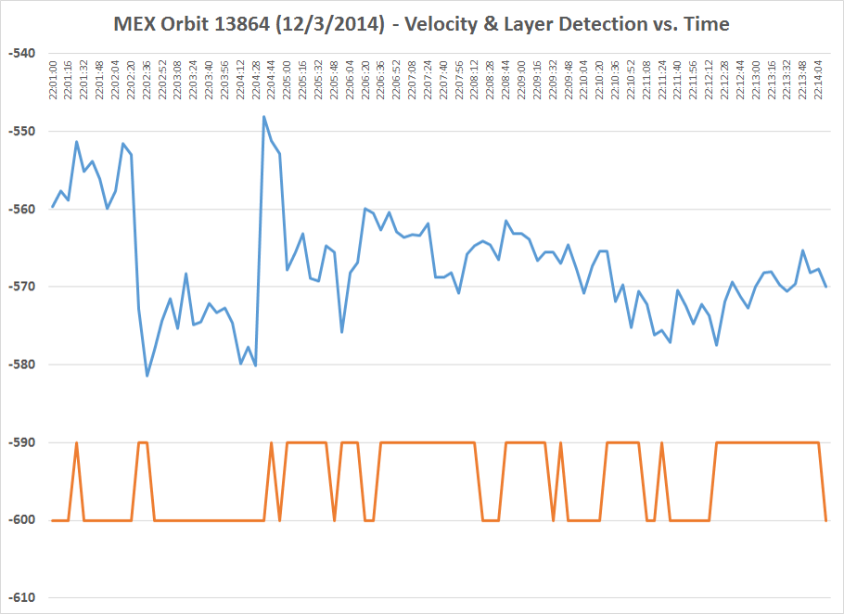
MEX Orbit 13864 – 12/5/2014

Slide 9
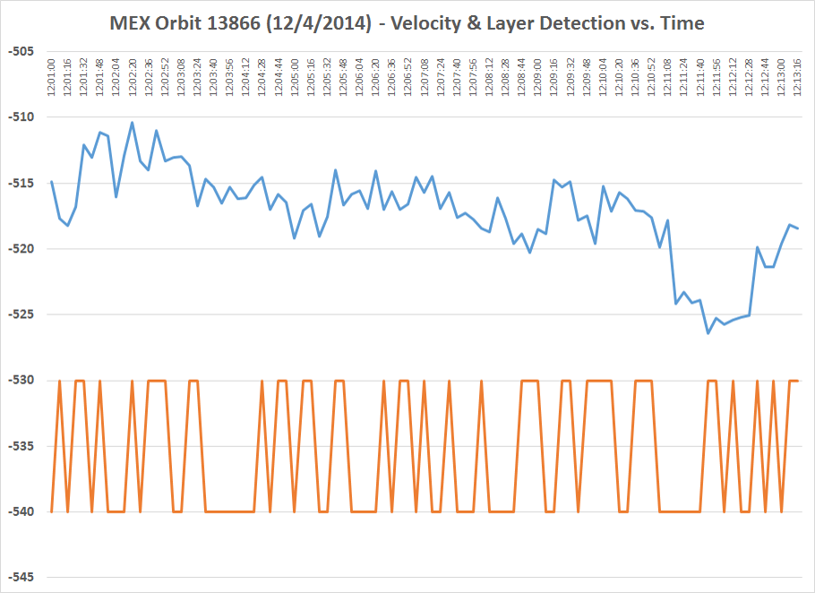
MEX Orbit 13866 – 12/5/2014

Slide 10
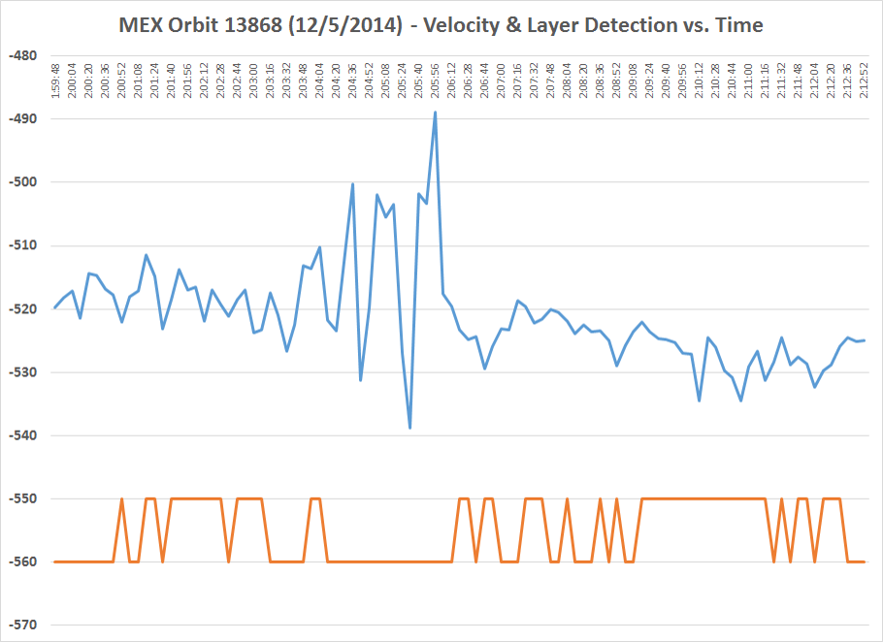
MEX Orbit 13868 – 12/5/2014

Slide 11
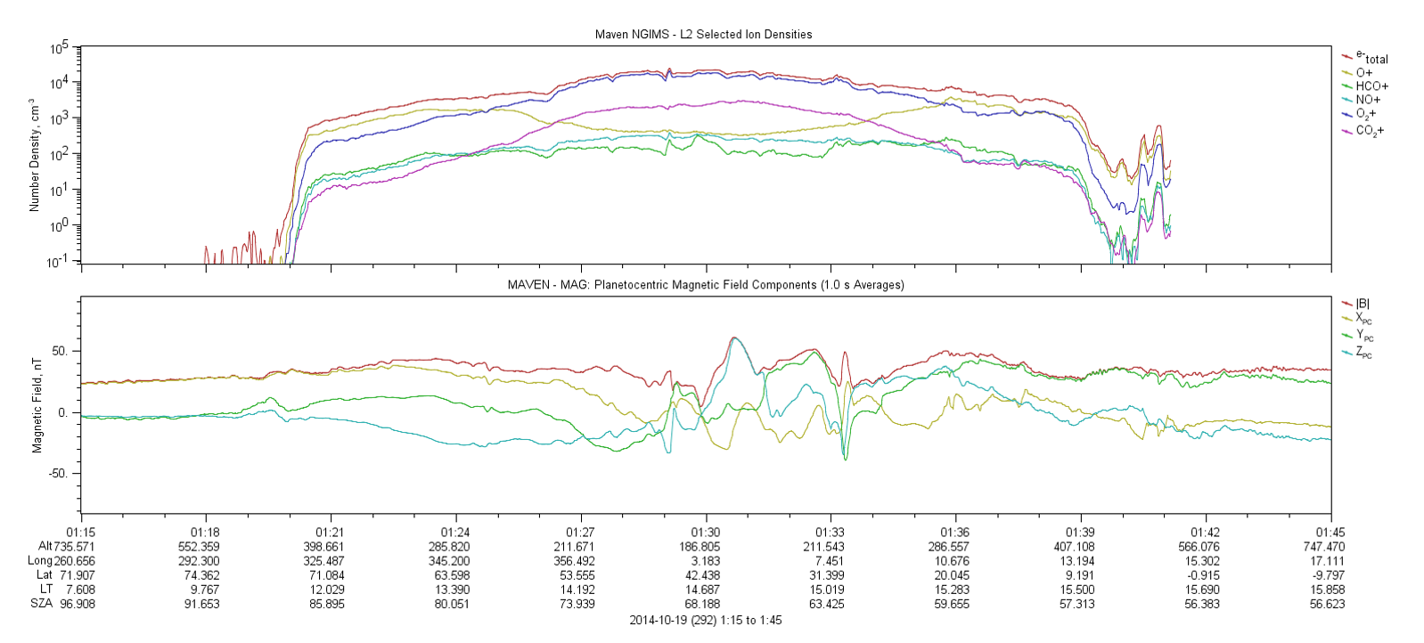
NGIMS – Ion Analysis

Slide 12
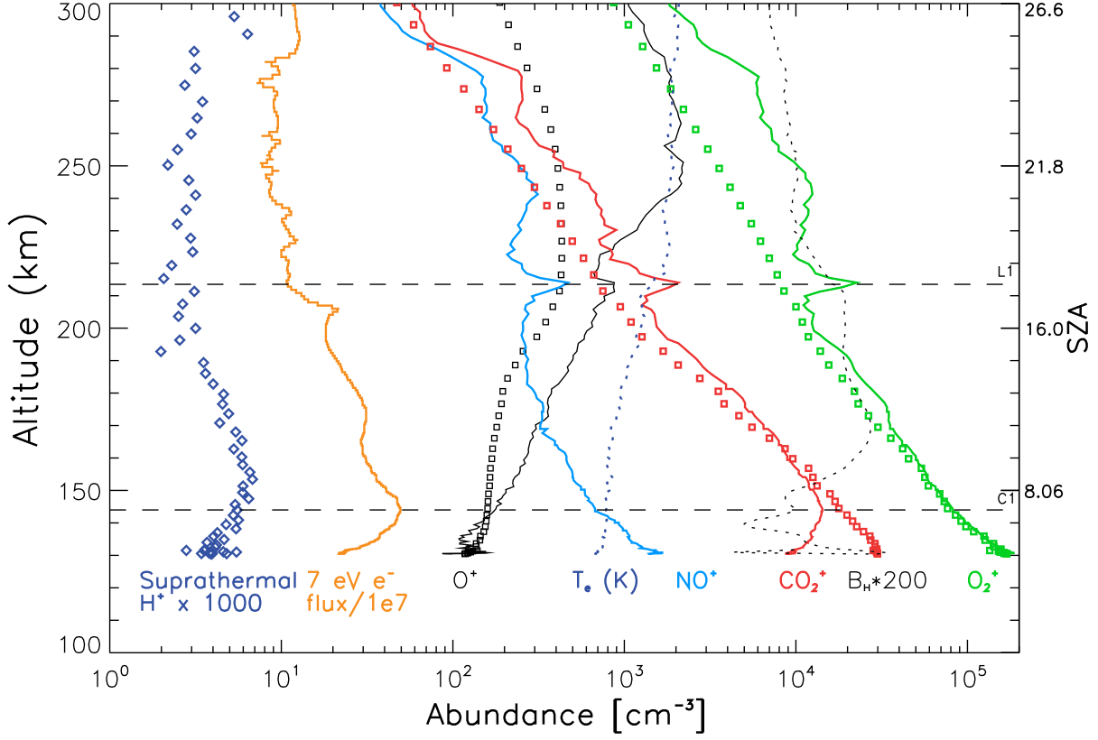
Second Density Peak
From Bougher, et al (2015)

Slide 13
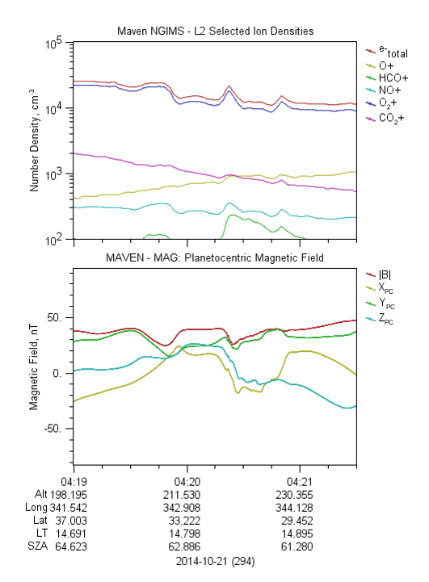
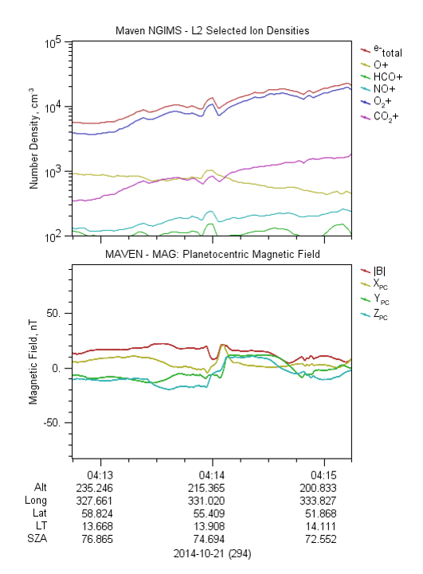
Magnetic Field Fluctuations

Slide 14
Conclusions – What We Know Now
Solar Wind (SWIA)
Features are a natural part of the Martian environment, appearing ~50% of the time in steady solar wind conditions.
In more dynamic solar wind conditions, upper ionospheric layers generally will vanish entirely, until the wind settles into a more steady state.

Slide 15
Conclusions – What We Know Now
Solar Wind (SWIA)
Features are a natural part of the Martian environment, appearing ~50% of the time in steady solar wind conditions.
In more dynamic solar wind conditions, upper ionospheric layers generally will vanish entirely, until the wind settles into a more steady state.
Ion Composition (NGIMS)
Largest component is the same as the main layer (O₂⁺), with all others at least an order of magnitude lower in density
Multiple ion densities enhanced, not just the dominant one
Layers appear to coincide with local magnetic field features

Slide 16

Conclusions – What We Know Now
Solar Wind (SWIA)
Features are a natural part of the Martian environment, appearing ~50% of the time in steady solar wind conditions.
In more dynamic solar wind conditions, upper ionospheric layers generally will vanish entirely, until the wind settles into a more steady state.
Ion Composition (NGIMS)
Largest component is the same as the main layer (O₂⁺), with all others at least an order of magnitude lower in density
Multiple ion densities enhanced, not just the dominant one
Layers appear to coincide with local magnetic field features
Explanation – An instability-driven current region?

