Slide 1
Upper Layers in the Topside of the Martian Ionosphere
Andrew J. Kopf
D.A. Gurnett, D.L. Kirchner, D.D. Morgan
The University of Iowa

Slide 2
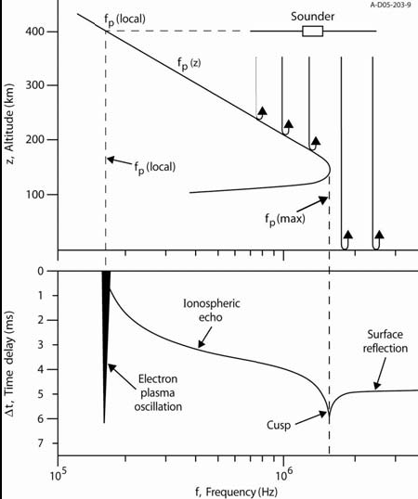

Slide 3
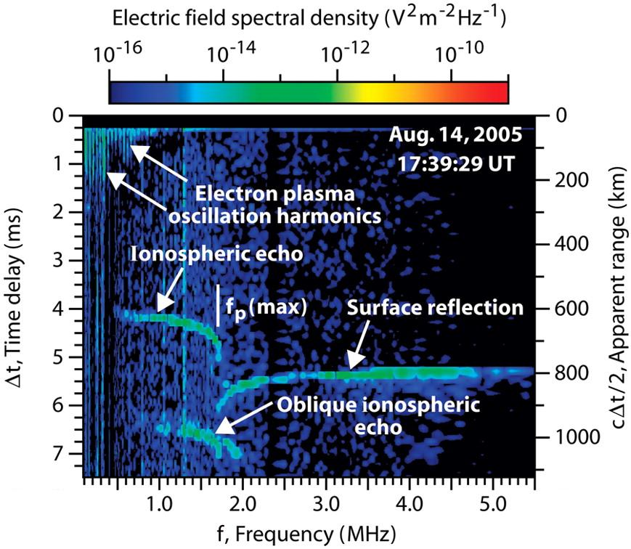

Slide 4
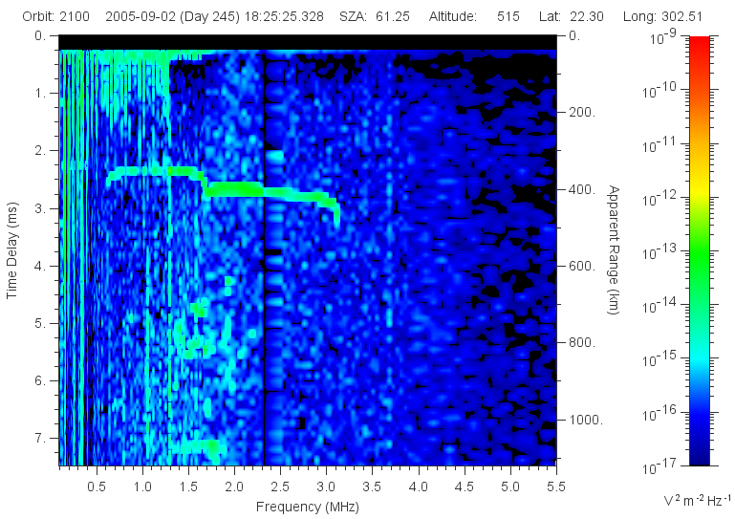
A Second Cusp

Slide 5
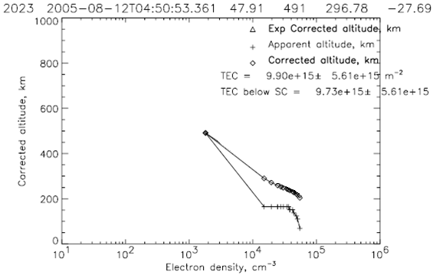
Density Profile

Slide 6
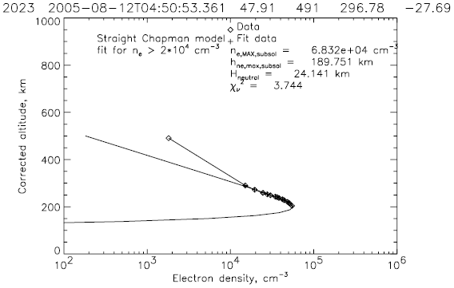
Chapman Fit

Slide 7
Properties of this second layer
Altitude = 200 km (average)
Max Electron Density = 4-6 x 10⁴ cm⁻³
  (Mean 48,000 cm⁻³)
Compare to Main Layer:
  Altitude = 130 km
  Density = 2 x 10⁵ cm⁻³
Two questions:
  What is happening physically?
  Why is this happening? (What mechanism?)

Slide 8
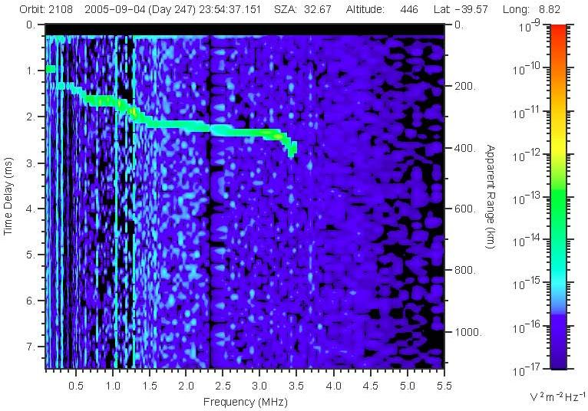
Case 1: Smooth Transition

Slide 9
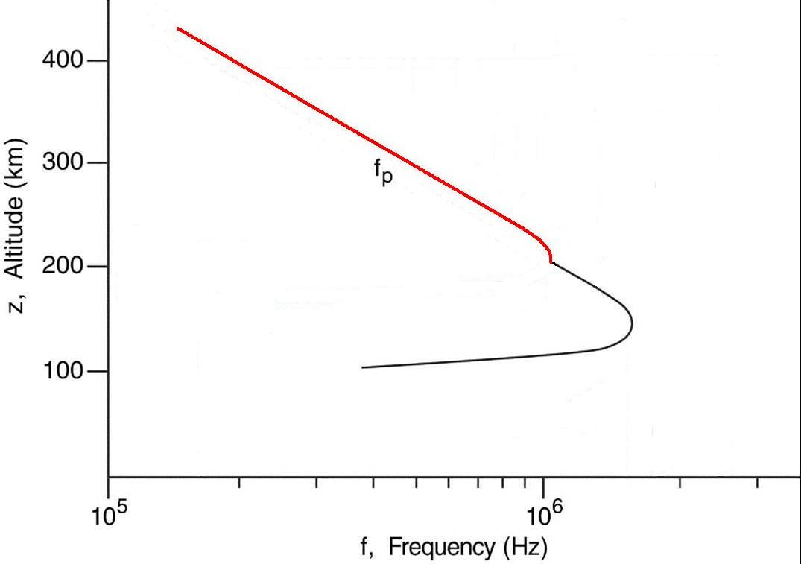
Theoretical Ionospheric Model

Slide 10
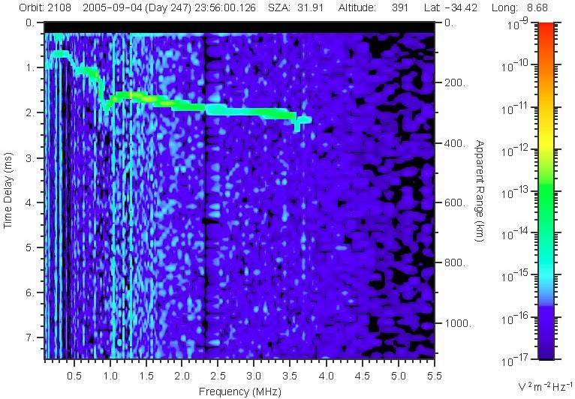
Case 2: A Clear Cusp

Slide 11
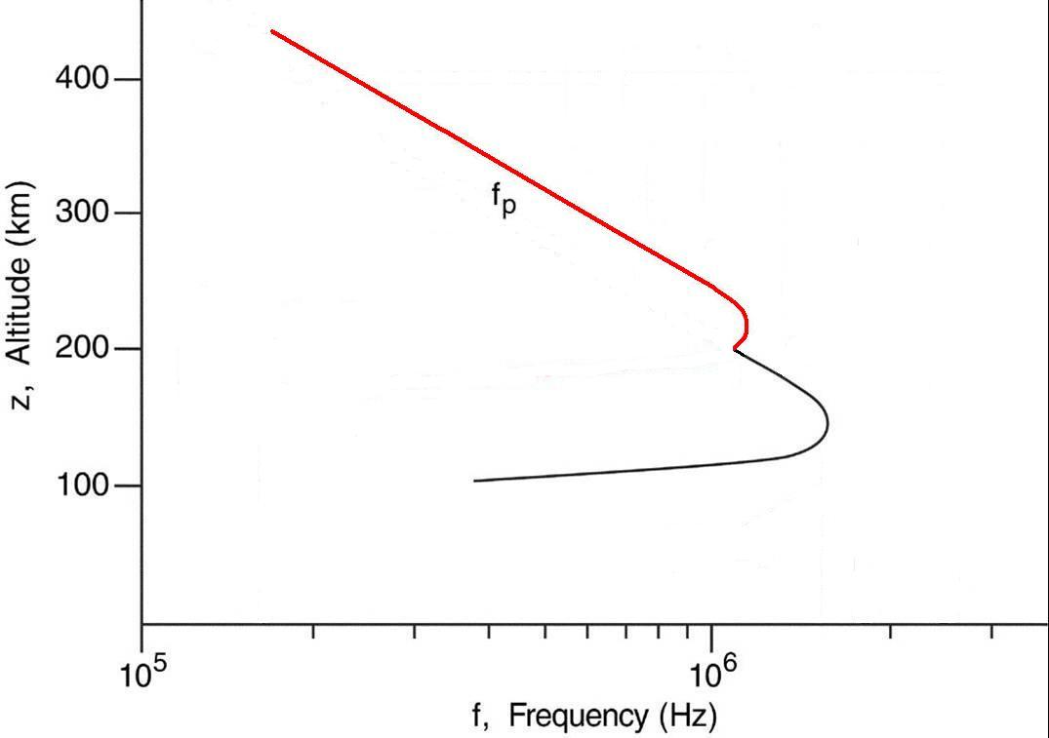
Theoretical Ionospheric Model

Slide 12
Possible Explanations
O⁺ ions
Ionization by energetic electrons, solar wind
Mars’ crustal magnetic field
Transport by solar wind
Kelvin-Helmholz instability

Slide 13
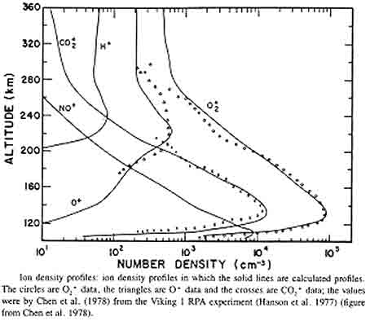
O⁺ ions?

Slide 14
Solar Effect on Detection

Slide 15
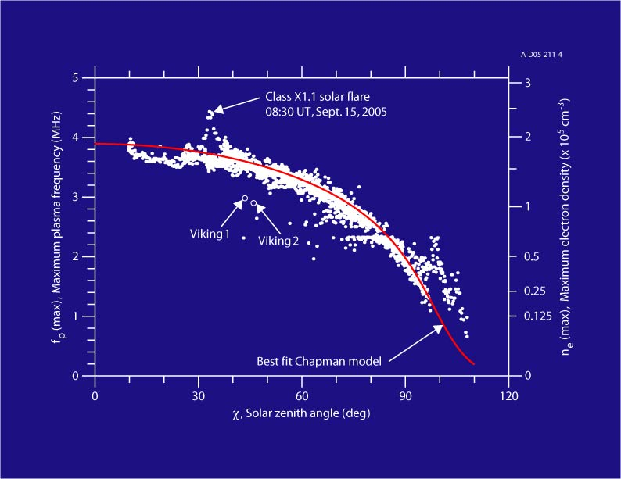
Main Layer SZA Dependence

Slide 16
Solar Wind - Oblique Echoes
Reflection off upward bulge in the ionosphere
Open field lines connect to the solar wind, allowing it to heat lower levels of the ionosphere, thus increasing n_{e}

Slide 17
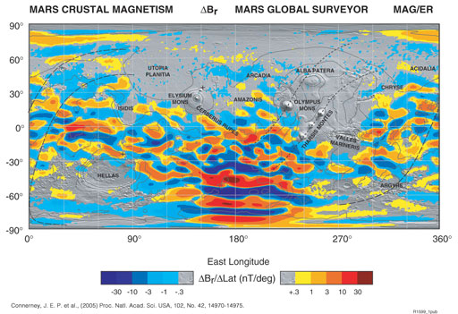
Magnetic Field Effects?

Slide 18
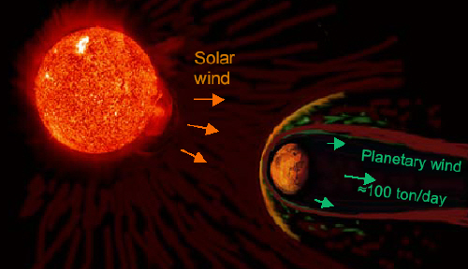
Transport
Transport could be a major contributor in creating this sudden change in density as a result of the lack of a global magnetic field

Slide 19

Kelvin-Helmholtz Instability

Slide 20
Recall: The Second Cusp

Slide 21
A Third Cusp

Slide 22
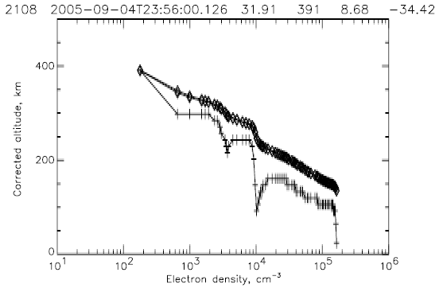
Combined Density Profile

Slide 23
Summary
Upper layer properties correlate well theory and previous measurements of O⁺ ions
Ability to detect feature appears to be a function of SZA
Feature may also be due to a number of other factors, including magnetic field effects, transport, and Kelvin-Helmholz instabilities
Third layer detected, possibly due to Hydrogen ions

