Slide 1
A MULTI-INSTRUMENT STUDY OF AURORAL HISS AT SATURN
Andrew J. Kopf
Ph.D. Defense
June 14, 2010

Slide 2
What is Auroral Hiss?
Low-frequency whistler-mode plasma wave emission
Found in high-latitude regions of planetary magnetospheres
Generated by field-aligned electron beams, emission propagates along field lines
First detected at Earth in 1959, similar emissions observed at Jupiter and Saturn
V-shaped funnel on spectrograms due to resonance cone propagation

Slide 3
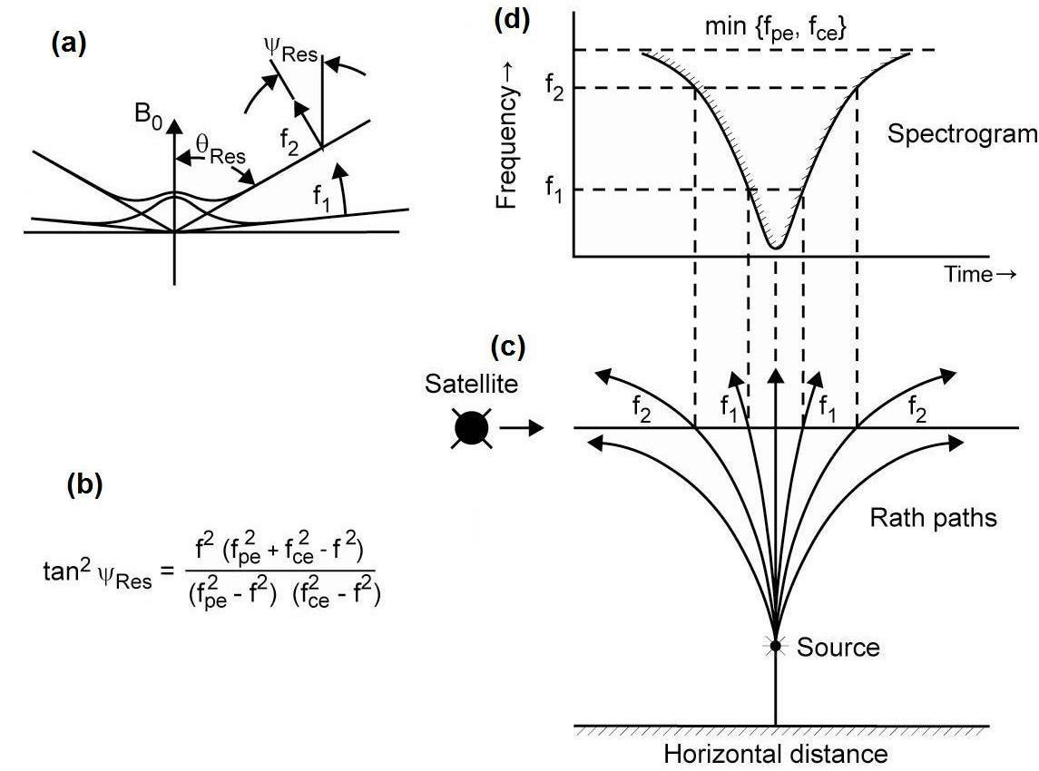
What is the Resonance Cone?

Slide 4
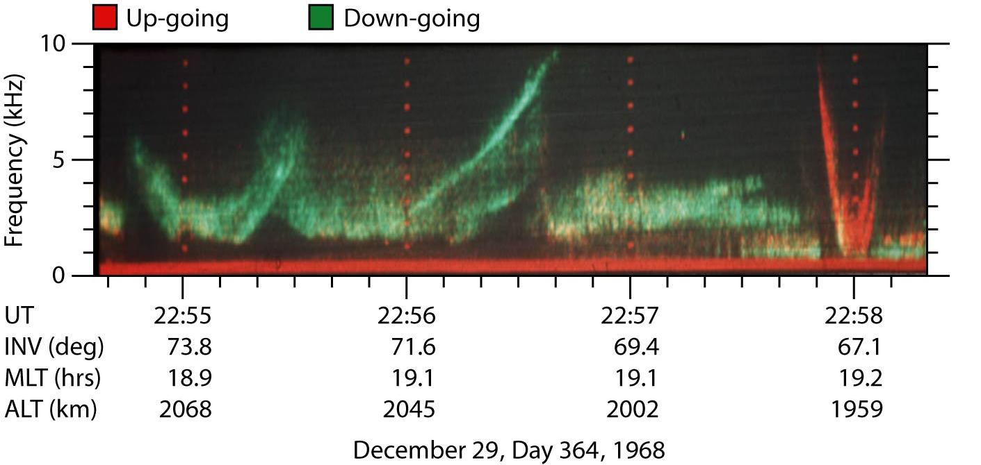
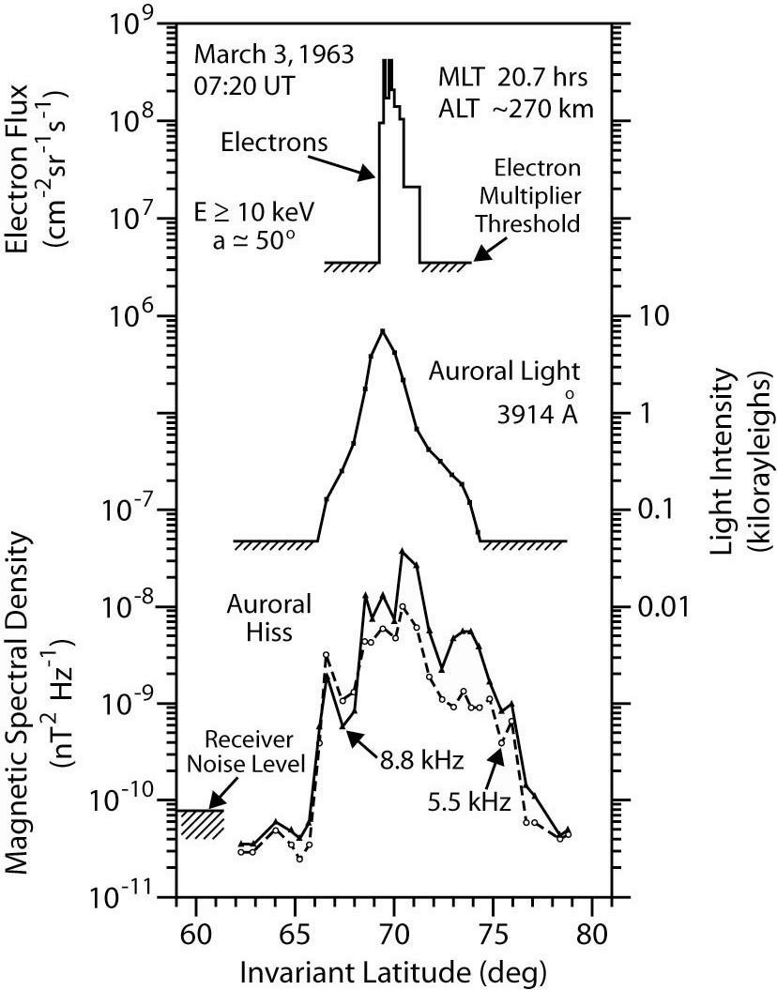
50 Years of Study
1959 – Ground based radio instruments in Antarctica detect radio emission correlated with visible aurora.
1962 – Injun 3 – correlation between electrons, auroral light, and auroral hiss
1968 – Injun 5 – auroral hiss can propagate upward or downward, correlated with electron beam direction
1974 – Taylor and Shawhan – auroral hiss requires coherent mechanism
1974/1976 – Echo 1 & 2 – sounding rockets verify conclusions of coherent generation

Slide 5
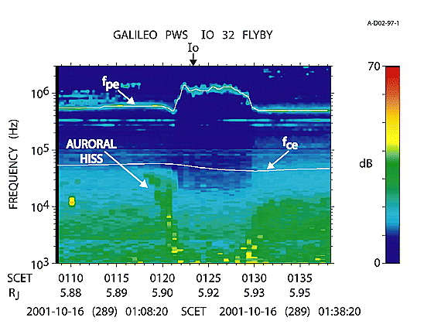
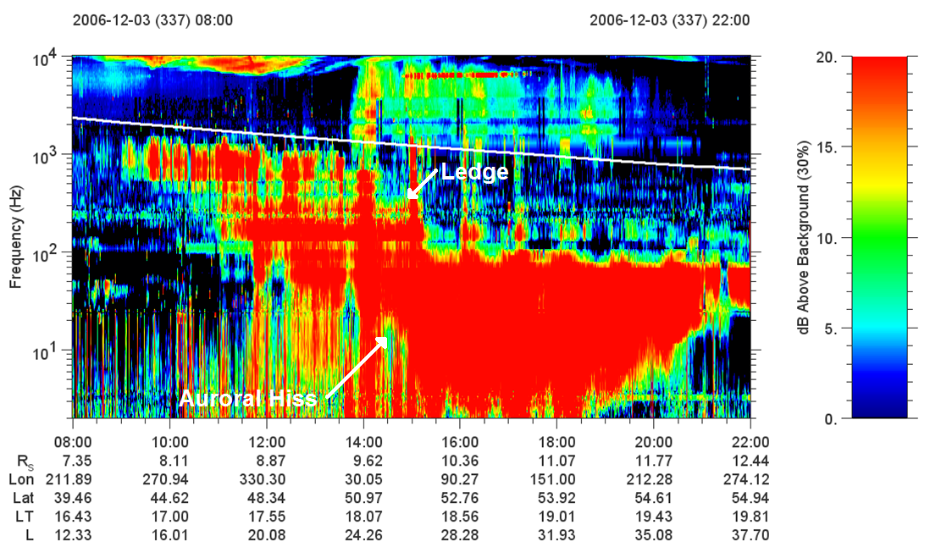
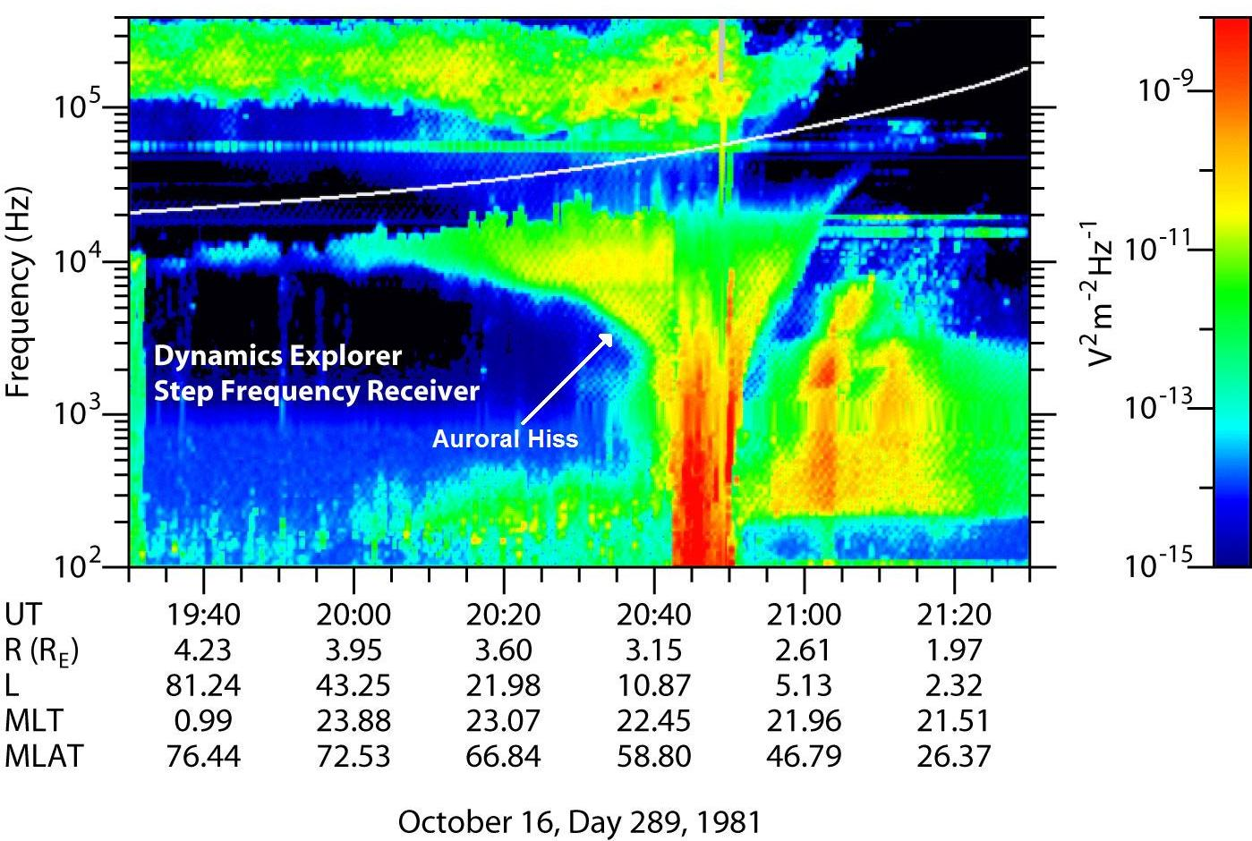
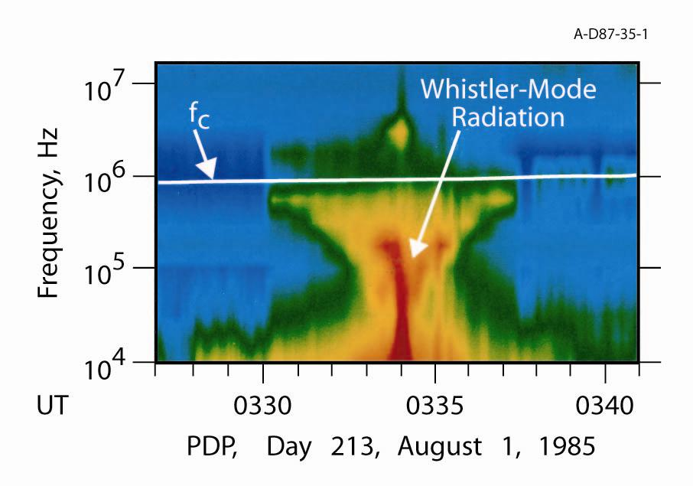
50 Years of Study
1981 – Dynamics Explorer – 10 years of data, comprehensive study
1985 – Space Shuttle – electron beam experiment artificially reproduces auroral hiss
1996 – FAST – high resolution ongoing survey, determines size and location of distinct source regions, correlates emission with field-aligned currents and low-energy electrons
2001 – Galileo (Jupiter) – similar emission found near Io
2006 – Cassini (Saturn) – detects auroral hiss

Slide 6
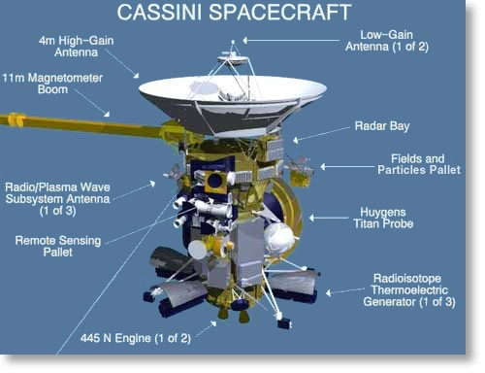
The Cassini Spacecraft

Slide 7
So What Are We Looking For?
This research has looked at the following:
  Location of the emission
  Direction of propagation
  Is there a periodicity?
  Correlation with currents/density structures
  Correlation with electron beams
  Analysis of beams to determine wave growth

Slide 8
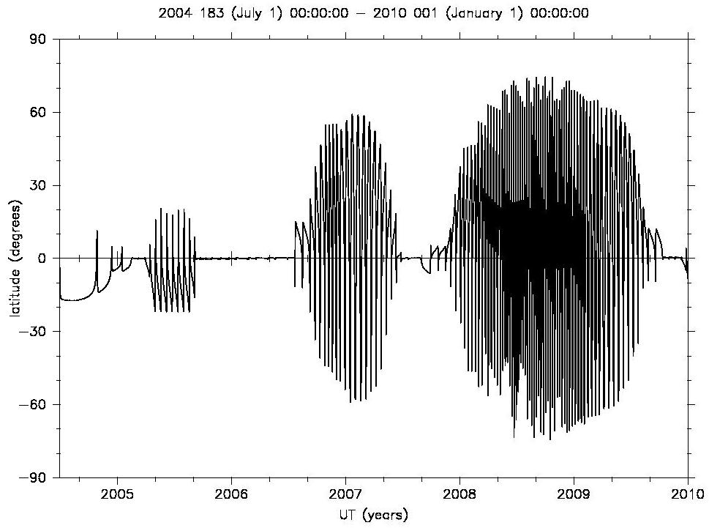
Orbital Trajectory

Slide 9
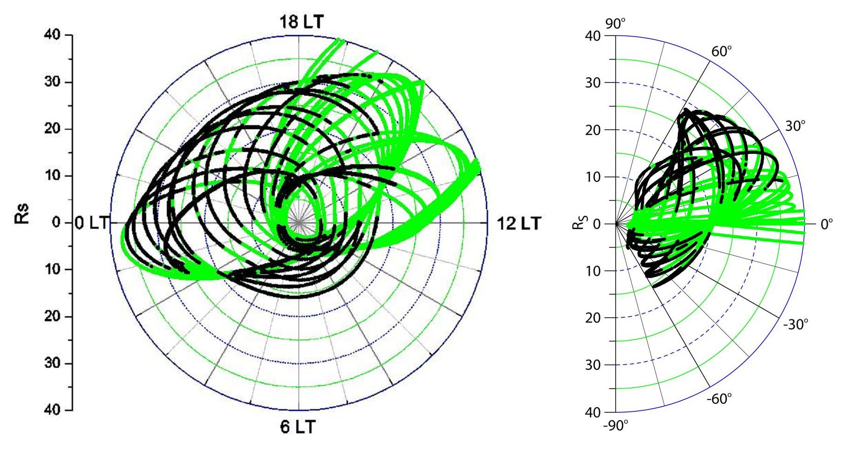
Location

Slide 10
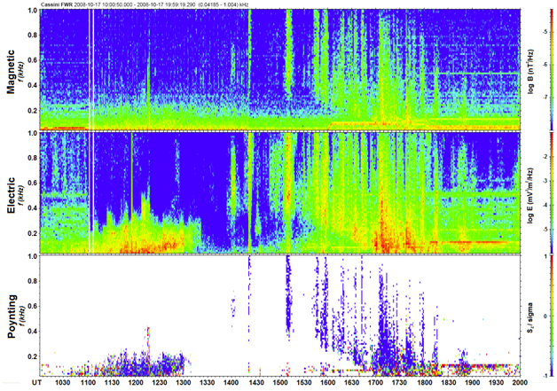
Propagation Direction

Slide 11
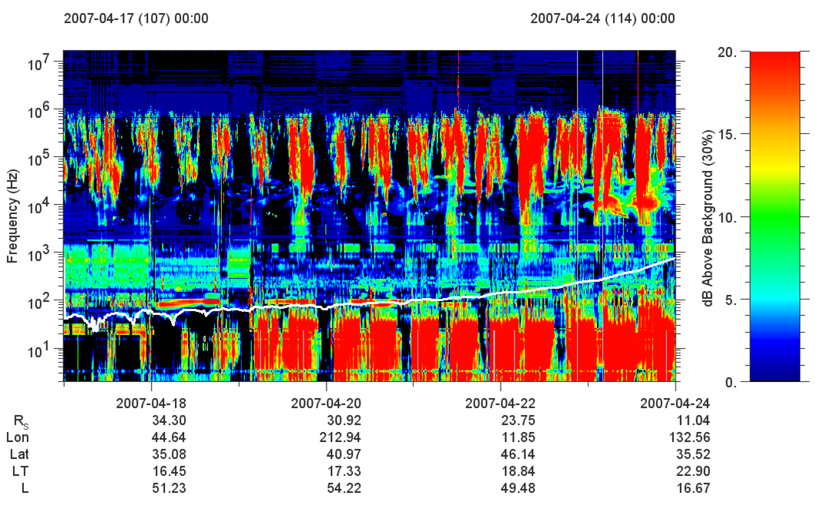
Is There A Periodicity?

Slide 12
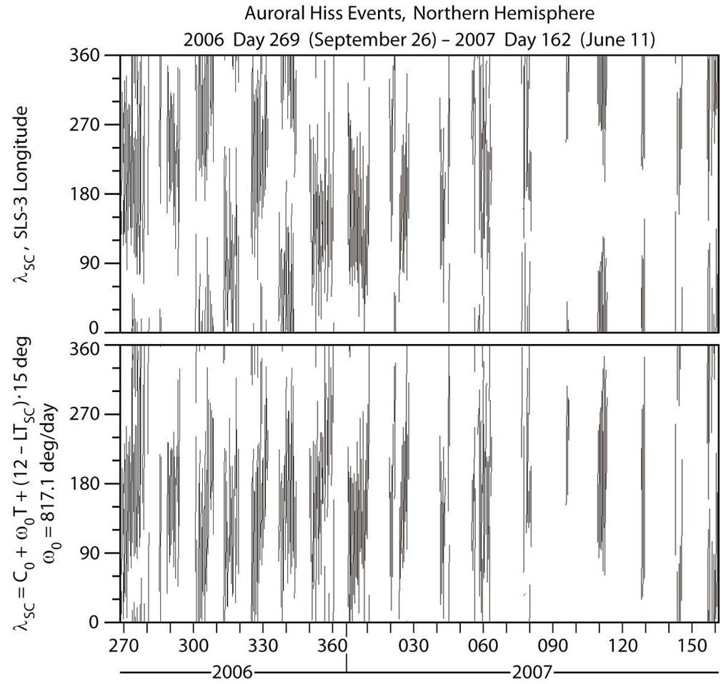
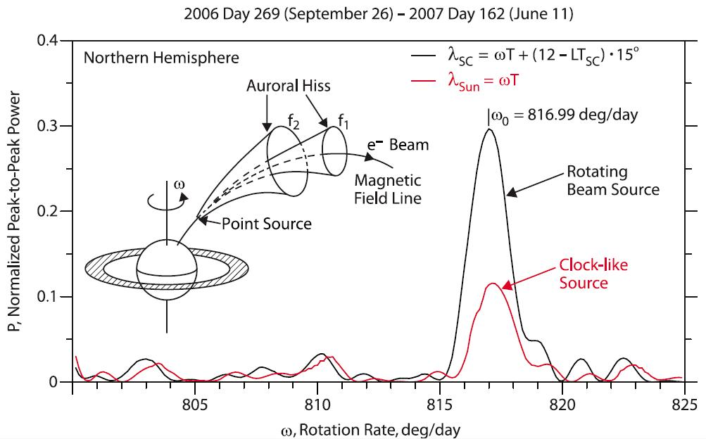
What is the Periodicity?

Slide 13
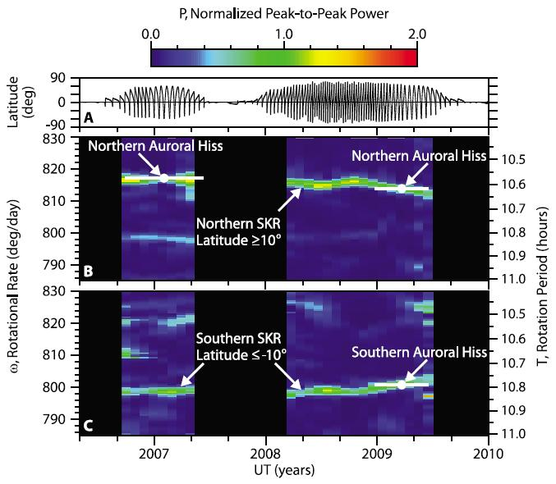
Not One, But Two!

Slide 14
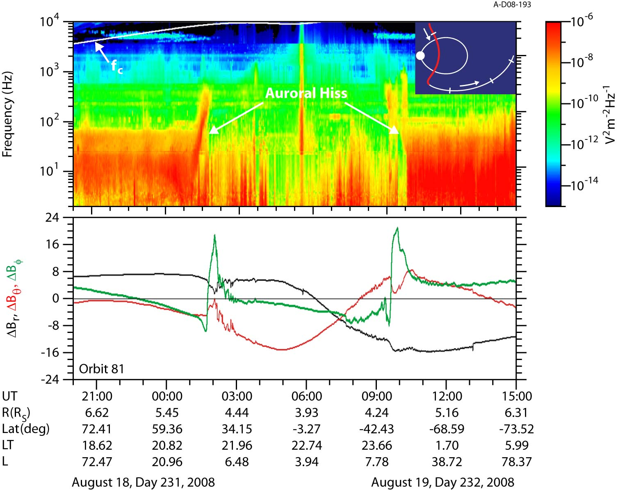
Field-Aligned Currents

Slide 15
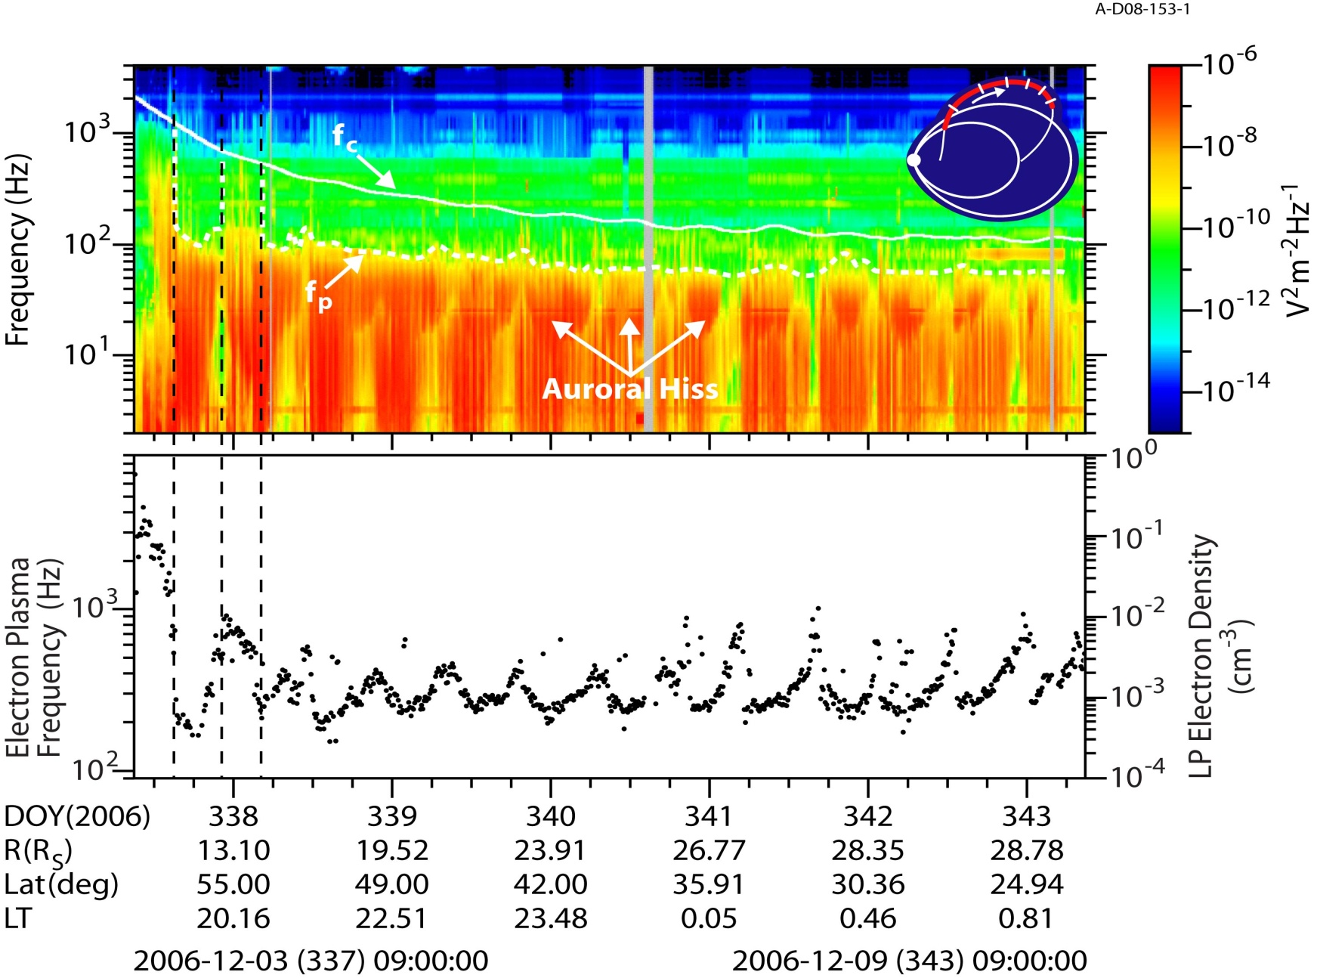
Background Electron Densities

Slide 16
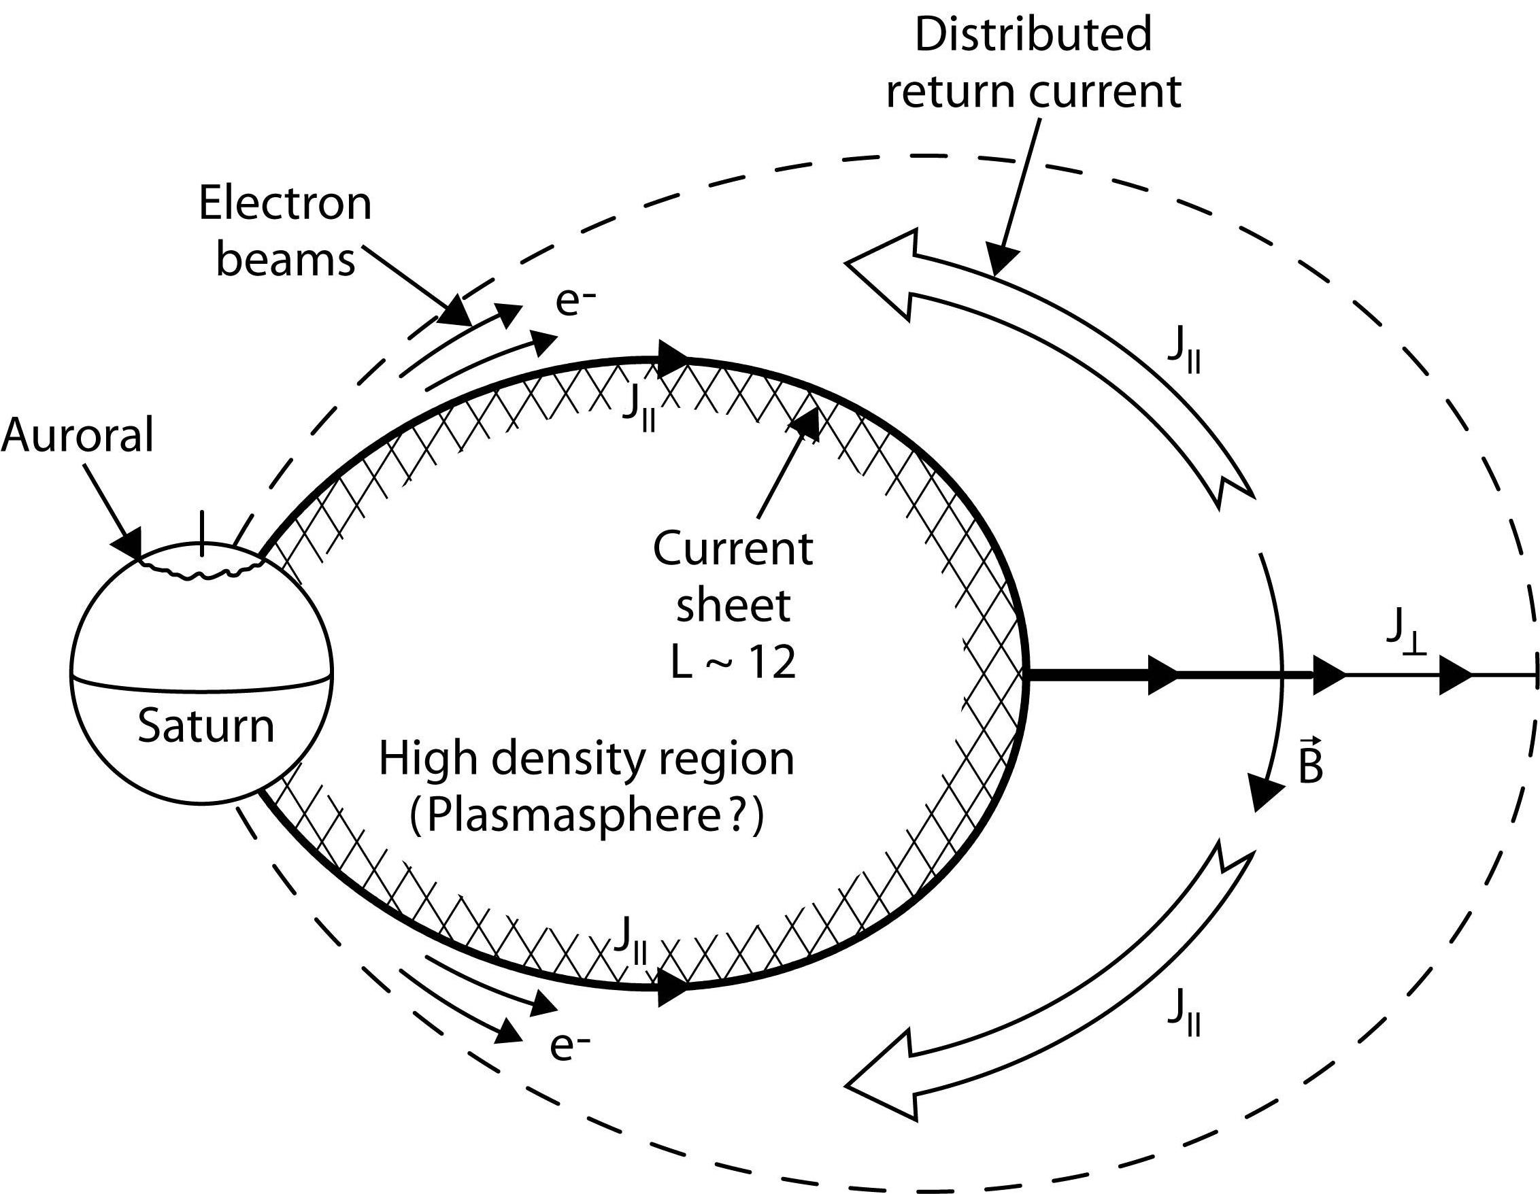
The Saturn Current System

Slide 17
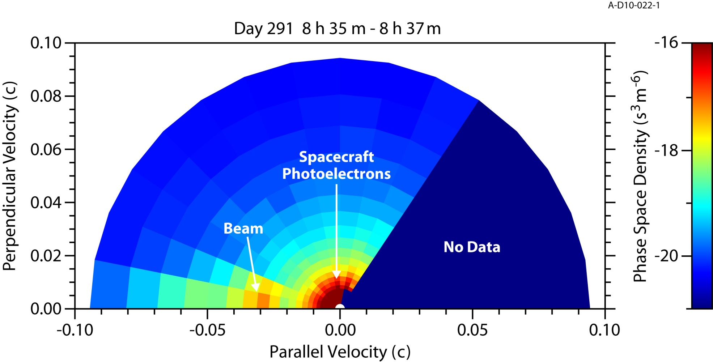
Electron Beams

Slide 18
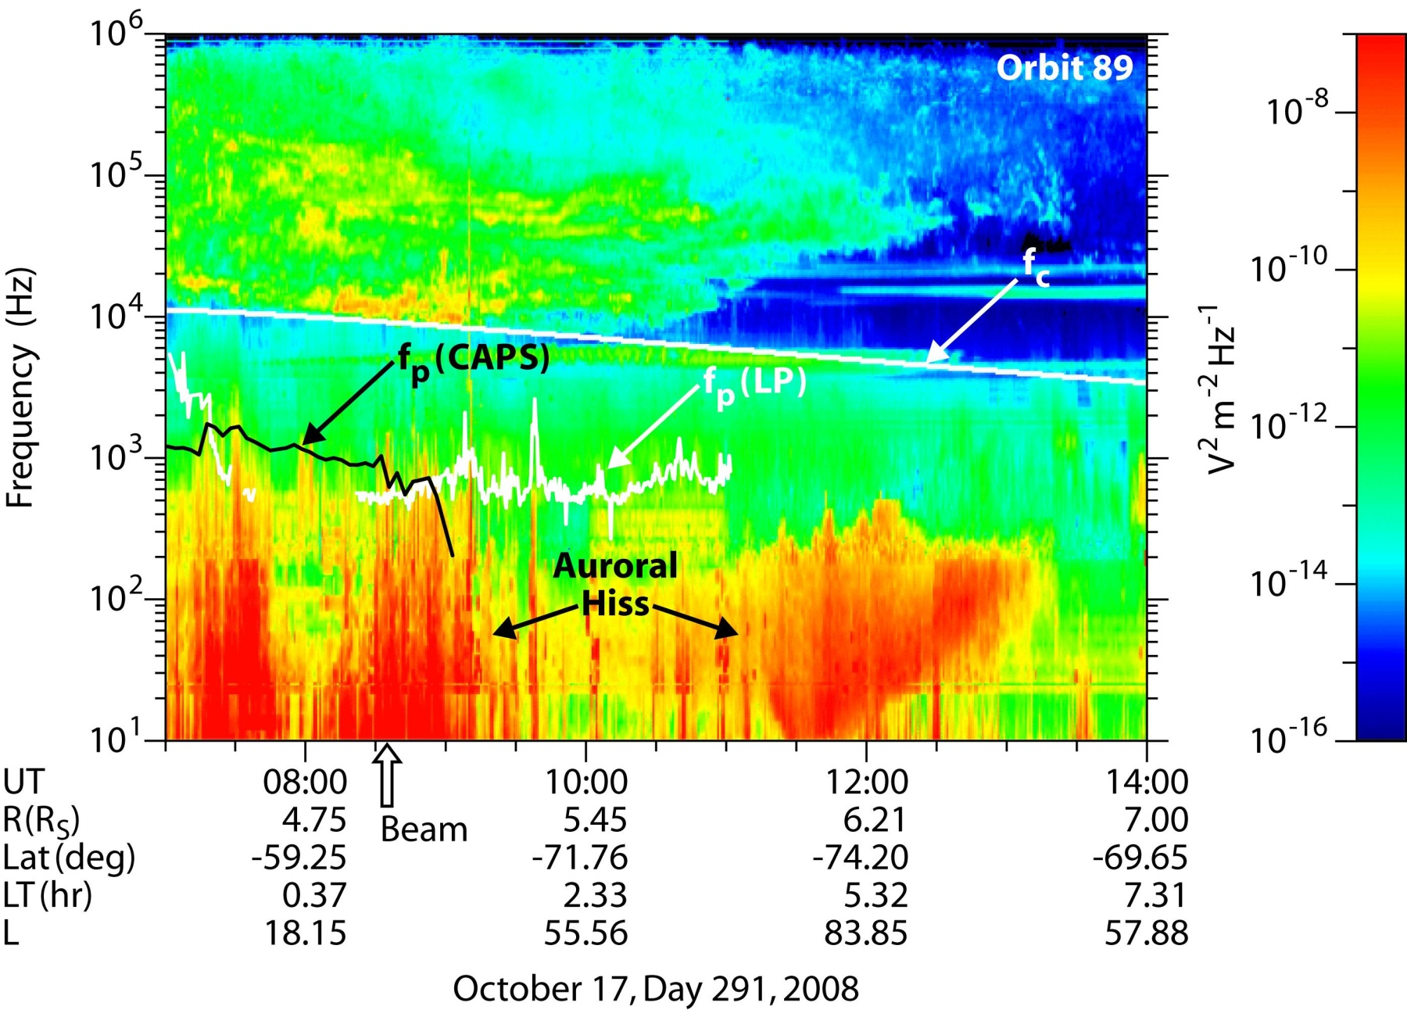
Cassini Orbit 89, Day 291, 2008

Slide 19
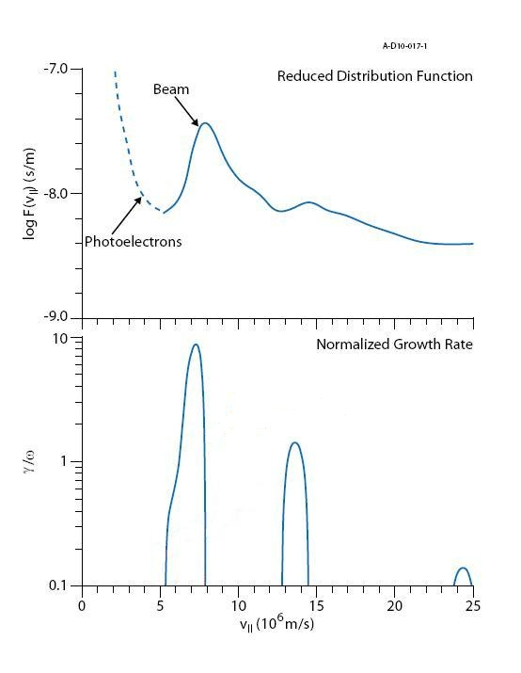
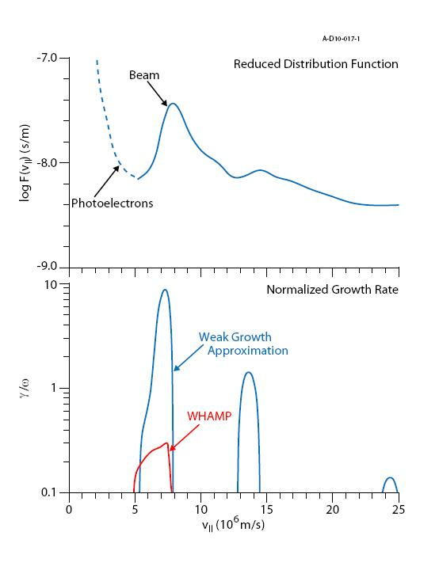
Will It Grow?
Derived an analytic formula for the growth rate, based on work from Morgan et al. [1994]
Computed whistler-mode growth for this beam and others at nearby times
Turned to a method that doesn’t utilize the Weak Growth Approximation, a numerical code known as WHAMP
Computes full solution without approximation for a distribution of Maxwellian functions

Slide 20
The Absence of Beams
To date, auroral electron beams have only been detected in conjunction with auroral hiss emission in Orbit 89.
Possible explanations
  Short duration, narrow events require Cassini to be in right place at right time
  No reason to expect beams to follow the path of auroral hiss propagation at large distances
  Low electron densities in auroral regions challenge sensitivity of CAPS to identify beam

Slide 21
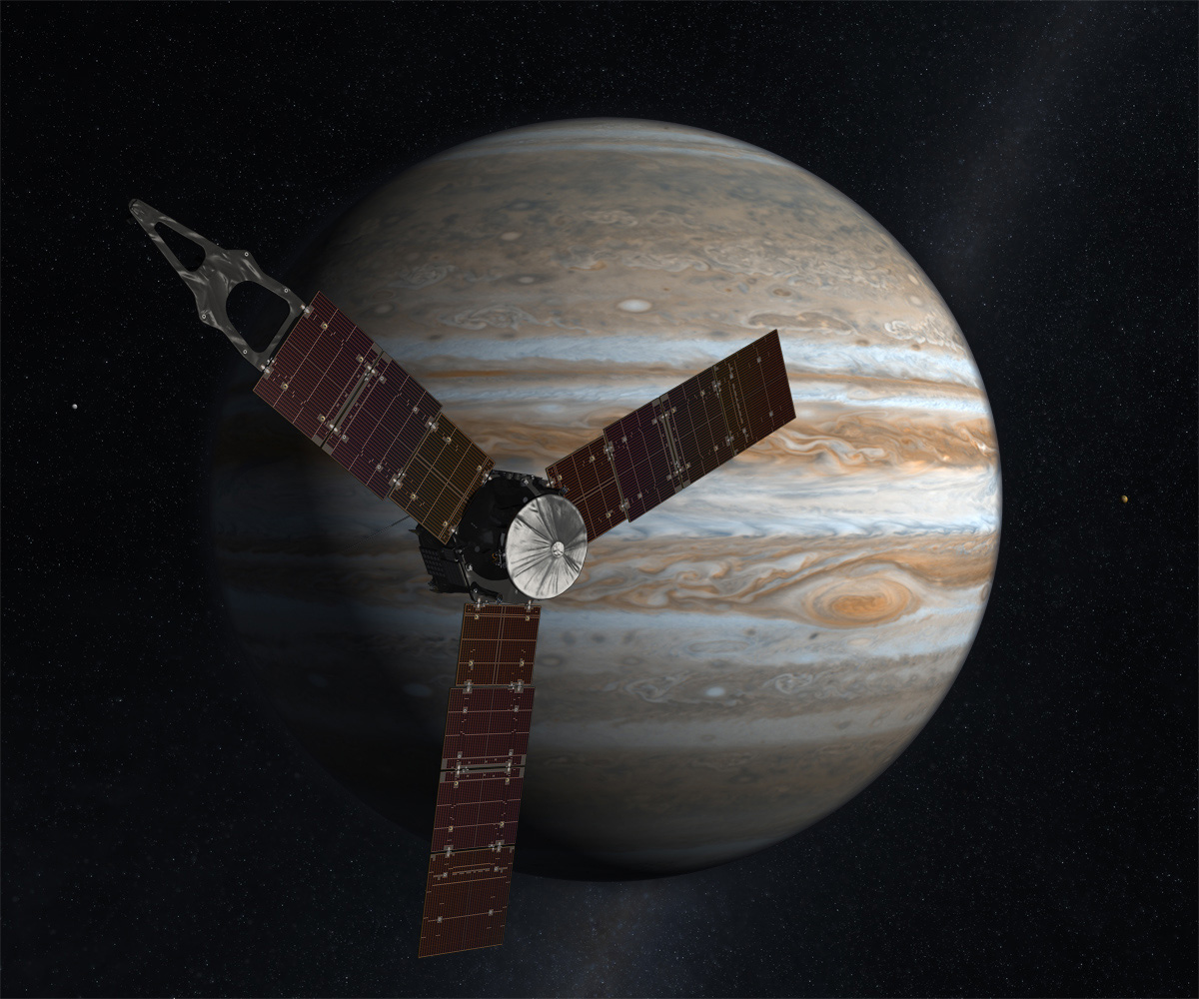
The Future of Auroral Hiss

Slide 22
Summary
50 years of study at Earth has provided great foundation for Saturn research
Ledge-like feature on low-latitude side of the emission associated with transition from high-density region, bounded by upward field-aligned current
Two hemispheres have different periodicities, each matching the associated SKR modulation rate in that hemisphere
Lone orbit with electron beam events produces high whistler-mode growth rates. Emission indicates Cassini likely flew in or near the source region of auroral hiss emission

