Slide 1
The SOURCE OF AURORAL HISS?
WHISTLER-MODE GROWTH RATES FOR THE DAY 291 ELECTRON BEAM
Andrew J. Kopf
University of Iowa
Cassini PSG Meeting
October 19, 2009

Slide 2
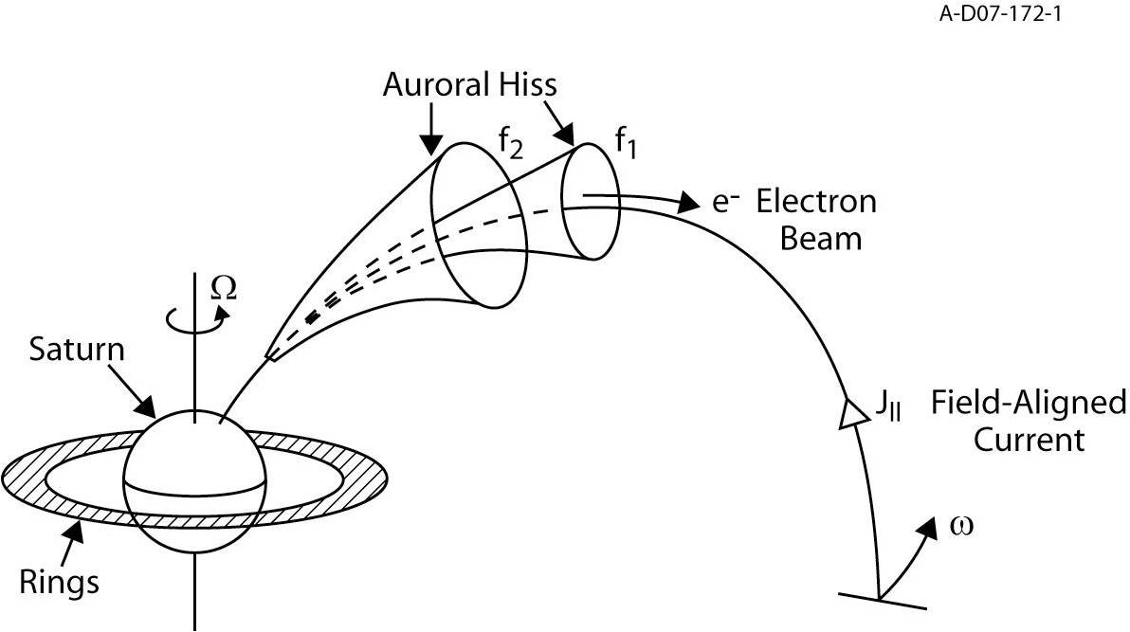
Theory of Auroral Hiss

Slide 3
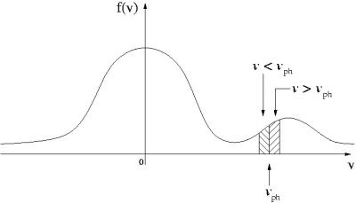
A Beam-Driven Instability

Slide 4
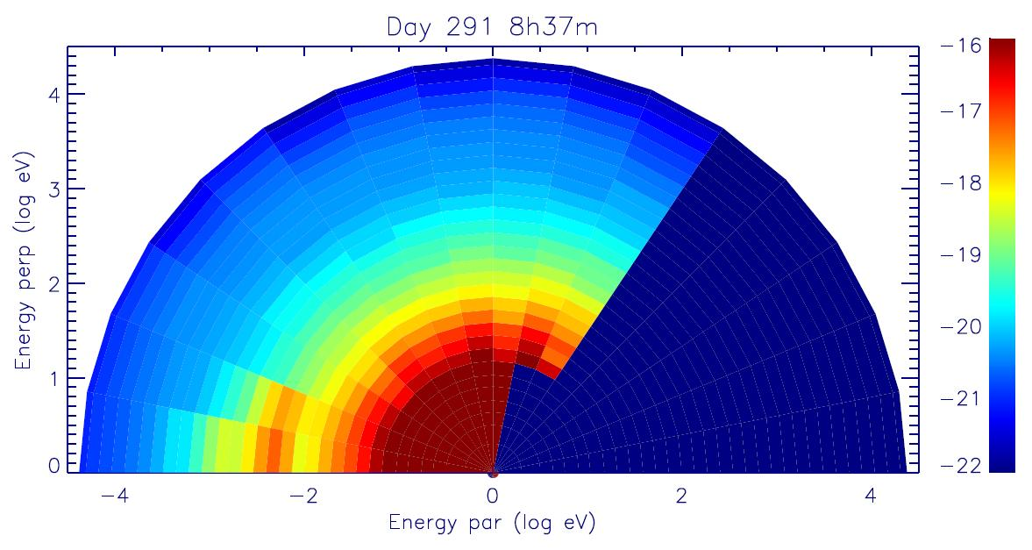
ELS Spectrogram

Slide 5
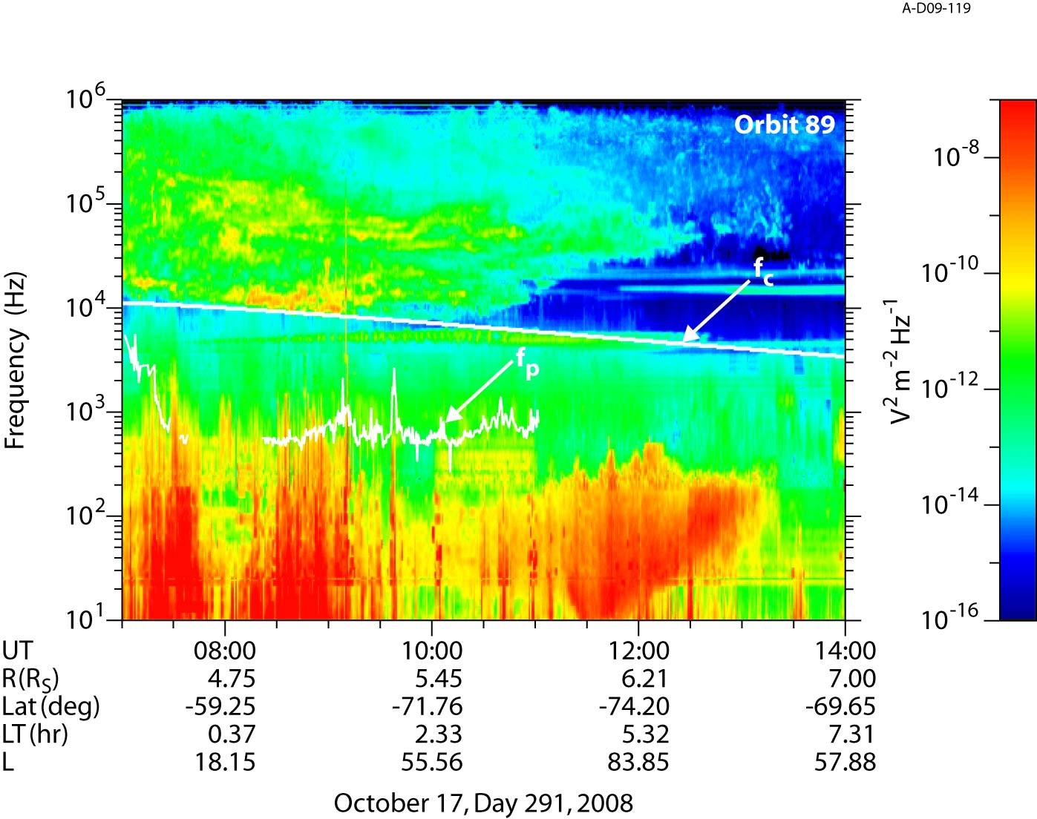

Slide 6
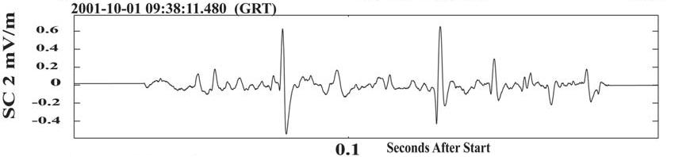
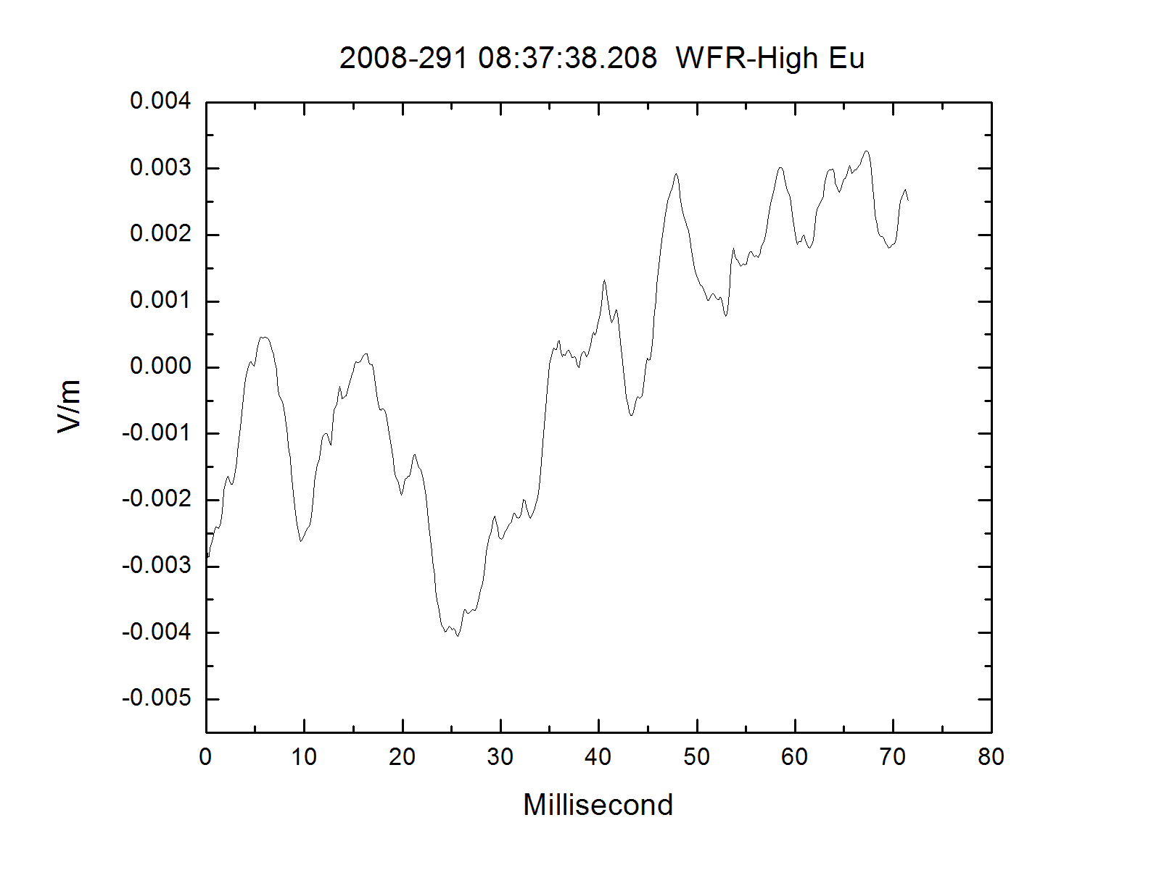
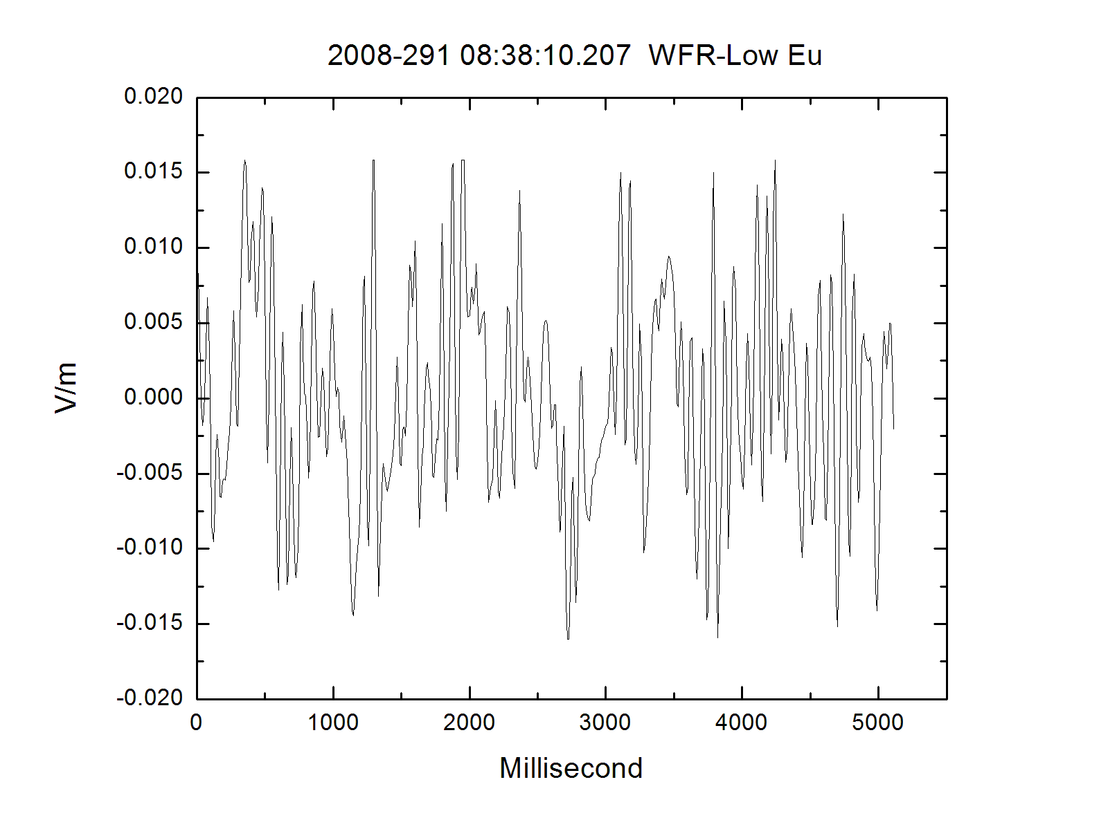
Electrostatic Solitary Waves

Slide 7
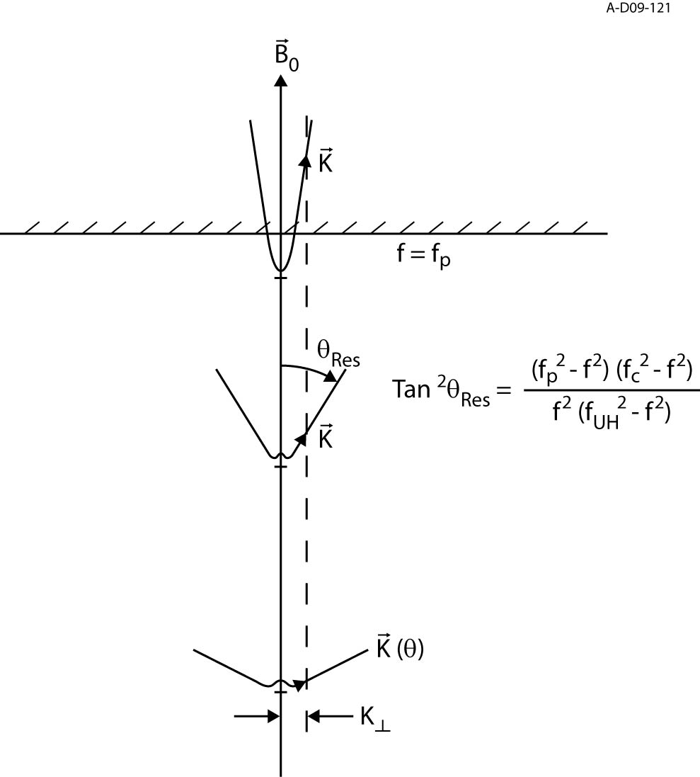

Slide 8
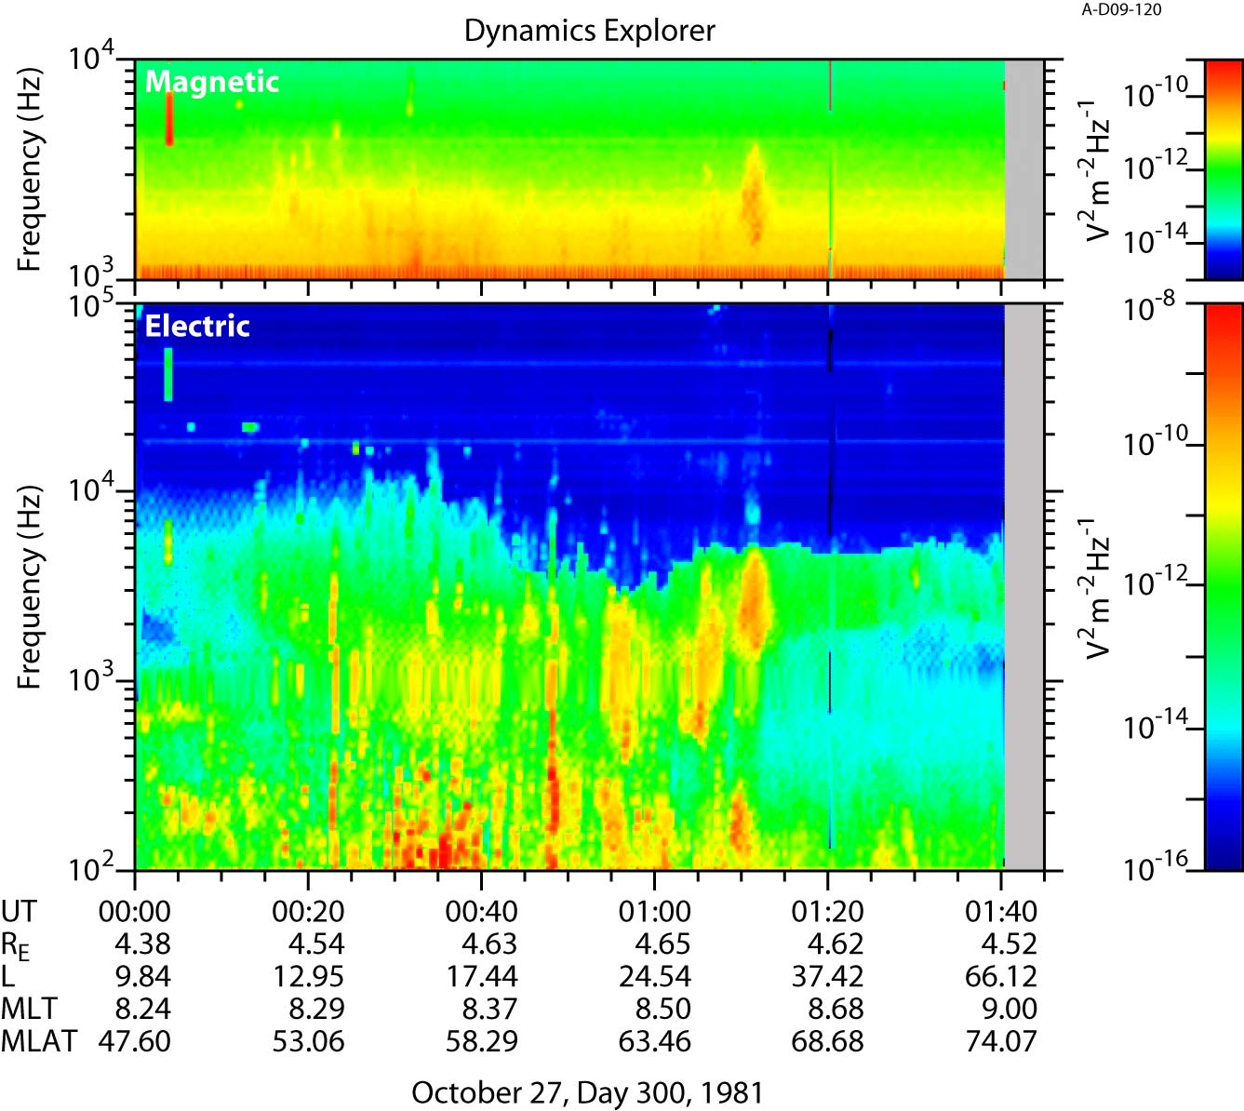

Slide 9
Methods of Calculation
Numerical Simulation
  WHAMP
    Requires approximation of the data
Analytical Calculation
  Maxwellian Approximation
  Data Interpolation and Integration
    Requires obtaining a reduced distribution function to calculate growth

Slide 10
The Numerical Approach
Waves in Homogeneous Anisotropic Multicomponent Plasmas (WHAMP)
Solves dispersion relation of waves in magnetized plasmas with Maxwellian velocity distributions
Each component specified by density, temperature, particle mass, anisotropy, and drift velocity
For given values of k, will yield real and imaginary (growth) parts of frequency

Slide 11
The Analytical Approach
Often unsolvable due to the complexity of the system, requires making a few assumptions.
Following a similar approach to Morgan et al. (1994), we start with the derived equation by Kennel (1966) and assume:
  (1) Resonance Cone propagation
  (2) Ions play a negligible role

Slide 12
The Analytical Approach
If we further assume that:
  (3) ω_{c} >> ω_{p} > ω
  (4) Only m=0 significant (small electron population)
Letting J₀² = 1, cancelling, and moving terms:

Slide 13
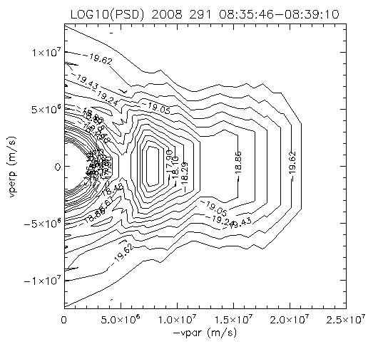
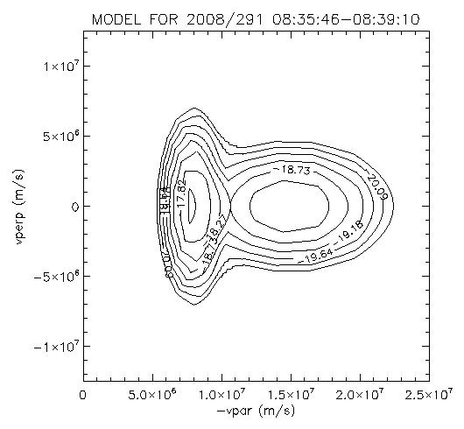
Maxwellian Approximation

Slide 14
Data Interpolation & Integration
We can further simplify this, since:
Thus, we finally end up with:

Slide 15
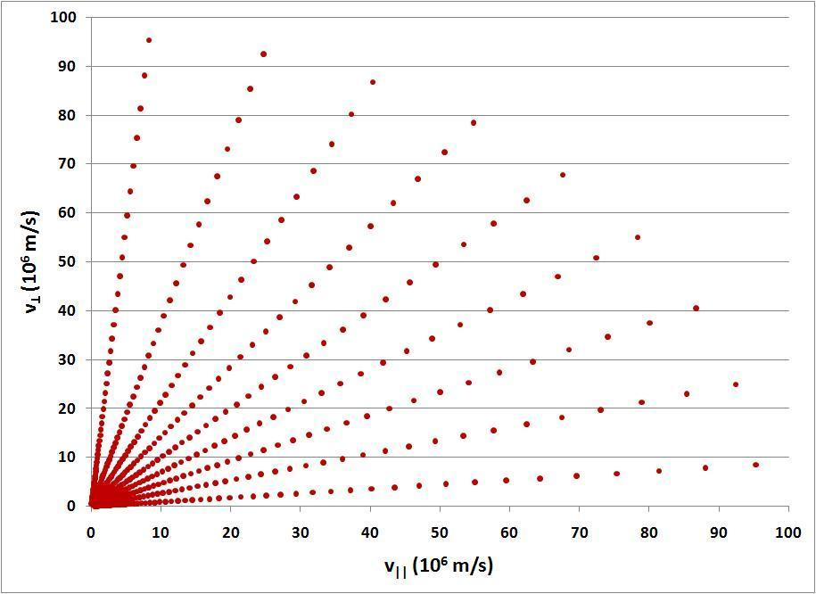

Slide 16
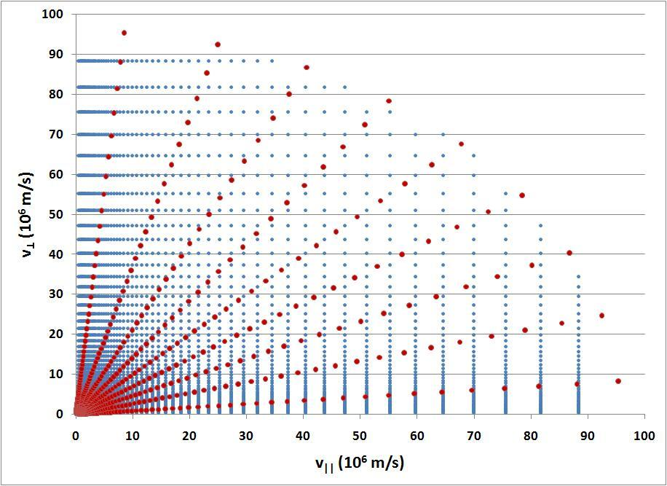

Slide 17
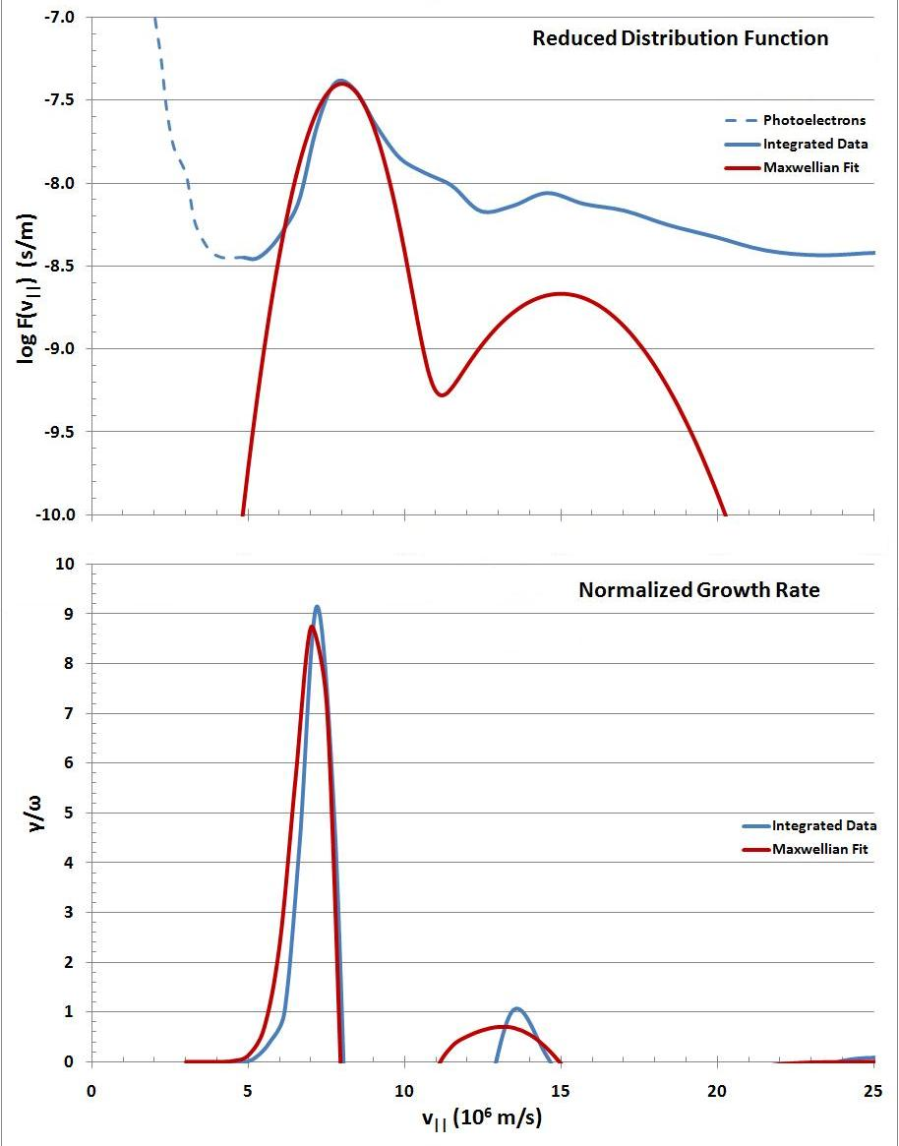

Slide 18
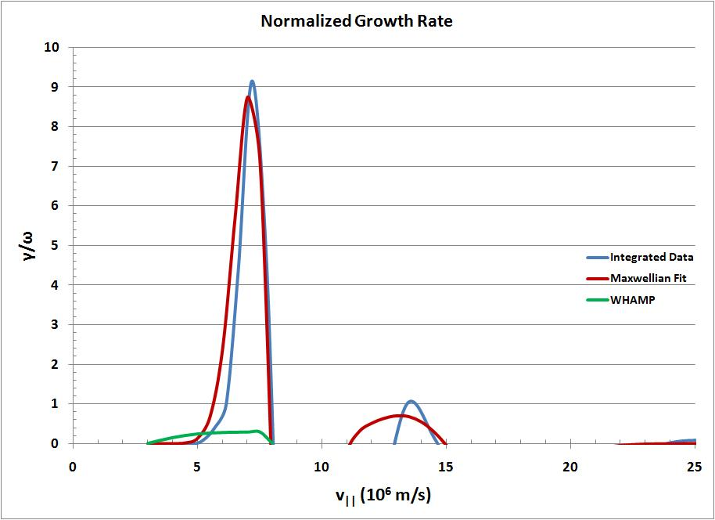

Slide 19
Conclusions
Although analytical and numerical models produce different results, both indicate very high growth rates.
Day 291 beam is significant enough to produce the observed auroral hiss emission.
Overly large growth rates in analytical calculations may indicate non-linear effects.
More beams are required to confirm these results.

