Slide 1
THE SOLAR SYSTEM:
Mysteries in our own Backyard
Andrew Kopf
Astrophysics/Space Physics Seminar
October 7, 2008

Slide 2
Today’s Goals
To not talk about my research
To avoid technical details
To present some of my favorite and most puzzling mysteries of our own solar system
To explore recent insights and theories
To show there are just as many fascinating mysteries 10000 light seconds away as there are 10000 light years away
To show lots of pretty pictures
To provide more questions than answers

Slide 3
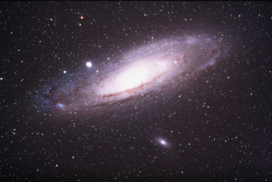
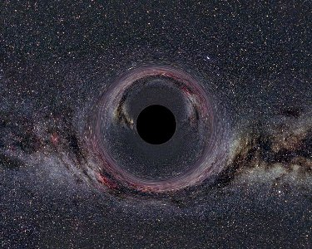
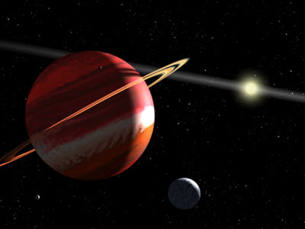
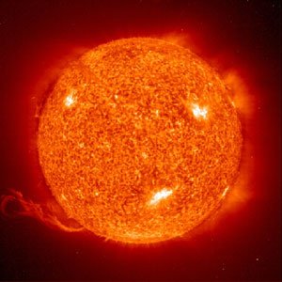
WHERE ARE
TODAY’S BIGGEST
MYSTERIES?
2,540,000 light years
1600 light years
10.5 light years
.0000158 light years

Slide 4
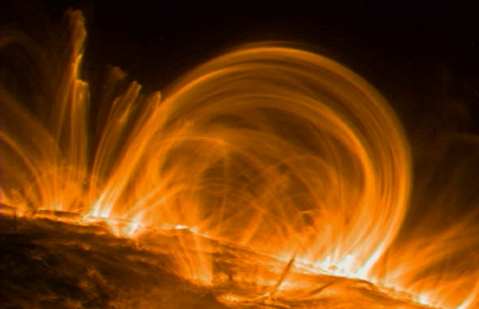
THE SUN’S TEMPERATURES
Two main theories
  Nanoflares
    Due to magnetic reconnection, on order of 10¹⁸ J in energy
    Millions of small regions
    Appear to be too few
    Gradual reconnection?
  Wave Heating
    Magneto-acoustic and Alfvén from Photosphere turbulence, => shock waves => heat
    Delivery mechanism?
    Non-uniformity problem
    10% of needed energy seen
T ~ 2,000,000 K
T ~ 6000 K
T ~ 15,000,000 K

Slide 5
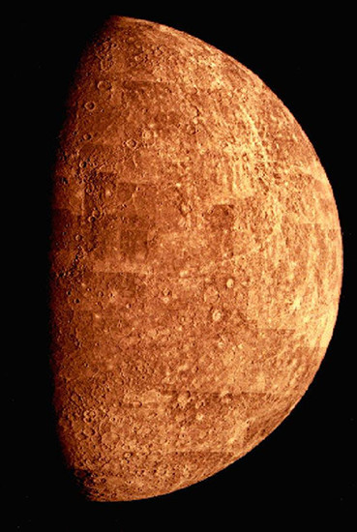
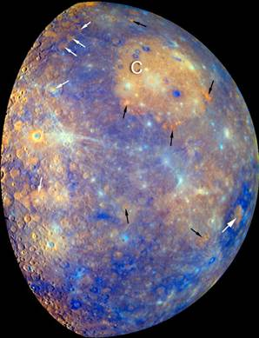
MERCURY’S SURFACE
1974 – Mariner 10 shows smooth plains on Mercury
Speculated to be due to volcanic activity like the basaltic maria on Moon
Unlike Moon, Mercury’s plains lighter than their surroundings
Apollo 16 – bright regions on Moon due to impacts
Mariner resolution and sunlight angles prevent determining mechanism.
2008 – Messenger flyby
C – Caloris Impact Basin
Orange – Low-iron regions
Blue – Older rocks
White – Young, smooth plains
Black – Explosive eruption site

Slide 6
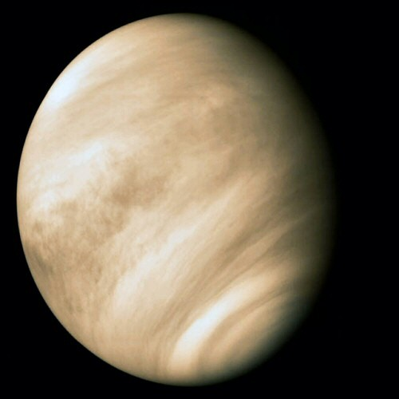
VENUS’ ROTATION
Venus has a very slow rotation, taking 243 days to spin on its axis.
BUT, Venus is one of only two planets in our solar system that spins retrograde. Why?
Impact?
Chaotic Atmosphere?
  Flipped rotation axis?
  Reverse old rotation?
  Most initial conditions yield result, but through very different paths

Slide 7
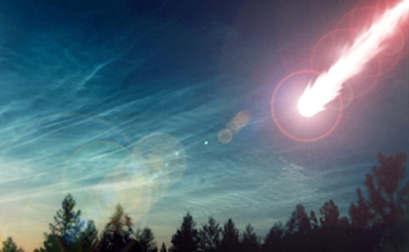
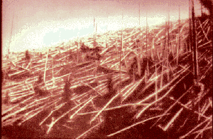
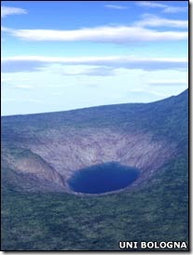
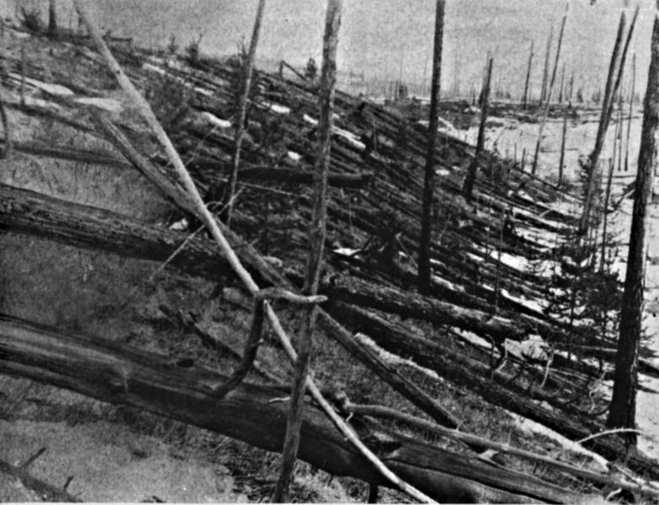
EARTH
Tunguska Event
Siberia, Russia
June 17, 1908
80 million trees down in 2150 km²
Blast equivalent to 10-15 Megatons
5.0 on Richter
Largest impact event on land in recent history
No impact crater

Slide 8
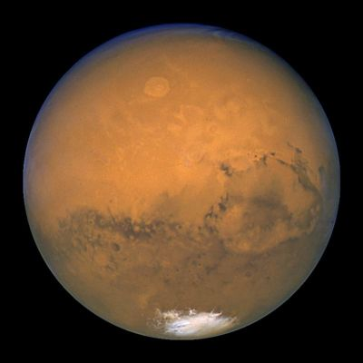
MARS’ HEMISPHERES
Large impact?
  Thrown out early due to geography
  Elliptical region
  No crater rim
  Would melt planet
Northern ocean?
  Large shoreline variations (spin axis modulation?)
  Unclear evidence of existence in rocks
Caltech, 6/25/08 – Impact works if:
  Hit at 30-60 deg
  6-10 km/s
  1600-2700 km
Vast flat lowlands
Mountainous Highlands

Slide 9
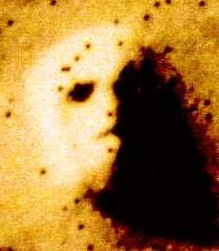

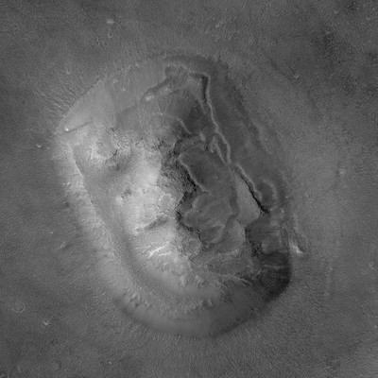
THE FACE ON MARS
July 25, 1976 – Viking 1 images Cydonia, sees an unusual formation
Some speculate that the face may be an artificial feature
MGS and MRO take high resolution images of the “face”, reveal its true nature

Slide 10
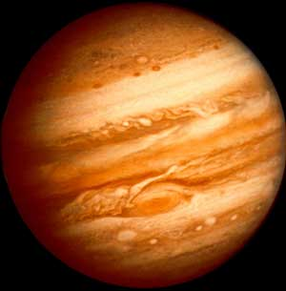

JUPITER’S… UMMM…

Slide 11
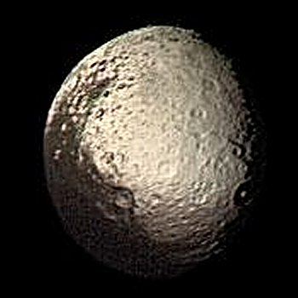
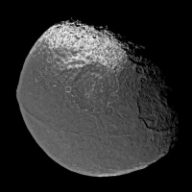
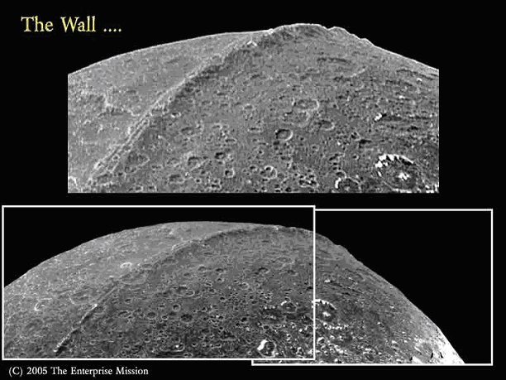
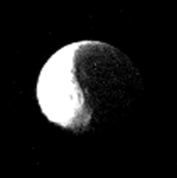
IAPETUS
1300 km long
20 km wide
13 km high
Theories:
  Remnant of young, fast rotating period, formed early and cooled quickly
  Icy materials that welled up beneath surface and solidified
  Conspiracy theories of artificial origin, largely due to Cassini images of the Wall and other lunar features
“Yin-Yang Moon”
Tidal lock w/ Saturn
80% ice, 20% rock
Only regular moon with highly inclined orbit

Slide 12
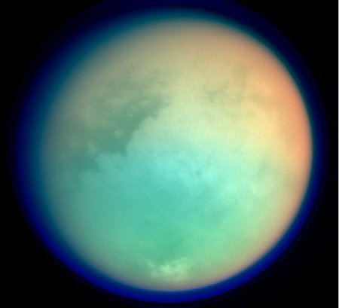
TITAN’S ATMOSPHERE
Only moon with a dense atmosphere
98% N₂, 2% CH₄
1.5 Earth pressure
Atmosphere full of organic hydrocarbons, Liquid lakes on surface
Most Earth-like in S.S.
Where is N₂ from?
  Lack of noble gases would not suggest comets
  Outgassing of decomposed materials in interior?
Lightning?
Prebiotic environment?

Slide 13
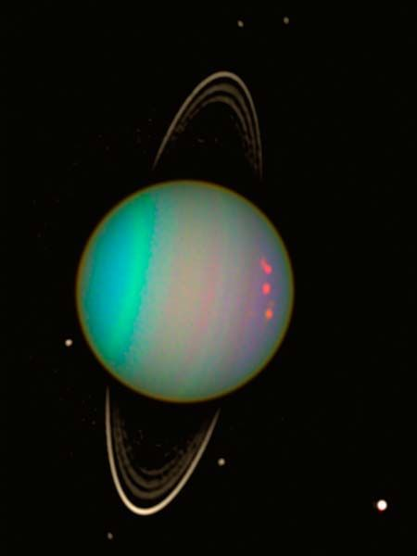
URANUS’ TILT
Uranus lies on its side, 98° axial tilt
Retrograde rotation
Most common theory: Uranus collided with Earth-sized protoplanet
Moons orbit in Uranus plane, not solar plane
Jupiter & Saturn crossed 1:2 orbital resonance. Combined gravitation altered orbit, transferred angular momentum, knocked Uranus off-axis

Slide 14
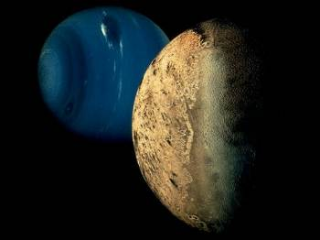
TRITON’S ORBIT
Where did it come from?
  Kuiper belt object?
  Captured from Uranus?
How was it captured?
  Collision with another moon?
  Part of binary?
Another puzzle – Triton has a thin atmosphere, which is getting warmer and larger, melting frozen N₂ surface
Only large moon with retrograde orbit
Synchronous rotation with Neptune
Inclined, circular orbit
Rotation axis tilted 157 degrees with respect to Neptune’s axis, which is inclined 30 degrees from Neptune’s orbit

Slide 15
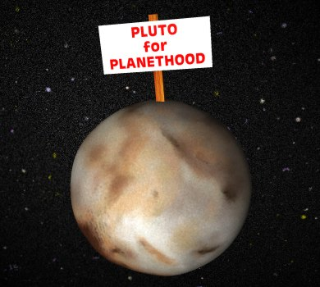
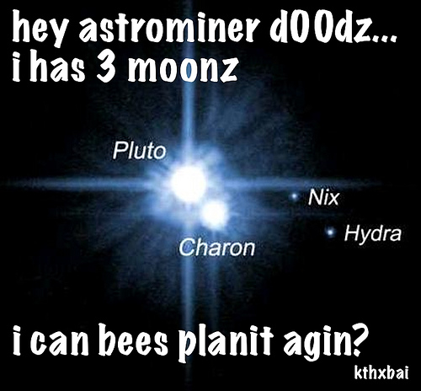
PLUTO’S PLANETHOOD
1930 – Discovered, given planet status
2003 – Eris found in Kuiper Belt, 27% larger than Pluto
2006 – IAU declares new planet criteria, demotes Pluto
IAU’s closed door procedure stirs controversy, many astronomers still call Pluto a planet
Surprising discovery around same time has added fuel to the fire

Slide 16
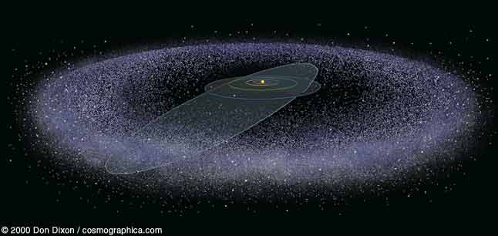
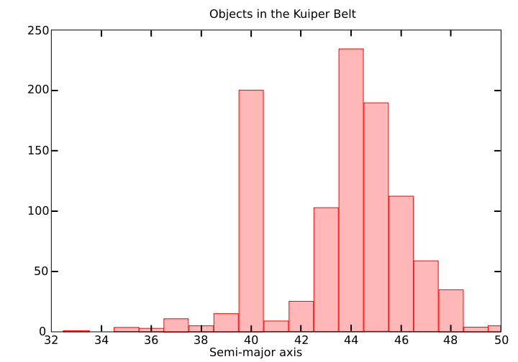
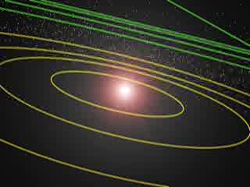
KUIPER BELT
Sudden “cliff ” at 50-55 AU
  Insufficient matter to accrete into larger bodies
  Earth-sized object cleared out region
Not a “cliff ”, but a “gap”?
  2003 discovery of Sedna supports this, as Sedna’s closest approach is 76 AU, but its orbit does not reach out to Oort Cloud distances
2:3
Kuiper Belt – 30-55 AU
200 times more massive than asteroid belt
CH₄, NH₃, H₂O
Number of KBO expected to increase with distance
1:2

Slide 17
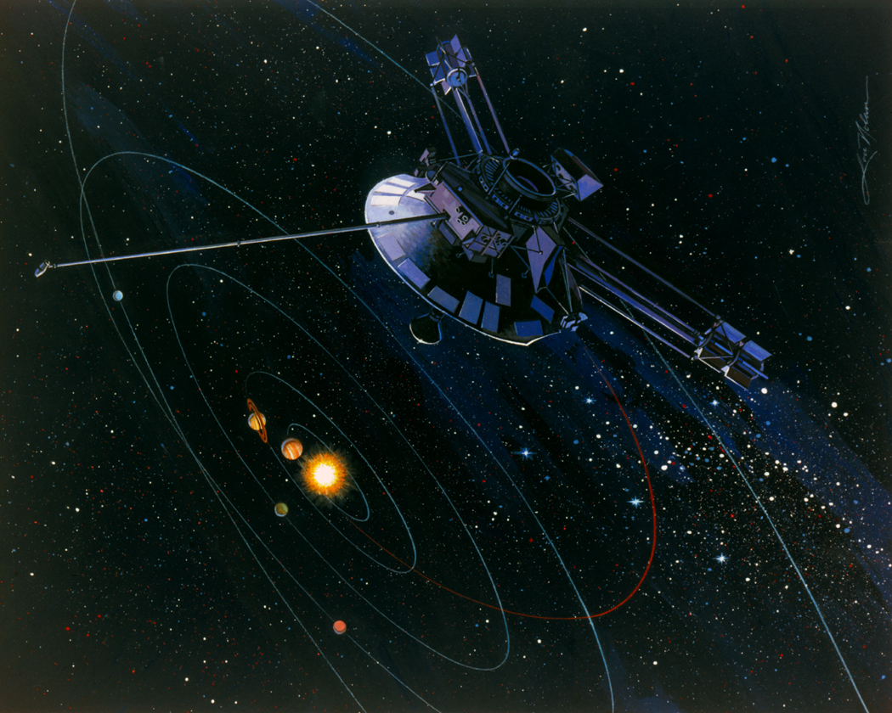
PIONEER ANOMALY
Real Deceleration
  Gravity from other source, like Kuiper or Dark Matter
    Must violate equivalence
  Interplanetary medium drag
    Densities are too small
  Due to craft itself
    Gas Leak
    Asymmetrical craft radiation
    Electromagnetic forces
New Physics
  Clock acceleration between ephemeris and atomic time
  MOND theories
    Gravity or Inertia
  Aethereal Gravitation
  Scale Expanding Cosmos
1972/1973 – Pioneer 10 &11 launched to explore the outer solar system
Probes experiencing unexpected additional sunward acceleration
Off course by 4x10⁵ km after 10¹⁰ km
Confirmed by 7 analyses

Slide 18
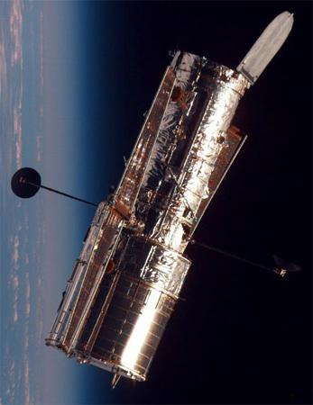
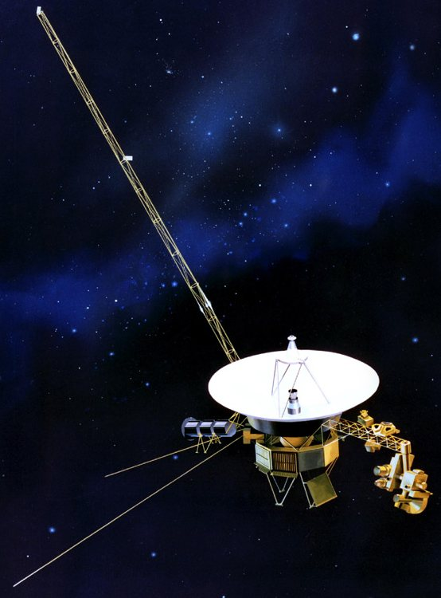
The Moral Of Today’s Story:
Unnecessary
Plenty Mysterious

