Slide 1


Upper Atmosphere sounding at mars:
13 years of marsis science
Andy Kopf
University of Iowa
With thanks to: D. Gurnett, J. Halekas,
D. Morgan, Z. Girazian, F. Chu, F. Duru,
Y. Harada, and F. Nemec

Slide 2
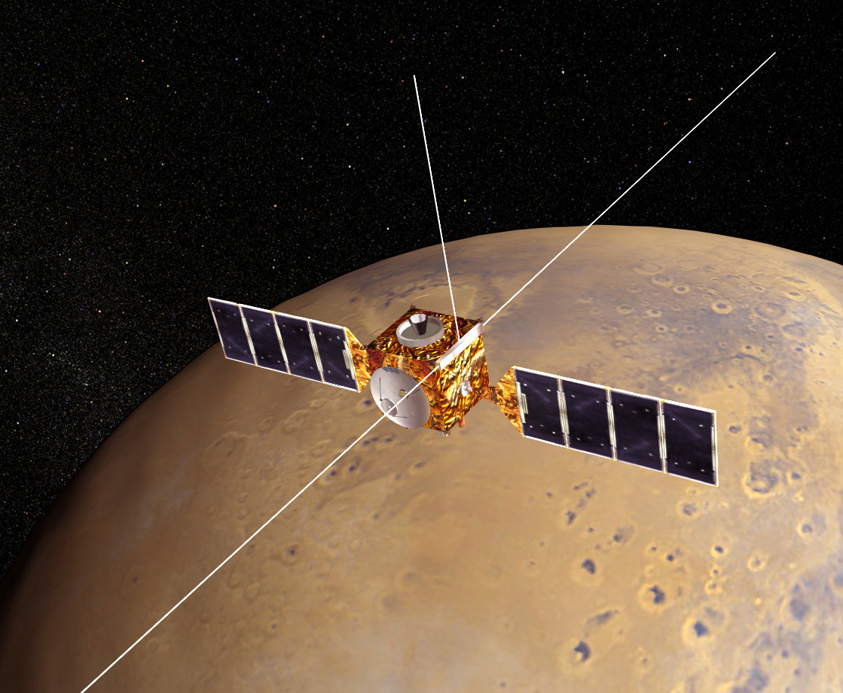
Mars express
Operated by European Space Agency
Launched: June 2, 2003
Mars Arrival: December 25, 2003
MARSIS Deployed: May 4 – June 10, 2005
MARSIS Science: July 2005 – Present

Slide 3
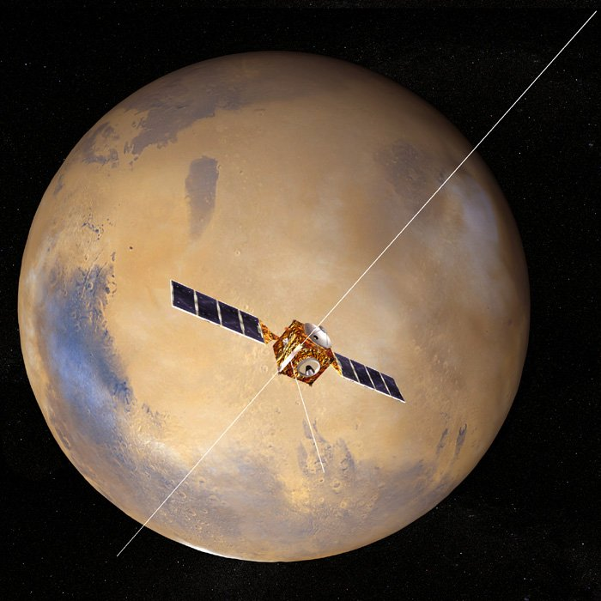
marsis
Mars Advanced Radar for Subsurface and Ionosphere Sounding
Twin 20-meter dipole antennae
7 meter monopole
Capable of operating in two main modes, one for ionospheric science (AIS), the other for subsurface radar sounding
  Operates in only one at a time

Slide 4
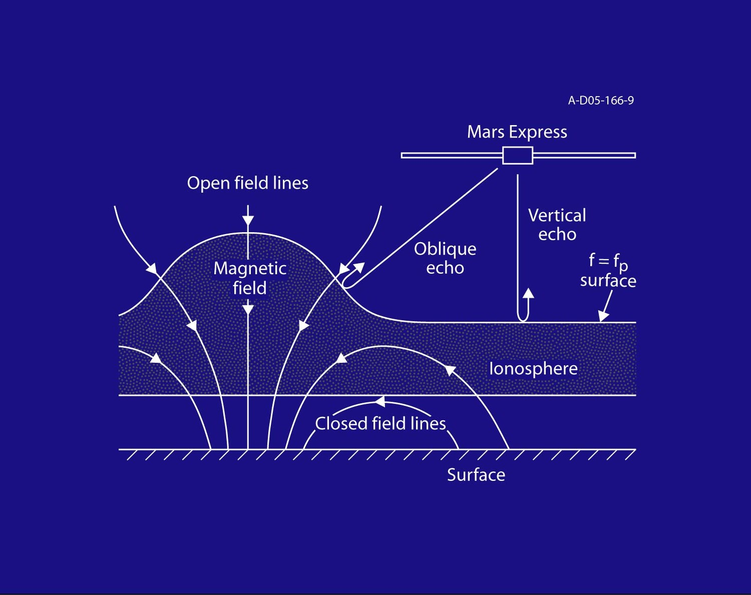
Sounding with marsis
MARSIS emits a multi-frequency “chirp”, and listens for the reflected echo from the ionosphere
The main echo will come from the horizontally stratified ionosphere
MARSIS may (and does) see other echoes, in places where the ionosphere is not smooth, or in certain plasma conditions

Slide 5
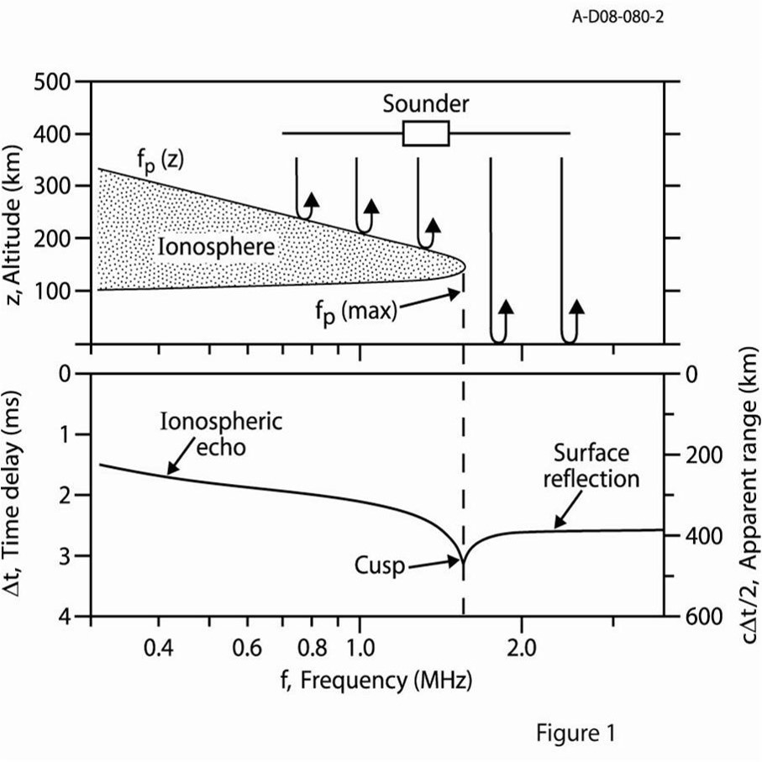

Sounding principles
Radio signal can propagate freely through space (and the ionosphere) at frequencies above the local plasma frequency
Reflection occurs when the pulse frequency equals the ionospheric plasma frequency. This gives the density (in cm⁻³), where:
Cusps appear at density profile maximums, since the group velocity approaches zero.

Slide 6
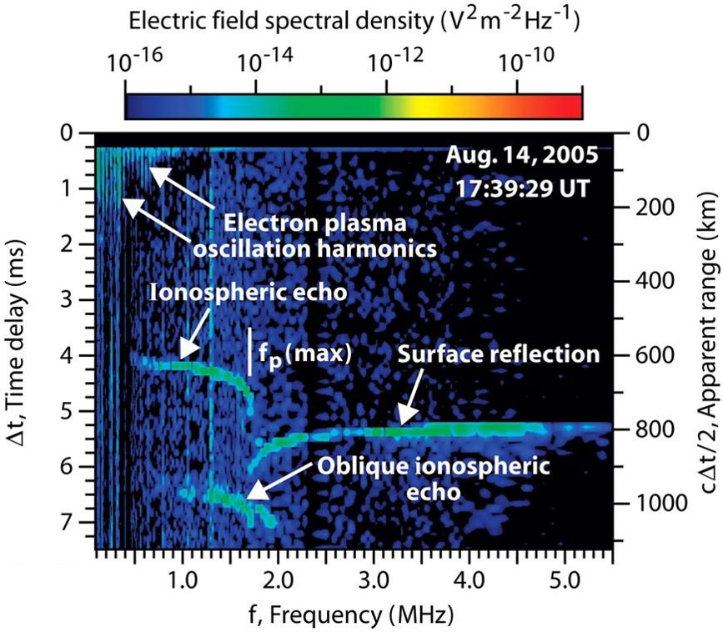
General observations
Ionospheric echo shows altitude profile of the ionosphere
Surface reflection can appear at frequencies above maximum plasma frequency of ionosphere
Other features, such as plasma harmonics, cyclotron harmonics, and oblique echoes are frequently present as well.

Slide 7
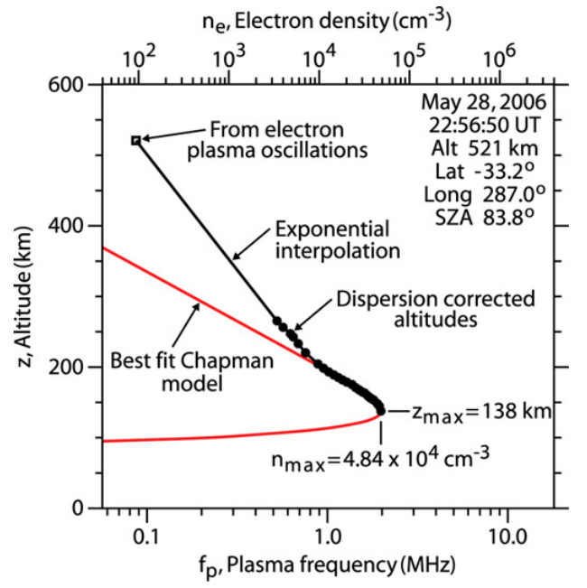
Fitting the ionosphere
Once the altitudes of the traced points have been corrected for dispersion, we can then fit the profile with a Chapman model function to obtain:
  Altitude of the density maximum
  Maximum density of the ionosphere
Both values, but especially the density, are dependent on the solar zenith angle

Slide 8
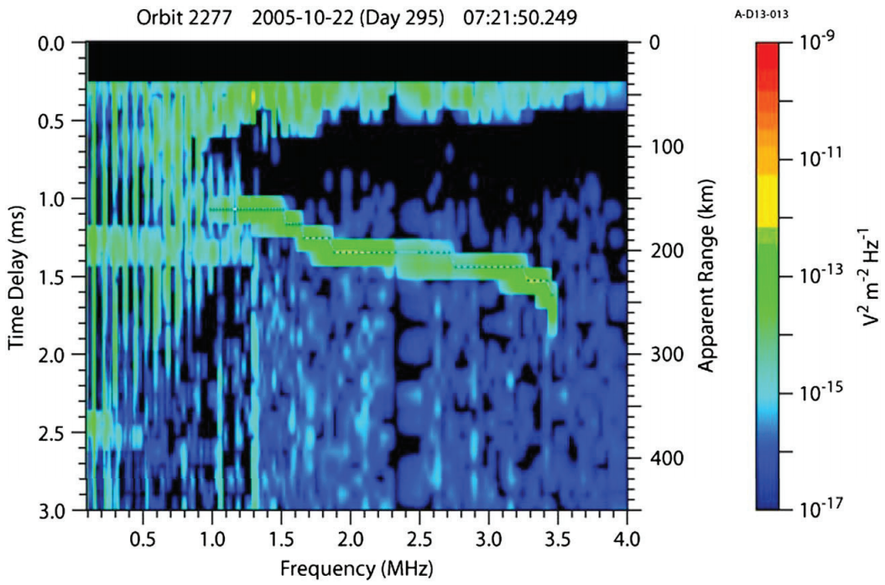
Plasma harmonics
MARSIS also sees harmonics occur as it steps up in frequency. These harmonics are associated with the local plasma frequency, and are seen to vary with altitude as the spacecraft orbits Mars.
These harmonics only appear in slower-moving (ionospheric) plasma. Once outside, the faster solar wind plasma is carried away too quickly for the echo to return to Mars Express.

Slide 9
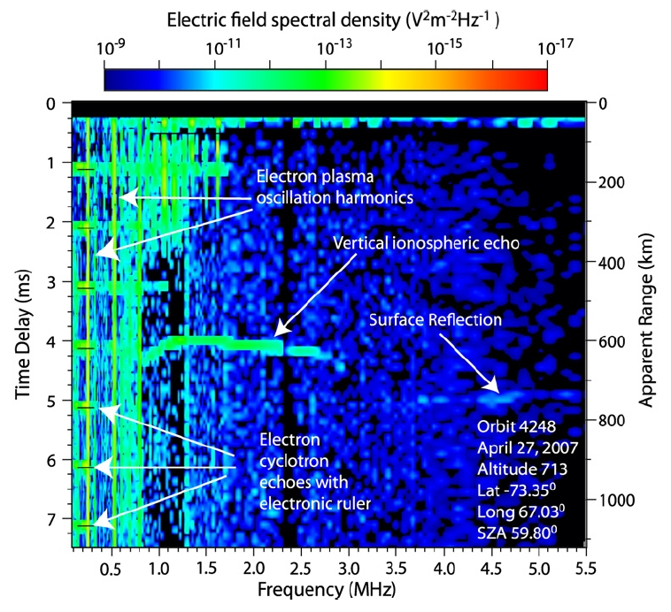
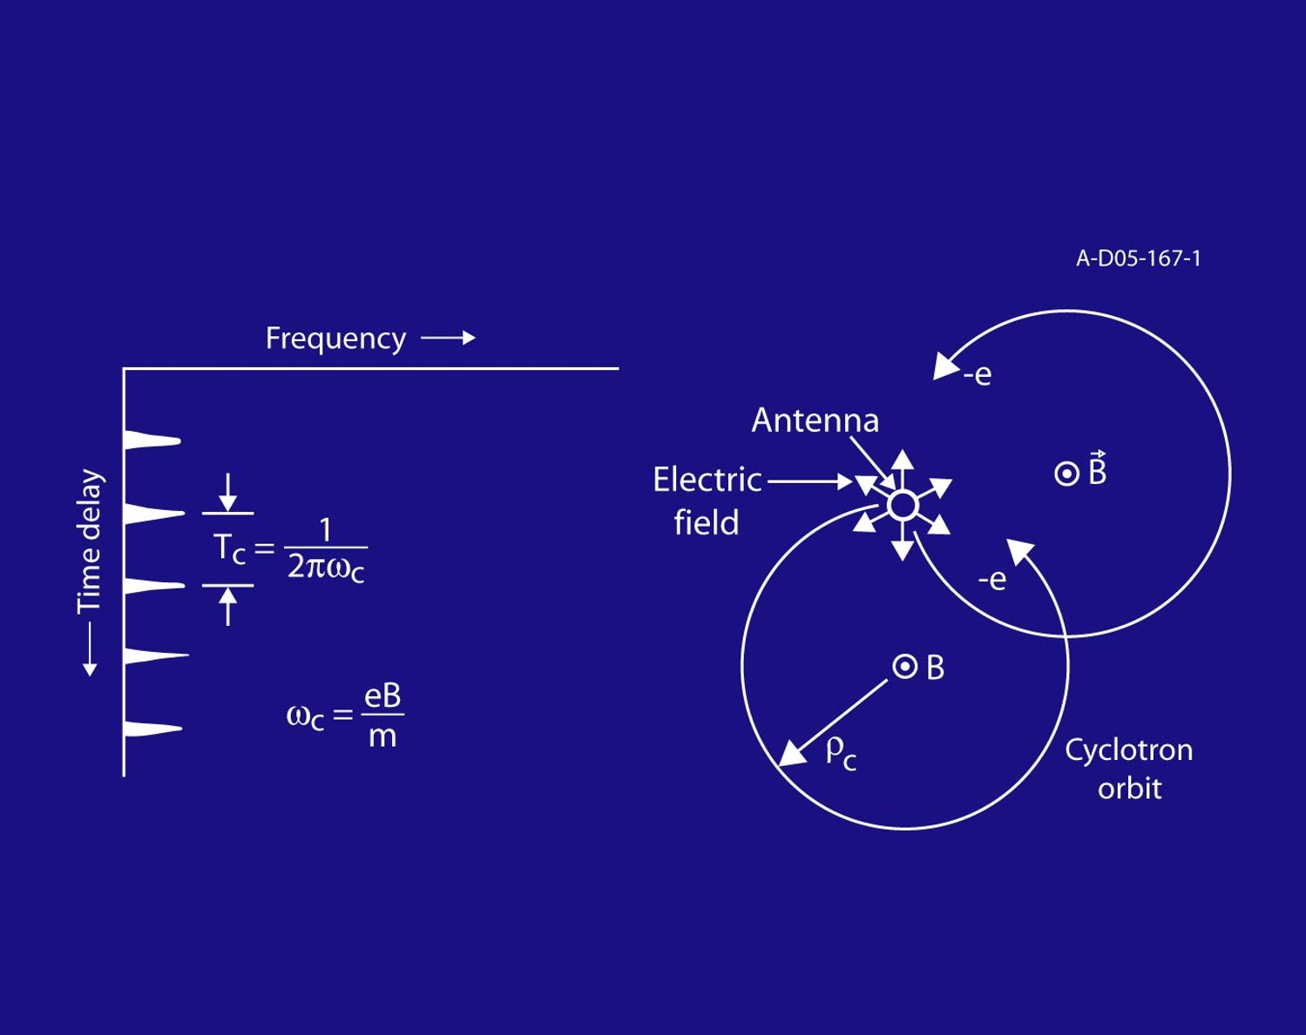
Cyclotron harmonics
Oscillation harmonics can also occur at regular time delay intervals. This has been interpreted as being harmonics of the cyclotron frequency

Slide 10
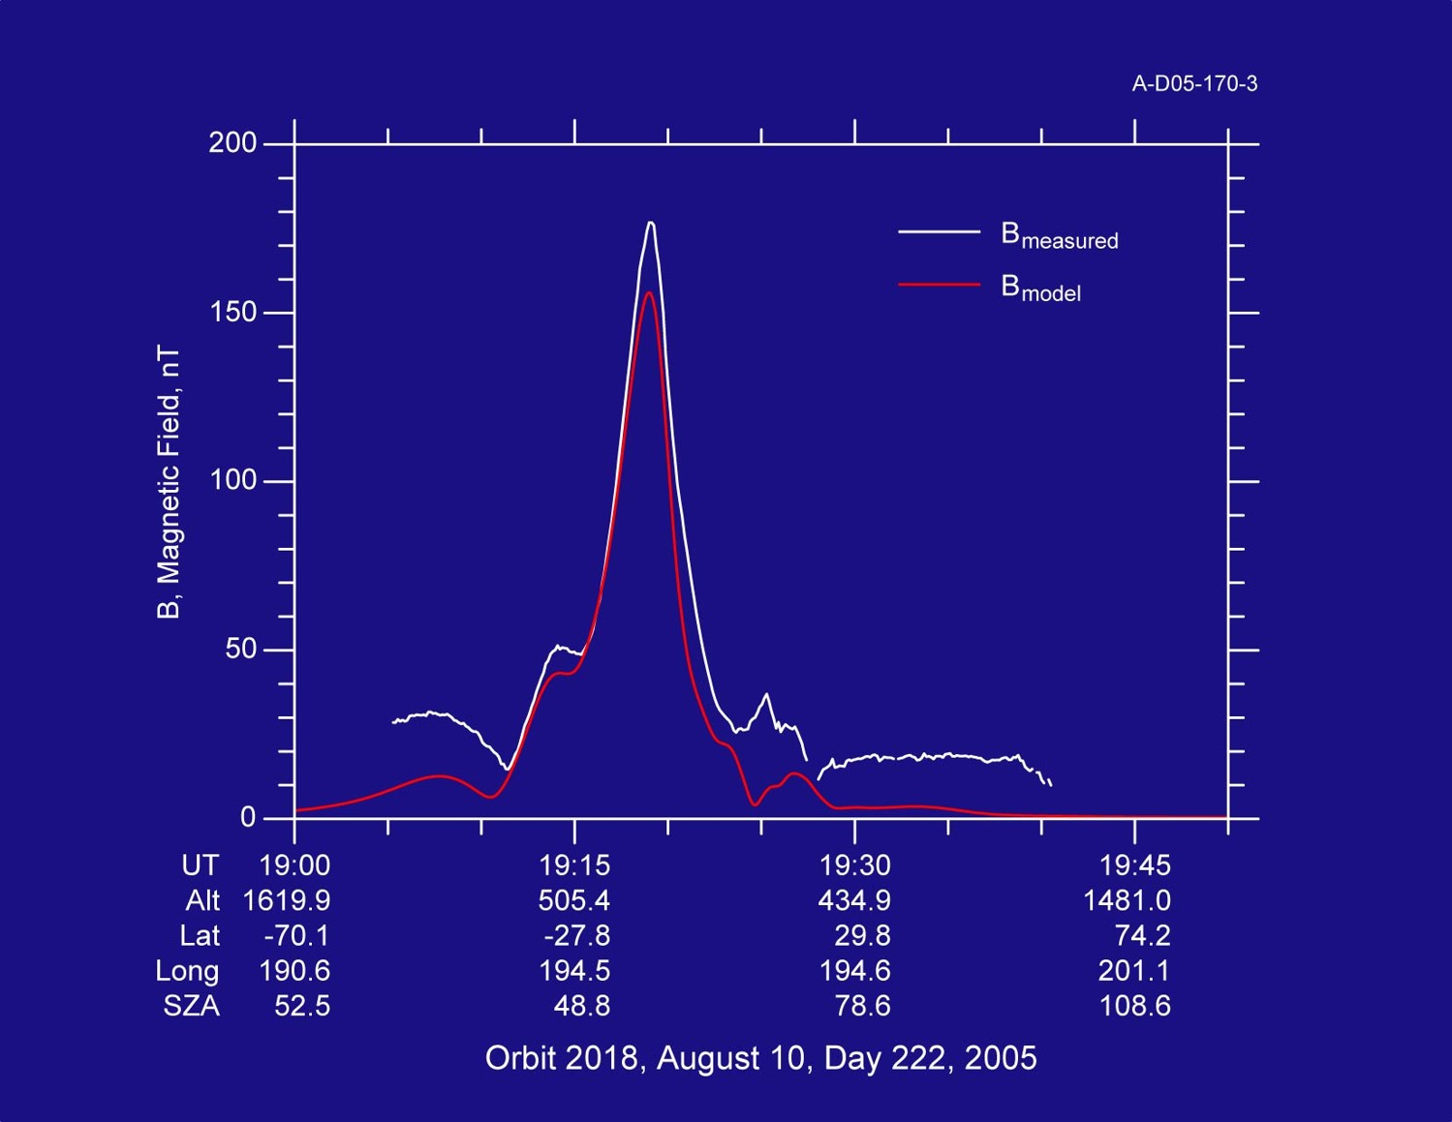
Mars express “magnetometer”

Slide 11
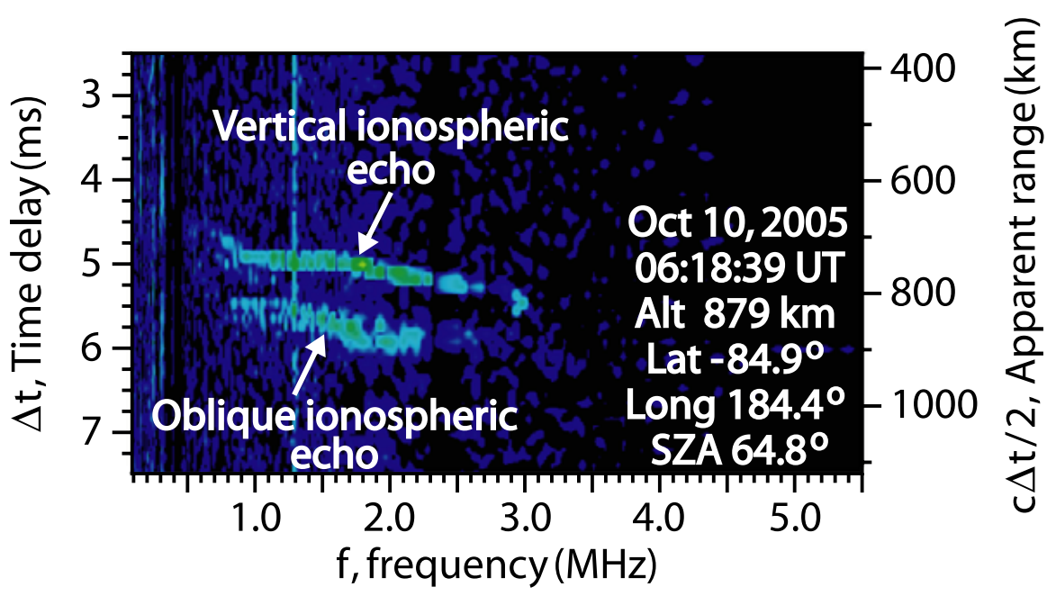
Oblique echoes
Sometimes, additional ionospheric echoes appear with longer time delays than the main echo
It is physically impossible for the echo to come from a second straight-down source

Slide 12
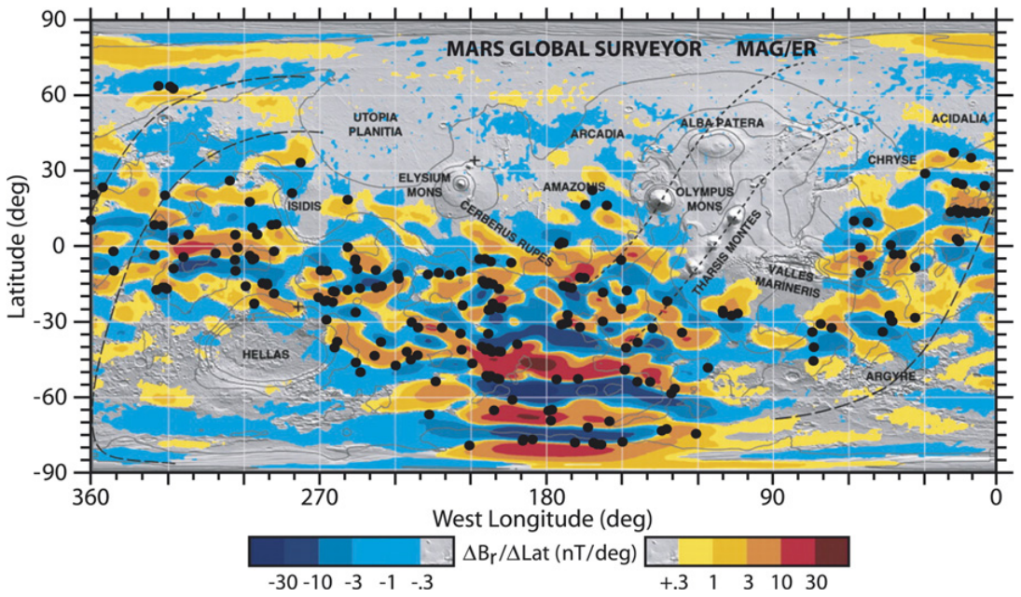
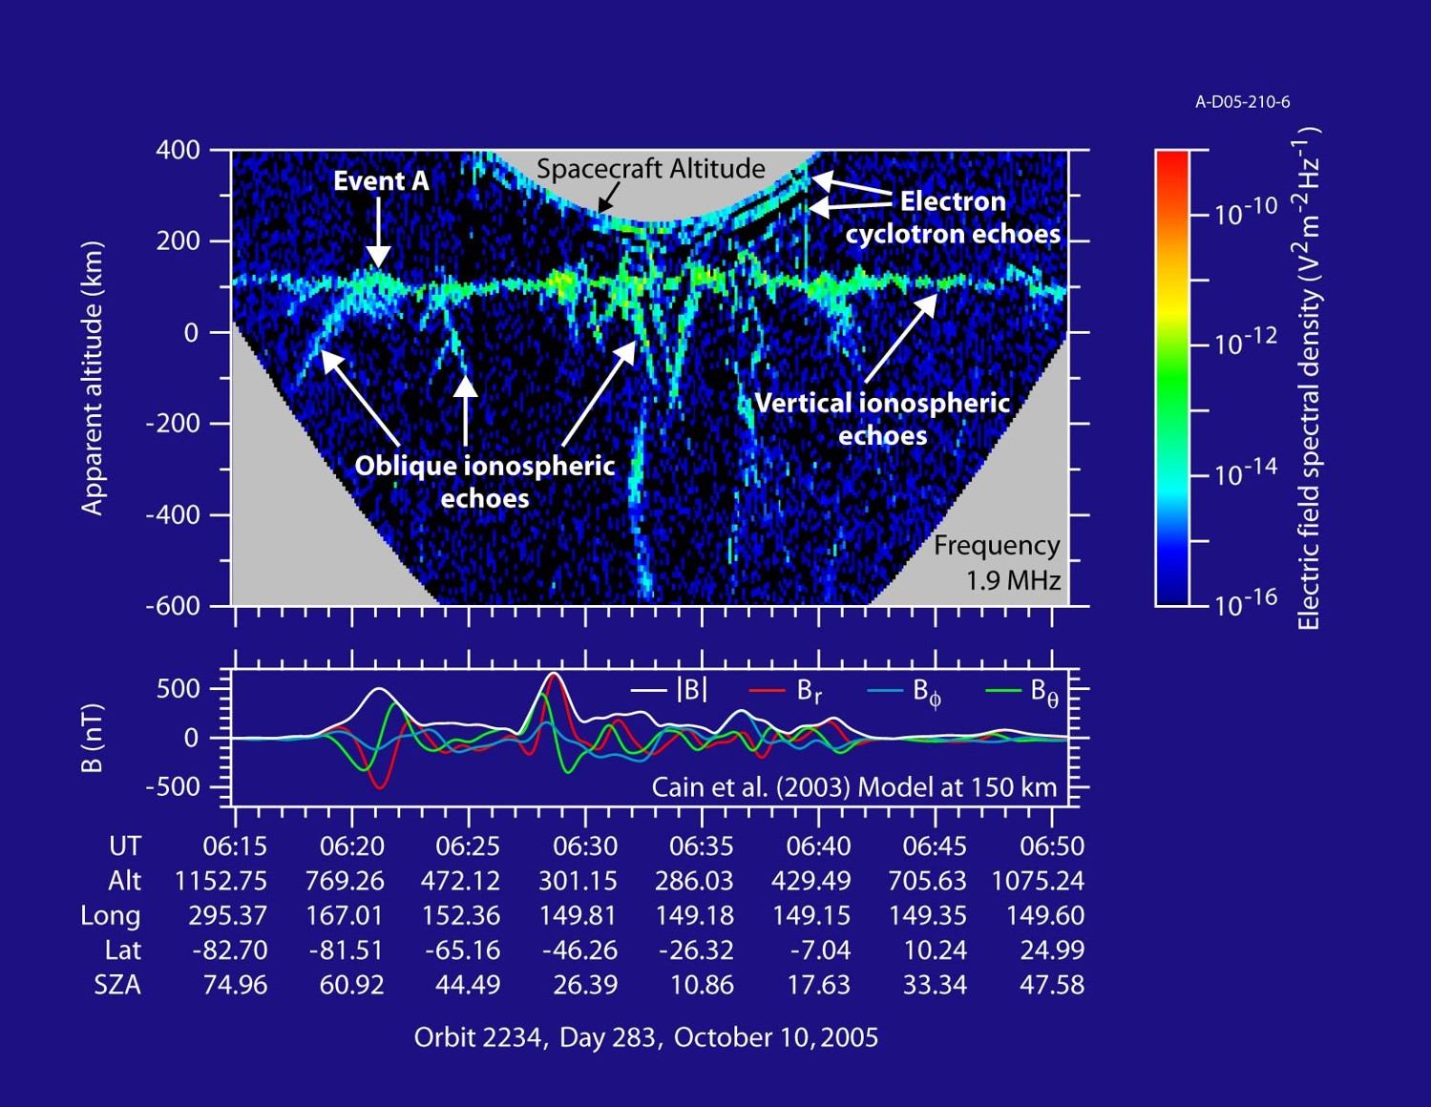
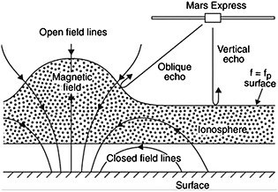
Oblique echoes

Slide 13
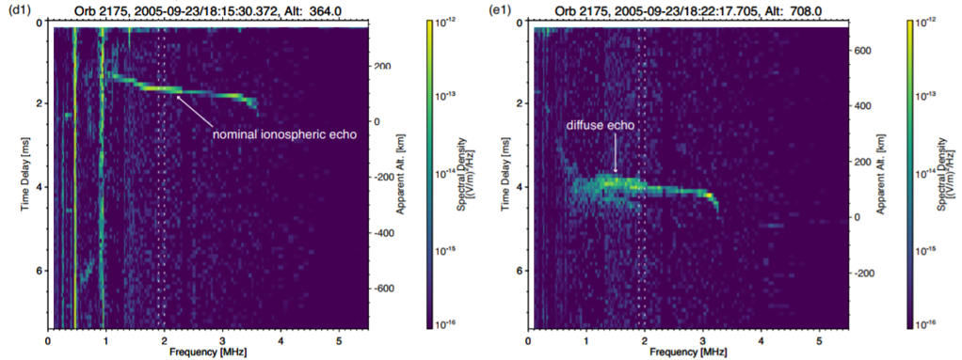
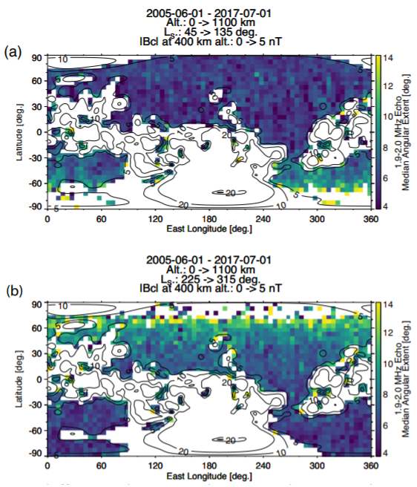
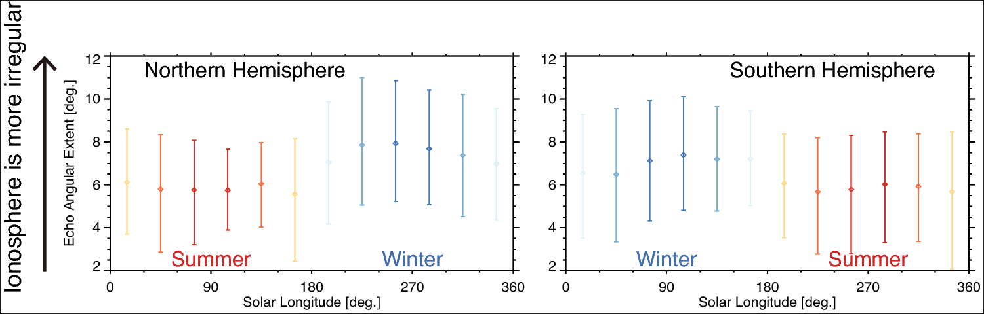
Seasonal Asymmetry of Diffuse Echoes
Figures from Harada et al., JGR, 2018

Slide 14
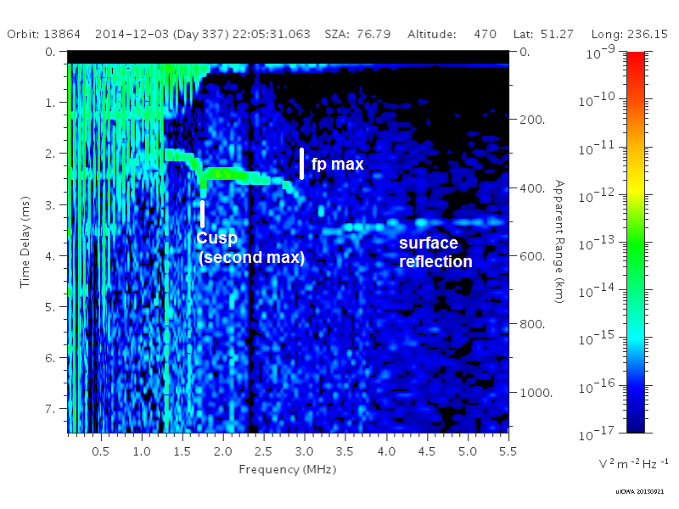
Transient Upper layers
An additional cusp is frequently observed at lower frequencies than the cusp of the main layer
This appearance of this feature implies the presence of an additional peak in the density profile at a lower density, and therefore at a higher altitude

Slide 15
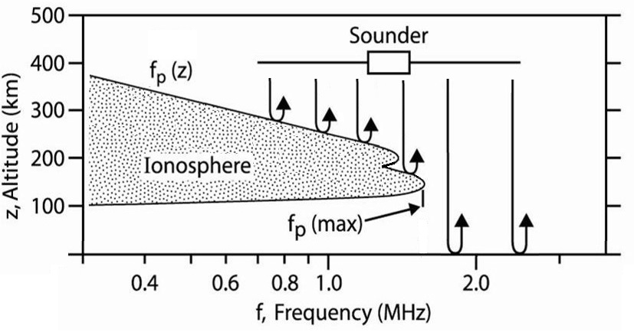
A Non-monotonic profile

Slide 16
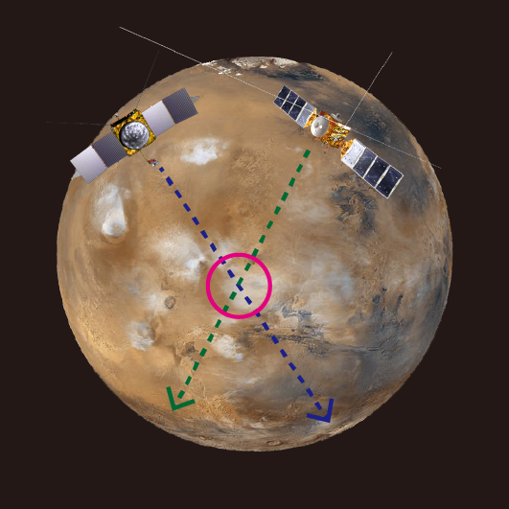
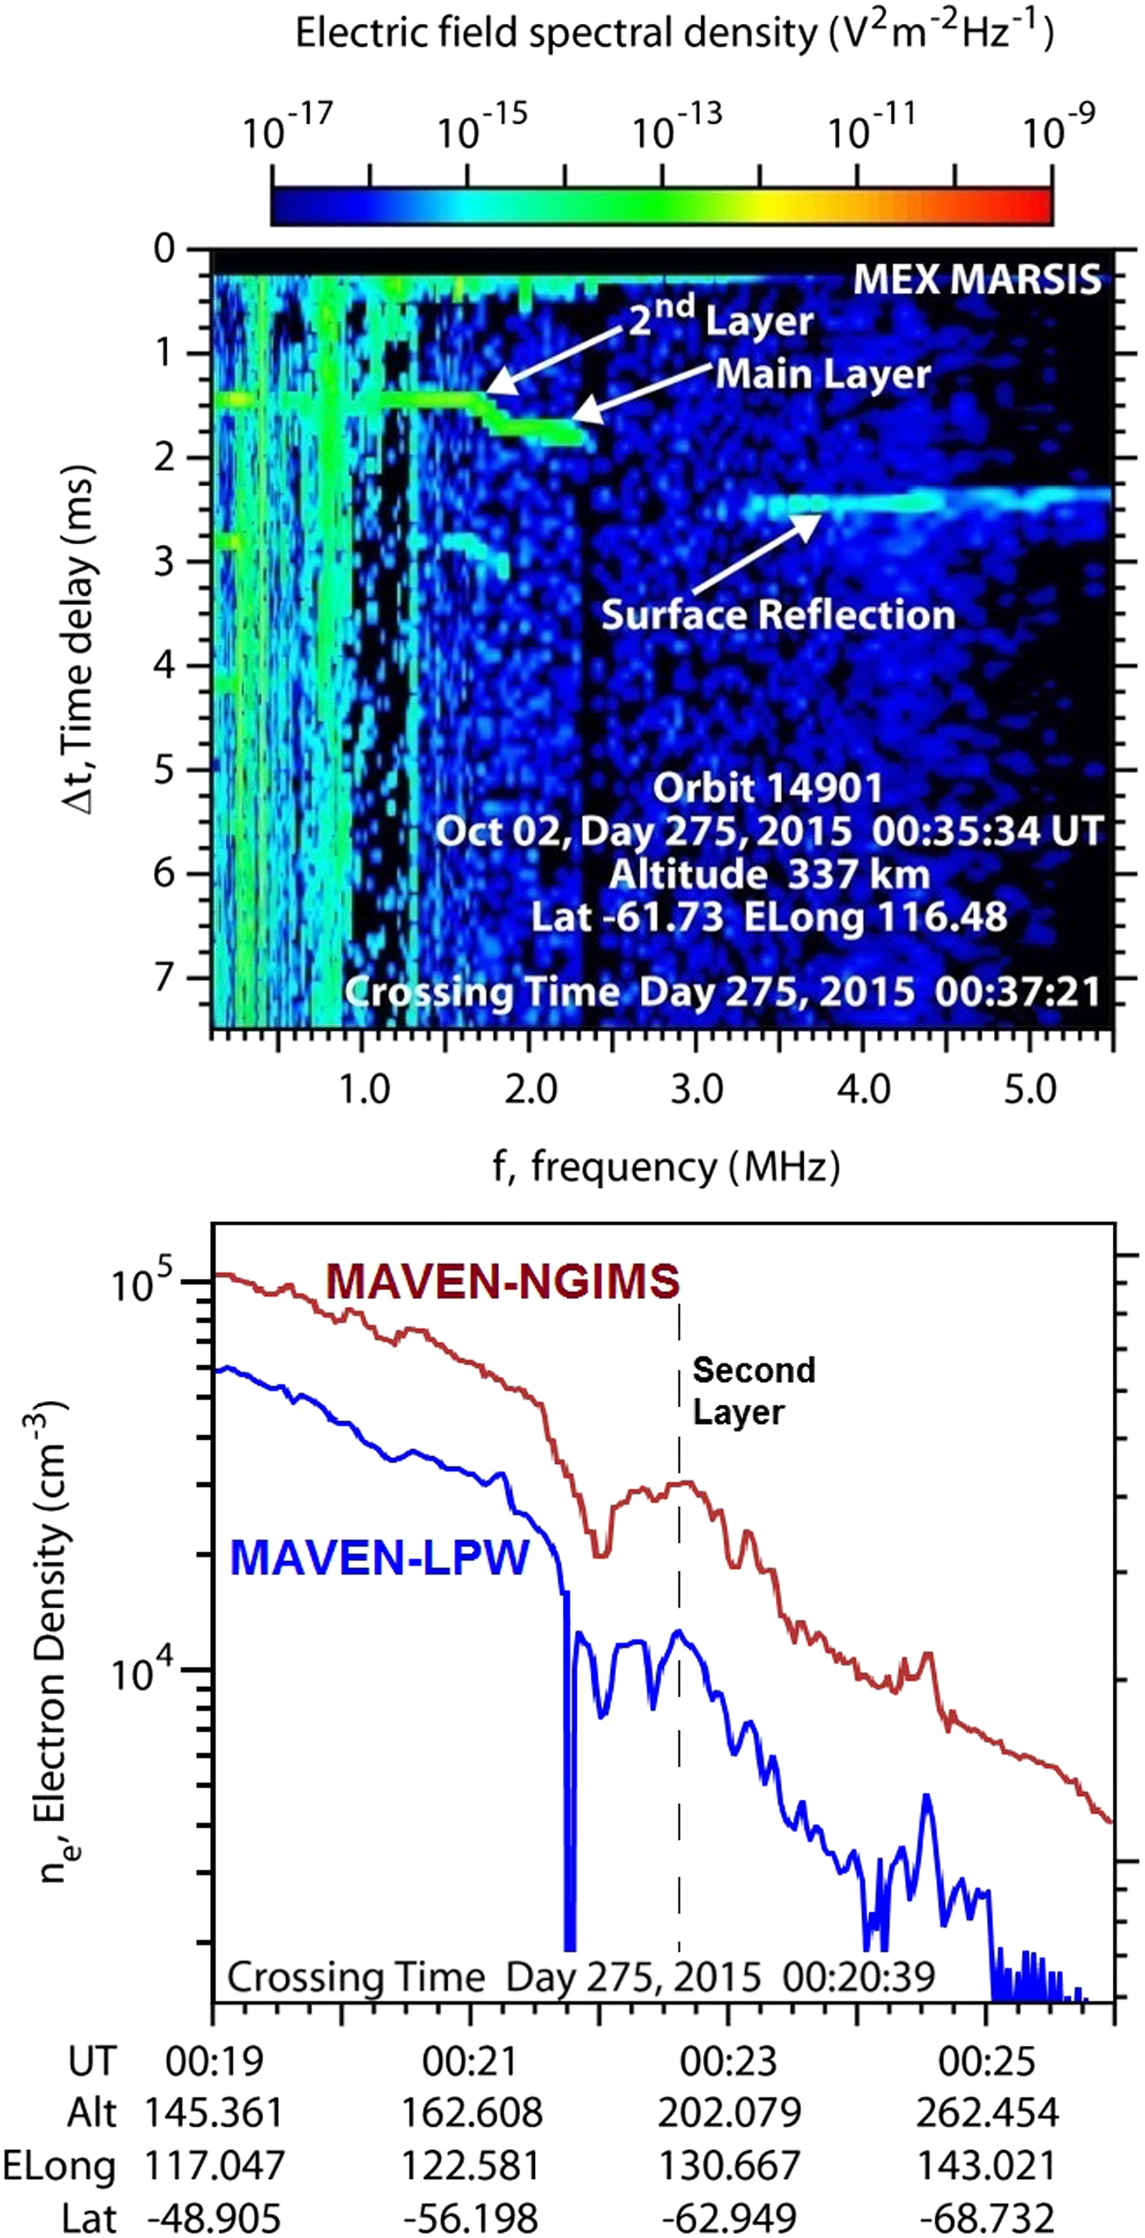
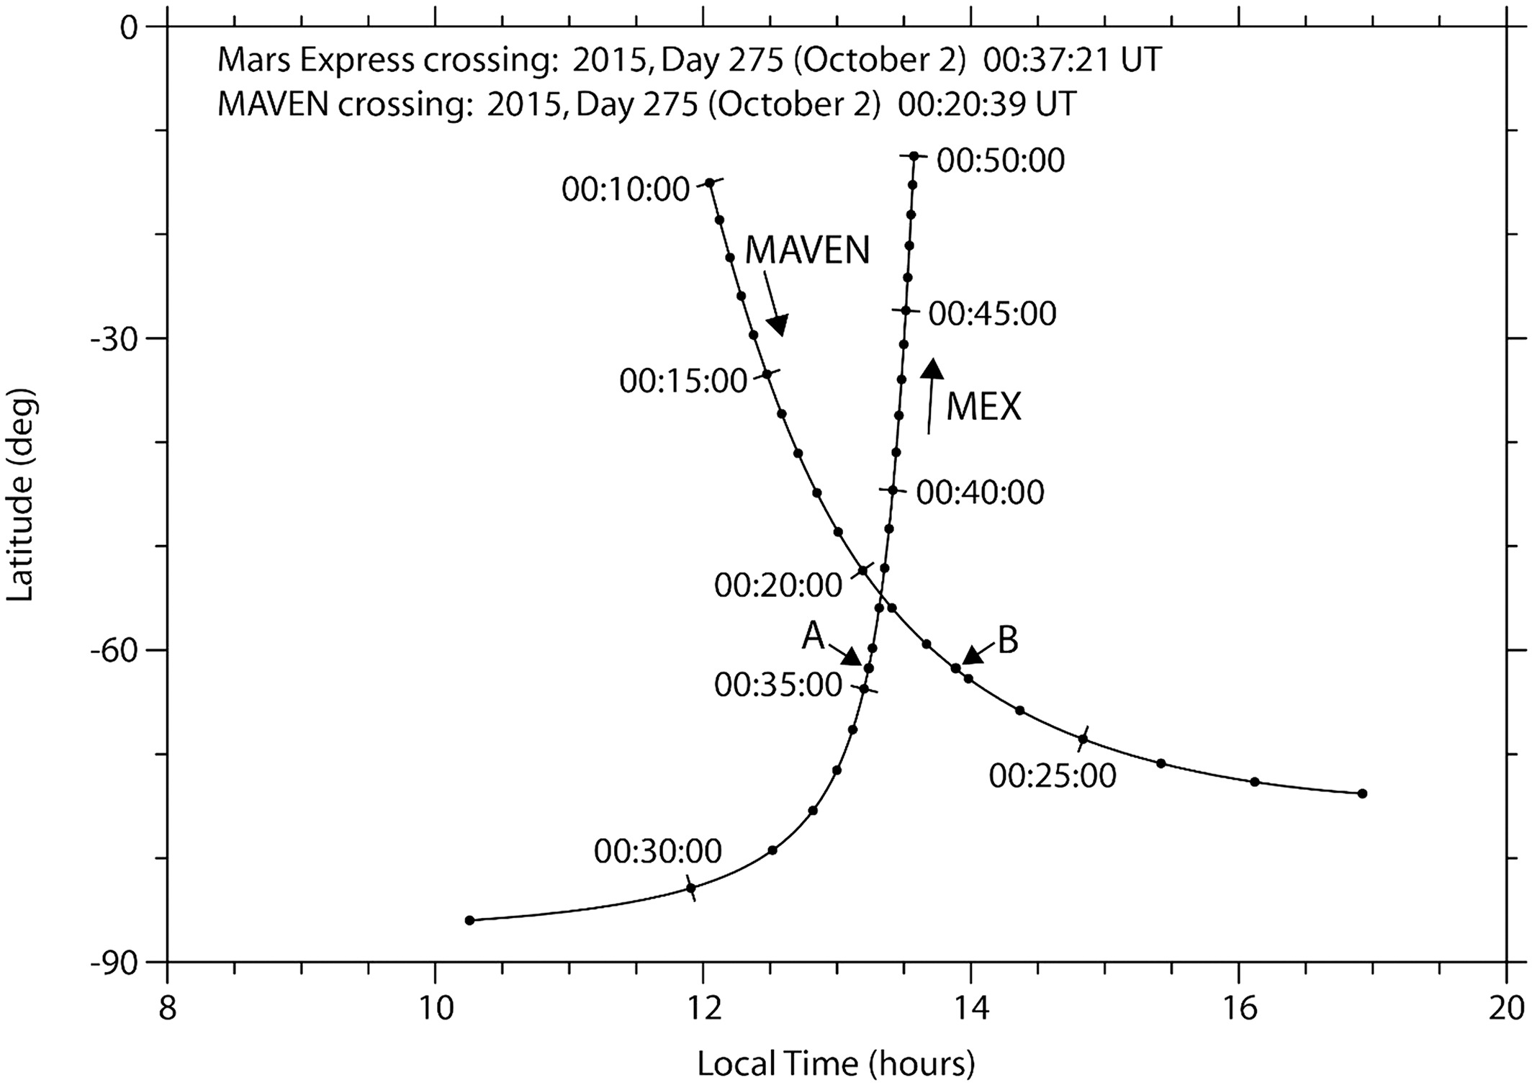
Topside layer - Conjunction Observation
Addition of MAVEN allowed for correlated observations
Close-time orbital crossings enable dual studies, if MAVEN is low enough to observe in situ
Feature jointly detected in Oct. 2015 orbit

Slide 17
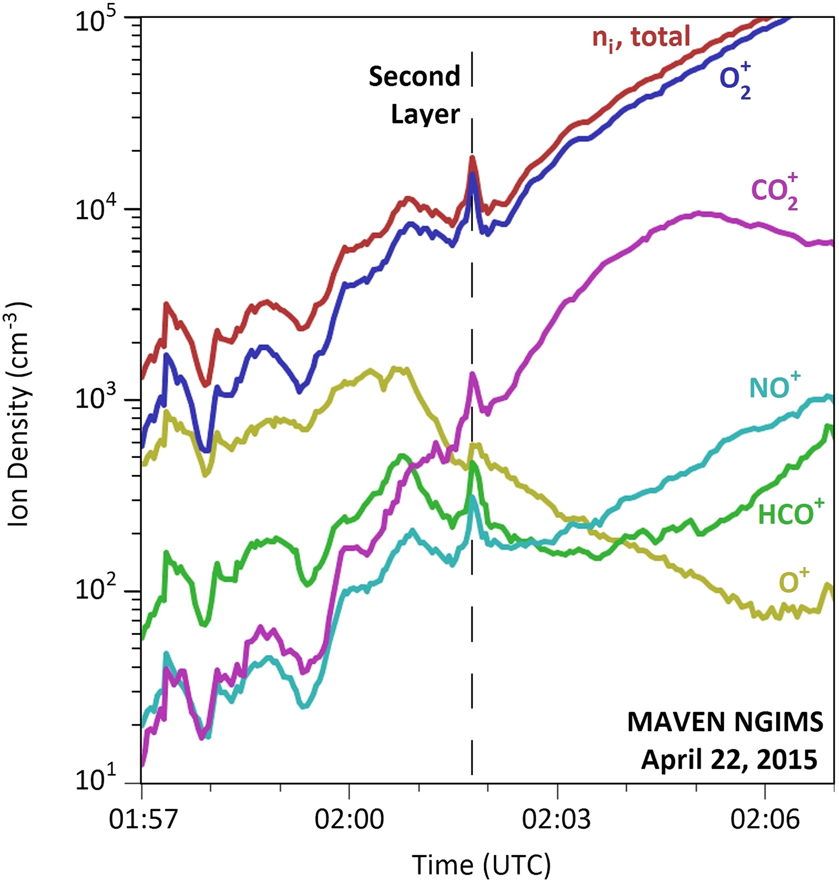
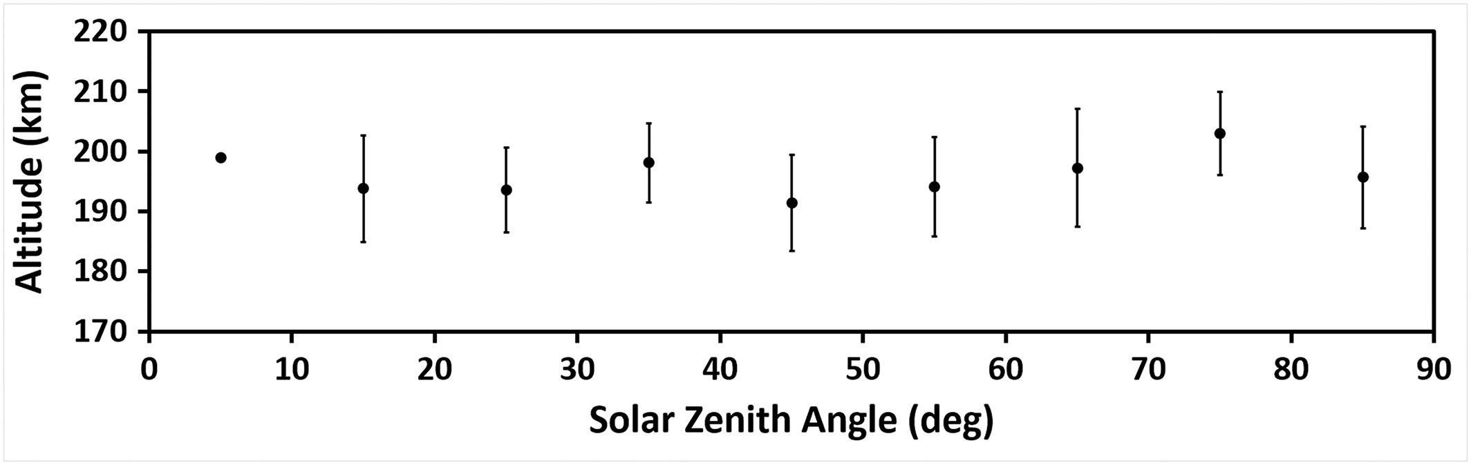
Topside Layer - Conjunction Observation
Layer observed in electrons and ions
Ion data shows increase in all except O⁺
MAVEN observations [Kopf et al., 2017] correlate well with previous MARSIS studies
Some evidence of current structures in magnetometer observations

Slide 18
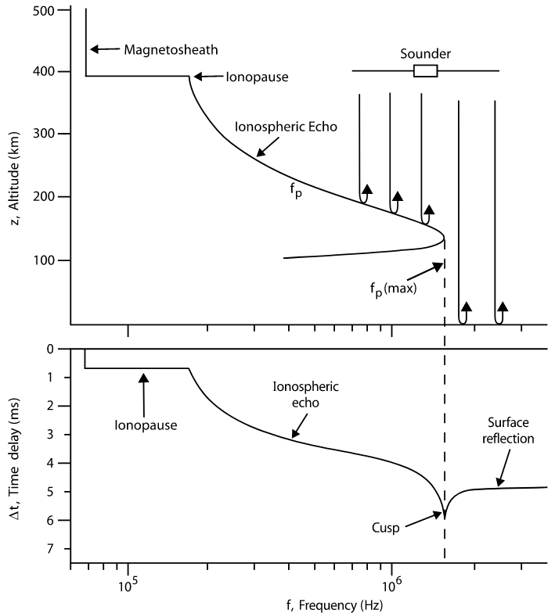
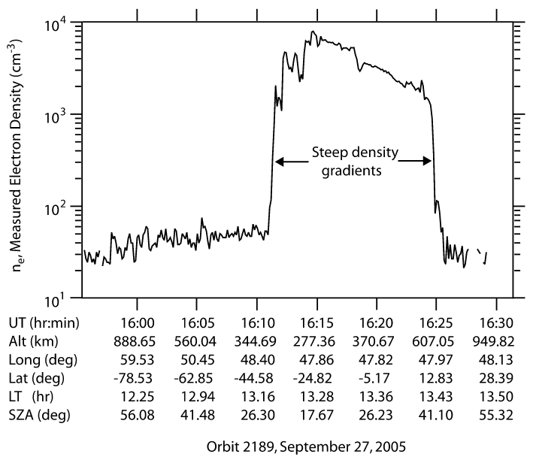
TRANSIENT IONOPAUSE – DENSITY GRADIENTS

Slide 19
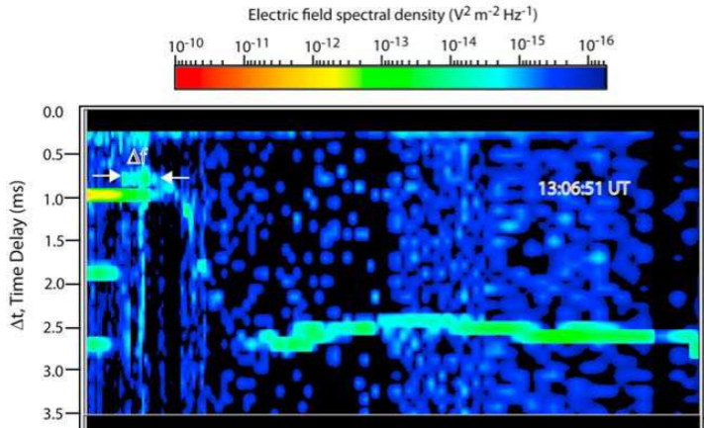
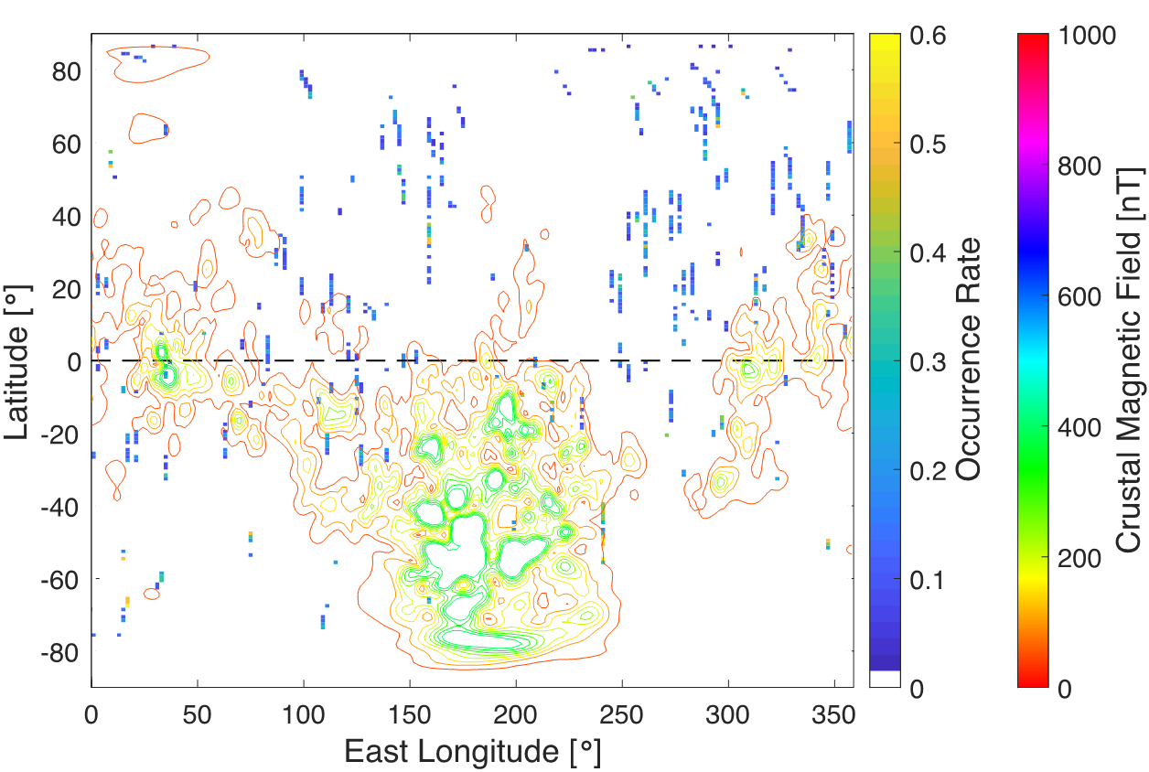
Radar Detections of Martian IONOPAUSE
MARSIS radar is capable of directly seeing echoes from the ionopause boundary
Detections made at all dayside solar zenith angles
Normalized occurrence rate reveals tendency toward detections away from crustal field regions (right)
Preliminary figure from Feng Chu
Preliminary figure from Feng Chu

Slide 20
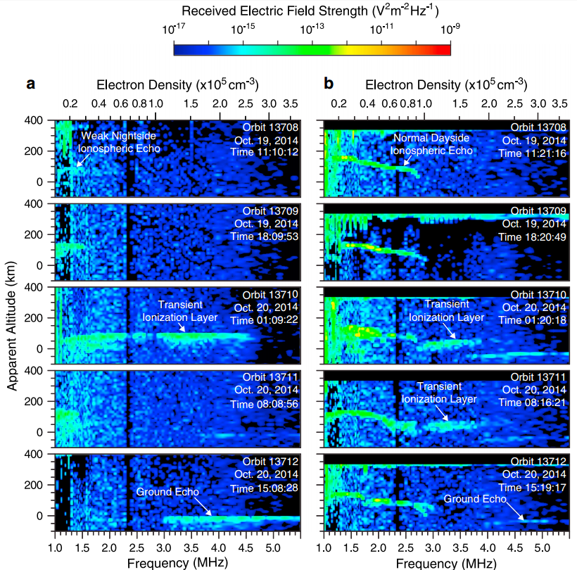
Comet layer
In late 2014, comet Siding Spring flew within 135,000 km of Mars at a velocity of 56 km/s. Due to the high speed, dust impacts had the potential to strongly ionize the upper atmosphere.
Generated a transient layer at 100 km, with density up to 2.6 x 10⁵ cm⁻³. This is the highest ever seen on the nightside.
Layer present on dayside as well, at a slightly lower density (1.8 x 10⁵ cm⁻³), but still larger than the main layer.
Lasted between 14 and 21 hours.

Slide 21
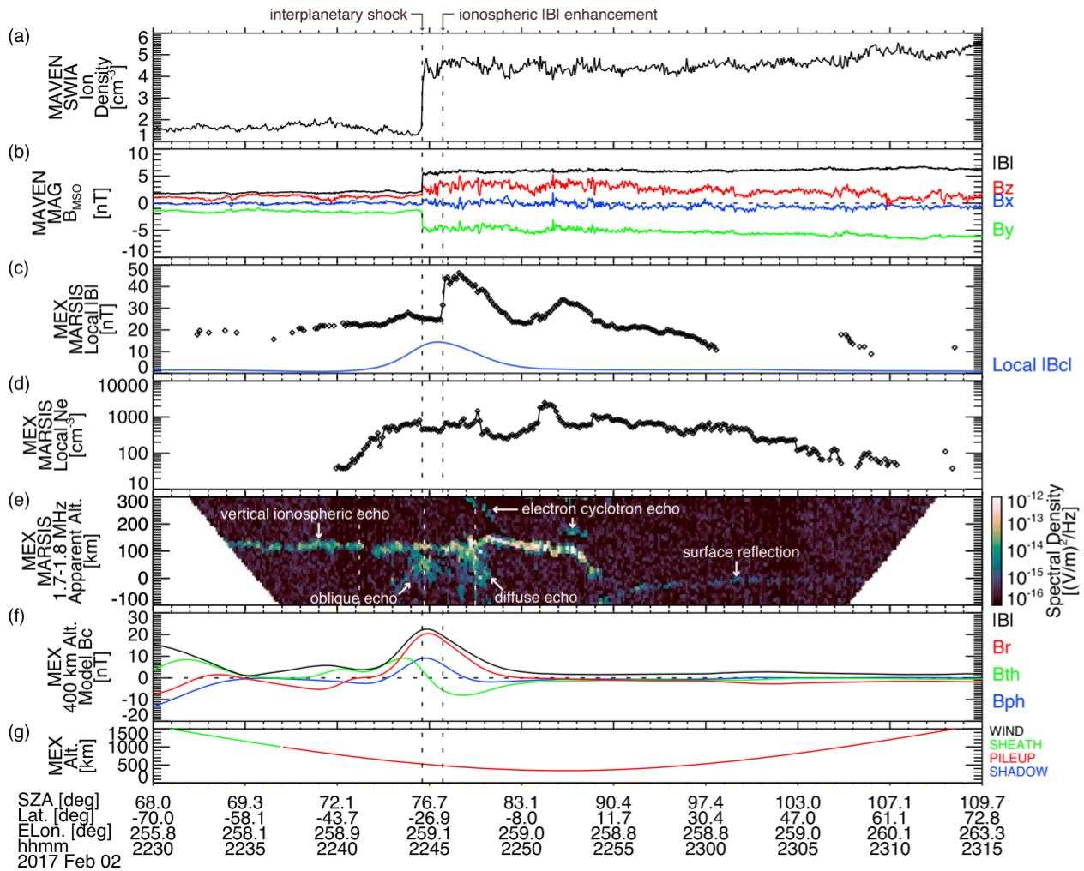
A Shock Hits Mars
Dual spacecraft observation using MARSIS and MAVEN instruments.
Shock first hit MAVEN, in the upstream solar wind, reached MEX a minute later, as MEX was in the ionosphere.
Shock created a very disturbed and diffuse ionosphere, along with sharp changes local to the spacecraft.
Figure from Harada et al., JGR, 2017

Slide 22
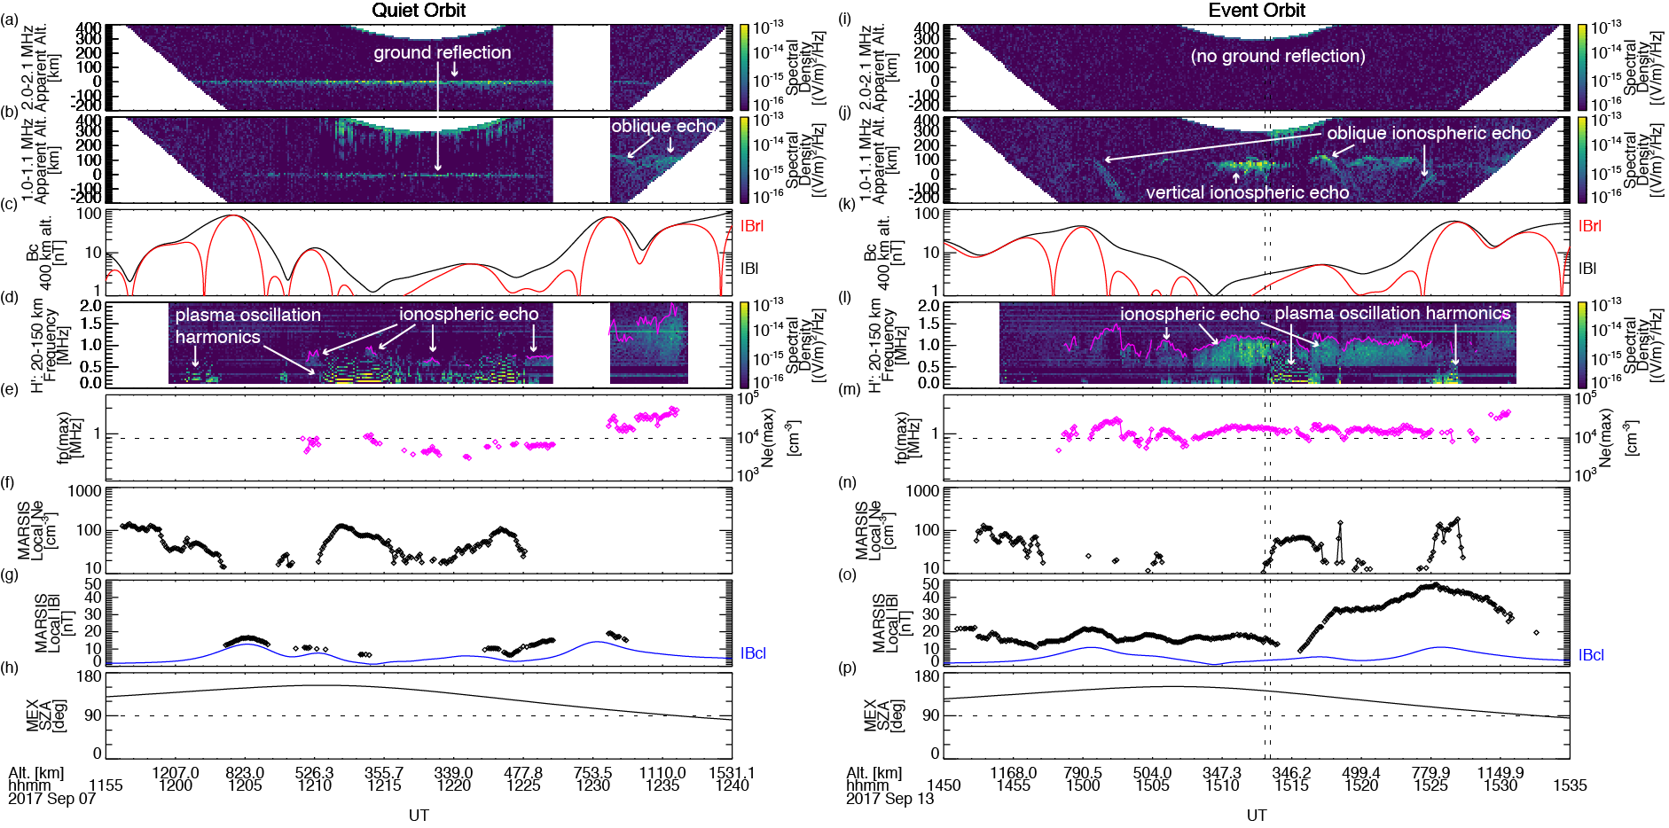
Shock WAVE Effects on Nightside
1
1. Disappearance of ground reflection
2. Increased peak electron densities
3. Enhancement in induced magnetic fields
2
3
Figure from Harada et al., GRL, 2018

Slide 23
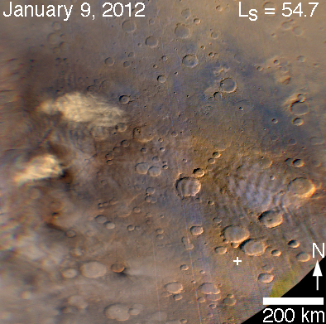
Dust Storms and Lightning
In a follow-up to a previous study, we are analyzing possible lightning events detected by the MARSIS radar.
Several candidate events, but only one of these events has been seen in the vicinity of a dust storm.
No lightning events have been observed during the recent Mars dust storm this summer
Figure from Bruce Cantor, Malin Space, using MRO-MARCI

Slide 24
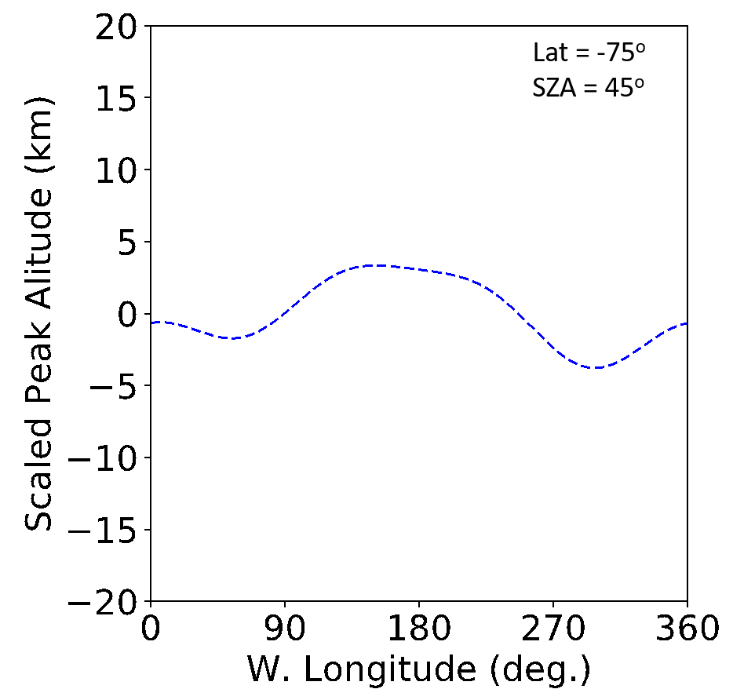
Thermal Tides and Atmospheric Coupling
Longitudinal variations in the peak ionospheric altitude are observed
May be driven by thermal tides in the upper atmosphere
Study would provide constraint on the coupling between the lower and upper atmospheres
Preliminary figure from Zach Girazian

Slide 25
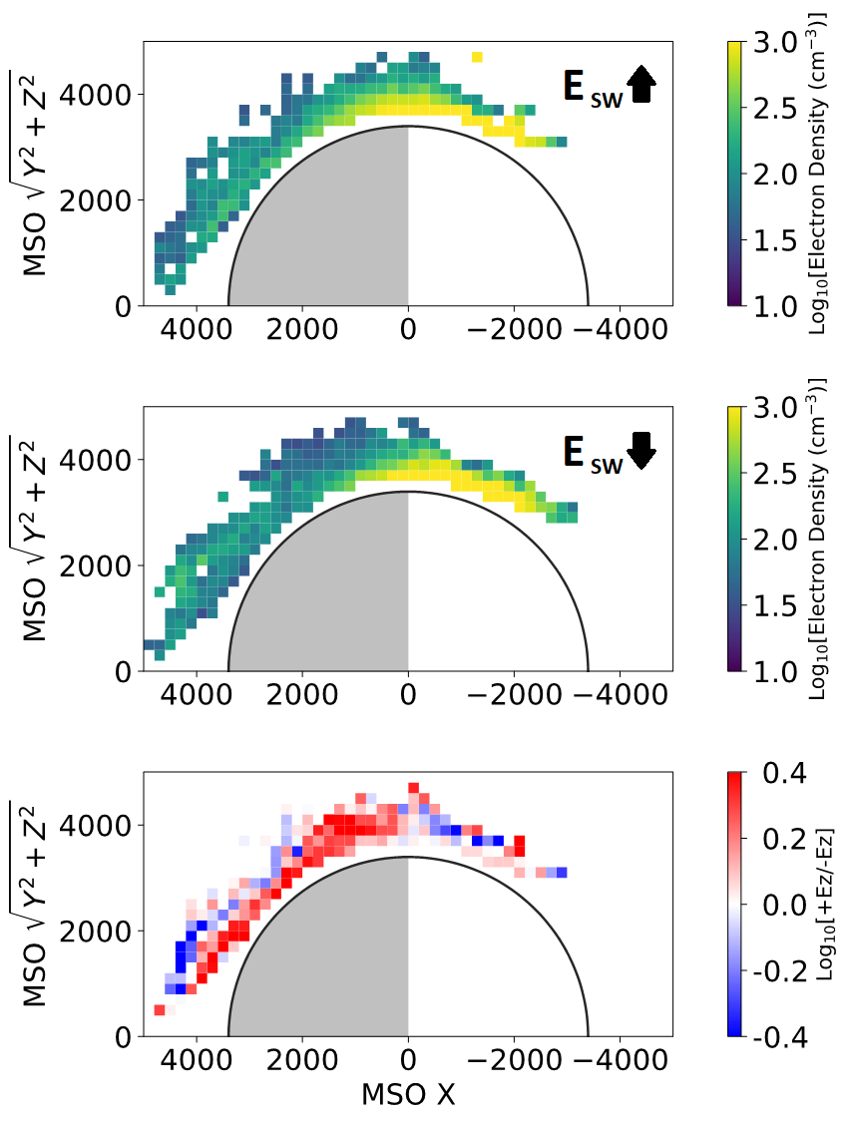
Solar Wind Electric Field
Spacecraft-local electron densities are affected by the orientation of the solar wind electric field
(E = -v x B)
Higher densities are seen on the nightside with an +Z electric field orientation (bottom panel)
Preliminary figure from Zach Girazian

Slide 26
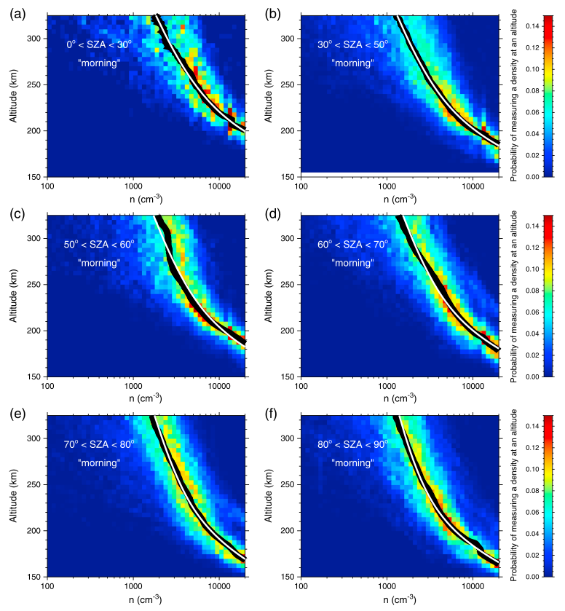
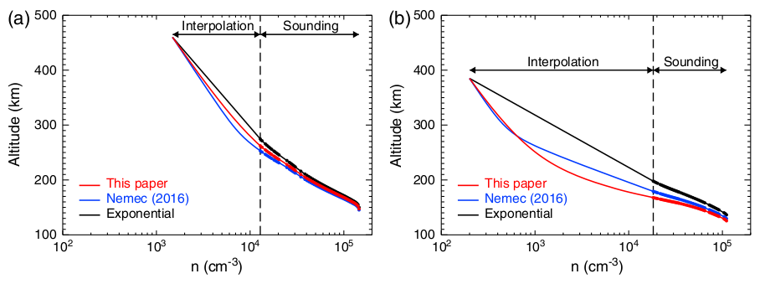
NEMEC MODEL & INCLUSION of MAVEN-LPW
Model by F. Nemec uses interpolation to fit “gap” between MEX and first MARSIS sounding echo
Analysis of in situ LPW data allows for update to the model using actual measurements as a basis for the interpolation, to complement the existing MARSIS ionospheric traces
Figures from Nemec, et al., JGR (2017)

Slide 27
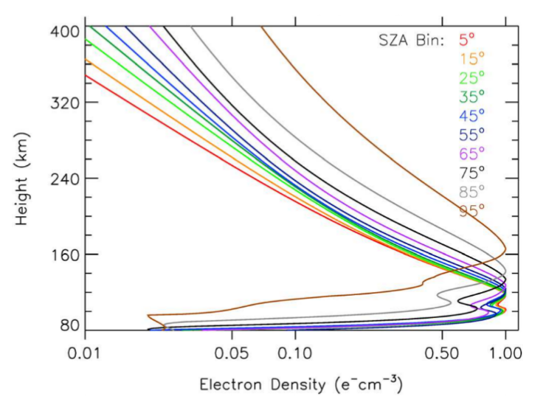
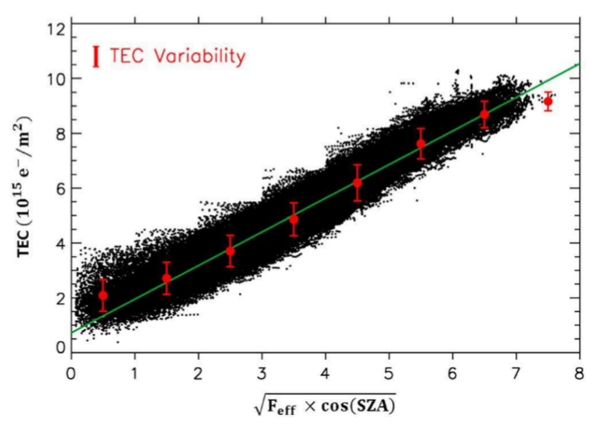
UPDATE TO MIRI MODEL WITH MEX, MAVEN, MRO
Mars Initial Reference Ionosphere (MIRI) model provides estimates of key parameters of the Martian ionosphere and dependence on solar drivers
Analysis used 215,000 MARSIS peak densities and derived density profiles
TEC model derived using 126,000 values from MRO-SHARAD
Both validated using MAVEN-ROSE results
Figures from Mendillo, et al., JGR (2018)

Slide 28
SUMMARY
MARSIS has produced a wide range of scientific results, including some that were arguably not expected from the instrument
Opportunities for multi-spacecraft studies have opened up since the arrival of MAVEN in 2014
The instrument is still in great health with little to no degradation
Exciting new results still yet to come… stay tuned!

