Slide 1
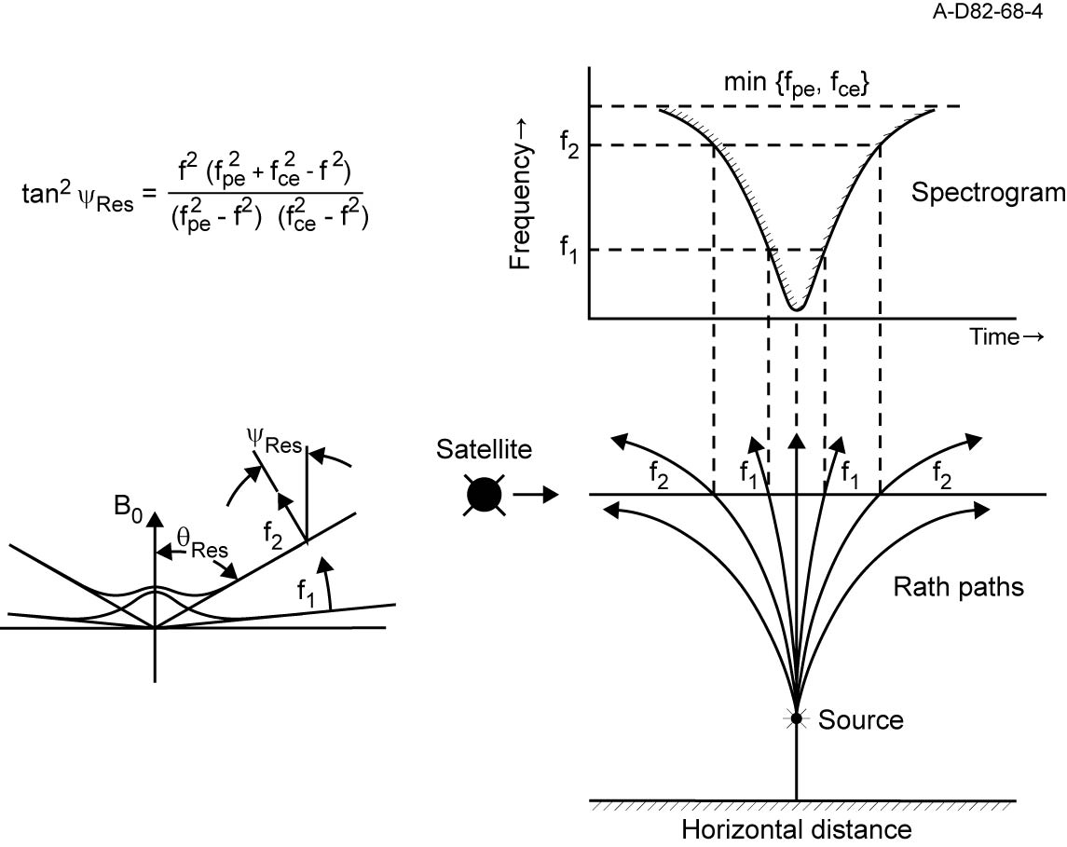
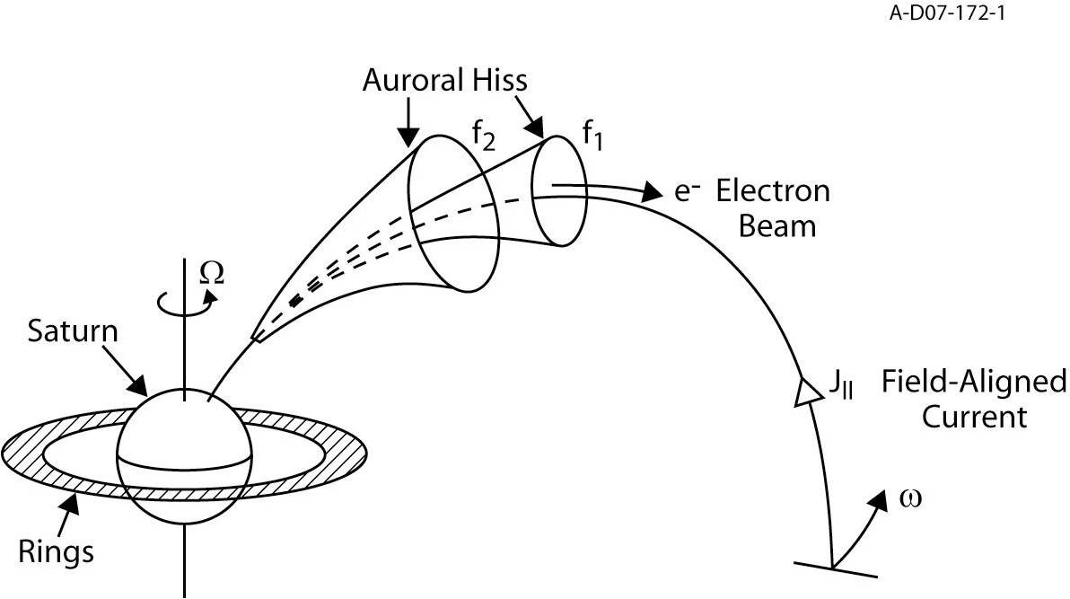
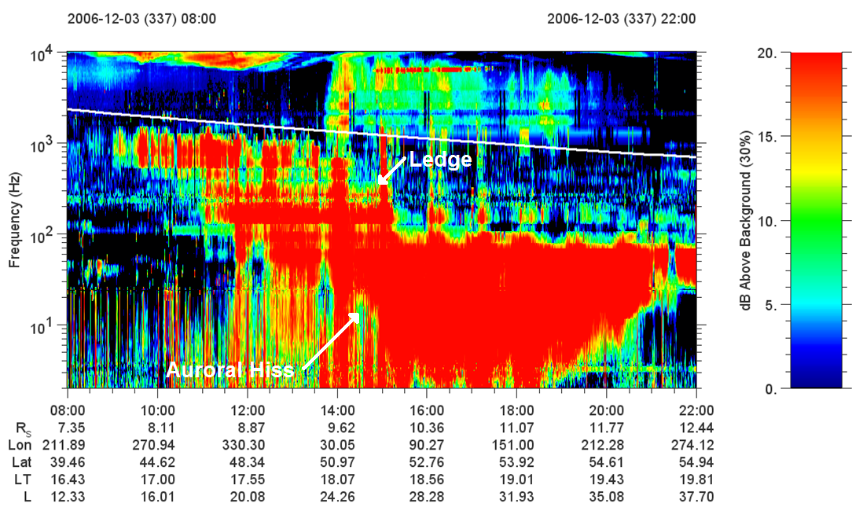
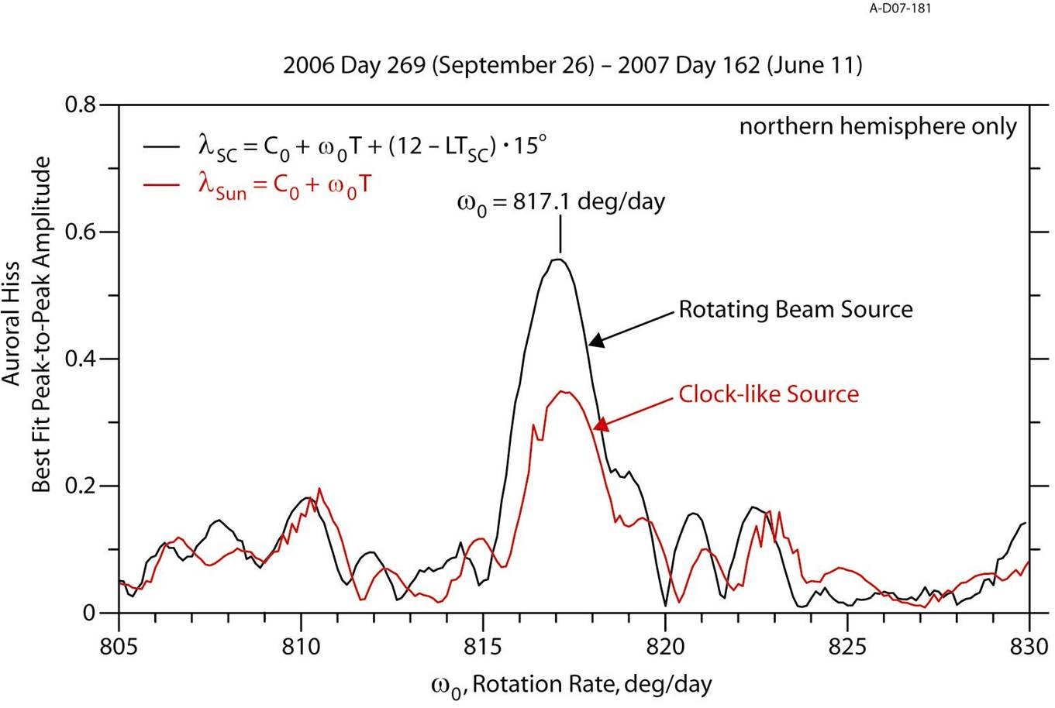
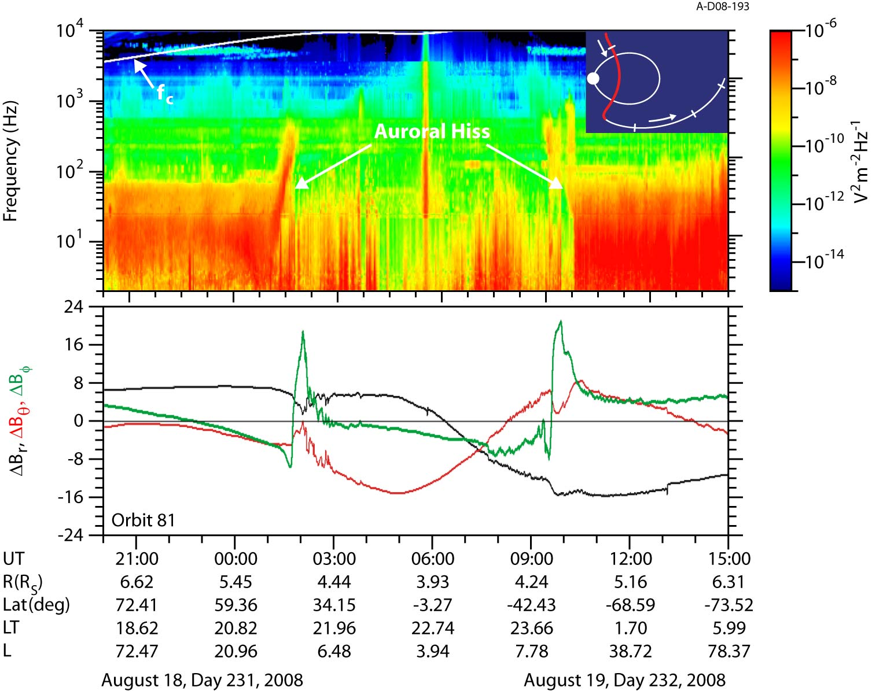
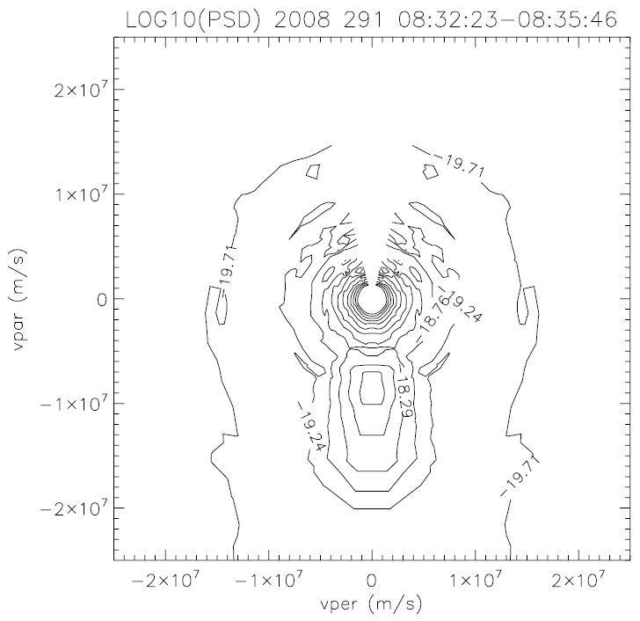
AURORAL HISS AT SATURN – A MULTI-INSTRUMENT STUDY
A.J. Kopf, D.A. Gurnett, G.B. Hospodarsky, W.S. Kurth, M.K. Dougherty, D.G. Mitchell, J.S. Leisner, K.K. Khurana, S. Grimald, C. Arridge, P. Schippers, N. Andre, and A. Coates
INTRODUCTION
Over the last two years, the Cassini spacecraft has undergone a series of high inclination orbits, allowing investigation and measurements of the Saturnian auroral zone. The Radio and Plasma Wave Science (RPWS) Investigation has detected low frequency funnel-shaped whistler mode emissions along the auroral field lines, much like the auroral hiss observed at Earth. The poleward and equatorward flaring of the auroral hiss funnel on the frequency-time spectrogram is the result of whistler mode waves propagating upward into a region of diminishing plasma density. These detections are important in understanding the auroral processes occurring at Saturn. Integration of RPWS data with that from other instruments, including MAG and MIMI, reveals a more complete picture of this emission, demonstrating the field, currents, and particles involved with this emission. Early analysis of this multi-instrument study will be presented.
THEORY OF GENERATION AND PROPAGATION
Auroral hiss is a plasma wave emission which frequently occurs in high-latitude regions of planetary magnetospheres. Auroral hiss is known to propagate in the whistler mode,
as the frequency is always above the local proton cyclotron frequency but beneath both the electron cyclotron frequency and electron plasma frequency. Whistler mode waves
are the only plasma waves that can propagate in this range of frequencies. On a frequency-time spectrogram, this emission displays a characteristic funnel shape with a V-shaped
low-frequency cutoff. The emission’s V-shaped nature is explained by emission from a localized source propagating near the resonance cone, as shown in Figure 1.
The resonance cone is defined as a cone of angles with respect to the magnetic field where the index of refraction goes to infinity, and denotes the region around the magnetic
field line in which the emission is restricted to propagate. This boundary is a property of the index of refraction. A diagram of this is shown in the lower left diagram of Figure 1.
As the k-vector deviates further from the magnetic field direction, it approaches an angle where the index of refraction asymptotes to infinity, which is defined as the resonance
cone angle. This condition, however, is not uniform for all components of the emission, as the resonance angle is frequency dependent. Lower frequencies will have a smaller
resonance cone angle than higher frequencies. In addition, this emission has an upper cutoff, as the resonance cone angle becomes undefined at either the plasma frequency
or cyclotron frequency. These results imply that as a spacecraft flies through a region of whistler mode emission propagating along the resonance cone, it will encounter higher
frequencies first, and detect lower frequencies only near the midpoint of its pass through this region, yielding the V-shaped signature.
This radio emission, however, is only one part of the larger picture of auroral emissions. Figure 2 shows a basic model for how auroral hiss is generated and how it propagates
as it travels away from the planet. As shown in this figure, the auroral hiss originates from the high-latitude regions of the planet’s magnetosphere, and is produced by upward-
propagating electron beams. To be clear, auroral hiss emissions can actually be produced by either upward or downward propagating electron beams. However, the detection
of such emissions is dependent upon the location of the spacecraft as it orbits the planet. In the case of Cassini, we expect all detected auroral hiss emissions to be upward
propagating, simply due to the distance that Cassini keeps from Saturn over the course of its orbit. As this emission propagates away from the planet, it expands outward along
a conical surface, centered on magnetic field lines. In addition, field-aligned current structures are often observed, generated by the flow of particles in the planet’s magnetic
system, which travel in the opposite direction from the electron beams. Finally, under the assumption that this entire system has the properties of a rotating beam structure,
rotating around along with the planet, this emission should be observed to be periodic in nature.
Auroral hiss is believed to be generated by an accelerated beam of electrons in the high latitude regions of the planetary magnetosphere. The generation of these electron beams
in the auroral regions has been little more than theory until recently, when data from the FAST satellite suggested a quasi-static parallel potential structure in the auroral regions.
Parallel electric fields in diverging electric field structures were found to be accelerating auroral electrons upwards, while converging electric field structures are responsible for
accelerating the downward-flowing electrons that produce the visible aurora. In both cases, these electrons carry the field-aligned currents required and observed in the system.
FIGURE 1
FIGURE 2
AURORAL HISS AT SATURN
Although Cassini arrived at Saturn in the middle of 2004, most all of the first two years were spent at low magnetic latitudes, preventing the observation
of emissions from the auroral region. It wasn’t until late September of 2006 that Cassini was redirected into a more inclined orbit, allowing the study of
these regions. From this point until May of 2007, and again starting in January of 2008, Cassini’s orbit was sufficiently inclined to reach high magnetic
latitudes (>30 degrees), allowing the RPWS instrument to make auroral hiss measurements. As anticipated, once Cassini was in a region where detection
of these emissions was possible, such observations were made.
Figure 3 shows a frequency-time spectrogram of an auroral hiss event observed by Cassini. This spectrogram is characteristic of Cassini observations,
and shows most all of the typical features observed in this frequency range. This event clearly displays the typical funnel shape spectrum generally
observed with auroral hiss, the characteristic signature of this emission, as a result of its resonance cone propagation. One other feature that should be
noted in the spectrogram in Figure 3 is the ledge-like step that occurs at roughly 14:00 UT. This step is also a characteristic feature observed in RPWS
spectrograms. The step is always oriented such that the emission can be observed at higher frequencies on the equatorward side of the emission, but
then displays a step down with increasing latitude. Since the emission in the higher latitudes displays an abrupt cutoff well below the electron cyclotron
frequency, the electron plasma frequency is assumed to be the lower of the two frequencies, and the one which defines the maximum frequency of the
emission in these cases. It follows that the observed step reflects a sudden drop in the density on the order of two orders of magnitude. This is generally
explained by suggesting the presence of a plasma cavity, which was commonly observed at Earth by Dynamics Explorer. In the DE data, the center of the
auroral hiss emissions, that is to say near the magnetic field lines, commonly had significantly lower plasma densities. This feature at Saturn is believed
to reflect the same thing.
FIGURE 3
PERIODICITY
The hypothesized model of a rotating beam source suggests that observations would show a periodicity corresponding to the rotation period of the planet. Indeed, in periods where Cassini has been at high magnetic latitudes for extended durations of time, this periodicity does appear. One surprising observation, however, is that, the periodicity of the auroral hiss do not follow the same periodicity as the SKR.
In order to determine an accurate periodicity from the auroral hiss emission, the data were organized using a generic rotating beam source model. In this model, there are only two free parameters, a constant representing the initial longitude at time T=0, and the frequency of rotation of the emission. The frequency was adjusted incrementally, and at each step the quality of the organization of the data was determined. The frequency which best organized the data was 817.1 degrees per day, corresponding to just less than 10.6 hours for a planetary rotation rate. This result is shown above in Figure 4.
FIELD-ALIGNED CURRENTS
Field-aligned currents are also expected to be present in these regions. Since auroral hiss propagates around magnetic field lines, theory suggests currents would be observed consistently in correlation with the radio emissions. We look for variations in the B_{φ} component, as a current flowing parallel to the direction of propagation of the radio emission would induce a magnetic field that wraps around the field-aligned current.
Figure 5, showing both RPWS and MAG data, displays an example of how these field-aligned currents correlate with the radio emission. It is very common to see these current structures in conjunction with the radio emission, to the point where it is more curious when they are not observed. What has come as a bit of a surprise, however, is that these current structures are not observed at the center of the radio emission, but rather at the equatorward edge.
ELECTRON BEAMS
The final aspect of auroral hiss emissions is particle beams, particularly electron beams. In order to explain auroral hiss emission at Saturn, it is necessary to identify electron beams that appear in conjunction with the radio emissions, and then determine if these beams are sufficient in velocity and energy to produce the observed radiation.
Figure 6 shows a contour plot of ELS data, which was chosen specifically for the appearance of an electron beam. This beam can be clearly identified in the region where the parallel velocity is of order -1x10⁷. As one would expect, this beam correlates well with whistler-mode emission observed in the RPWS spectrograms, though once again appears to be on the equatorward edge of the radio emission, in this case in a region of burst-like, non-funnel-shaped emission.
FIGURE 4
FIGURE 5
FIGURE 6

