Slide 1
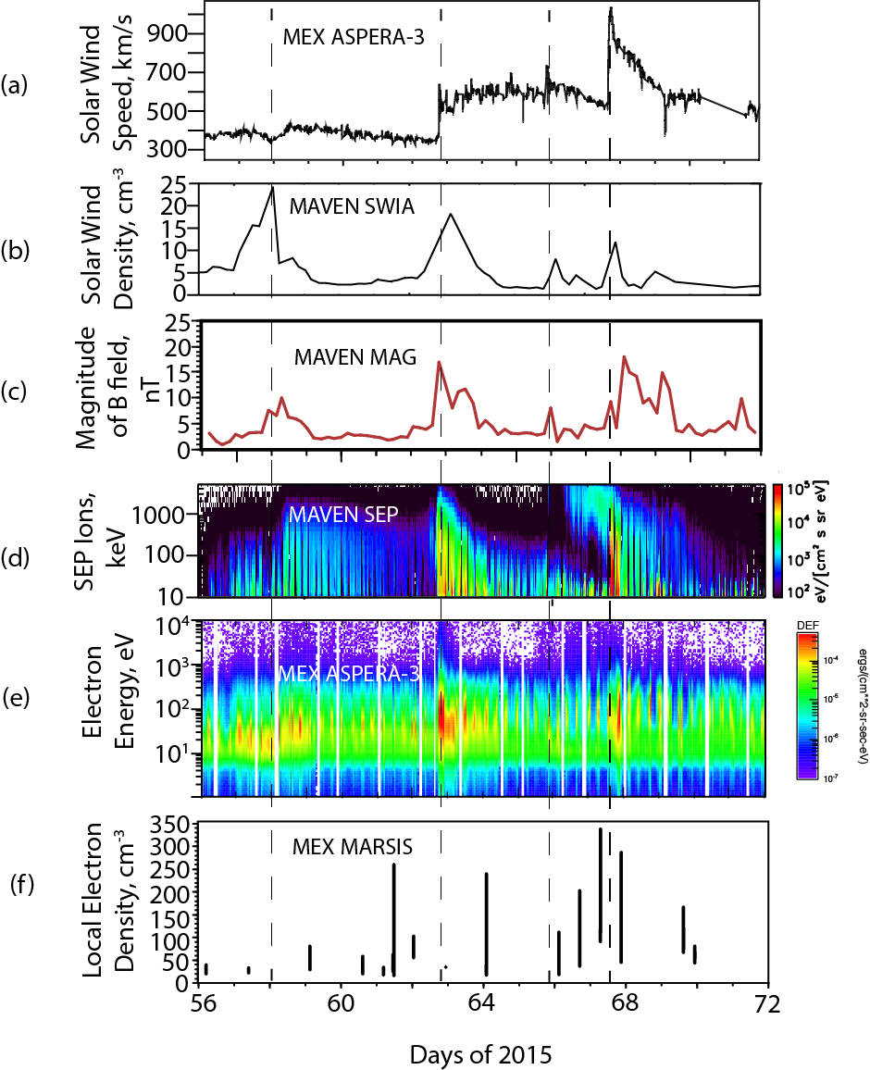
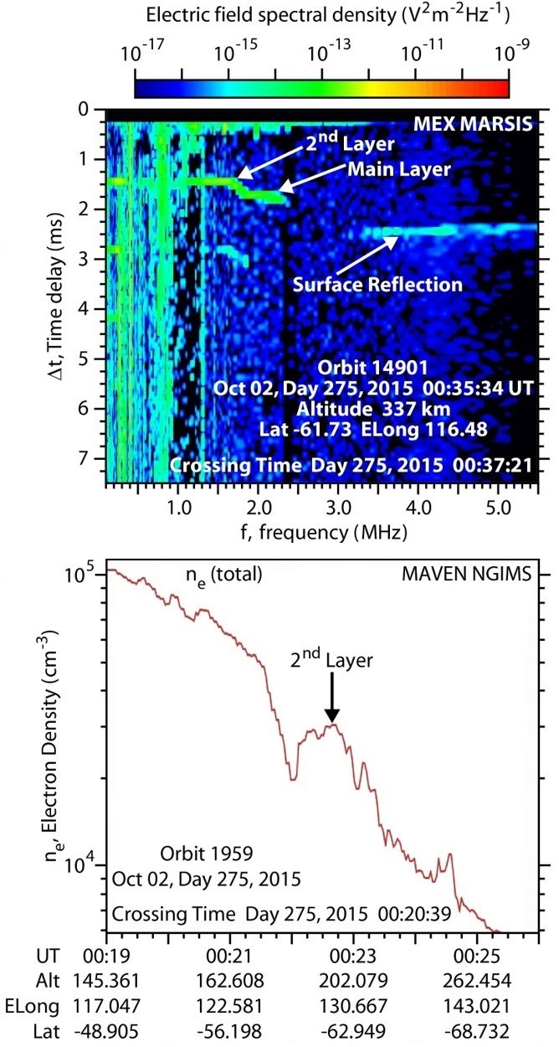
Recent MARSIS-AIS Science
F. Duru studied an ICME event with multiple instruments
A. Kopf observed the topside layer with MEX and MAVEN

Slide 2
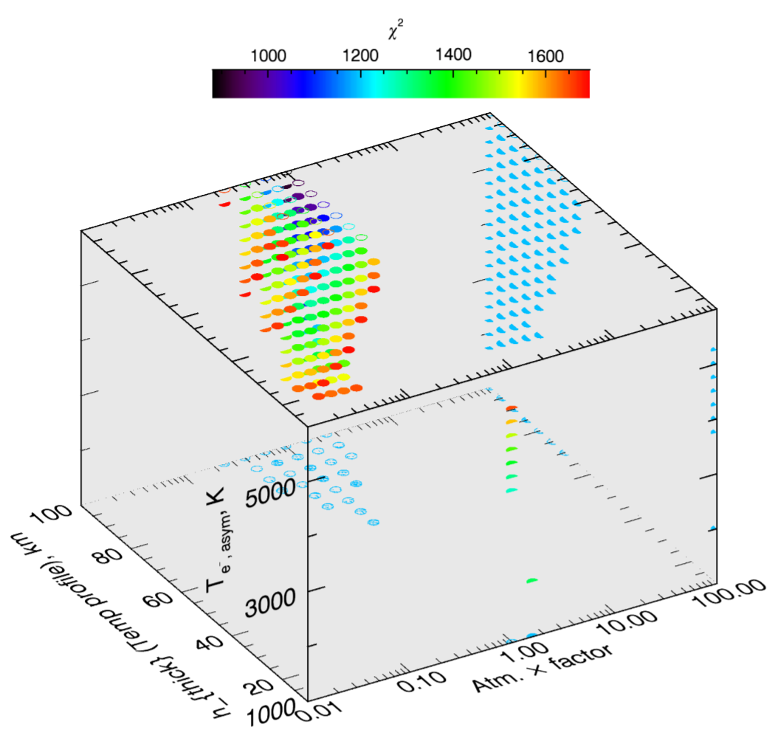
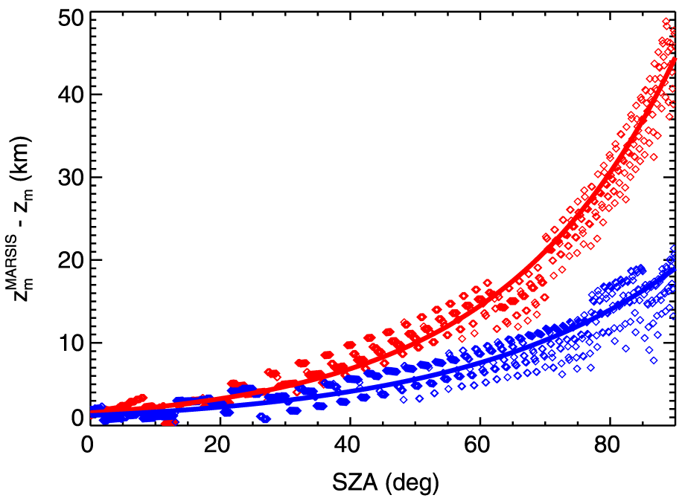
Recent MARSIS-AIS Science
D. Morgan used MARSIS and MarMCET to constrain the night ionosphere and atmosphere
F. Nemec worked to improve the accuracy of MARSIS electron density profiles

Slide 3
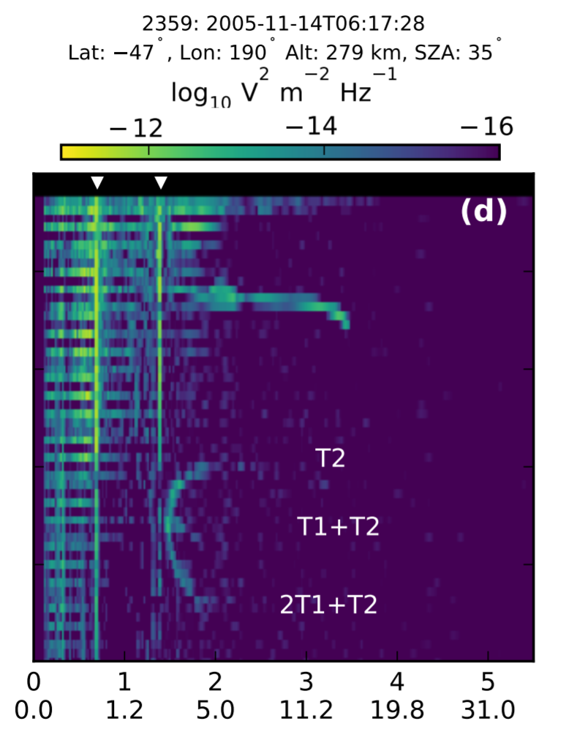
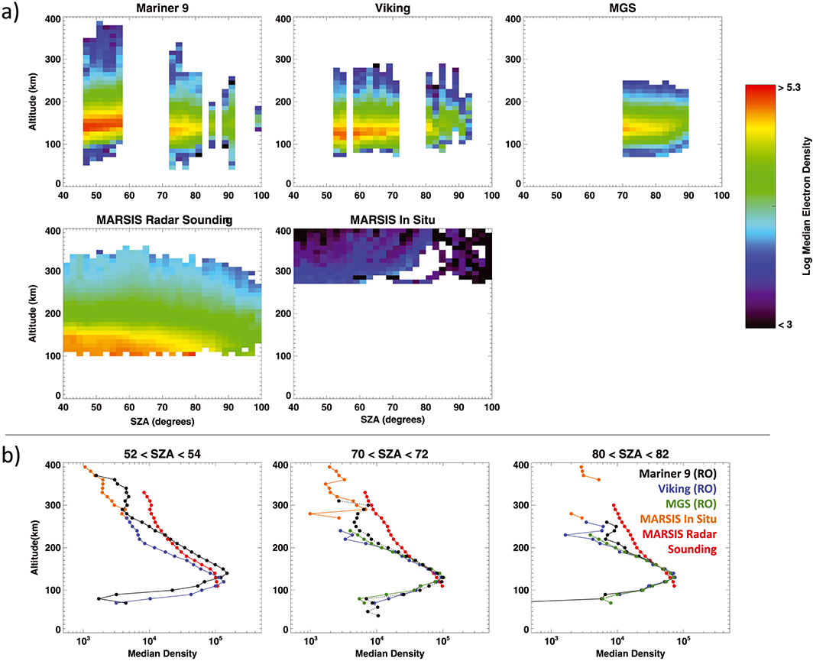
Recent MARSIS-AIS Science
M. Vogt compared MARSIS profiles to radio occultations made by multiple spacecraft
D. Andrews analyzed reflections from field-aligned irregularities

Slide 4
Recent MARSIS-AIS Publications
Published
Nemec, F., D.D. Morgan, and D.A. Gurnett (2016), On improving the accuracy of electron density profiles obtained at high altitudes by the ionospheric sounder on the Mars Express spacecraft, J. Geophys. Res. Space Physics, 121, doi:10.1002/2016JA023054.
Vogt, M.F., P. Withers, K. Fallows, C.L. Flynn, D.J. Andrews, F. Duru, and D.D. Morgan, Electron densities in the ionosphere of Mars: A comparison of MARSIS and radio occultation measurements, J. Geophys. Res., 121, doi:10.1002/2016JA022987.
Resubmitted following Review
Kopf, A.J., D.A. Gurnett, G.A. DiBraccio, D.D. Morgan, and J.S. Halekas, The Transient Topside Layer and Associated Current Sheet in the Ionosphere of Mars, J. Geophys Res. Space Physics.
Submitted, Under Review
Duru, F., D.A. Gurnett, D.D. Morgan, J. Halekas, R.A. Frahm, R. Lundin, W. Dejong, C.Ertl, A. Venable, C. Wilkinson, J.E.P. Connerney, J.R. Espley, D. Larson, P.R. Mahaffey, J.D. Winningham, and J. Plaut, Response of the Martian ionosphere to a strong ICME on 8 March 2015 resulting in high ion escape rates, Planet. & Space Sci.
Morgan, D.D., C. Dieval, D.A. Gurnett, R.J. Lillis, M.O. Fillingim, and F. Nemec, Constraining Mars’ nightside atmospheric properties with MARSIS ionospheric traces, Radio Science.
Andrews, D.J., H.J. Opgenoorth, T. Leyser, S. Buchert, N.J.T. Edberg, D.D. Morgan, D.A. Gurnett, A.J. Kopf, K. Fallows, and P. Withers, MARSIS radar reflections from field-aligned irregularities in the Martian ionosphere, J. Geophys. Res. Space Physics.

Slide 5
MARSIS AIS Timing Issue
The AIS sounding cycle consists of a sounding pulse followed by a blank period, followed then by 80 receive windows. The pulse is 91.4 µs long, as is each window.
The time between the end of the pulse and the start of the receive window was the erroneous interval.
Originally believed that this interval was 162.5 µs (253.9 µs from pulse start time). It was discovered that this interval was too long by fitting spacecraft altitude with the apparent range of the surface reflection

Slide 6
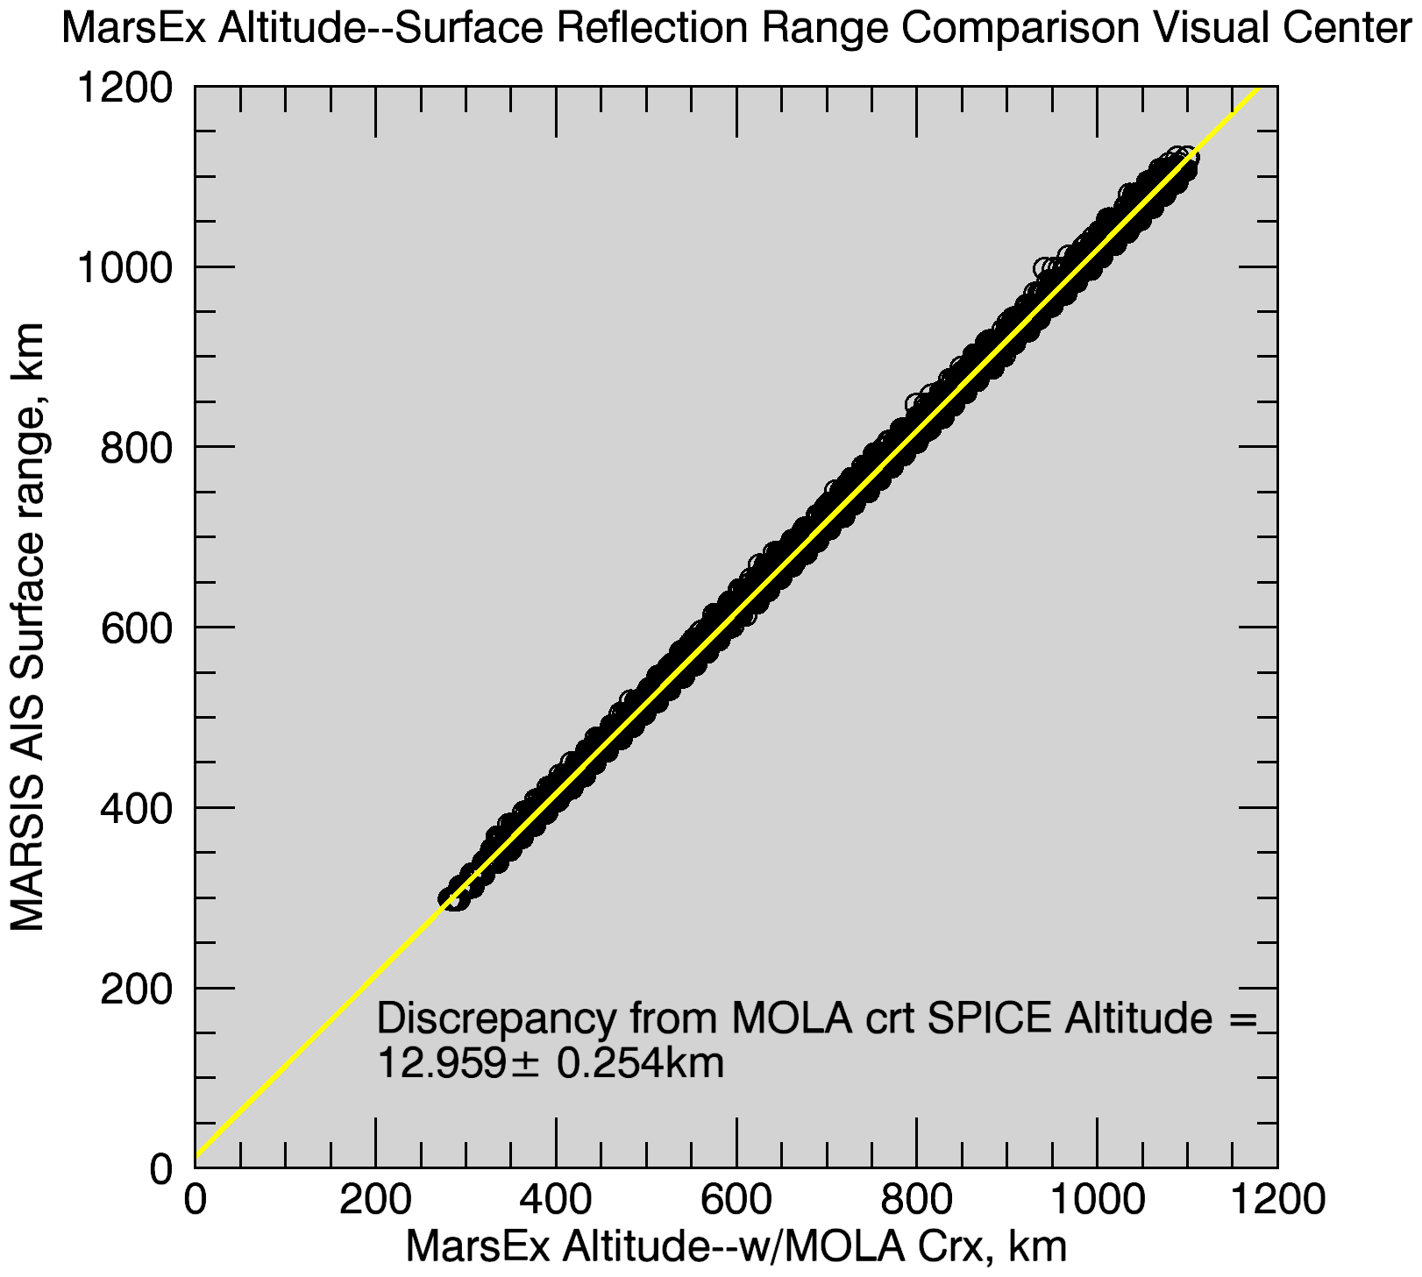
MARSIS AIS Timing Correction
5845 surface reflection traces over 62 orbits were fit to study this error.
MEX altitude was computed from SPICE radial distance from planet center, corrected with MOLA elevations.
Fit yields time from start to receive is 167.443 µs instead of 253.9 µs.
This yields an discrepancy in range of 12.96 ± 0.25 km.
This should be subtracted from apparent ranges, or added to altitudes so based.

