Slide 1



An Intro To Mars Express: MARSIS and ASPERA-3

Slide 2
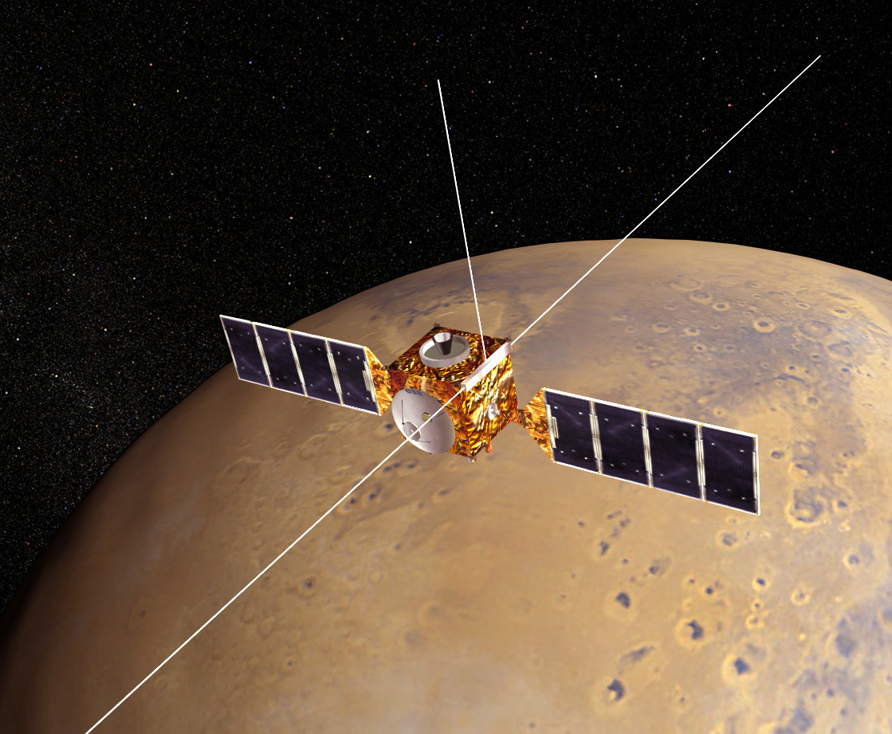
Mars express
Operated by European Space Agency
Launched: June 2, 2003
Mars Arrival: December 25, 2003
Carried Beagle 2 lander, which landed but failed to communicate.
MARSIS Deployed: May 4 – June 10, 2005
MARSIS Science: July 2005 – Present

Slide 3
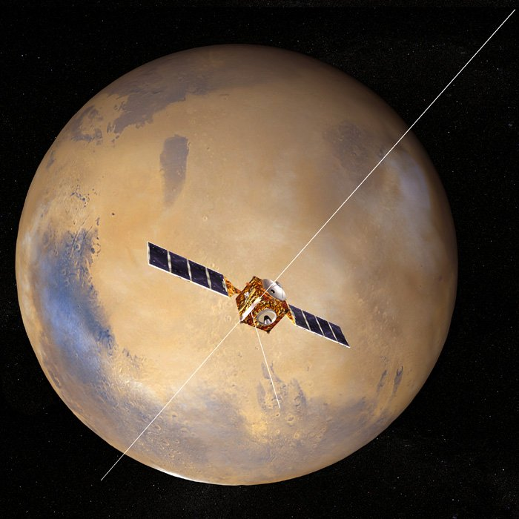
marsis
Mars Advanced Radar for Subsurface and Ionosphere Sounding
Twin 20-meter dipole antennae
7 meter monopole
Capable of operating in two main modes, one for ionospheric science, the other for subsurface radar sounding
For ionospheric sounding, operates from 0.1-5.4 MHz.

Slide 4
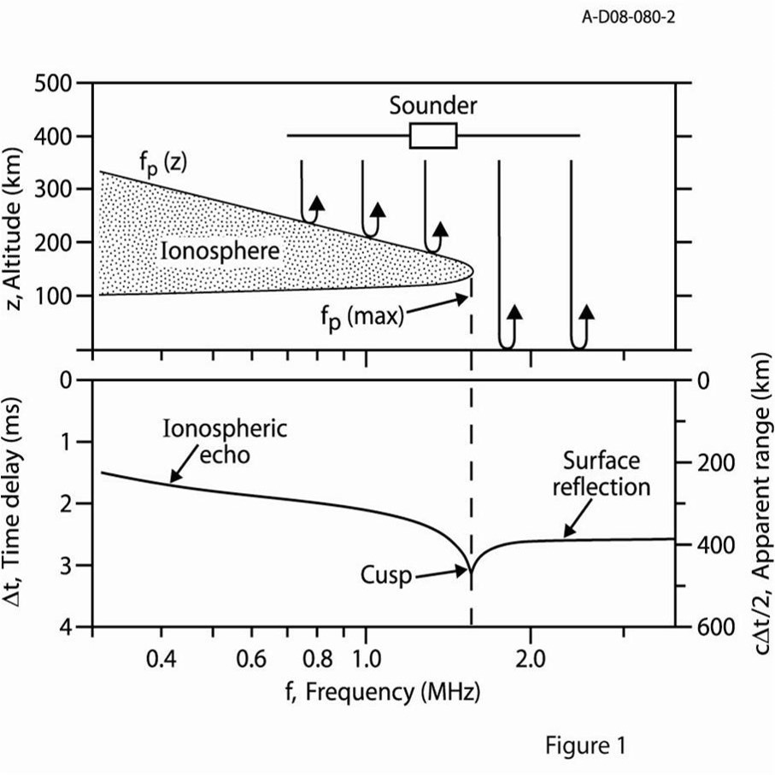
Sounding With MARSIS
MARSIS steps through up to 160 frequencies, emitting a 91us pulse and listening for the echoed signal, repeating every 7.54 sec.
Radio signal can propagate at frequencies above the local plasma frequency
Reflection occurs when the pulse frequency equals the ionospheric plasma frequency.
The main echo comes from the horizontally stratified ionosphere, though others can occasionally be seen.
Cusps appear at density profile maximums.

Slide 5
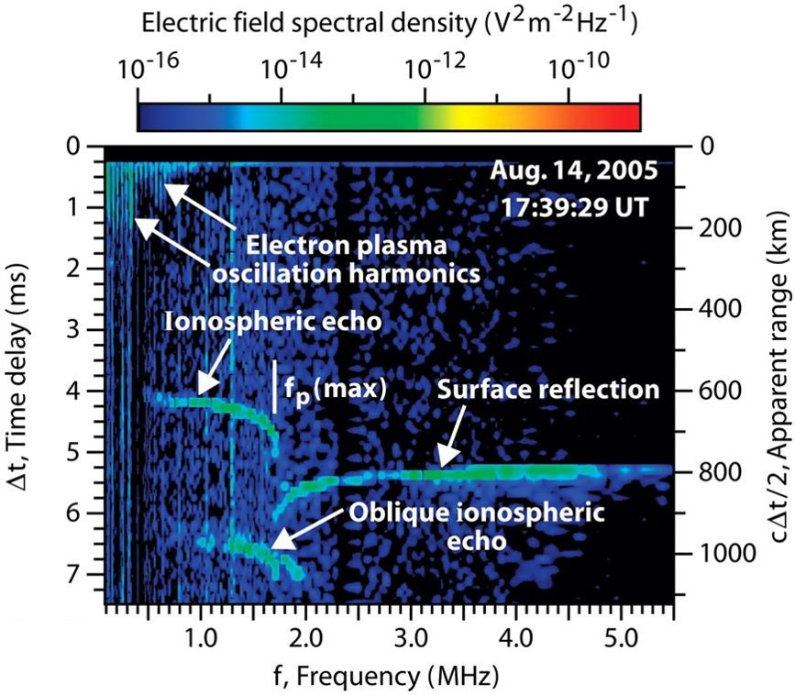
General observations
Ionospheric echo shows altitude profile of the ionosphere
Surface reflection can appear at frequencies above maximum plasma frequency of ionosphere
Other features, such as plasma harmonics, cyclotron harmonics, and oblique echoes are frequently present as well.

Slide 6
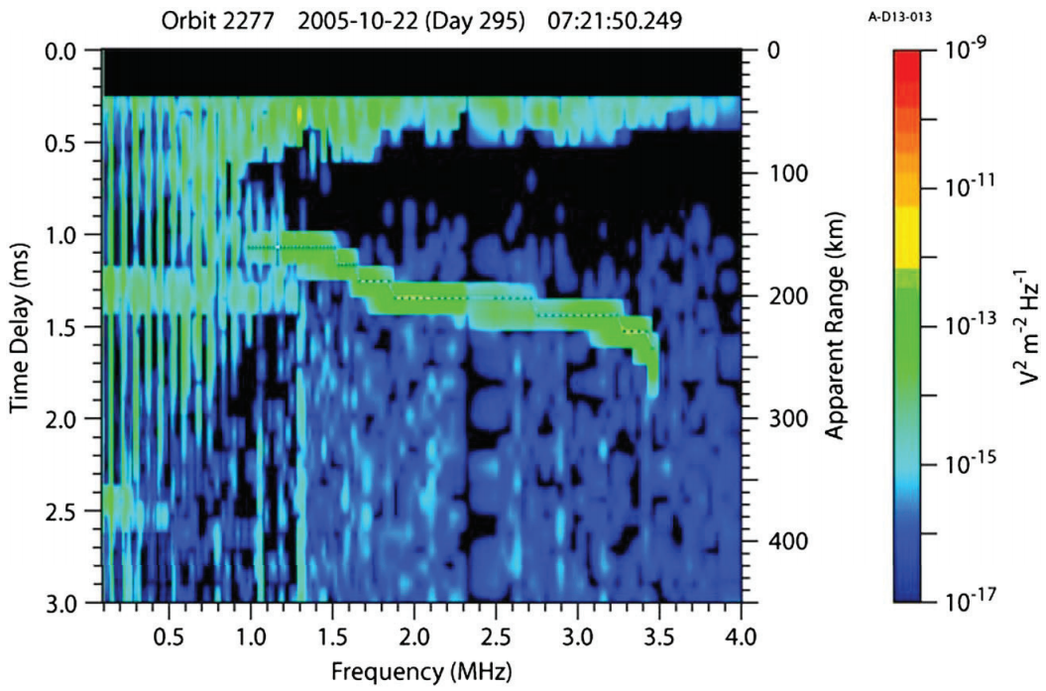
Plasma harmonics
MARSIS also sees harmonics occur as it steps up in frequency. These harmonics are associated with the local plasma frequency, and are seen to vary as the spacecraft orbits Mars.
These harmonics only appear in slower-moving (ionospheric) plasma. Once outside, the faster solar wind plasma is carried away too quickly.
Frequency corresponds to plasma density local to the spacecraft

Slide 7
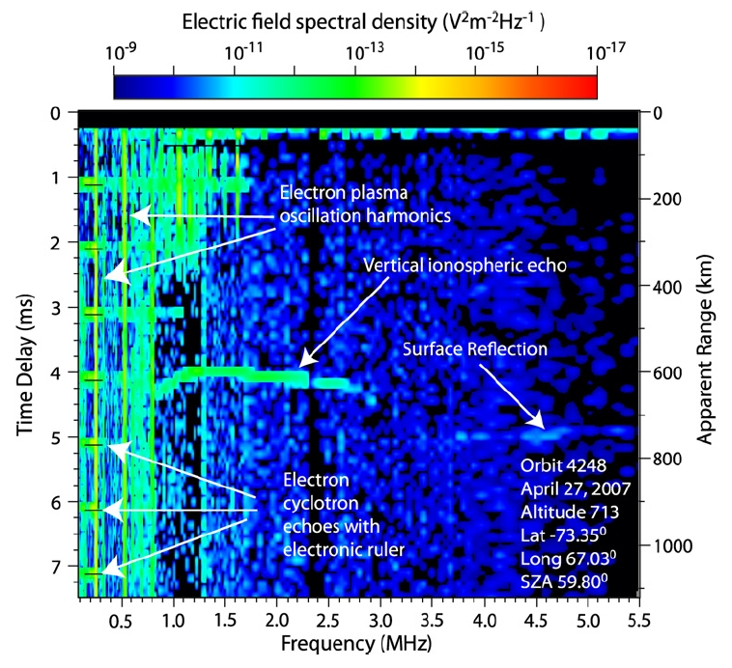
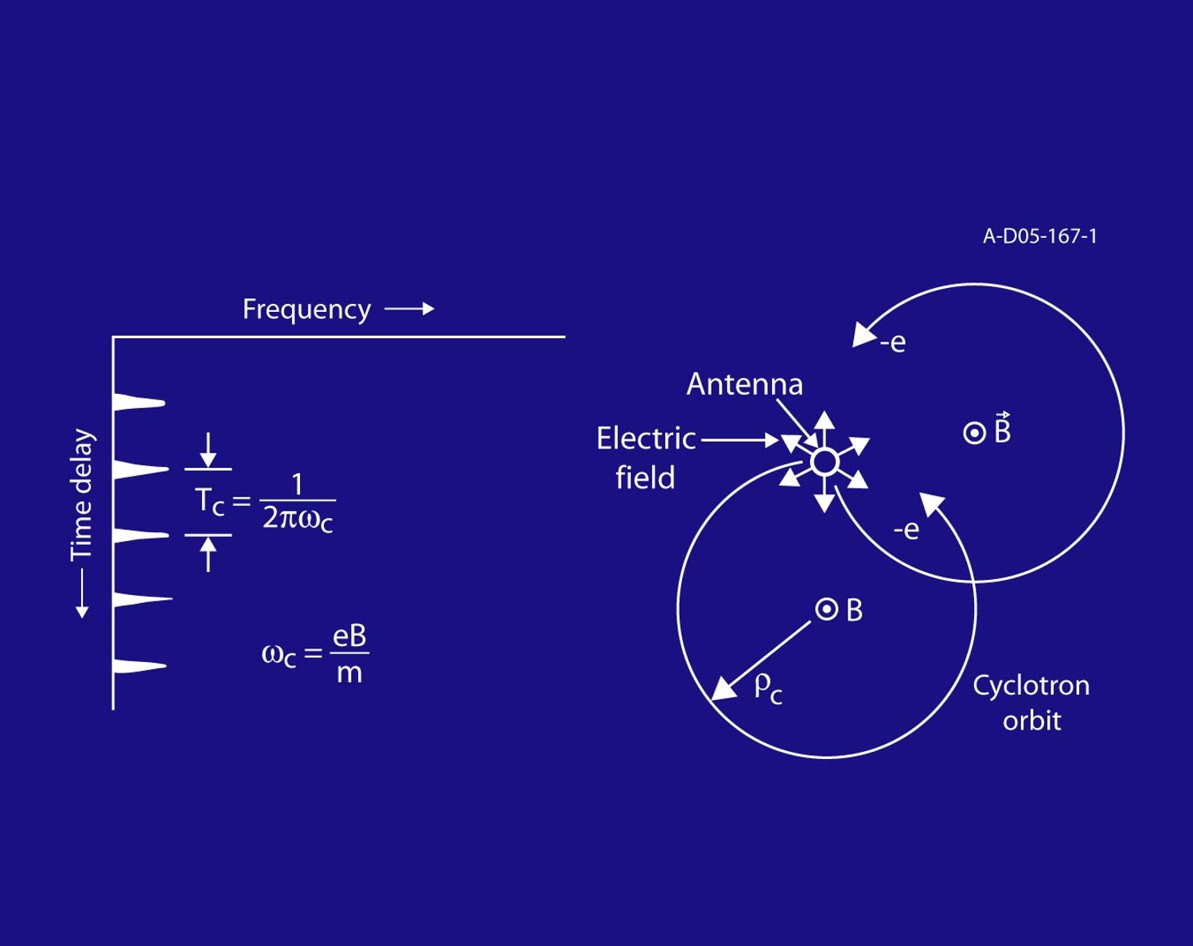
Cyclotron harmonics
Oscillation harmonics can also occur at regular time delay intervals. This has been interpreted as being harmonics of the cyclotron frequency, related to the local magnetic field

Slide 8
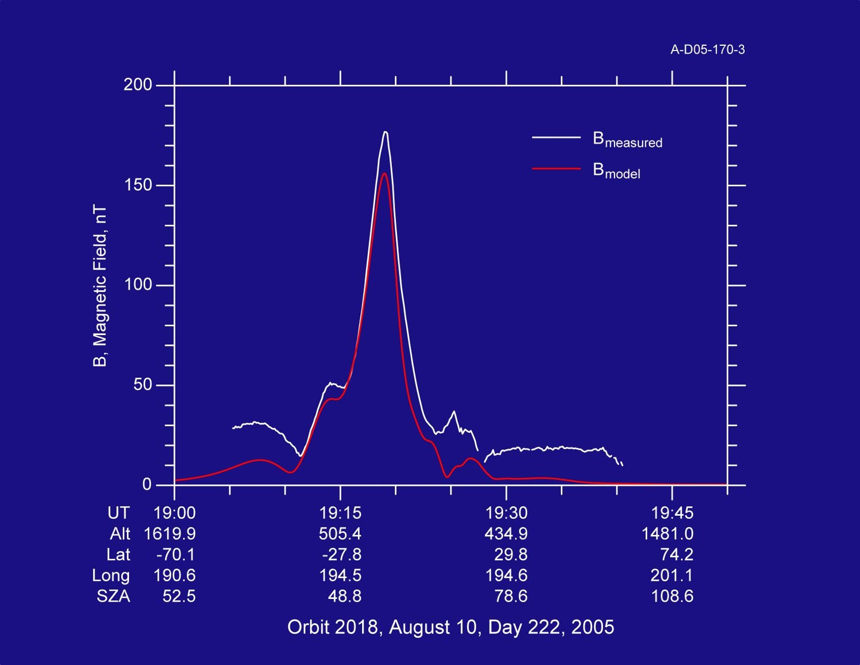
Mars express “magnetometer”

Slide 9
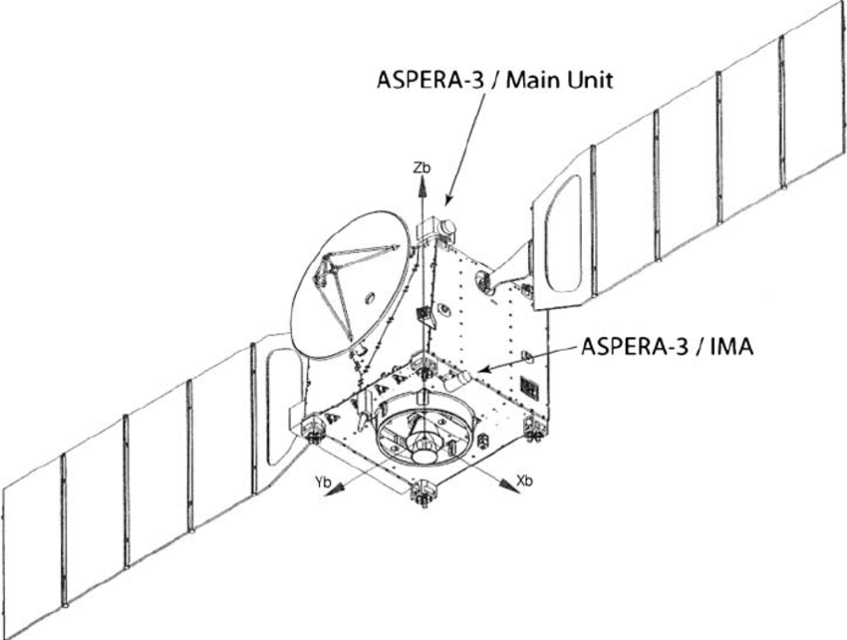
ASPERA-3
Analyzer of Space Plasma and Energetic Atoms
Includes an Electron Spectrometer (ELS), an Ion Mass Analyzer (IMA), and both an energetic Neutral Particle Detector and Imager (NPD/NPI)
Provides both in-situ plasma measurements and analysis of near-Mars space through neutral imaging

Slide 10
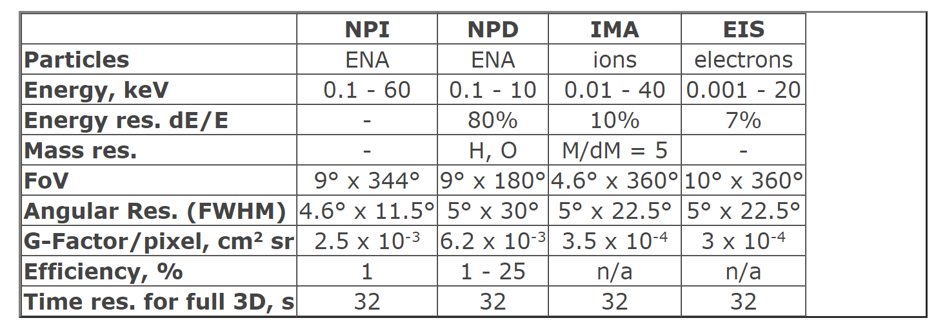
ASPERA-3 Operational Ranges
NPI – integral energetic neutral flux with high angular res., but no mass and energy resolution.
NPD –mass and velocity of hydrogen and oxygen for 0.1-10 keV
ELS – electron distributions up to energies to 20 keV
IMA – major ions and molecular ions from 20-106 amu/q from 100 eV - 40 keV

Slide 11
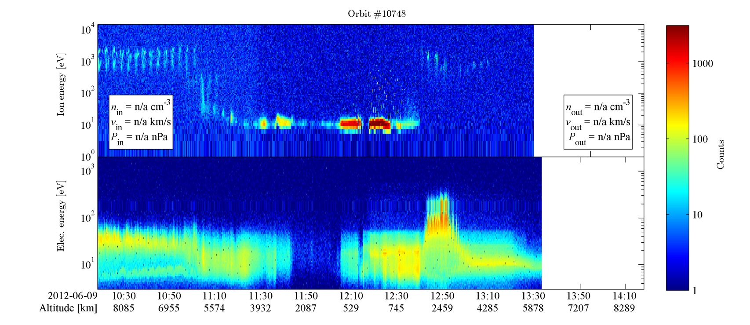
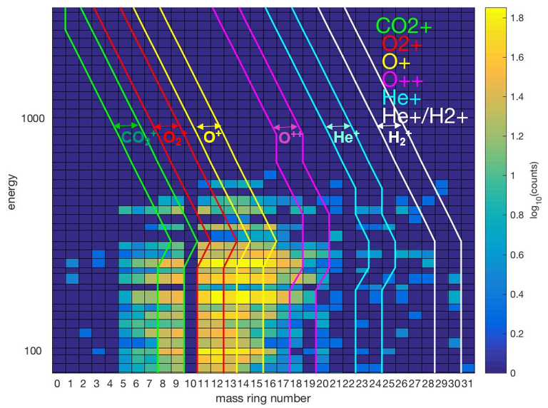
ASPERA-3 Sample Data

Slide 12
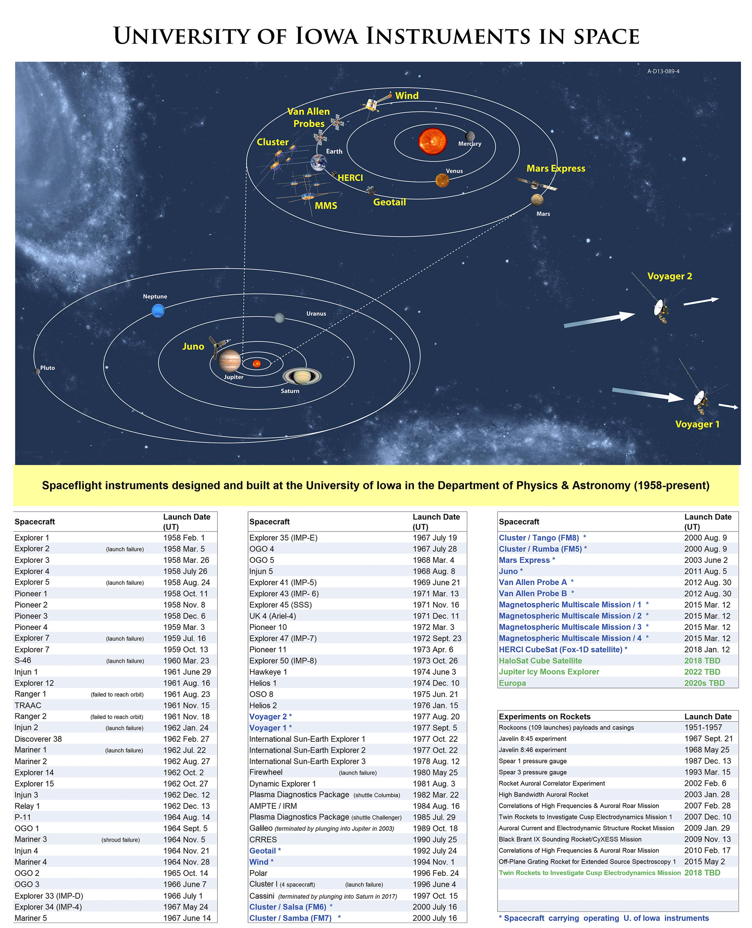
Just The Beginning?
The University of Iowa has a long history of space research dating back to Explorer 1 (1958)
Iowa missions include Mariner, Pioneer, Voyager, Galileo, Cassini, Cluster, and Juno, among many others.
SwRI is also involved with Juno, Jupiter IRTF, and New Horizons as well, among others.
Potential for future integration of these other databases with VESPA in the future.

