Slide 1
Correlated mex-maven observations of transient topside layers in the martian ionosphere
Andy Kopf
With D.A. Gurnett, D.D. Morgan, and J.S. Halekas
Maven psg meeting – June 14, 2016
Special Thanks to J. Connerney and M. Behna

Slide 2
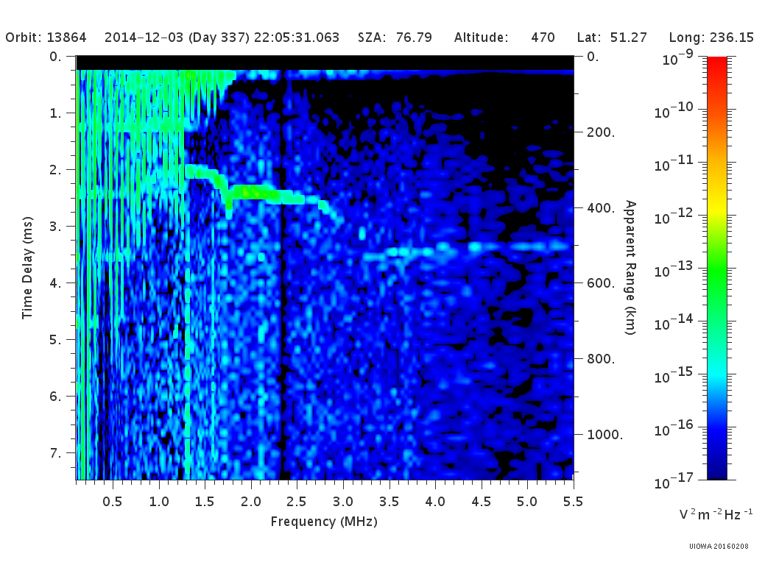
Topside layers from mex-marsis
In an ionosphere where density increases monotonically with decreasing altitude, MARSIS would show a smooth ionospheric trace with a cusp at the peak density of the ionosphere.
In roughly 50% of ionograms, MARSIS shows a second cusp, or at least a step in the trace, indicating a second density maximum at a higher altitude.
Kopf, et al. (2008) showed these to be highly transient, appearing for short time intervals in MARSIS observations, generally under a minute of spacecraft observations.
Origin was unclear, suspected to be instability

Slide 3
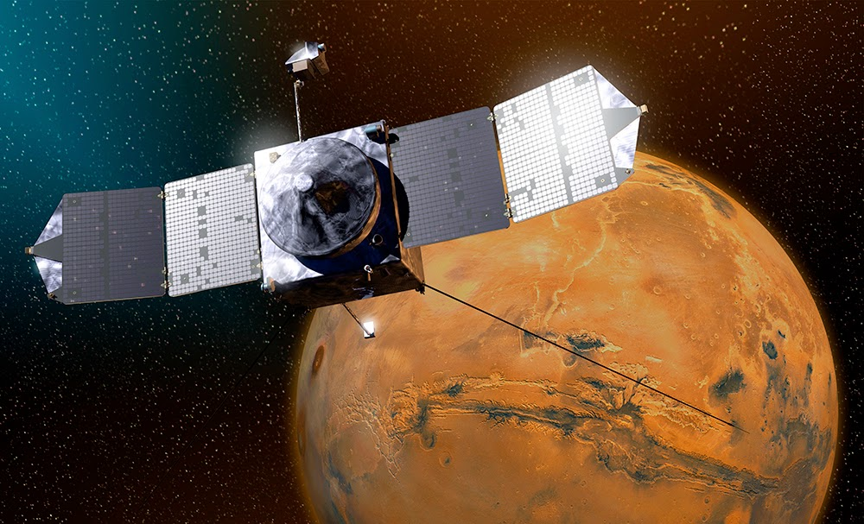
Opportunities for mex-maven collaboration
The addition of MAVEN to the Mars environment allows for dual-spacecraft observation to help finally answer this question.
When MAVEN is outside the bow shock, solar wind monitoring can provide insight into any possible solar effects on the formation of this upper layer.
When the two spacecraft can make nearly-simultaneous observations of the same position, a better view of the layer’s structure can be seen. We refer to these as “crossing orbits”.

Slide 4
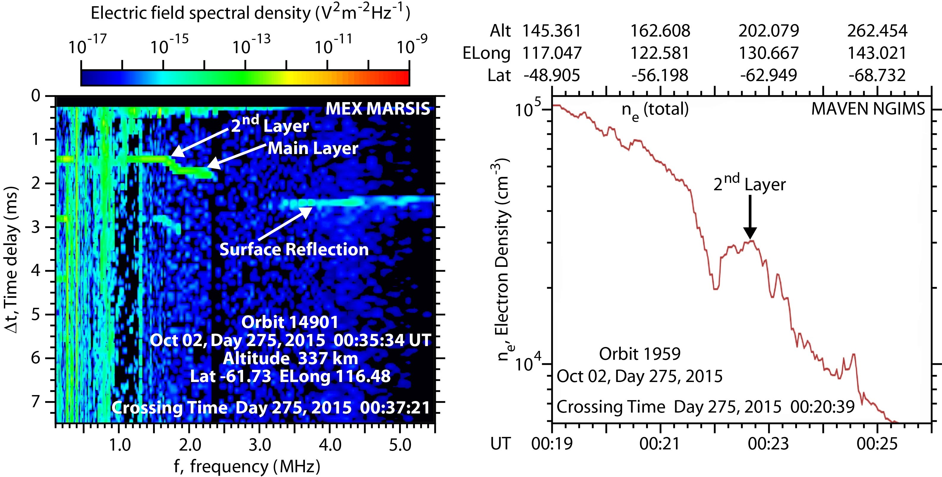
A successful crossing orbit
This is a rare example of a near-simultaneous observation of a density feature in the ionosphere, only two minutes off of the orbital crossing time.
Left – the ionospheric echo observed by MARSIS, which shows a remote detection of the transient second layer in the upper ionosphere.
Right – A direct in-situ detection by the NGIMS instrument at the corresponding aerographic position, showing a clear second peak in the ionosphere at around 190 km in altitude.
The two measurements were taken 13 minutes apart at nearly the same position.

Slide 5
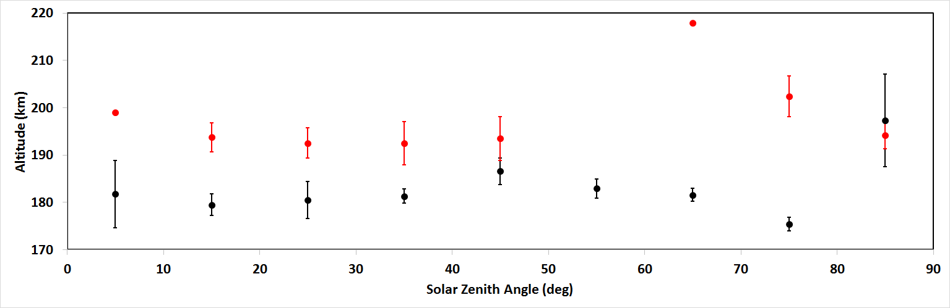
General statistics – SECOND LAYER ALTITUDE
Mars Express (black) and MAVEN (red) detections of the second layer.
MAVEN points include roughly 50 observations from the first half of the prime mission (thru 5/15/15).
MARSIS statistics from Kopf, et al (2008), using nearly 1500 detections from 2005.
Altitude discrepancy may be related to solar conditions, MAVEN near solar max, MEX near minimum.

Slide 6
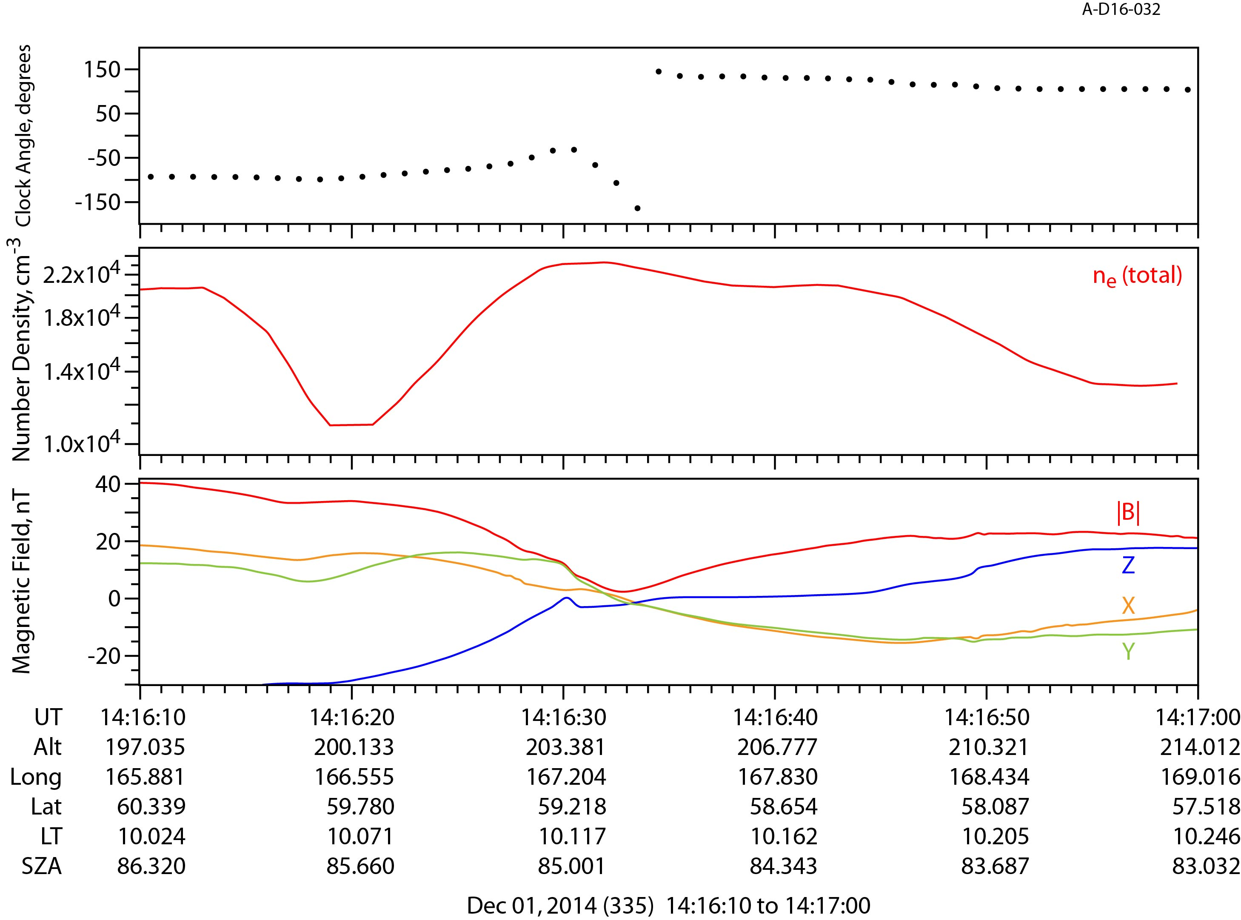
MAVEN
OBSERVATIONS
Synergies of various MAVEN observations have shed further light on this layer
The density increase usually aligns with a sharp change in the magnetic field strength, and component directions, indicating the presence of a current.
Calculations show this change corresponds to a rotation in the magnetic field clock angle.

Slide 7
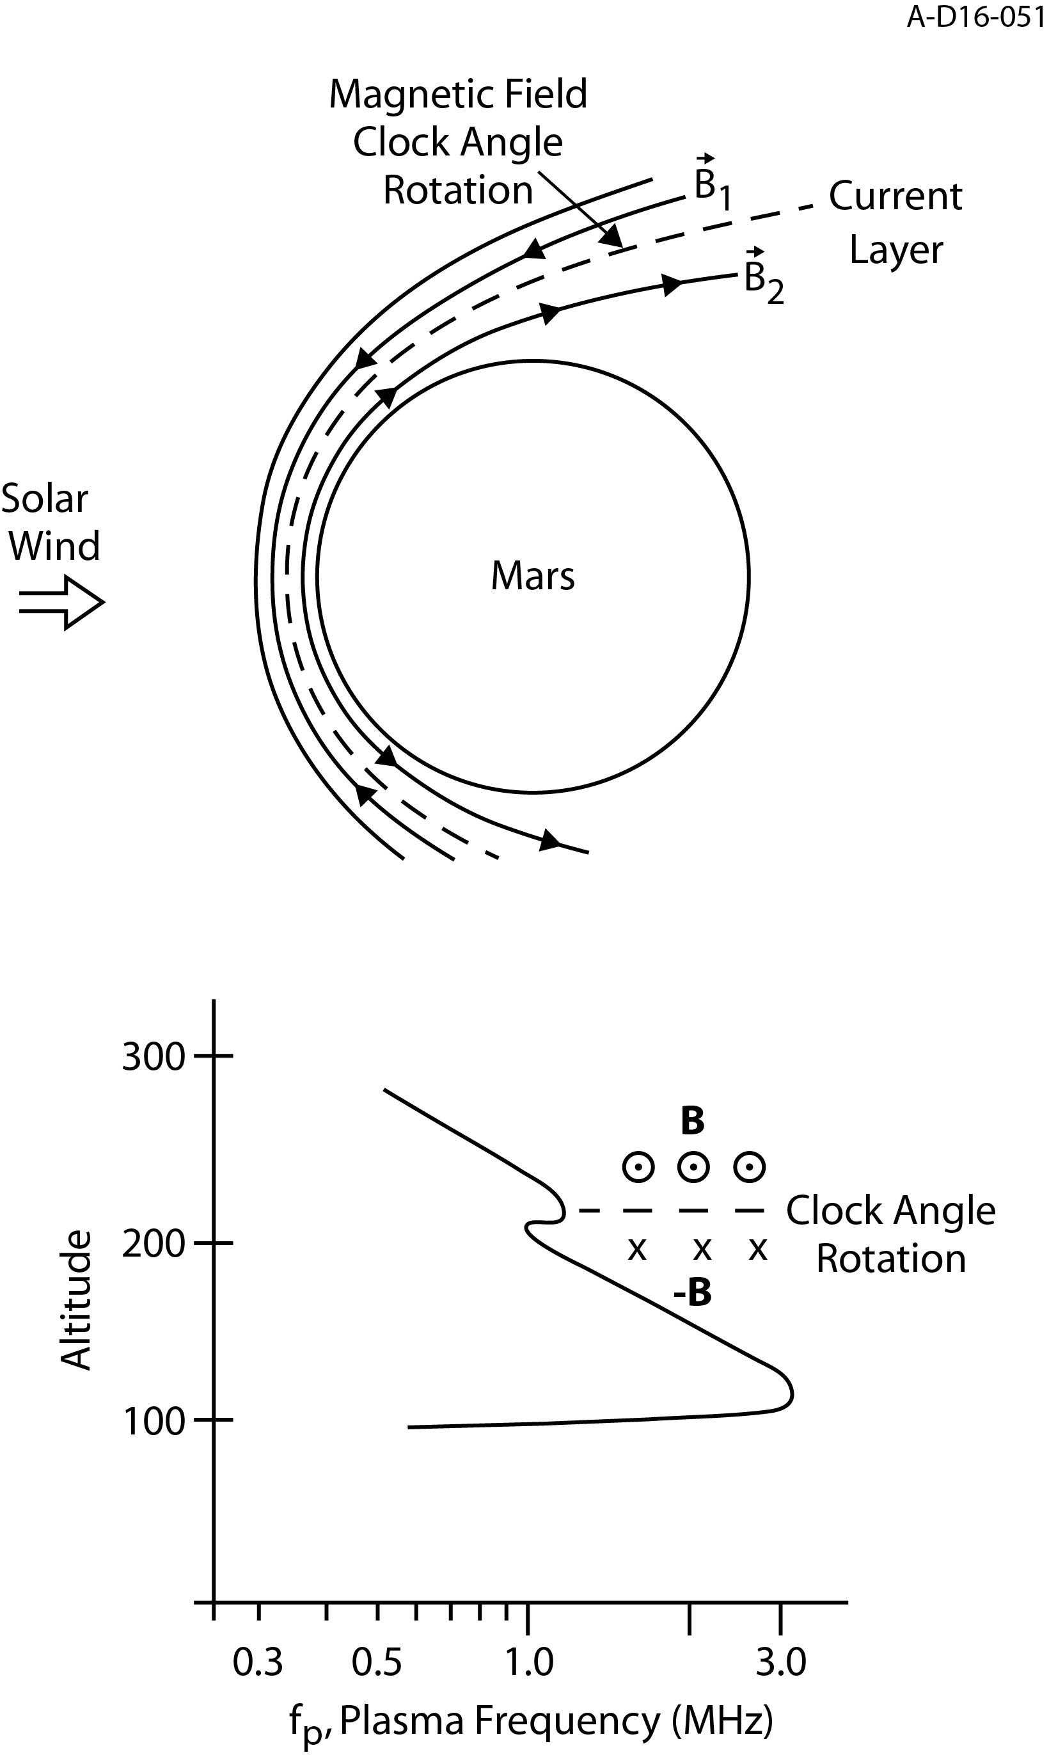
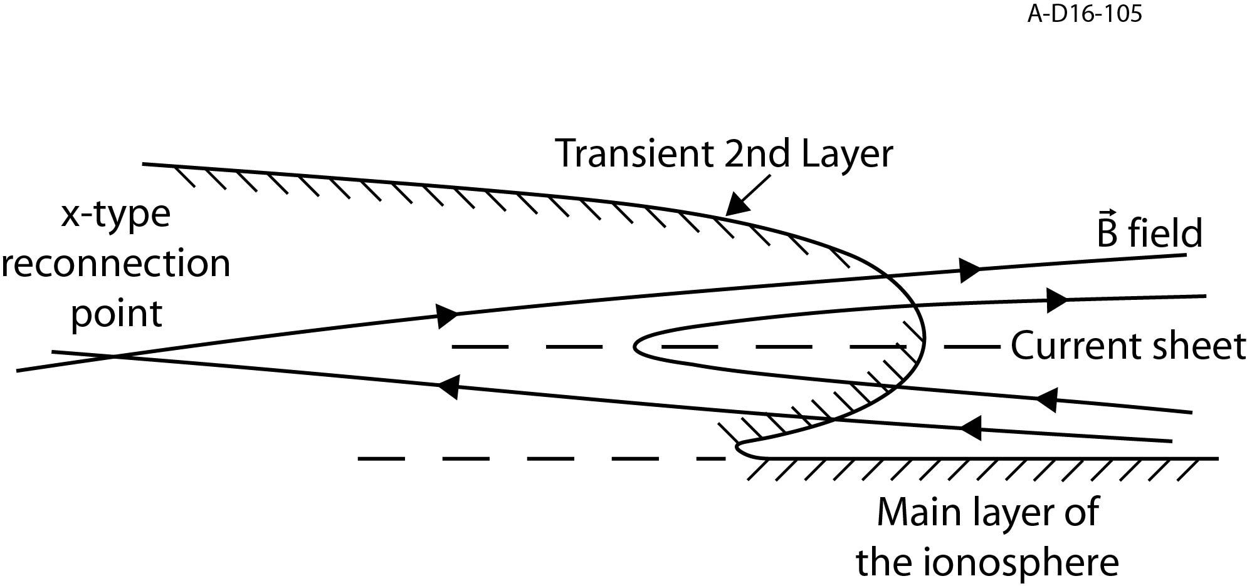
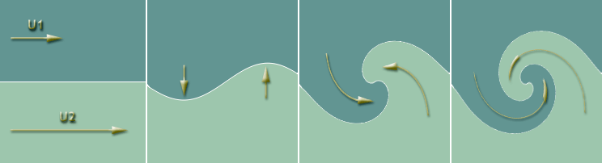
POSSIBLE EXPLANATIONS (and concerns)
Rotations in the solar wind magnetic field could yield the observed current and clock angle rotation. Concerns remain about needed frequency and the lack of horizontal stratification of the current.
As this is in the region where photochemical equilibrium begins to break down, a flow velocity difference could create a Kelvin-Helmholtz instability. Velocity difference not been seen in the crossing orbit case.
X-type reconnection could induce the current and density increase. While magnetic pressure dominates plasma pressure at this altitude in the crossing orbit case, the magnetic profile is smooth with no sharp changes.
NOTE: Crustal fields to seem to enhance this feature, but it also appears in places without the presence of this magnetism.

