Slide 1

progress report Andy Kopf

Slide 2
Personnel Changes
2017
Co-Investigator Don Gurnett
Began Phased Retirement 8/2017
Project Manager Andy Kopf
Research Scientist Yuki Harada
Started 5/2017
Departed 3/2018
2018
Co-Investigator Don Gurnett
In Phased Retirement
Project Manager Andy Kopf
Research Scientist David Morgan
Part-Time (20%)
Postdoc Feng Chu
Started 5/2018
Research Scientist TBA
Starting 8/2018

Slide 3
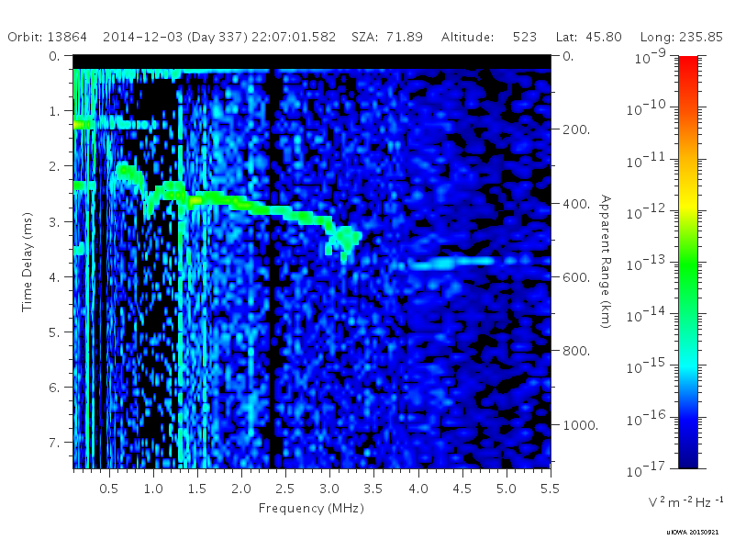
MARSIS TIMING ERROR

Slide 4
Effect on Data Products
Level 2 – Processed Data
Timing Error is an internal software error, not a data error
UNAFFECTED
Level 3 – Spectrogram Plots
Timing Error appears as roughly a one pixel horizontal in the black bar at the top
AFFECTED – All interpreted time delays/apparent altitudes may be in error
Level 5 – Local Electron Densities and Magnetic Fields
Electron Densities UNAFFECTED, solely a horizontal periodic effect
Magnetic Fields UNAFFECTED, calculated from relative spacing between harmonics. Those with only one frequency response are within the error bars of that measurement.

Slide 5
Archival/Re-archival status
Level 3 – Spectrograms
Reprocessed for entire mission in early 2017
Submitted to PSA in March-July 2017, not yet in the archive
Level 5 – Local Measurements
Completed through 3rd MAVEN period (August 15, 2015)
3rd Period was submitted to PSA in January 2017, is not yet in the archive
Now handled by Firdevs Duru (Coe College) for future submissions
Next two submissions currently being packaged for delivery

Slide 6
MeetingS & PUBLICATIONS
Sep 2017 – ESPC, Riga, Latvia
Oct 2017 – MAVEN PSG, Tucson, Arizona (Remotely)
Nov 2017 – MEX SWT, Paris, France (Remotely)
Dec 2017 – AGU Fall Meeting, New Orleans, Louisiana
Mar 2018 – MAVEN PSG, Boulder, Colorado
Apr 2018 – VESPA Workshop, Prague, Czechia
Harada et al., GRL (2017)
MEX/MAVEN interplanetary shock study
Nemec et al., JGR-SP (2017)
MEX/MAVEN ionospheric density comp.
Harada et al., JGR-SP (2018)
Diffuse ionospheric echoes
Harada et al., GRL (2018)
MARSIS nightside ionosphere for solar event
Dieval et al., JGR-SP (2018)
Shapes of electron density structures
Three submissions currently under review

Slide 7
SCIENCE

Slide 8
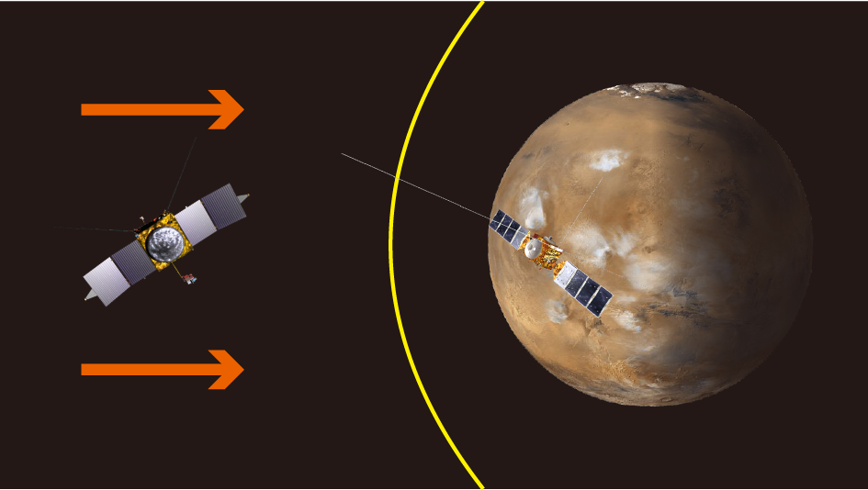
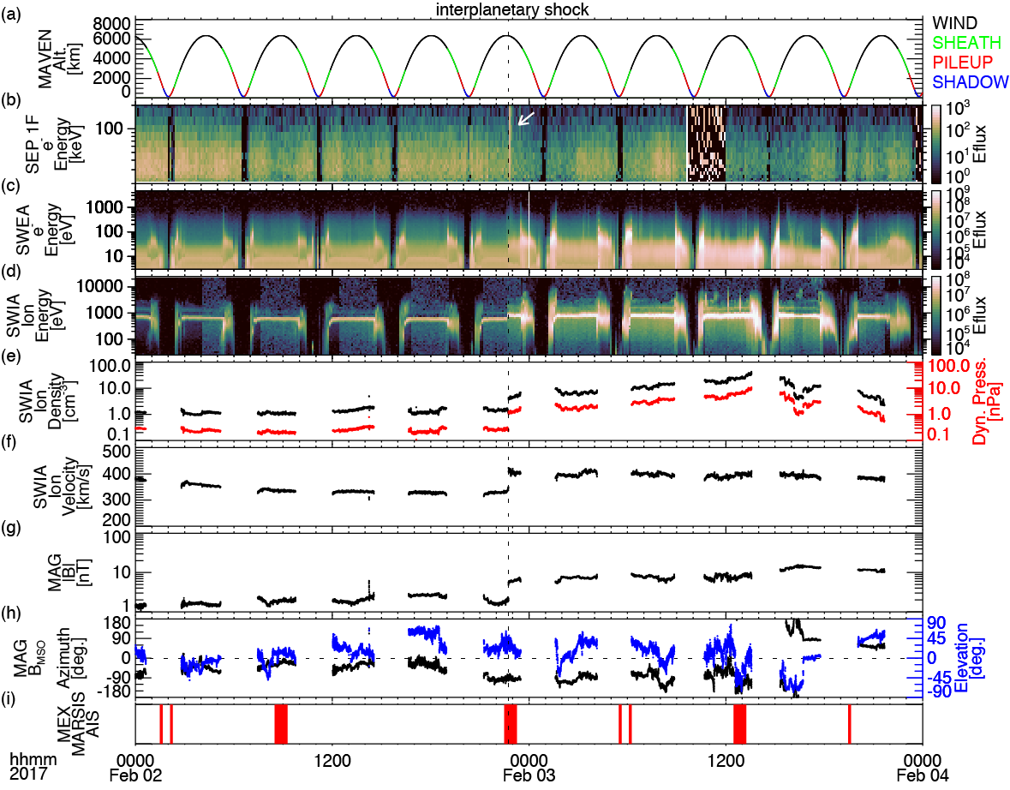
(ii-a) MAVEN in SW + MARSIS in Dayside Ionosphere: A CIR Event
Multiple MAVEN instruments observed the effects of a CIR shock late on February 2, 2017.
Solar wind instruments SWEA and SWIA detected a sudden but sustained increase in the flux of energetic solar wind particles
Increased were observed in both density and velocity
Local magnetic field increased by nearly an order of magnitude
MARSIS was in AIS mode during this time

Slide 9
(ii-a) MAVEN in SW + MARSIS in Dayside Ionosphere: A CIR Event
MARSIS detected similar spikes in local magnetic field and density on about a 1-minute delay.
MARSIS detected diffuse echoes a few min after the shock arrival at Mars, which are caused by irregular structure in the disturbed ionosphere
These diffuse echoes were absent during other orbits traveling over the same location, suggesting their transient nature

Slide 10
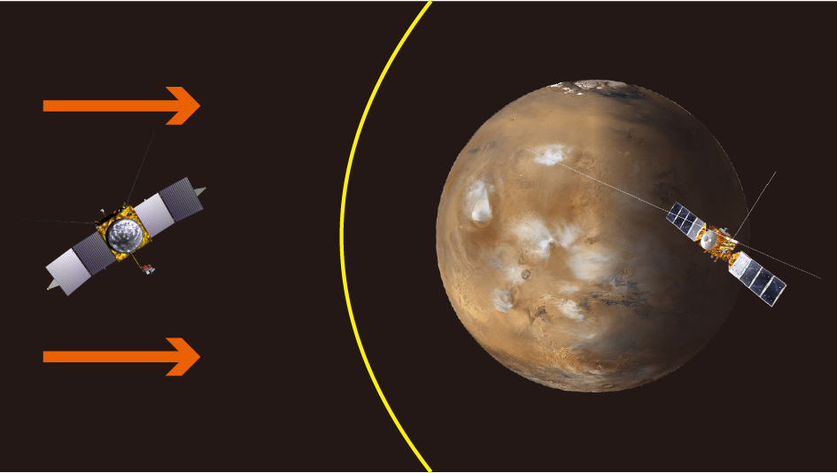
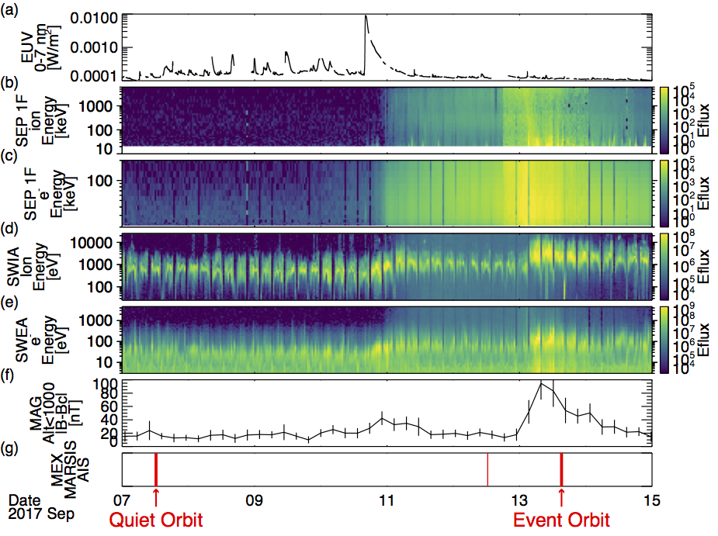
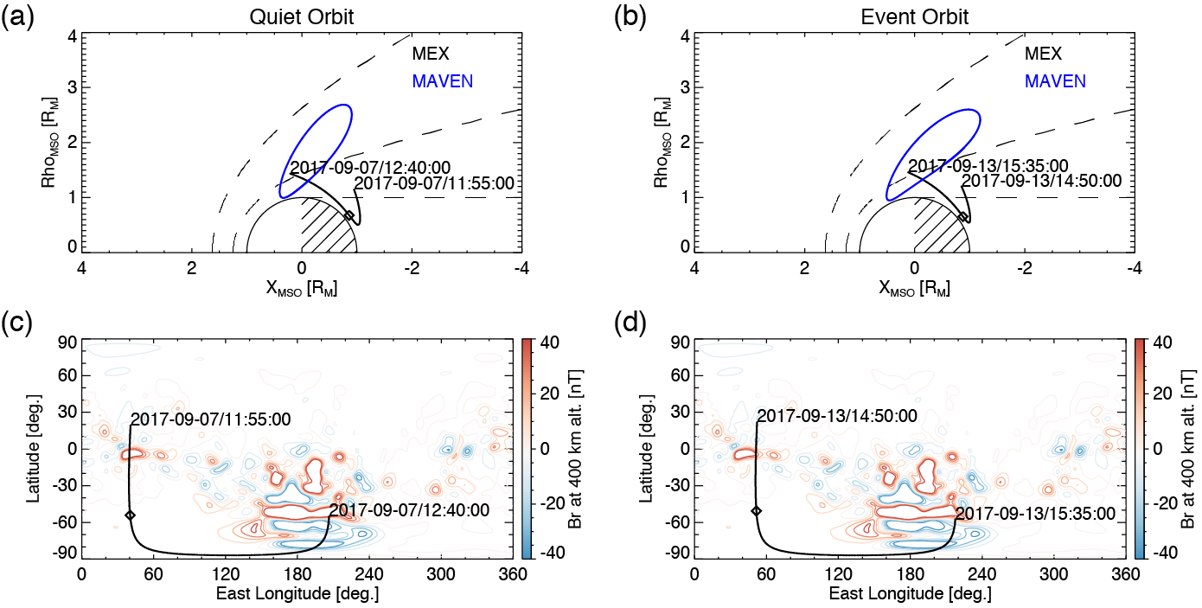
(ii-b) MAVEN in SW + MARSIS in Nightside Ionosphere: September 2017 Solar Event

Slide 11
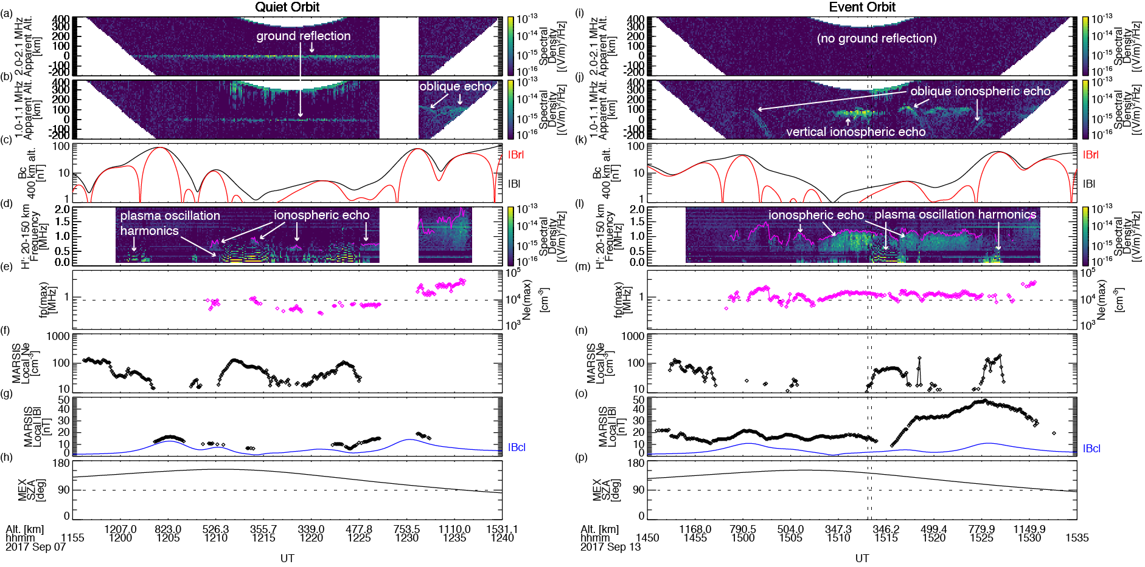
(ii-b) MAVEN in SW + MARSIS in Nightside Ionosphere: September 2017 Solar Event
1
1. Disappearance of ground reflection
2. Increased peak electron densities
3. Enhancement in induced magnetic fields
2
3

Slide 12
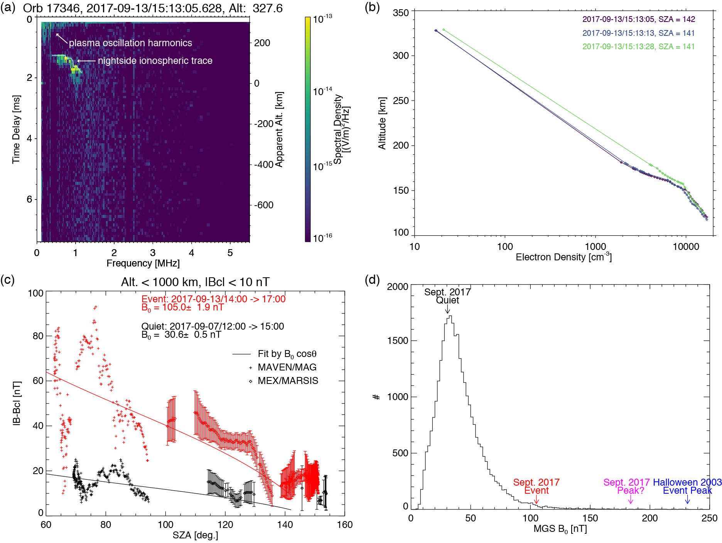
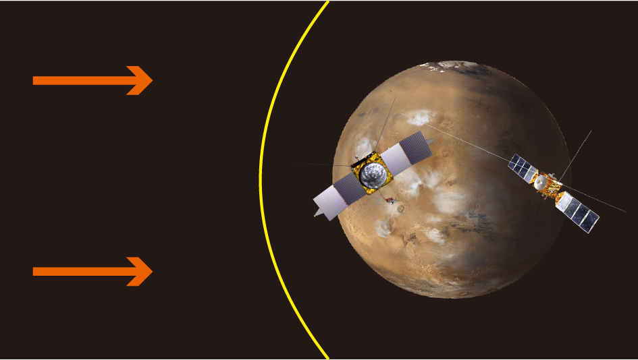
(ii-b) MAVEN in SW + MARSIS in Nightside Ionosphere: September 2017 Solar Event
1. Peak density altitude ~120 km <- electron impact ionization
2. Induced B amplification over a wide SZA range - (iv) Dayside MAVEN + Nightside MARSIS
3. The Sept. 2017 event is one of historically high dynamic pressure events
1
2
3

Slide 13
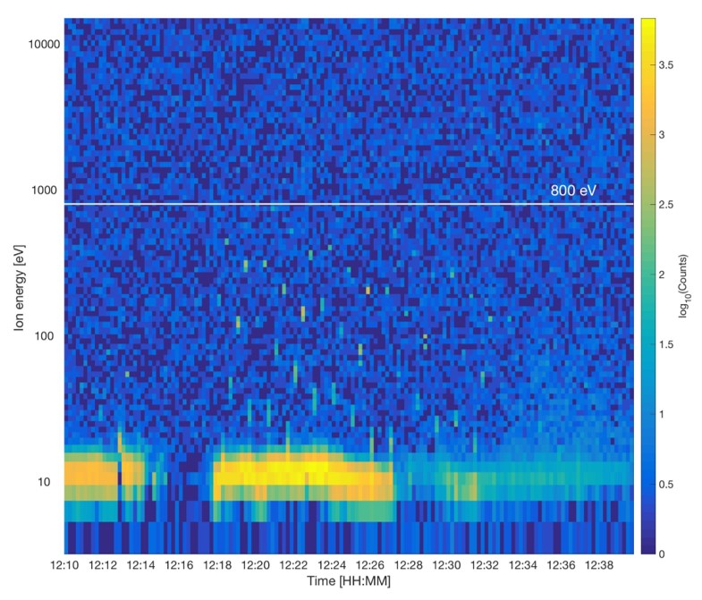
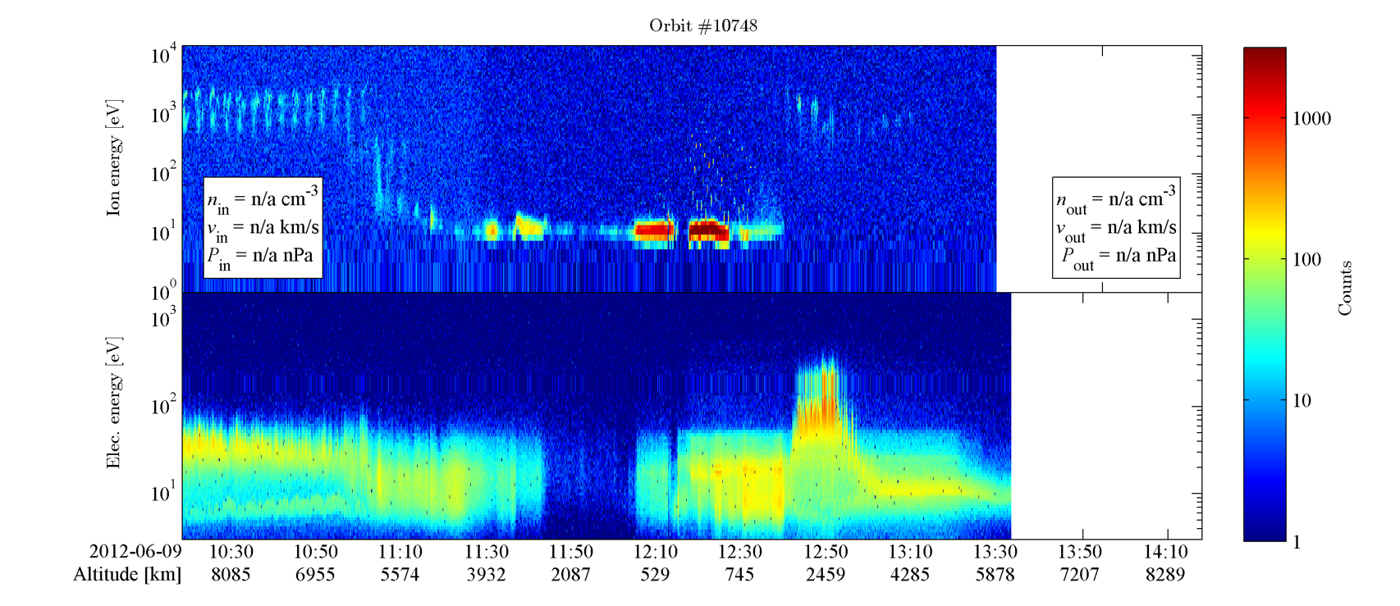
“Marsis effect” in ASPERA-IMA

Slide 14
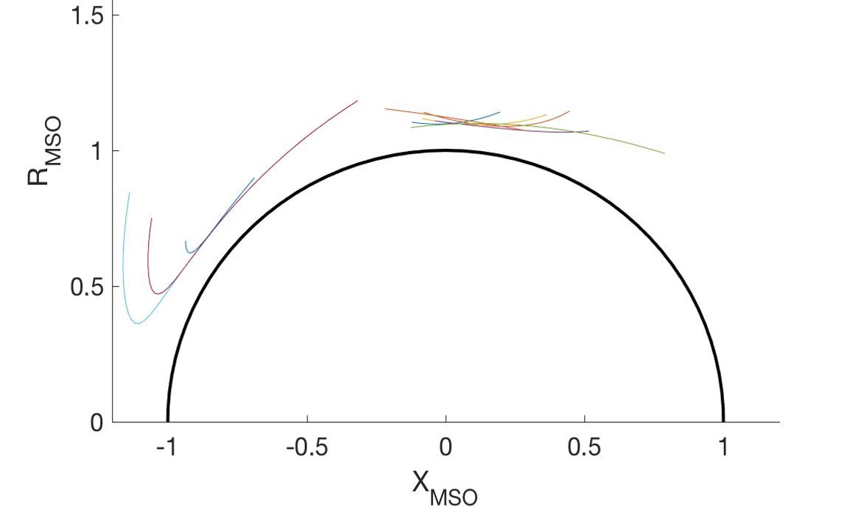

Analyzed in detail 10 selected orbits during the period 2010-06-23 to 2016-09-25 with clear signatures of the MARSIS operations in the IMA data
MARSIS operated in ionospheric sounding mode and IMA operated nominally

Slide 15
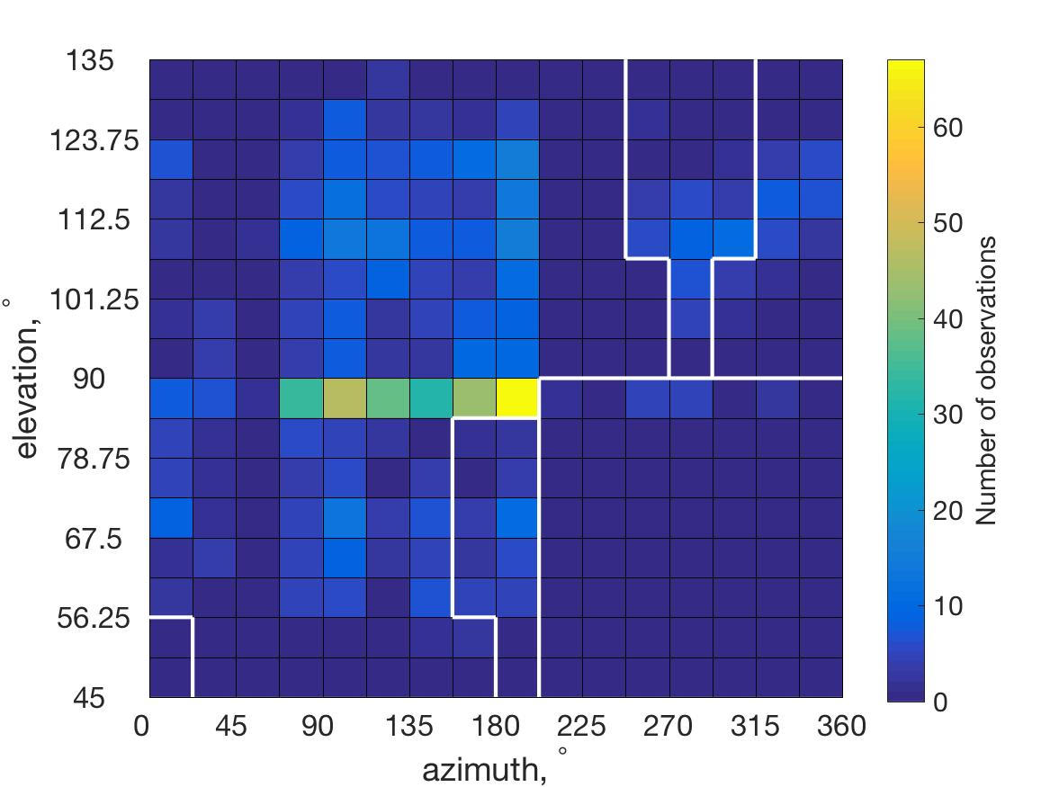
Observations: Directionality
IMA
MARSIS
~10°
IMA
Narrow over elevation beams
Aligned with MARSIS dipole?
Asymmetric?
MARSIS
~120°

Slide 16
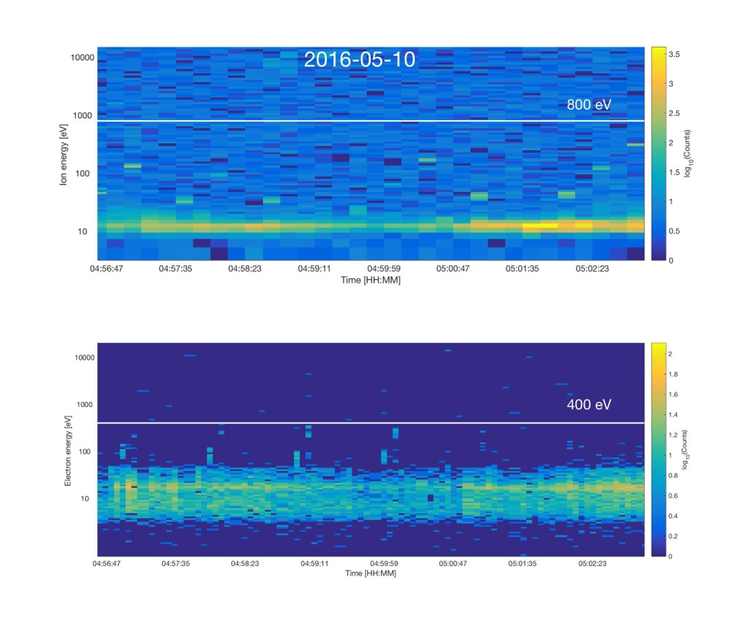
Summary of Observations
Accelerated ions observed when MARSIS transmits at frequencies close to f_{pe}
Typical energy 100 – 500 eV. Always below 800 eV
Highly anisotropic angular distribution
Accelerated electrons observed very rare. Not observed simultaneously with ions. Gyrating electrons detected by MARSIS (Gurnett et al., 2005)?
Possibility for active experiments?

Slide 17
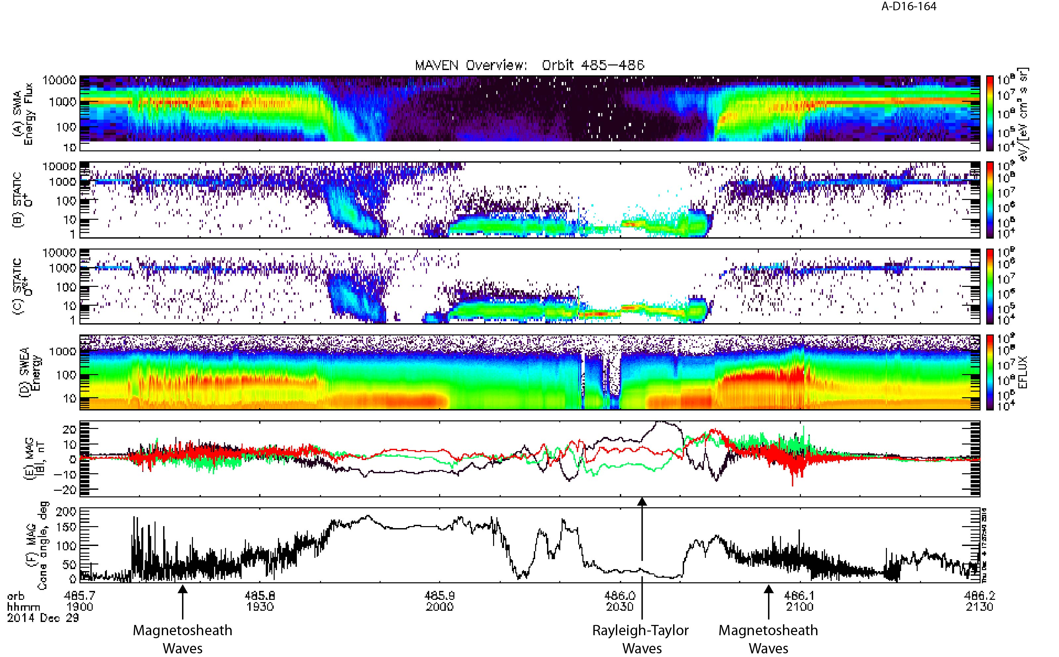
Parallel B-field EFFECTS
MAVEN observes strong magnetic oscillations in this time frame, coincident with strong wavelike behavior in SWIA ions (A) and SWEA electrons (D)
Period from 19:10-19:40 UT is while MAVEN is in the magneto-sheath. Same for 20:45-21:00 UT.
Low freq. waves near periapsis. May be due to Rayleigh-Taylor instability at ionospheric altitudes [Fowler et al, 2016]

Slide 18
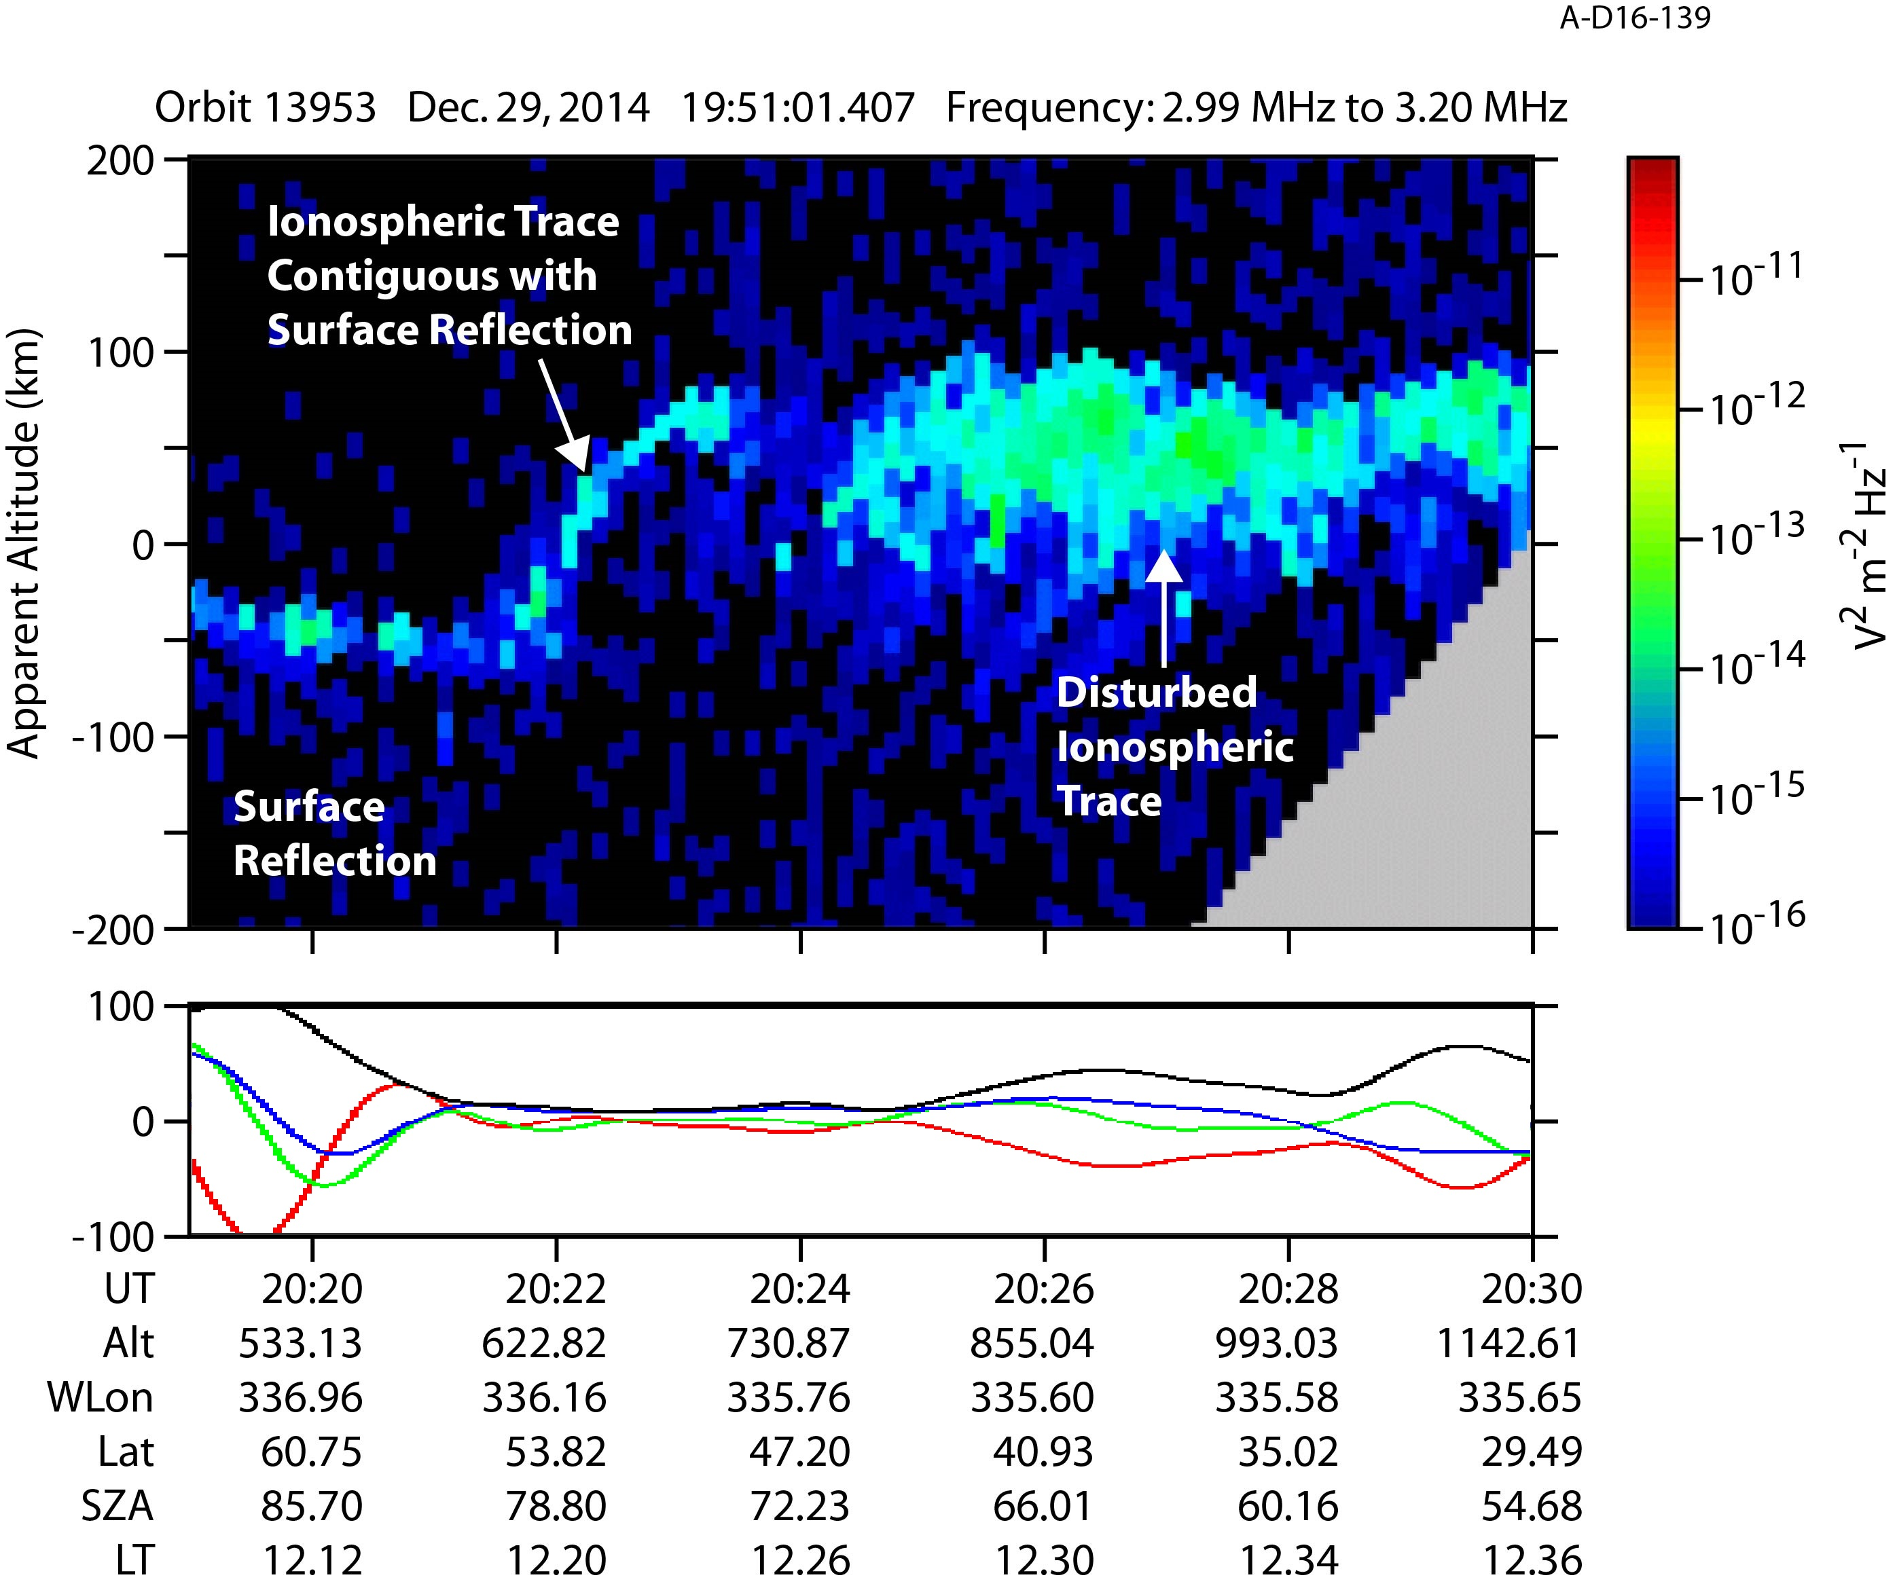
MARSIS OBSERVES A DISTURBED IONOSPHERE
MARSIS radargram from coinciding orbit, from 20:19-20:30 UT, averaged over frequencies from 2.99-3.2 MHz.
Two atypical features:
(1) – as MEX exits a region of moderate crustal fields, the surface and ionosphere reflections coincide
(2) – continuing to travel southward, ionosphere rises steadily in apparent altitude, then abruptly becomes highly disturbed

Slide 19
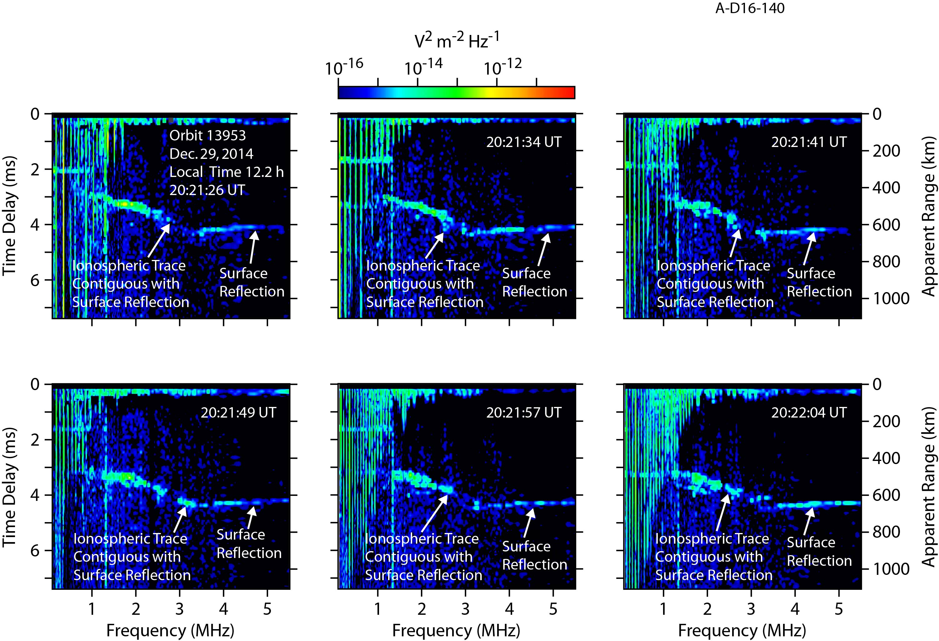
Connected ionospheric and surface reflections
Six consecutive ionograms from the previously discussed orbit, from 20:21:26-20:22:04 UT.
Ionosphere appears to approach the planetary surface without the typical cusp-like falloff, connecting the two reflections smoothly.
Possible low-altitude plasma?

Slide 20
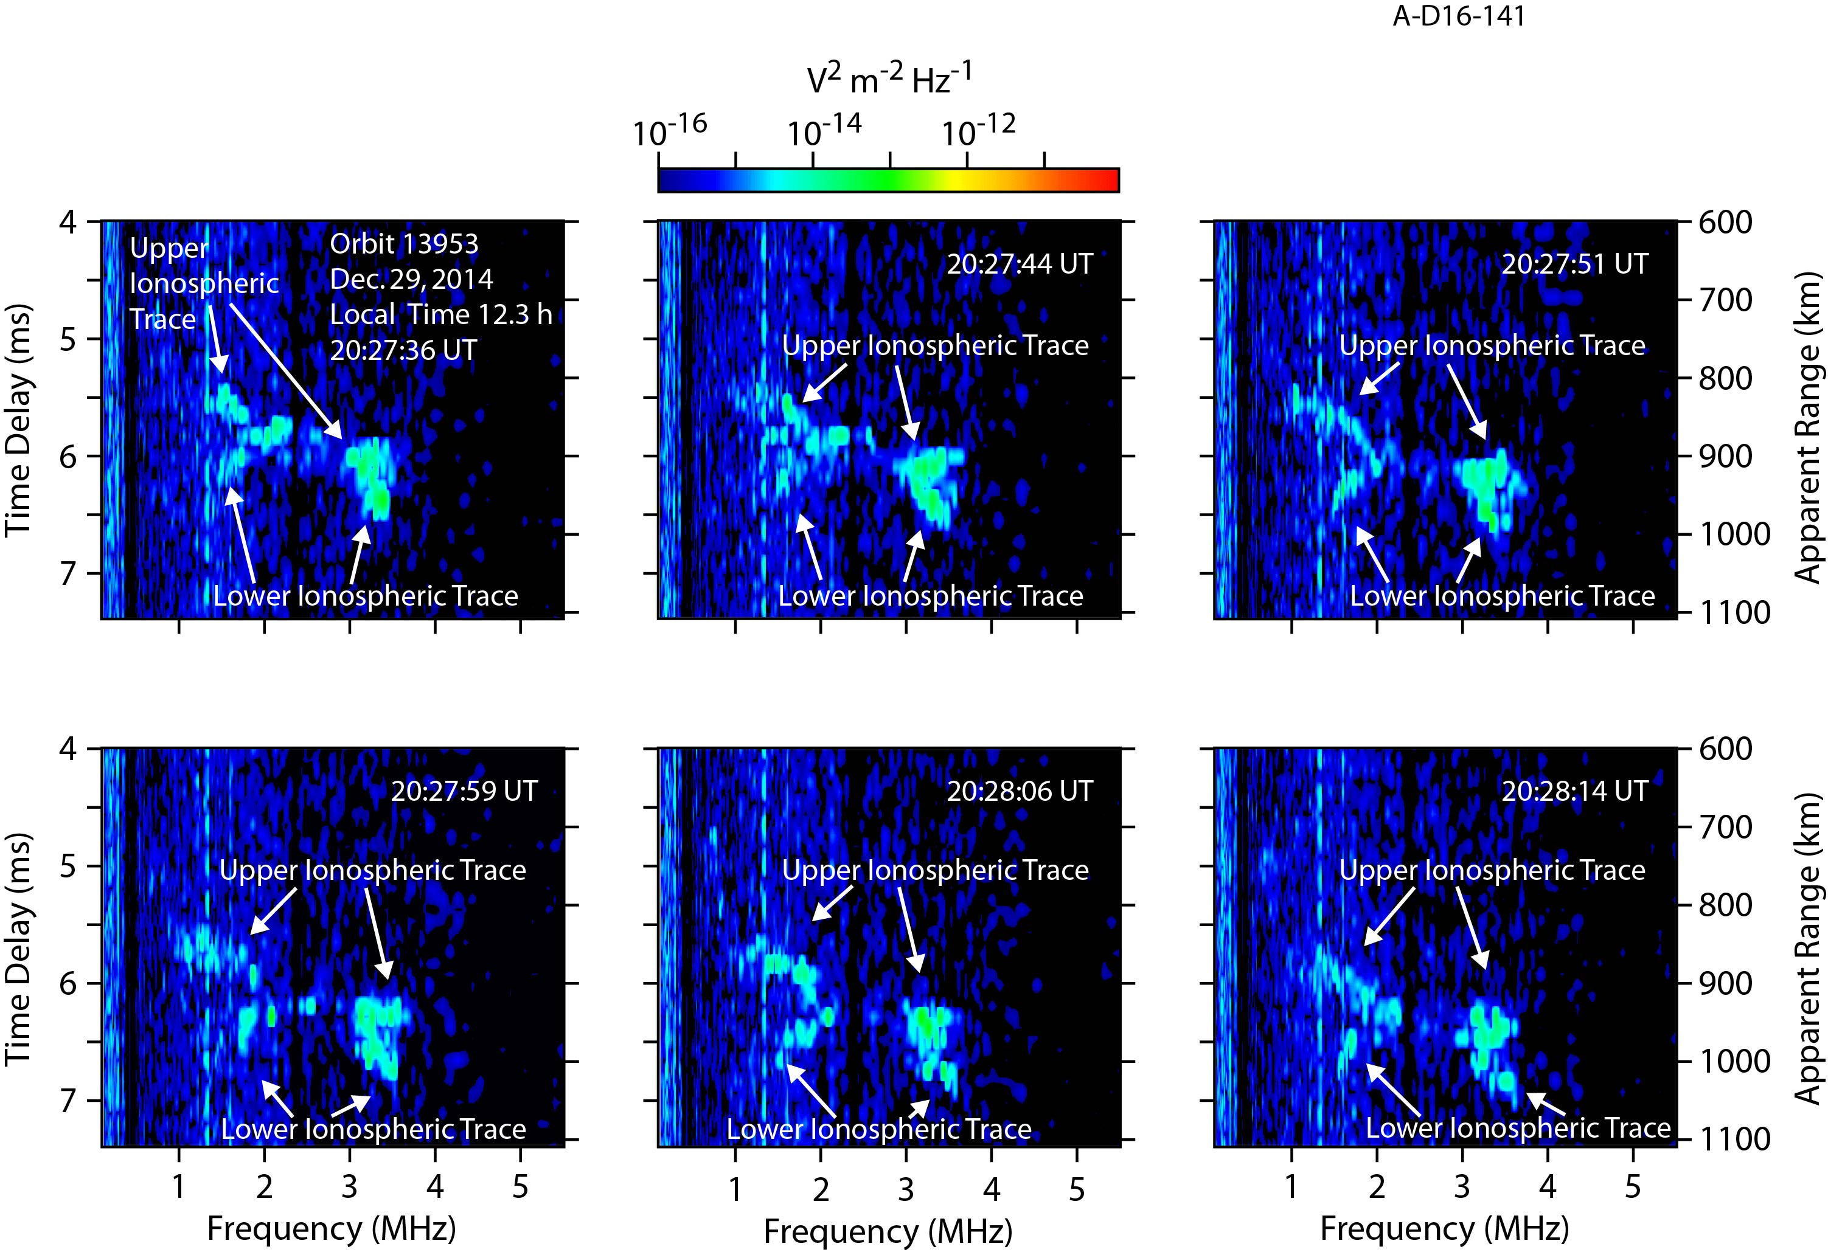
A Disturbed ionosphere
Six consecutive ionograms between 20:27:36-20:28:14 UT, which show a unique configuration of two ionospheric traces diverging at both low and high frequencies.
Coincides with the period of disturbed ionospheric traces observed in the radargram

Slide 21
NEW/UPCOMING Science

Slide 22
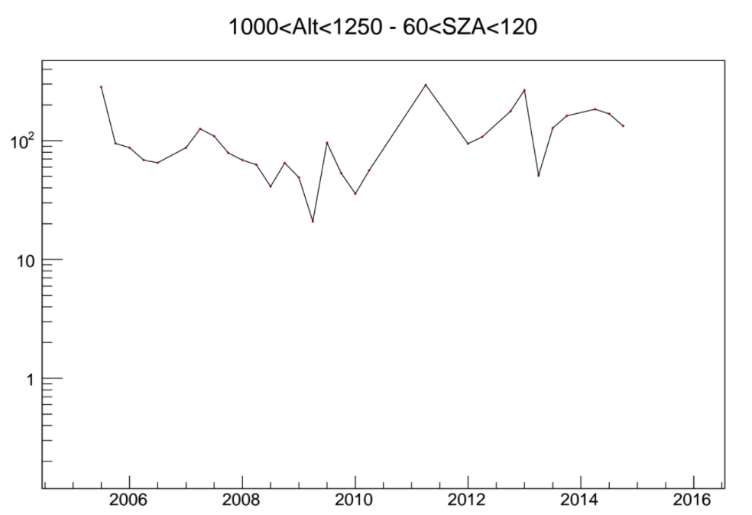
Solar Cycle Studies
MARSIS has now been operational for more than a full solar cycle
Studying densities over 11 years to examine seasonal changes and solar cycle effects
Being led by Firdevs Duru (Coe College)

Slide 23
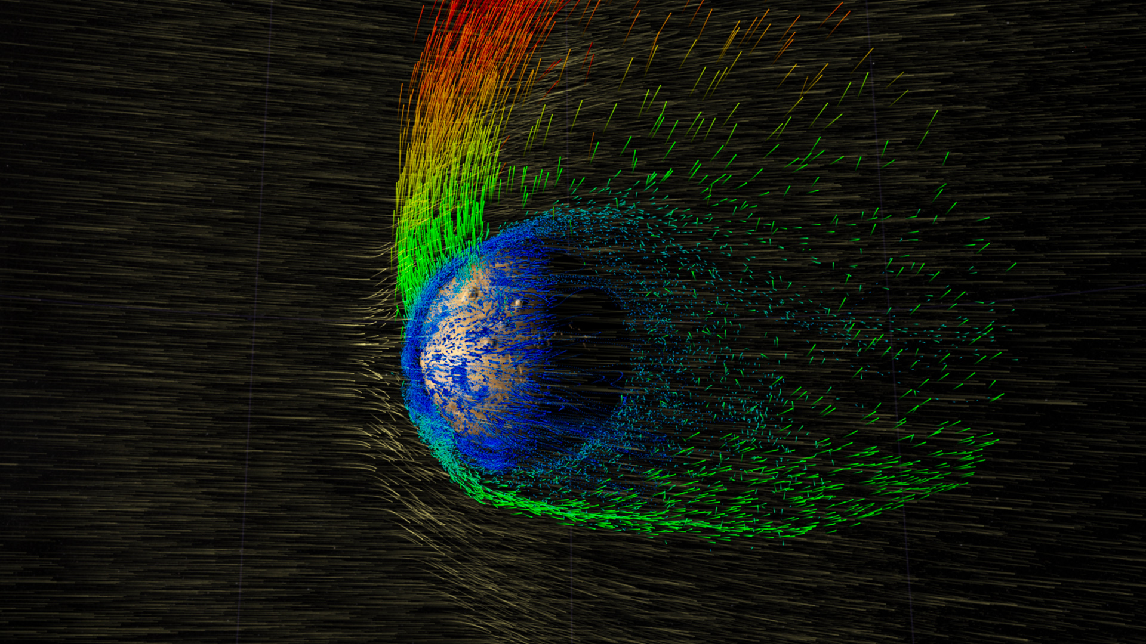
response to solar wind variations
MARSIS has made many observations during many periods where MAVEN is in the solar wind monitoring upstream conditions.
Variations in solar wind parameters may produce observable effects on the structure of the ionosphere.

Slide 24
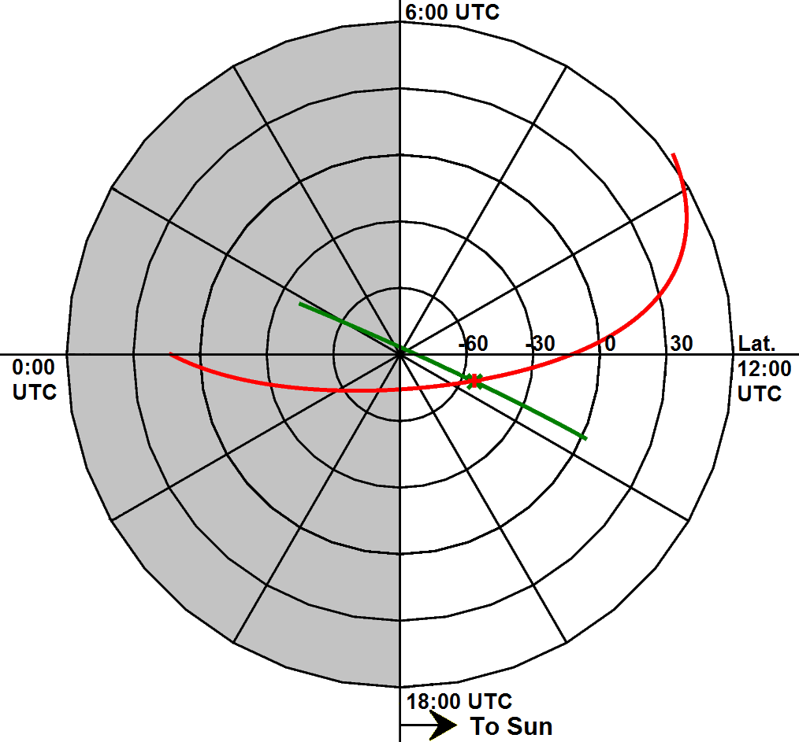
MEX-maven crossing orbits
MAVEN and Mars Express orbits occasionally coincide at common locations within short time frames
Allow for near-simultaneous studies of the Martian ionosphere
MARSIS soundings while MAVEN is observing in situ provides a more complete perspective of ionosphere

Slide 25
Questions?

