Slide 1

progress report Andy Kopf

Slide 2
Personnel Changes
2016
Co-Investigator Don Gurnett
Project Manager David Morgan
Retired 1/2017
Research Scientist Firdevs Duru
Coe College Faculty 8/2016
Postdoc Andy Kopf
2017
Co-Investigator Don Gurnett
Project Manager Andy Kopf
Research Scientist Yuki Harada
Started 5/2017

Slide 3
MARSIS TIMING ERROR
The AIS sounding cycle consists of a sounding pulse followed by a blank period, followed then by 80 receive windows. The pulse is 91.4 µs long, as is each window.
The time between the end of the pulse and the start of the receive window was the erroneous interval.
Originally believed that this interval was 162.5 µs (253.9 µs from pulse start time). It was discovered that this interval was too long by fitting spacecraft altitude with the apparent range of the surface reflection

Slide 4
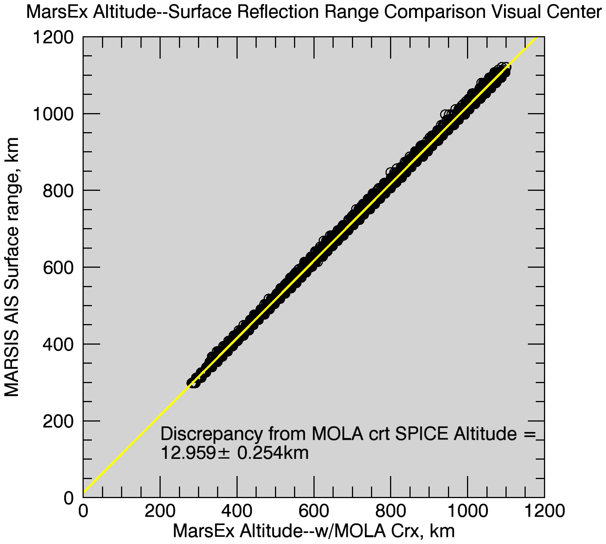
MARSIS TIMING CORRECTION
5845 surface reflection traces over 62 orbits were fit to study this error.
MEX altitude was computed from SPICE radial distance from planet center, corrected with MOLA elevations.
Fit yields time from start to receive is 167.443 µs instead of 253.9 µs.
Yields a discrepancy in range of 12.96 ± 0.25 km.
This should be subtracted from apparent ranges, or added to altitudes so based.

Slide 5
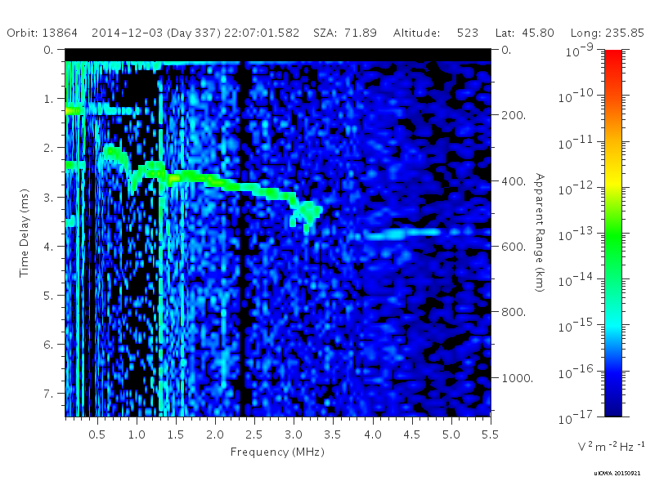

Slide 6
Effect on Data Products
Level 2 – Processed Data
Timing Error is an internal software error, not a data error
UNAFFECTED
Level 3 – Spectrogram Plots
Timing Error appears as roughly a one pixel horizontal in the black bar at the top
AFFECTED – All interpreted time delays/apparent altitudes may be in error
Level 5 – Local Electron Densities and Magnetic Fields
Electron Densities UNAFFECTED, solely a horizontal periodic effect
Magnetic Fields UNAFFECTED, calculated from relative spacing between harmonics. Those with only one frequency response are within the error bars of that measurement.

Slide 7
Archival/Re-archival status
Level 3 – Spectrograms
Reprocessed for Nominal Mission and EM5
Submitted to PSA, not yet in the archive
EM1-4 currently in progress. Goal of completion in late June/early July
Level 5 – Local Measurements
Completed through 3rd MAVEN period (August 15, 2015)
Now handled by Firdevs Duru (Coe College) for future submissions
Next submission currently under internal review, expected shortly

Slide 8
MeetingS & PUBLICATIONS
Jun 2016 – MAVEN PSG, Boulder, CO
Sep 2016 – MUAN Workshop, Leicester, United Kingdom (Remotely)
Nov 2016 – MAVEN PSG, Berkeley, CA
Dec 2016 – AGU Fall Meeting, San Francisco, CA
Jan 2017 – MEX SWT Meeting, Kiruna, Sweden
Apr 2017 – EGU General Assembly, Vienna, Austria
May 2017 – Mars Aeronomy Conference, Boulder, CO
Nemec et al., JGR-SP (2016)
Improving accuracy of density profiles
Vogt et al., JGR-SP (2016)
Comparing MARSIS & radio occultation
Kopf et al., JGR-SP (2017)
Topside layers and associated currents
Four submitted publications currently under review/revision

Slide 9
SCIENCE

Slide 10
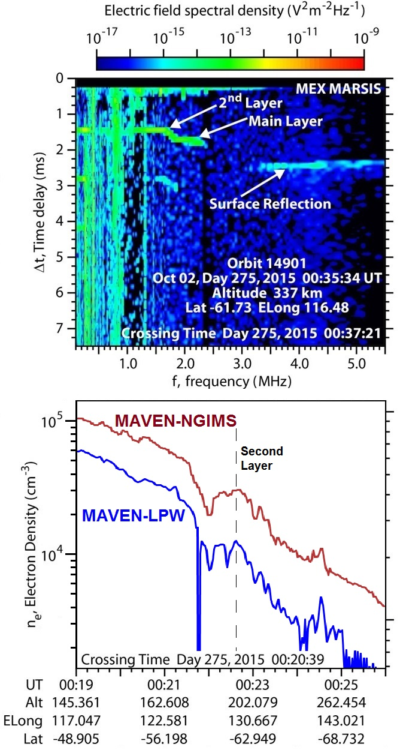
Transient Topside Layers
Study of additional electron density maximums that frequently appear at around 200 km
Commonly observed in MARSIS data, also now seen in MAVEN in situ profiles
First joint observation of the second layer by both spacecraft made in 2015 during a crossing of the orbits, published in 2017

Slide 11
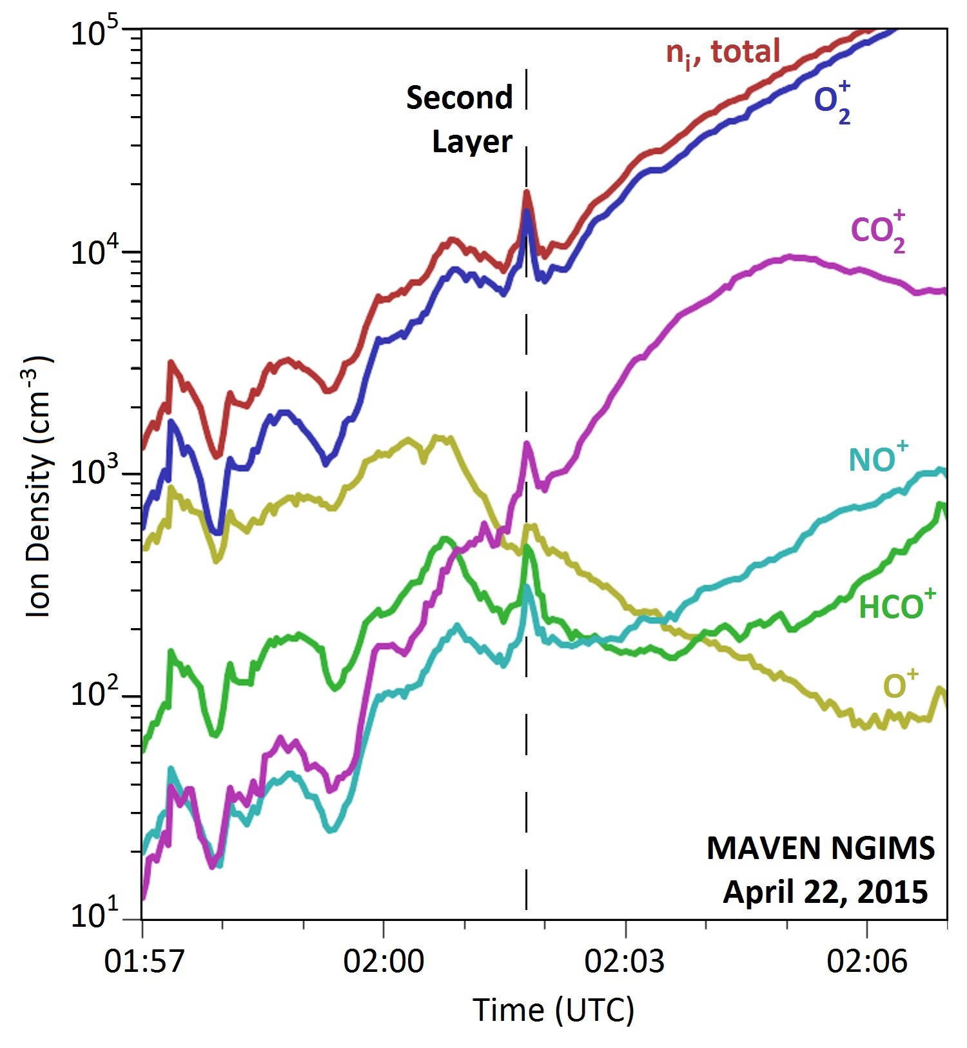
Ion density increase
In addition to electrons, ions also show a density increase in nearly every species
Region is dominated by O₂⁺ ions
Something is driving an overall density increase at these altitudes, well above the main layer, but well below the strong influence of the solar wind

Slide 12
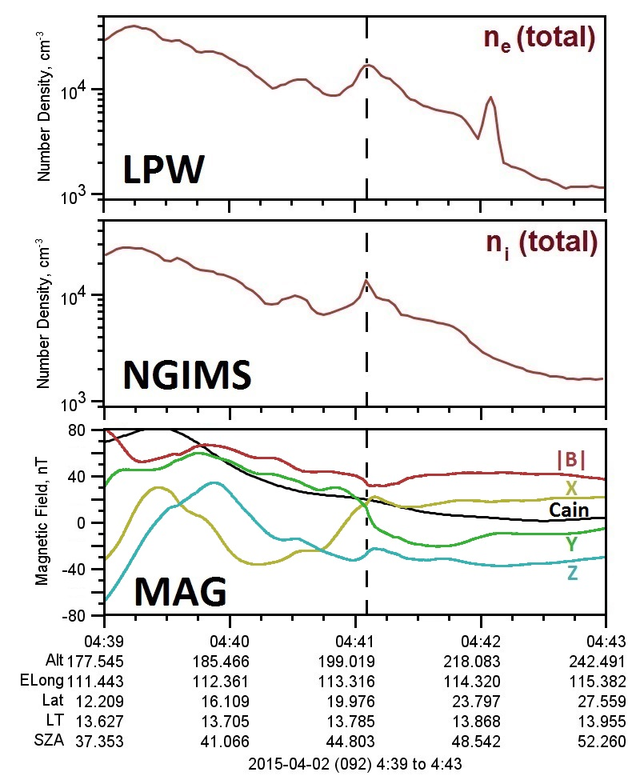
A Current Sheet
MAVEN MAG data reveals the presence of a local current sheet at these altitudes
Accompanied by a local minimum in the magnetic field strength at the location of the density peak
Current is NOT horizontally stratified, and can be observed at any orientation
Current sheet orientation has a possible trend with LT, as more horizontal cases are observed toward dusk

Slide 13
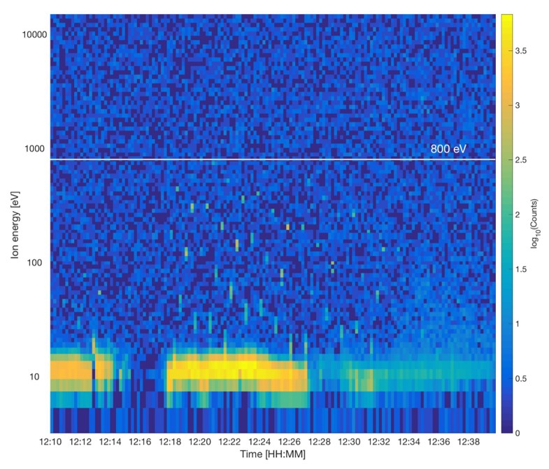
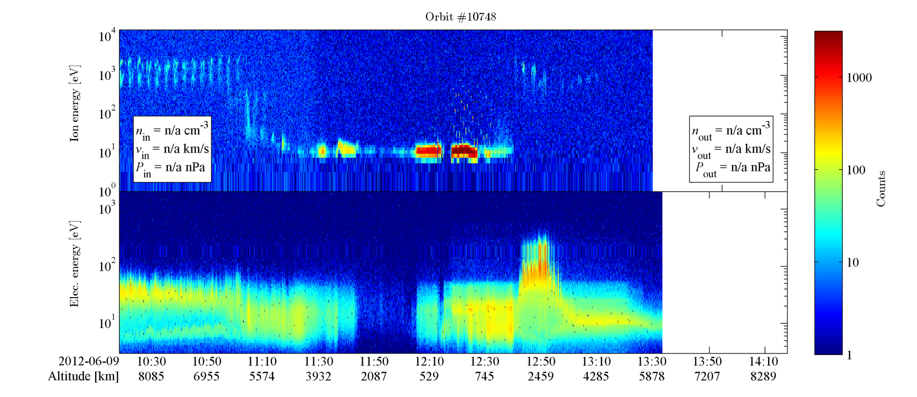
“Marsis effect” in ASPERA-IMA

Slide 14
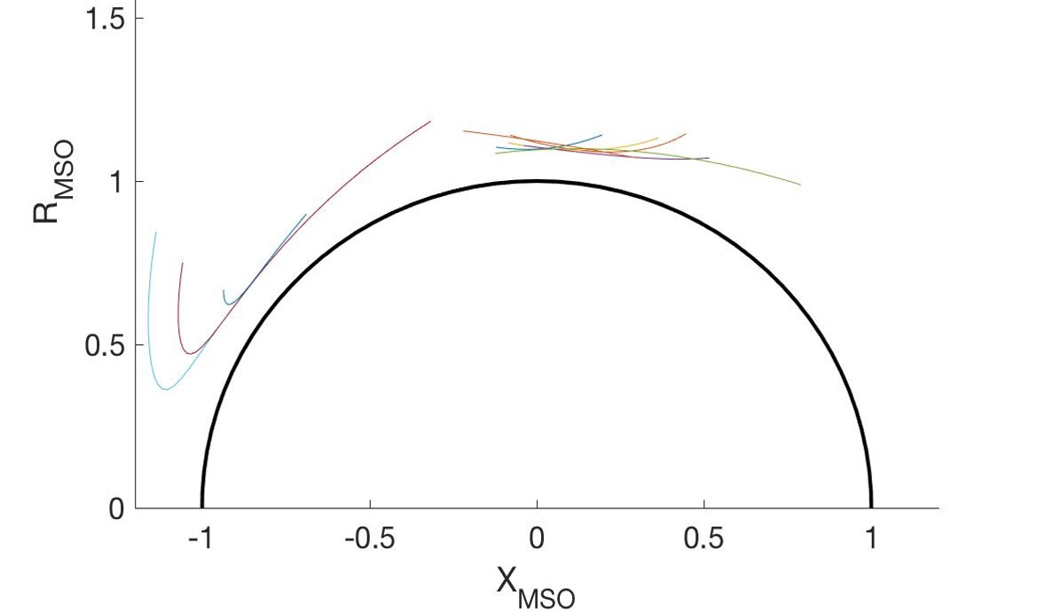

Analyzed in detail 10 selected orbits during the period 2010-06-23 to 2016-09-25 with clear signatures of the MARSIS operations in the IMA data
MARSIS operated in ionospheric sounding mode and IMA operated nominally

Slide 15
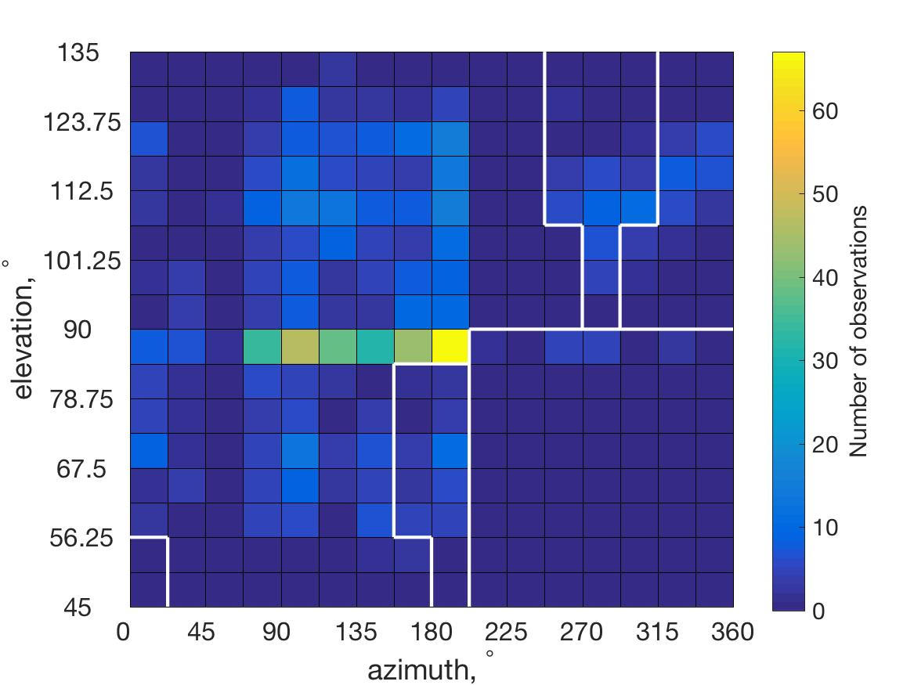
Observations: Directionality
IMA
MARSIS
~10°
IMA
Narrow over elevation beams
Aligned with MARSIS dipole?
Asymmetric?
MARSIS
~120°

Slide 16
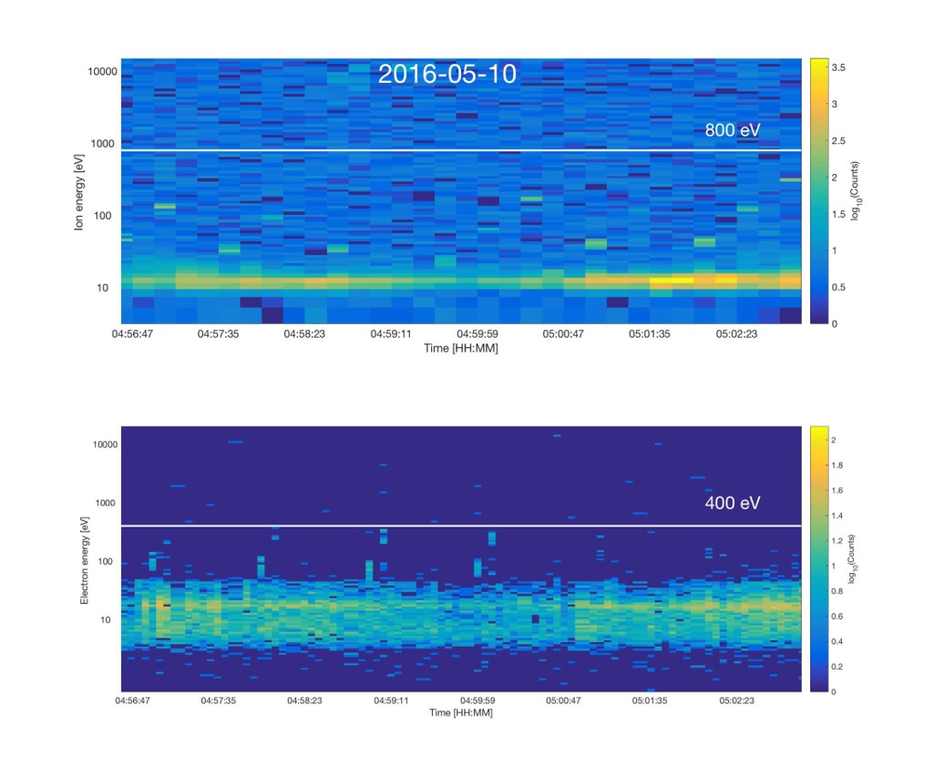
Summary of Observations
Accelerated ions observed when MARSIS transmits at frequencies close to f_{pe}
Typical energy 100 – 500 eV. Always below 800 eV
Highly anisotropic angular distribution
Accelerated electrons observed very rare. Not observed simultaneously with ions. Gyrating electrons detected by MARSIS (Gurnett et al., 2005)?
Possibility for active experiments?

Slide 17
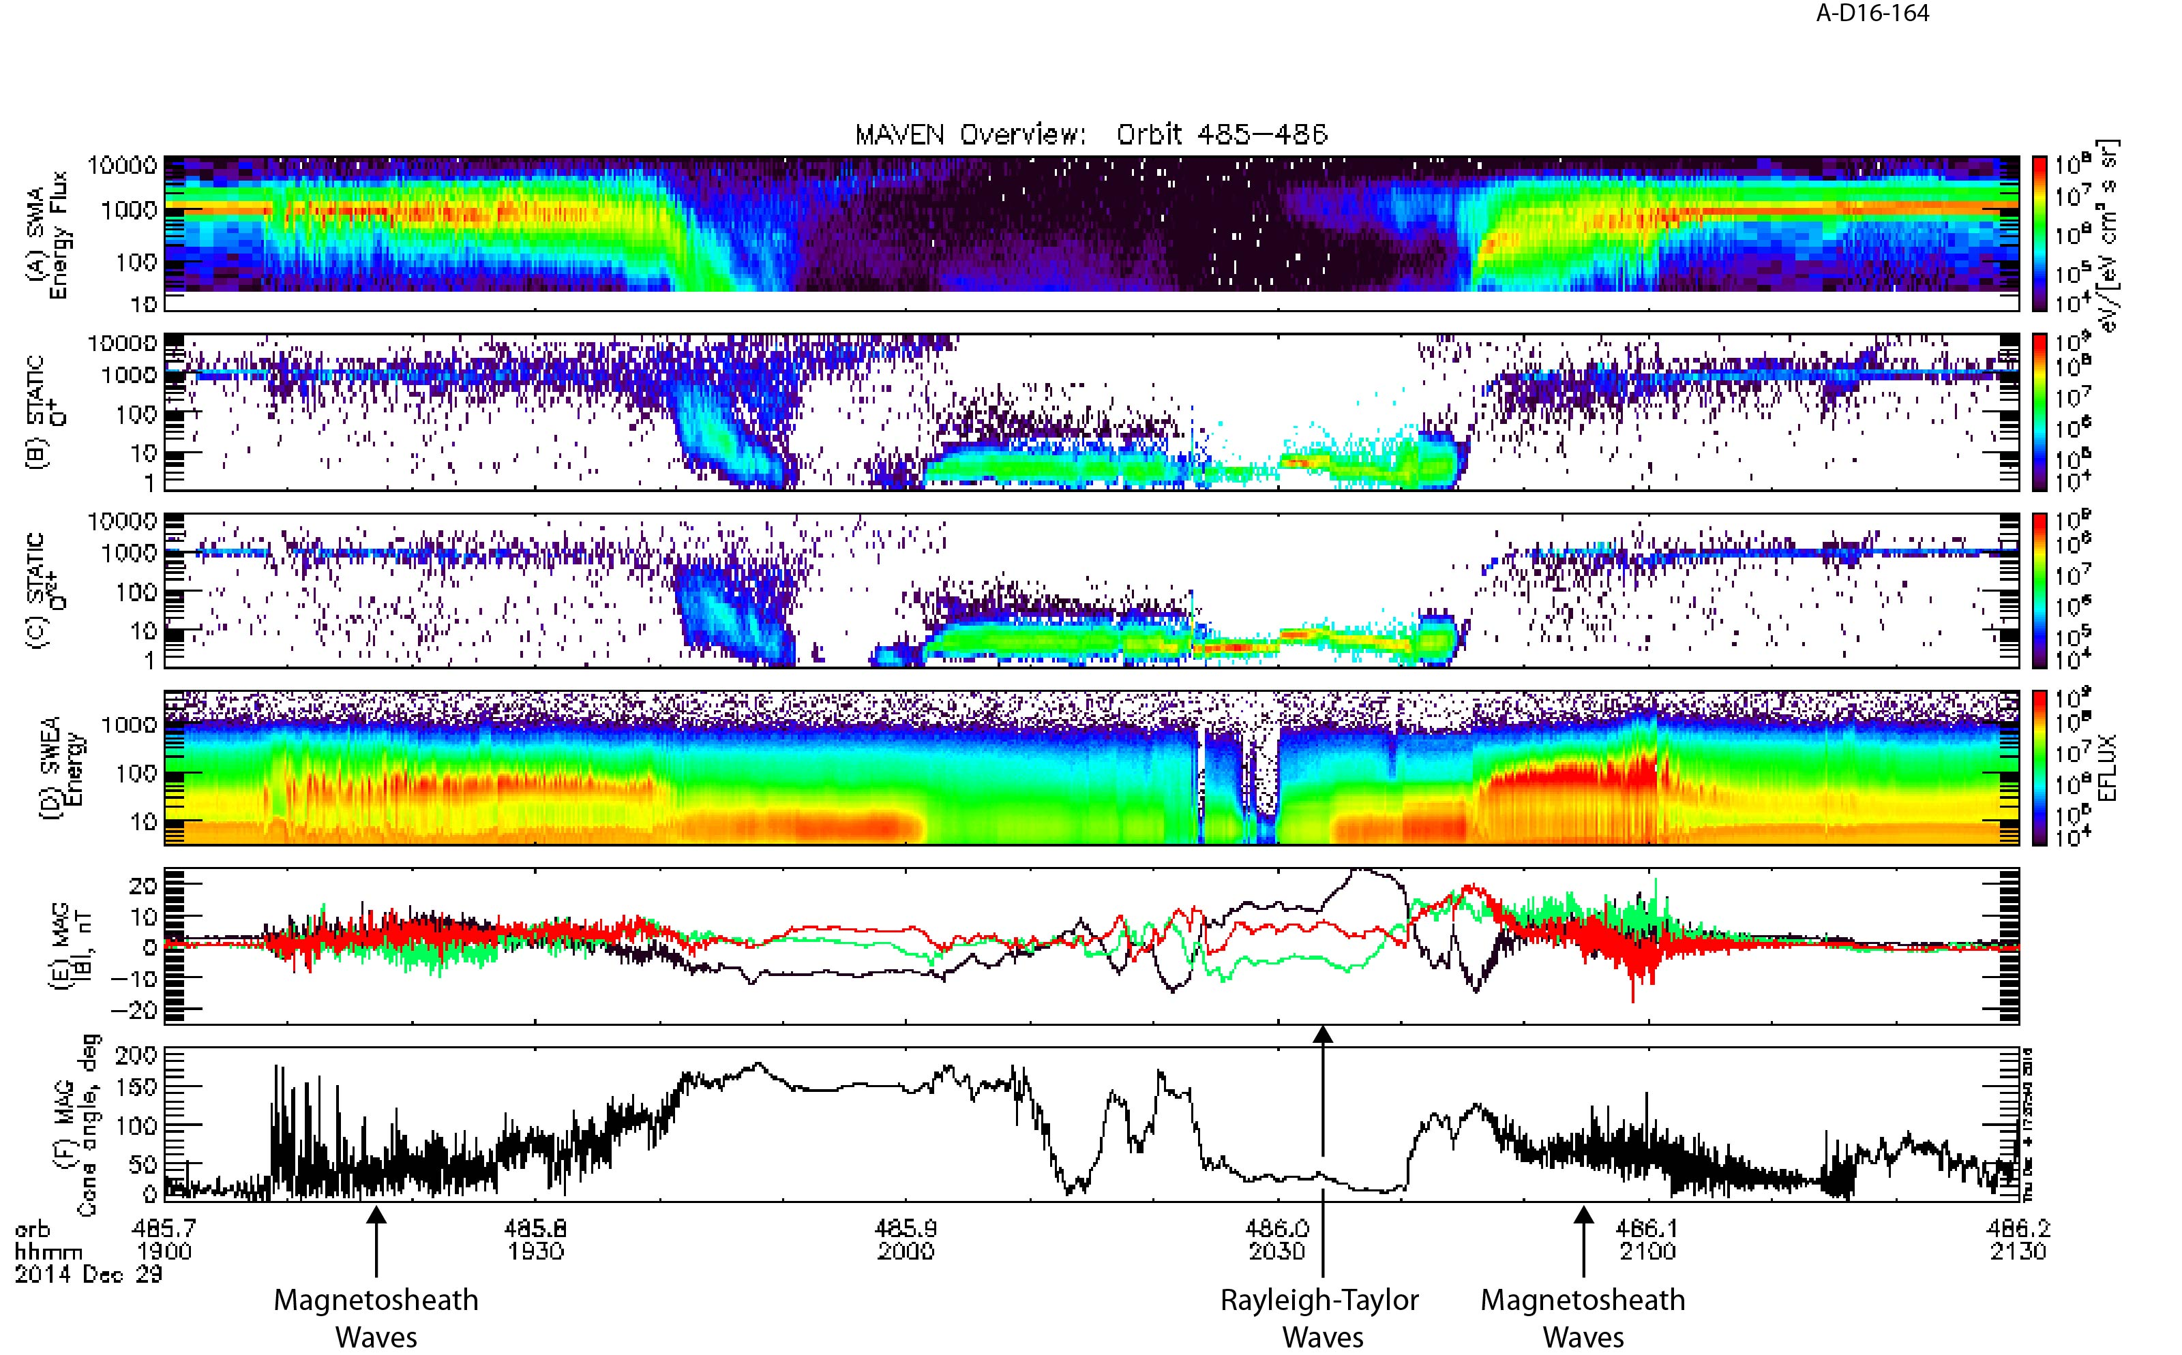
Parallel B-field EFFECTS
MAVEN observes strong magnetic oscillations in this time frame, coincident with strong wavelike behavior in SWIA ions (A) and SWEA electrons (D)
Period from 19:10-19:40 UT is while MAVEN is in the magneto-sheath. Same for 20:45-21:00 UT.
Low freq. waves near periapsis. May be due to Rayleigh-Taylor instability at ionospheric altitudes [Fowler et al, 2016]

Slide 18
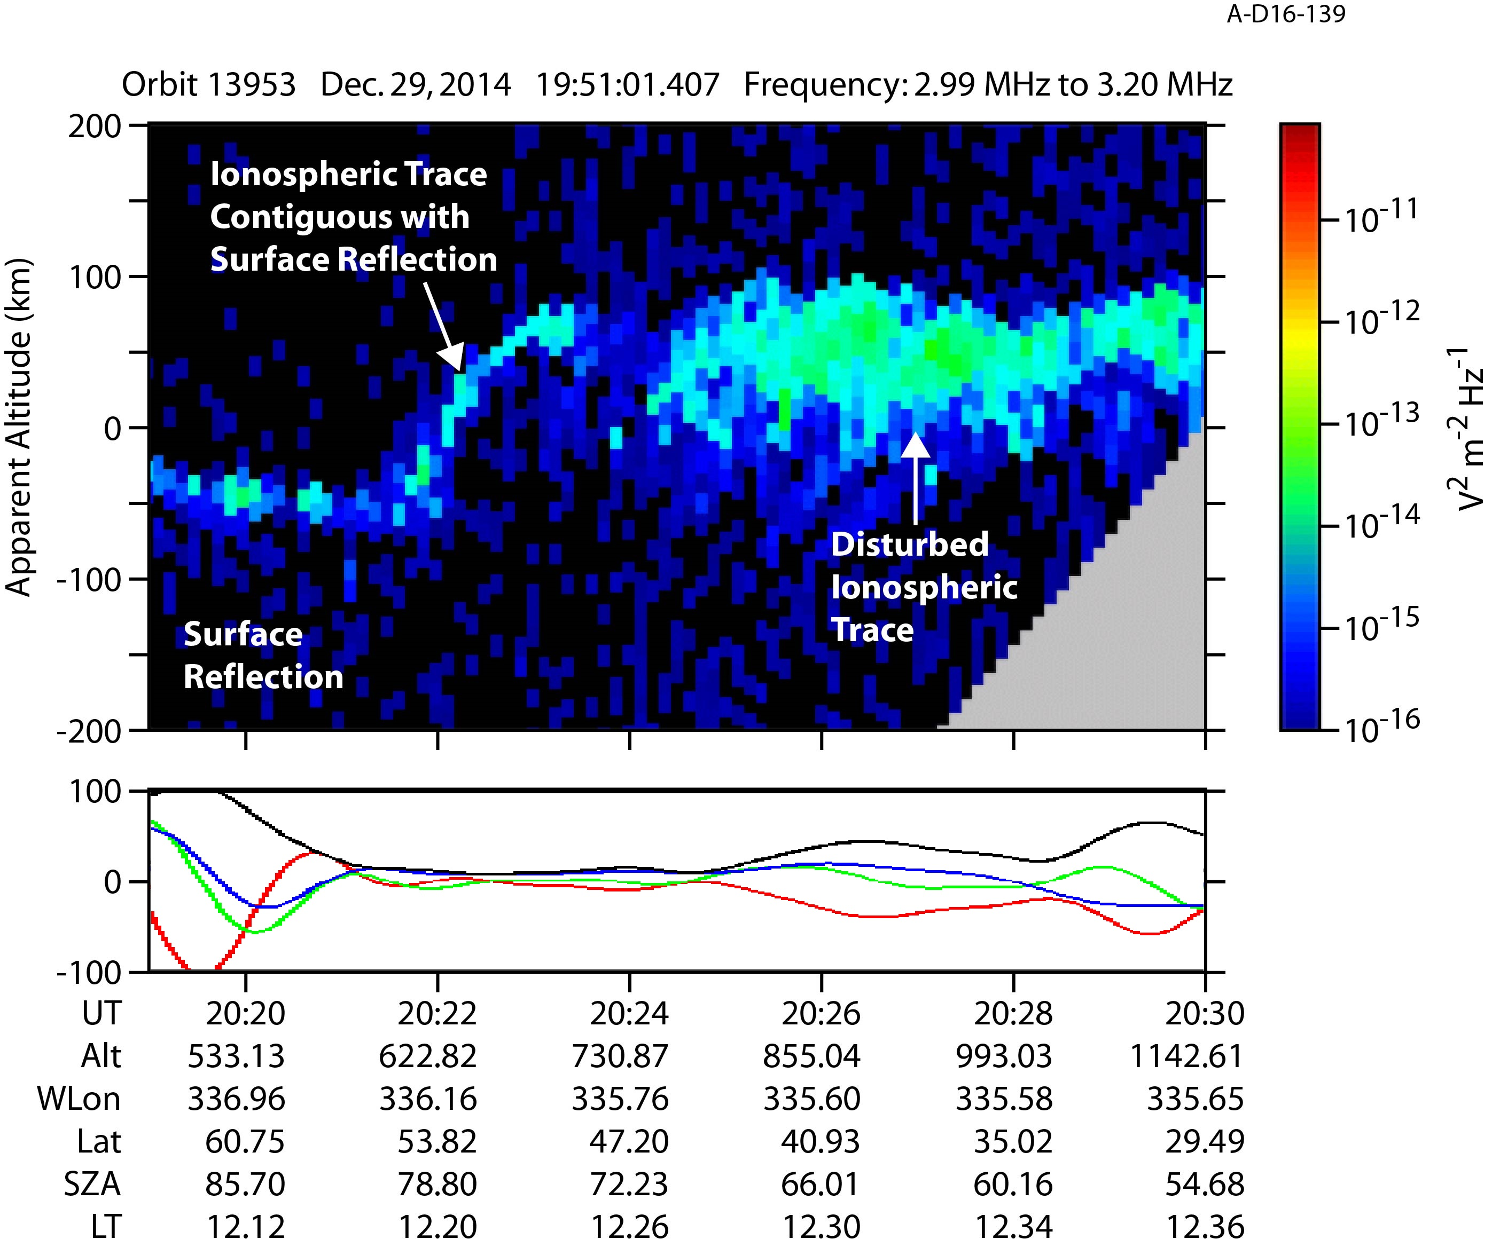
MARSIS OBSERVES A DISTURBED IONOSPHERE
MARSIS radargram from coinciding orbit, from 20:19-20:30 UT, averaged over frequencies from 2.99-3.2 MHz.
Two atypical features:
(1) – as MEX exits a region of moderate crustal fields, the surface and ionosphere reflections coincide
(2) – continuing to travel southward, ionosphere rises steadily in apparent altitude, then abruptly becomes highly disturbed

Slide 19
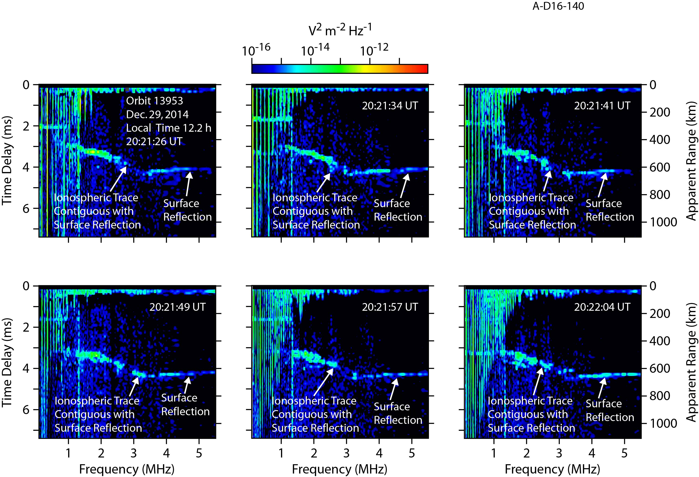
Connected ionospheric and surface reflections
Six consecutive ionograms from the previously discussed orbit, from 20:21:26-20:22:04 UT.
Ionosphere appears to approach the planetary surface without the typical cusp-like falloff, connecting the two reflections smoothly.
Possible low-altitude plasma?

Slide 20
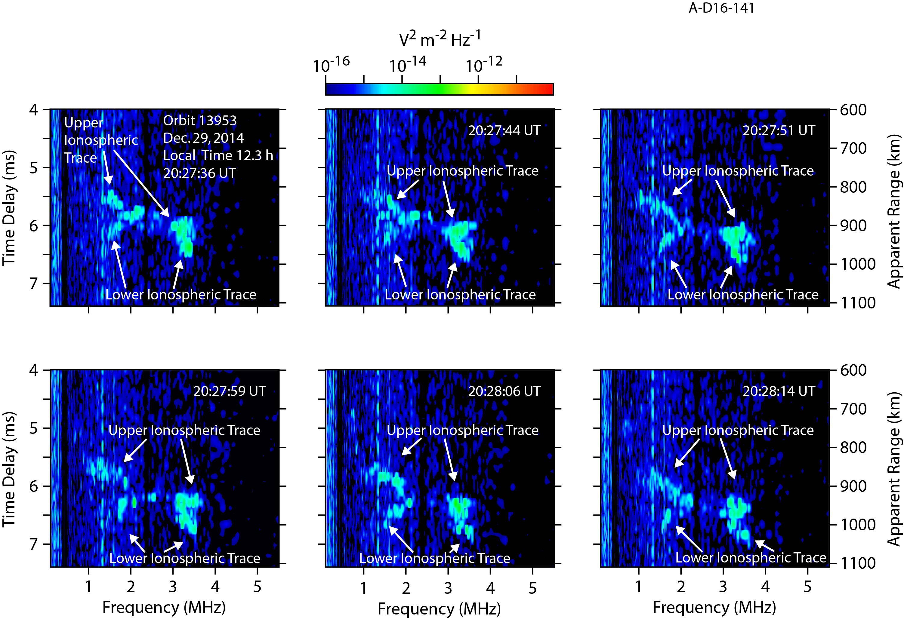
A Disturbed ionosphere
Six consecutive ionograms between 20:27:36-20:28:14 UT, which show a unique configuration of two ionospheric traces diverging at both low and high frequencies.
Coincides with the period of disturbed ionospheric traces observed in the radargram

Slide 21
NEW/UPCOMING Science

Slide 22
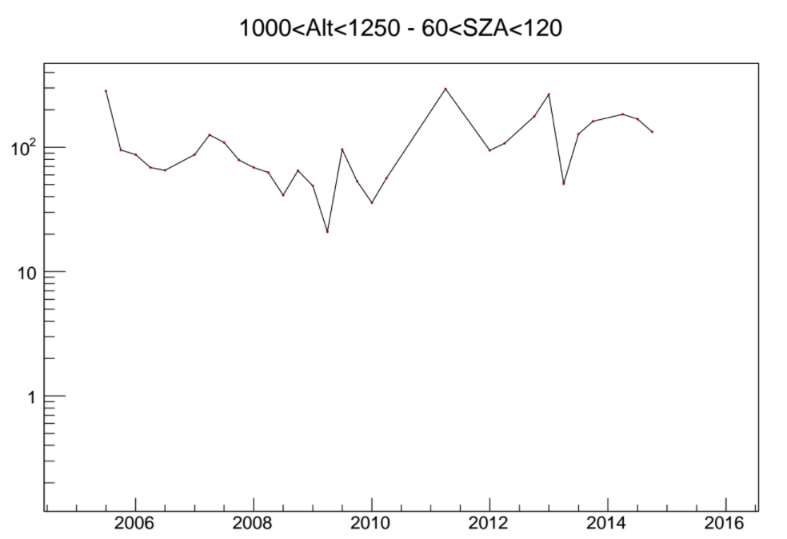
Solar Cycle Studies
MARSIS has now been operational for more than a full solar cycle
Studying densities over 11 years to examine seasonal changes and solar cycle effects
Being led by Firdevs Duru (Coe College)

Slide 23
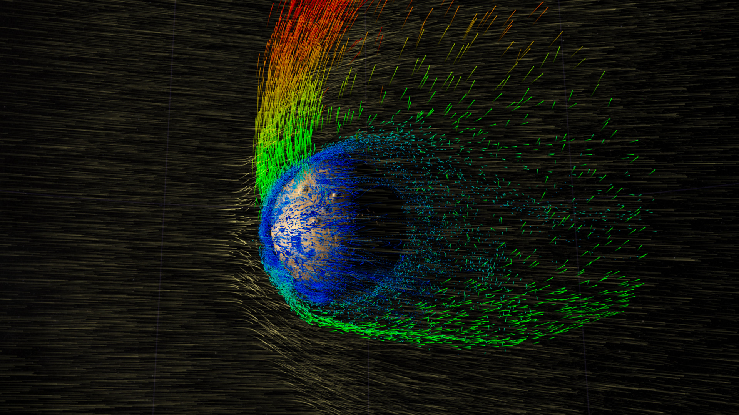
response to solar wind variations
MARSIS has made many observations during many periods where MAVEN is in the solar wind monitoring upstream conditions.
Variations in solar wind parameters may produce observable effects on the structure of the ionosphere.

Slide 24
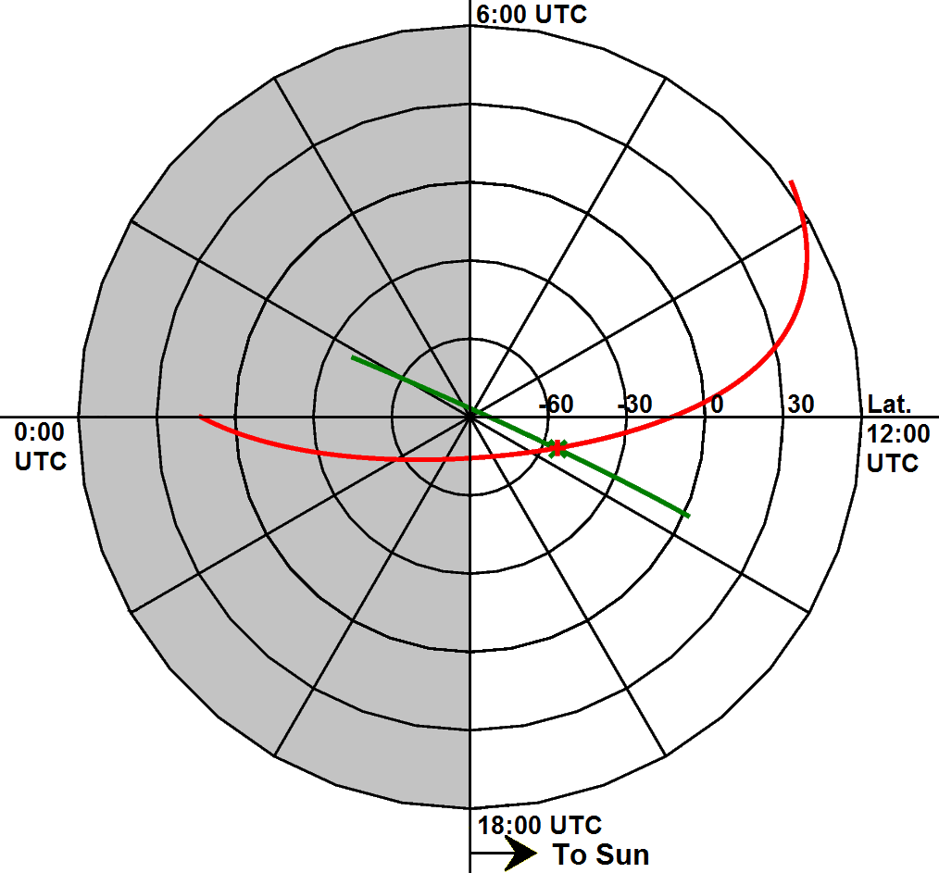
MEX-maven crossing orbits
MAVEN and Mars Express orbits occasionally coincide at common locations within short time frames
Allow for near-simultaneous studies of the Martian ionosphere
MARSIS soundings while MAVEN is observing in situ provides a more complete perspective of ionosphere

Slide 25
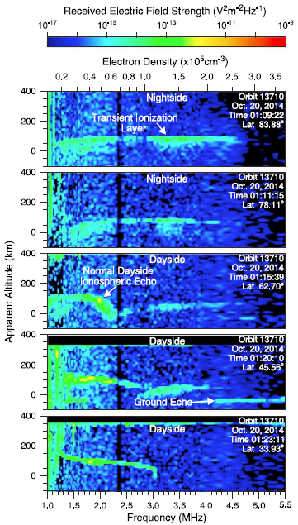
Siding Spring Revisited
Special Section at EPSC in September
Close encounter with comet in October 2014
Produced layer of ionization at altitudes below the main ionospheric peak, with densities higher than normal at Mars.
Present on dayside and nightside for two successive orbits, or between 14-21 hours after closest approach
Likely produced by dust impacts from comet

Slide 26
Questions?

Slide 27
RECENT PUBLICATIONS
Published
Nemec, F., D.D. Morgan, and D.A. Gurnett (2016), On improving the accuracy of electron density profiles obtained at high altitudes by the ionospheric sounder on the Mars Express spacecraft, J. Geophys. Res. Space Physics, 121, doi:10.1002/2016JA023054.
Vogt, M.F., P. Withers, K. Fallows, C.L. Flynn, D.J. Andrews, F. Duru, and D.D. Morgan (2016), Electron densities in the ionosphere of Mars: A comparison of MARSIS and radio occultation measurements, J. Geophys. Res., 121, doi:10.1002/2016JA022987.
Kopf, A.J., D.A. Gurnett, G.A. DiBraccio, D.D. Morgan, and J.S. Halekas (2017), The Transient Topside Layer and Associated Current Sheet in the Ionosphere of Mars, J. Geophys Res. Space Physics, 122, doi:10.1002/2016JA023591.

Slide 28
PENDING PUBLICATIONS
Under Review/Revision
Duru, F., D.A. Gurnett, D.D. Morgan, J. Halekas, R.A. Frahm, R. Lundin, W. Dejong, C.Ertl, A. Venable, C. Wilkinson, J.E.P. Connerney, J.R. Espley, D. Larson, P.R. Mahaffey, J.D. Winningham, and J. Plaut, Response of the Martian ionosphere to a strong ICME on 8 March 2015 resulting in high ion escape rates, Planet. & Space Sci.
Andrews, D.J., H.J. Opgenoorth, T. Leyser, S. Buchert, N.J.T. Edberg, D.D. Morgan, D.A. Gurnett, A.J. Kopf, K. Fallows, and P. Withers, MARSIS radar reflections from field-aligned irregularities in the Martian ionosphere, J. Geophys. Res. Space Physics.
Fallows, K, P. Withers, D. D. Morgan, and A. J. Kopf, Extremely high plasma densities in the Mars ionosphere associated with cusp-like magnetic fields, J. Geophys. Res. Space Physics.
Dieval, C., A. J. Kopf, and J. A. Wild, Altitude variations of magnetically controlled electron density structures in the dayside Martian ionosphere, J. Geophys. Res. Space Physics.

