Slide 1
New Observations of Upper Ionospheric Layers with Mars Express and MAVEN
Andrew j. kopf
Marsis-sharad science team meeting
November 3, 2015

Slide 2
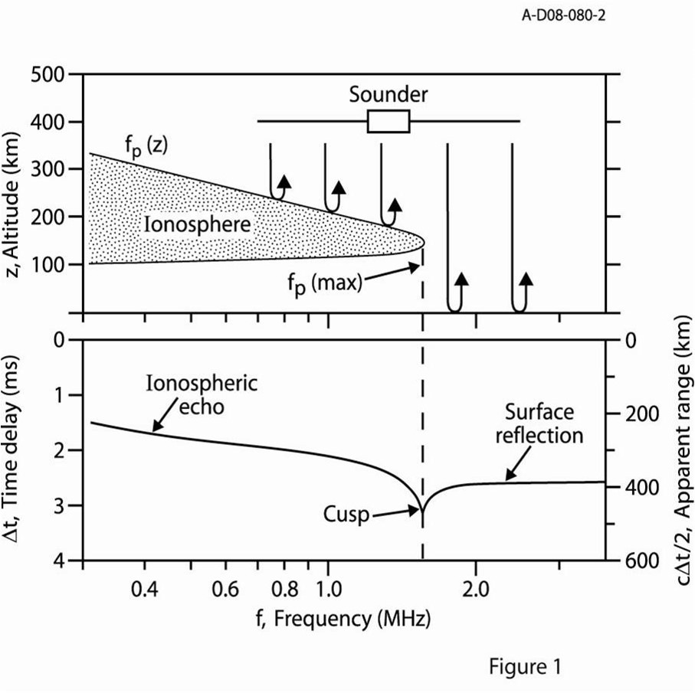
Sounding Principles
Radar pulse can not propagate at frequencies below the plasma frequency
Reflection occurs when the pulse frequency equals the electron plasma frequency
Cusps occur at density profile maximums

Slide 3
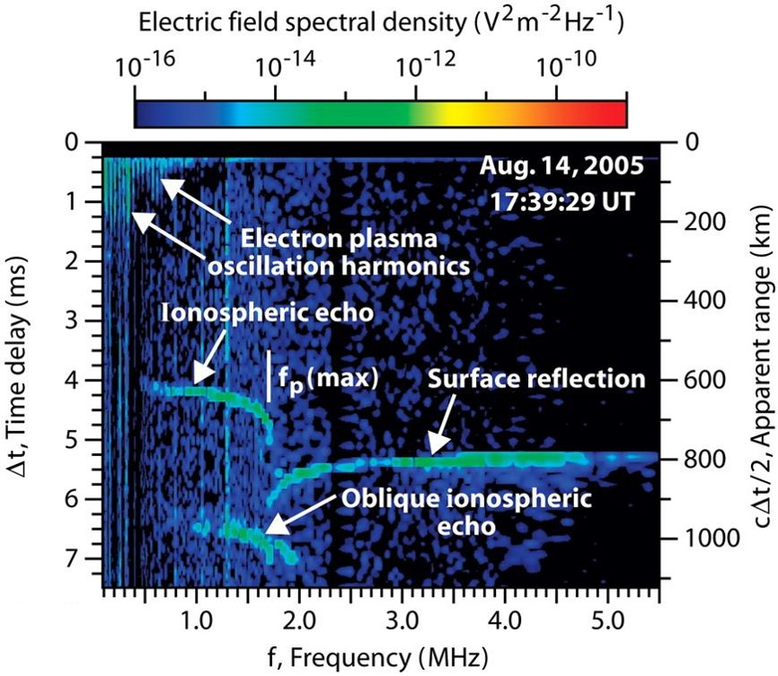
General Case

Slide 4
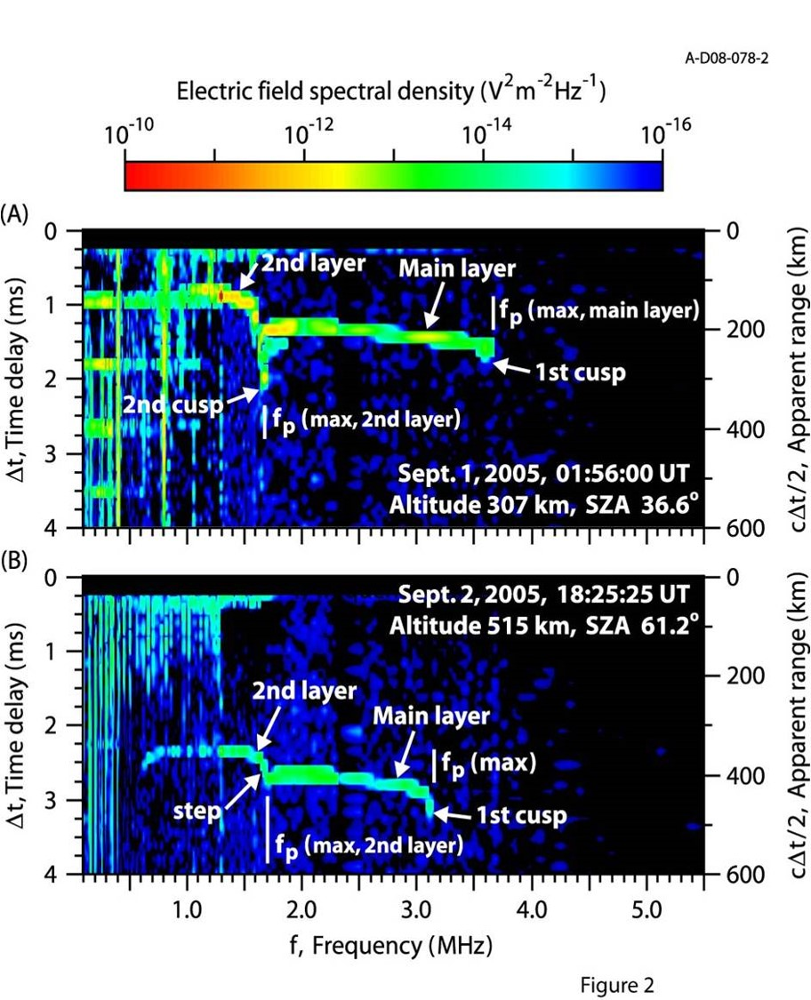
Topside Structure: “Cusps” and “Steps”
(A) shows a full second cusp, indicating a clear peak in the density profile
(B) shows a “step” at a lower frequency at an inflection point (dn/dz approaches but never equals zero)
Both indicate the presence of a second topside layer

Slide 5
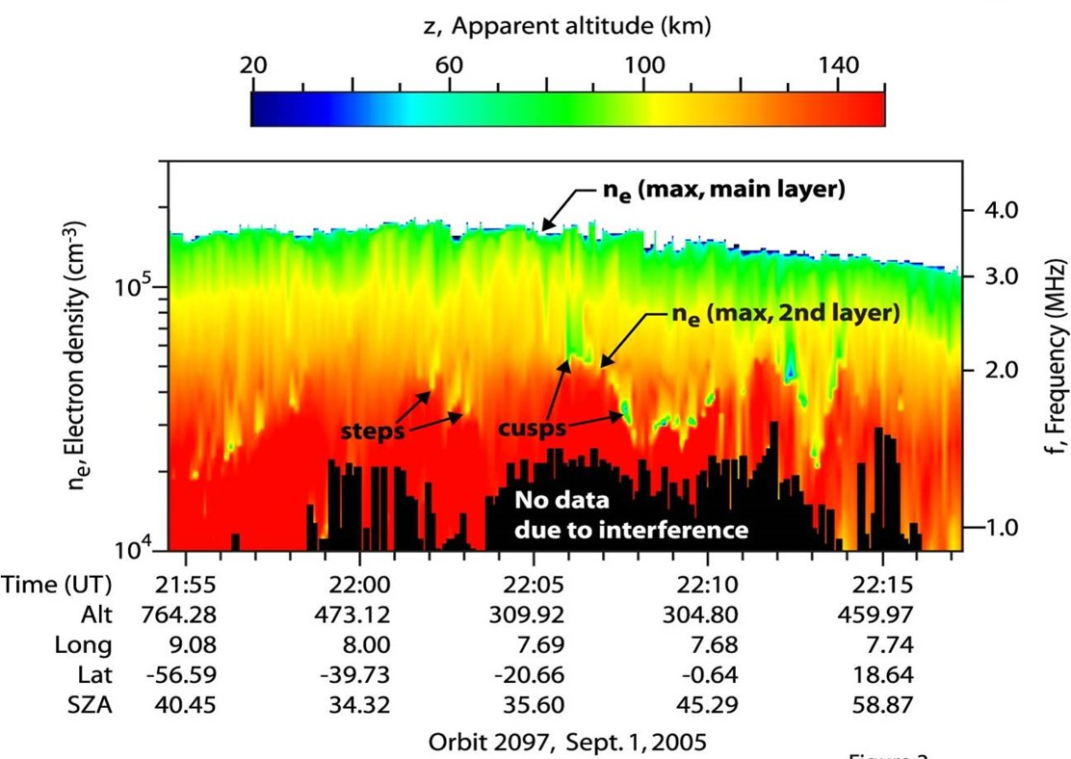
Variable and Transient
While the altitude and density of the main layer are roughly constant, the 2nd layer varies in both
Altitude 180-220 km
Density 2-5 x 10⁴ cm⁻³
2nd layer is also transient, coming and going at irregular intervals.

Slide 6
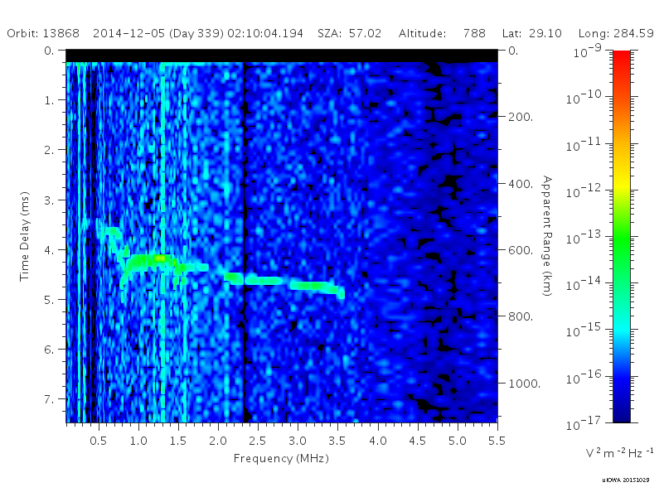
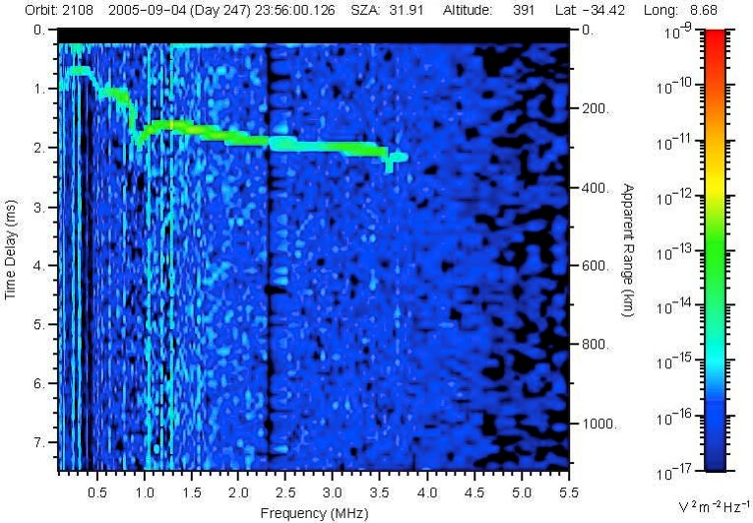
There Can Be More Than Just One

Slide 7
The Limits of Mars Express
While highly successful in the discovery and general survey of these features, Mars Express was not equipped to fully answer what these features were.
MARSIS, a topside sounder, could not peer into or beneath these features, so had no knowledge of composition or general structure.
Solar wind moments could be obtained, but were averages over an entire orbit, not on time scales that could help explain these short-term features.

Slide 8

Enter MAVEN…
Adding the new spacecraft to the environment allowed these problems to begin to be dealt with.
MAVEN has (among others):
SWIA, a solar win analyzer that can obtain 3-component velocities, densities, and ion temperatures.
NGIMS, a mass spectrometer, which can break down the ionospheric composition as MAVEN flies thru it.

Slide 9
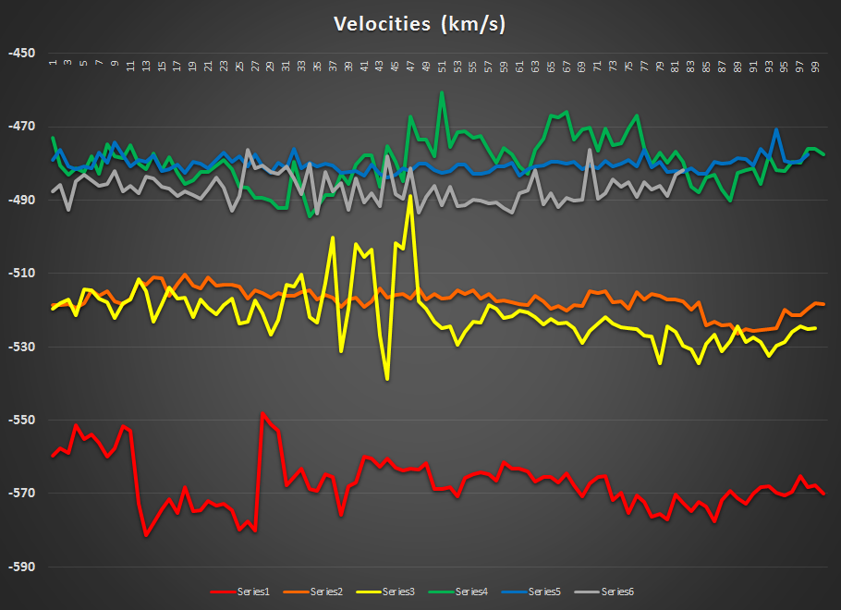
Solar Wind from MAVEN SWIA
Studying three consecutive days of coincident MARSIS and SWIA data to search for effects of the solar wind on the presence of layers
First three are done
Data comes from December 3-5, 2014

Slide 10
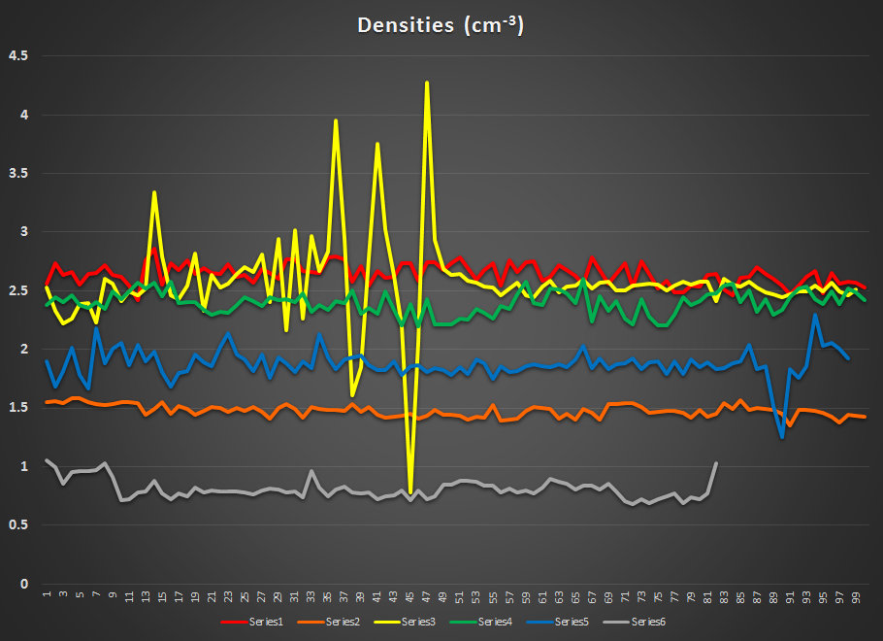
Densities: Not a Factor (Within a single orbit)

Slide 11
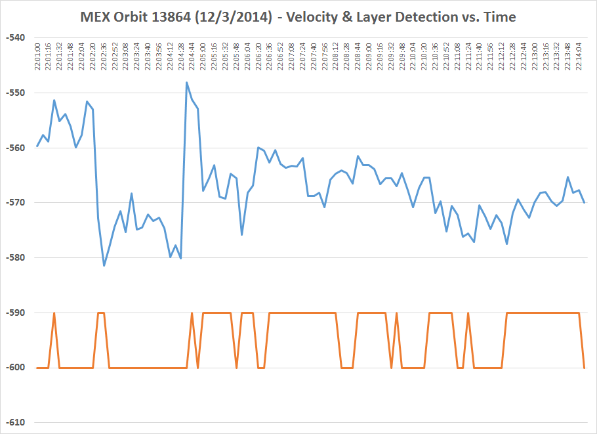
SWIA 13864 – 12/3/14

Slide 12
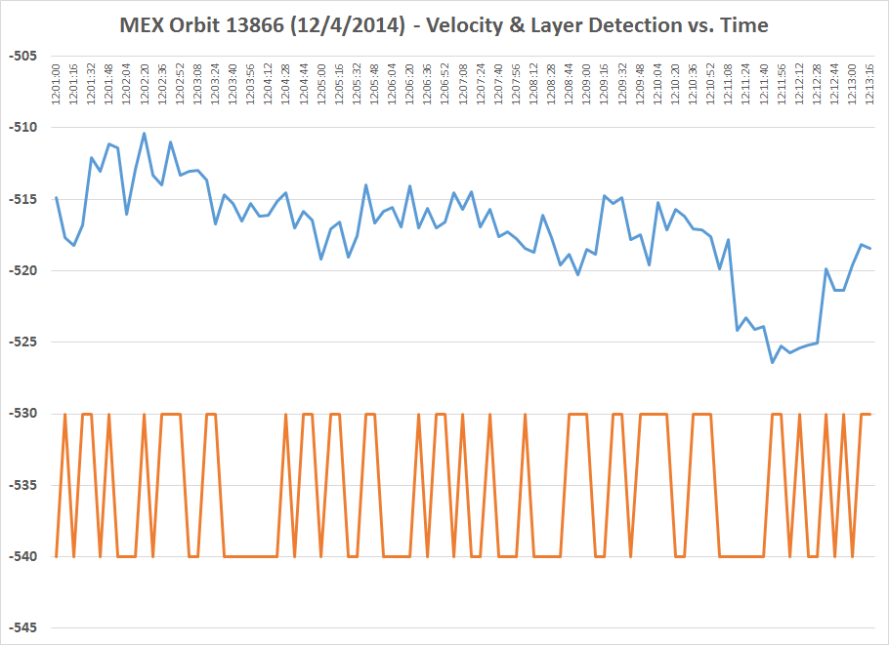
SWIA 13866 – 12/4/14

Slide 13
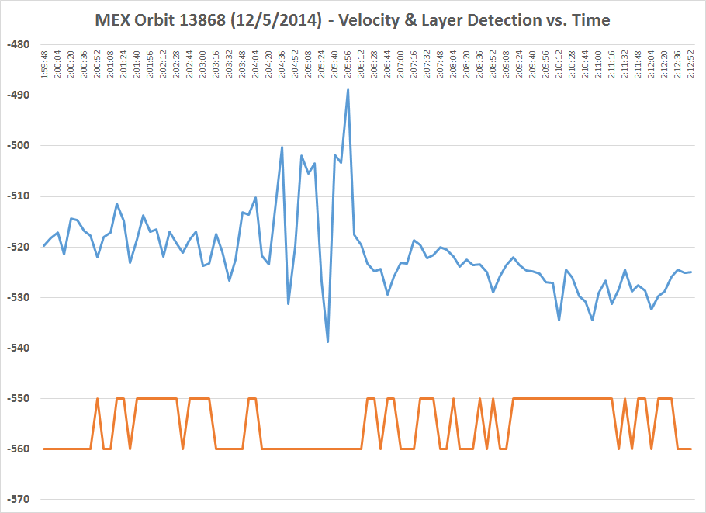
SWIA 13868 – 12/5/14

Slide 14
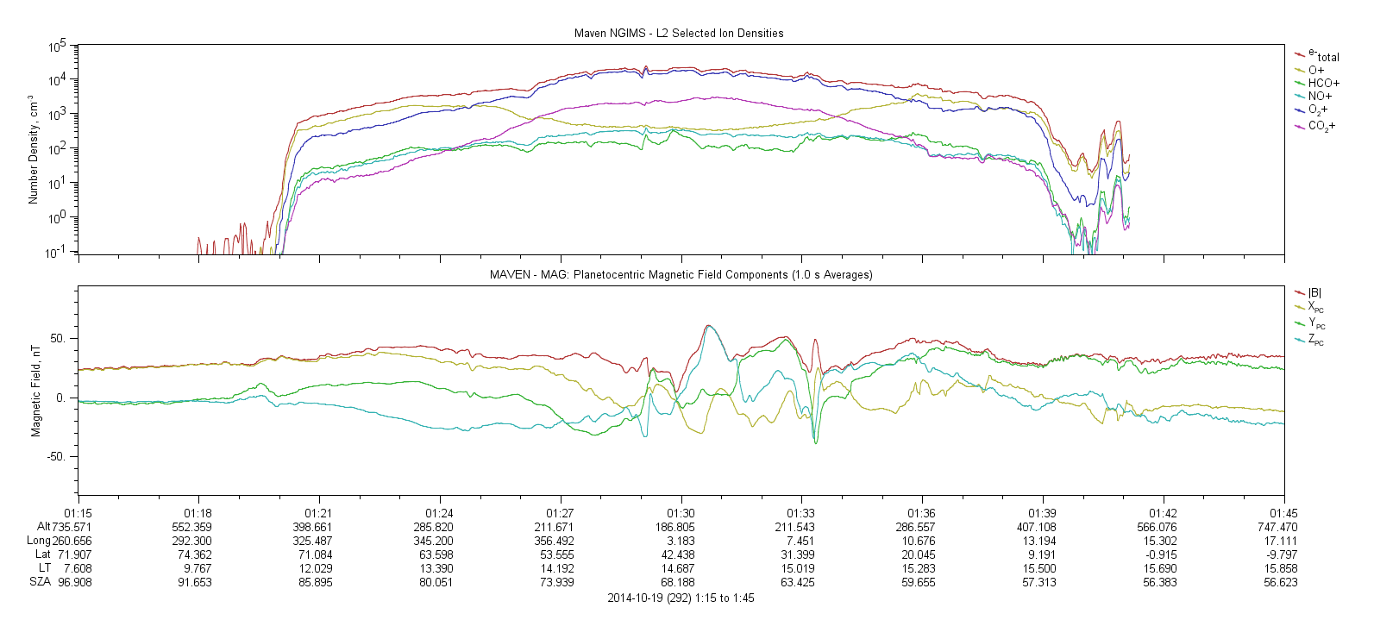
Ion Composition – MAVEN NGIMS

Slide 15
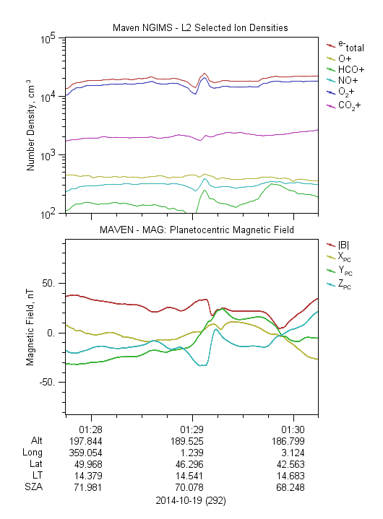
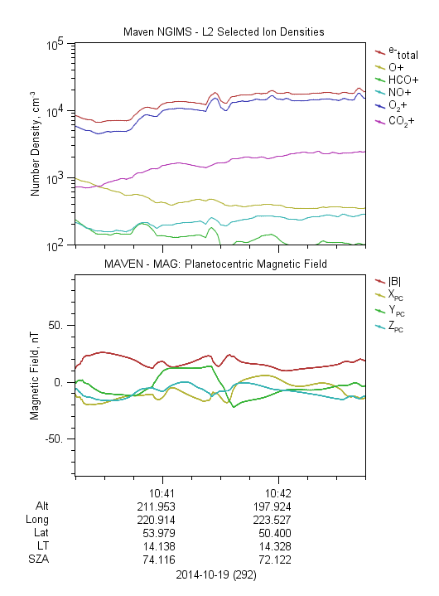
NGIMS 10/19/14

Slide 16
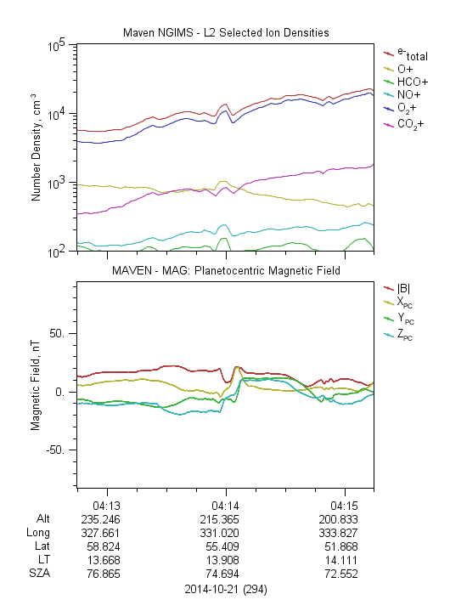
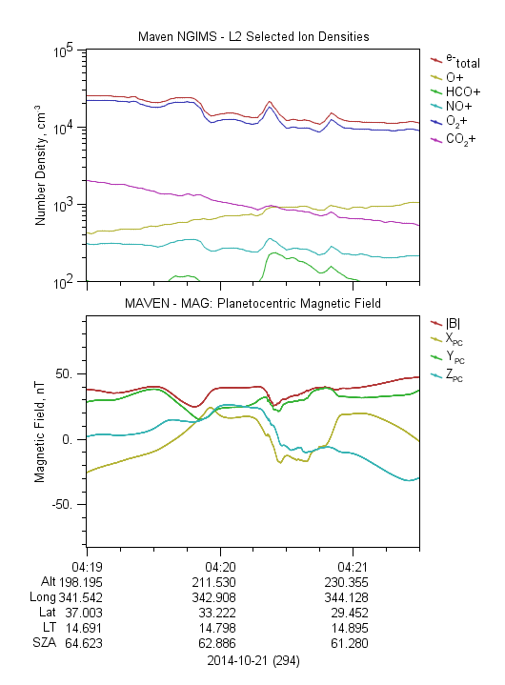
NGIMS 10/21/14

Slide 17
So What More Do We Know Now?
Solar Wind (SWIA)
In steady solar wind conditions, layers are highly transient, but still present up to 50% of the time. They are thus a natural feature of that environment.
In more dynamic solar wind conditions, upper layers will generally vanish until the solar wind returns to a more steady state, apparently disrupted by the sharp change.

Slide 18
So What More Do We Know Now?
Solar Wind (SWIA)
In steady solar wind conditions, layers are highly transient, but still present up to 50% of the time. They are thus a natural feature of that environment.
In more dynamic solar wind conditions, upper layers will generally vanish until the solar wind returns to a more steady state, apparently disrupted by the sharp change.
Ion Composition (NGIMS)
Largest component of the upper layers is the same as with the main layer (O₂⁺). All other ions are orders of magnitude lower.
Multiple ions show an increase in density in upper layers, not just the dominant O₂⁺.
Layers appear to coincide with small local magnetic field features, suggesting a current.

Slide 19

Possible Explanation – Wave/Instability?
The shear between the steady-state solar wind and the upper ionosphere (due to their different velocities) yields an instability (Kelvin-Helmholtz?) that would manifest as a denser region above a depleted region.
These would naturally form, disperse, and reform under the influence of an unchanging solar wind.
Sharp variation in the solar wind would disrupt the steady mixing, preventing the smooth formation of the instability and thus eliminating the “layers”.

