Slide 1
The Saturnian Auroral Hiss
A Multi-Instrument Study
A.J. Kopf¹, D.A. Gurnett¹, G.B. Hospodarsky¹, W.S. Kurth¹, M.K. Dougherty², D.G. Mitchell³, J.S. Leisner⁴, K.K. Khurana⁴, S. Grimald^{5,6}, C. Arridge^{5,6}, P. Schippers⁷, N. André⁷, A. Coates^{5,6}
(1) – Department of Physics & Astronomy, University of Iowa, Iowa City, IA
(2) – Space & Atmospheric Physics, Blackett Laboratory, Imperial College, London, UK
(3) – Applied Physics Laboratory, Johns Hopkins University, Laurel, MD
(4) – Institute of Geophysics & Planetary Physics, UCLA, Los Angeles, CA
(5) – Mullard Space Science Laboratory, University College, London, UK
(6) – The Centre for Planetary Sciences at UCL/Birkbeck, University College, London, UK
(7) – Centre d’Etude Spatiale des Rayonnements, CNRS/Université Paul Sabatier, Toulouse, FR

Slide 2
AURORAL HISS
Whistler-mode plasma wave emission in high-latitude regions of magnetosphere
First observed at Earth in 1960s. Has since been detected on other planets, including Jupiter and Saturn
Saturn detections due to upward-propagating electrons along magnetic field lines
Believed to propagate near resonance cone around field-aligned currents
Characteristic funnel shape on spectrogram

Slide 3
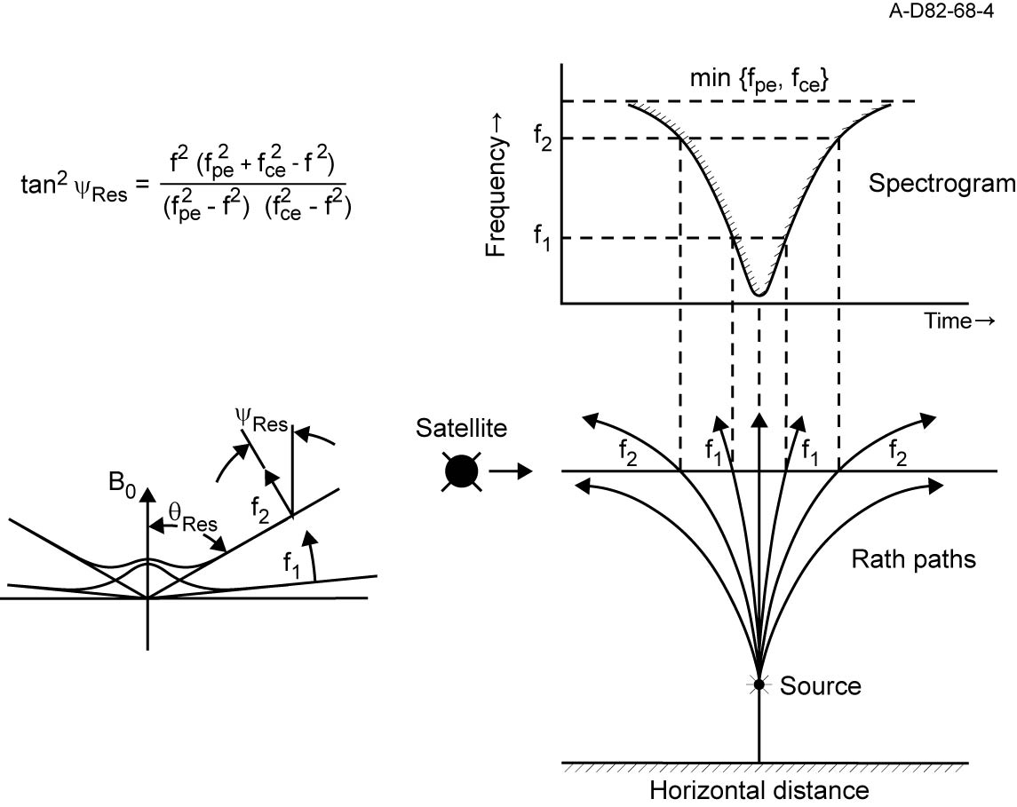
RESONANCE CONE

Slide 4
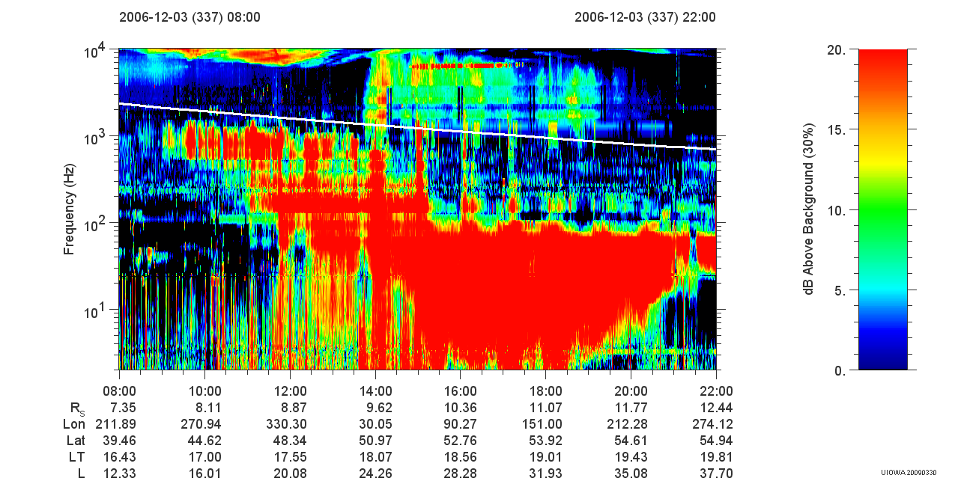

Slide 5
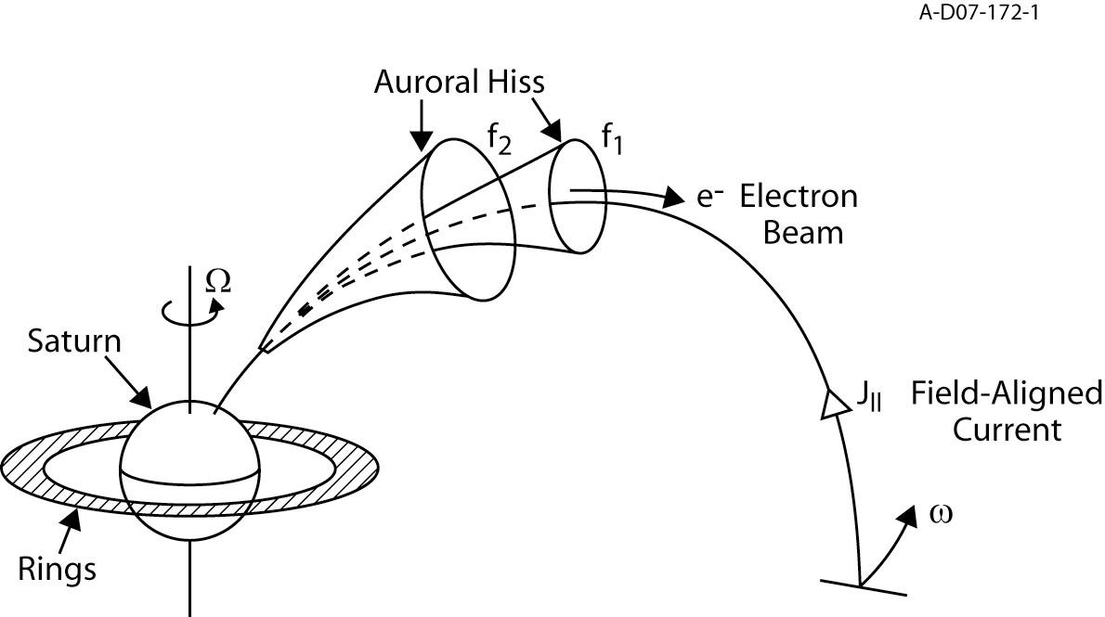
The Generation & Propagation of Auroral Hiss

Slide 6
What Are We Looking For?
Location – Observe emission at
  Any longitude of the planet
  Higher latitudes (unless very far away)
Periodicity – evidence for rotating beam or clock-like source models
Associated field-aligned currents
Associated particle beams

Slide 8
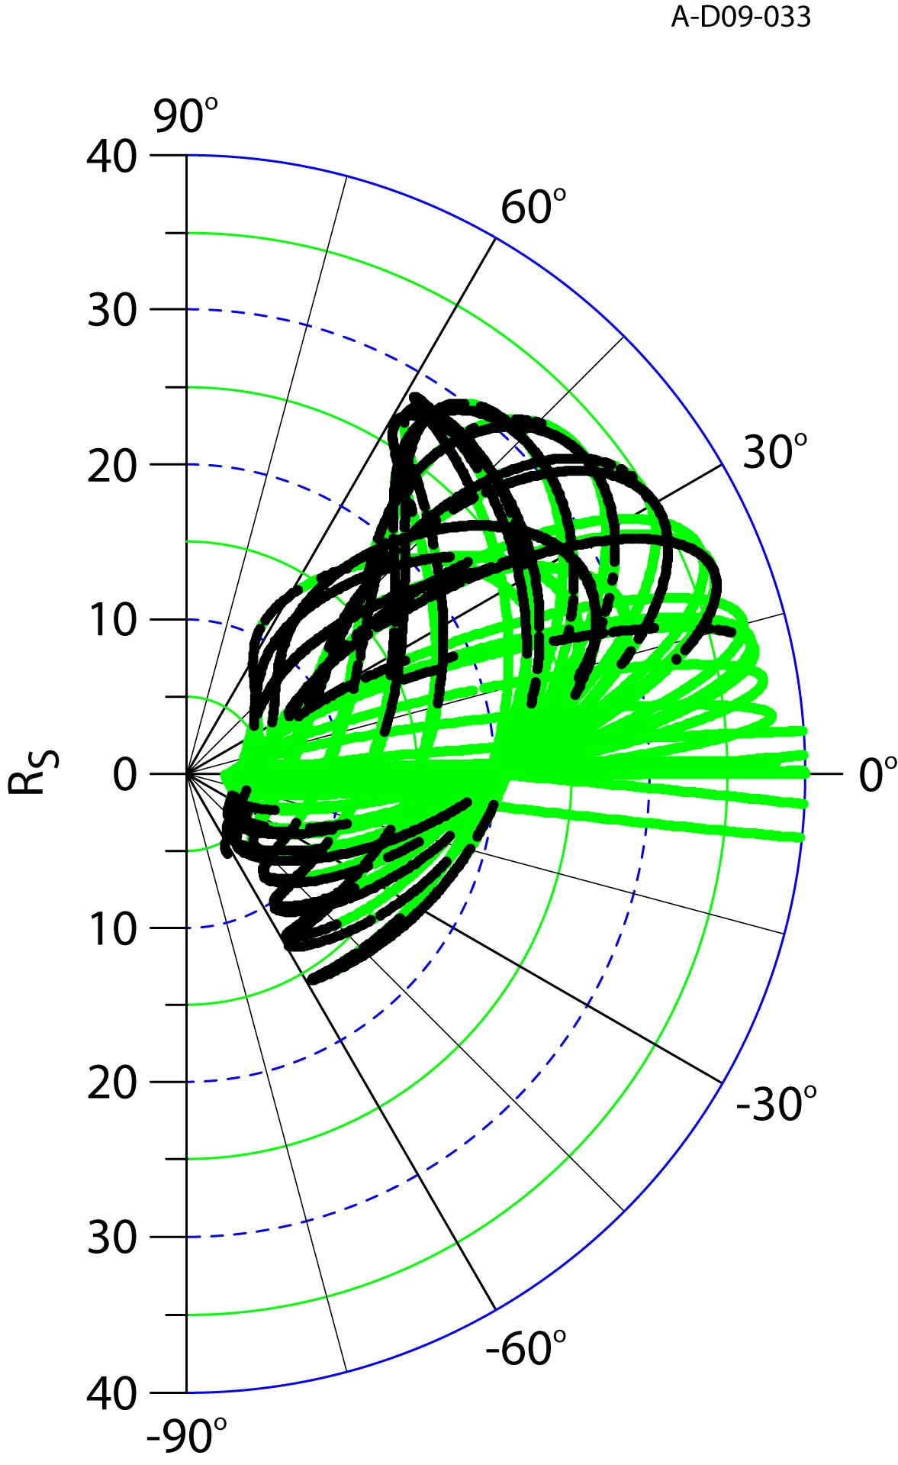
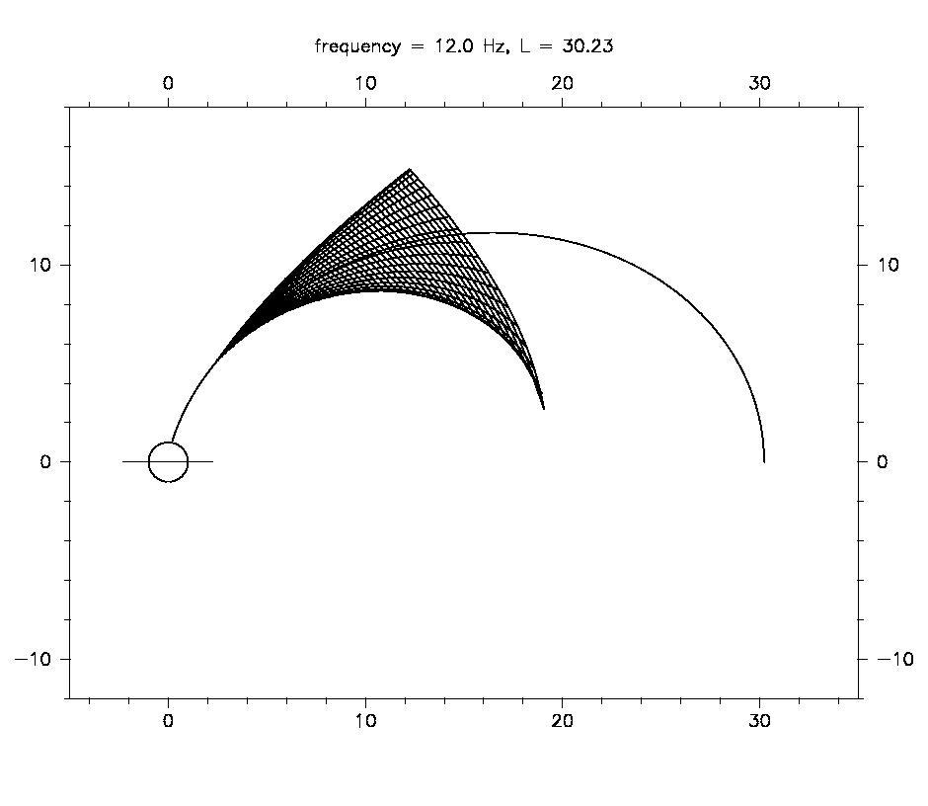

Slide 9
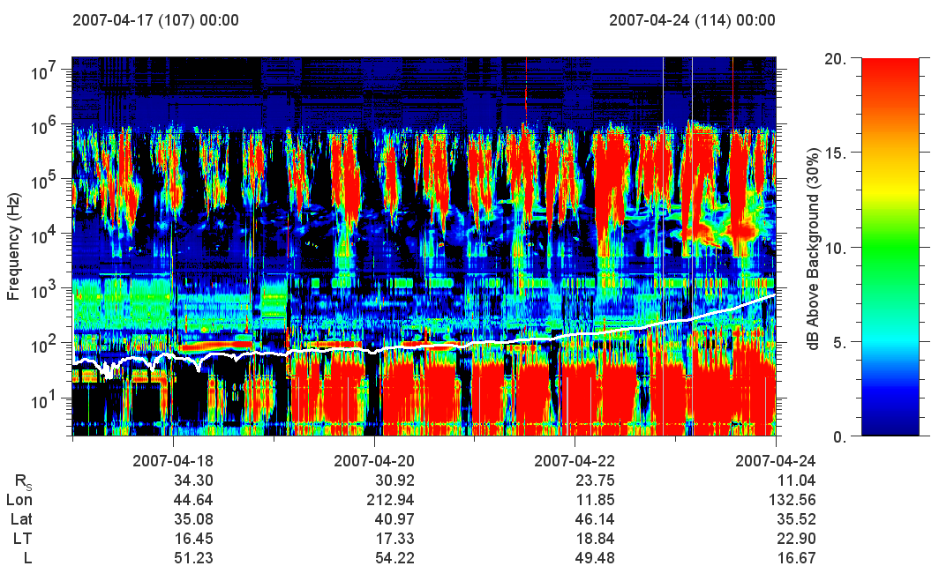

Slide 10
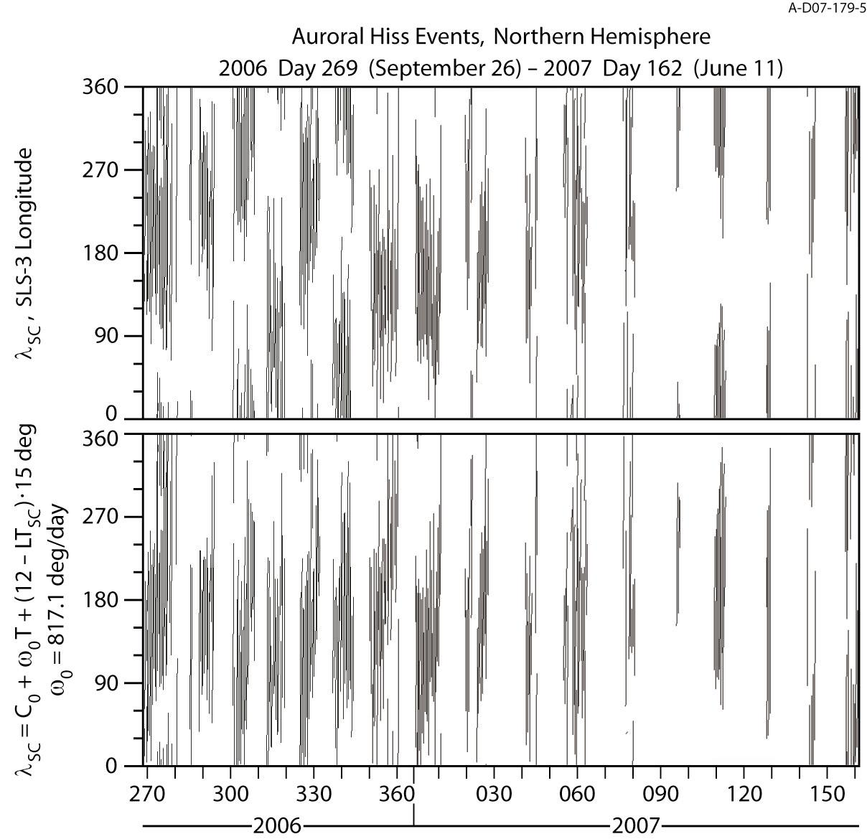
Periodicity

Slide 11
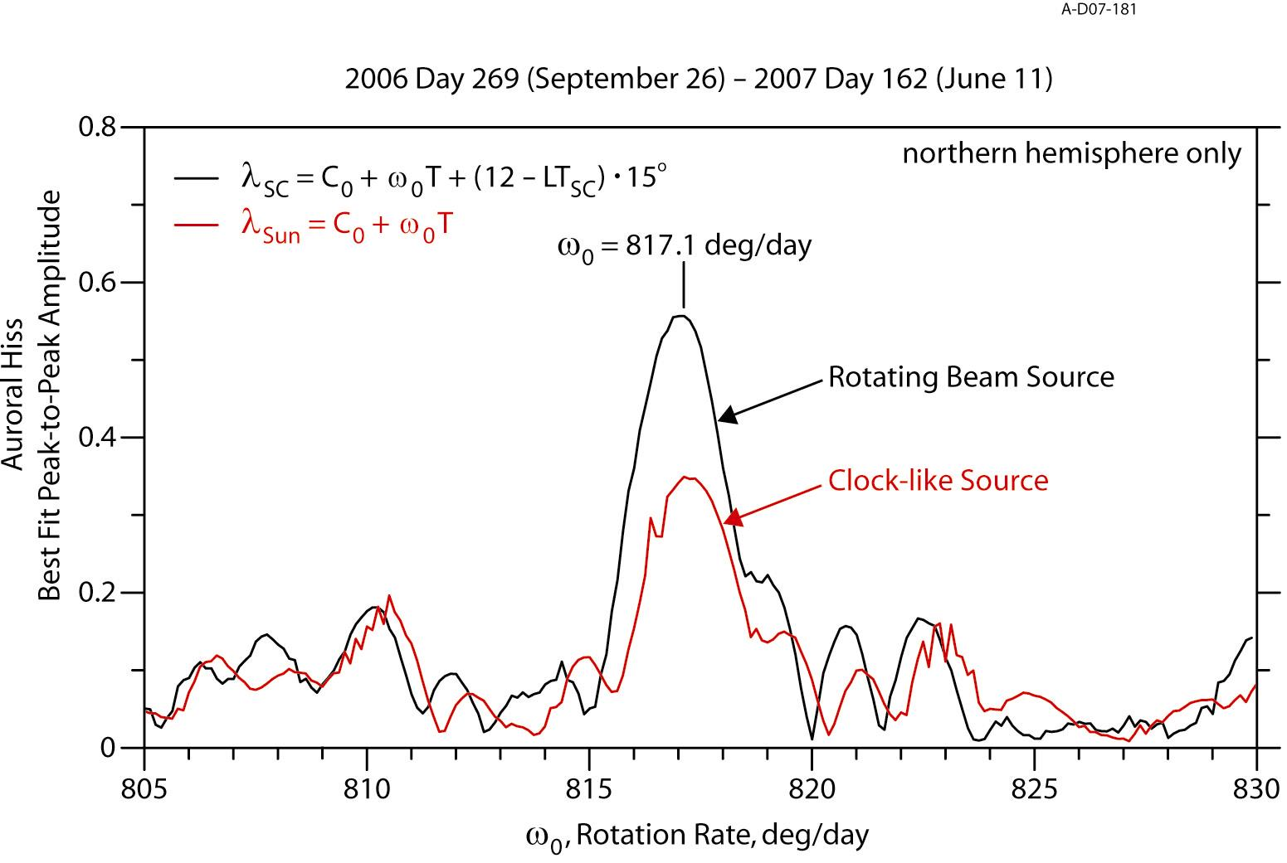
Modulation Spectrum

Slide 12
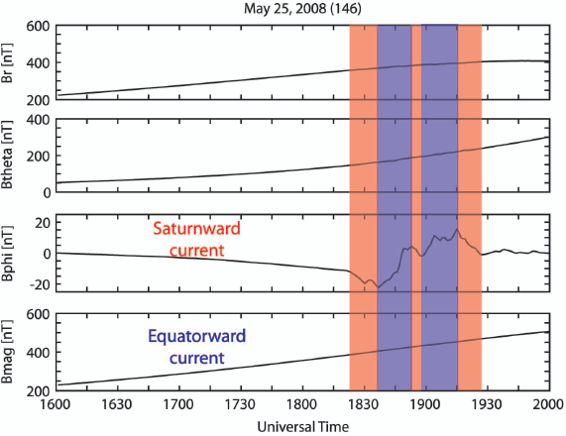
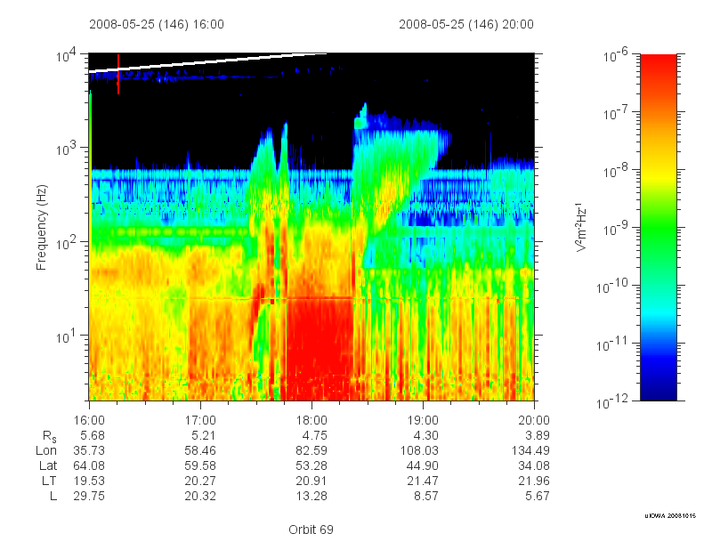

Slide 13
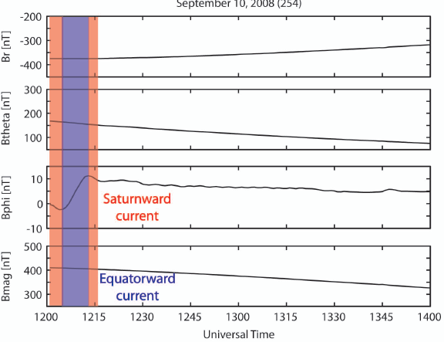
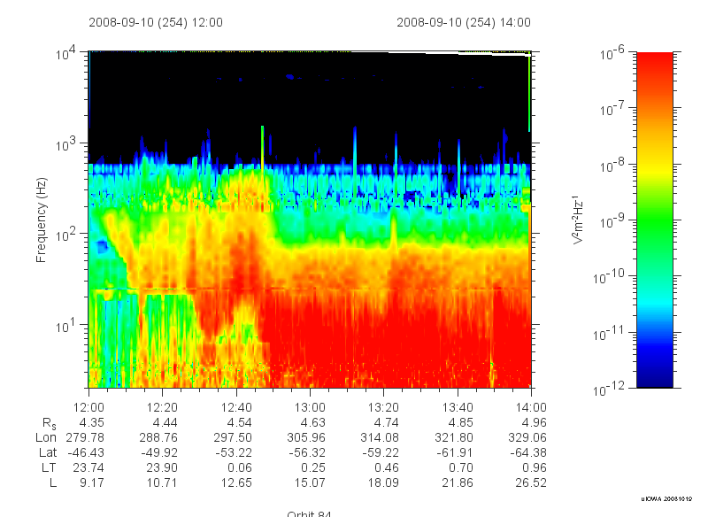

Slide 14
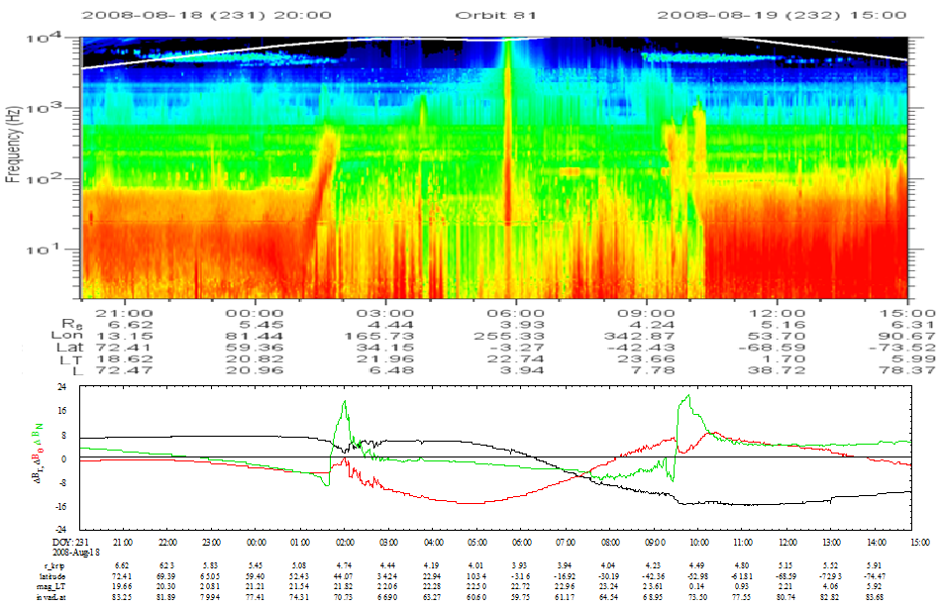

Slide 15
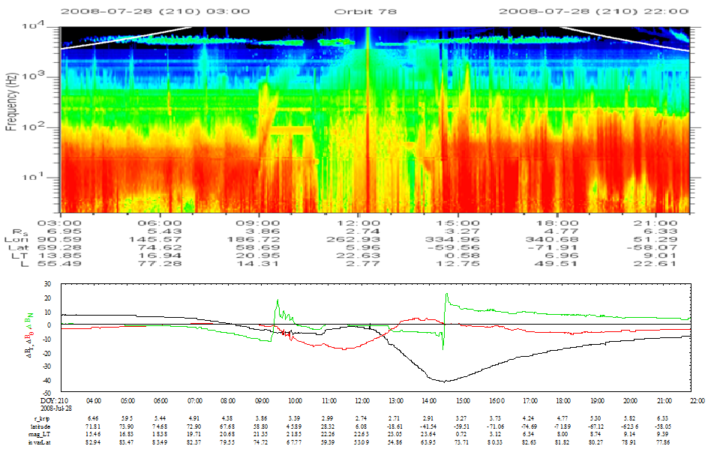

Slide 16
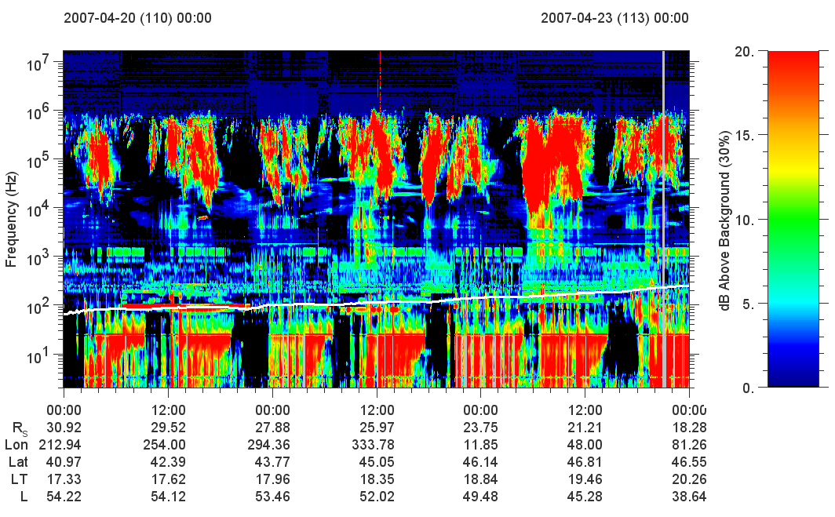

Slide 17


Slide 18
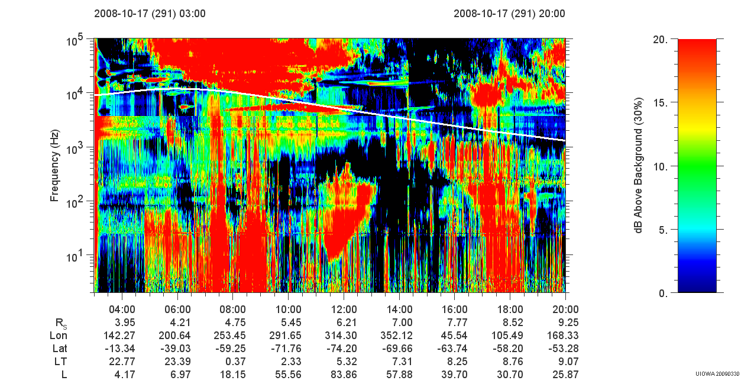

Slide 23
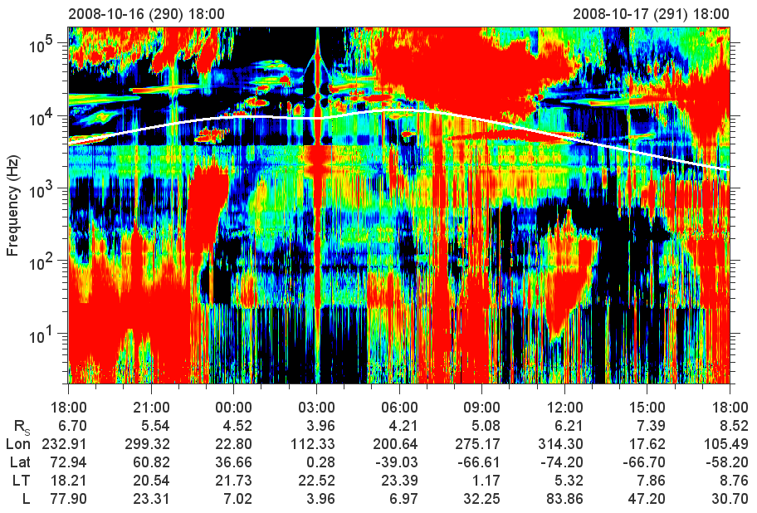
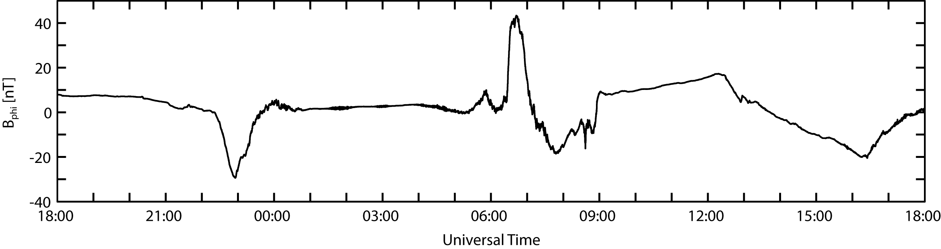

Slide 24
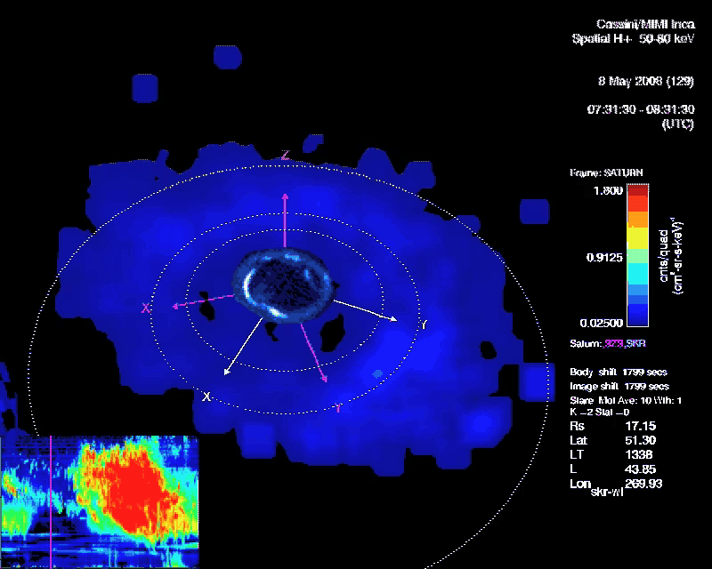
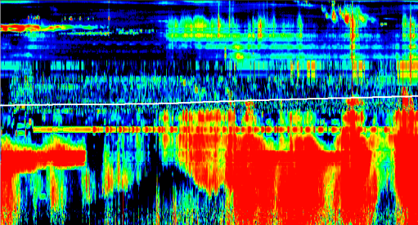

Radio Emission From Saturn’s Aurora
(Video courtesy of D. Mitchell, APL)

Slide 25
SUMMARY
Whistler mode auroral hiss events detected at Saturn, show similar features to those at Earth
Emission displays two periodicities
  1 hour burst periodicity possibly due to ion conics
  10.8 hour periodicity with properties of a rotating beam source
Field-aligned current structures commonly observed, but do not align with center of hiss
Ion Beams detected at same location as current structures, not along center of radio emission
Correlation exists between optical/uv, plasma density, and radio emission, suggesting a large and complex system behind this process.

