Slide 1



CORRELATED OBSERVATIONS OF THE TRANSIENT TOPSIDE MARTIAN IONOSPHERIC LAYER
Andy Kopf, dept. of physics & Astronomy, the University of Iowa
thanks to don gurnett, gina dibraccio, david morgan, & jasper halekas

Slide 2
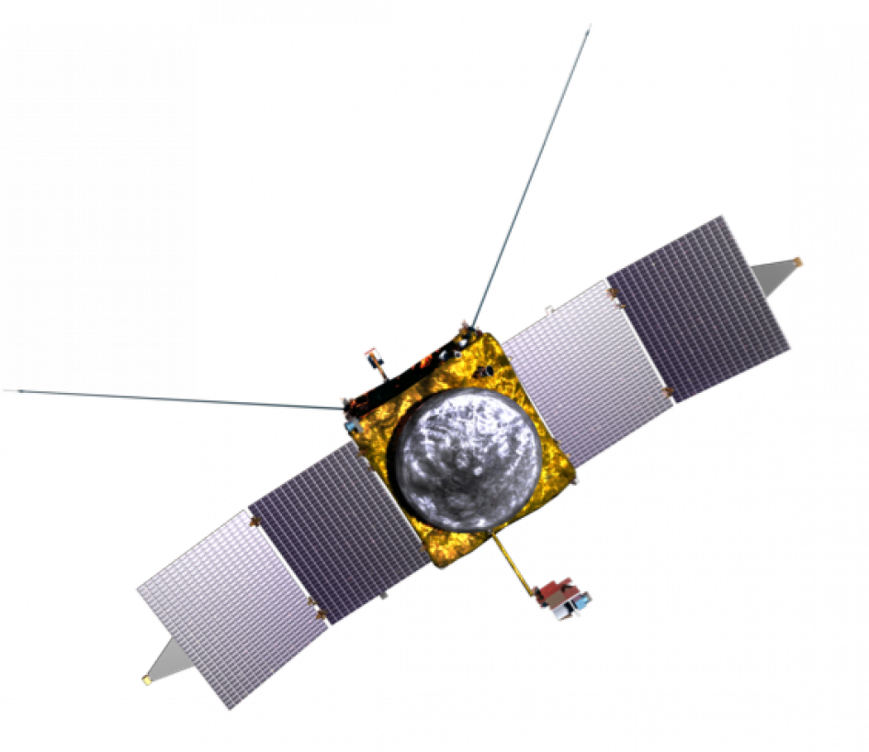
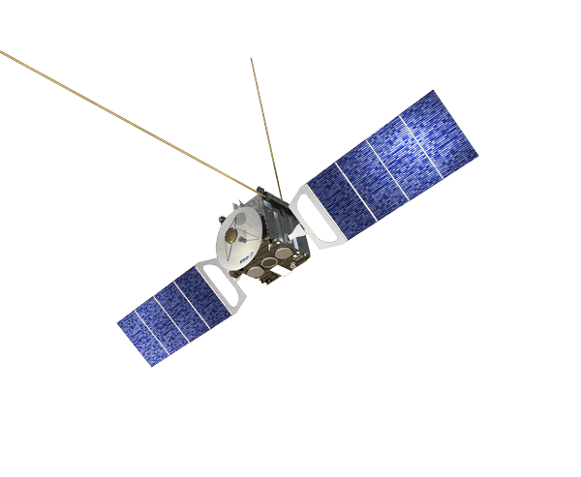
Correlated two-sPACECRAFT observations

Slide 3
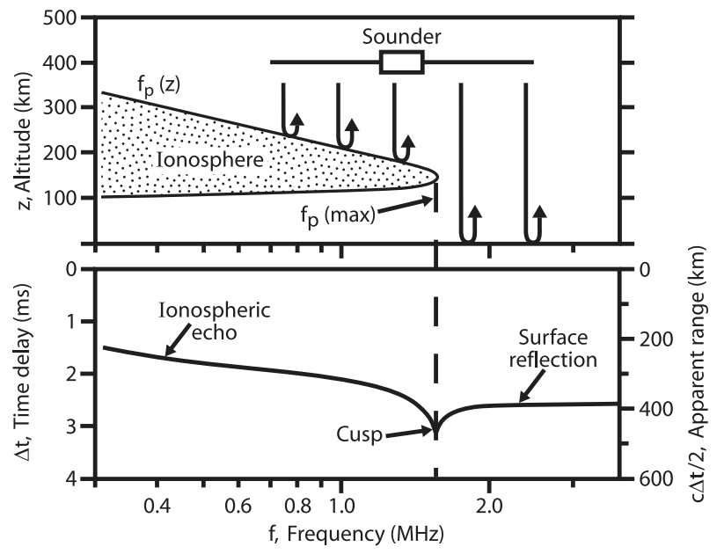
ionospheric STUDIES with mars express
Mars Advanced Radar for Subsurface and Ionosphere Sounding (MARSIS)
Use radar reflection of the ionosphere to study remotely (MEX orbit periapsis is near 300 km altitude)
Obtain observation every 7.5 seconds
Reflected ionospheric echo provides density profile of the ionosphere

Slide 4
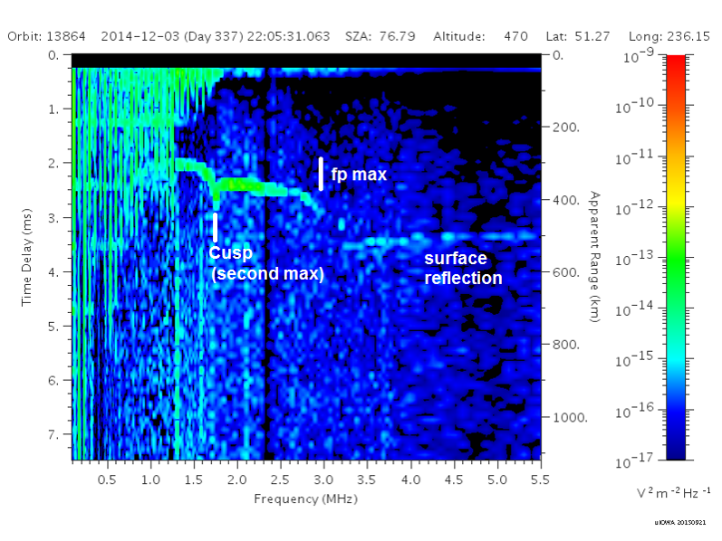
The topside ionospheric layer with mex
MARSIS regularly observes an additional cusp in the profile at altitudes near 200 km, at a density of 2-5 x 10⁴ cm⁻³.
Since the main cusp appears at density maximum in the profile, second cusp interpreted to be a second maximum.
Kopf et al. [2008] described the general properties of this layer.

Slide 5
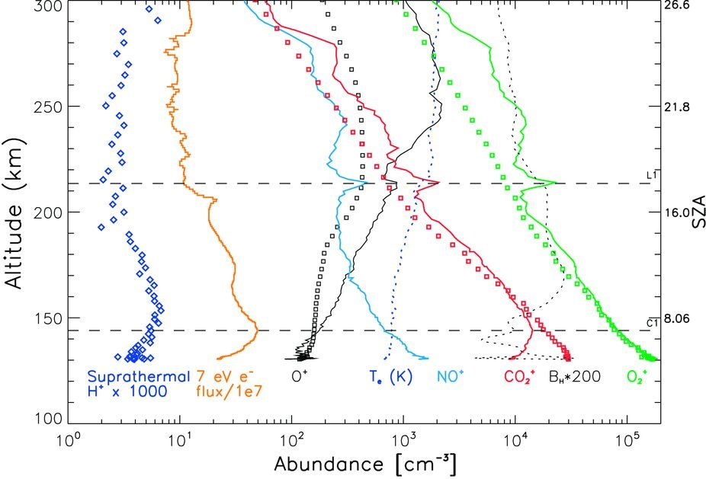
The Topside ionospheric layer with maven
Figure at left from Bougher et al. [2015].
Clear localized increase in the density near 200 km altitude, which is dominated by O₂⁺ ions. Most other ion species also show density increases.
Low altitude orbit allows for in situ observations of particle density profiles up to twice per orbit at this altitude.

Slide 6
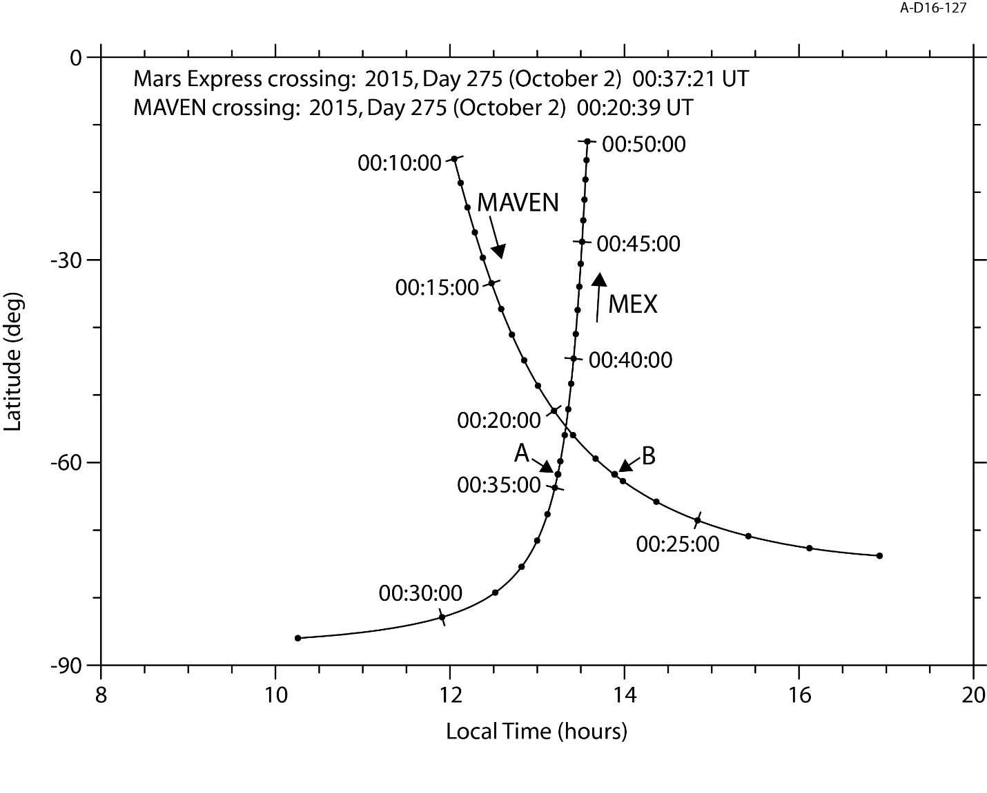
Crossing orbit
With two spacecraft, the opportunity exists to jointly study the ionosphere
Criteria imposed to maximize usability:
Orbits cross on dayside of Mars
MAVEN below 400 km at crossing
MARSIS in Ionospheric Sounding mode
NGIMS measuring ions on that orbit
Spacecraft reach crossing point within a few minutes of each other

Slide 7
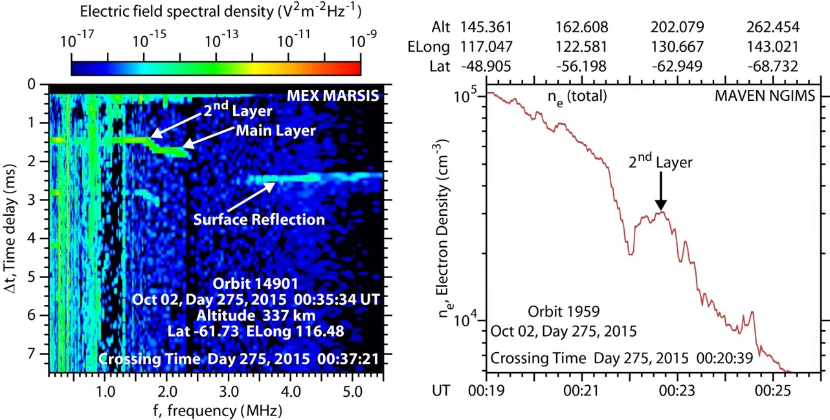
Crossing orbit comparison
One fruitful orbit to date
On October 2, 2015, MAVEN observed a second density peak at 200 km, two minutes after the orbit crossing. MARSIS ionograms showed a second cusp at that latitude, two minutes before it reached the crossing (orbit direction is opposite)
Additional crossing orbits coming in April

Slide 8
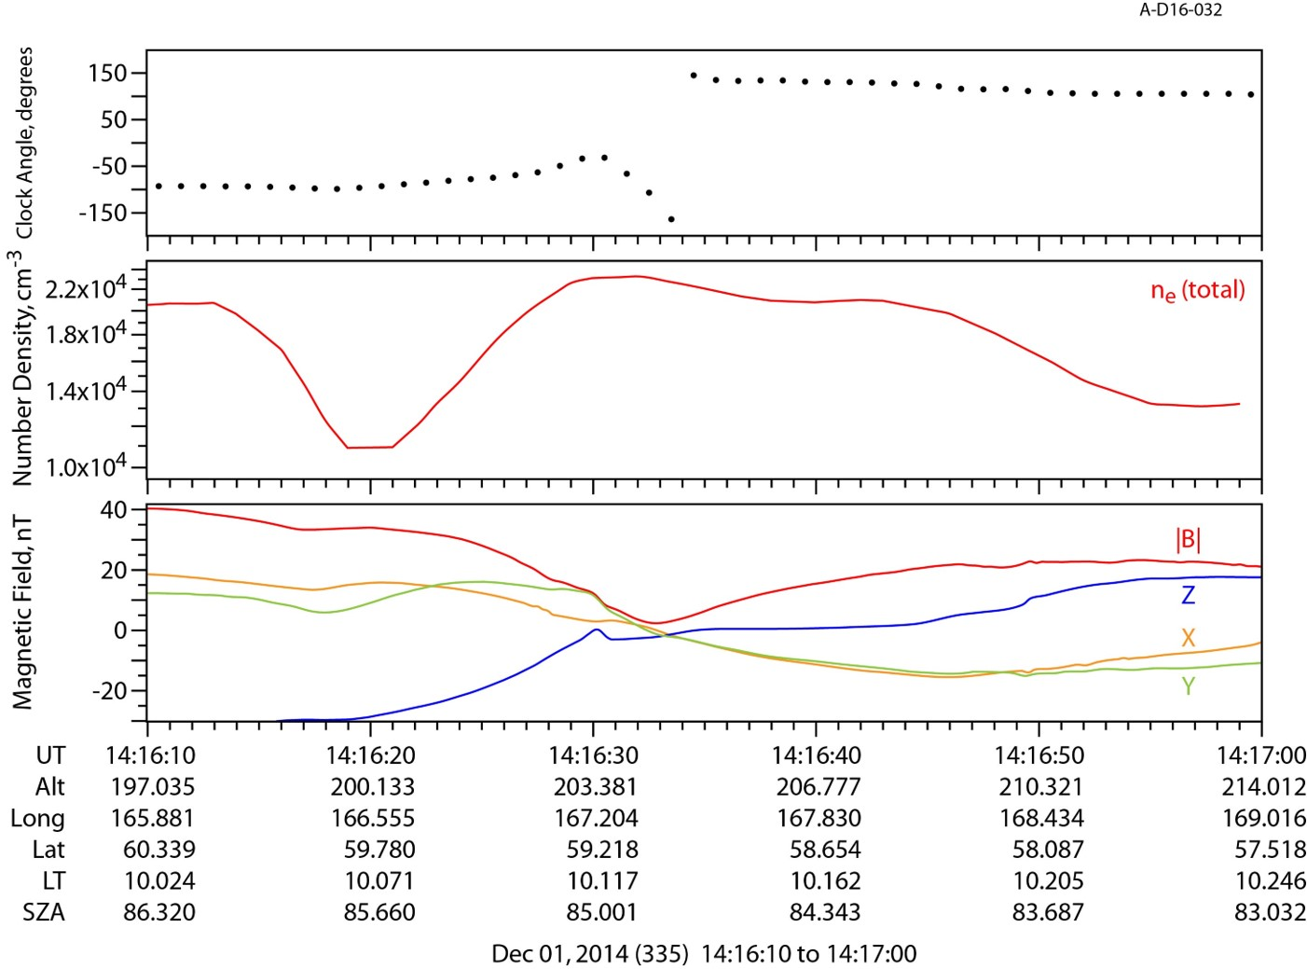
An associated current sheet
Current layer detected in conjunction with density increase
Identified initially by local minimum in magnetic field, accompanied by rotation in field direction. In 88% cases.
Minimum Variance Analysis (MVA) performed on 18 of these cases to study this current

Slide 9
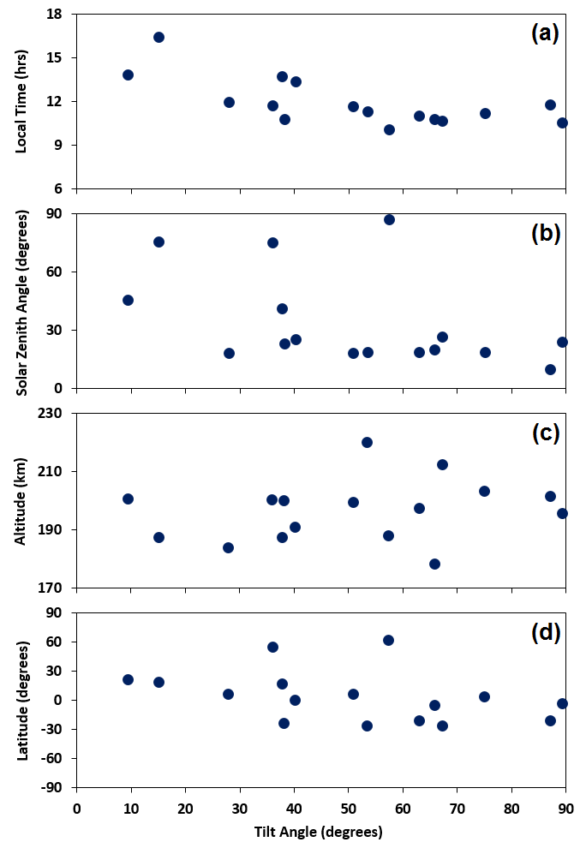
Current sheet properties
MVA found that the current was not horizontally stratified
Tilt Angle (0º = horizontal) plotted against various orbit and spacecraft parameters
Current becomes more horizontal toward dusk, more vertical in dawn sector
No correlation with SZA, Alt., or Lat.
Current Layer generally observed away from crustal fields. Usually in regions of less than 50 nT B-field strength.

Slide 10
Possible explanations (AND concerns)
Kelvin-Helmholtz Instability
Observed elsewhere at Mars
Dawn-dusk asymmetry occurred at Mercury
Velocity gradient not yet observed
X-type Magnetic Reconnection
Again would show rotation
No plasma flow observed, most common away from main crustal fields
Magnetized plasma parcels downstream?
Magnetic Flux Ropes
Would show magnetic field rotation
Lack of axial field detection, decrease in field magnitude, non-zero MVA eigenvector all are problems
Magnetic Field Convection
Current induced by rotations in the solar wind magnetic field
Fields drape over planet
Current not horizontal, time scales

