Slide 1


New Observations of the martian ionosphere and its variability
Invited Review Presentation
Andy Kopf
University of Iowa

Slide 2
A wealth of continuing science
Multiple ionosphere-studying orbiting spacecraft remain operational at Mars, including some for well over a decade
Focus today will primarily be on results from MAVEN and Mars Express, but a few studies used data from a variety of additional spacecraft
All of these have been published since last year’s EGU General Assembly
Recent work on atmospheric loss will not be shown, as Bruce Jakosky has just covered this in the preceding talk, and others will talk about it in detail later.
Apologies to all of you whom I did not include. I only have 12 minutes ☺

Slide 3
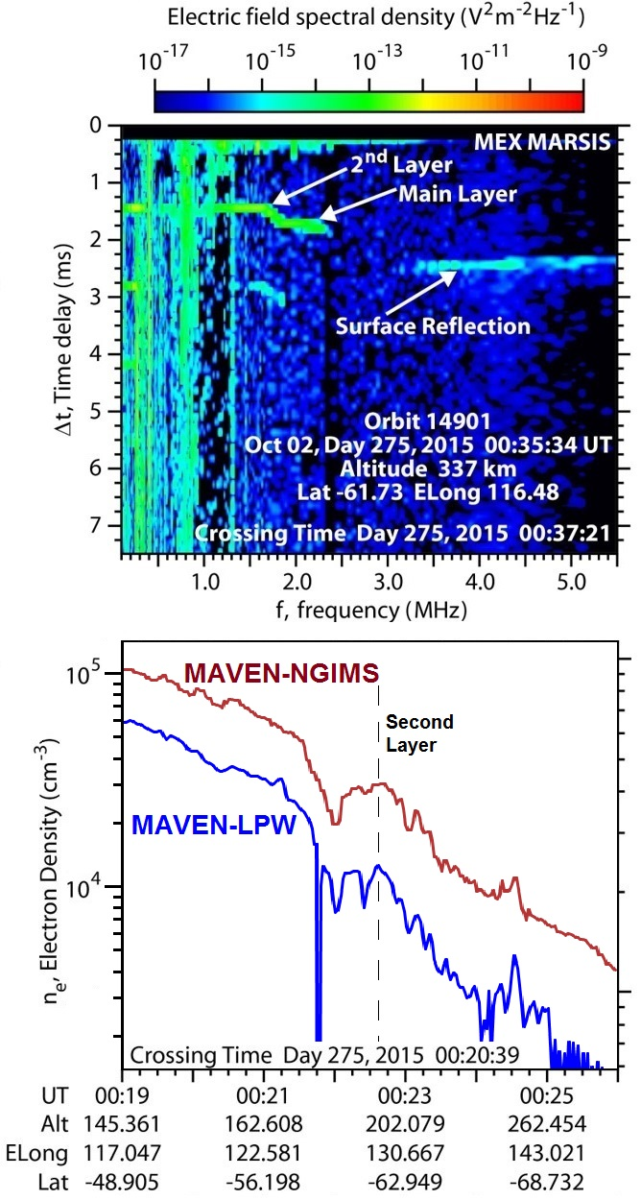
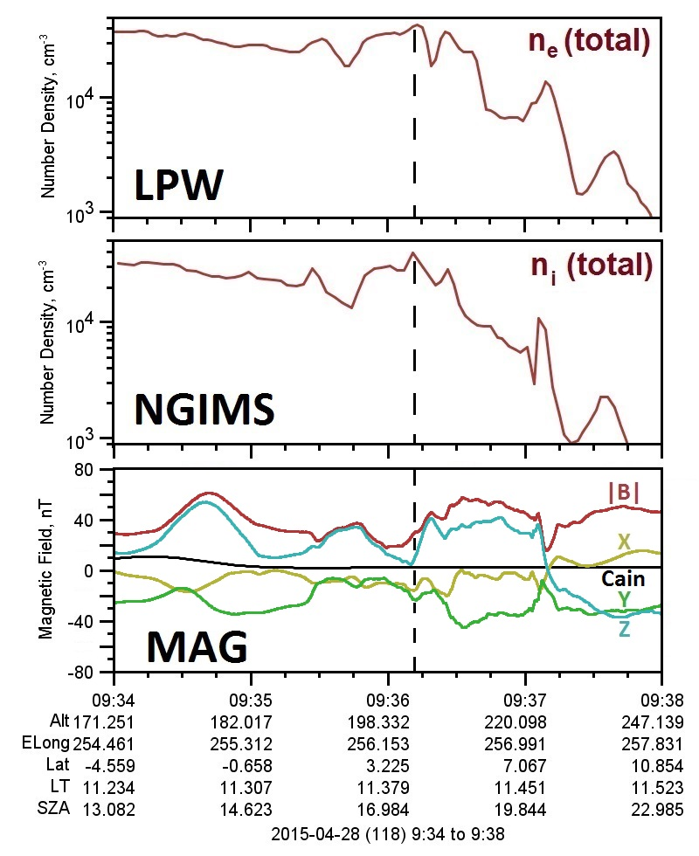
Topside layers and currents
A. J. Kopf, et al., 2017, JGR:SP (accepted)
MAVEN-focused survey of the topside layer originally seen by MEX-MARSIS.
Observed at common location by both MEX and MAVEN during a close conjunction of the two spacecraft.
MEX-observed properties confirmed by MAVEN in situ measurements
MAVEN-MAG observations reveal the presence of a local magnetic minimum and an associated current sheet in roughly 85% of MAVEN detections.
Reason for formation still unclear.

Slide 4
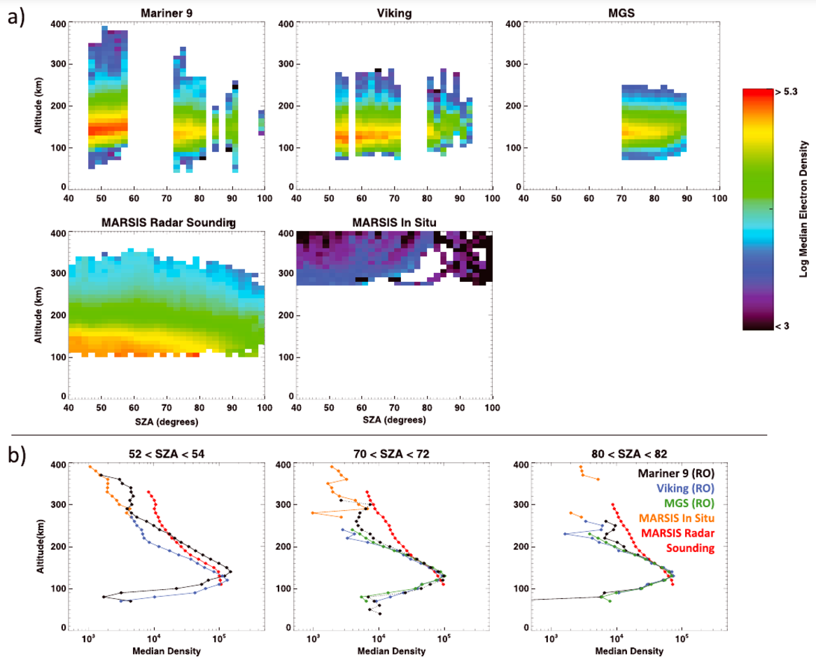
Comparison of ionospheric electron densities
M. Vogt, et al., 2016, JGR:SP
Compared occultation measurements of the electron density profile from Viking, Mariner 9, and MGS with in situ and remote sounding of MARSIS (MEX).
Data show good agreement below ~200 km, but MARSIS data are consistently at higher densities than radio occultation above this altitude.
MARSIS data have larger scale heights than radio occultation at lower altitudes (<200 km)

Slide 5
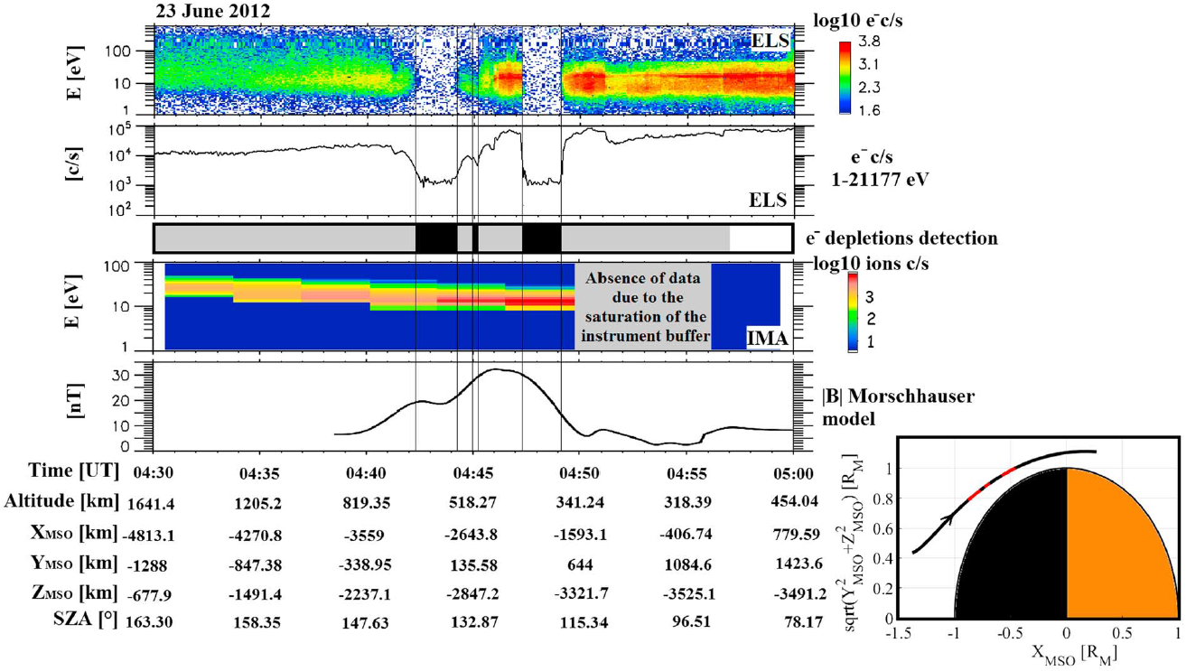
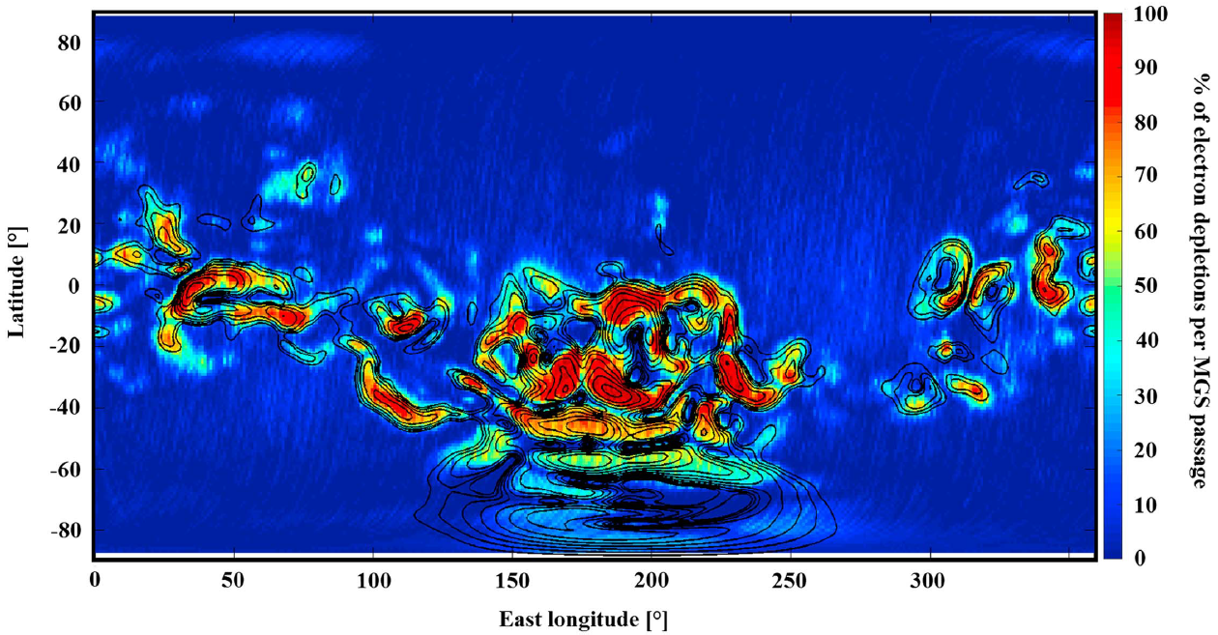
Suprathermal electron depletions
M. Steckiewicz, et al., 2017, JGR:SP
Multispacecraft analysis of the phenomenon (MGS, MEX, MAVEN)
134,500 depletions observed between 125-900 km, largely on nightside.
Strong link between depletions and crustal fields at altitudes >170 km. Significant difference between two hemispheres at these altitudes.
At lower altitudes, hemispheres are more alike; events may be produced by atmospheric absorption by CO₂.

Slide 6
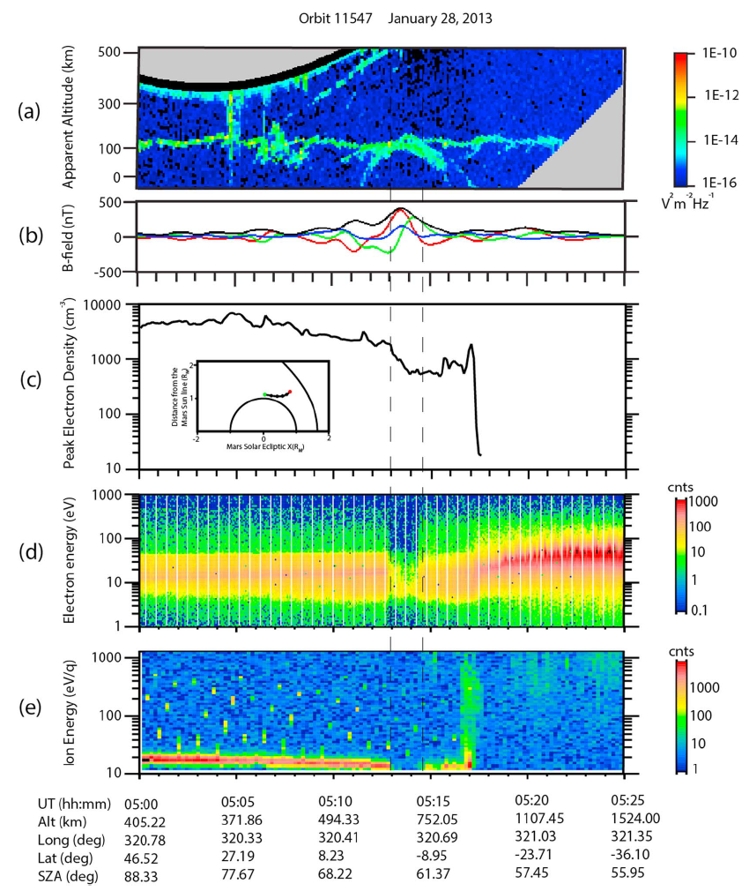
Density structure in a vertical mag-field region
F. Duru, et al., 2016, GRL
Bulge in density contour due to presences of crustal magnetic fields
Enhancement in lower ionosphere is associated with a plasma cavity in the upper ionosphere
Solar wind electrons accelerated downward, and ionospheric ions upward, similar to field line-driven auroral acceleration at Earth
Heating by precipitating electrons may increase scale height and drive a loss of ionospheric plasma at high altitudes

Slide 7
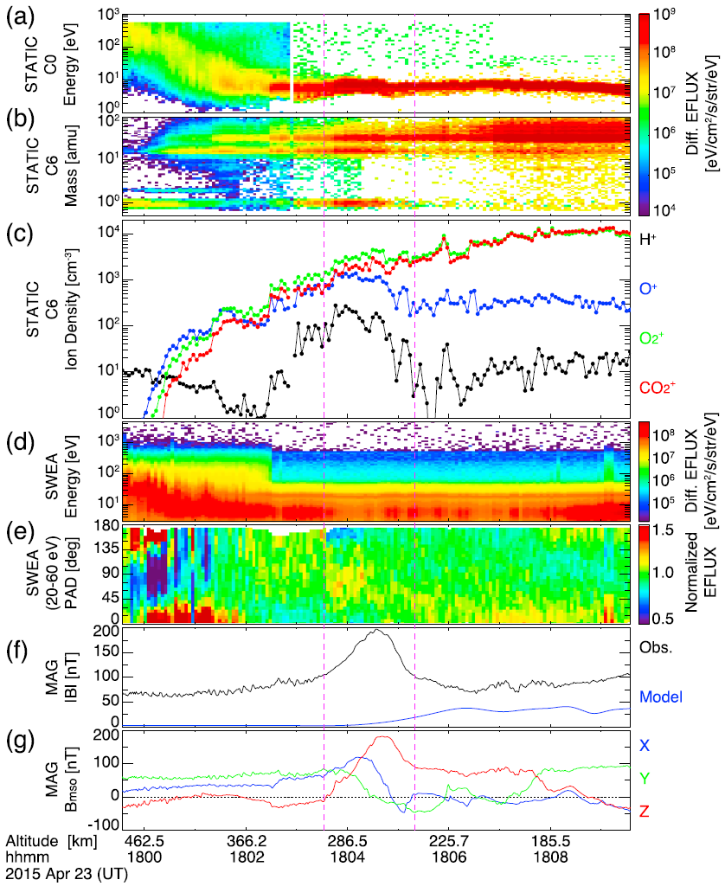
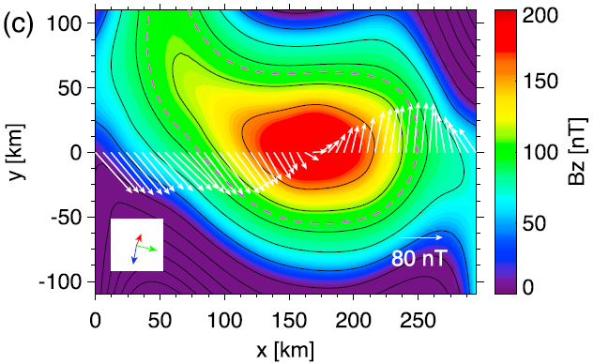
Giant ionospheric flux rope
T. Hara, et al., 2017, JGR:SP
Giant flux rope detected in the dayside ionosphere, near 300 km altitude, downstream from crustal fields
200 nT peak field amplitude – largest difference from crustal field models of MAVEN primary science mission
Axial orientation indicates it formed by interaction of crustal fields with draped interplanetary magnetic field
Occurred during interplanetary CME, suggesting disturbed upstream state played a role in its formation

Slide 8
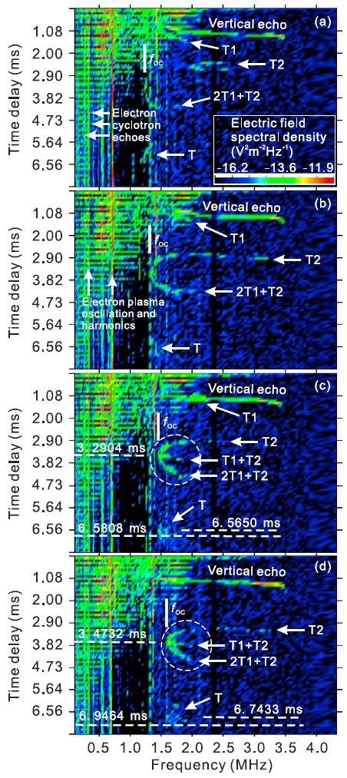
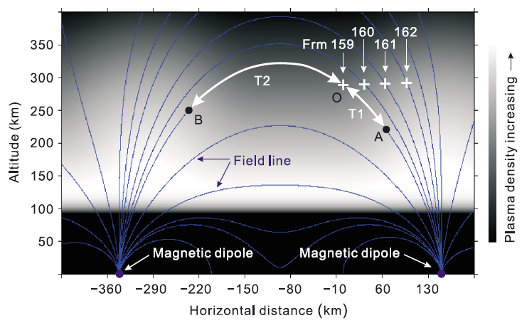
Epsilon signature - Ducted EM waves
Z. Zhang, et al., 2016, GRL
Epsilon-shaped signal in the ionospheric echo for MEX-MARSIS, from combination of multiple oblique echo signatures.
Similar to signature in terrestrial F-region
Interpreted to originate from multiple reflections of EM-waves propagating along pulse-generated crustal field-aligned plasma bubbles (waveguides)
Highly rare, as it requires a transverse density gradient of zero, which is hard to fulfill at Mars.

Slide 9
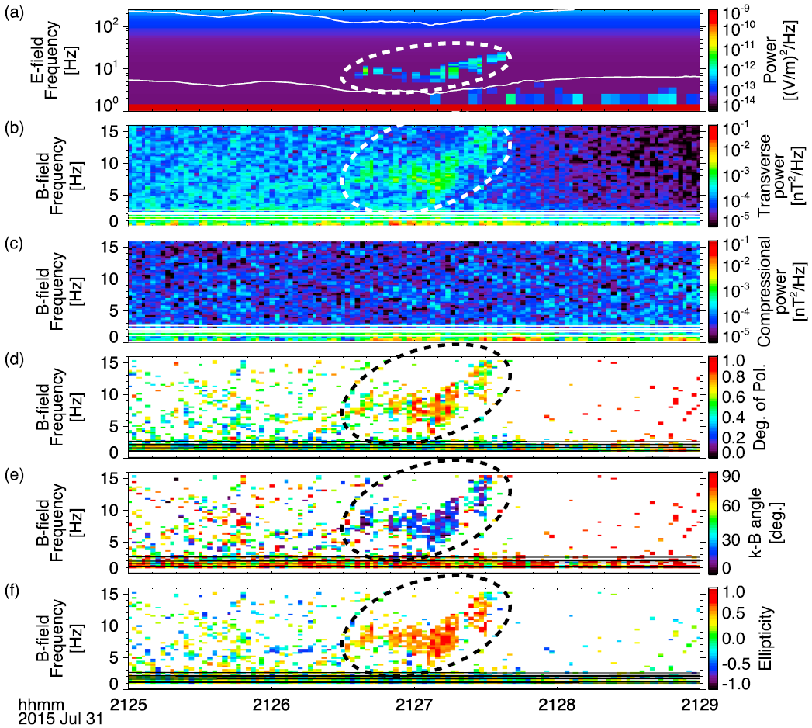
Electron induced whistler-mode waves
Y. Harada, et al., 2016, JGR:SP
Narrowband waves in whistler regime, observed on nightside of Mars.
Observed on both open and closed magnetic field lines.
Computed linear growth rates suggest these can be generated by cyclotron resonance with anisotropic electrons, having either one-sided (open field lines) or two-sided (closed) loss cones.

Slide 10
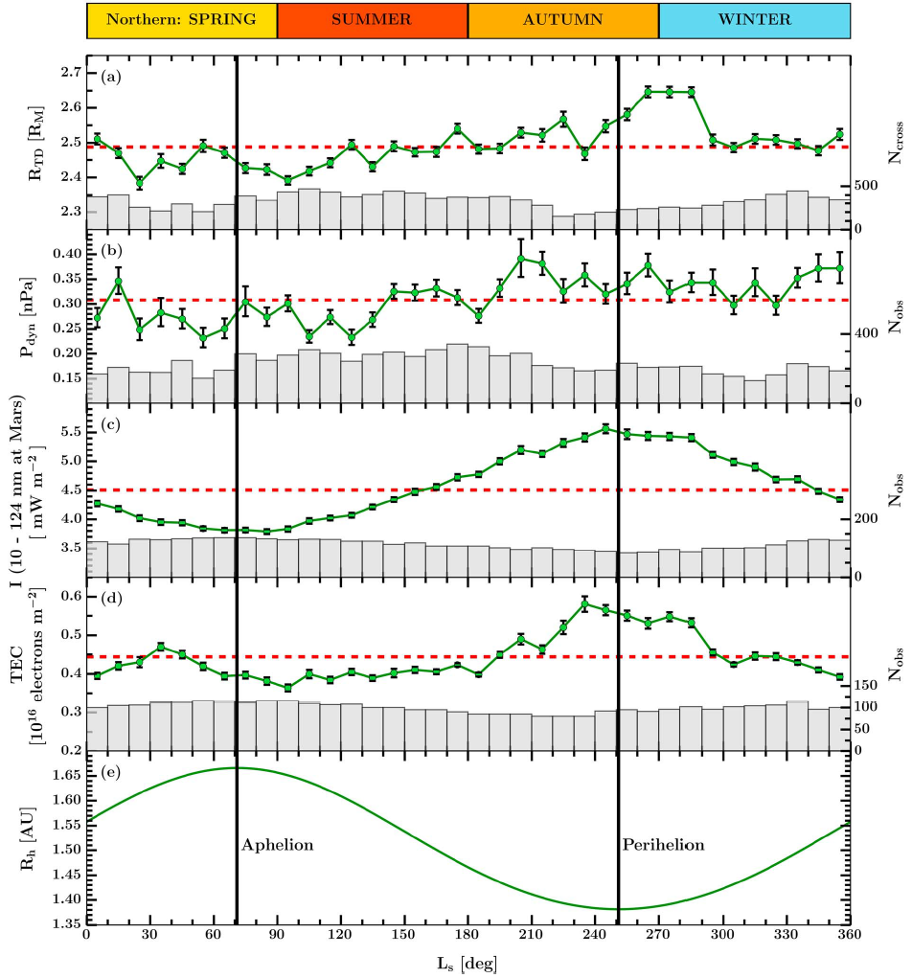
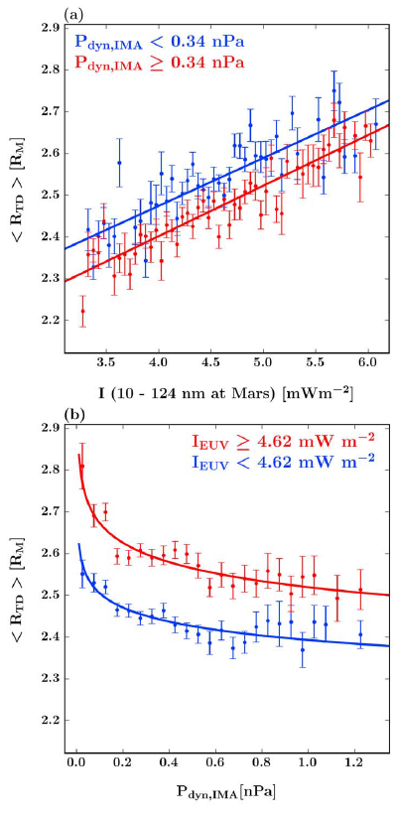
Annual variation of bow shock location
B.E.S. Hall, et al., 2016, JGR:SP
Five Martian years of ASPERA-3 data coverage (MEX) containing 11861 bow shock crossings
Bow shock distance varies with L_{S} from 2.39-2.65 R_{M} over Martian year (11%).
Small hemispherical difference (2.4%), and same annual variations occur in both hemispheres.
Bow shock more sensitive to EUV irradiance than solar wind dynamic pressure variations.

Slide 11
summary
Mars remains a very research-intensive target, with much still being learned about the ionosphere, its variability, and the global magnetospheric picture.
The ionosphere is highly dynamic, containing several kinds of transient structures, various types of waves, and also displays significant response to solar inputs
The addition of MAVEN to the Mars environment has not only added another spacecraft perspective, but opened the door to a variety of multi-spacecraft studies, a few of which were presented here today.
A great many areas are still available to explore – but we are well equipped to observe them with the instruments we have in orbit right now. Exciting science still to come!

