Slide 1
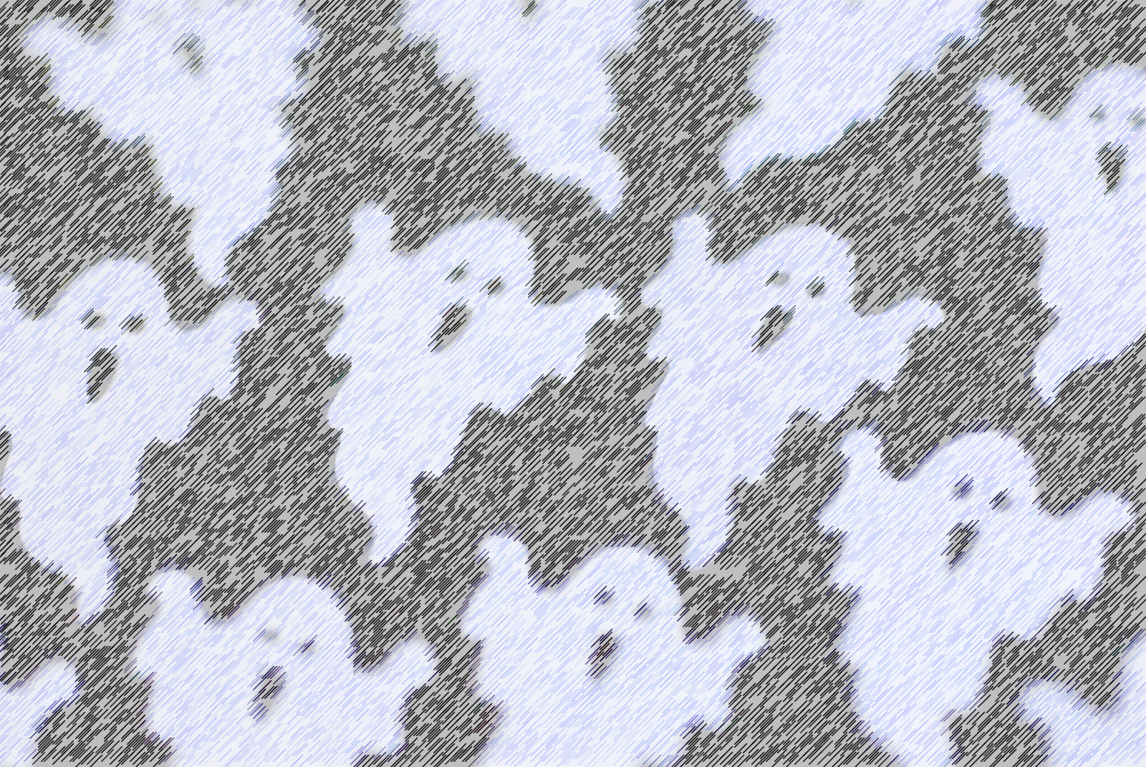
CHASING GHOSTS: A VARIABLE MARTIAN IONOSPHERE
Andrew J. Kopf
The University of Iowa
Physics & Astronomy Colloquium
February 8, 2016

Slide 2
A brief outline
Earth v. Mars Comparison
MARSIS and Mars Express
Ionospheric Structure – Previous Results
Ionospheric Structure – New Results with MAVEN
Other MARSIS Findings (Time Permitting)

Slide 3
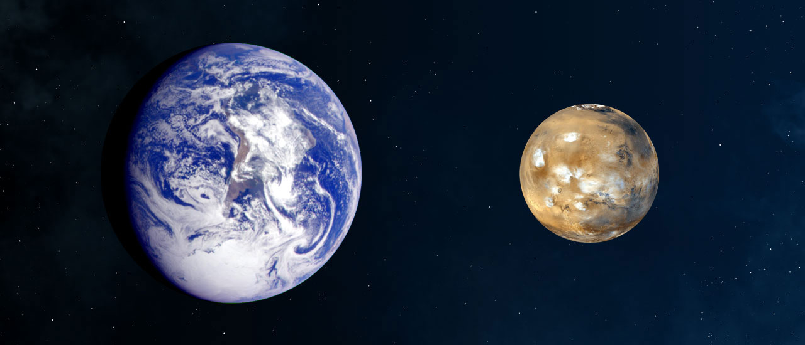
EARTH VS. MARS

Slide 4
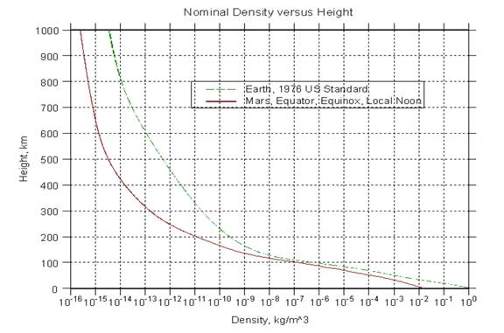
Atmospheric density

Slide 5
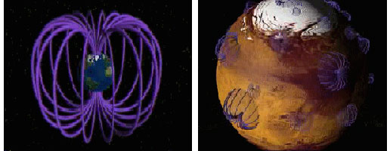
MAGNETIC FIELDS

Slide 6
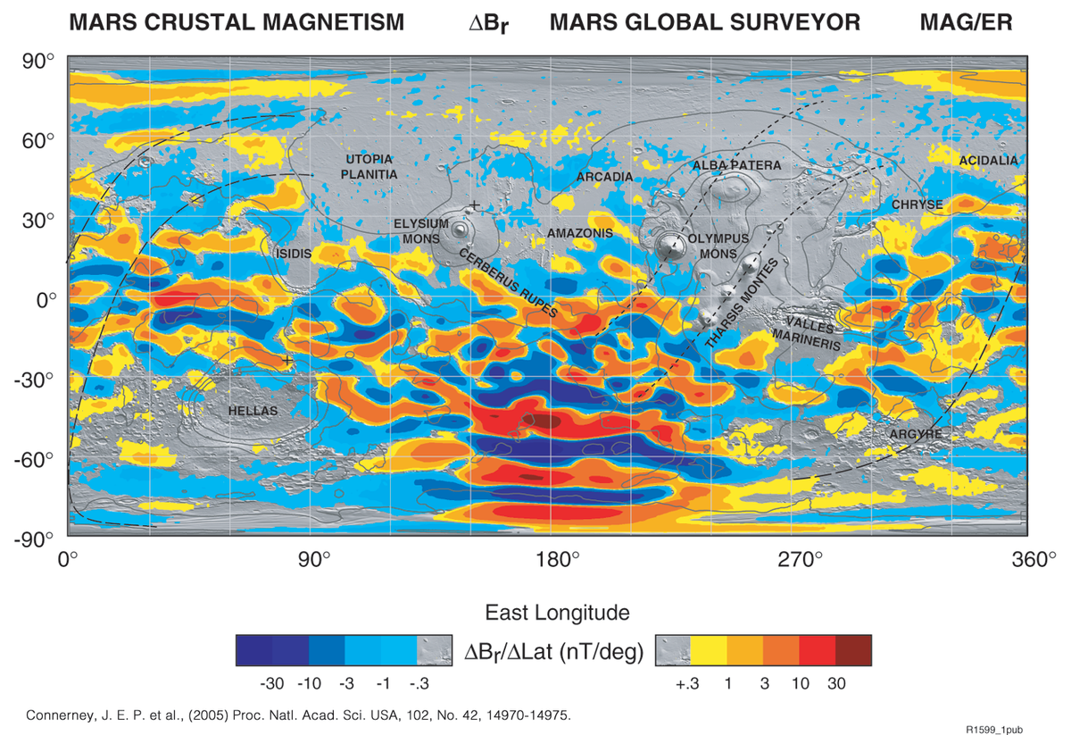
Crustal fields

Slide 7
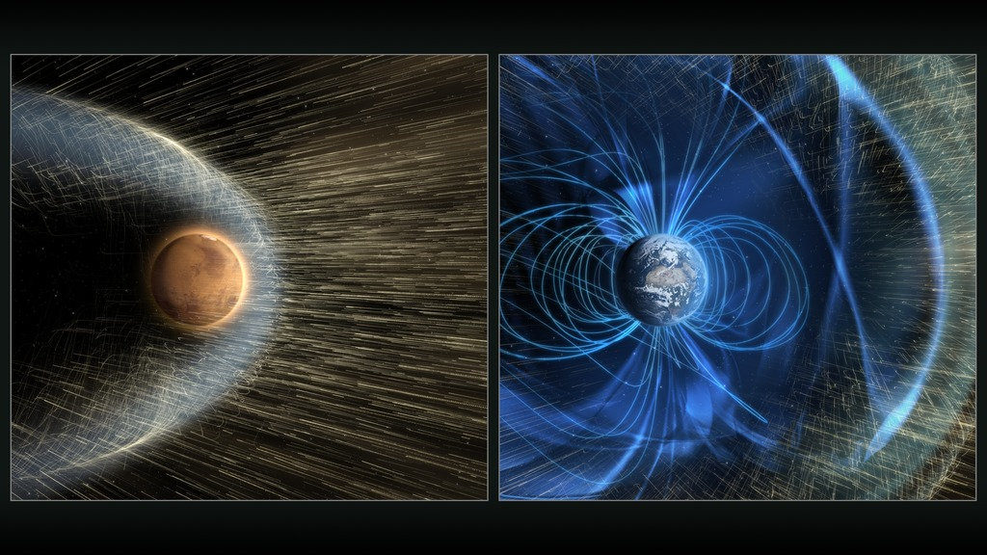
Solar wind interaction

Slide 8
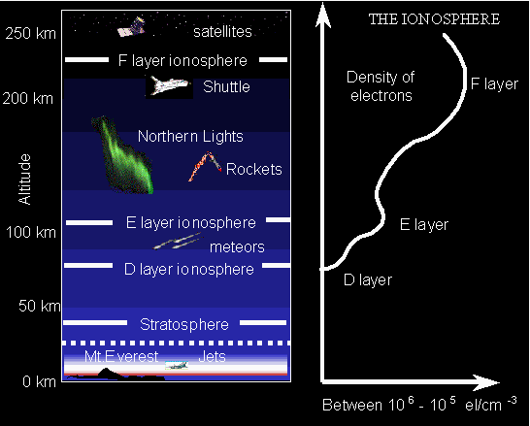
The ionosphere
Higher-altitude layer of the atmosphere with more direct interaction with outside influences
Ionized by solar radiation
Layer(s) of charged particles (plasma)
Influences radio propagation to distant places on the Earth

Slide 9
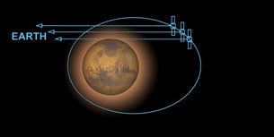
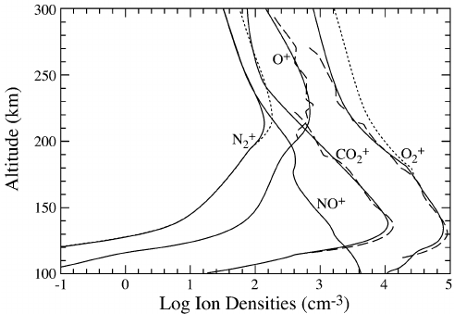
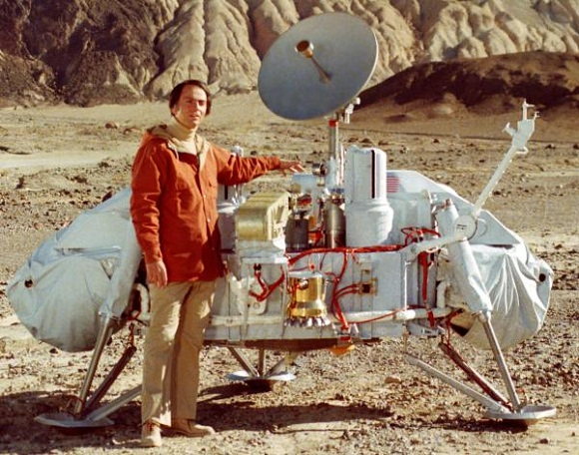
Early density profiles

Slide 10
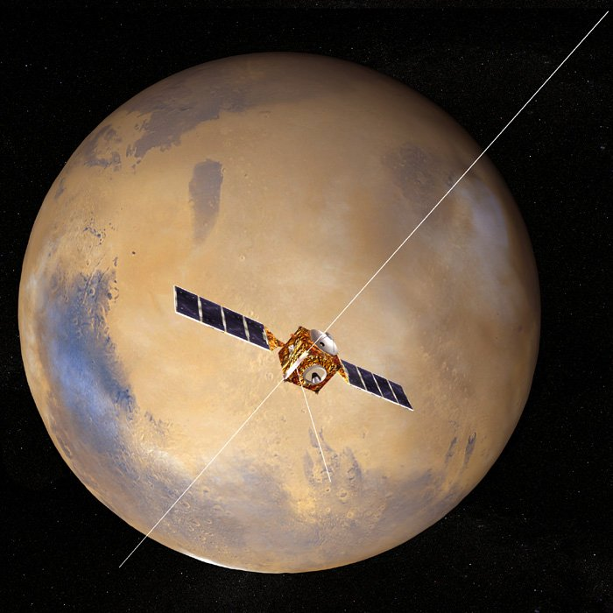
marsis
Mars Advanced Radar for Subsurface and Ionosphere Sounding
Twin 20-meter dipole antennae
7 meter monopole
Capable of operating in two main modes, one for ionospheric science, the other for subsurface radar sounding

Slide 11
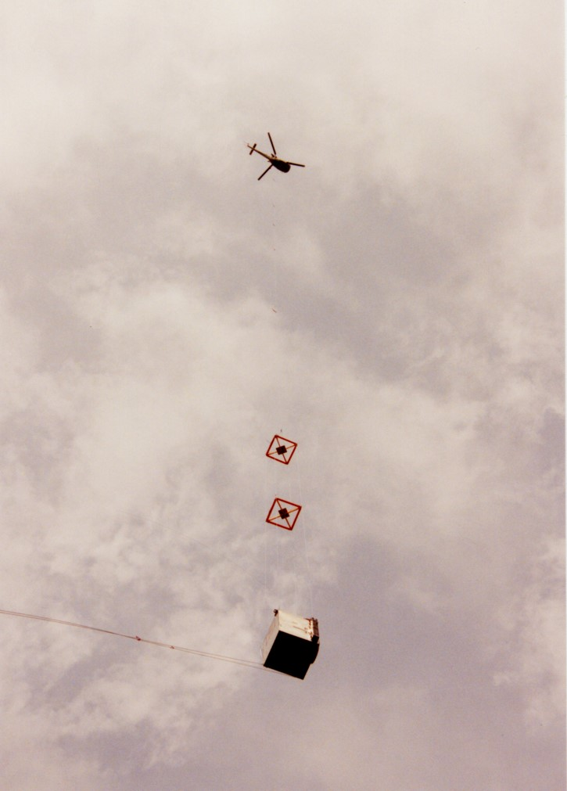
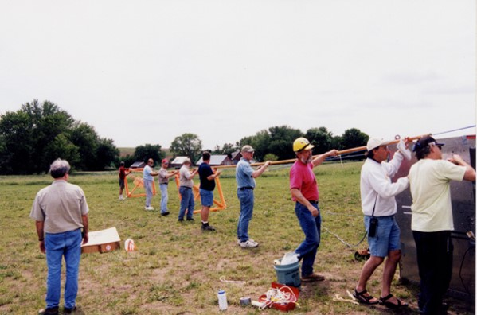
Testing MARSIS
Instrument was attached to a large box-shaped structure, lifted into the air by a helicopter
Tested by targeting the Rocky Mountains

Slide 12
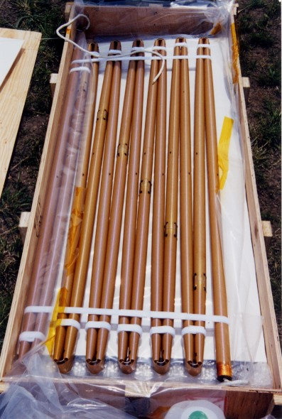
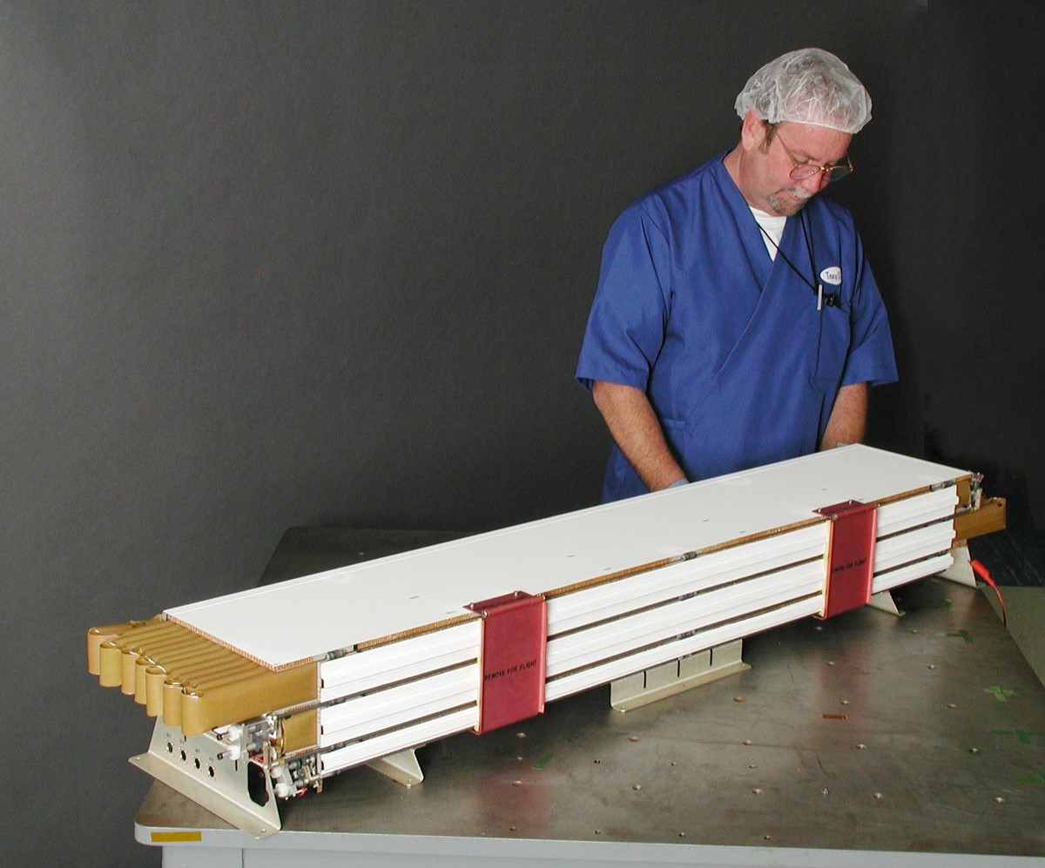
Making it fit

Slide 13
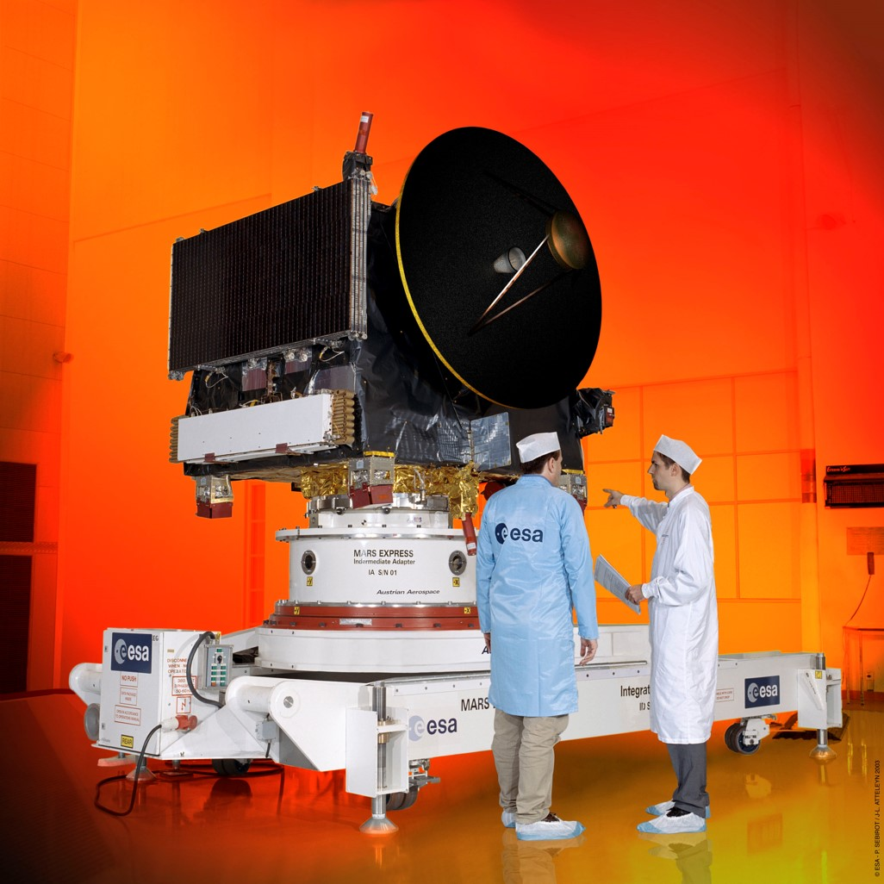
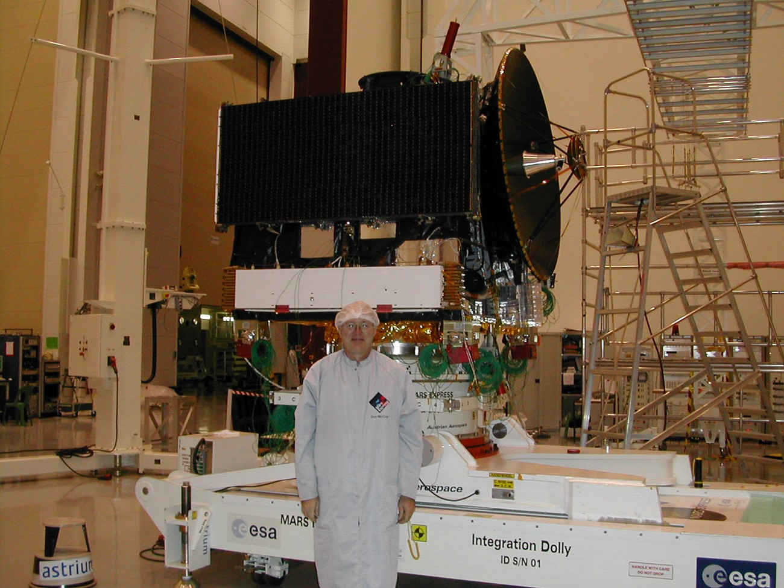
installation

Slide 14
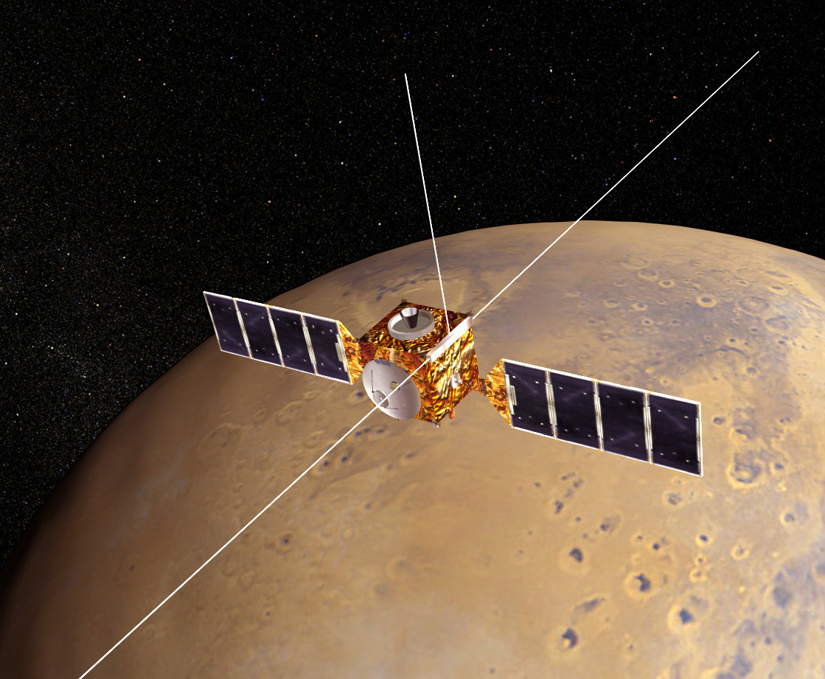
Mars express
Operated by European Space Agency
Launched: June 2, 2003
Mars Arrival: December 25, 2003
Carried Beagle 2 lander, which landed but failed to communicate.
MARSIS Deployed: May 4 – June 10, 2005
MARSIS Science: July 2005 – Present

Slide 15
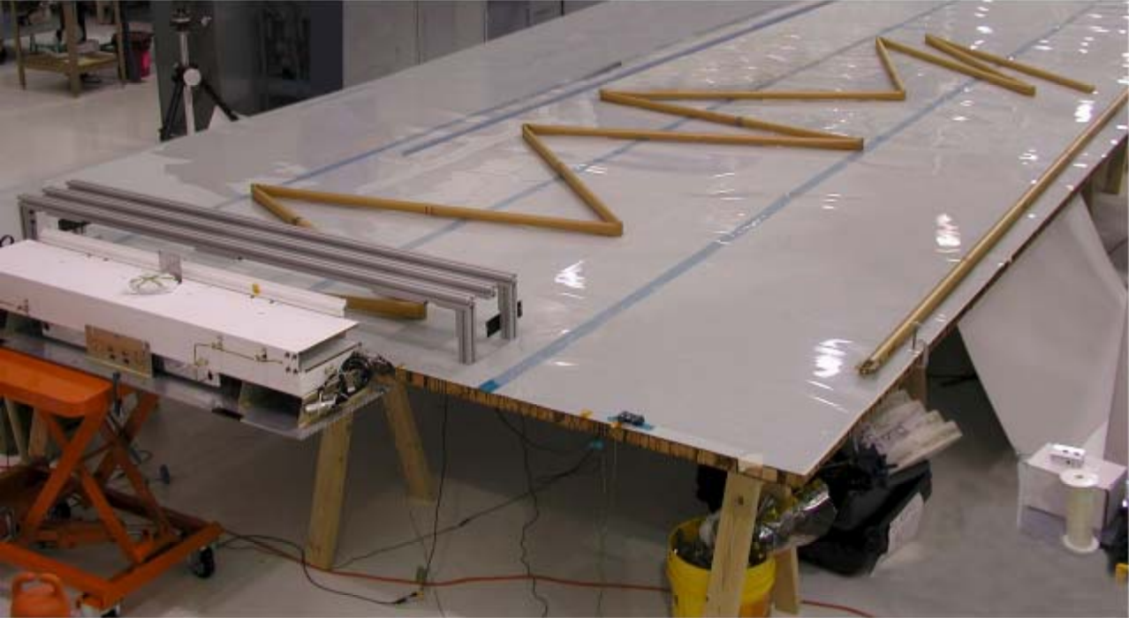
Deploying the antennae

Slide 16
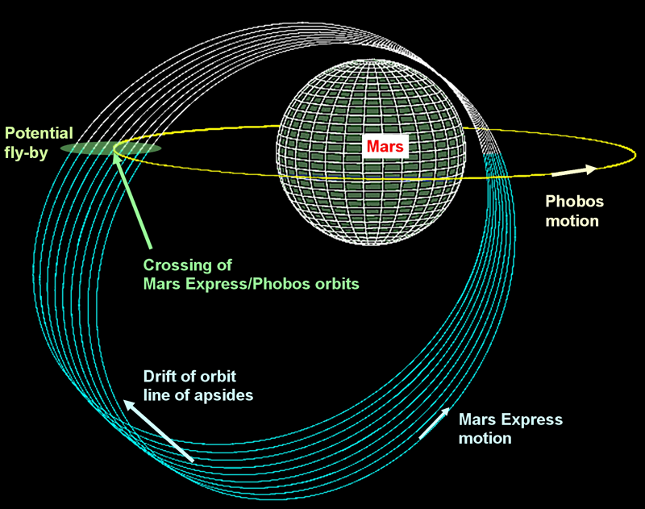
ORBIT PARAMETERS
Periareion – 298 km
Apoareion – 10107 km
Inclination – 86.3 degrees
Period – 7.5 hours
Orbit drifts gradually, to allow for better planetary coverage along with low-altitude passes of different regions

Slide 17
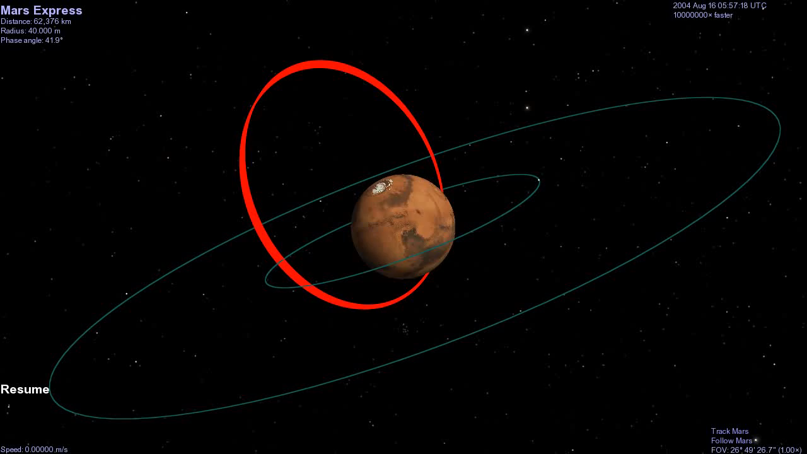
orbit

Slide 18
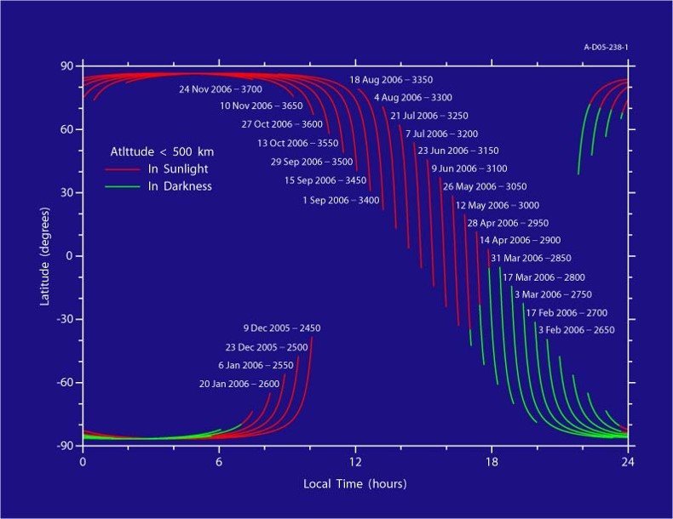
Why is precession good?

Slide 19
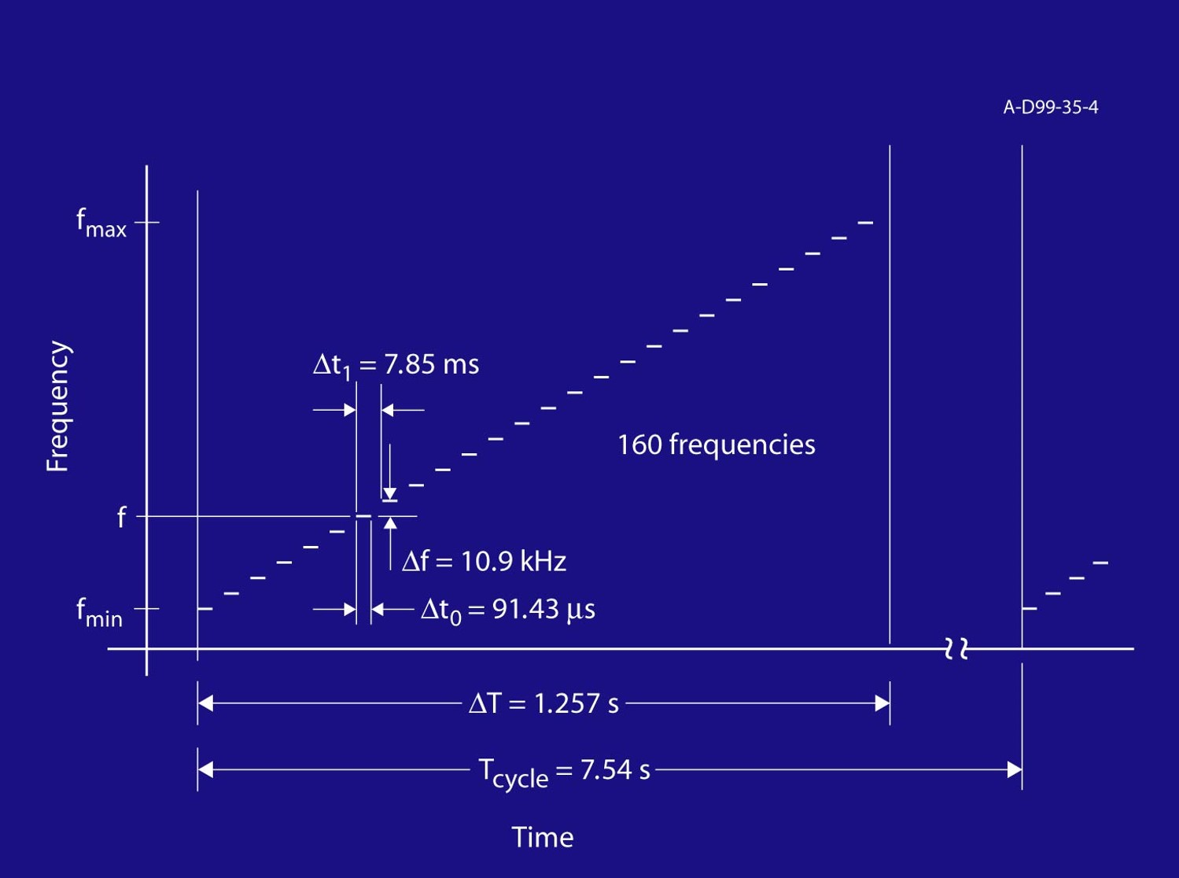
How marsis works
Studies ionosphere at 160 frequencies between 0.1 and 5.4 MHz
Observation cycle of 7.54 seconds
MARSIS can sound for about 45 minutes out of each orbit, when Mars Express is at altitudes low enough to get a response from the ionosphere

Slide 20
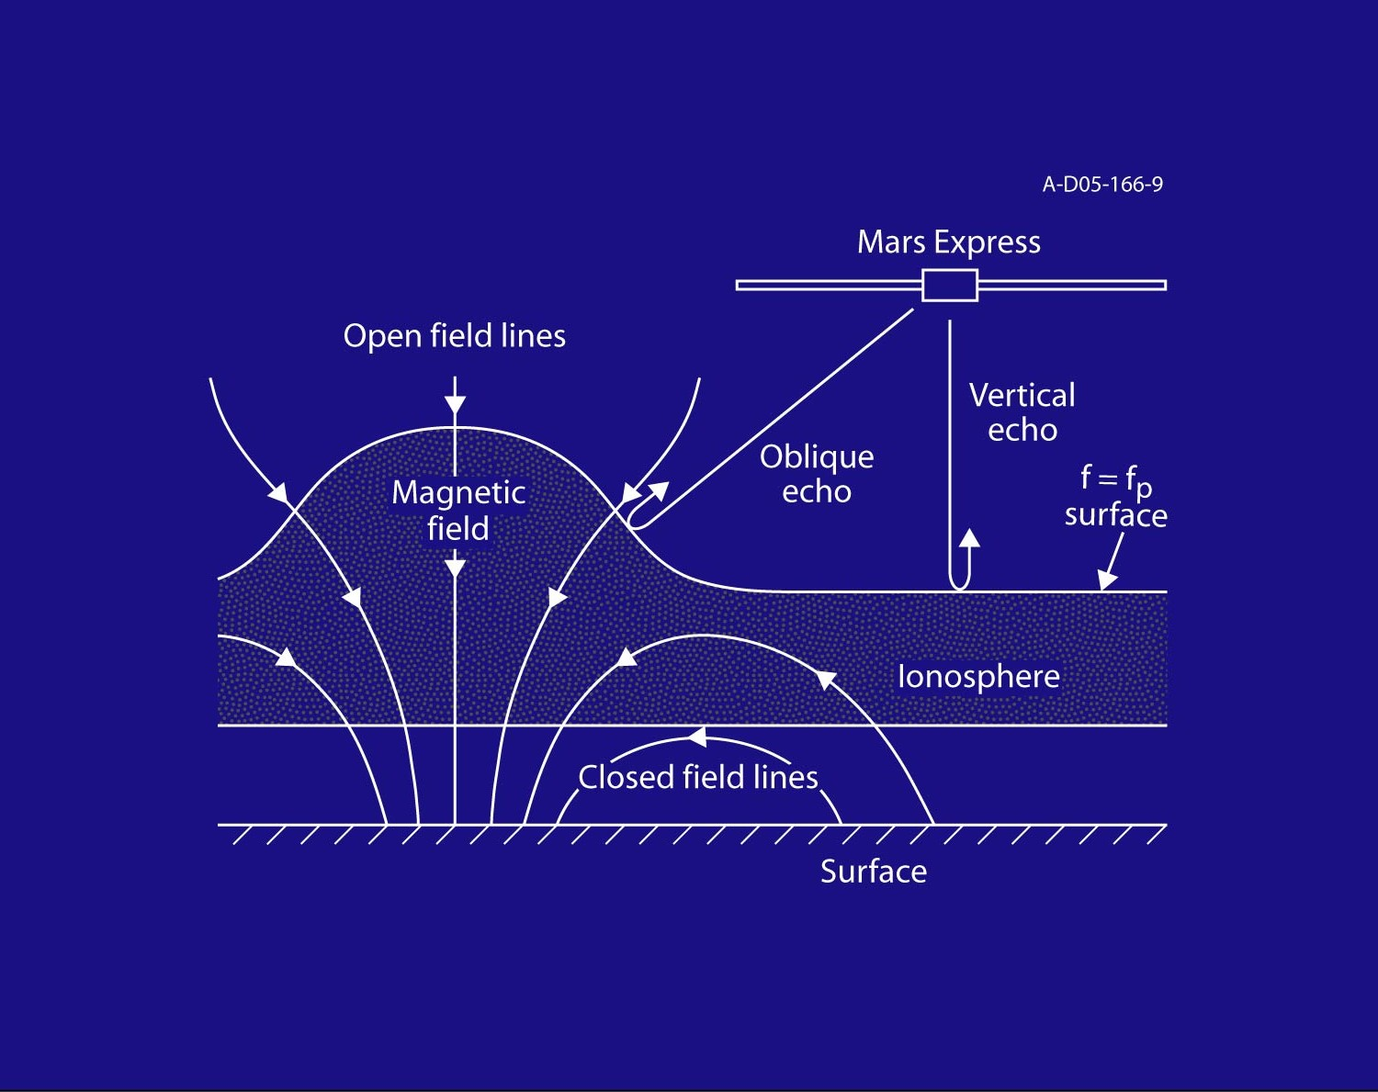
Sounding with marsis
MARSIS emits a multi-frequency “chirp”, and listens for the reflected echo from the ionosphere
The main echo will come from the horizontally stratified ionosphere
MARSIS may (and does) see other echoes, in places where the ionosphere is not smooth, or in certain plasma conditions

Slide 21
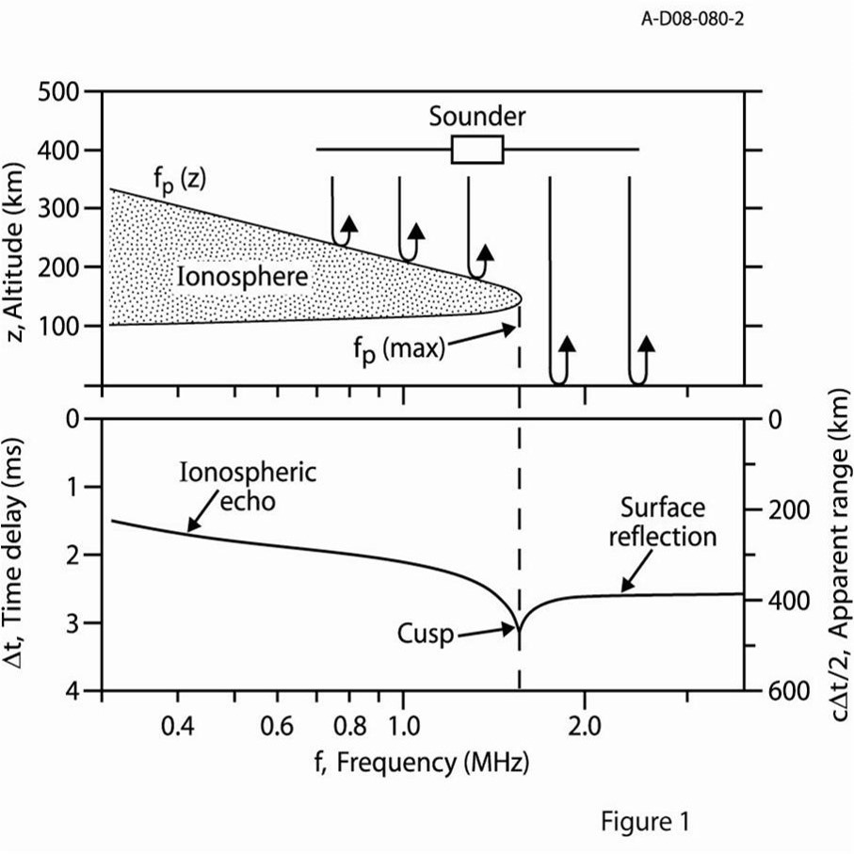

Sounding principles
Radio signal can propagate freely through space (and the ionosphere) at frequencies above the local plasma frequency
Reflection occurs when the pulse frequency equals the ionospheric plasma frequency. This gives the density (in cm⁻³), where:
Cusps appear at density profile maximums, since the group velocity approaches zero there.

Slide 22
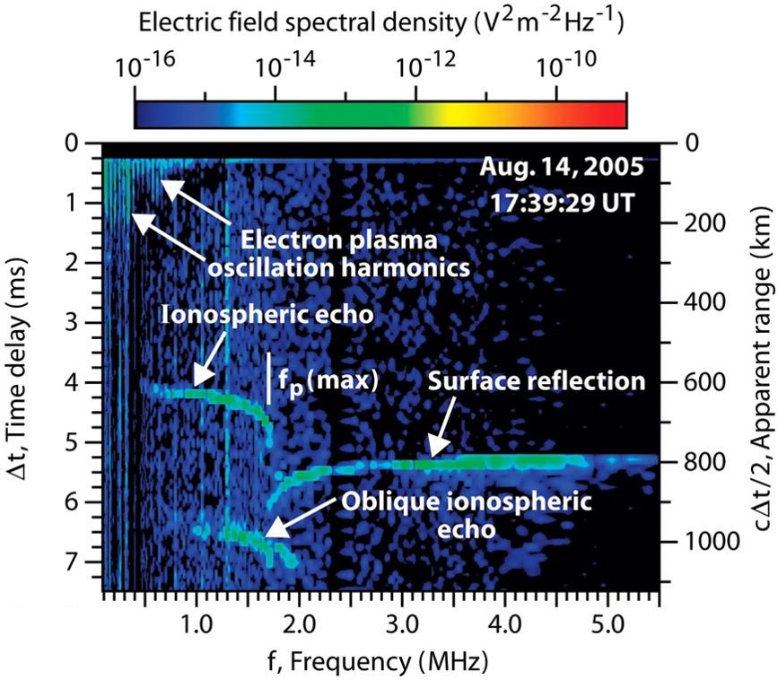
General observations
Ionospheric echo shows altitude profile of the ionosphere
Surface reflection can appear at frequencies above maximum plasma frequency of ionosphere
Other features, such as plasma harmonics, cyclotron harmonics, and oblique echoes are frequently present as well.

Slide 23
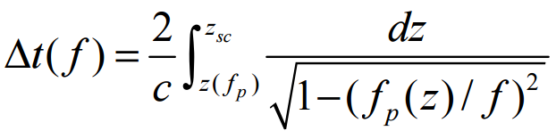
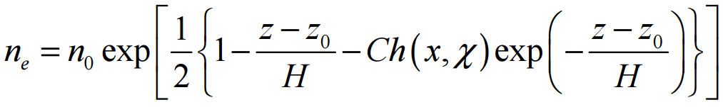
And then we do math…
The apparent range gives an estimate for the altitudes of the ionospheric reflection. However, to be accurate, we must correct for plasma dispersion.
Assuming vertical reflection from a horizontally stratified ionosphere, we find that the time delay (as a function of frequency) is:
This can then be inverted to give the frequency/density as a function of altitude:

Slide 24
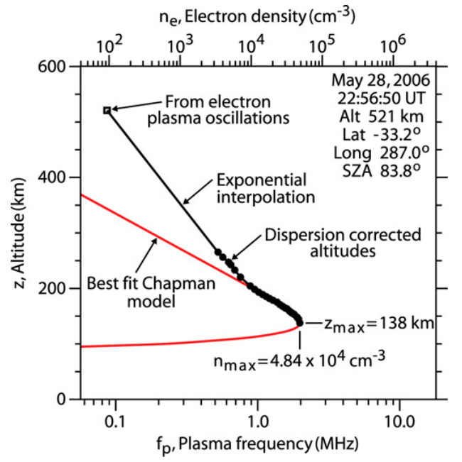
Fitting the ionosphere
Once the altitudes of the traced points have been corrected for dispersion, we can then fit the profile with a Chapman model function to obtain:
Altitude of the density maximum
Maximum density of the ionosphere
Both values, but especially the density, are dependent on the solar zenith angle

Slide 25
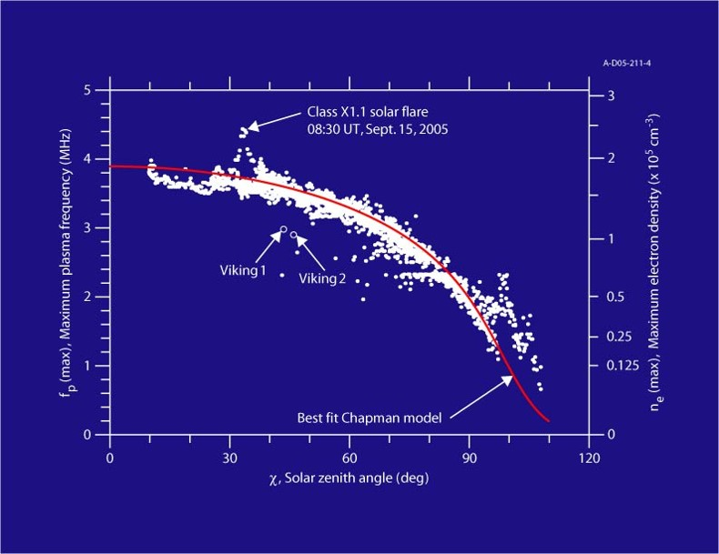
Solar zenith angle dependent

Slide 26
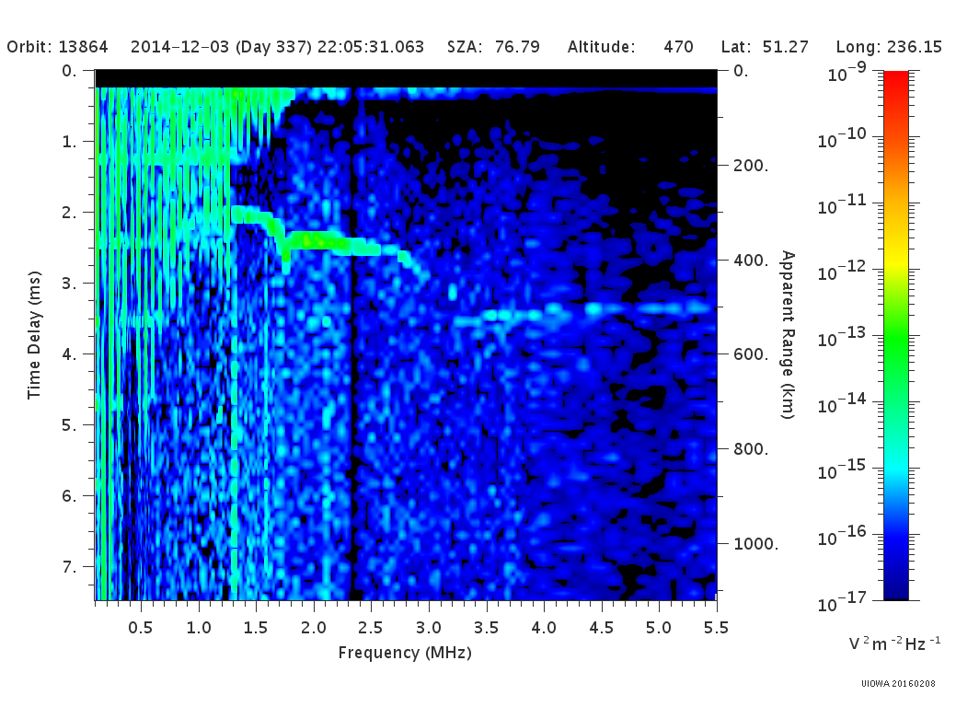
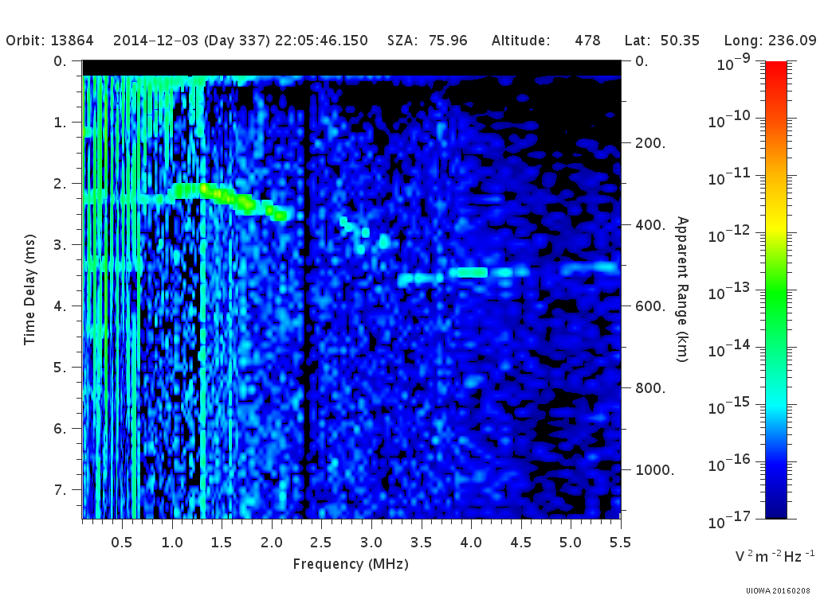
A “ghost” appears

Slide 27
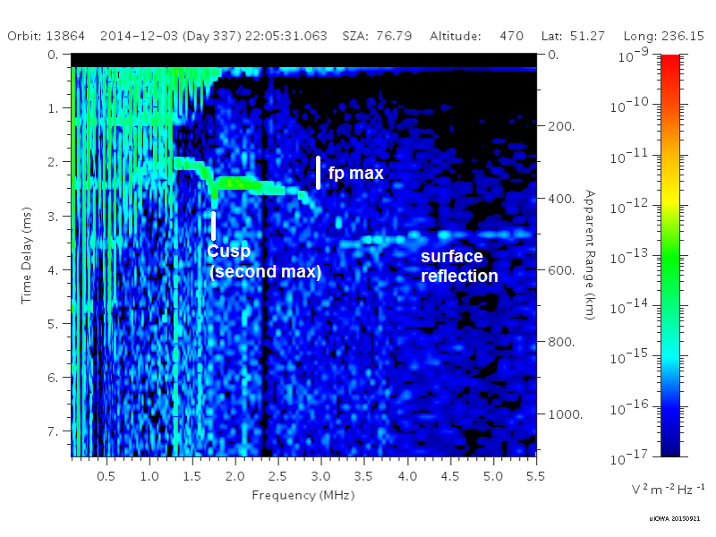
Transient Upper layers
An additional cusp is frequently observed at lower frequencies than the cusp of the main layer
This appearance of this feature implies the presence of an additional peak in the density profile at a lower density, and therefore at a higher altitude

Slide 28
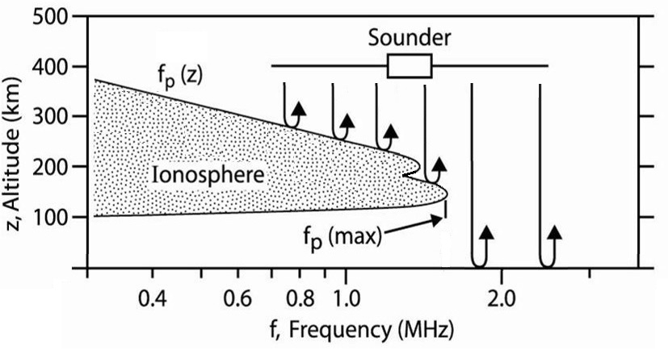
HOW DOES THIS HAPPEN?

Slide 29
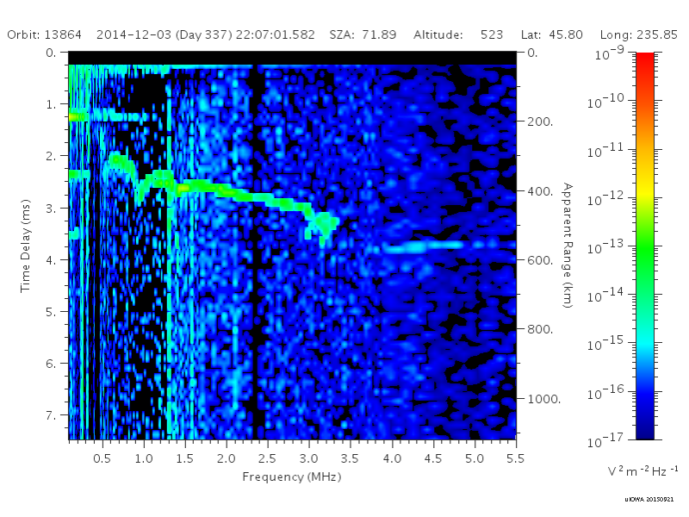
More than one…

Slide 30
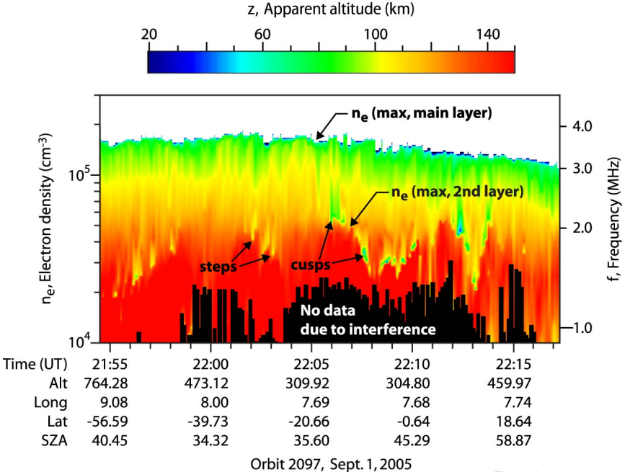
IDENTIFYING THE DISCONTINUITY

Slide 31
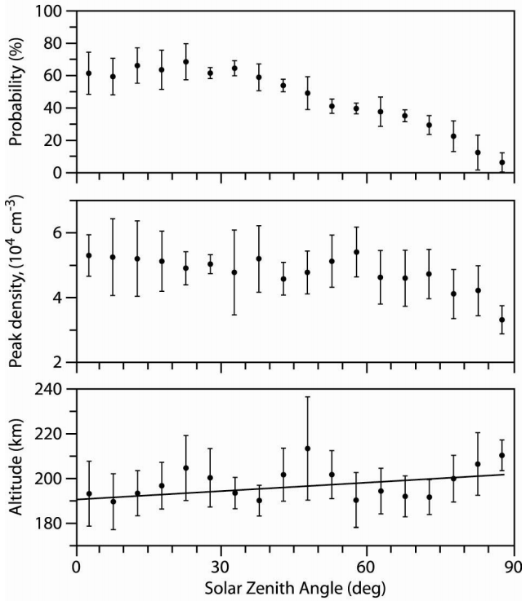
ORIGINAL STUDY (2008)
All data sets were from fall of 2005
These layers are highly transient – they are present roughly 50% of the time for most SZAs, and less near the terminator
Peak density is fairly consistent, but does also drop slightly at high SZAs. Consistently around 4-6 x 10⁴ cm⁻³
Altitude has an small upward trend with SZA, getting higher near the terminator, but always near 200 km

Slide 32
But why? – dead ends
Enhancement/Biteout in the particle density? – Mars Express doesn’t dip low enough into the ionosphere to directly pass through this region and measure.
MHD Waves from Solar Wind fluctuations? – Onboard instruments can give solar wind moments, but are orbit averages, not short-term enough to use here.
Kelvin-Helmholtz Instability? – Effects would likely become more prominent toward the terminator, where these features are less-frequently observed.
Magnetic Reconnection and Transport? – No magnetometer on Mars Express.

Slide 33
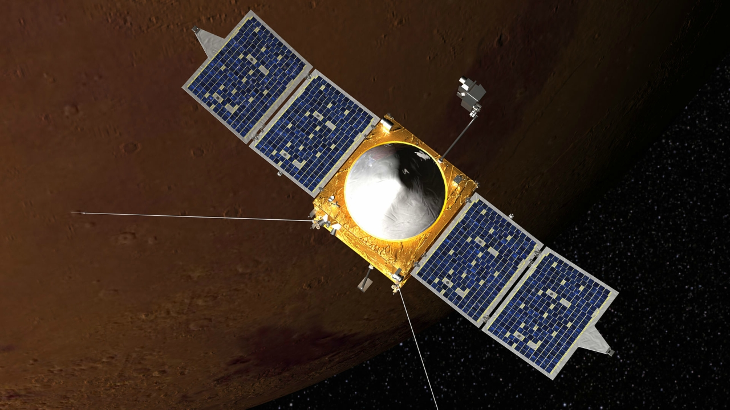
maven
Operated by NASA
Launched: November 18, 2013
Mars Arrival: September 22, 2014
Full Science Operations began in early November 2014
Diverse instrument suite, including some not found on Mars Express

Slide 34
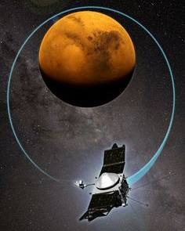
ORBIT PARAMETERS
Periareion – 150 km
Apoareion – 6200 km
Inclination – 75 degrees
Period – 4.5 hours
Orbit is occasionally adjusted to allow for week-long “Deep Dip” configuration that sends MAVEN down to near 125 km

Slide 35
Mars express vs. maven
MARS EXPRESS
MUCH longer duration in orbit, yielding many more data sets with which to work
Constant sounding while above this region gives large-scale spatial overview of these features
Can not determine inner workings due to higher altitude orbit
MAVEN
Flies directly through this region, giving direct measurement of properties, including vertical profile and depth
On-board instruments give particle counts, magnetic field measurements, and solar wind parameters
Only two chances per orbit, via quick pass-through, limits chances to observe

Slide 36
Two-part joint study
SOLAR WIND STUDY
Mars Express low, MAVEN high
Solar Wind Ion Analyzer (SWIA) on MAVEN tracks solar wind density, three-component velocity, and temperature at high (4-second) resolution
Correlate variations in the solar wind with variations in the observation of upper layers by Mars Express (MARSIS)
PARTICLE DENSITY STUDY
Mars Express high(er), MAVEN low
Neutral Gas and Ion Mass Spectrometer (NGIMS) on MAVEN measures densities of many individual ion species
Spike in density expected near 200 km
Correlate observations of layers with MARSIS layer detections

Slide 37
Solar wind – data selection
To minimize the possible variables, that data desired included:
A period of Mars Express orbits where MARSIS consistently had full sounding passes
MAVEN should be oriented so as to regularly enter the solar wind (not behind Mars)
The above two happen simultaneously
A period in early December of 2014 included roughly ten consecutive orbits where Mars Express was in full ionospheric-sounding mode. MAVEN was aligned properly to measure the solar wind as well in this time.
The two overlapped every other Mars Express orbit for a total of five observations.
Both spacecraft moved to the night-side shortly later, preventing an expanded study

Slide 38
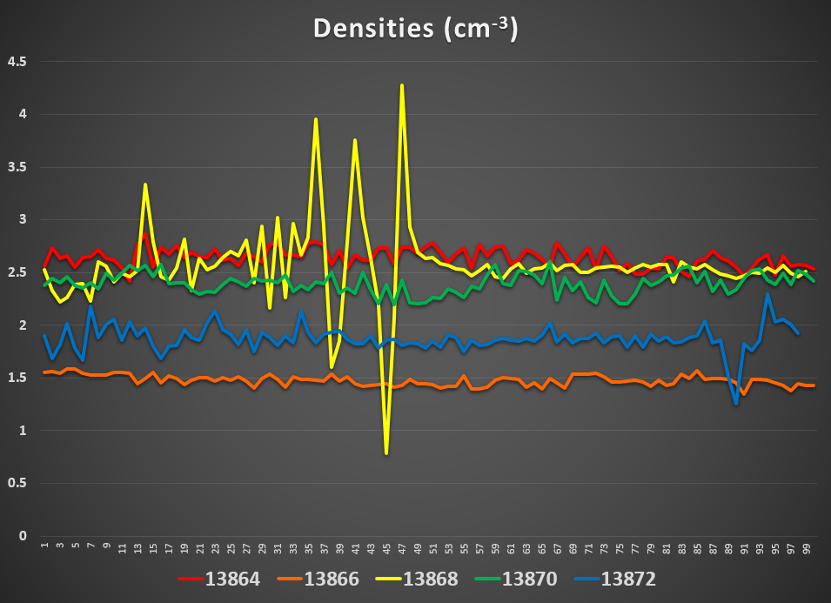
Solar wind study – Density

Slide 39
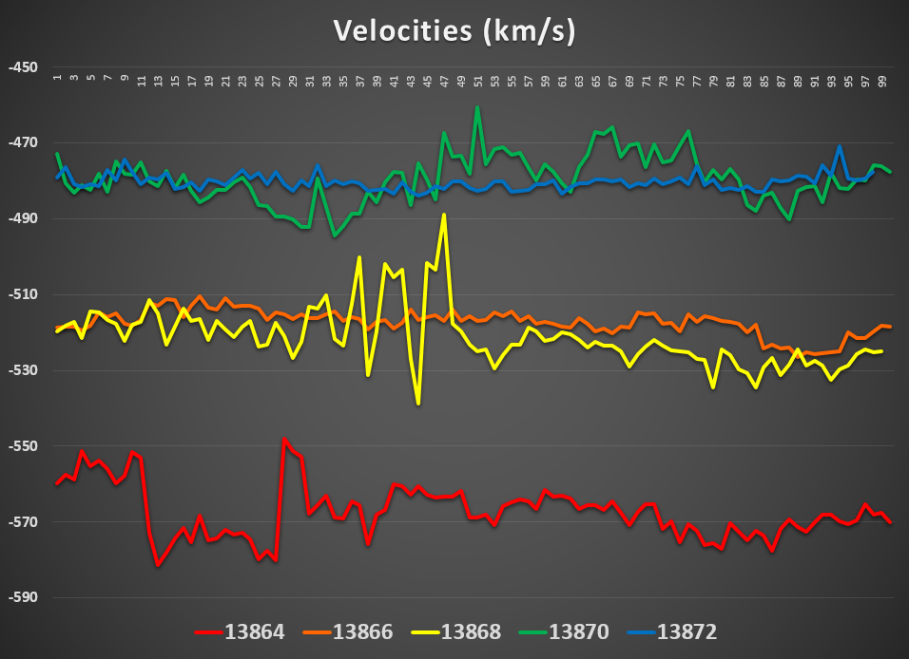
Solar wind study – velocity

Slide 40
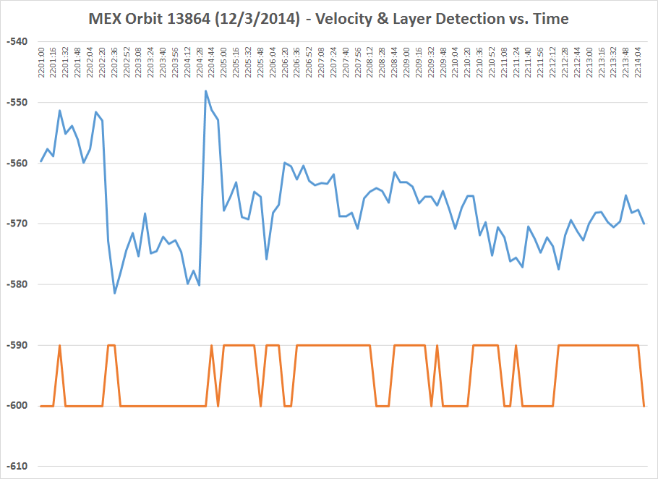
Solar wind – orbit 13864

Slide 41
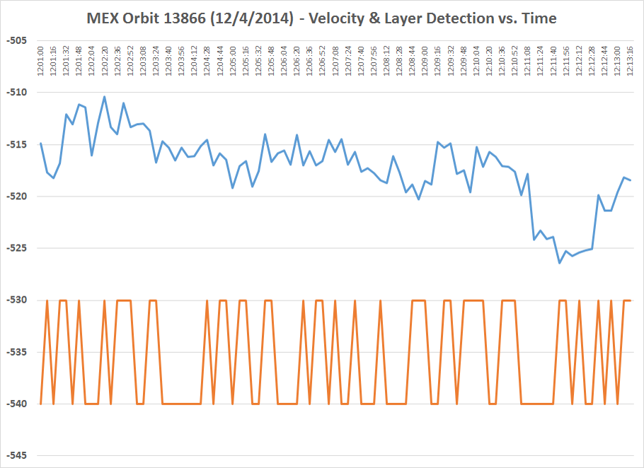
Solar wind – orbit 13866

Slide 42
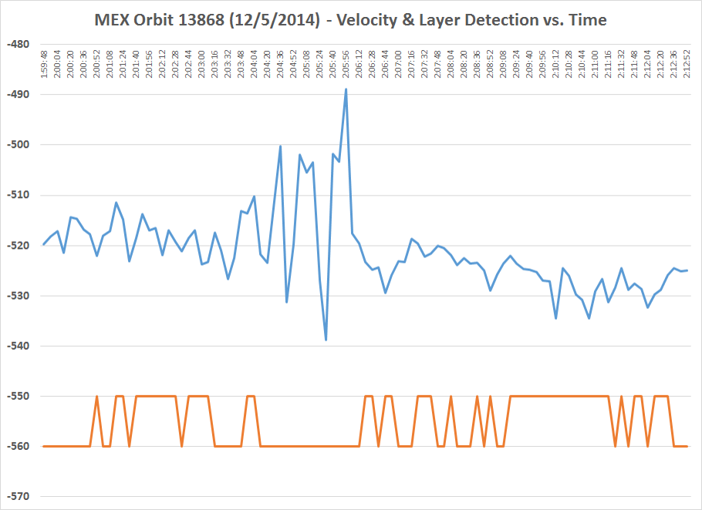
Solar wind – orbit 13868

Slide 43
Solar wind - takeaways
Variations in the solar wind do NOT cause the appearance of these features – rather, large-scale dynamics in the solar wind actually eliminate their presence.
In steady solar wind conditions, the layers are present at a roughly 50% rate, with some variation for the location in terms of solar zenith angle.
➔ “Upper layers” are a natural part of the Martian environment, due either to (1) an interaction with a steady solar wind, or (2) a Mars-based phenomenon.

Slide 44
Particle density study
Identify “crossing orbit” times, where the two spacecraft orbits intersect. To limit the useable sets, the following basic conditions were applied:
MAVEN must be in the ionosphere to study the region within a short time of intersect.
The two spacecraft should reach this point within a few minutes of each other.
The crossing point must be on the day side of the planet.
In the first three MAVEN data releases (data thru 8/15), there are 41 candidate orbits.
23 have no MARSIS ionospheric data (instrument off or in subsurface sounding mode)
18 have MARSIS data but cross deep on the night side (no ionospheric signal)
This leaves 0 useable orbits
Next MAVEN release (thru 11/15) is on February 15, has ONE optimistically useable orbit, and six others with only partial MARSIS coverage, making them unlikely.

Slide 45
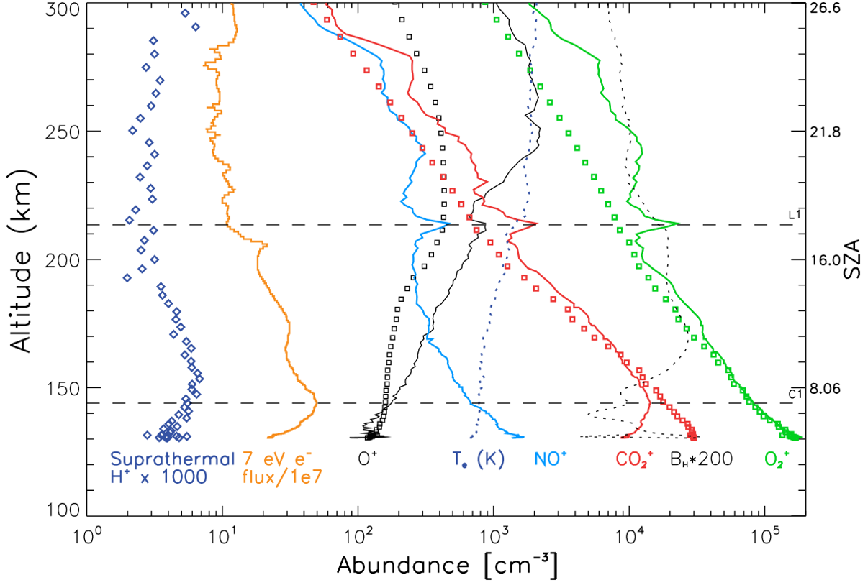
PARTICLE DATA (NGIMS)
From Bougher, et al
(2015)

Slide 46
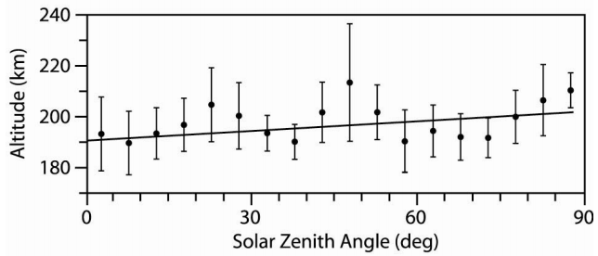
Altitude via mars express

Slide 47
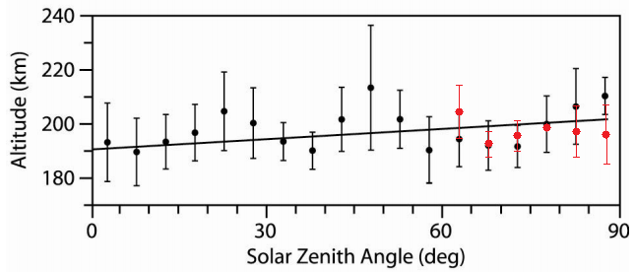
Altitude via maven

Slide 48
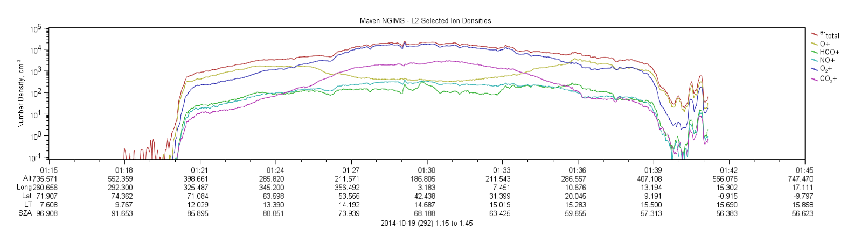
PARTICLE DATA (NGIMS)

Slide 49
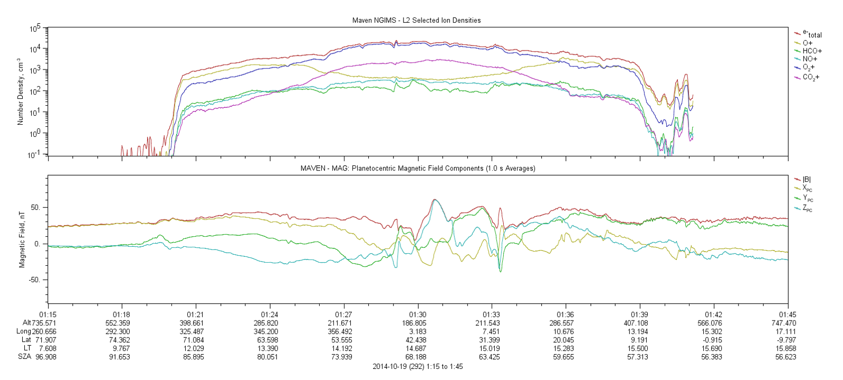
NGIMS & MAGNETOMETER DATA

Slide 50
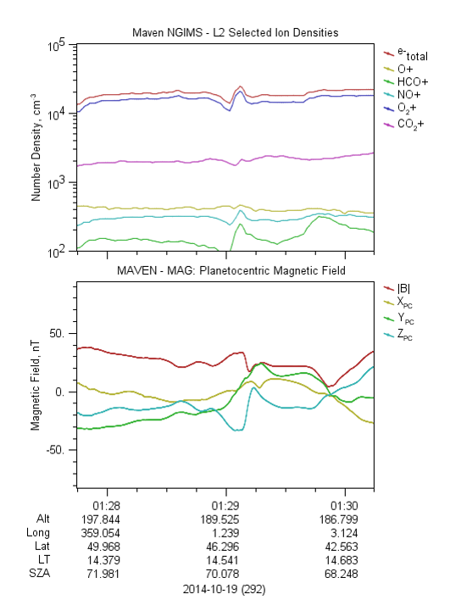
A closer look
NGIMS instrument frequently shows a jump up in density by a factor of 2-3 in the region near 200 km in altitude.
Density jump is the result of nearly all ion components increasing in density.
Magnetometer almost always shows a kink in the magnetic field magnitude at the same place, and generally also has one or more field components flip direction at the same time.

Slide 51




Slide 52

The big dip

Slide 53


SOLAR WIND CLOCK ANGLE

Slide 54


Slide 55



Slide 56


Field draping
From Luhman & Brace,
(1991)

Slide 57


Example: comets

Slide 58
Particles – Takeaways
Fundamentally, the “upper layers” seen by MARSIS are an enhancement in the density of the ionosphere around 200 km, accompanied by a neighboring depletion.
The enhancement/depletion occurs in most all species, not just the dominant O₂⁺.
The layer is accompanied by a sharp dip in the magnetic field, which generally includes a flip in direction of at least one of the magnetic field components.
➔ This layer seems to be generated by a current region, enhancing density at an altitude near 200 km, and depleting it nearby. The origin of this current appears to be the solar wind, due to clock angle changes and magnetic field draping.

Slide 59
Other marsis stuff

Slide 60

Comet layer
In late 2014, comet Siding Spring flew within 135,000 km of Mars at a velocity of 56 km/s. Due to the high speed, dust impacts had the potential to strongly ionize the upper atmosphere.
Generated a transient layer at 100 km, with density up to 2.6 x 10⁵ cm⁻³. This is the highest ever seen on the nightside.
Layer present on dayside as well, at a slightly lower density (1.8 x 10⁵ cm⁻³), but still larger than the main layer.
Lasted between 14 and 21 hours.

Slide 61

Oblique echoes
Sometimes, additional ionospheric echoes appear with longer time delays than the main echo
It is physically impossible for the echo to come from a second straight-down source

Slide 62



Oblique echoes

Slide 63


Cyclotron harmonics
Oscillation harmonics can also occur at regular time delay intervals. This has been interpreted as being harmonics of the cyclotron frequency

Slide 64

Mars express “magnetometer”

Slide 65

Plasma harmonics
MARSIS also sees harmonics occur as it steps up in frequency. These harmonics are associated with the local plasma frequency, and are seen to vary with altitude as the spacecraft orbits Mars.
These harmonics only appear in slower-moving (ionospheric) plasma. Once outside, the faster solar wind plasma is carried away too quickly for the echo to return to Mars Express.

Slide 66

Flow boundary

Slide 67


PREVIOUS WORK
From Duru, et al
(2010)

Slide 68


ALTITUDE VS. SUBSOLAR LATITUDE (FIXED SZA)

Slide 69


Altitude map
From T. Bridgman, NASA (2004)

Slide 70


