Slide 1


An ionized layer in the upper atmosphere of mars caused by dust impacts from comet siding spring
A.J. Kopf, D.A. Gurnett, D.D. morgan, A.M. Persoon, L.J. Granroth, J.J. Plaut, and J.L. Green

Slide 2
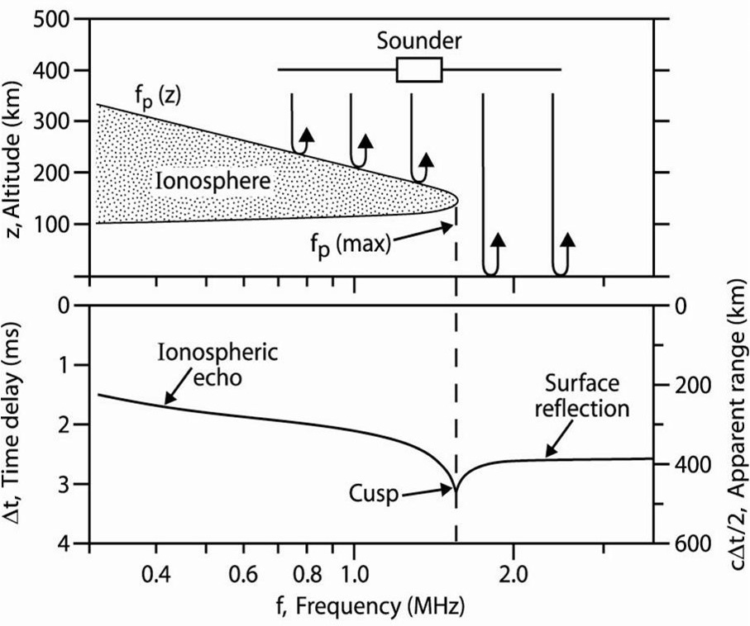
MARSIS Principles
MARSIS, a step-frequency radar sounder, sounds at a series of discrete frequencies, and then measures the time delay until an echo is received.
Signal travels until the frequency matches the plasma frequency, and then reflects
At frequencies above the peak plasma frequency (peak density), surface reflections can be observed.

Slide 3
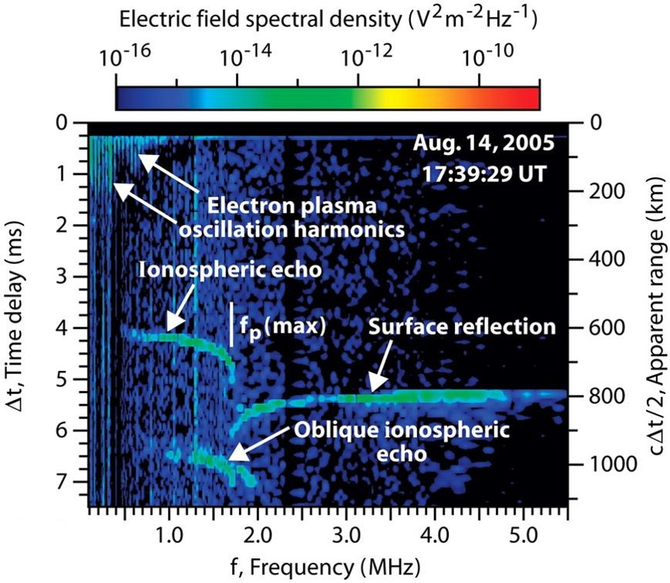
Typical MARSIS data
Sample of a typical MARSIS ionogram
Ionospheric reflection observed at lower frequencies, with a cusp marking the peak frequency (density). A surface reflection appears at higher frequencies
Other elements, such as local electron plasma harmonics, cyclotron harmonics, and oblique echoes, are also commonly observed by MARSIS.

Slide 4
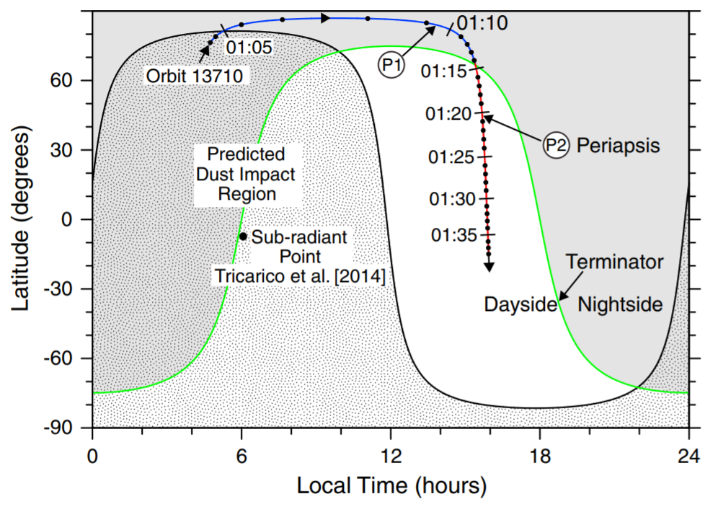
Siding Spring Orbital Geometry
During the period around Siding Spring’s closest approach, the MEX periapsis was at high northern latitudes, traveling from polar nightside to northern dayside.
While various longitudes were observed during these orbits, the orientation does not change much in terms of latitude and local time.

Slide 5
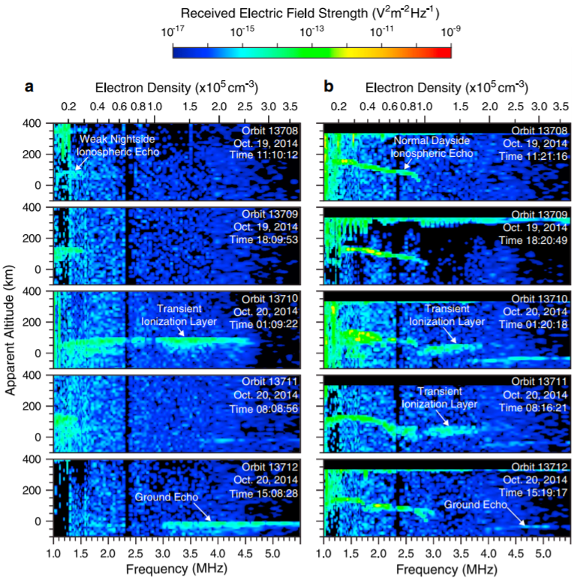
Unusual Ionization
Near SS closest approach, MARSIS began to observe unusually high-frequency ionospheric returns in both dayside and nightside regions.
These frames show observations from common regions in five consecutive orbits. The one immediately after closest approach is in the center.

Slide 6
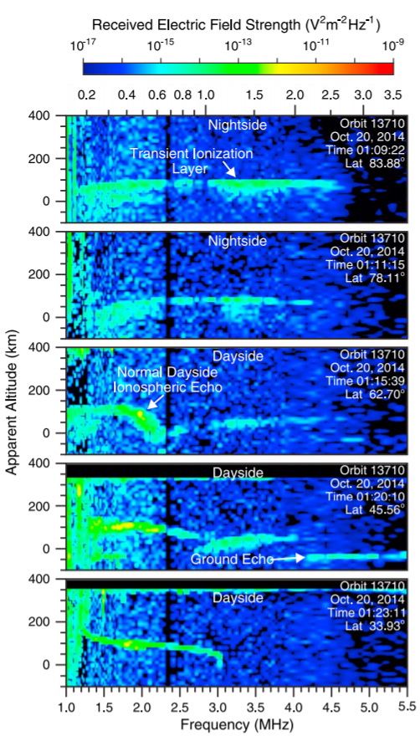
LatiTudinal Variation
The feature is persistent over the course of the entire orbit, starting with nightside observations and continuing into the northern dayside areas.
The signal becomes harder to detect as MEX goes deeper into the dayside on this pass.
The ensuing pass still included some dayside ionization, but with little to none in the nightside and polar regions.

Slide 7
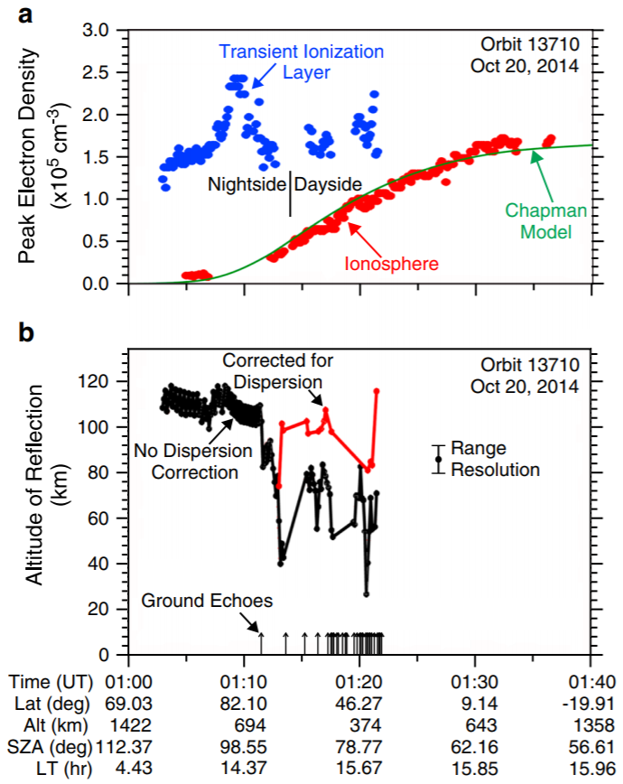
Very High Density
Higher densities than the peak of the ionosphere are observed on both the day and night sides. These are some of the highest ever seen by MARSIS.
Very few ground echoes seen during periods where this layer is detected due to the increased ionization.
Published max altitude of 100 ± 7 km has been updated by a MARSIS timing error correction, now about 115 ± 7 km.

Slide 8
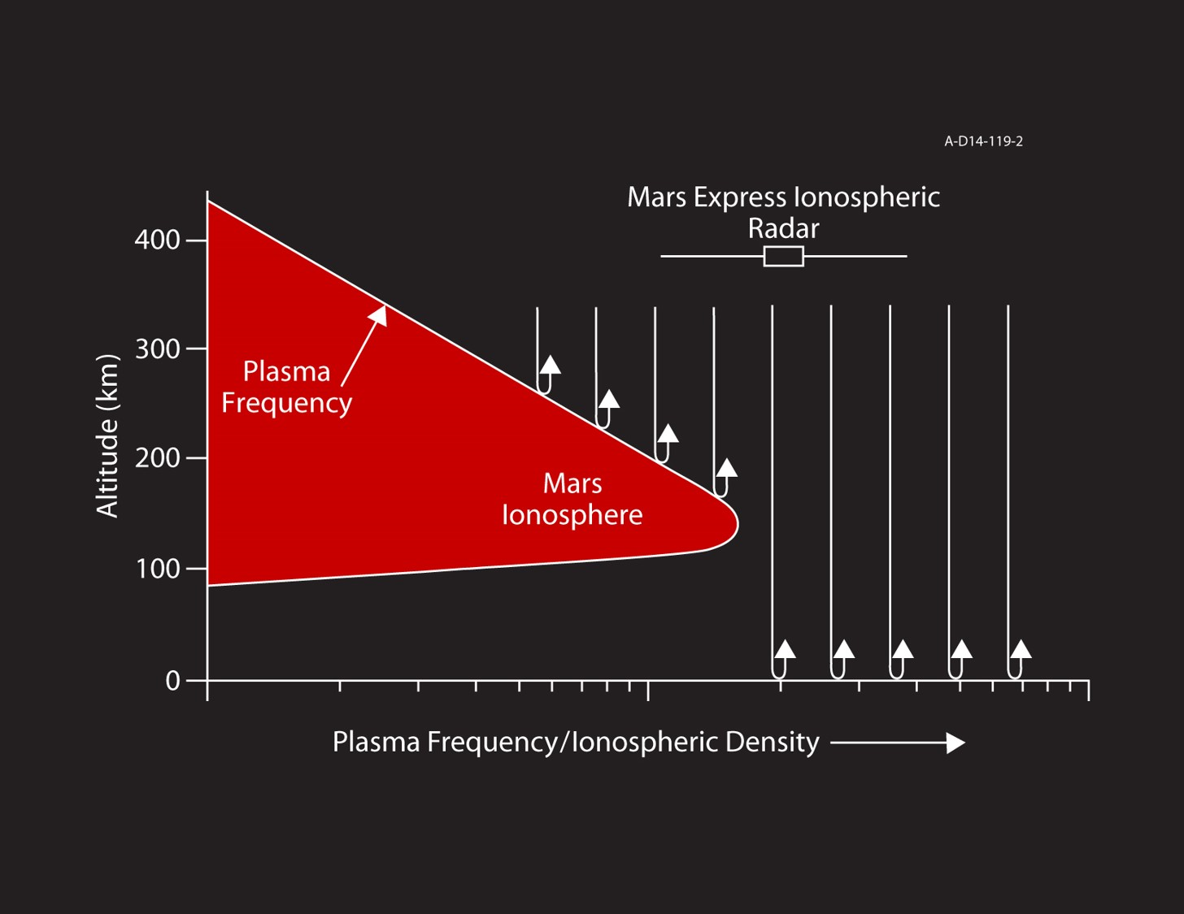
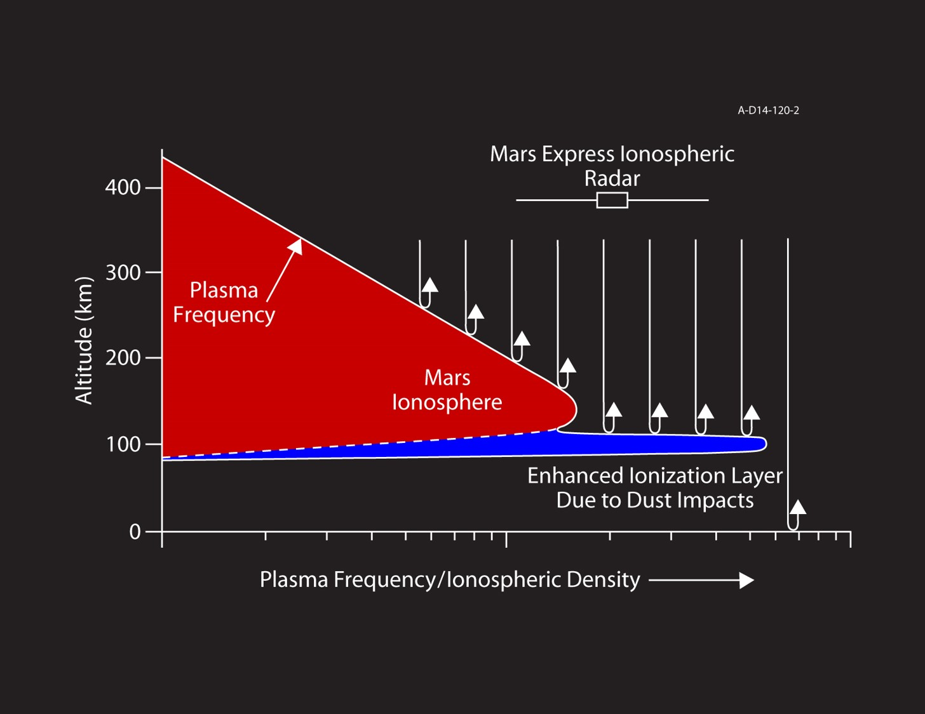
A (Temporarily) Modified Picture

Slide 9
What About Local Conditions?
MARSIS has the ability to measure local plasma density using the electron plasma oscillation harmonics.
MARSIS can typically observe these oscillations down to very low densities, about 30 cm⁻³, if plasma flow is minimal.
Variations were observed, but have not been published to date, due to a solar event complicating the larger picture.

Slide 10
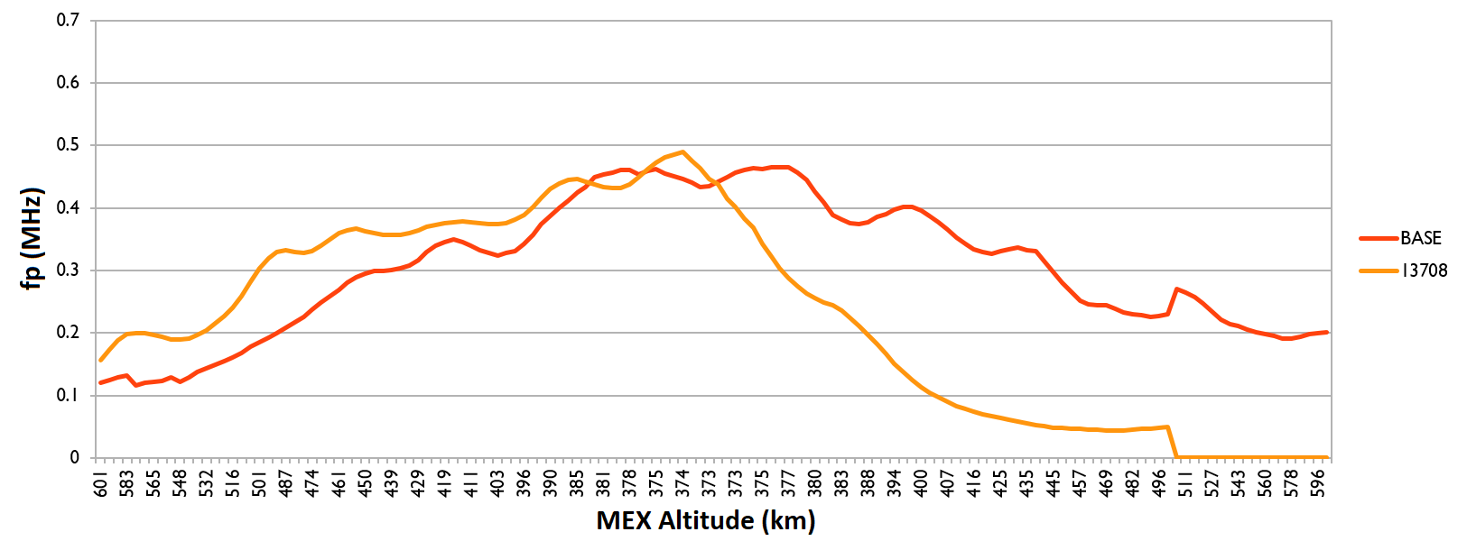
13708 – PERIAPSIS 7 hours before siding spring

Slide 11
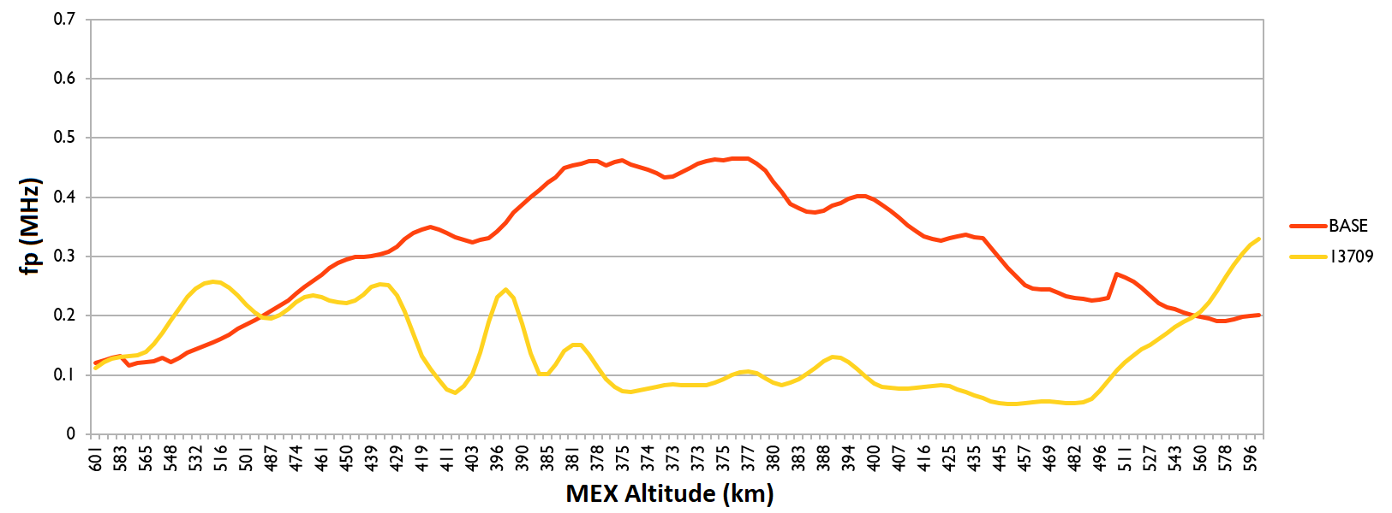
13709 – PERIAPSIS 7 minutes before siding spring’s closest approach

Slide 12
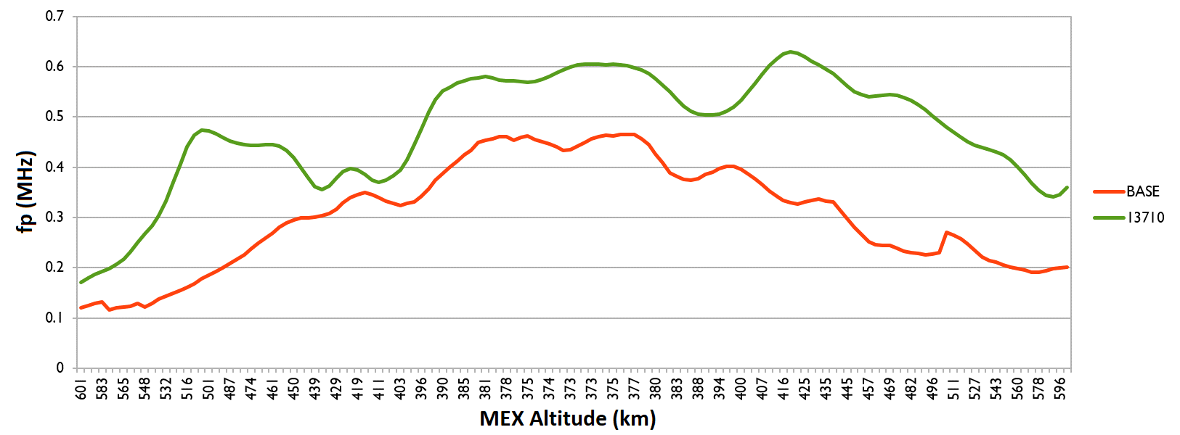
13710 – Periapsis 7 hours after siding spring

Slide 13
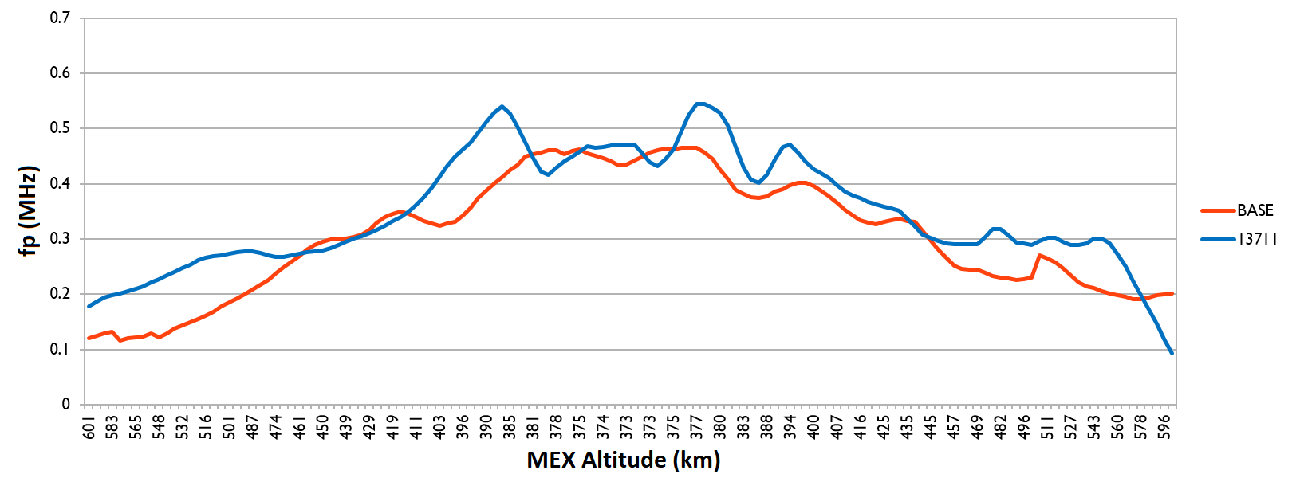
13711 – Periapsis 14 hours after siding spring

Slide 14
Summary
MARSIS observed a dense ionized layer in the upper atmosphere of Mars, likely caused by dust impacts.
Layer observed on two passes following closest approach, at 7 h and 14 h later.
Ionization layer was observed at altitudes between 95 and 115 km, with a peak electron density of 1.5-2.5 x 10⁵ cm⁻³, higher than normally observed in the Martian ionosphere.
Layer suspected to be produced by dust from the comet impacting and ionizing the upper atmosphere.
Local density measurements may show effect of the comet’s coma on upper ionosphere.

