Slide 1
The SOURCE OF AURORAL HISS? WHISTLER-MODE GROWTH rates DAY 291, 2008
Andrew J. Kopf
University of Iowa
Day 291 Event Special Meeting
November 19, 2009

Slide 2
Outline
Brief Overview of Auroral Hiss
Characteristic Properties
Generation & Propagation
Methods of Growth Rate Analysis
Numerical (WHAMP)
Analytical Methods
Results
Day 291 – 8:35 Beam
Other Day 291 Events
Is It Auroral Hiss?

Slide 3
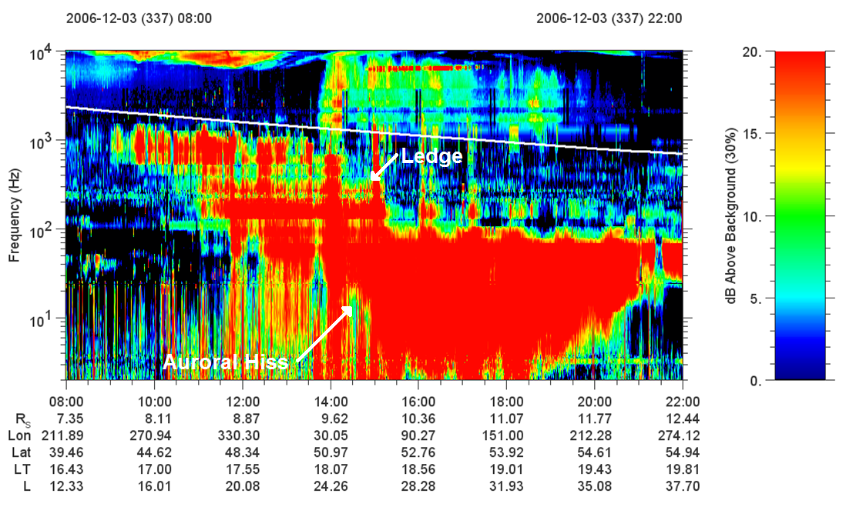

Slide 4
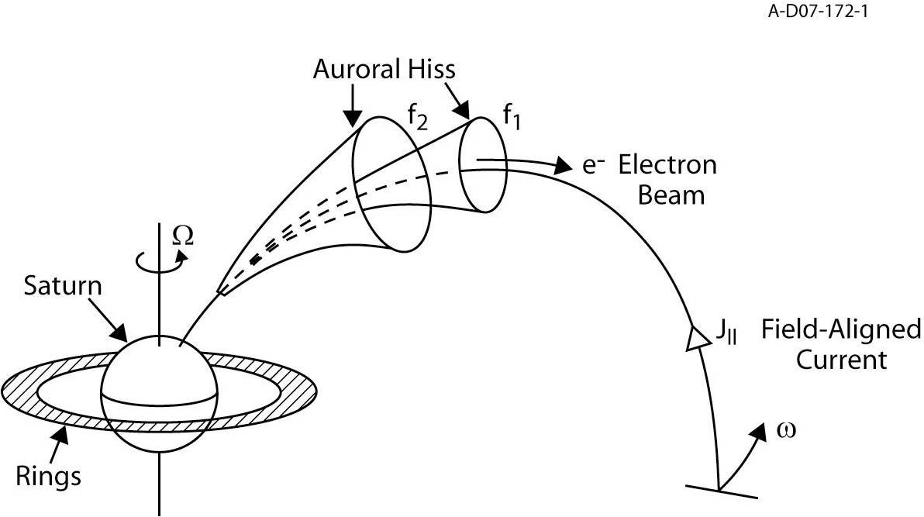
Theory of Auroral Hiss

Slide 5
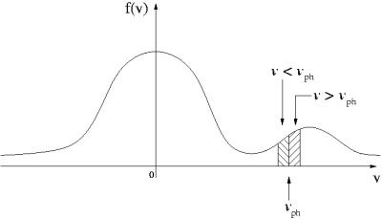
A Beam-Driven Instability

Slide 6
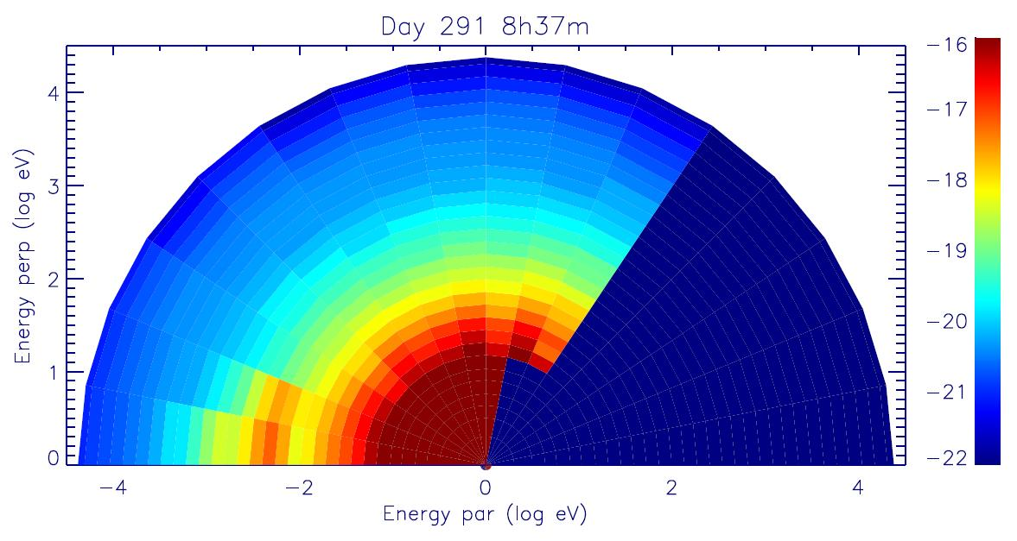
ELS Spectrogram

Slide 7
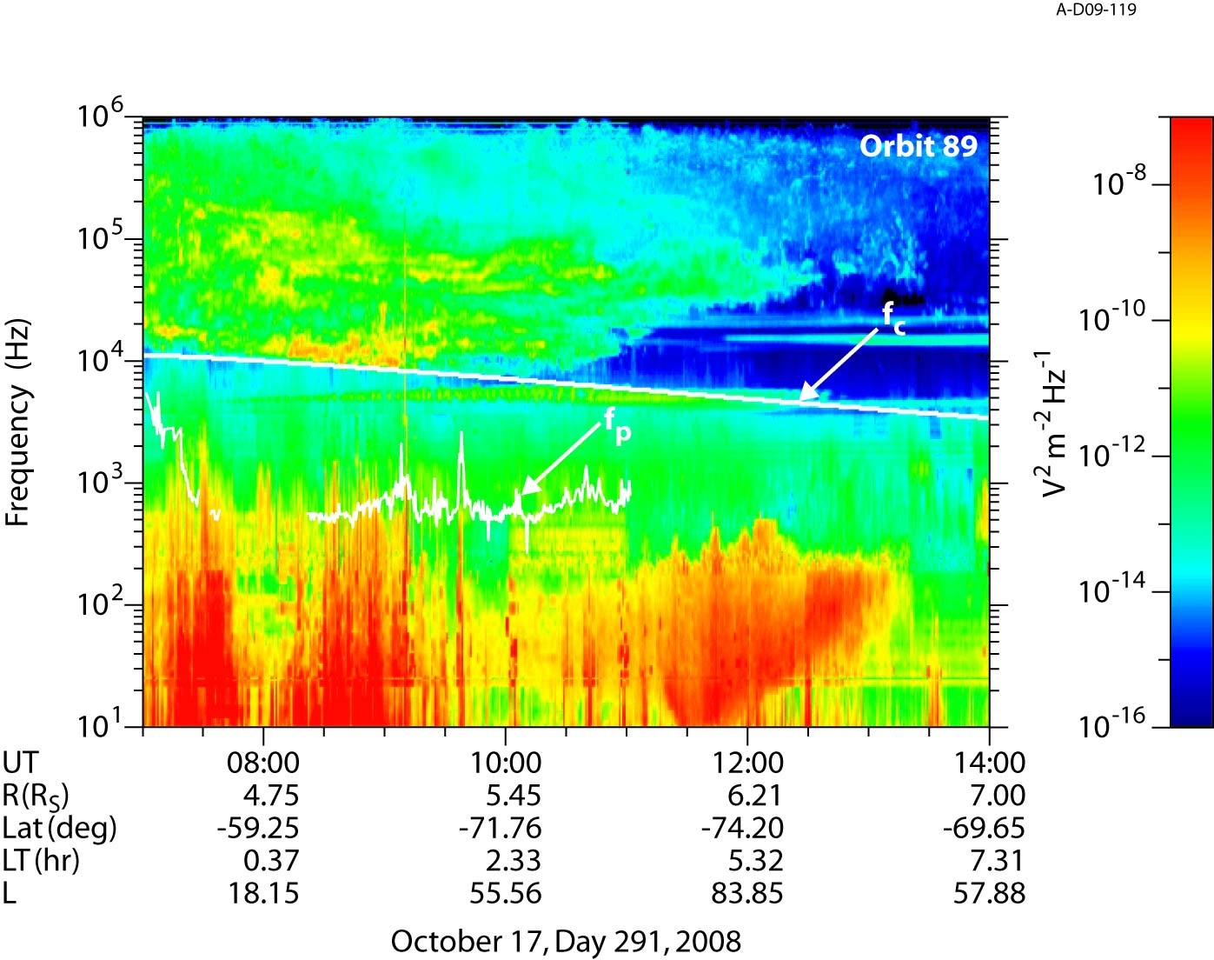

Slide 8
Methods of Calculation
Numerical Calculation
WHAMP
Requires approximation of the data
Analytical Calculation
Maxwellian Approximation
Data Interpolation and Integration
Requires obtaining a reduced distribution function to calculate growth

Slide 9
The Numerical Approach
Waves in Homogeneous Anisotropic Multicomponent Plasmas (WHAMP)
Solves dispersion relation of waves in magnetized plasmas with Maxwellian velocity distributions
Each component specified by density, temperature, particle mass, anisotropy, and drift velocity
For given values of k, will yield real and imaginary (growth) parts of frequency

Slide 10
The Analytical Approach
Often unsolvable due to the complexity of the system, requires making a few assumptions.
Following a similar approach to Morgan et al. (1994), we start with the derived equation by Kennel (1966) and assume:
(1) Resonance Cone propagation
(2) Ions play a negligible role

Slide 11
The Analytical Approach
If we further assume that:
(3) ω_{c}² >> ω_{p}² > ω²
(4) Only m=0 significant (small electron population)
Letting J₀² = 1, cancelling, and moving terms:

Slide 12
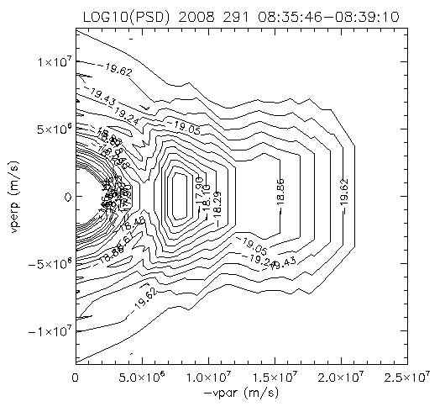
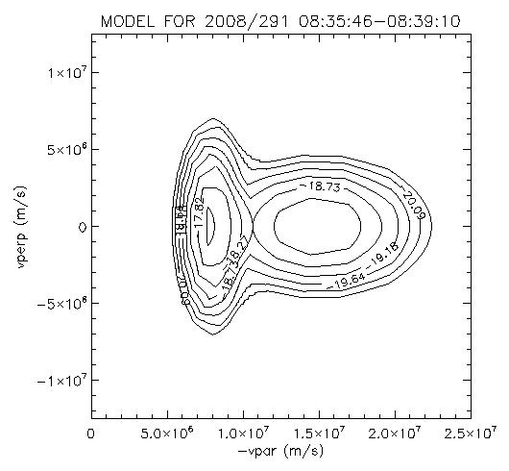
Maxwellian Approximation

Slide 13
Data Interpolation & Integration
We can further simplify this, since:
Thus, we finally end up with:

Slide 14
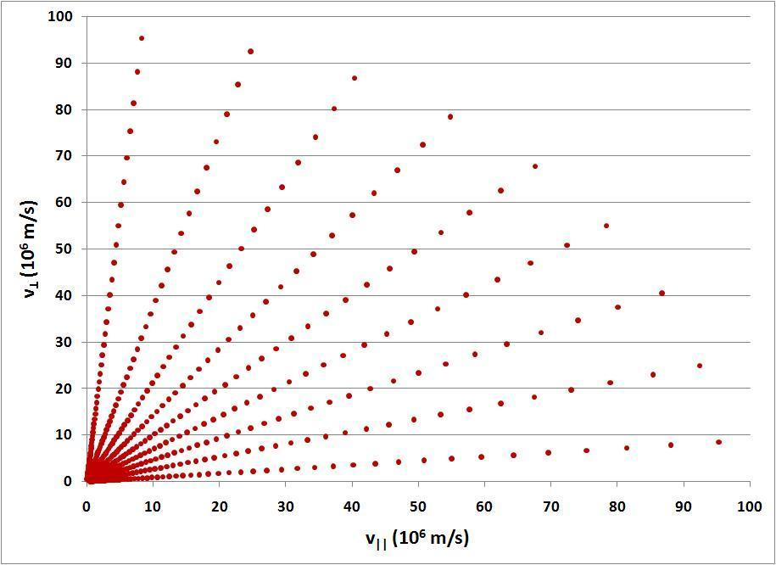

Slide 15
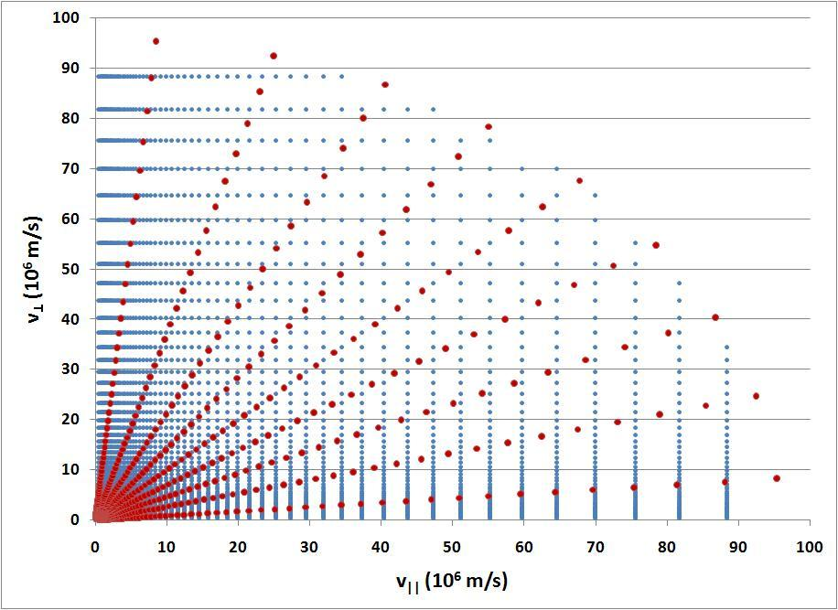

Slide 16
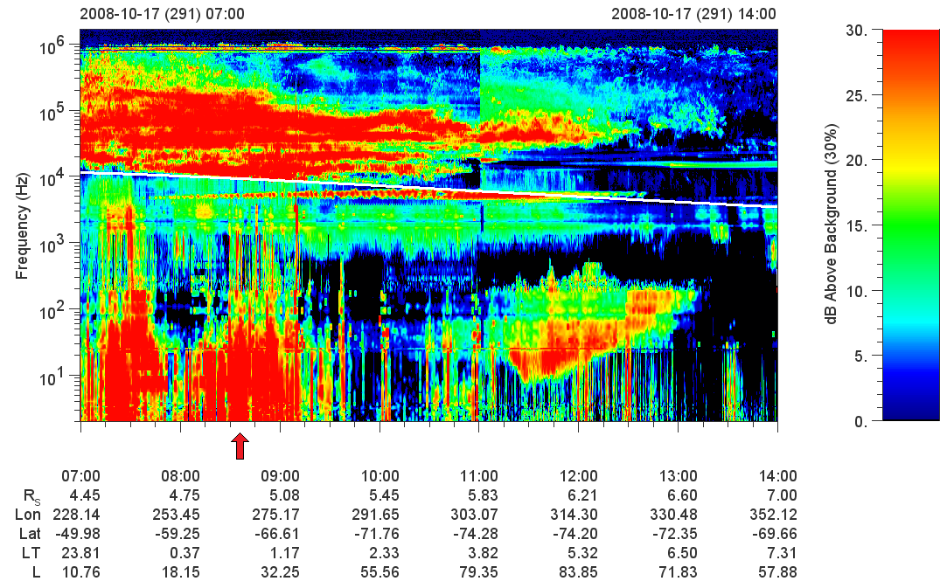

Slide 17
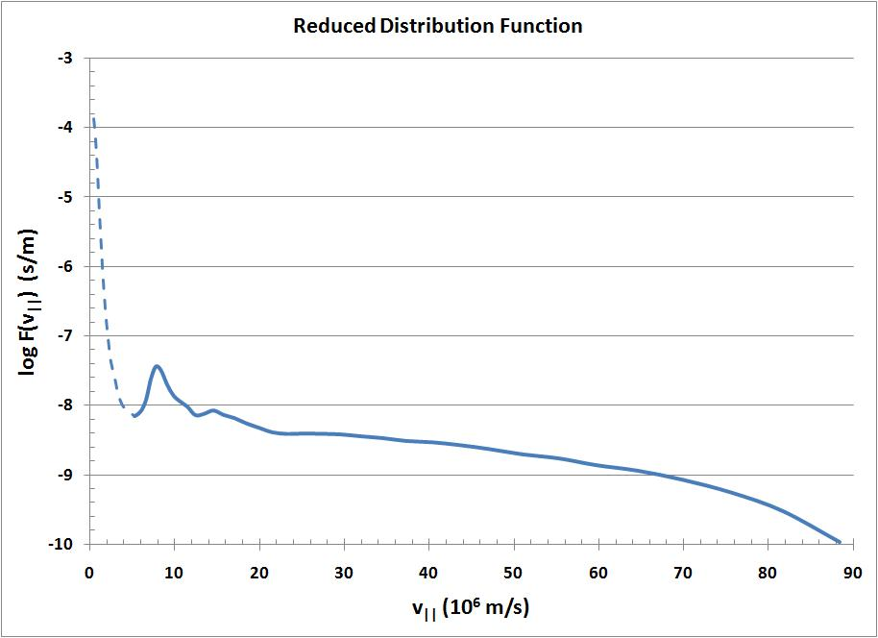

Slide 18
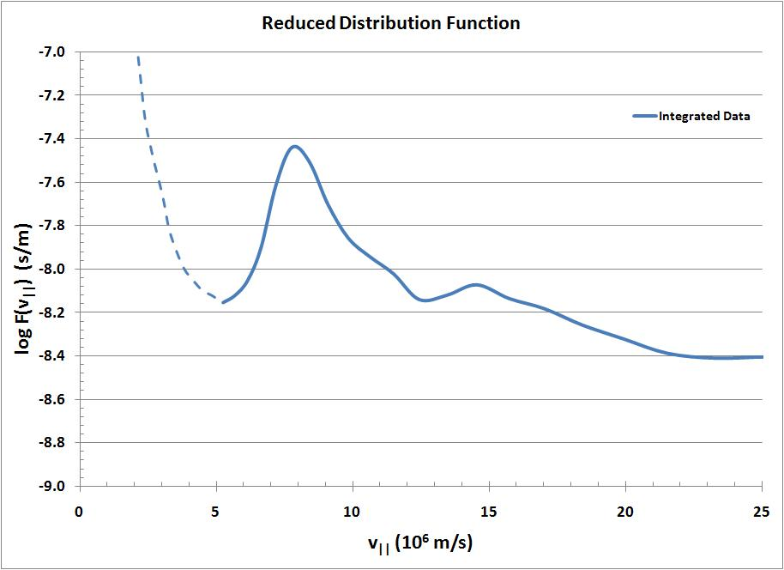

Slide 19
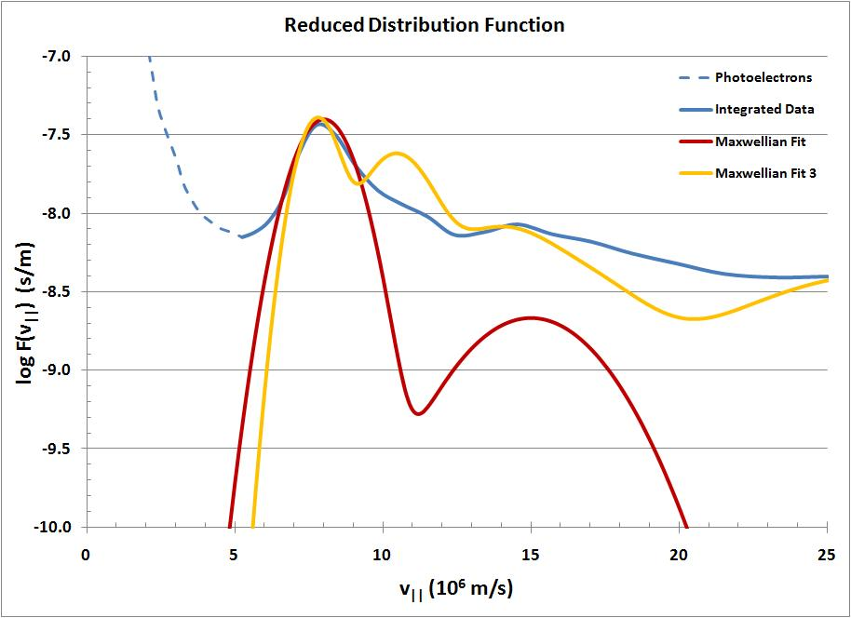

Slide 20
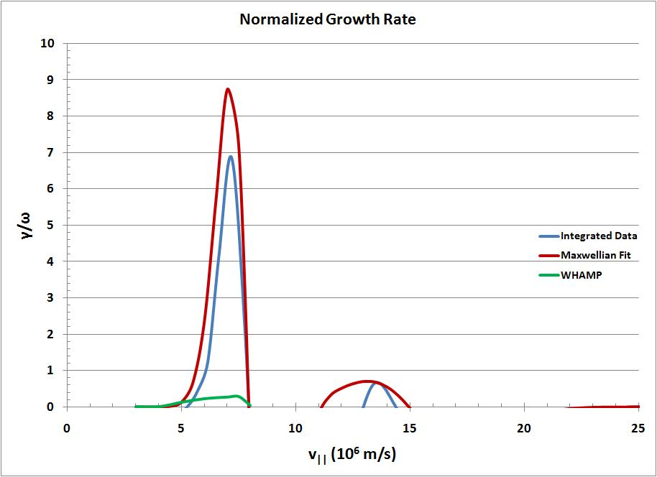

Slide 21
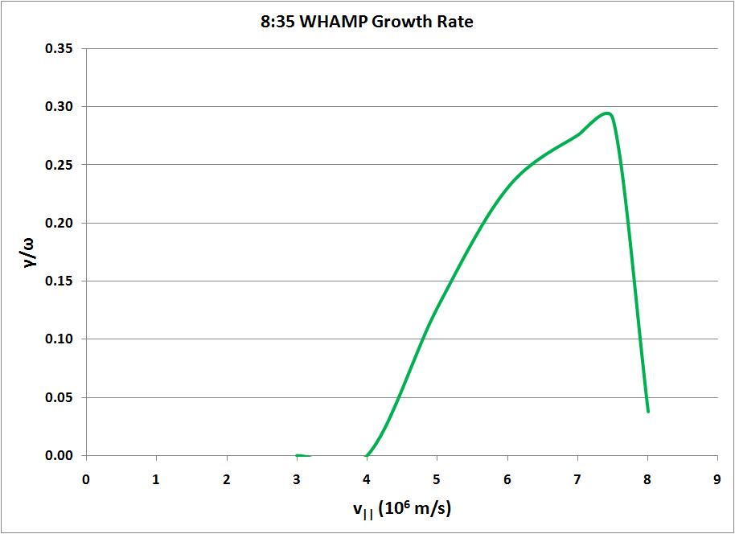

Slide 23
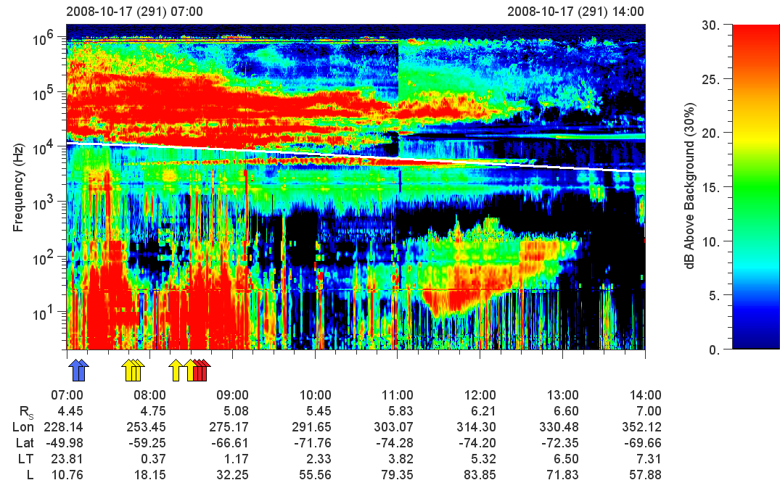

Slide 24
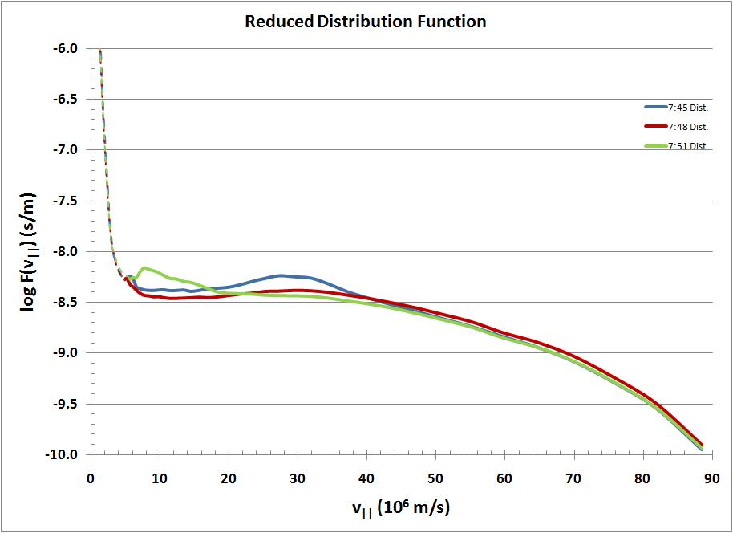

Slide 25
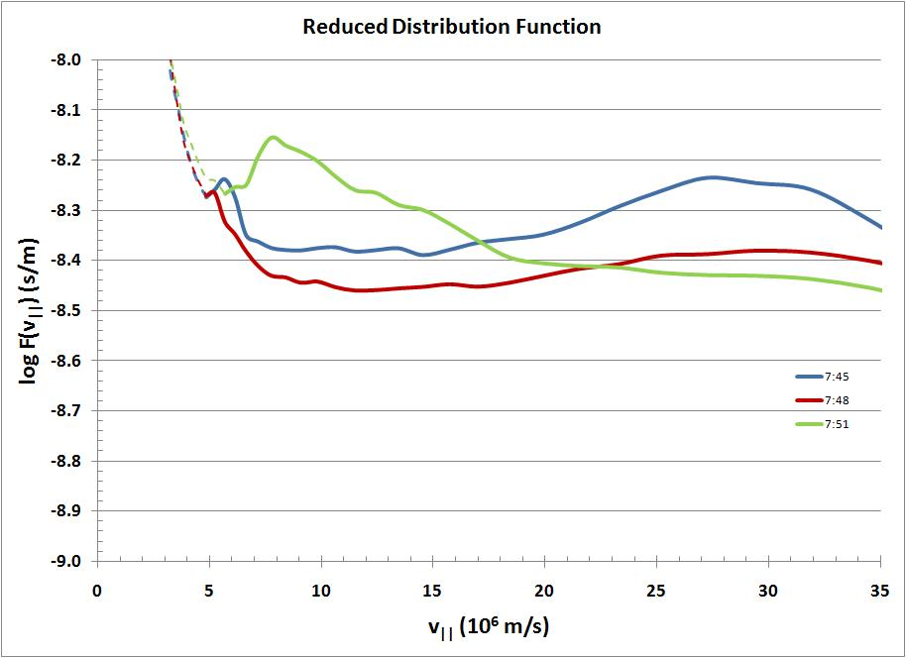

Slide 26
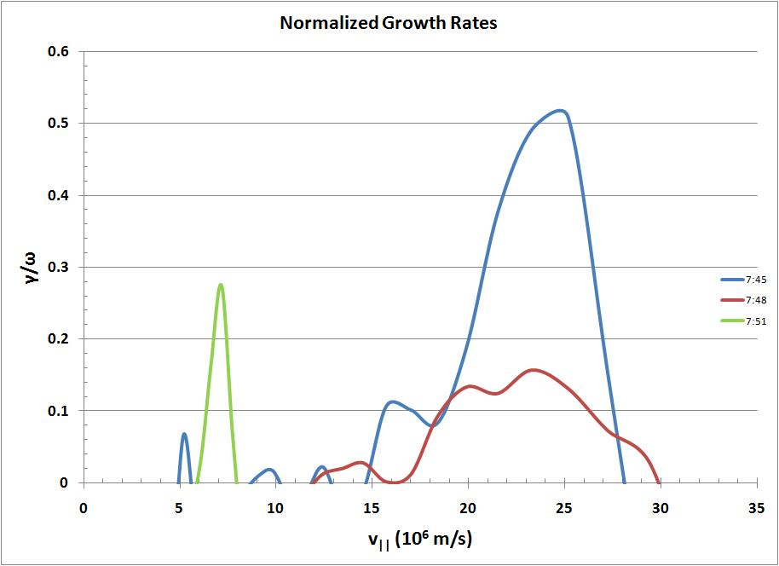

Slide 27
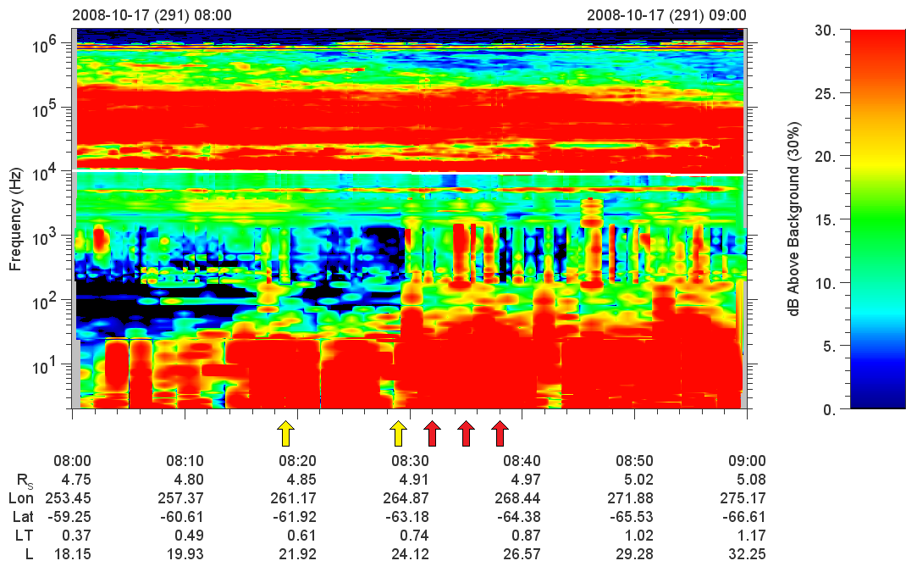

Slide 28
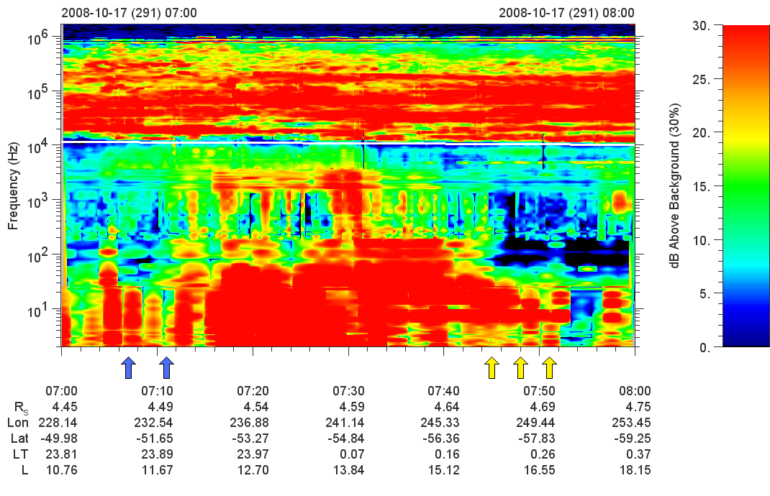

Slide 30


Slide 31
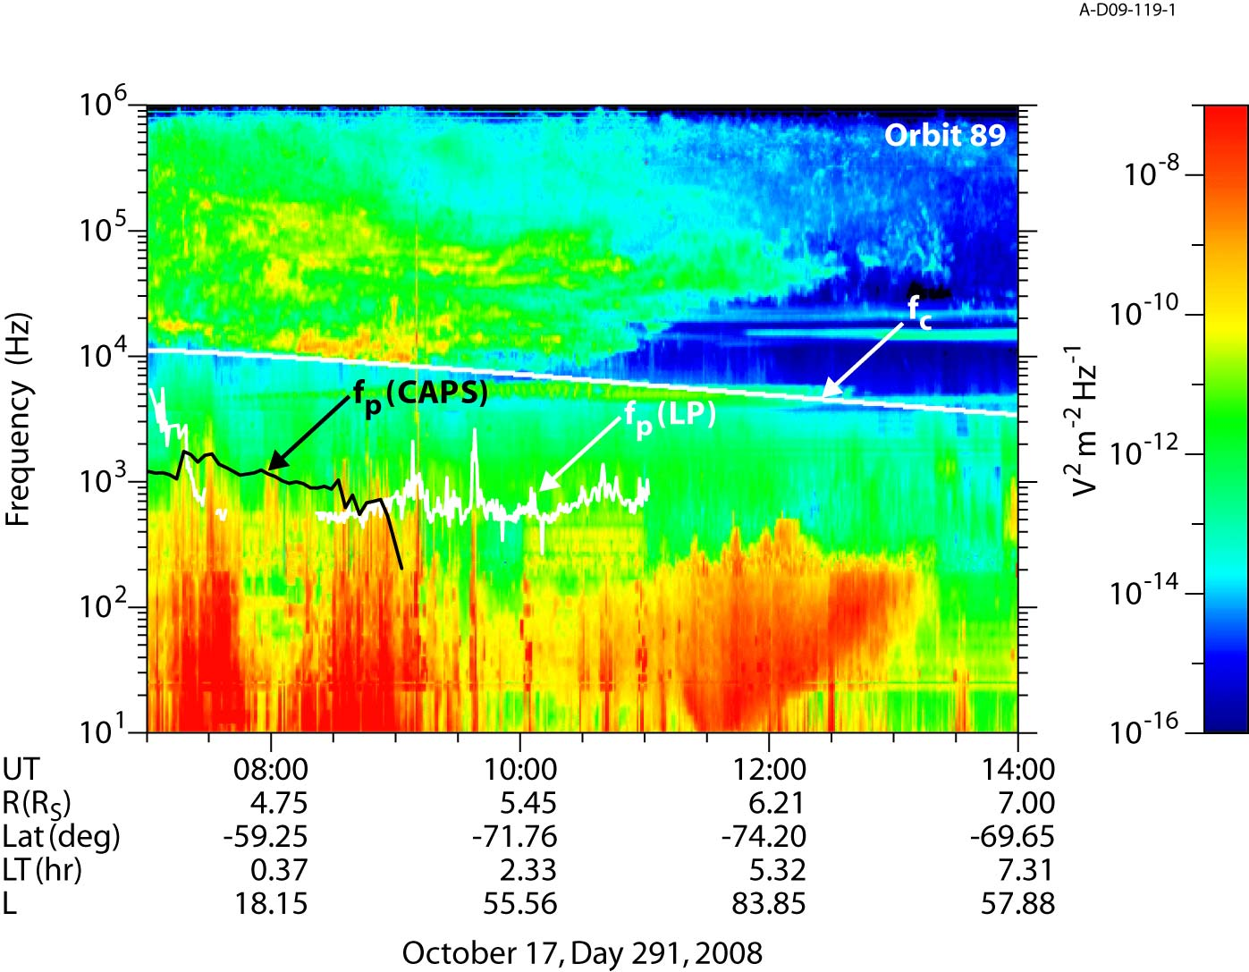

Slide 32
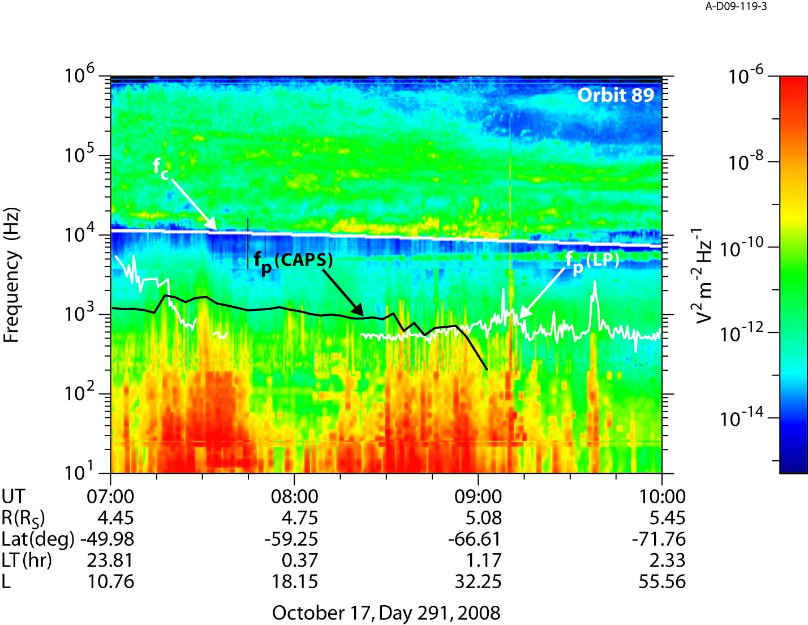

Slide 33
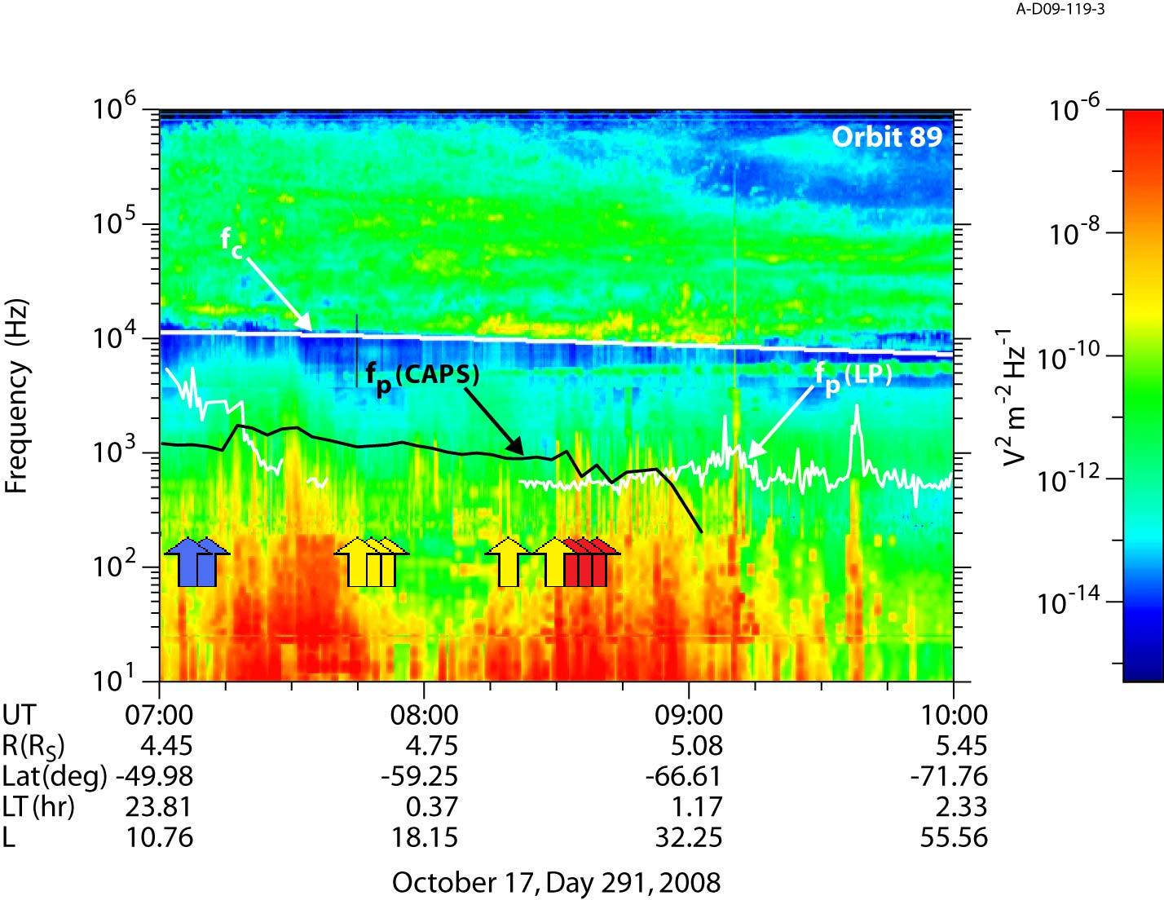

Slide 34
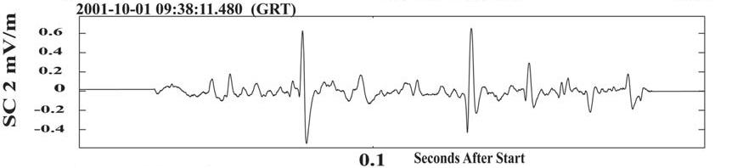
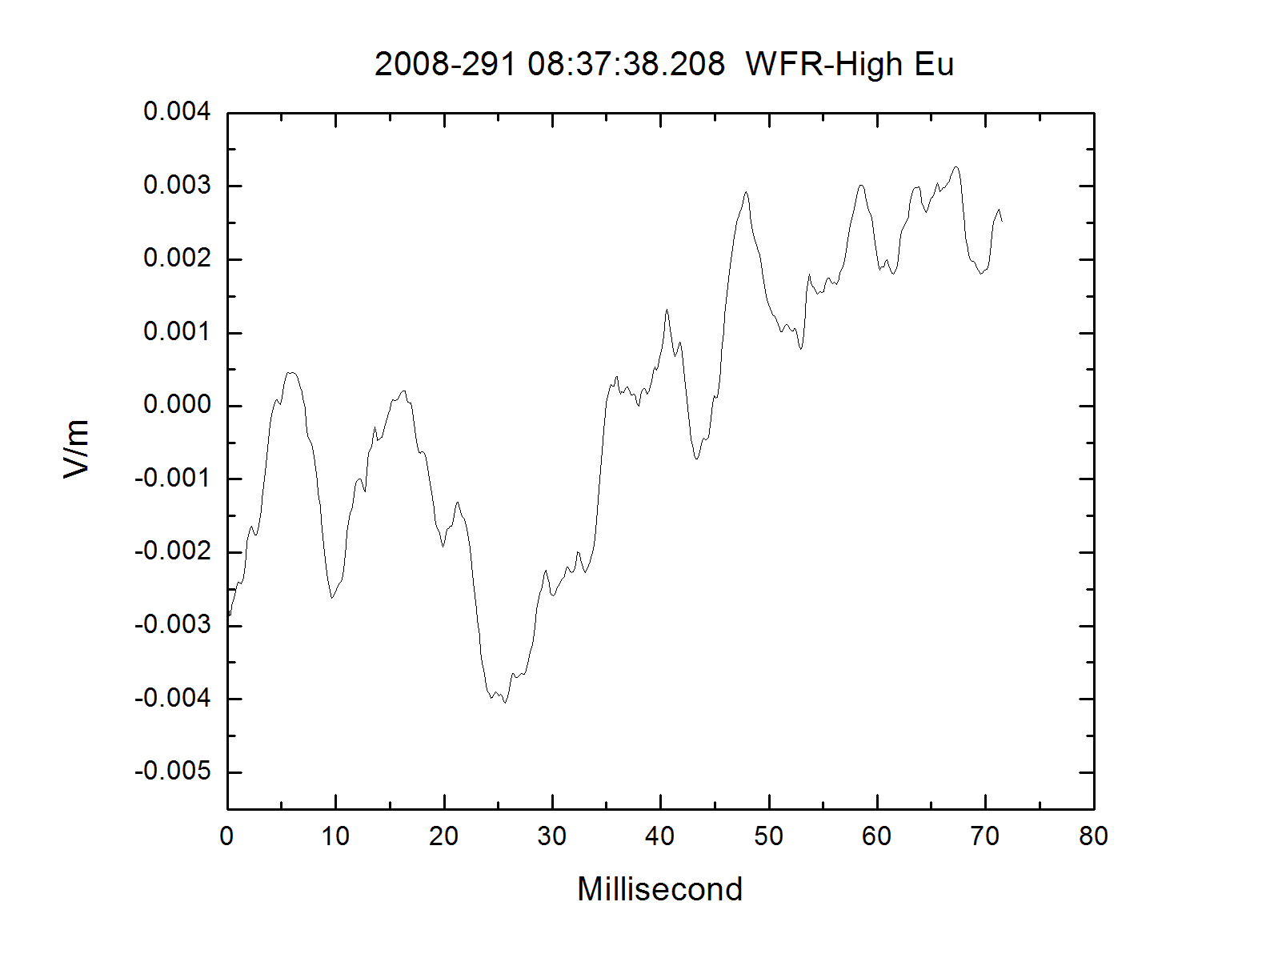
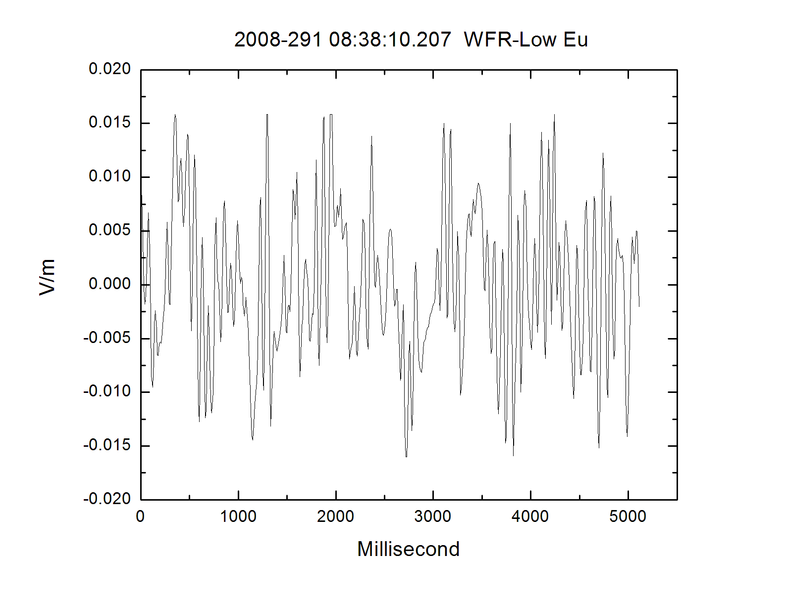
Electrostatic Solitary Waves

Slide 35
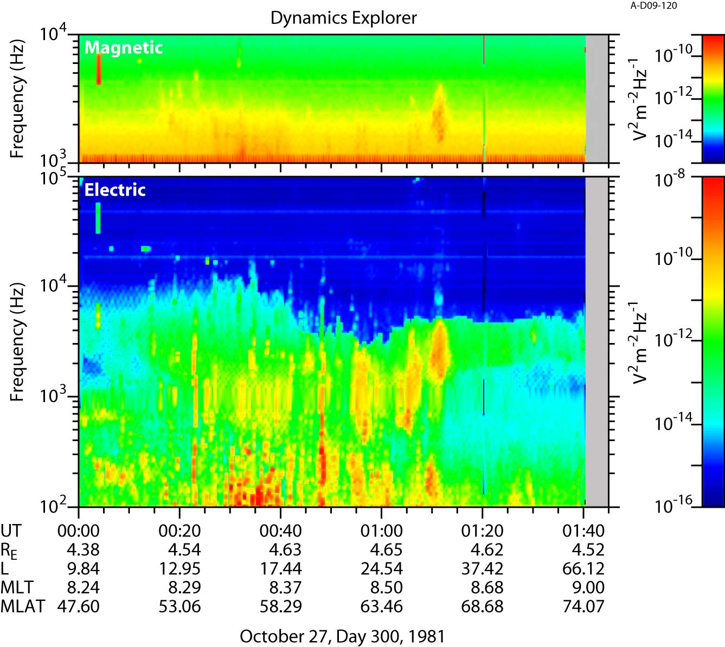

Slide 36
Conclusions
Multiple day 291 beam events are significant enough to produce the auroral hiss emission.
Although analytical and numerical models produce different results for 8:35, both indicate very high growth rates.
Overly large growth rates in analytical results likely indicate breakdown in γ<<ω assumption.
Beams from other orbits are required to confirm and expand on these results.

Slide 37
