Slide 1
AURORAL HISS AT SATURN – A MULTI-INSTRUMENT CASSINI STUDY
Andrew J. Kopf
Comprehensive Exam
July 1, 2009

Slide 2
Outline
Introduction
Previous Work
Theory of Auroral Hiss
The Cassini Spacecraft
Auroral Hiss at Saturn
Goals of this Research

Slide 3
Introduction to Auroral Hiss
Whistler-mode plasma wave emission in high-latitude regions of magnetosphere
Discovered by ground-based instruments
First satellite observations in 1960s. Has since been detected on other planets.
Generated by beam of electrons
Saturn detections due to upward-propagating electrons along magnetic field lines
Believed to propagate near resonance cone around field-aligned currents
Characteristic funnel shape on spectrogram

Slide 4
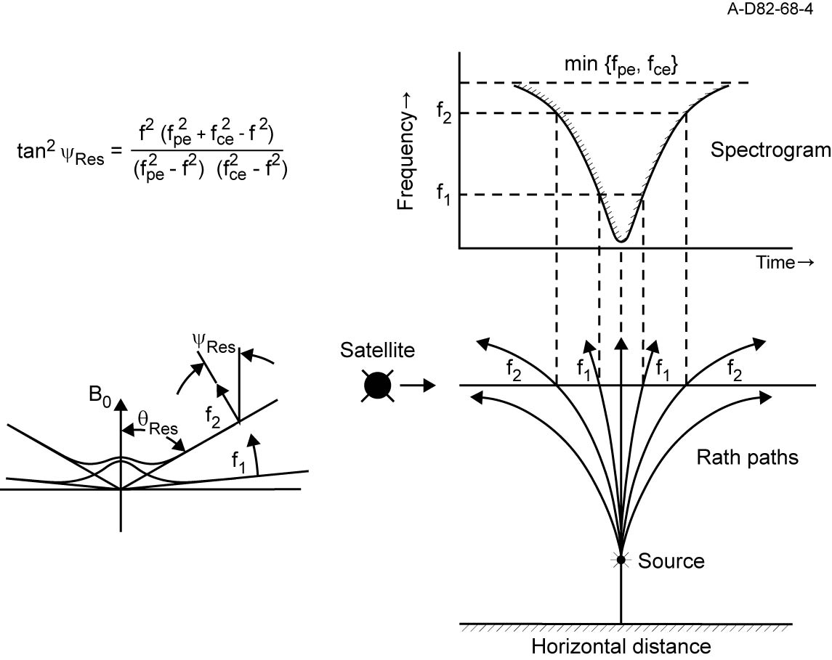
Resonance Cone Propagation

Slide 5
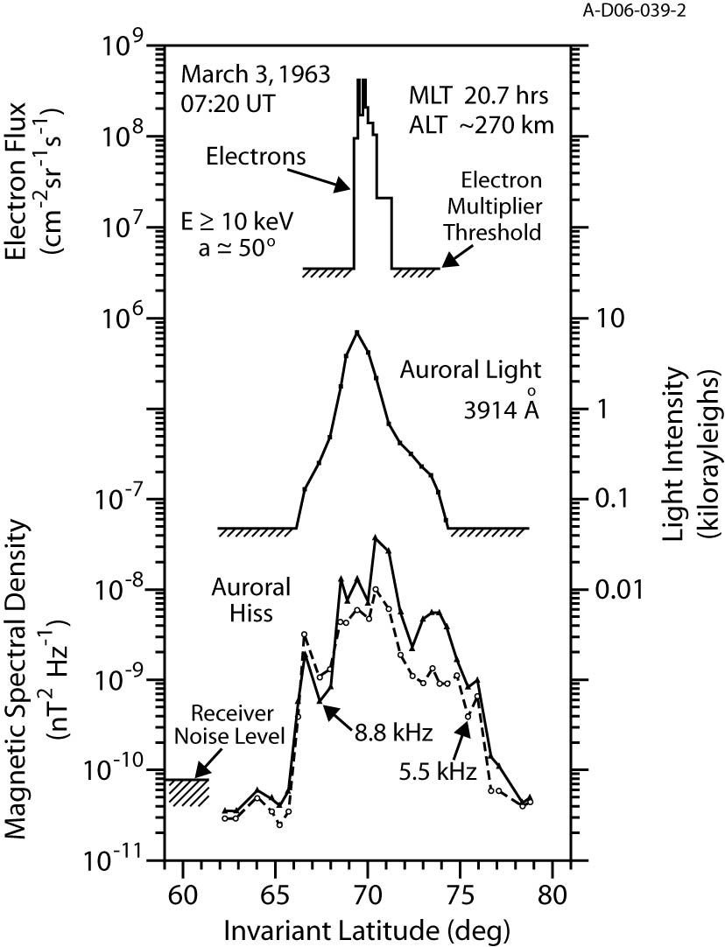
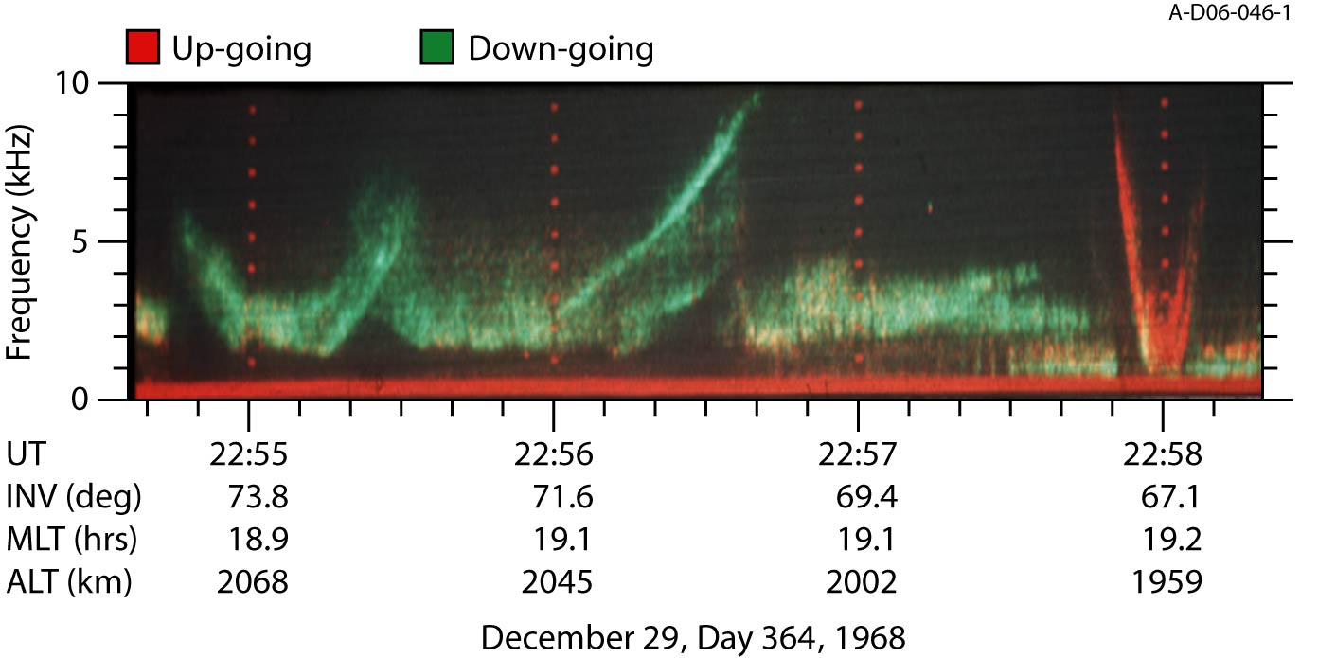
Injun 3 & Injun 5

Slide 6
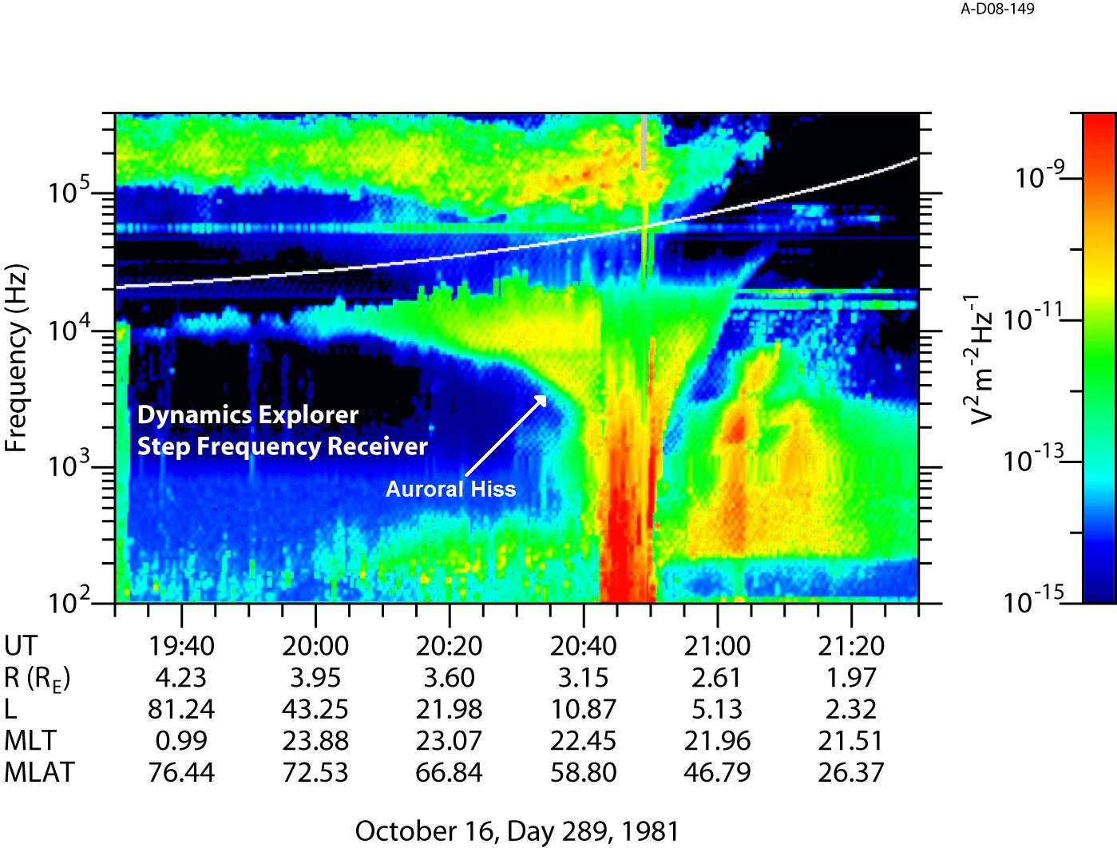
Dynamics Explorer

Slide 7
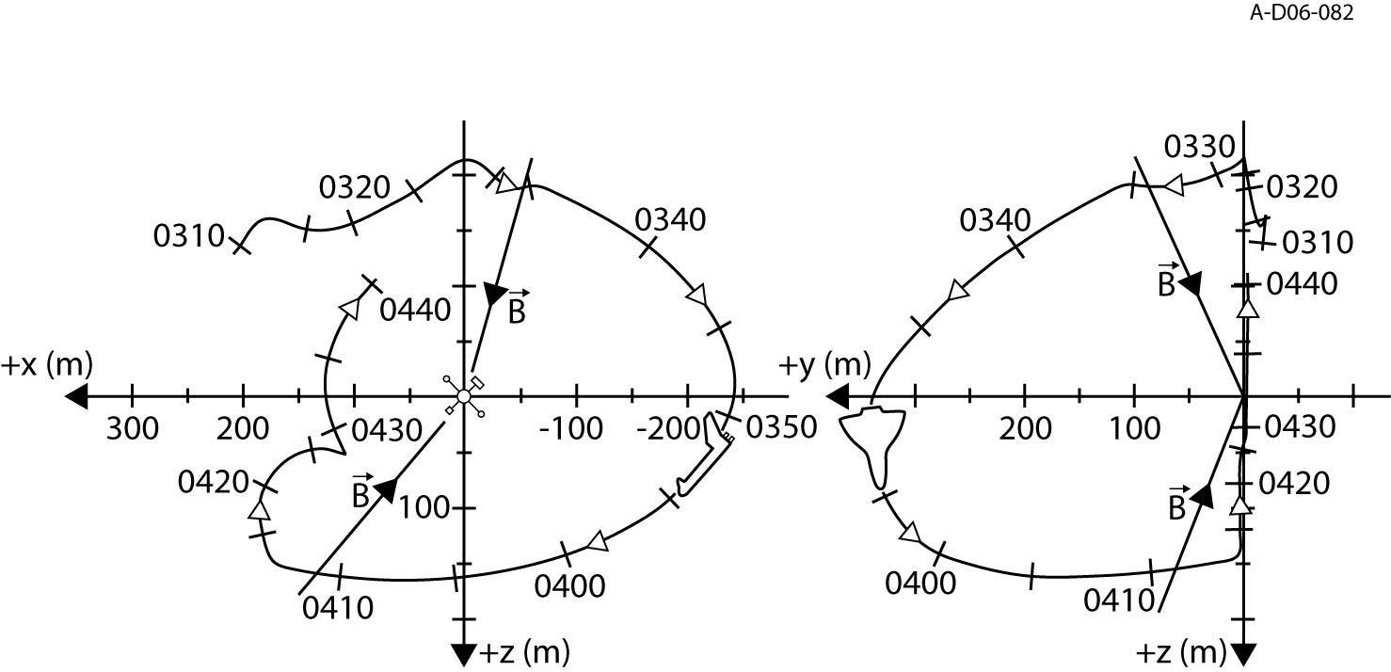
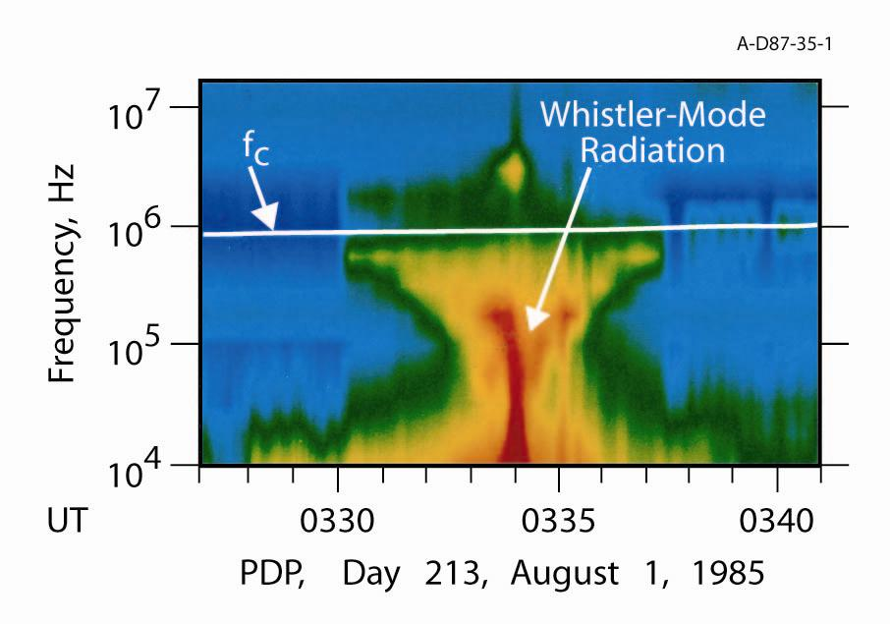
Challenger PDP

Slide 8
FAST

Slide 9
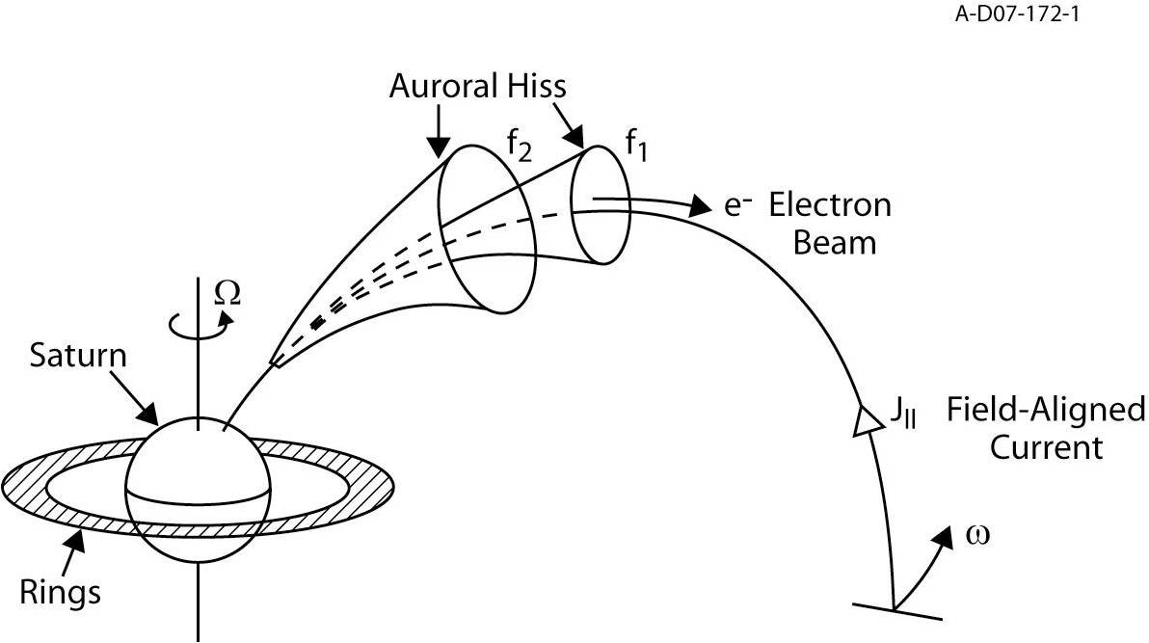
Theory of Auroral Hiss

Slide 10
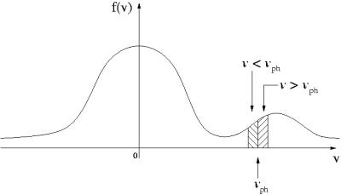
Generation - Exciting an Instability

Slide 11
Growth Rate & Ray Tracing
Growth Rate
Complicated analytical calculation, solvable only in special, non-physical situations
Numerical simulation (WHAMP)
Ray Tracing
Haselgrove’s Equations
Provides location of source region
Requires magnetic field knowledge

Slide 12
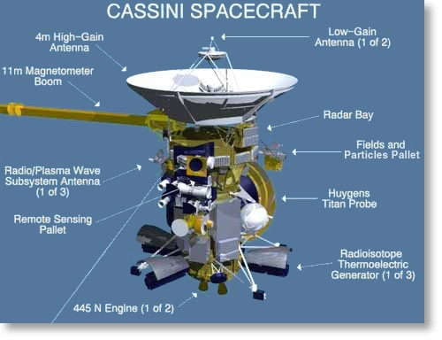
The Cassini Spacecraft
At Saturn since July 1, 2004
Key Instruments
RPWS
MAG
MIMI
CAPS

Slide 13
Auroral Hiss At Saturn
A comprehensive study of auroral hiss requires knowledge of the following:
Location
Periodicity
Field-Aligned Currents
Particle Beams

Slide 14
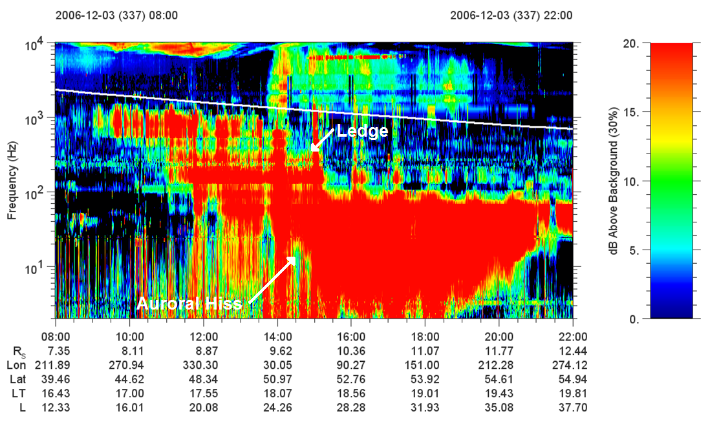
Cassini RPWS Spectrogram

Slide 15
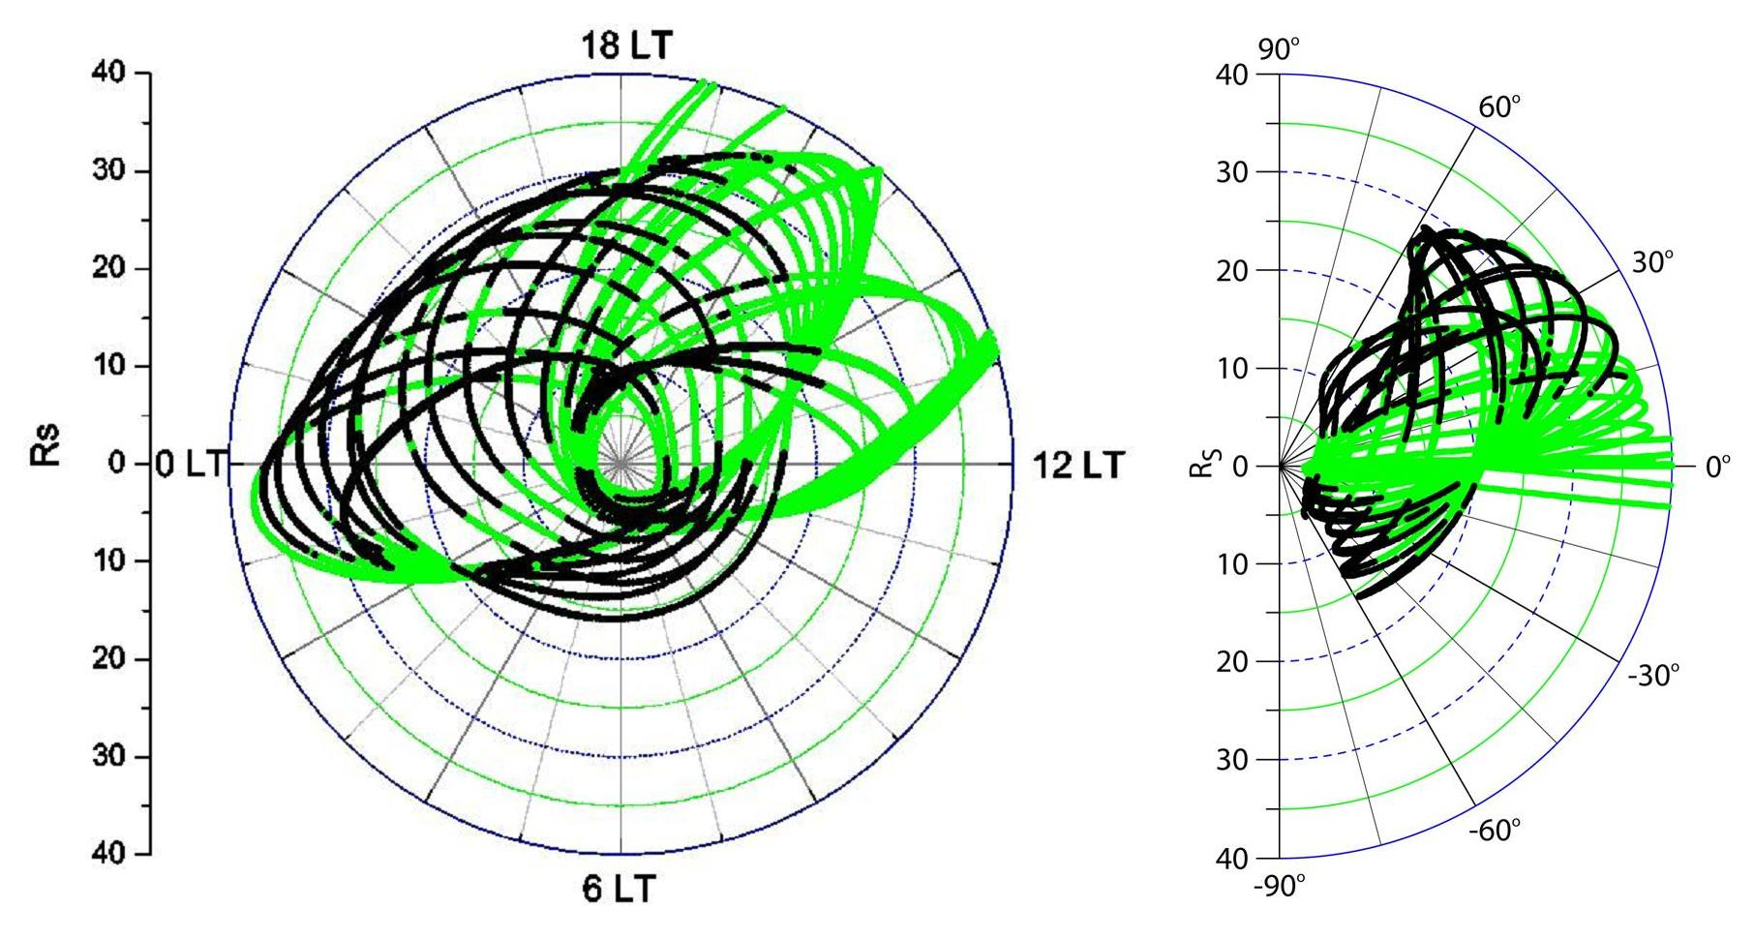
Location

Slide 16
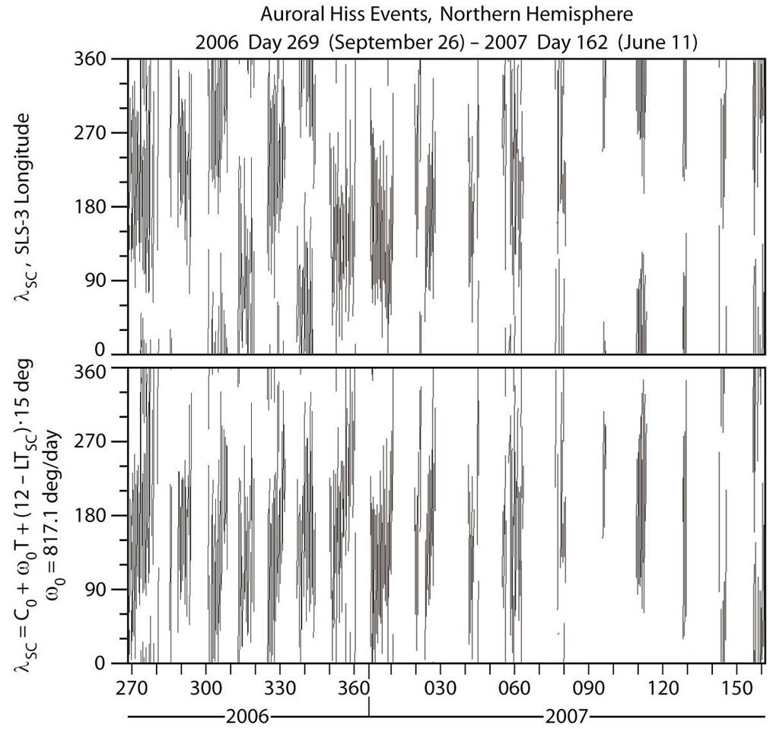
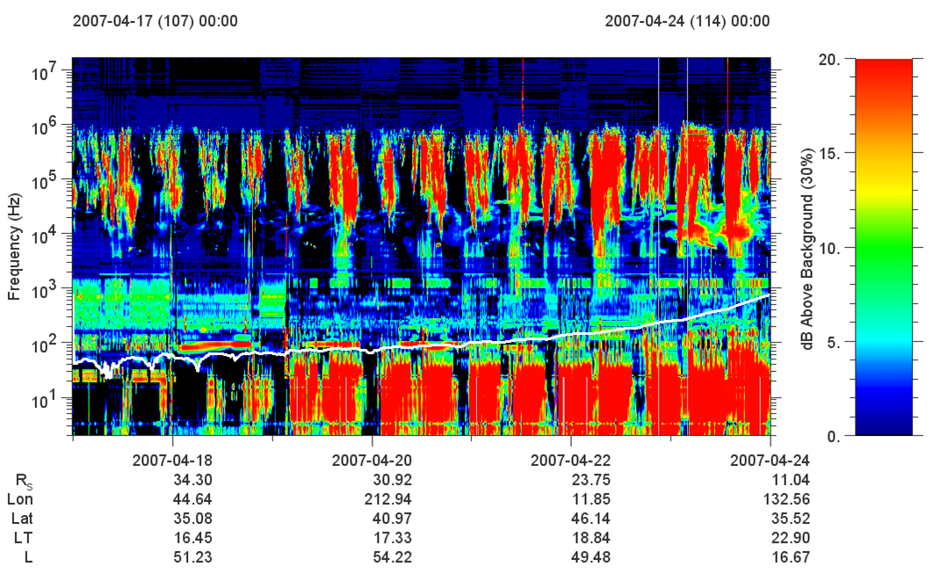
Periodicity

Slide 17
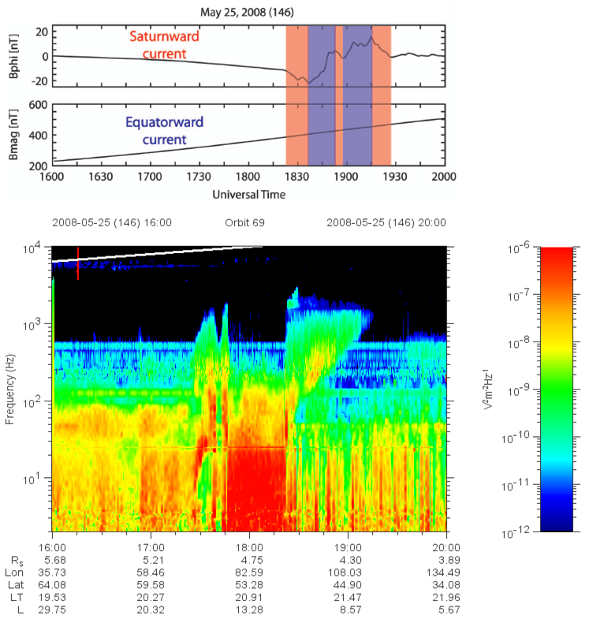
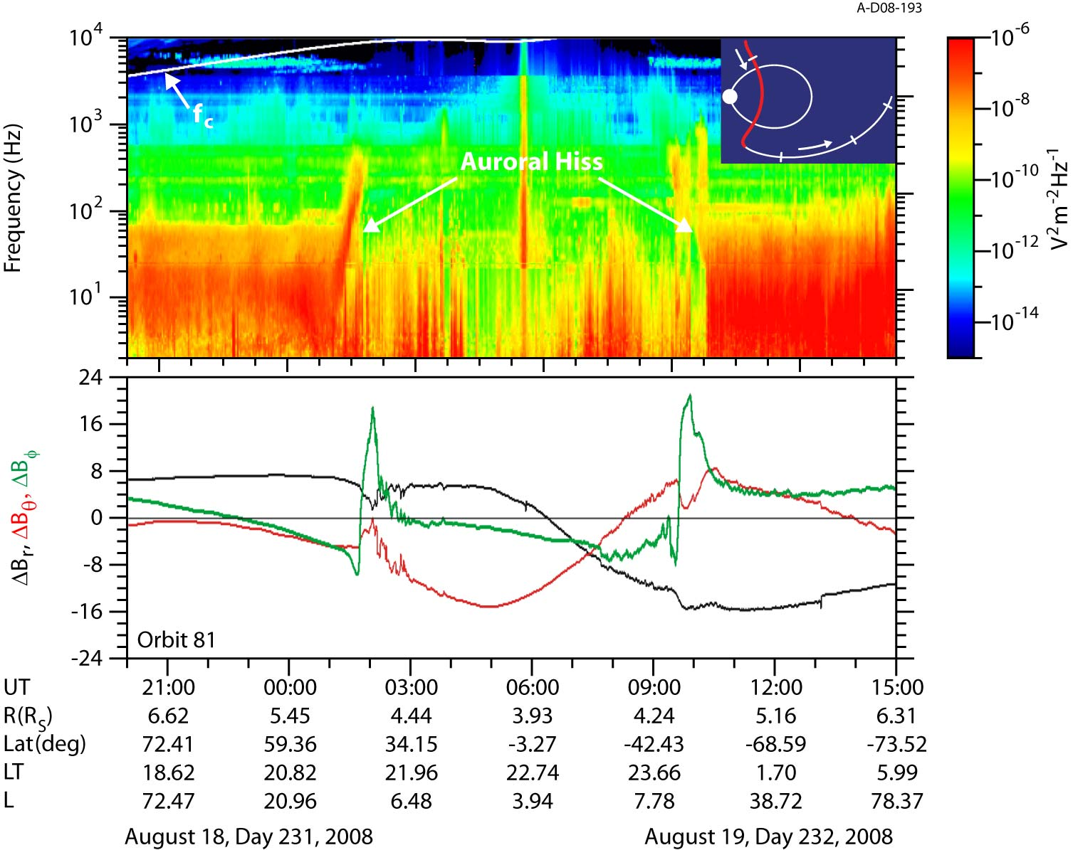
Field-Aligned Currents

Slide 18
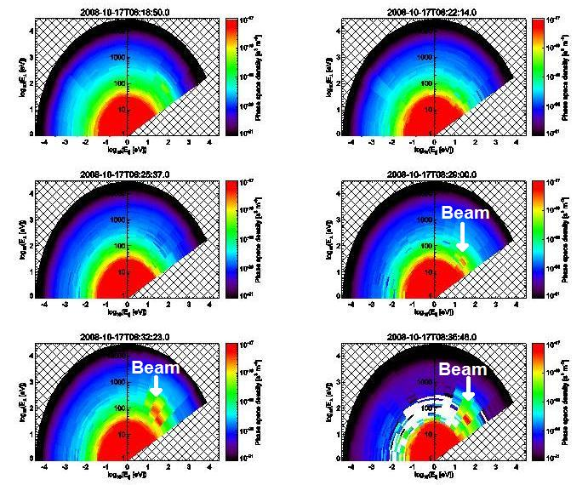
Electron Beams

Slide 19
Goals of this Research
Expand periodicity analysis to recent data
Is it constant or variable like SKR?
Continue correlating field-aligned currents
Locate more examples of electron beams
Analytical & numerical growth rate analysis
Locate source region with ray tracing
Incorporate MAG models if successful
Compare all aspects with Earth

