Slide 1
The Saturnian Auroral Hiss A Multi-Instrument Study
Andrew Kopf
March 24, 2009
Special Thanks to: D. Gurnett, G. Hospodarsky, W. Kurth, J. Leisner, D. Mitchell, & K. Khurana

Slide 2
OUTLINE
What is auroral hiss?
Auroral hiss at Earth
Auroral hiss at Saturn
Testing the theory – what we’re looking for

Slide 3
AURORAL HISS
Whistler-mode plasma wave emission in high-latitude regions of magnetosphere
First observed at Earth in 1960s. Has since been detected on other planets
Believed to propagate near resonance cone around field-aligned currents
Characteristic funnel shape on spectrogram
Saturn detections due to upward-propagating electrons along magnetic field lines

Slide 4
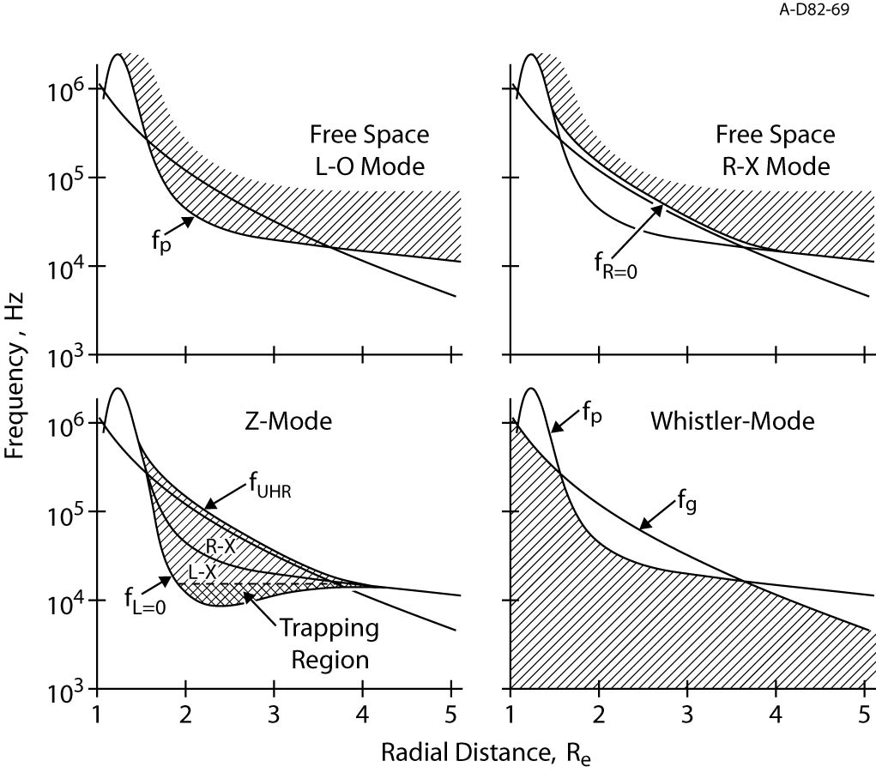
MODES

Slide 5
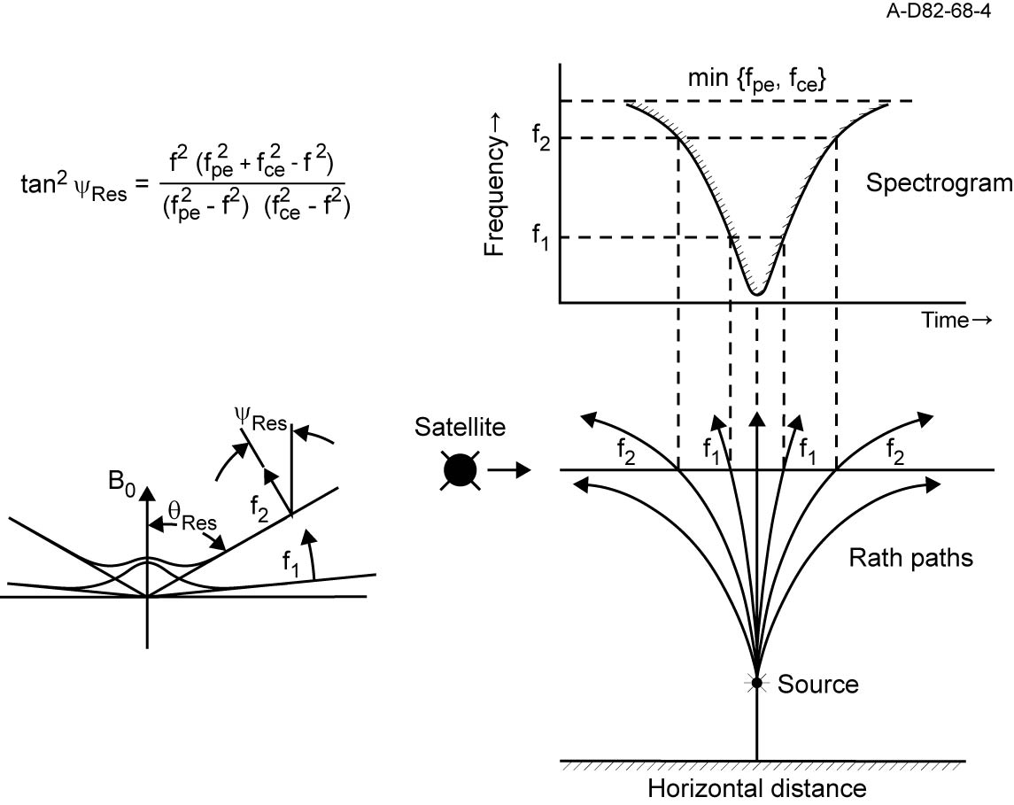
RESONANCE CONE

Slide 6
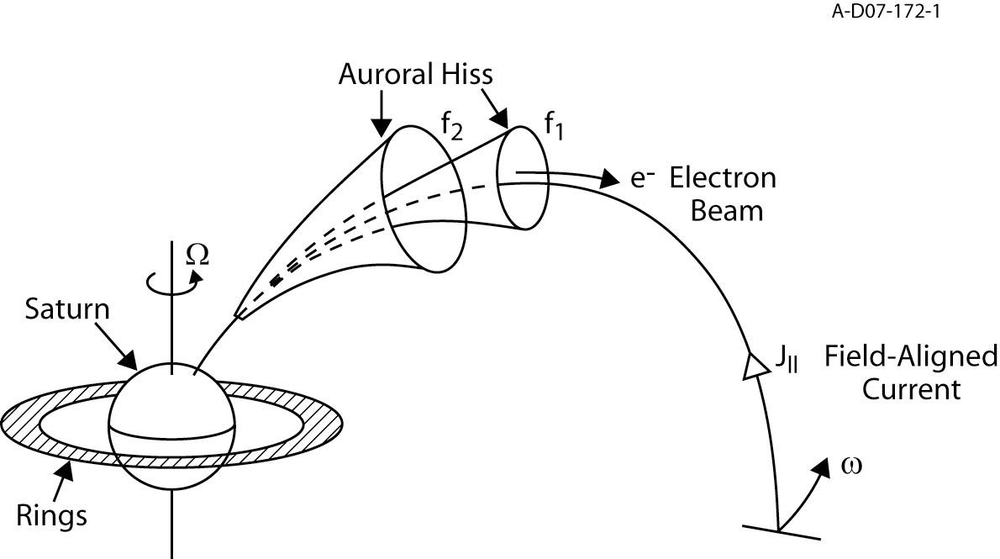
The Generation & Propagation of Auroral Hiss

Slide 7
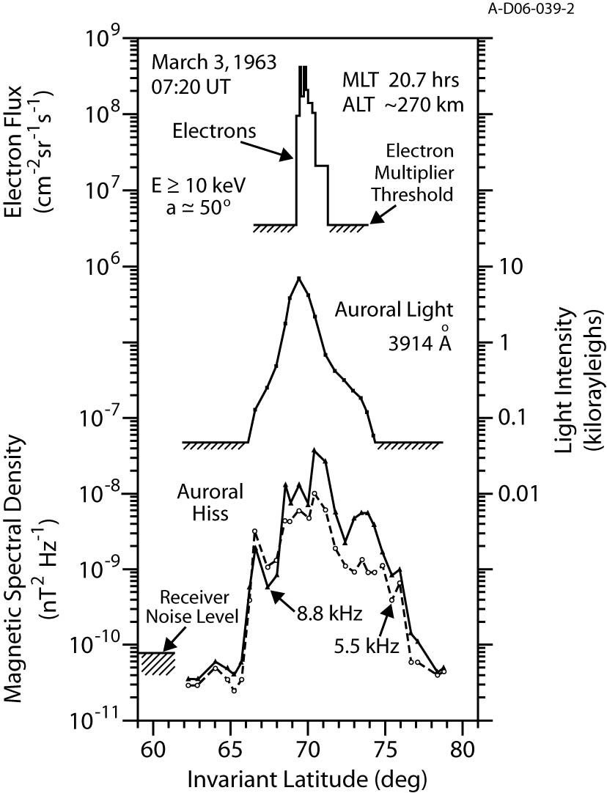

Slide 8
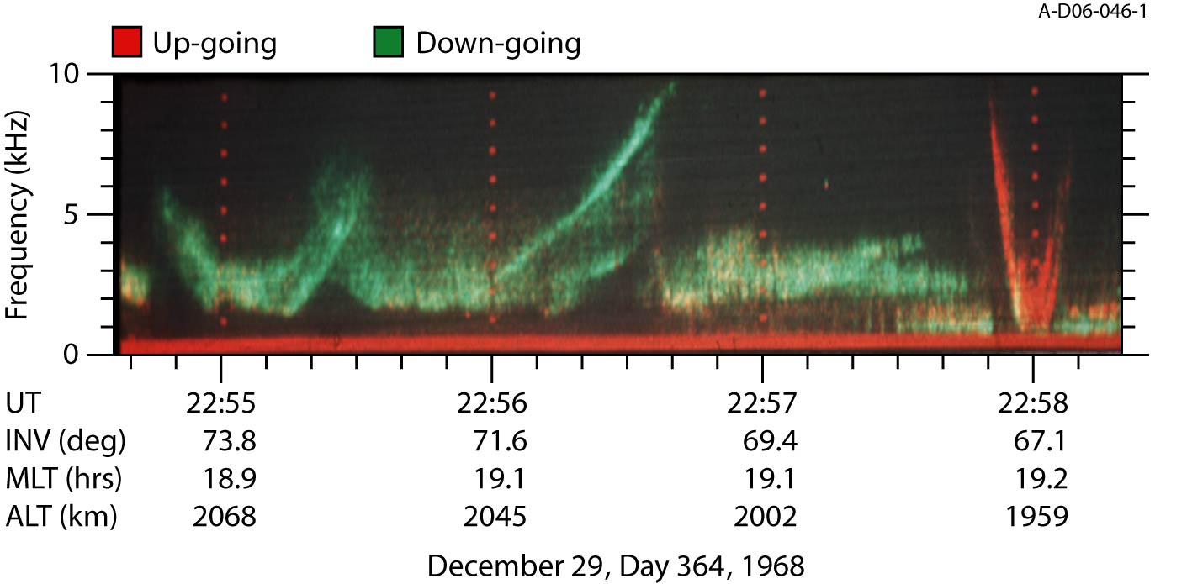

Slide 9
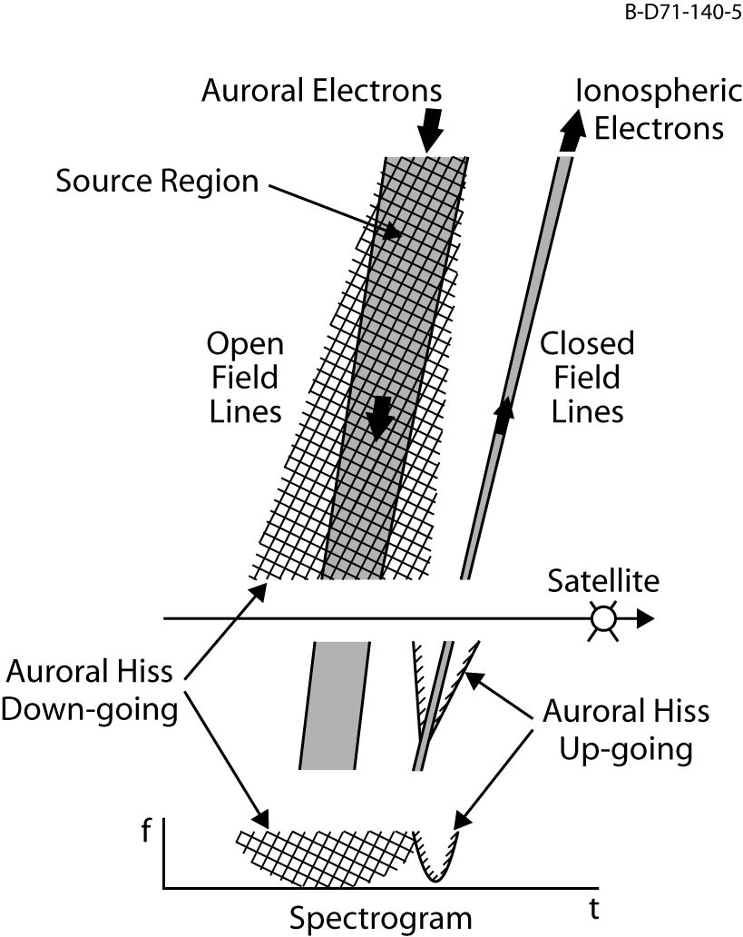

Slide 10
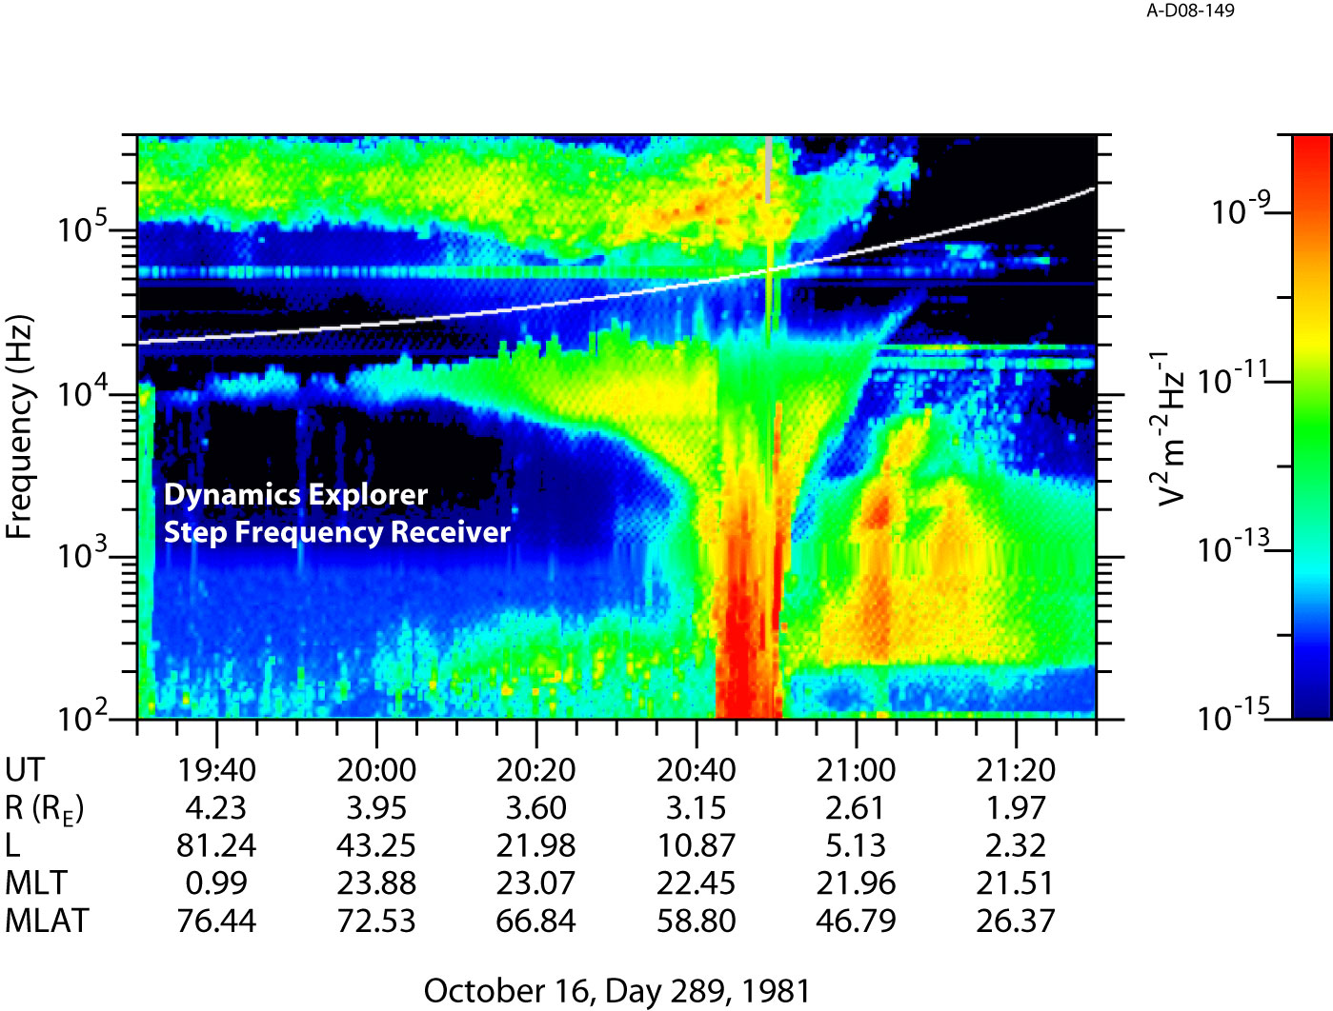

Slide 11
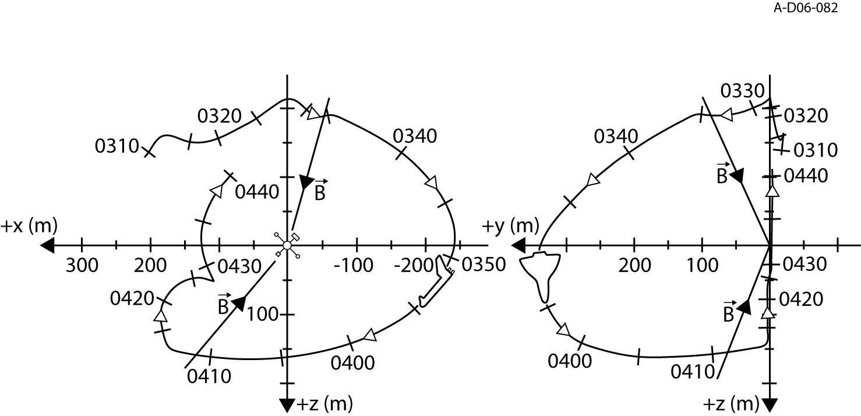
Shuttle Experiment

Slide 12
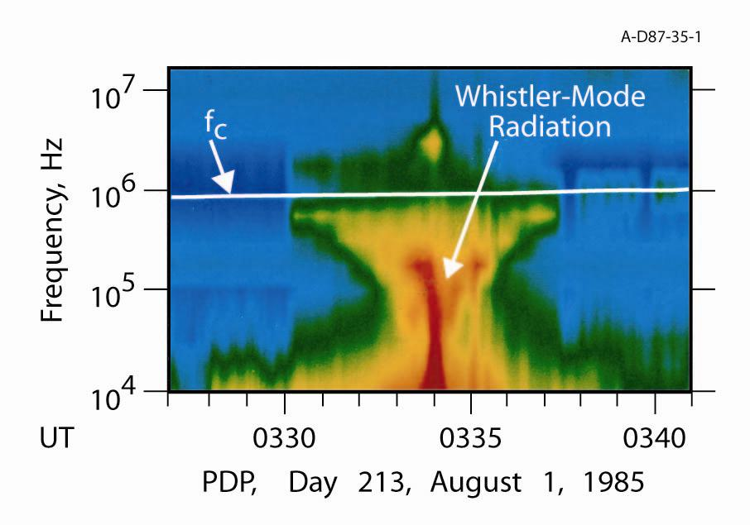

Slide 13
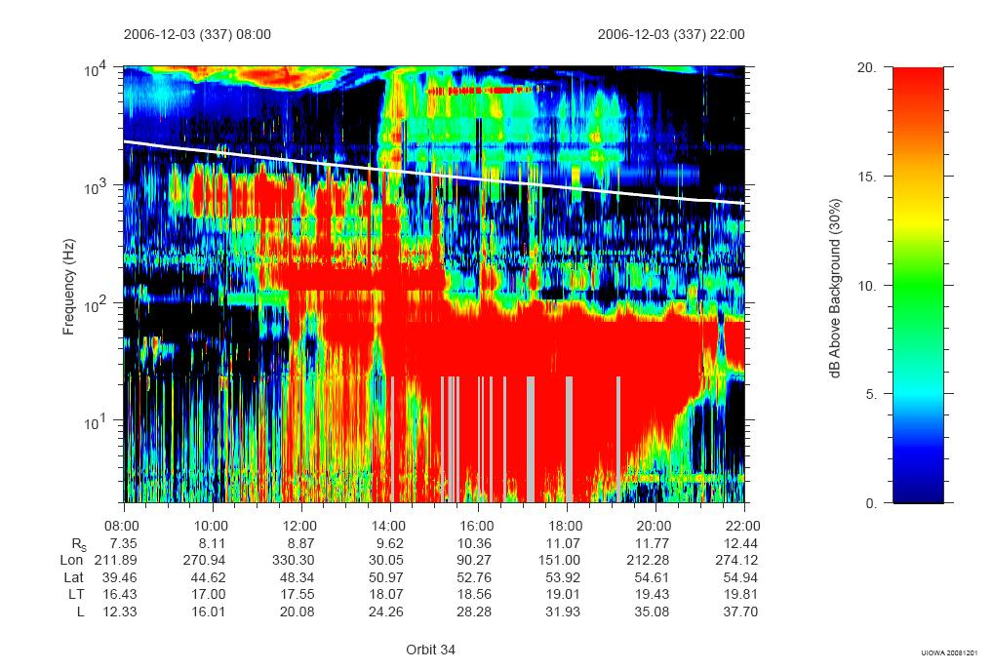

Slide 14
Testing the Theory

Slide 15
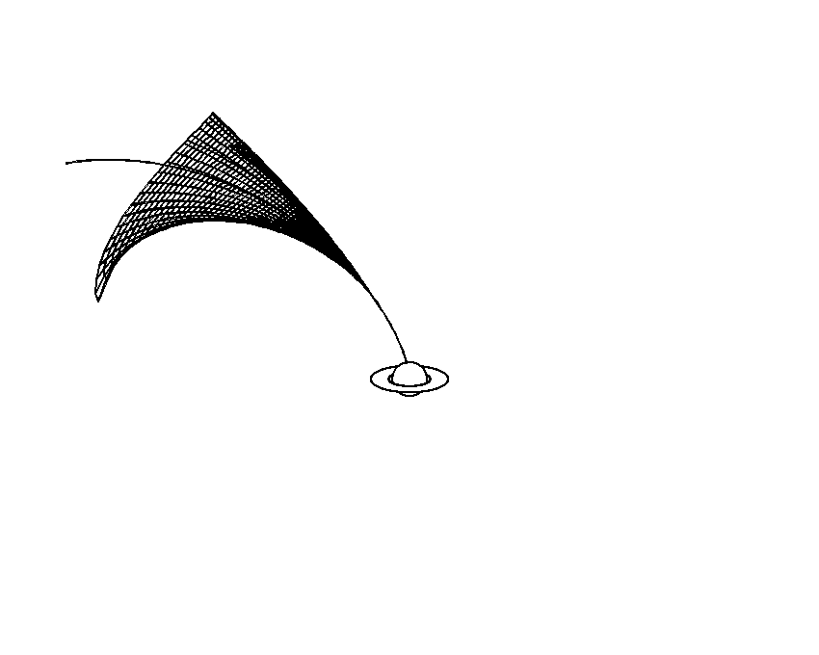
Testing the Theory

Slide 16
What Are We Looking For?
Location – Observe emission at
Any longitude of the planet
Higher latitudes (unless very far away)

Slide 19
What Are We Looking For?
Location – Observe emission at
Any longitude of the planet
Higher latitudes (unless very far away)
Periodicity – evidence for rotating beam or clock-like source models

Slide 20
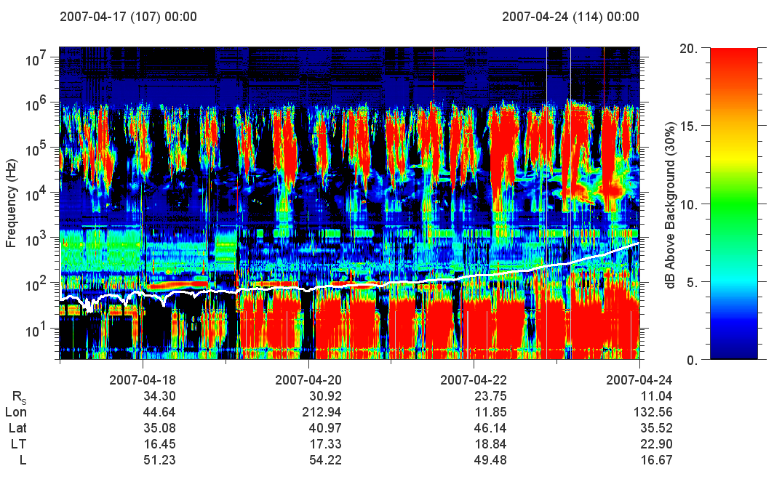

Slide 21
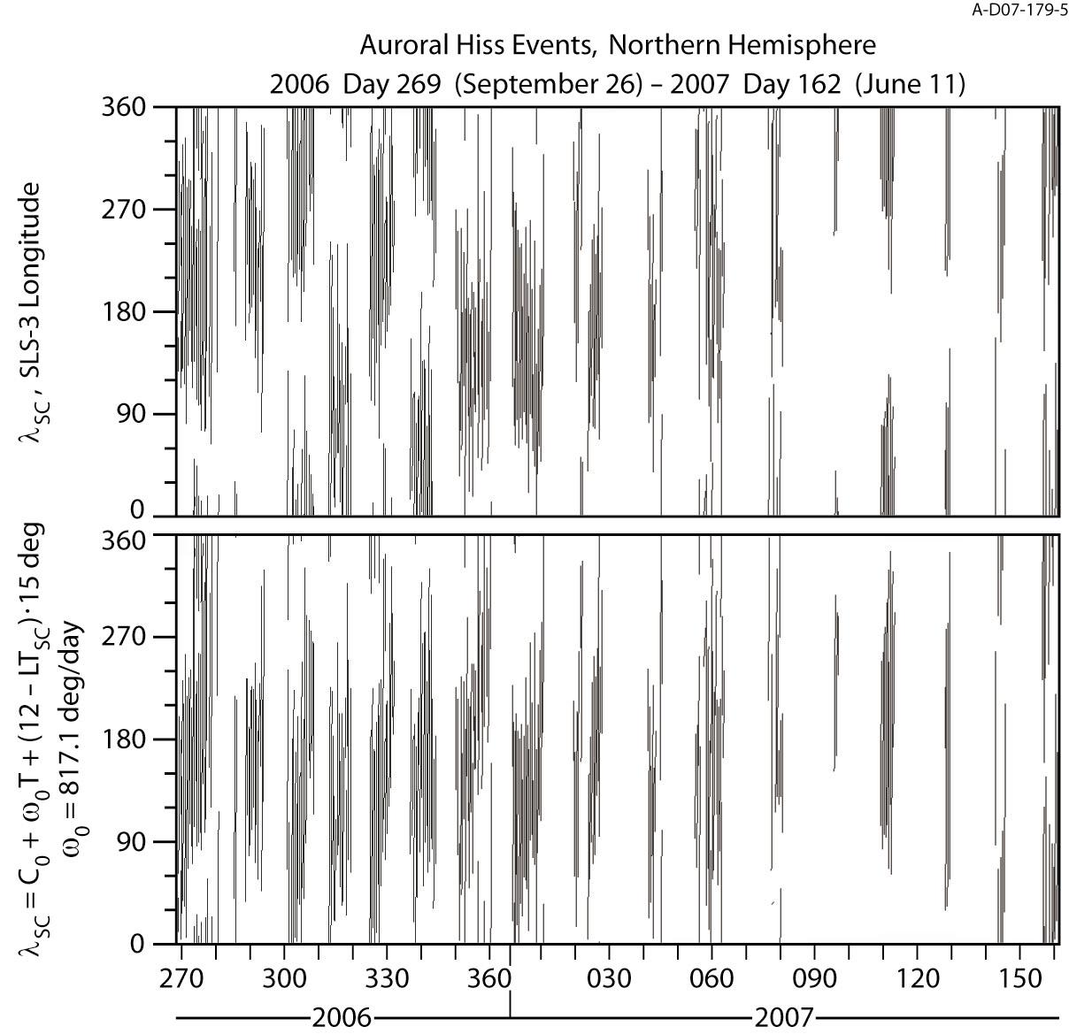
Periodicity

Slide 22
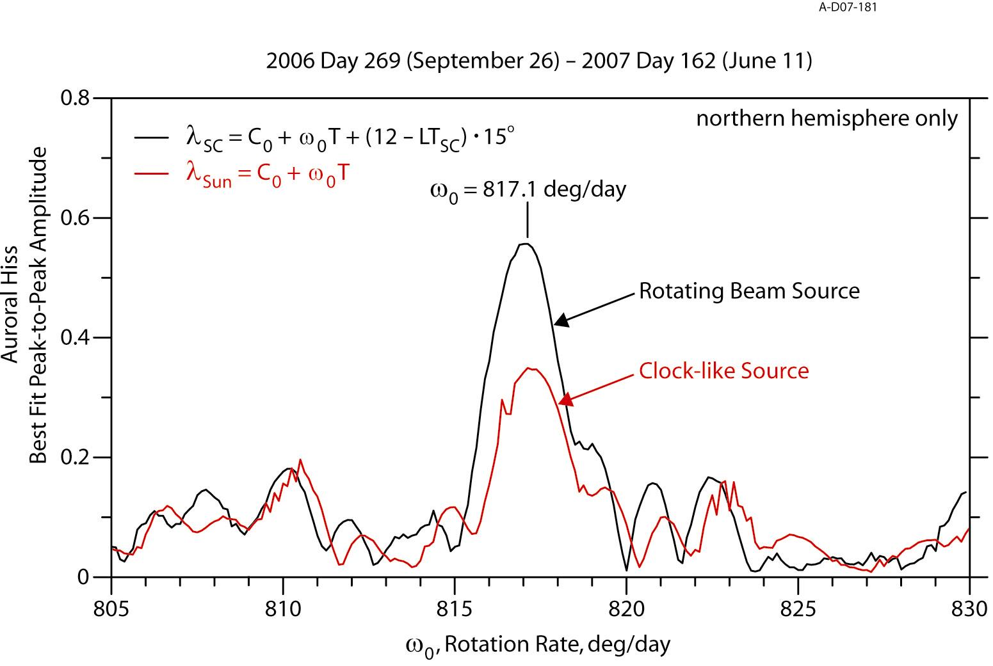
Modulation Spectrum

Slide 23
What Are We Looking For?
Location – Observe emission at
Any longitude of the planet
Higher latitudes (unless very far away)
Periodicity – evidence for rotating beam or clock-like source models
Associated field-aligned currents

Slide 24
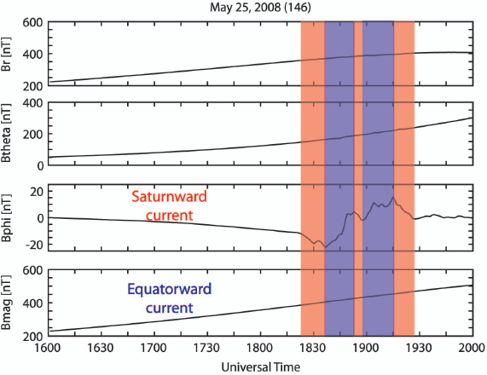
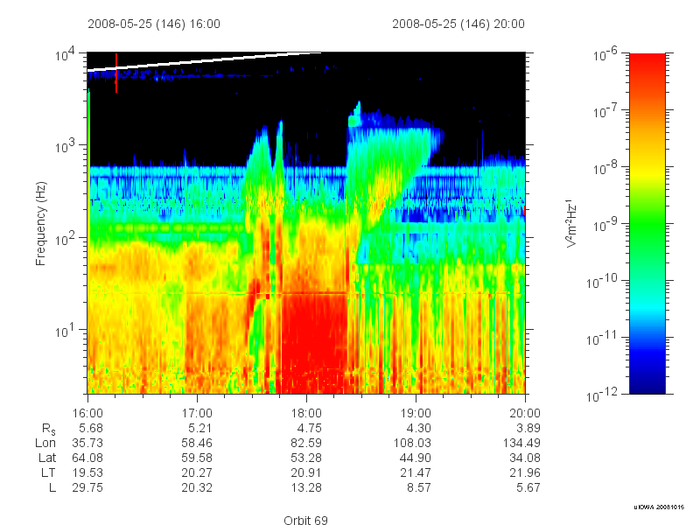

Slide 25
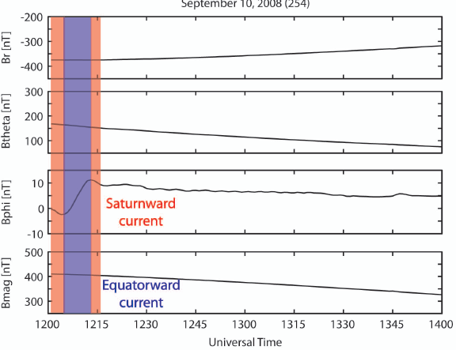
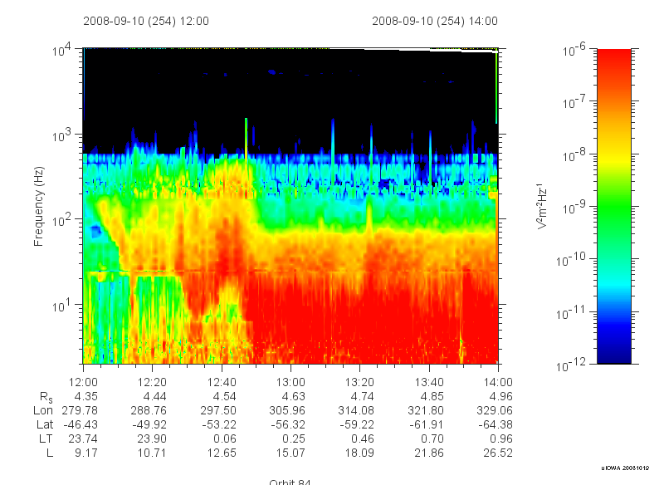

Slide 26
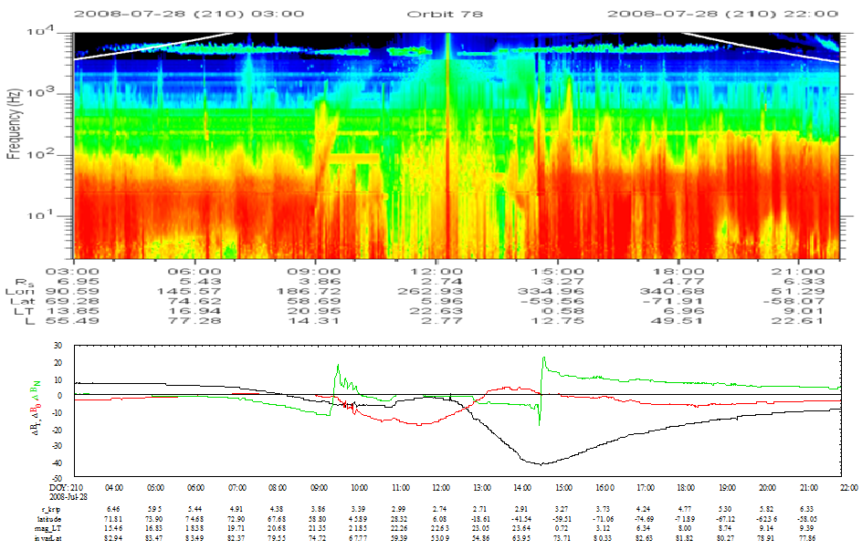

Slide 27
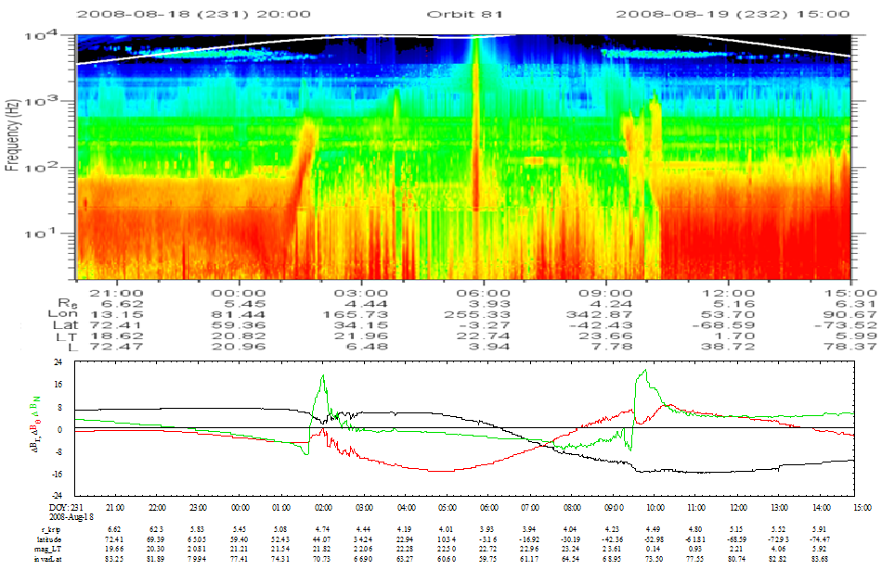

Slide 28
What Are We Looking For?
Location – Observe emission at
Any longitude of the planet
Higher latitudes (unless very far away)
Periodicity – evidence for rotating beam or clock-like source models
Associated field-aligned currents
Associated particle beams

Slide 29
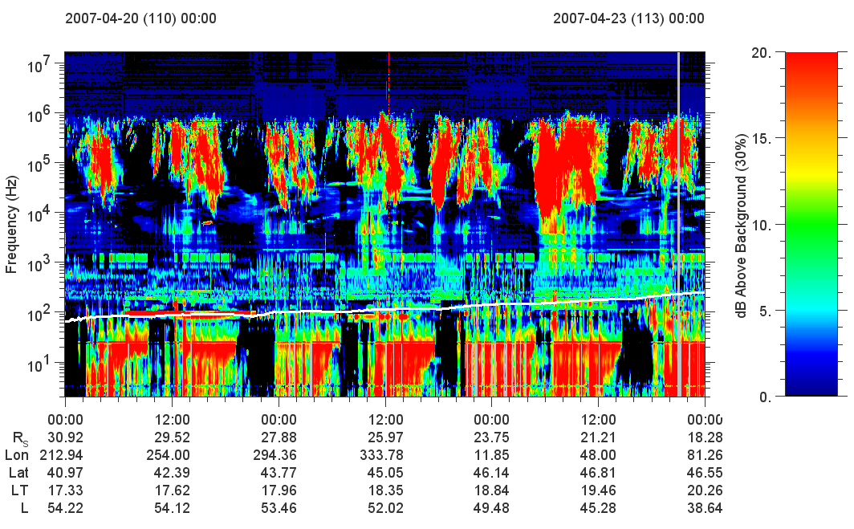

Slide 30


Slide 31
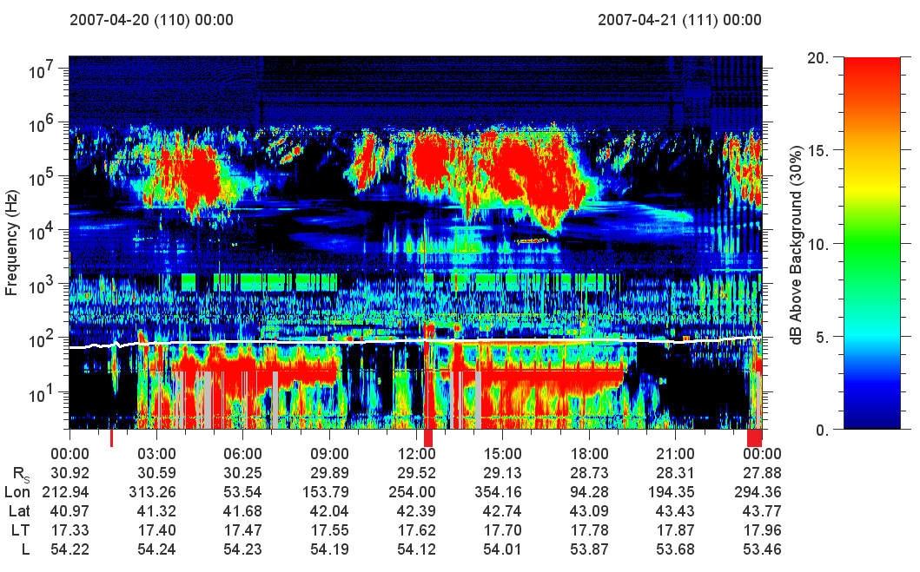

Slide 32
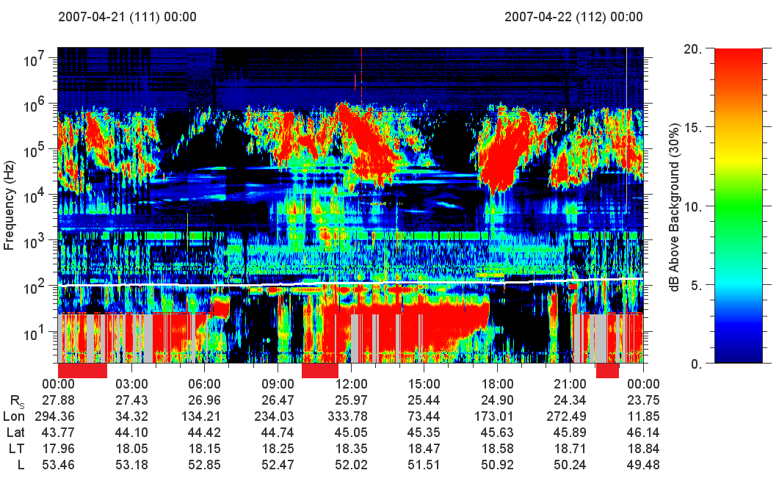

Slide 33
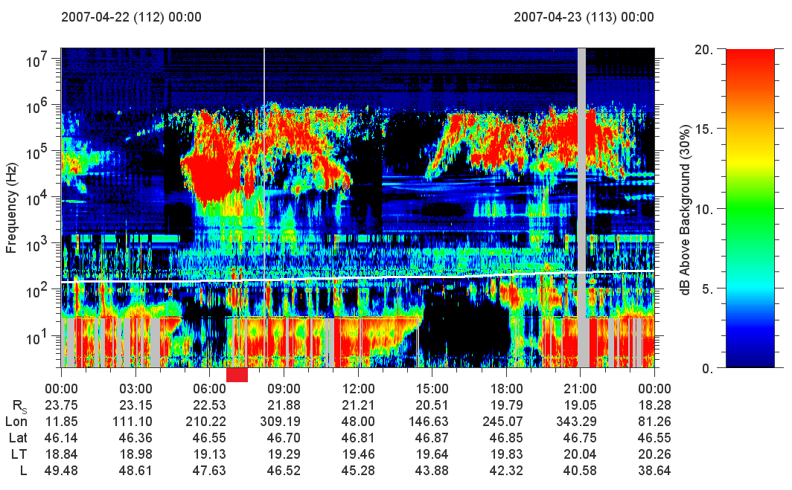

Slide 34
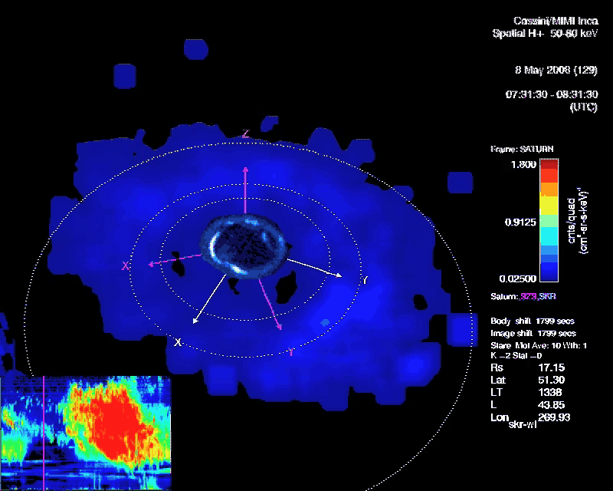

Radio Emission From Saturn’s Aurora
(Video courtesy of D. Mitchell, APL)

Slide 35
SUMMARY
Whistler mode auroral hiss events detected at Saturn, show similar features to those at Earth
Emission displays two periodicities
1 hour burst periodicity possibly due to ion conics
10.8 hour periodicity with properties of a rotating beam source
Field-aligned current structures commonly observed, but do not align with center of hiss
Ion Beams detected at same location as current structures, not along center of radio emission
Correlation exists between optical/uv, plasma density, and radio emission, suggesting a large and complex system behind this process.

