Slide 1
Radar Sounding Results of the Ionosphere of Mars
Detection of An Upper Layer
Andrew J. Kopf
February 13, 2007

Slide 2
Presentation Outline
Introduction & Background
  Mars Express
  Ionospheric Sounding and MARSIS
  The Ionogram and Analysis
Results from the main ionospheric layer
  Electron Density Profiles
  Oblique Ionospheric Echoes
  Solar Zenith Angle Dependence
My current focus: An upper layer
  What are its properties?
  What is it made of?
  Where does it come from?
  Why don’t we always see it?

Slide 3
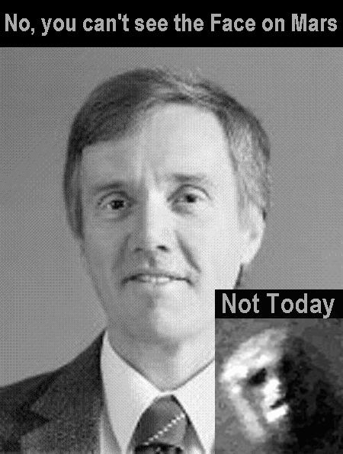

Slide 4
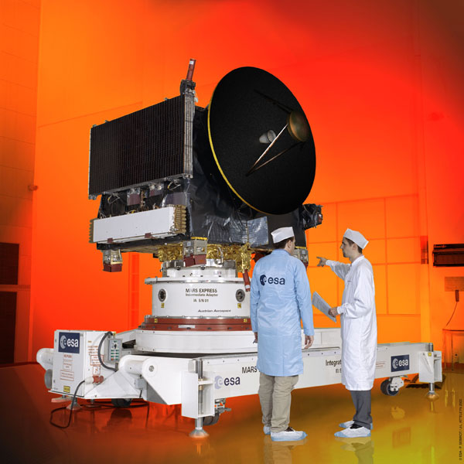
Mars Express
ESA probe launched by Soyuz 6/2/03
Entered orbit around Mars 12/25/03
MARSIS antennae deployed on 5/10/05 and 6/14/05
MARSIS began operating 7/4/05

Slide 5
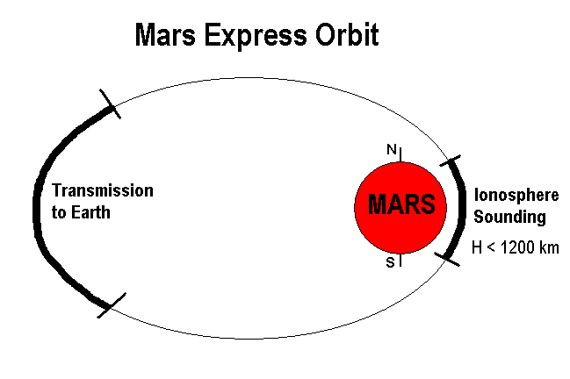
Mars Express Orbit
Periapsis = 275 km, Apoapsis = 10,100 km, Period = 6.75 hr

Slide 6
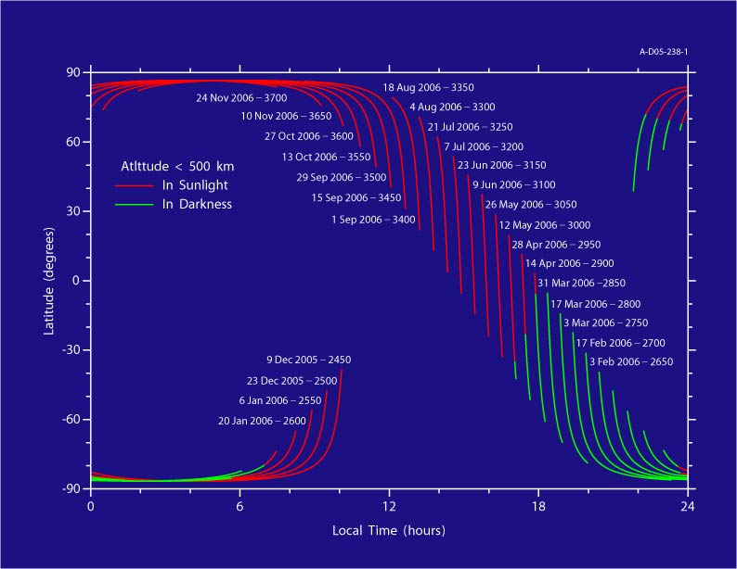
Orbit Evolution

Slide 7
What Is The Ionosphere?
The ionosphere is an upper layer of the atmosphere which becomes ionized by solar radiation
Has properties of both a gas and a plasma
Important for radio, as it influences radio propagation to distant places of the Earth
Reflects radio waves until frequency exceeds layer’s peak plasma frequency

Slide 8
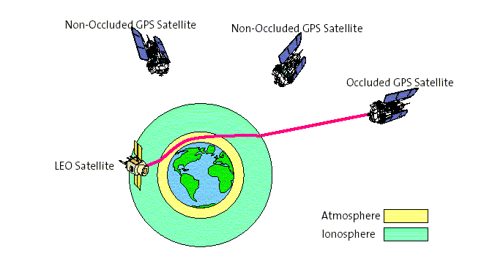
Radio Occultation
Until Mars Express, most of our knowledge of the Martian ionosphere came from radio occultation measurements
These provided an average electron density along the line of sight from Earth to a Mars-orbiting spacecraft
Limited to Solar Zenith Angles from about 48° to 132°

Slide 9
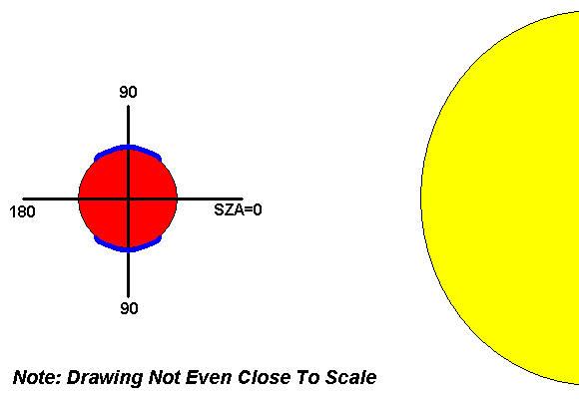
Solar Zenith Angle

Slide 10
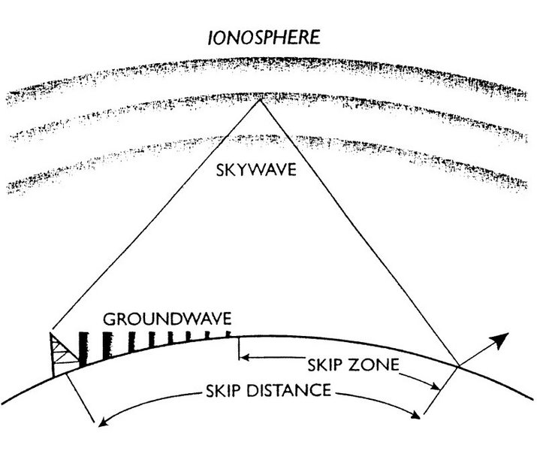
Ionospheric Reflection

Slide 11
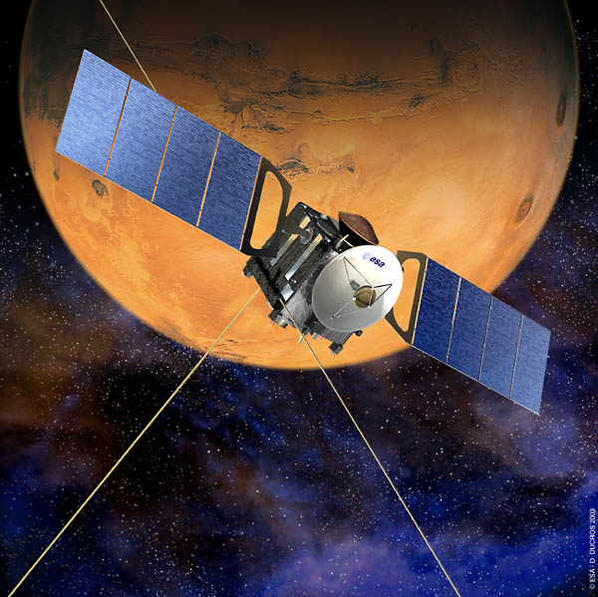
MARSIS
Mars Advanced Radar for Subsurface and Ionosphere Sounding
Two 20-m antennae act as a dipole: transmit radar “chirp” and receive reflected “echo”
Operates from 0.1 – 5.4 MHz for ionospheric sounding
Repeats transmit/receive cycle about every 7.543 seconds.
Each sounding pass lasts roughly 40 minutes
Complements radio occultation by providing better spatial resolution and full coverage of the planet

Slide 12
How Sounding Works
Ionospheric sounders transmit a short pulse at a fixed frequency f, and then detect any echoes that are reflected from the ionosphere
Reflection occurs because free-space EM-radiation can’t propagate at frequencies below the electron plasma frequency f_{p}:
For a horizontal ionosphere, reflection occurs at the point where f = f_{p}

Slide 13
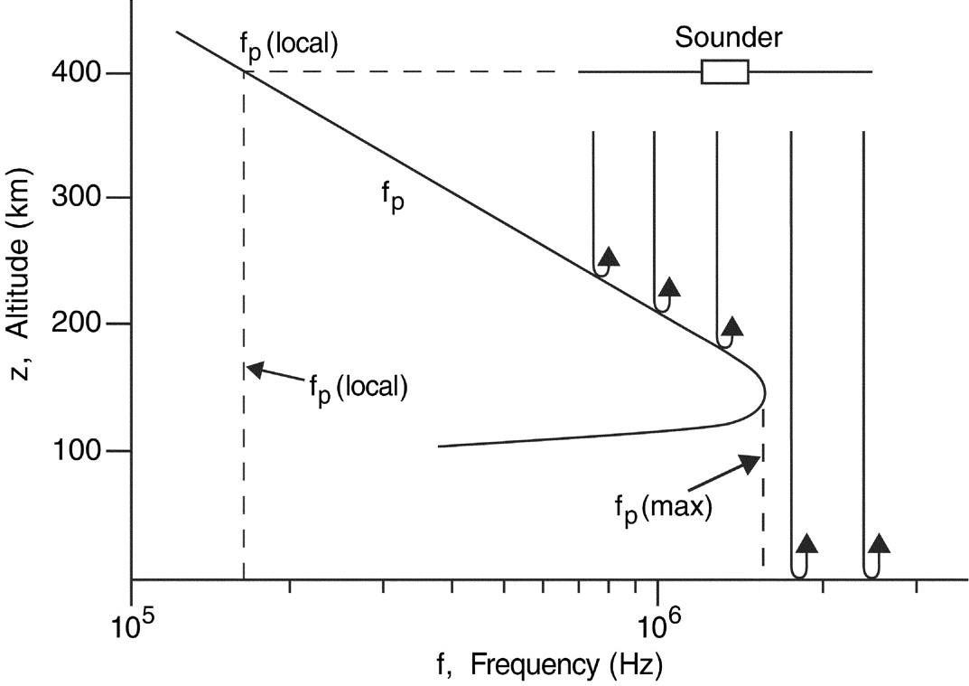
Sounding Diagram

Slide 14
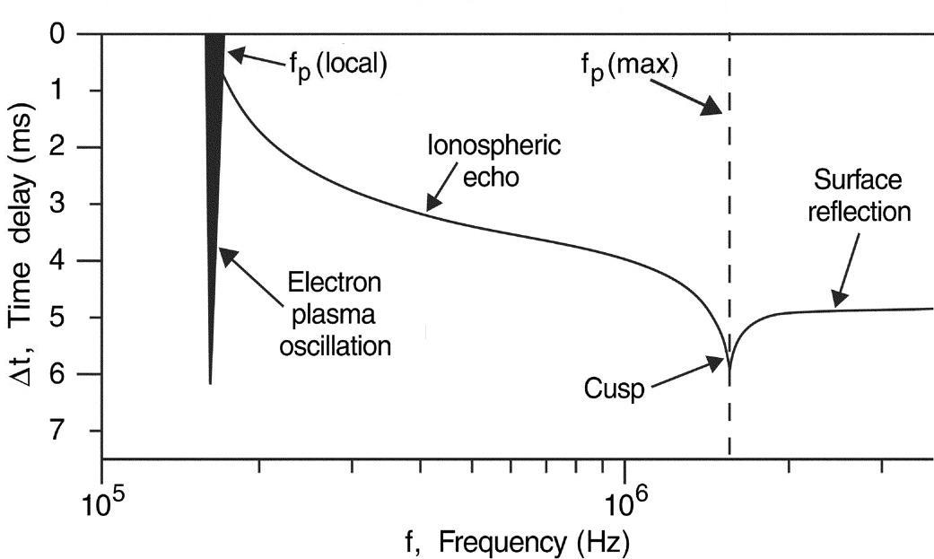
Idealized “Echo” Response

Slide 15
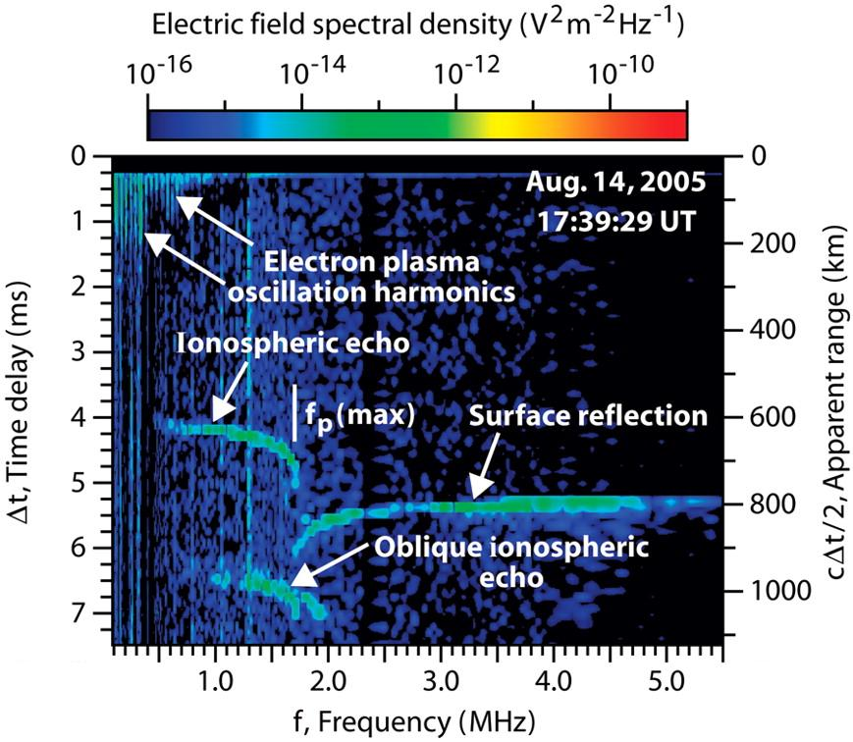

Slide 16
Using Time Delay
We want to form a density profile z(n_{e})
By measuring the time delay Δt in receiving the echo, the range can be computed
A free-space electromagnetic pulse will propagate through an unmagnetized plasma at the group velocity:
For vertical incidence on a horizontal ionosphere, the round trip delay time as a function of frequency is:

Slide 17
Inverting the integral
Since Δt(f) is known from the ionogram, we must invert this integral to obtain z(f_{p}).
The integral has the following solution:
where sin α = f_{p}(z)/f , sin α₀ = f_{p}(z_{sc})/f_{p}(max)
Once this is known, we can obtain z(n_{e})

Slide 18
Presentation Outline
Introduction & Background
  Mars Express
  Ionospheric Sounding and MARSIS
  The Ionogram and Analysis
Results from the main ionospheric layer
  Electron Density Profiles
  Oblique Ionospheric Echoes
  Solar Zenith Angle Dependence
My current focus: An upper layer
  What are its properties?
  What is it made of?
  Where does it come from?
  Why don’t we always see it?

Slide 19
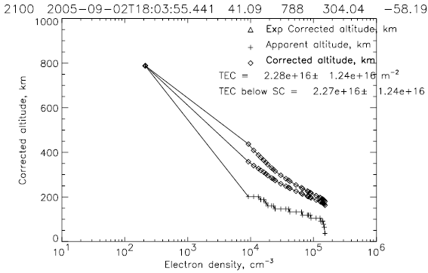
Density Profile

Slide 20
Fitting the profile
Once the inversion was completed, we used a theoretical model for the density profile and adjusted the parameters to give the best fit.
The model we used was the Chapman model, taken from his 1931 paper:
Ch(x,χ) is the Chapman grazing incidence function, which takes into account absorption of solar radiation by the atmosphere:

Slide 21
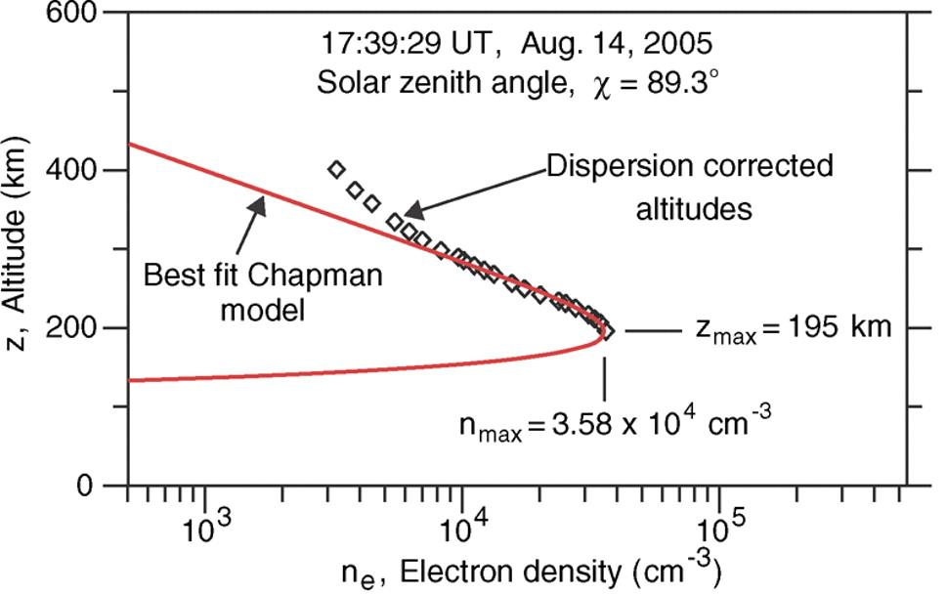
Chapman Fitting

Slide 22
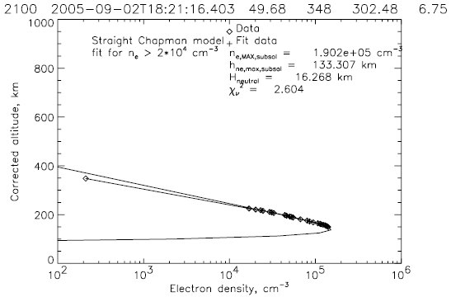
Chapman Fit

Slide 23
“Oblique Echoes”

Slide 24
Obliques on Ionogram

Slide 25
Where do we see them?
Apexes occur where the crustal field is nearly vertical

Slide 26
What Causes Oblique Echoes?
Reflection off upward bulge in the ionosphere
Open field lines connect to the solar wind, allowing it to heat lower levels of the ionosphere, thus increasing n_{e}

Slide 27
Solar Zenith Effects
The primary source that creates the ions that make up the ionosphere is solar photons
Photons ionize neutral molecules and atoms, creating ions and free electrons
Areas with direct sunlight (SZA ≈ 0) receive more photons than those with less direct illumination, and thus have:
  Higher maximum electron densities
  Higher maximum plasma frequencies

Slide 28
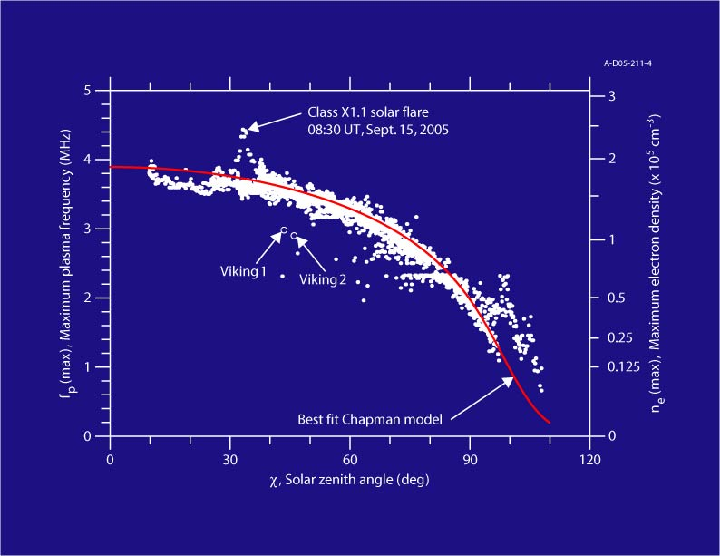
SZA Dependence

Slide 29
Presentation Outline
Introduction & Background
  Mars Express
  Ionospheric Sounding and MARSIS
  The Ionogram and Analysis
Results from the main ionospheric layer
  Electron Density Profiles
  Oblique Ionospheric Echoes
  Solar Zenith Angle Dependence
My current focus: An upper layer
  What are its properties?
  What is it made of?
  Where does it come from?
  Why don’t we always see it?

Slide 31
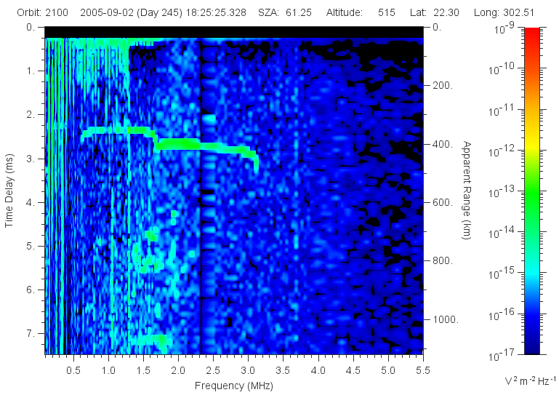
What? Another Cusp?

Slide 32
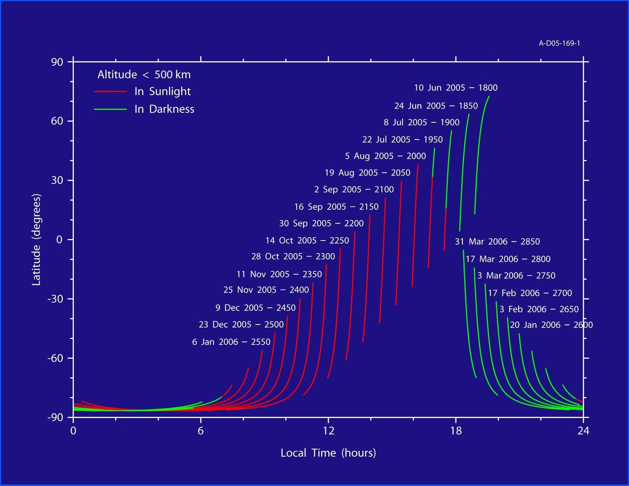
Orbits Analyzed

Slide 33
Analysis
As with the main layer, this feature was observed and traced on the ionogram
Inversion techniques same as before
Have thus far used Chapman model to analyze key characteristics. However, no scientific basis for this, so will also fit with Gaussian function
Altitude, Density, SZA, Latitude, and Longitude of each event were saved and plotted in graphing software

Slide 34
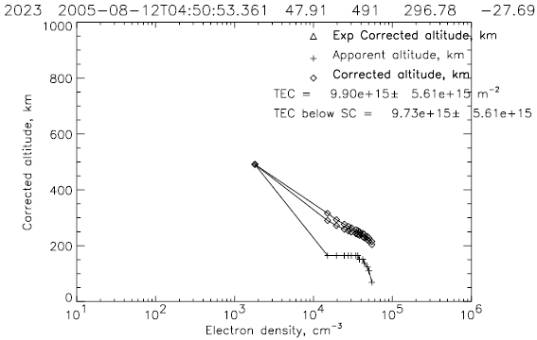
Density Profile

Slide 35
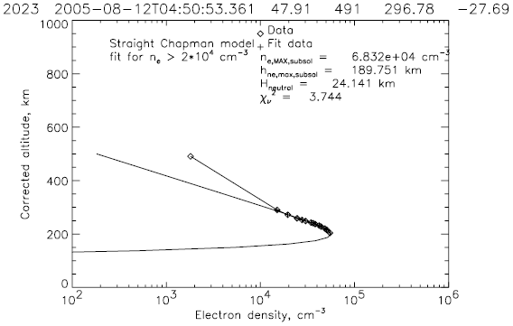
Chapman Fit

Slide 36
What are its Properties?
Altitude = 200 km (average)
Density = 4-6 x 10⁴ cm⁻³ (Mean 48,000)
Compare to Main Layer: 130 km, 2 x 10⁵ cm⁻³
In addition, a few peculiar properties
  Apparent SZA dependence: Clearly defined only about half the time in lowest SZAs studied (~45°), even less as SZA increases
  Appears (infrequently) even with essentially no solar interaction, implying a natural Martian source in addition to solar interaction

Slide 37
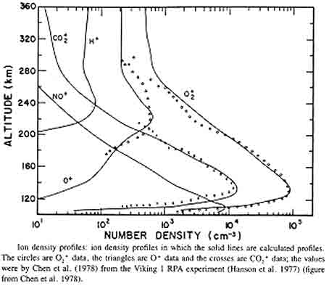
What is it made of?

Slide 38
Where does the O⁺ come from?
Primarily by ionization from a photon emitted from the Sun
  However, this layer appears sometimes even with minimal solar interaction
  Therefore, must also be a Martian source
Caused by normal molecular reactions in the atmosphere
  What reaction processes?

Slide 39
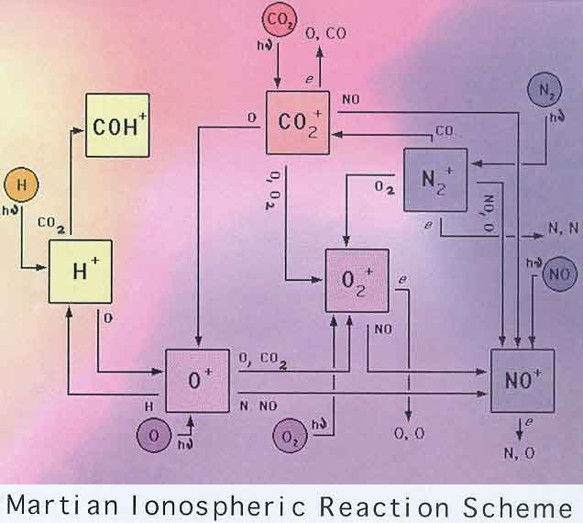
Martian Chemistry

Slide 40
Mars Atmospheric Composition
Carbon Dioxide 95.32%
Nitrogen 2.70%
Argon 1.60%
Oxygen 0.13%
Carbon Monoxide 0.07%
Water Vapor 0.03%
Ne, Kr, O₃, Xe, CH₄ Trace

Slide 41
So what are the reactions?
There are nine O⁺ creation processes and three destruction processes
Only four creation reactions and one destruction reaction are important, due to their abundance
Creation Reactions:
  CO₂⁺ + O → O⁺ + CO₂
  CO₂ + hν → O⁺ + CO + e hν = 19.1 eV
  CO₂ + e → O⁺ + CO +2e
  O + hν → O⁺ + e hν = 13.6 eV
Destruction Reactions:
  O⁺ + CO₂ → O₂⁺ + CO

Slide 42
Problem with Observation
This feature is also only seen on the dayside of Mars, and on average only about half the time in SZAs with decent solar interaction (≈45°)
Possible explanations:
  Need for significant solar interaction
    Even the main layer is often absent on the night side, as the ionosphere becomes too diffuse to reflect the radar chirp
    Early study of high solar interaction (≈0°) shows this second cusp in virtually every ionogram
  Magnetic field effects
    Feature often seen in correlation with changes in the magnetic field

Slide 43
Solar Effect on Detection

Slide 44
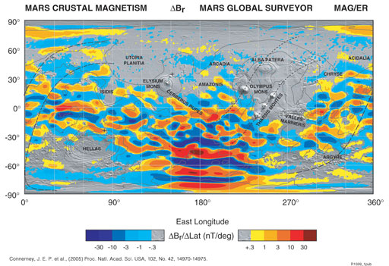
Magnetic Field Effects?

Slide 45
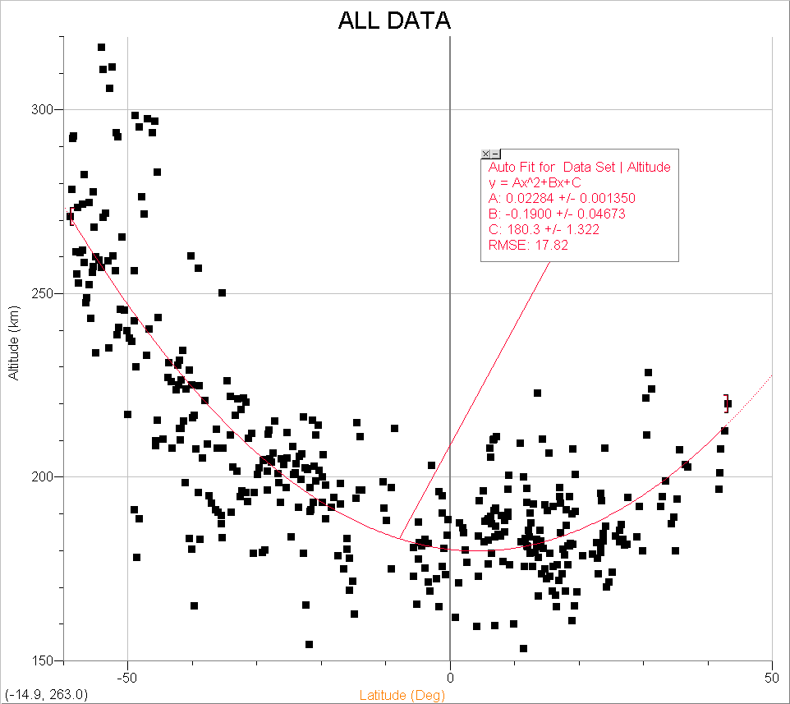
Peculiarity #2: Altitude
In this data, altitude of critical density is at least loosely mirroring the latitude
Correlates with spacecraft altitude as well
Something not studied in results from main layer
  May be normal result

Slide 46
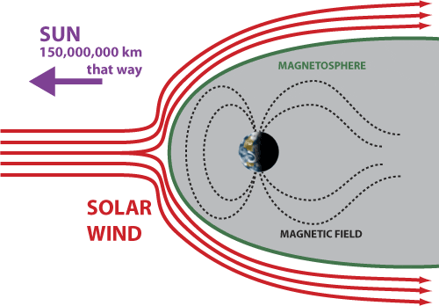
Transport?
Transition Altitude
  From Dr. Andrew Nagy (U. of Michigan): Well established that transition from photochemical equilibrium to transport domination takes place near 200 km on the dayside of Mars
  Change in mechanism could cause change in slope

Slide 47
Our response…
Dr. Gurnett and I both feel this is unlikely to be the sole cause of such an inconsistent but often times dramatic shift in the slope
  Supported by another type of observation I will mention shortly
After discussions with Dr. Nagy at AGU in San Francisco, in which he saw the images and results for the first time, he no longer believes this theory either…

Slide 48
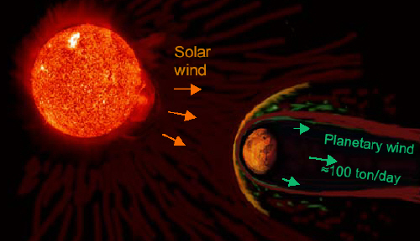
…HOWEVER…
Transport could still be a major contributing factor to creating this sudden change in density because of the lack of a global magnetic field

Slide 49
The Theory
O⁺ ions, concentrated at a higher altitude than O₂⁺ ions, and only half as massive, would be generally more susceptible to interaction with the solar wind
The solar wind could be transporting these ions to a higher altitude, causing the nearly vertical progression that we see in the density profiles
HOWEVER… another question remains to be answered…

Slide 50
Recall “Ideal” Response

Slide 51
…The Second Cusp…

Slide 52
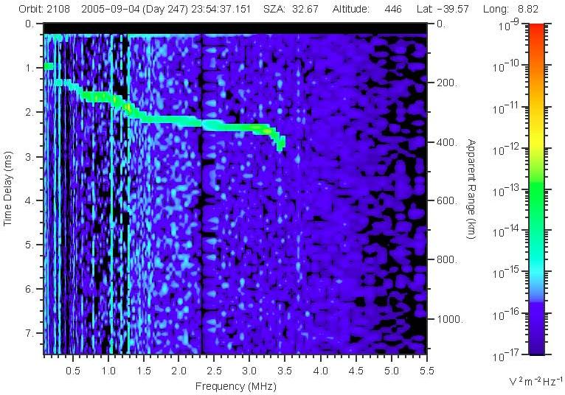
What? Another Another Cusp?

Slide 53
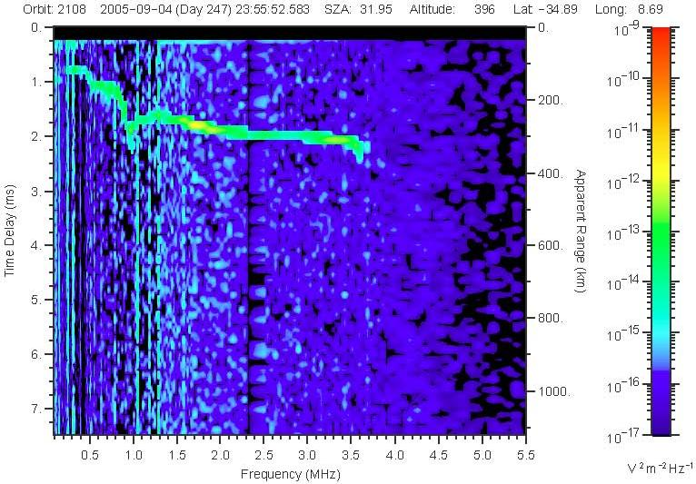
More Evidence…

Slide 54
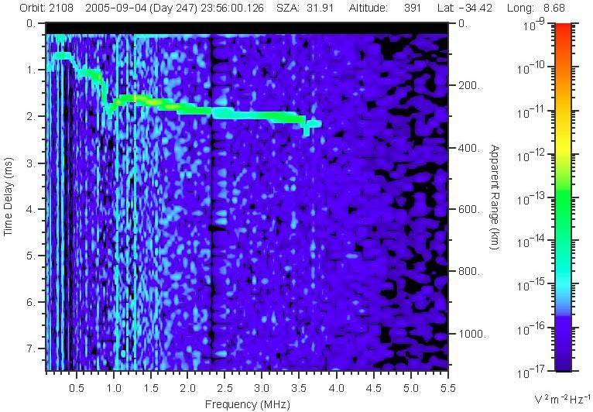
One more… for good measure

Slide 55
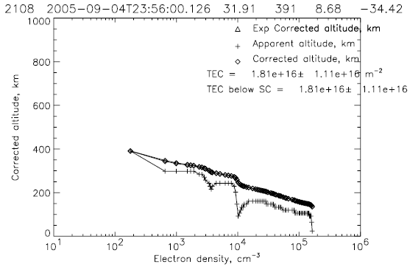
Combined Density Profile

Slide 56
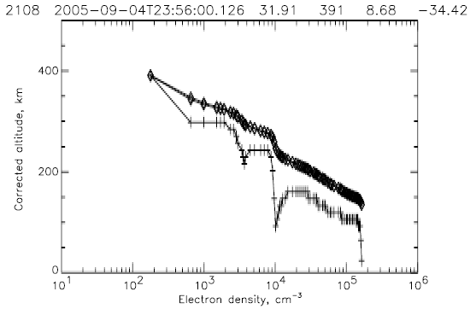
A closer look…

Slide 57
So what’s causing this cusp?
Can’t blame it on transport here, because we’re WAY above where that starts to take effect
Looking at the Hanson density profile, the next most populous ion is Hydrogen, the only ion whose density INCREASES with altitude
The solar wind is primarily Hydrogen ions. Combining this with Mars’ ionosphere could create a significant enough density to cause this cusp and corresponding step on the profile

Slide 58
Summary and Future Work
Upper layer properties correlate well with theory and previous measurements of O⁺ ions
Ability to detect feature appears to be a function of SZA
  Need measurements at lower SZA to fill in the gap
Visibility may also depend on crustal B-field structure
Alternate explanation of transport does not seem to be enough to explain the often drastic change in slope by itself, though may still be a key factor
Third layer detected, possibly due to Hydrogen ions

Slide 59
References
Chapman, S. The absorption and dissociative or ionizing effect of monochromatic radiation in an atmosphere on a rotating Earth, Part II. Grazing incidence, Proc. Roy. Soc. London 43 (26), 483-501, 1931.
Gurnett, D.A., et al. Radar soundings of the ionosphere of Mars, Science 310, 1929-1933, 2005.
Gurnett, D.A., et al. An overview of radar soundings of the Martian ionosphere from the Mars Express spacecraft, in press.
Krasnopolsky, V.A. Mars’ upper atmosphere and ionosphere at low, medium, and high solar activities: Implications for evolution of water, J. Geophys. Res. 107 (E12), 5128, doi:10.1029/2001JE001809, 2002.
Morgan, D.D., et al. Solar control of radar wave absorption by the Martian ionosphere, Geophys. Res. Lett. 33, L13202, doi:10.1029/2006GL026637, 2006.
Picardi, G., et al. MARSIS: Mars advanced radar for subsurface and ionosphere sounding, in: Wilson, A. (Ed.), Mars Express: A European Mission to The Red Planet, SP-1240, European Space Agency Publication Division, Noordwijk, Netherlands. pp. 51-70, 2004.

