Slide 1
Dynamics of the Martian ionosphere and magnetosphere as explored by multi-point measurements from MAVEN and Mars Express
Y. Harada¹, D. A. Gurnett², A. J. Kopf², J. S. Halekas², S. Ruhunusiri², C. O. Lee³, T. Hara³, J. Espley⁴, G. A. DiBraccio⁴, D. L. Mitchell³, C. Mazelle⁵, D. E. Larson³, and B. M. Jakosky⁶
¹Kyoto University, ²The University of Iowa, ³University of California, Berkeley, ⁴NASA GSFC, ⁵National Center for Scientific Research, ⁶University of Colorado Boulder

Slide 2
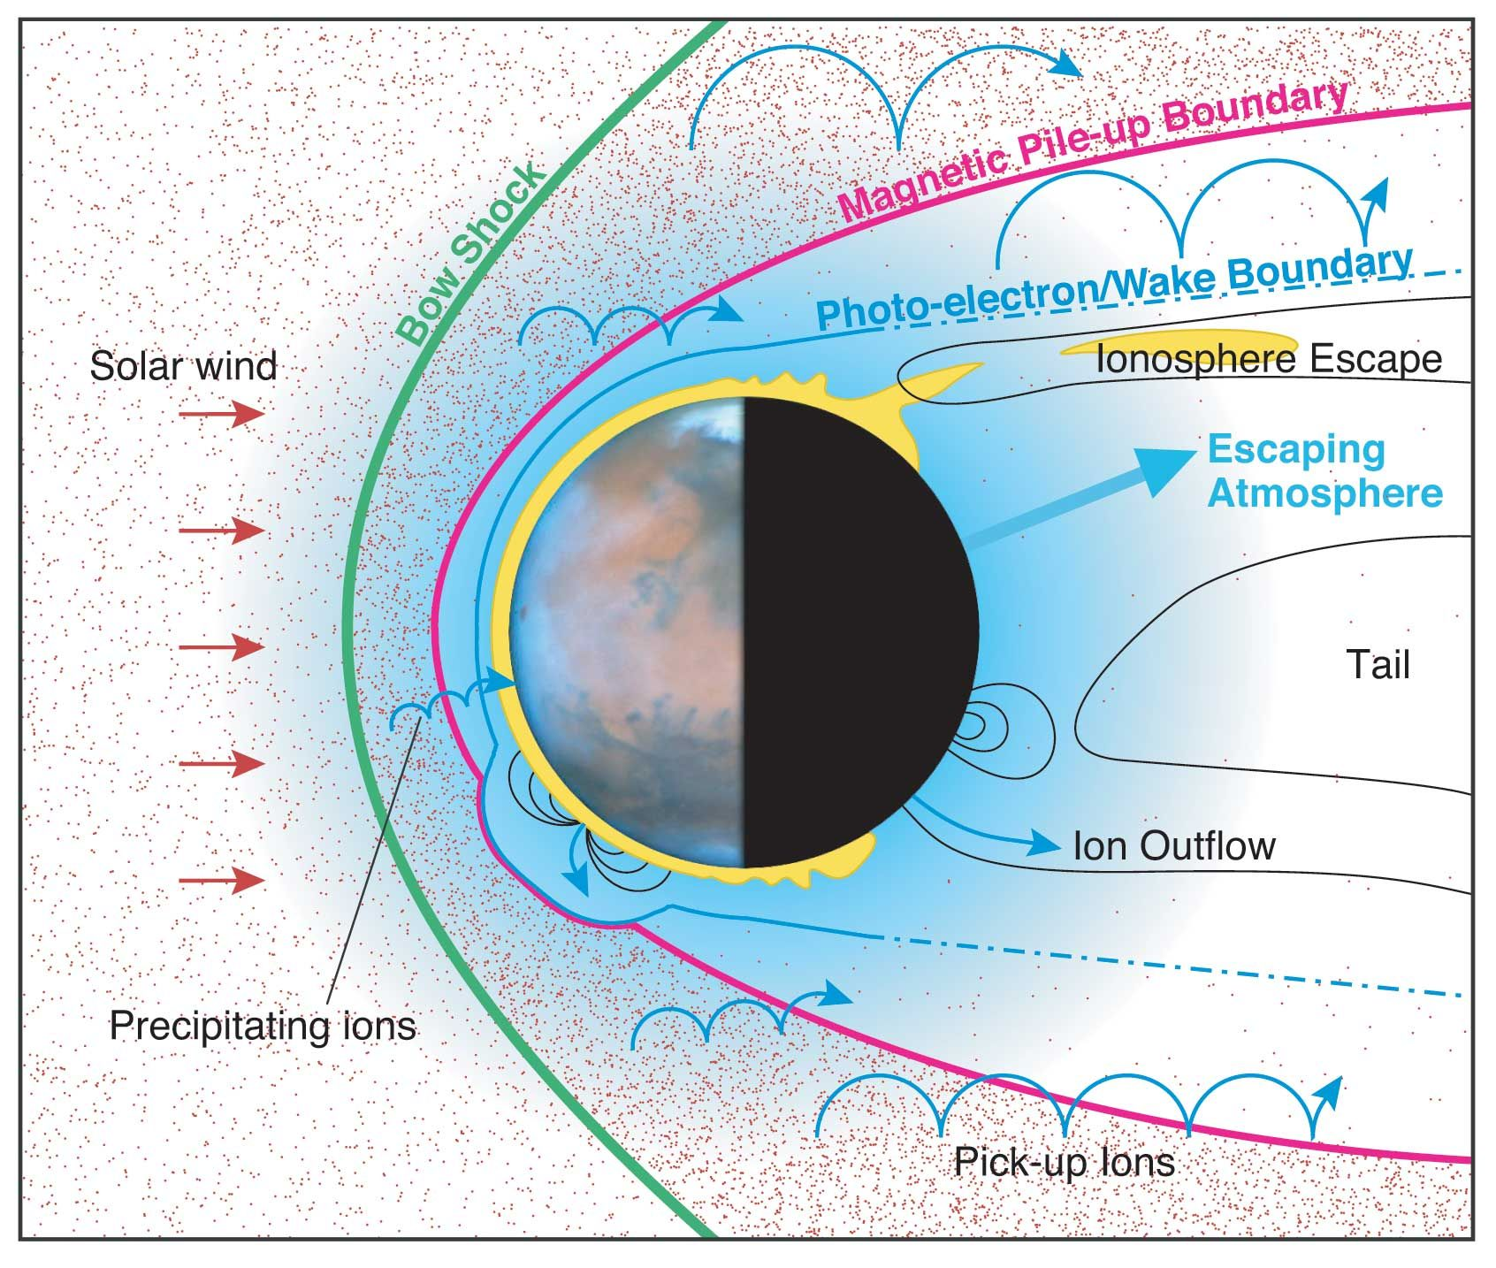
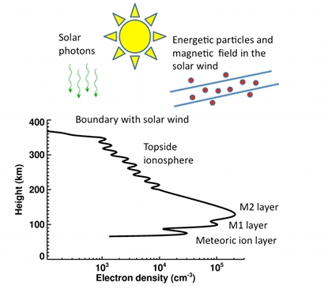
The Martian Ionosphere – A Dynamic Environment
Unlike at Earth, Mars lacks a global magnetic field to shield its atmosphere
  Highly susceptible to solar influence
  Remnant crustal magnetism affects ionosphere
Lower ionosphere dominated by photochemistry; upper regions by transport and solar wind
Still some major topics being studied
  Amount/composition of atmosphere loss
  Effects of crustal magnetic fields
  Seasonal and solar cyclical effects
  Response to solar dynamics
Multiple spacecraft can provide context for each other
Image Credit: UC-Boulder
Image Credit: ESA

Slide 3
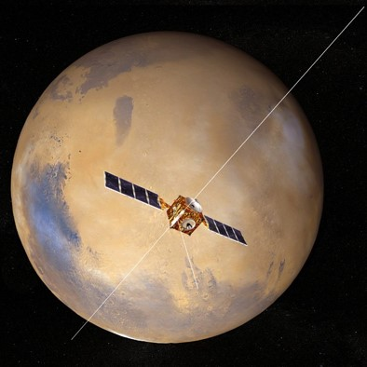
MARSIS (Mars Express)
Mars Advanced Radar for Subsurface and Ionosphere Sounding aboard Mars Express
MEX in orbit since Dec. 2003, MARSIS operating since July 2005
Twin 20-meter dipole antennae
7 meter monopole
Capable of operating in two main modes, one for ionospheric science, the other for subsurface radar sounding
  Ionospheric mode useful for collaborations with MAVEN

Slide 4
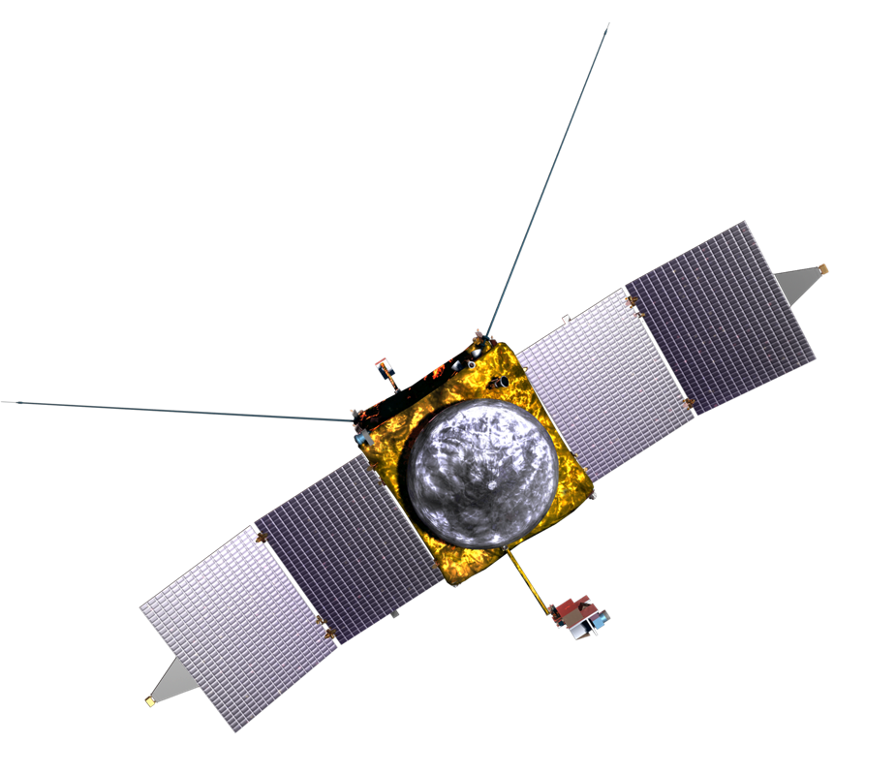
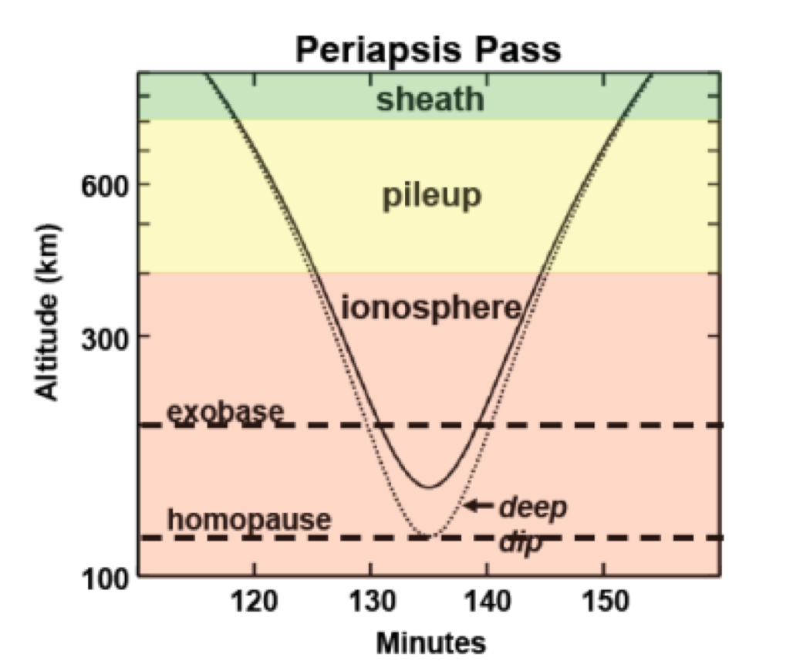




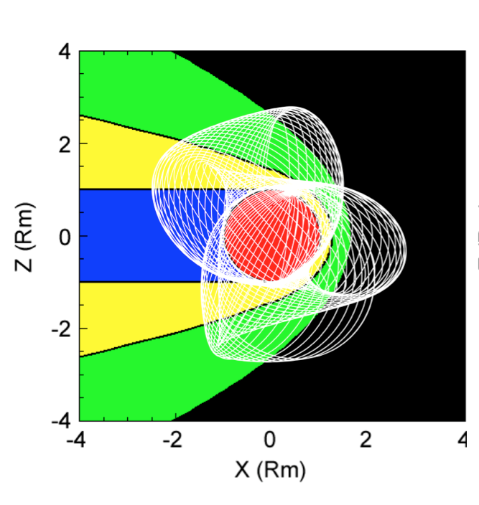

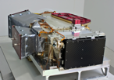



MAVEN
Sun, Solar Wind, Solar Storms
SEP
SWEA
EUV
SWIA
Ion-Related Properties and Processes
Neutrals and Ions Plus Evolution
STATIC
MAG
LPW
IUVS
NGIMS

Slide 5
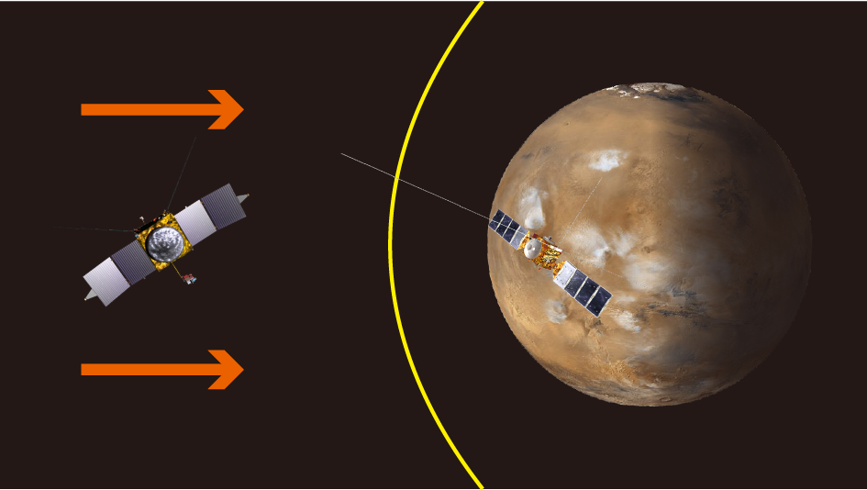
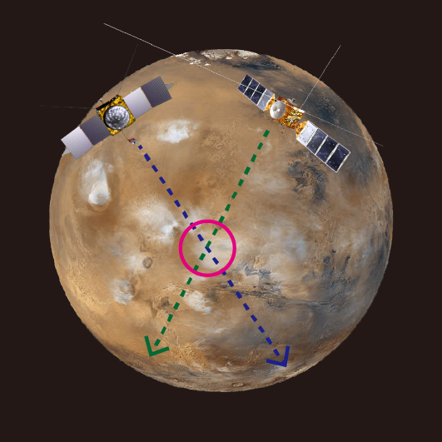
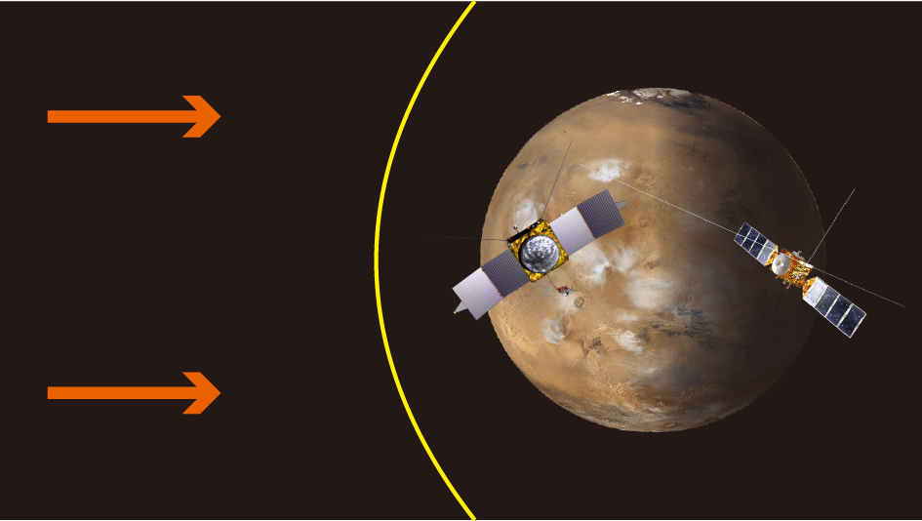
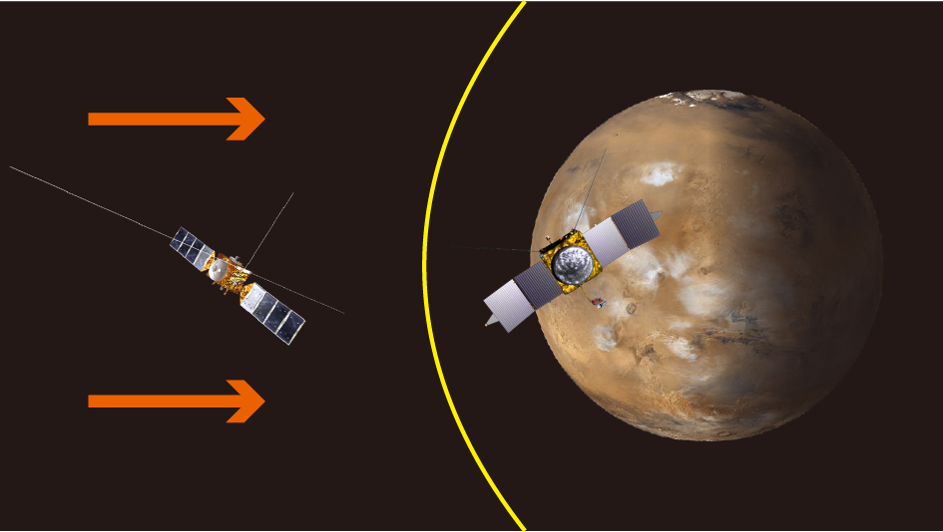
MEX + MAVEN Multi-point Measurements
(ii) MAVEN in SW + MEX near Mars
(iv) MAVEN on dayside
+ MEX on nightside
(i) Conjunction Observations
(iii) MEX in SW + MAVEN near Mars

Slide 6
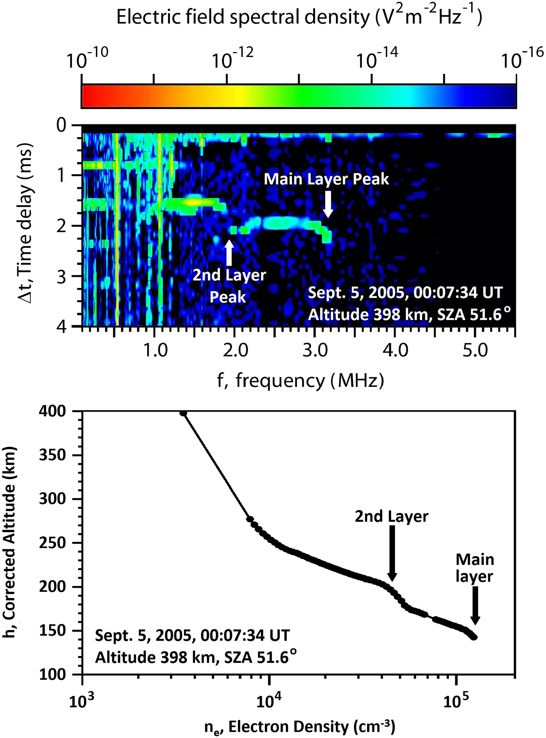
(i) Conjunction Observations – MAVEN in ionosphere + MARSIS above
MARSIS has observed higher altitude structures since early in the MEX mission
Feature, generally referred to as “second topside layer” [Kopf et al., 2008], appears near 200 km altitude.
MARSIS does not orbit low enough to measure in-situ to determine structure

Slide 7
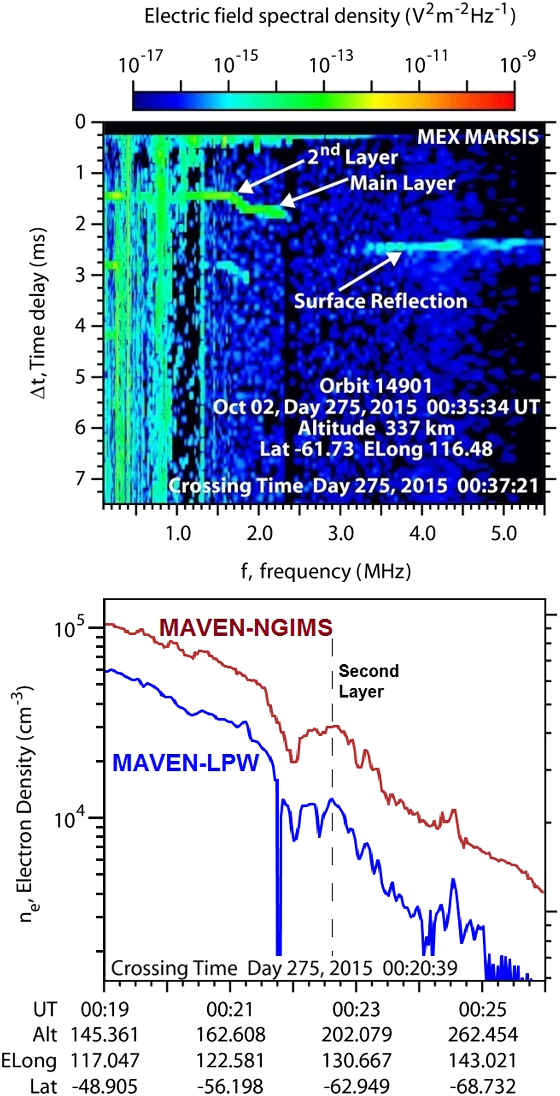
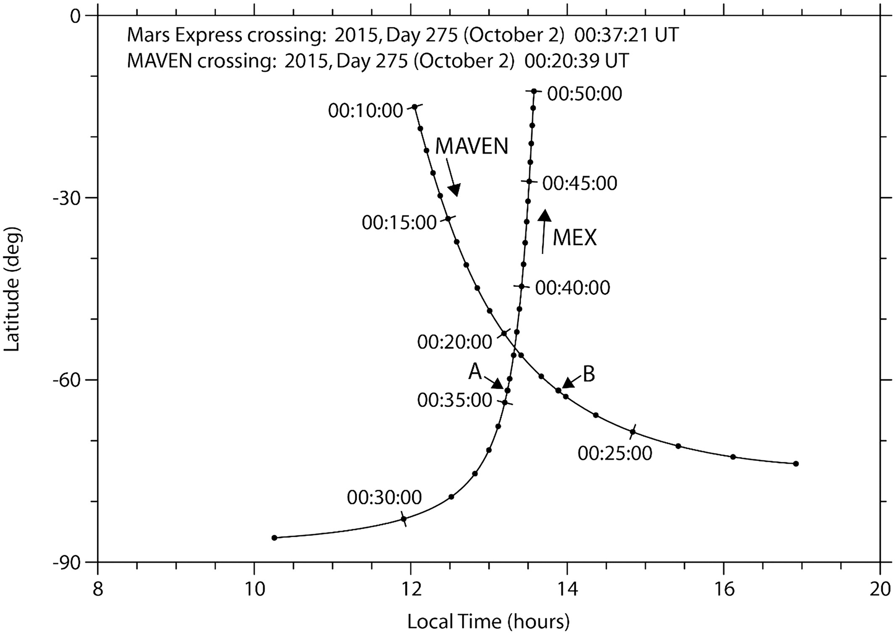
(i) Conjunction Observations – MAVEN in ionosphere; MARSIS above
Addition of MAVEN allowed for correlated observations
Close-time orbital crossings enable dual studies, if MAVEN is low enough to observe in situ
Feature jointly detected in Oct. 2015 orbit

Slide 8
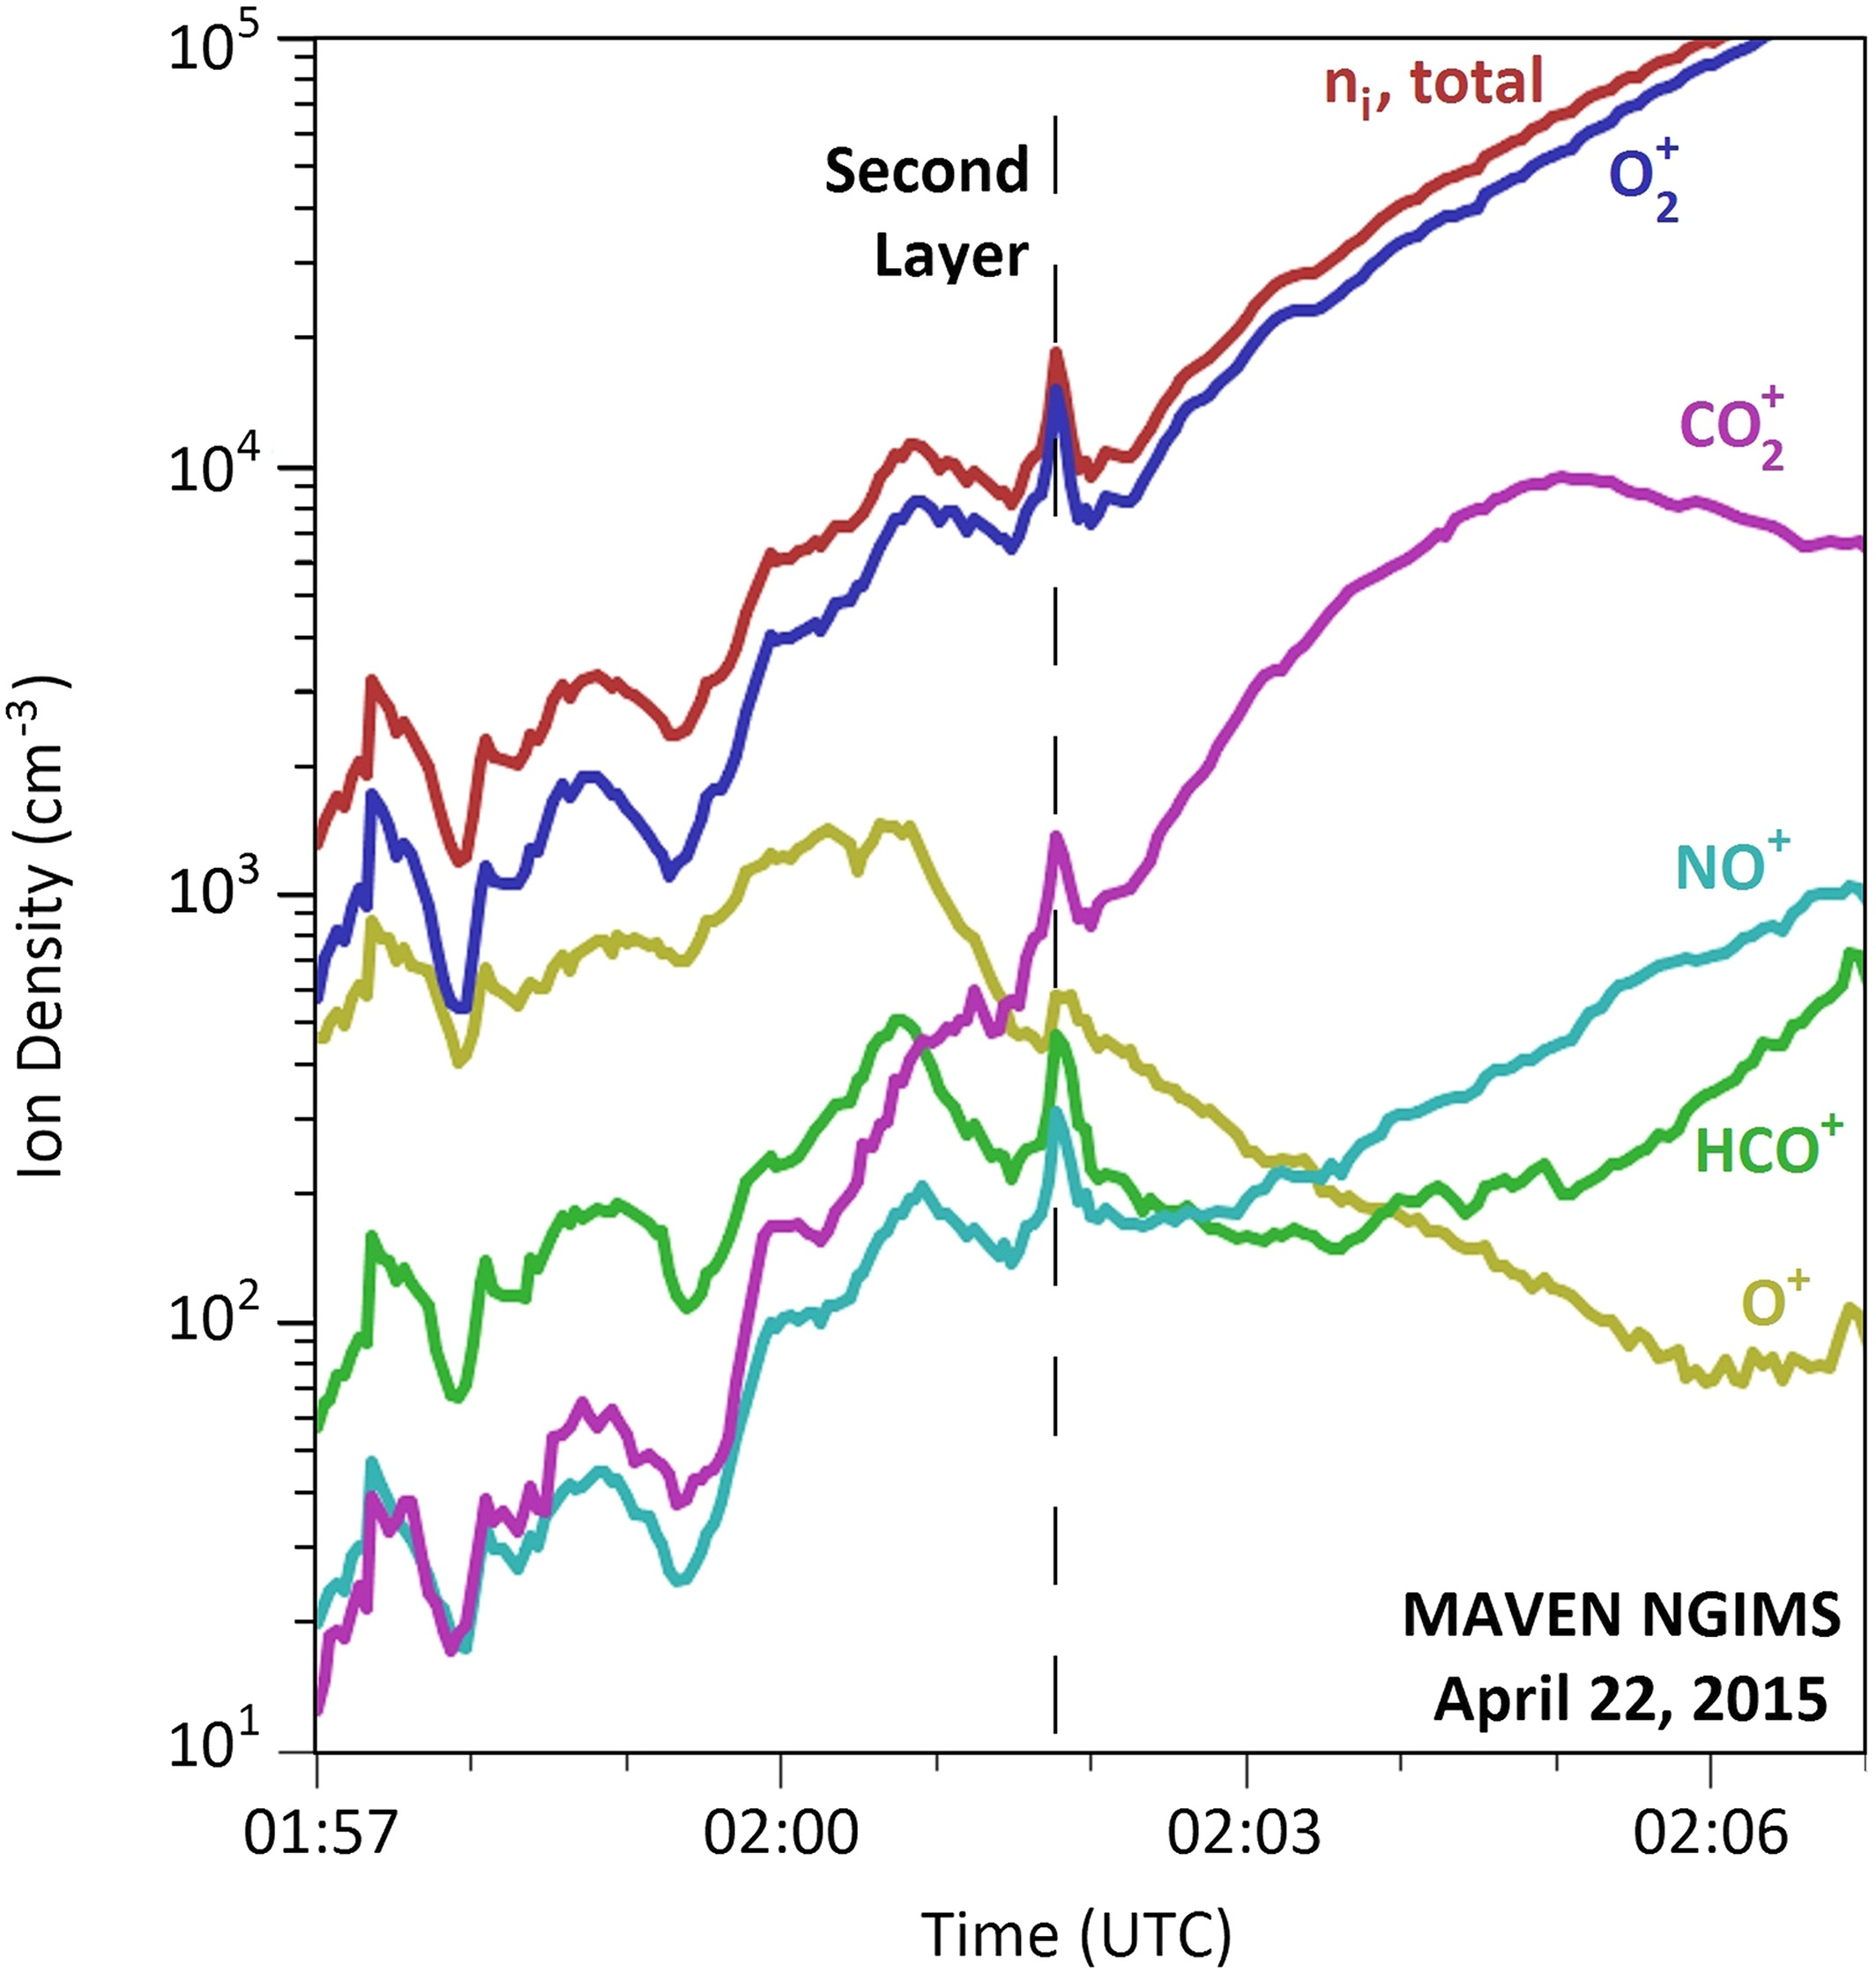
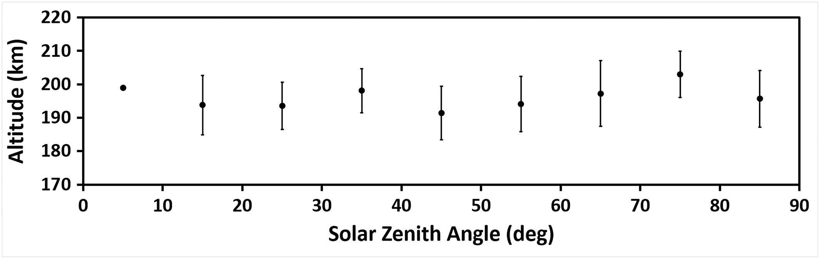
(i) Conjunction Observations – MAVEN in ionosphere; MARSIS above
Layer observed in electrons and ions
Ion data shows increase in all except O⁺
MAVEN observations [Kopf et al., 2017] correlate well with previous MARSIS studies
Some evidence of current structures in MAG data

Slide 9
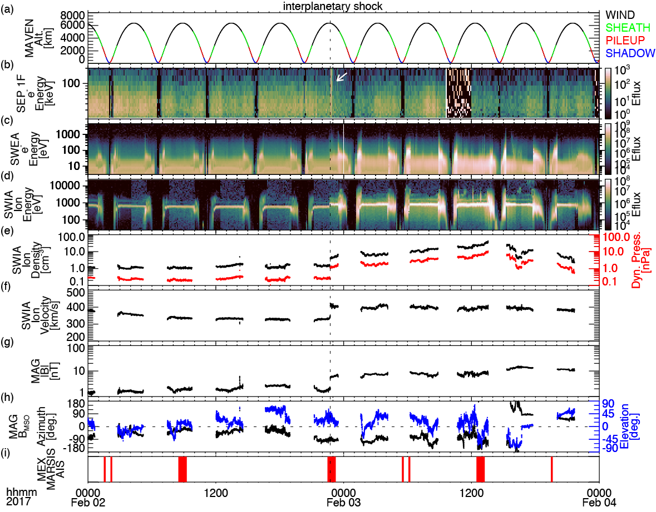
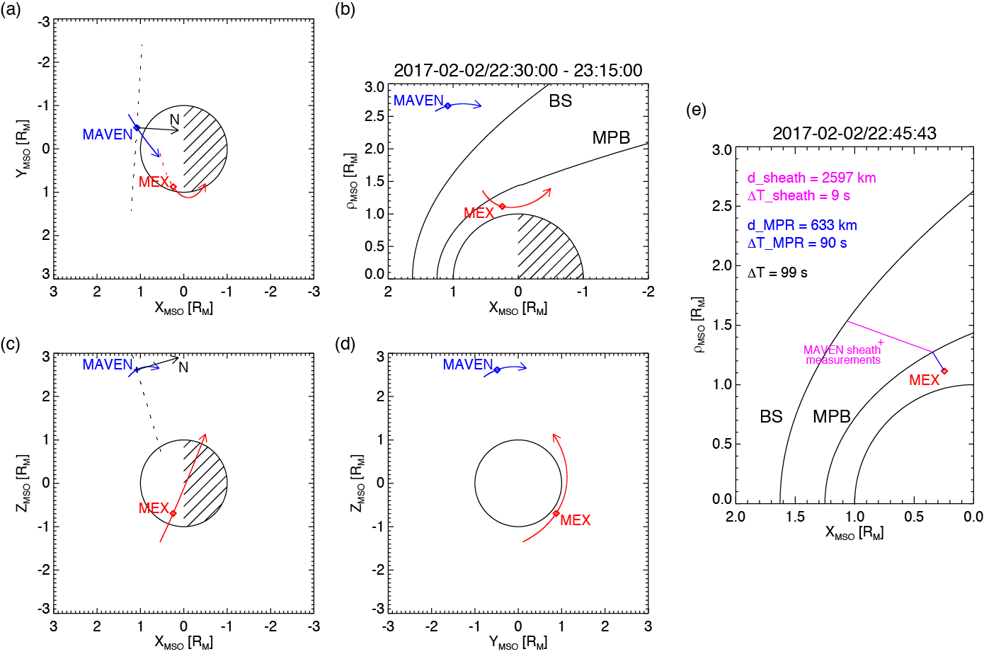
(ii-a) MAVEN in SW + MARSIS in Dayside Ionosphere:
A CIR Event
[Harada et al., 2017]

Slide 10
(ii-a) MAVEN in SW + MARSIS in Dayside Ionosphere:
A CIR Event
MARSIS detected a sudden local B increase ~1 min after the shock arrival at Mars
The ~1 min time lag is roughly consistent with the expected propagation time of a dynamic pressure pulse in the fast mode

Slide 11
(ii-a) MAVEN in SW + MARSIS in Dayside Ionosphere:
A CIR Event
MARSIS detected diffuse echoes a few min after the shock arrival at Mars
The diffuse echoes are caused by irregular structure in the disturbed ionosphere
These diffuse echoes were absent during other orbits traveling over the same location, suggesting their transient nature

Slide 12
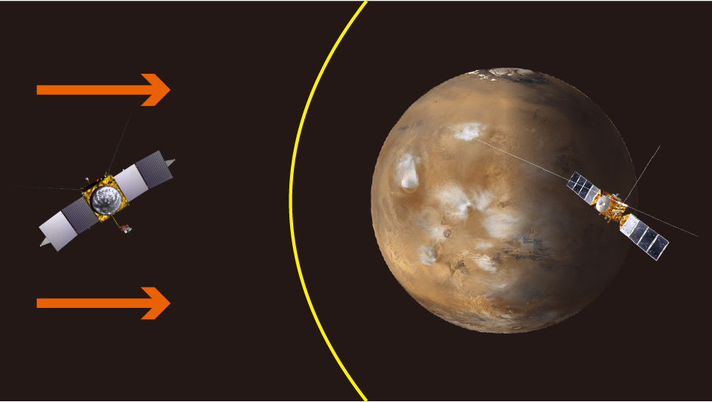
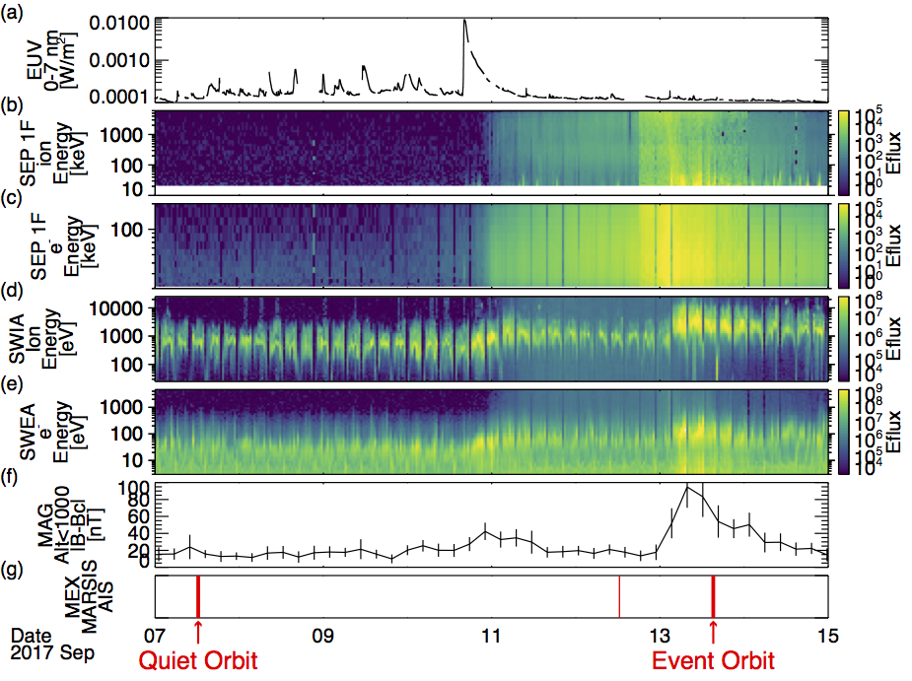
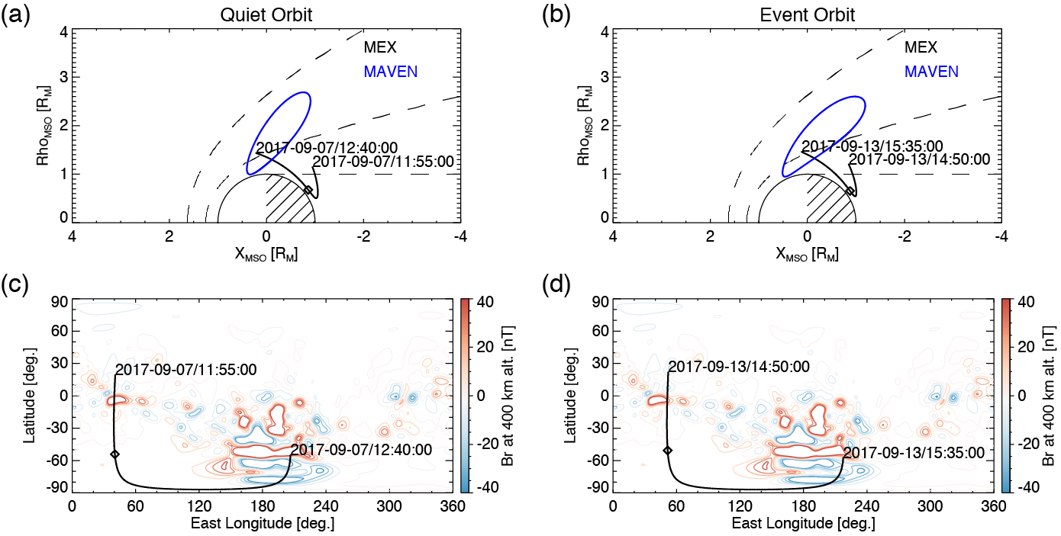
(ii-b) MAVEN in SW + MARSIS in Nightside Ionosphere:
September 2017 Solar Event
[Harada et al., 2018]

Slide 13
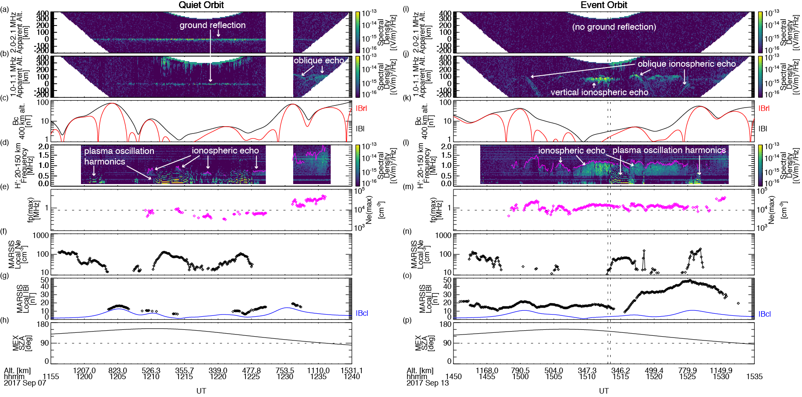
(ii-b) MAVEN in SW + MARSIS in Nightside Ionosphere:
September 2017 Solar Event
1
1. Disappearance of ground reflection
2. Increased peak electron densities
3. Enhancement in induced magnetic fields
2
3

Slide 14
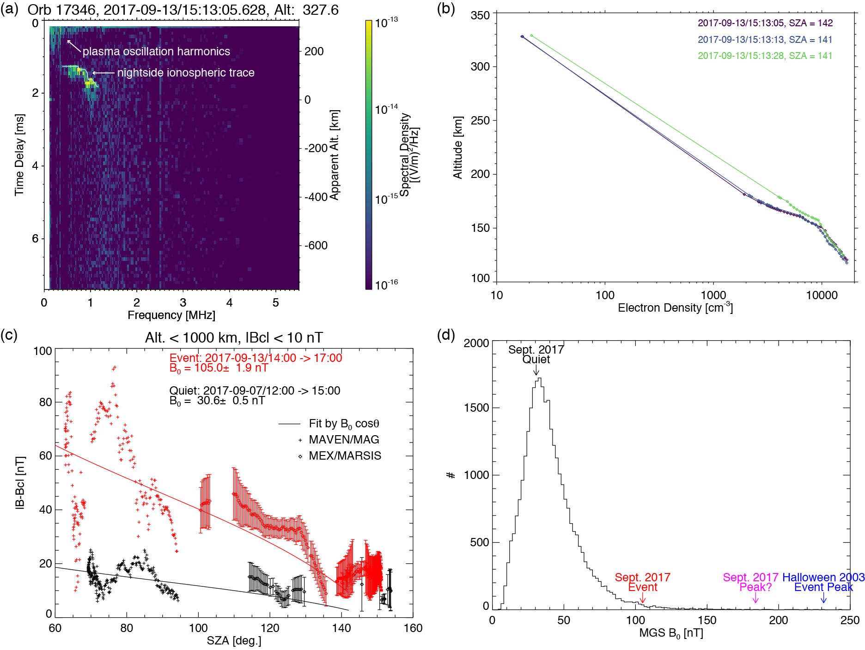
(ii-b) MAVEN in SW + MARSIS in Nightside Ionosphere:
September 2017 Solar Event
1. Peak density altitude ~120 km <- electron impact ionization
2. Induced B amplification over a wide SZA range - (iv) Dayside MAVEN + Nightside MARSIS
3. The Sept. 2017 event is one of historically high dynamic pressure events
1
2
3

Slide 15
Conclusions
Multipoint measurements have proven very useful for investigation of…
  transient ionospheric structure
  response timescales of the ionosphere and magnetosphere to SW events
  global evolution of the ionosphere during SW events
Expansion of multi-spacecraft work will be fruitful in the continued study of key remaining science questions

