Slide 1


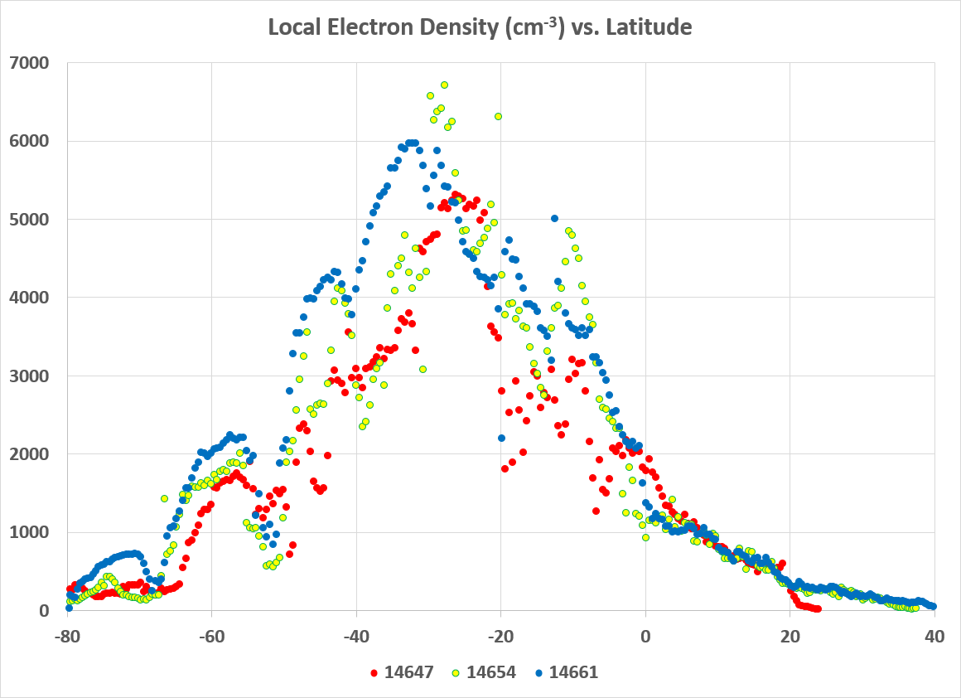
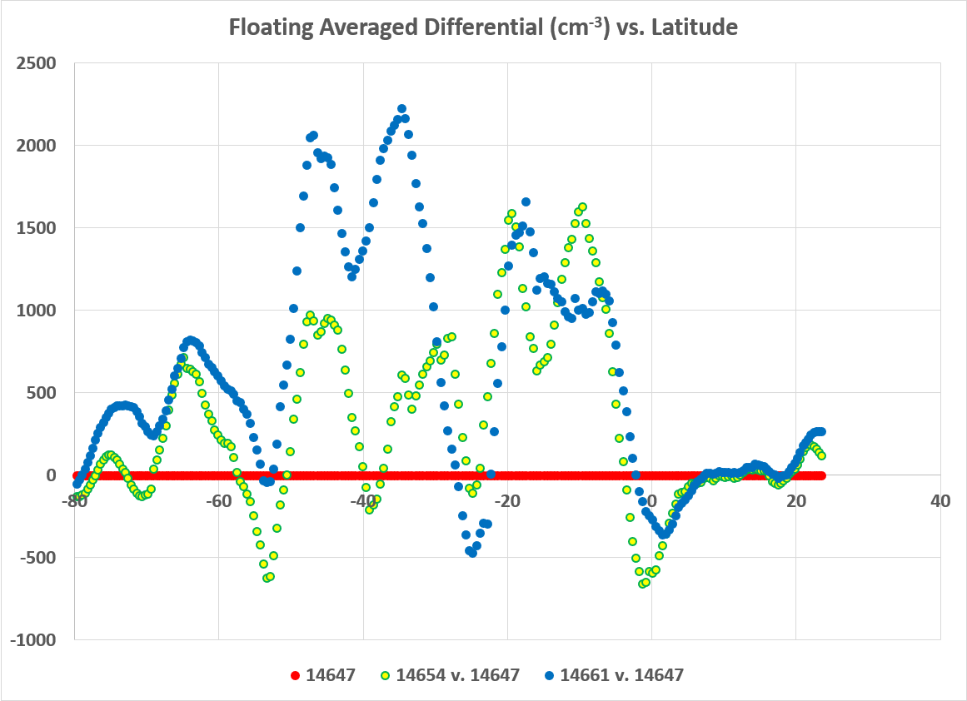
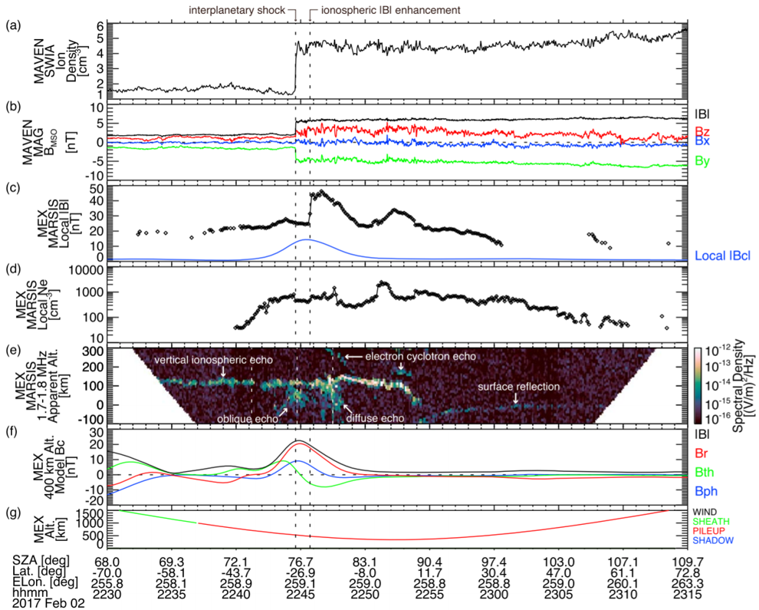
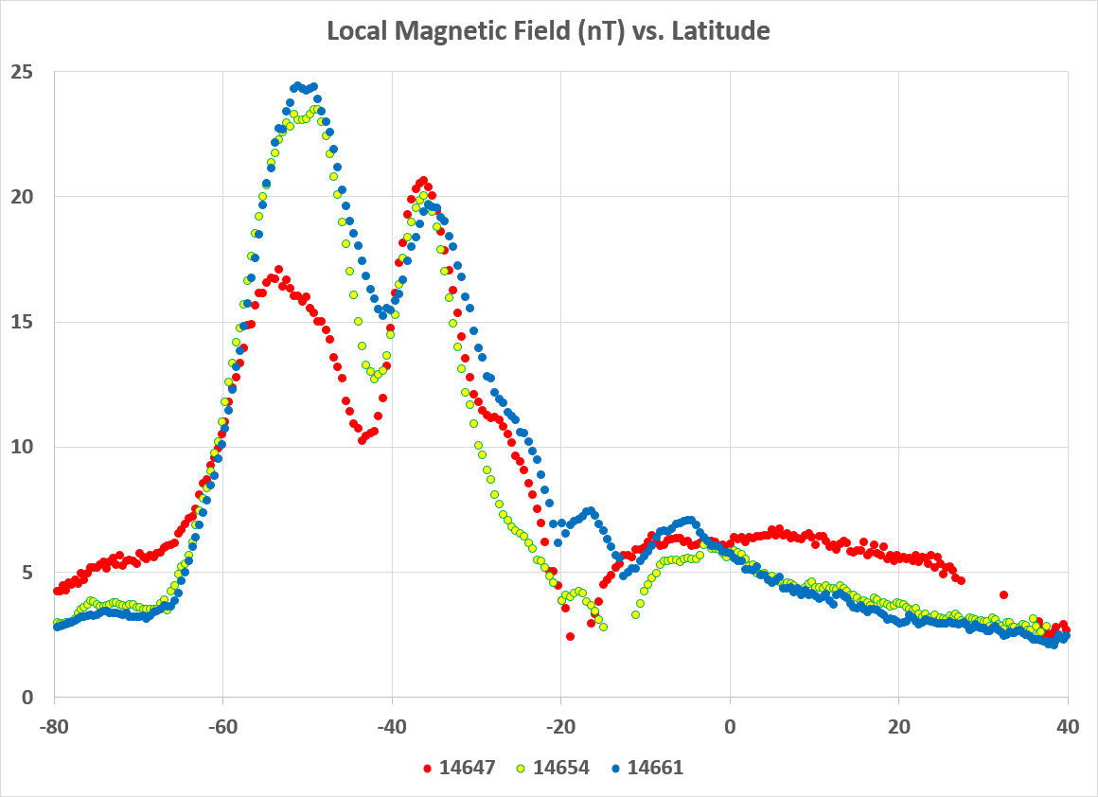
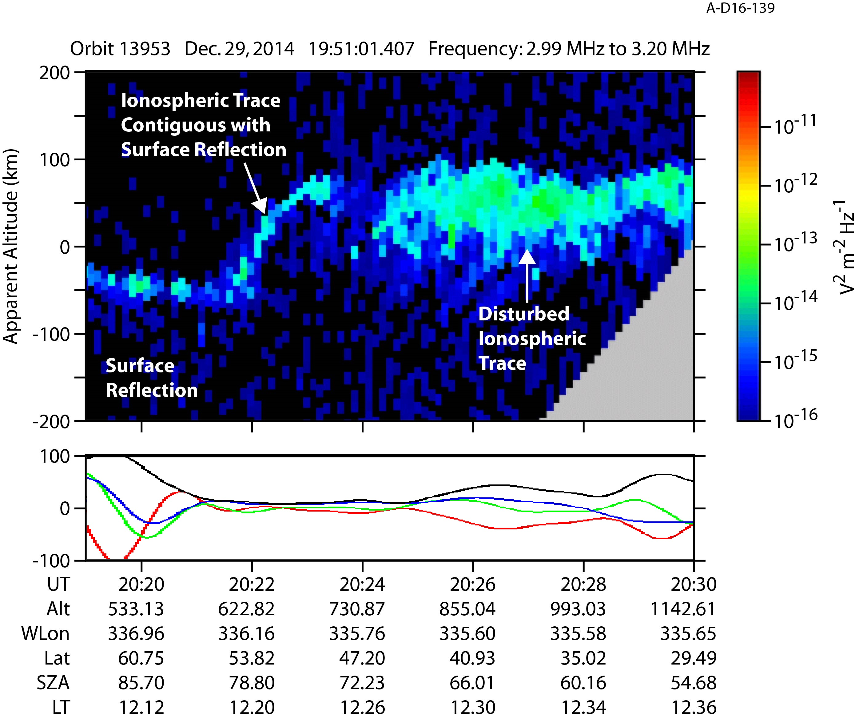
PS17-A020
Correlating Solar Wind Modulation with Ionospheric Variability at Mars from MEX and MAVEN Observations
Andrew Kopf, David Morgan, Yuki Harada, Jasper Halekas, and Donald Gurnett
The University of Iowa, Iowa City, IA, United States Email: andrew-kopf@uiowa.edu
1. Abstract
The synthesis of observations by the Mars Express and MAVEN spacecraft allows for a unique opportunity to study variability in the Martian ionosphere from multiple perspectives. One major source for this variability is the solar wind. While previous research has relied on Earth-based measurements for solar wind conditions at Mars, MAVEN can directly measure the solar wind impacting the Martian plasma environment when its orbit takes it outside the bowl shock. If the MARSIS instrument aboard Mars Express is simultaneously sounding the ionosphere, the influence from changes in the solar wind can be observed. Recent studies of special cases, such as shock wave impacts or parallel solar wind magnetic field orientations, have shown direct correlations between the solar wind and the behavior of ionospheric features. Here we extend this to more general solar wind conditions and examine how changes in the solar wind properties measured by MAVEN instruments, including density, velocity, and magnetic fields, correlate with ionospheric structure and dynamics observed simultaneously in MARSIS remote and local measurements.
3. Small Scale Variability – MEX-MARSIS local parameters vs. solar wind velocity
The Mars Express orbit is fairly repetitive on 7-orbit intervals, allowing for comparative measurements along common orbital tracks. Orbits 14647 (solar wind velocity 500 km/s), 14654 (450 km/s), and 14661 (400 km/s) were analyzed in the MARSIS local parameters, and compared to each other given the varying solar wind dynamic pressure, as the densities were roughly constant.
SPACECRAFT-LOCAL DENSITY
As wind speed decreases, local electron density increases. A 50 km/s decrease in velocity yields a 250 cm⁻³ increase in density
This effect is strongest near magnetism and when MEX is at low altitudes, where there is larger local density
The effect can be seen more pronounced when fixing the highest-velocity/pressure orbit as a baseline for comparison
This is likely due to the change in the solar wind dynamic pressure, causing the ionosphere of Mars to compress or expand
SPACECRAFT-LOCAL MAGNETISM
Two different results based on the location of Mars Express relative to the crustal magnetism
In areas of low magnetic field, the high-speed solar wind correlates with the higher local magnetic measurements
In higher magnetic field regions, the results are more convoluted, but trend toward the opposite, where high-speed solar wind conditions result in a lower local magnetic field
2. Large Scale Variability – Solar Events
Large scale variations in the solar wind plasma can often cause easily observed effects on the Martian ionosphere, due to the lack of a global magnetic field to protect it. These events include, for example, shocks and variable orientations of the magnetic field.
INTERPLANETARY SHOCK
On February 2, 2017, an interplanetary shock, likely associated with a CIR event, was detected by MAVEN while upstream of Mars
The shock caused sudden spikes in the solar wind plasma and magnetic field measurements
About one minute later, MARSIS, which was lower in the ionosphere, observed similar sharp variations in the local plasma
A disturbed ionosphere was seen below the spacecraft soon after.
These results are published in Harada et al., GRL, 2017.
PARALLEL SOLAR WIND MAGNETIC FIELD
MARSIS observations of an event late in 2014 contained two highly atypical features
(1) As Mars Express exits a region of moderate crustal magnetism, the surface and ionospheric reflections coincide, perhaps due to unusually high-density low-altitude plasma
(2) As Mars Express continues to travel southward, the ionospheric plasma rises steadily in apparent altitude, and then abruptly becomes highly disturbed, perhaps due to some kind of upstream distortion
No conclusive cause has been found to date for these observations
4. Key Takeaways
Large-scale solar events show clear effects, but even smaller ones have measurable impacts
Work still needs to be done to examine non-magnetized regions, to separate magnetic effects
Analysis of the ionospheric peak’s variability would determine how far these effects penetrate

