Slide 1
Correlating Solar Wind Modulation with Ionospheric variability at mars from mex and maven observations
A. J. Kopf, D.D. Morgan, J.S. Halekas, S. Ruhunusiri, D.A. Gurnett, and J.E.P. Connerney

Slide 2
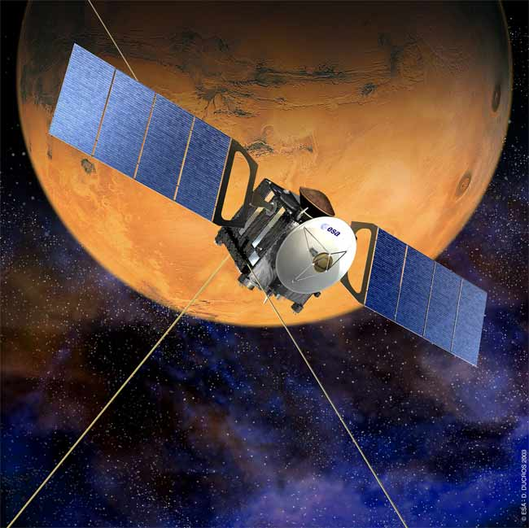
MARSIS & MARS EXPRESS
Twin 20-meter dipole antennae
Operates from 100 kHz to 5.5 MHz
Remote sounding of the ionosphere
Uses time delay of echo off the ionosphere to obtain density profiles of the ionosphere
Can often measure spacecraft-local parameters, including plasma density and local magnetic field strength

Slide 3
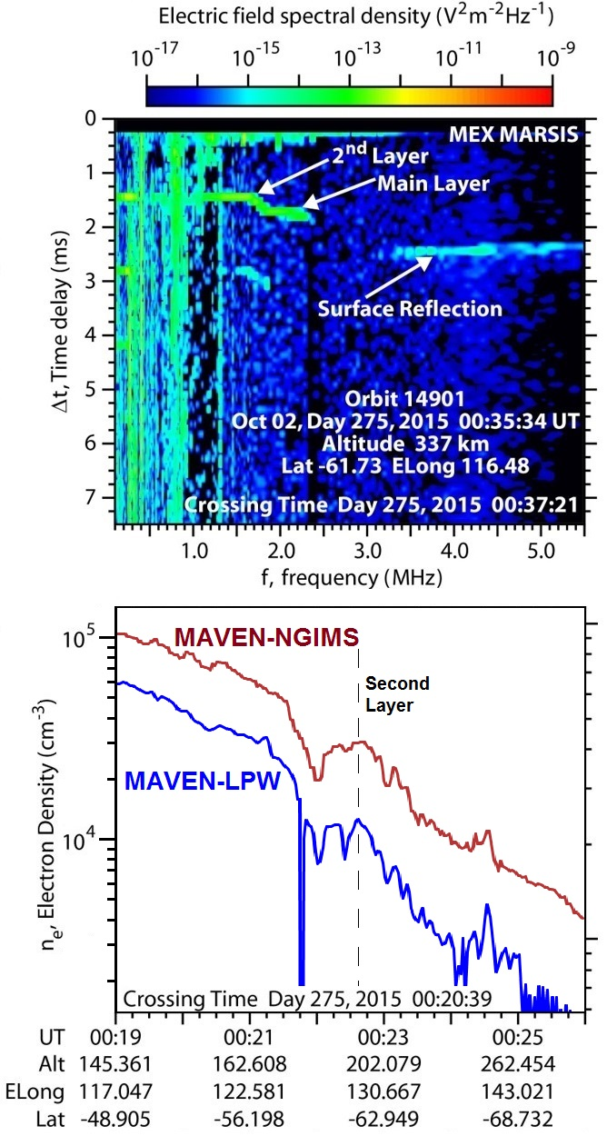
SYNERGY WITH MAVEN – Crossing orbits
In cases where MAVEN is in the ionosphere while MARSIS is operating, joint studies of common features are sometimes possible
When the orbits cross in a close time frame, common features can be studied
Here, the transient 2nd layer, first observed by MARSIS about 10 years ago, can be seen by both spacecraft at a common location about 12 minutes apart.

Slide 4
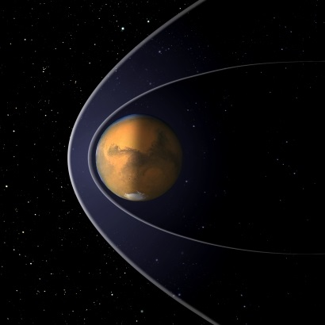
MAVEN as a solar wind monitor
With Mars Express and MAVEN both at Mars, it is possible to observe two inter-connected features at the same time
While MARSIS is sounding the ionosphere, if MAVEN is outside the bow shock, it can directly observe and measure the upstream solar wind
Variations in the solar wind may lead to disruptions of the ionospheric structure
“What shows effects and what doesn’t?”

Slide 5
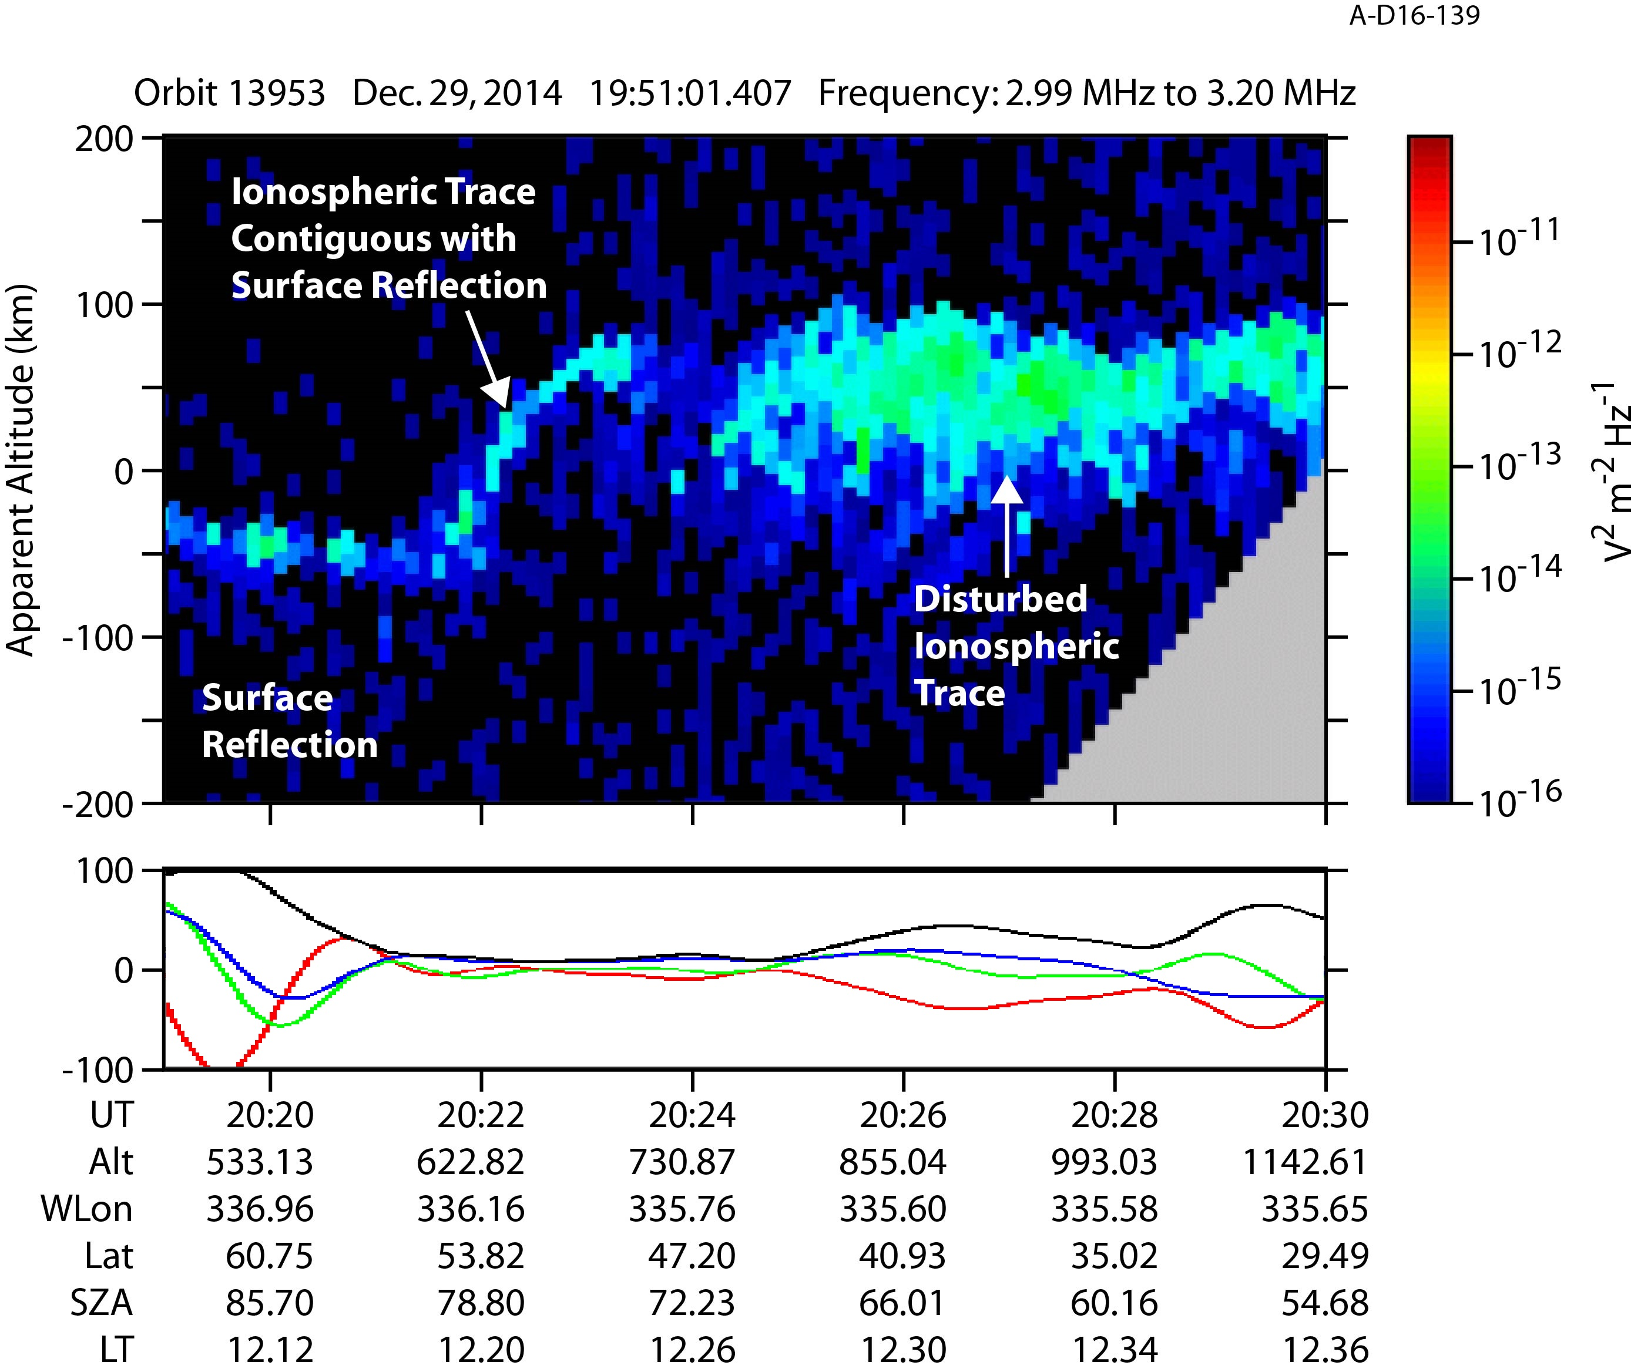
Parallel B-field coinciding with A DISTURBED IONOSPHERE
Study started by D. Morgan
MARSIS observations contained two atypical features:
(1) – as MEX exits a region of moderate crustal fields, the surface and ionosphere reflections coincide (possible low-altitude plasma)
(2) – continuing to travel southward, ionosphere rises steadily in apparent altitude, then abruptly becomes highly disturbed (upstream distortion?)
No clear causal relation was found to connect these pieces, but did demonstrate the importance of SW variability

Slide 6
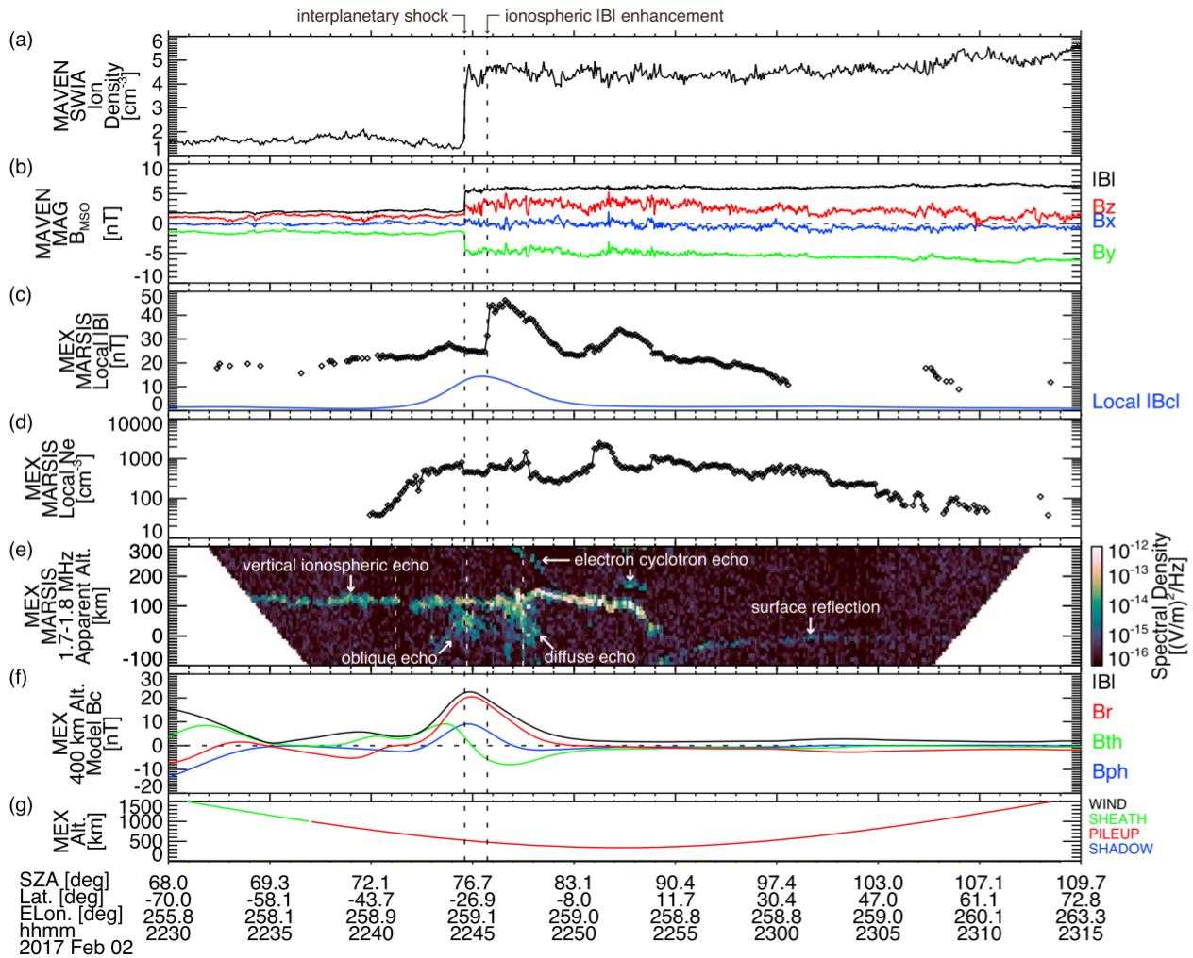
Interplanetary shock
Large-scale features can cause highly visible variations in the Mars plasma environment
On February 2, an interplanetary shock likely associated with a CIR was detected by MAVEN while upstream of Mars
The shock caused spikes in the solar wind plasma and magnetic field measurements.
About one minute later, MARSIS, lower in the ionosphere, observed similarly sharp variations in the local plasma, followed by a disturbed ionosphere below.
See Harada et al., GRL, 2017.

Slide 7
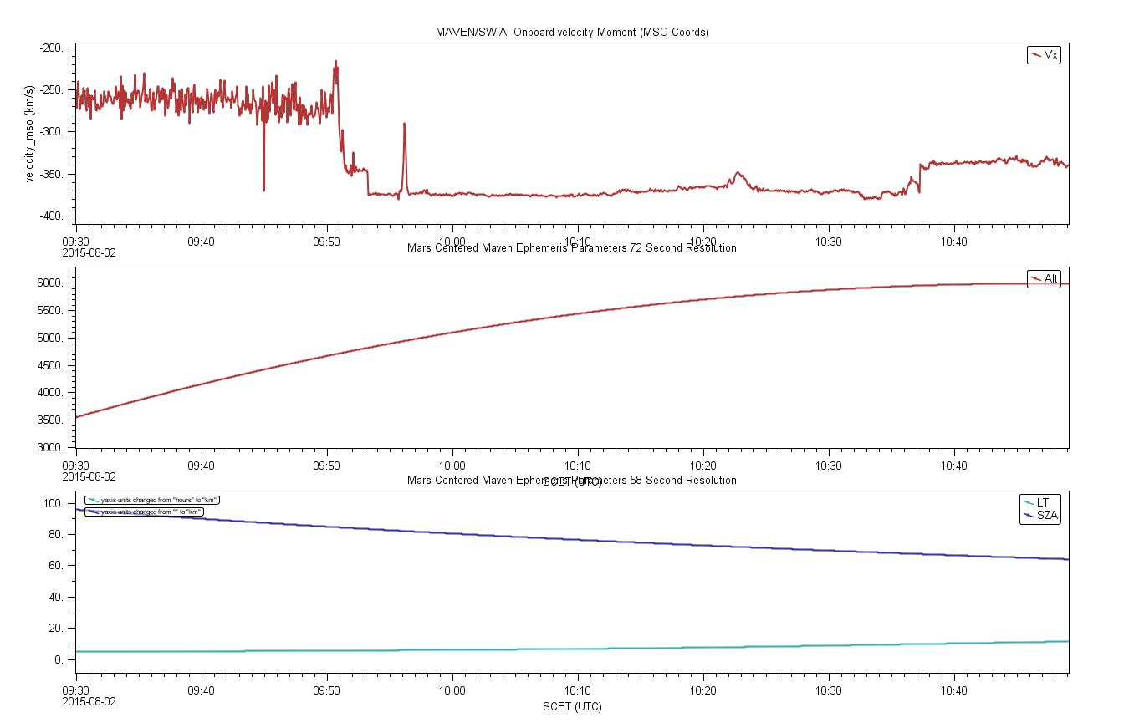
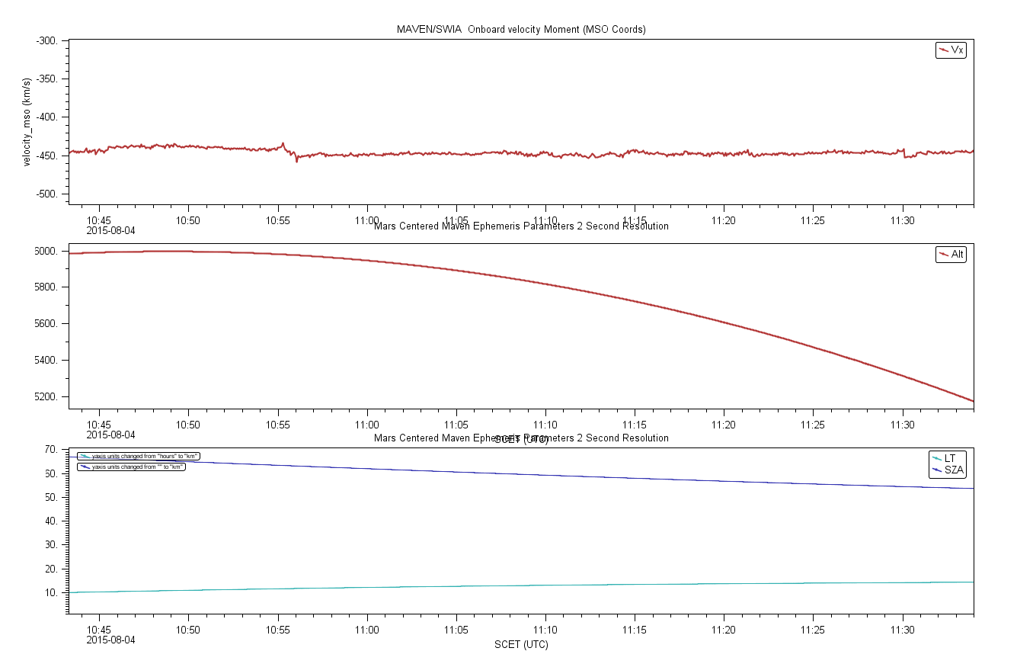
Is This Detectable From smaller variations?

Slide 8
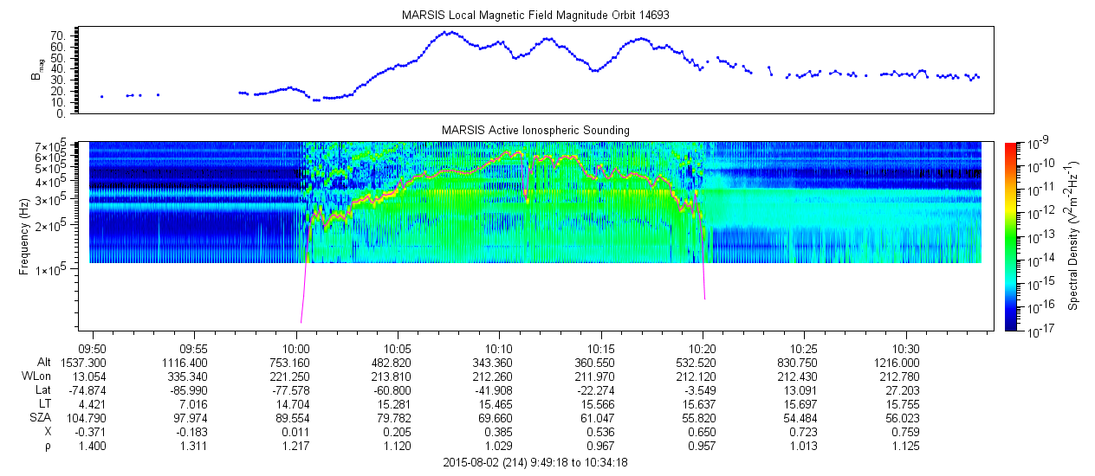
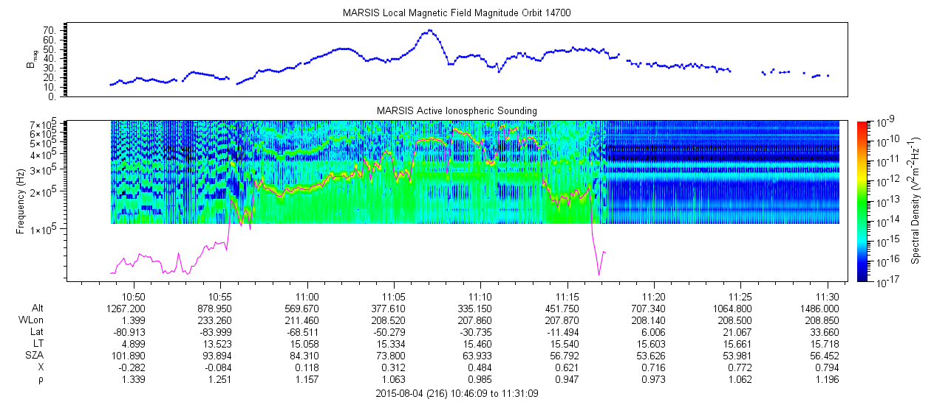
LOCAL PARAMETERS
Solar wind features observed by MAVEN happen outside of MARSIS plasma detections
Plasma density generally similar, but more variable in steady solar wind case.
Magnetic field observations are remarkably different for such comparable orbits, significantly higher in event case.

Slide 9
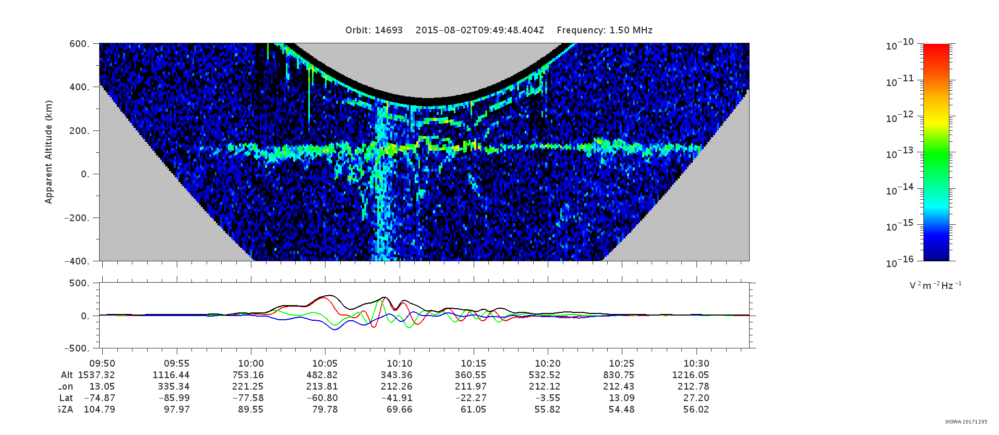
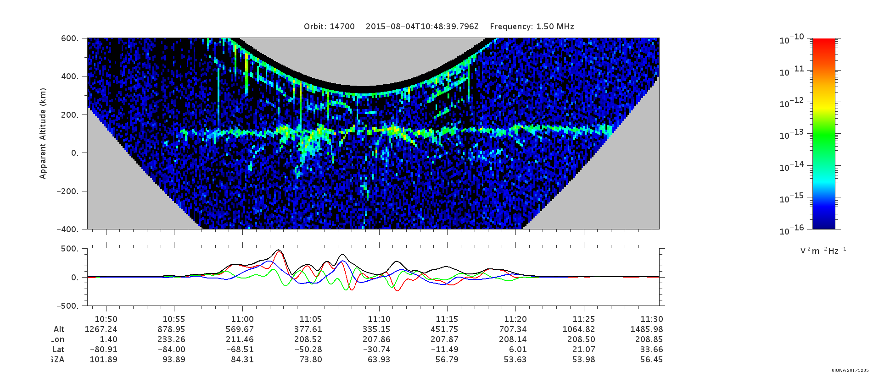
IONOSPHERE, as seen by marsis
Ionosphere appears more disrupted and turbulent in the non-steady solar wind case, particularly in the first half of the orbit.
From previous slide, local magnetic field measurements were higher in non-steady case despite the smaller Cain-model prediction shown here.

Slide 10
Comparing with different Solar Wind Inputs
The Mars Express orbit has a slow evolution, which makes its targets fairly repetitive on intervals of 7 orbits.
This allows for the comparison of different solar inputs while viewing approximately the same Martian region.
A search through the periods where MAVEN is also in the solar wind quickly yielded an ideal test period for this kind of analysis.
Orbit 14647 – solar wind 500 km/s
Orbit 14654 – solar wind 450 km/s
Orbit 14661 – solar wind 400 km/s
Orbit periapsis are at common latitude within 2 degrees, longitude varies by a total of 8 degrees.

Slide 11
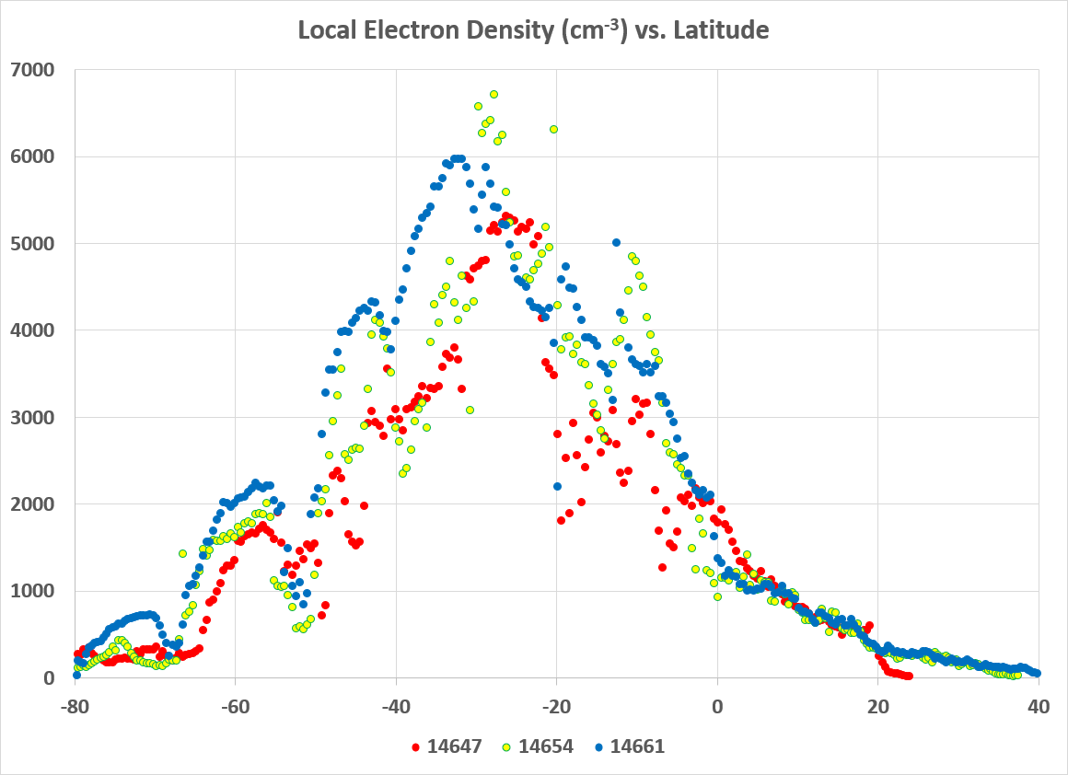
Comparing local density
Overall, as solar wind speed decreases, the local electron density increases
On average, each successive orbit is 250 cm⁻³ more dense than the previous one to go along with the 50 km/s decrease
This effect is strongest near magnetism and while MEX is at low altitudes
This is likely related to the change in solar wind dynamic pressure that comes with this velocity change, causing ionospheric compression or expansion.

Slide 12
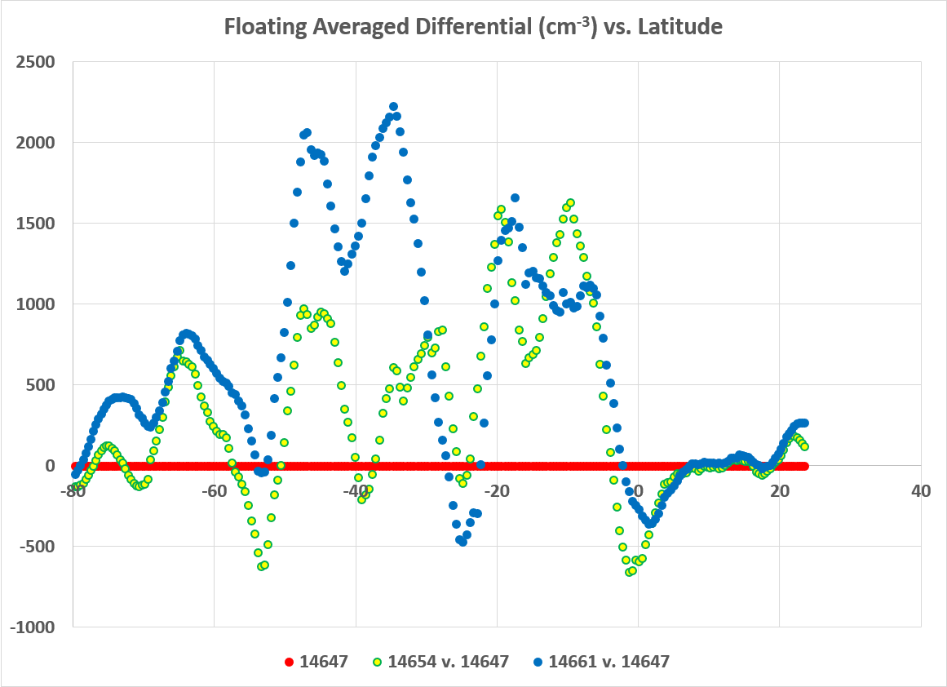
Comparing local density
Overall, as solar wind speed decreases, the local electron density increases
On average, each successive orbit is 250 cm⁻³ more dense than the previous one to go along with the 50 km/s decrease
This effect is strongest near magnetism and while MEX is at low altitudes
This is likely related to the change in solar wind dynamic pressure that comes with this velocity change, causing ionospheric compression or expansion.

Slide 13
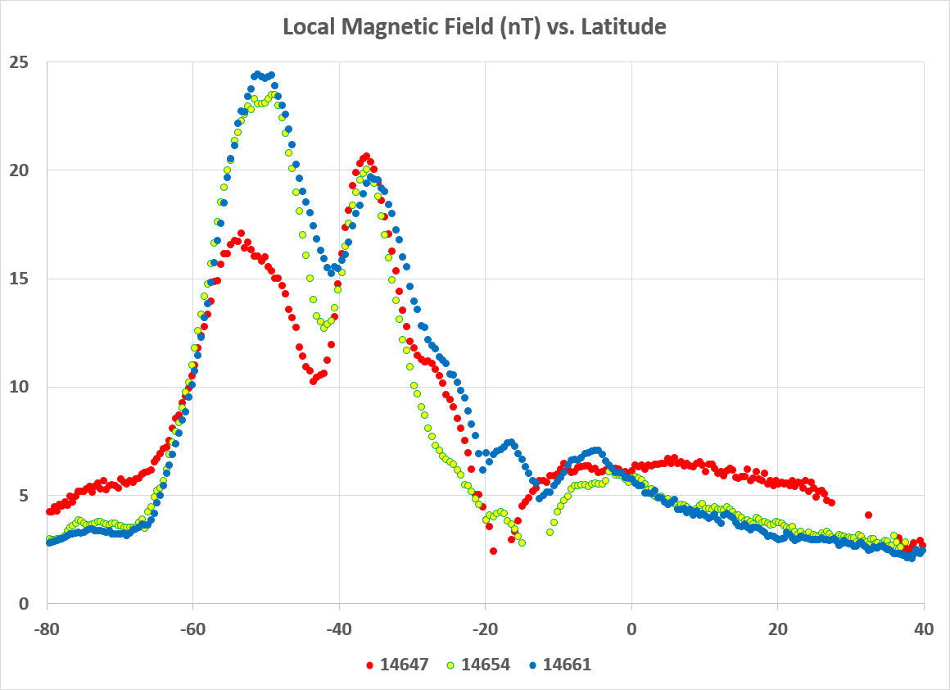
Comparing local magnetic field
In low-magnetic field regions, high-speed solar wind correlates with larger magnetic field detections
In high-magnetic field regions, the results are more convoluted, but trend toward the opposite, that higher magnetic fields are observed with lower wind speeds

Slide 14
Summary
What We See So Far:
Large scale events yield significant effects
Small, short-lived solar wind fluctuations produce little to no effect on high-altitude MEX local conditions, but may cause a more disturbed and turbulent ionosphere
Faster (constant) solar wind speeds yield lower local densities.
Magnetic correlation with wind properties appears to depend on degree of magnetism
Work Still To Be Done:
Additional cases in general to build statistics – LOTS of data still to be looked through
Quantitative analysis of ionospheric spread and its correlation with short fluctuations
Separate analysis of cases in magnetized and non-magnetized regions to separate out any magnetic dependence
Try very, very hard not to give away spoilers about The Last Jedi

