Slide 1
A SURVEY OF ELECTRON BEAMS ASSOCIATED WITH
SATURNIAN AURORAL HISS
A.J. Kopf, D.A. Gurnett, J.D. Menietti, P. Schippers,
G.B. Hospodarsky, W.S. Kurth, M.K. Dougherty,
D.G. Mitchell, J.S. Leisner, K.K. Khurana, S. Grimald, C. Arridge, N. André, A. Coates, O. Santolik

Slide 2
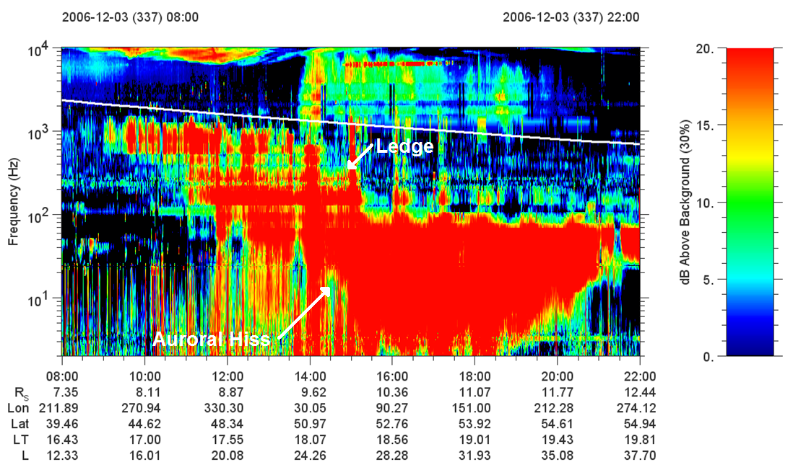

Slide 3
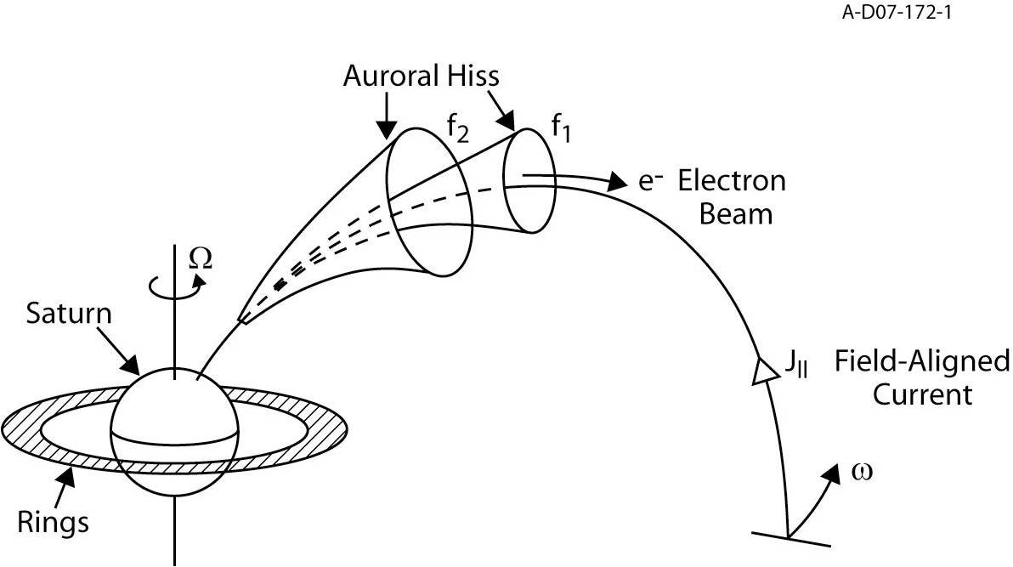
Theory of Auroral Hiss

Slide 4
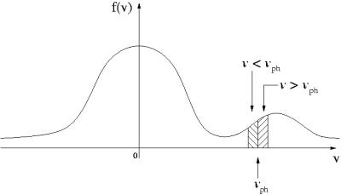
A Beam-Driven Instability

Slide 5
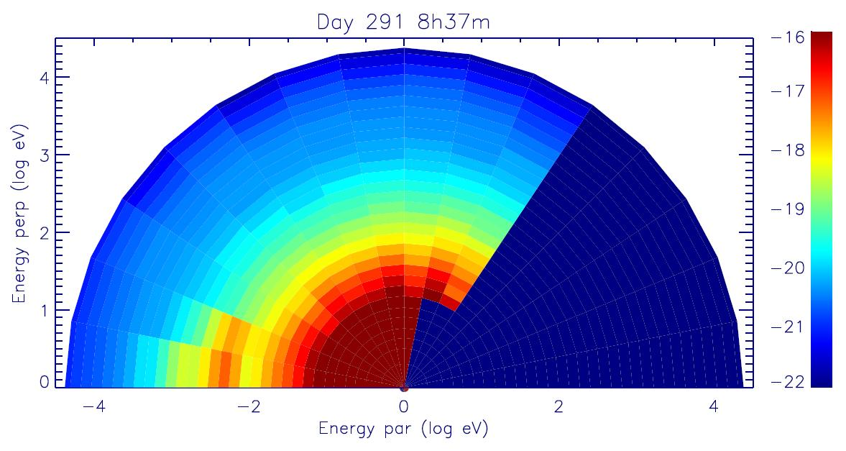
CAPS-ELS Spectrogram

Slide 6
The Numerical Approach
Waves in Homogeneous Anisotropic Multicomponent Plasmas (WHAMP)
Solves dispersion relation of waves in magnetized plasmas with Maxwellian velocity distributions
Each component specified by density, temperature, particle mass, anisotropy, and drift velocity
For given values of k, will yield real and imaginary (growth) parts of frequency

Slide 7
The Analytical Approach
Often unsolvable due to the complexity of the system, requires making a few assumptions.
Following a similar approach to Morgan et al. (1994), we start with the derived equation by Kennel (1966).
Kennel’s equation is lengthy, and requires a series of assumptions to reduce to a form that is useful in this calculation.

Slide 8
Assumptions & Approximations
Weak Growth (γ<<ω)
Resonance Cone Propagation
Ions play a negligible role
ω_{c}² >> ω_{p}² > ω²
Only m=0 Bessel function is significant
λ >> r_{c}

Slide 9
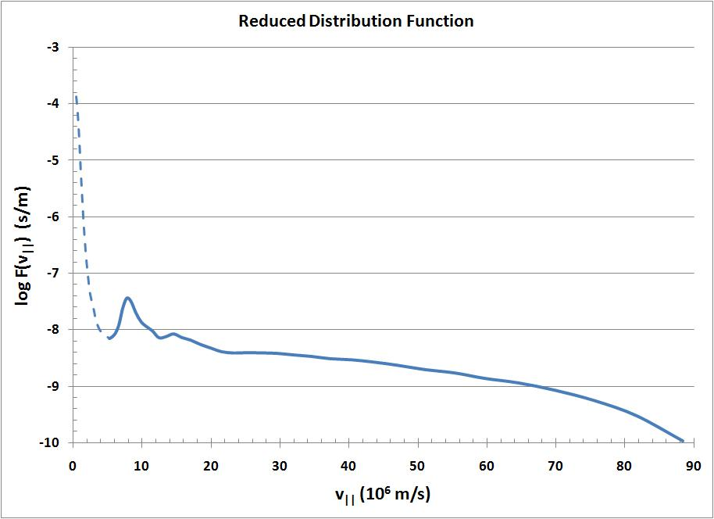

Slide 10
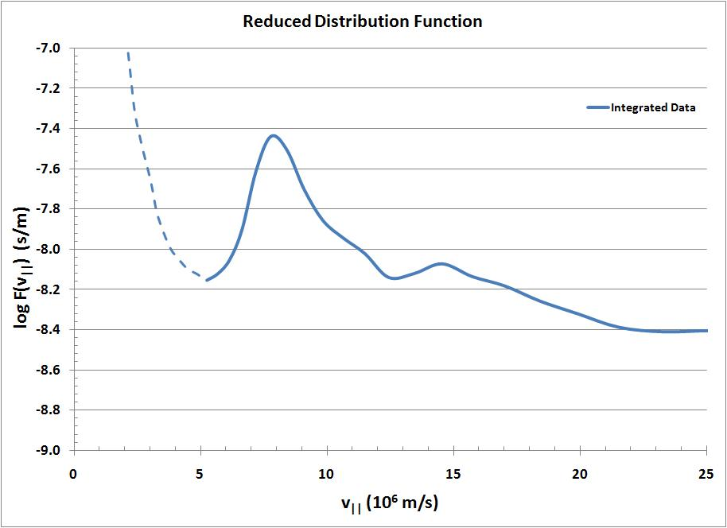

Slide 11
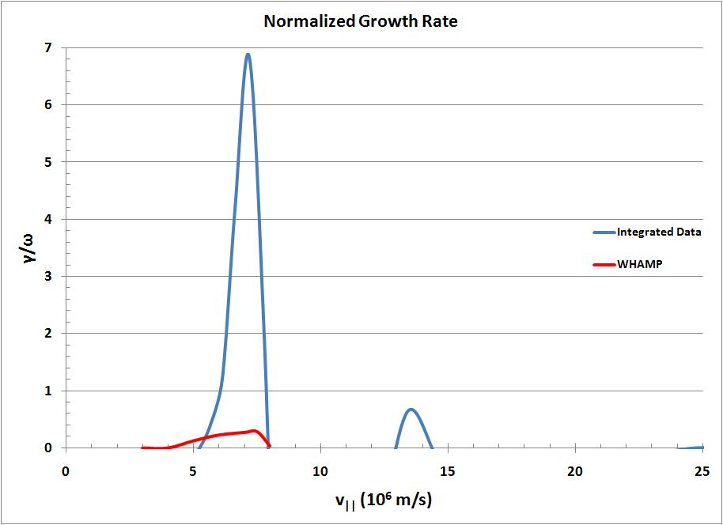

Slide 12
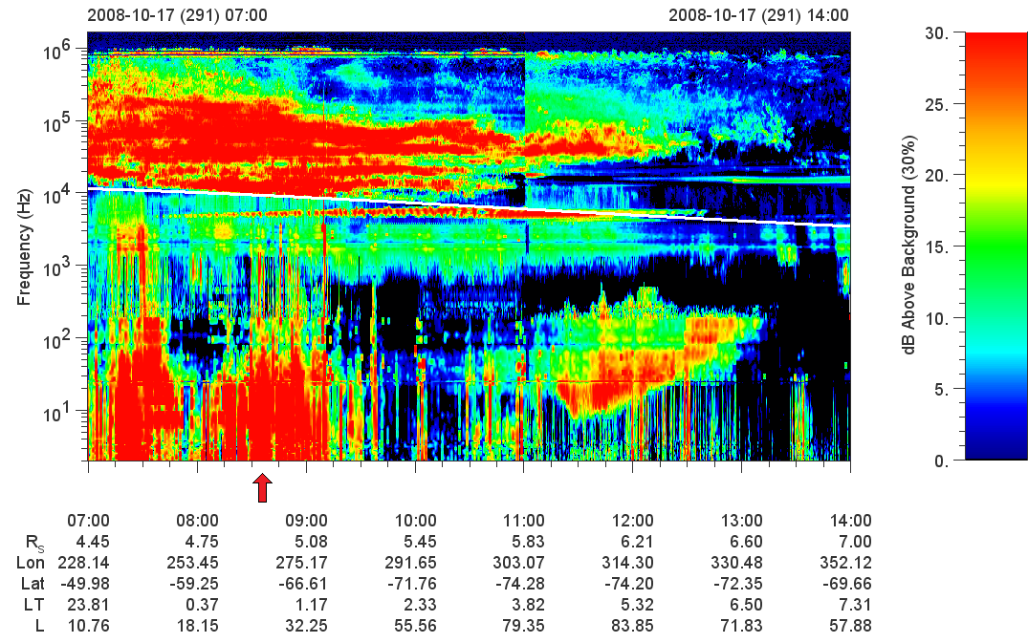

Slide 13
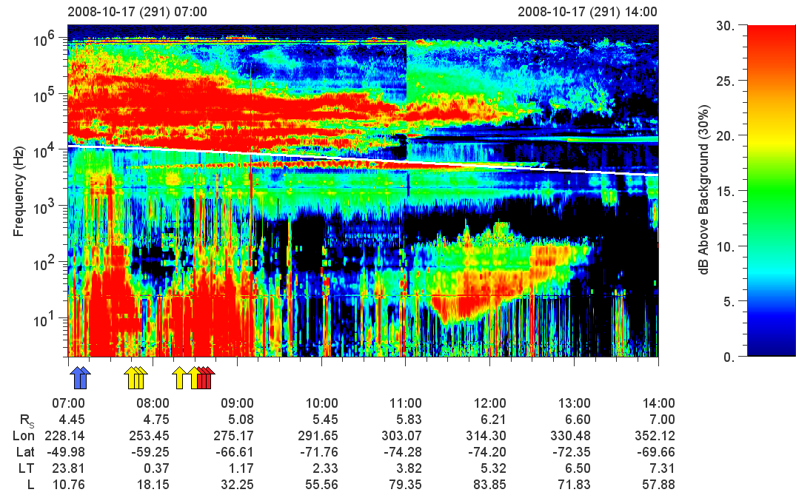

Slide 14
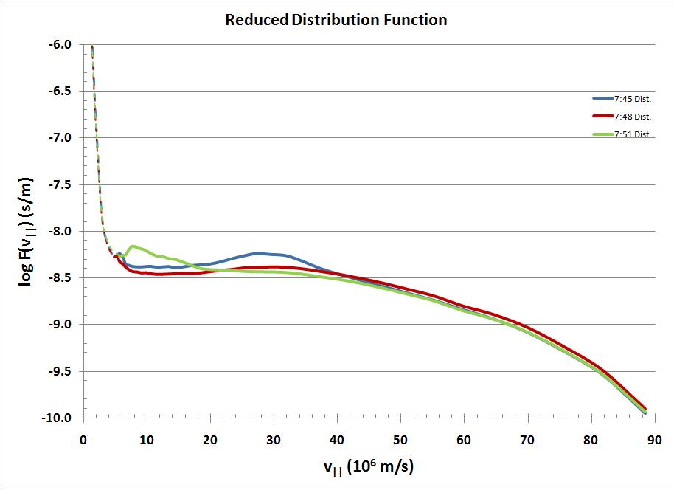

Slide 15
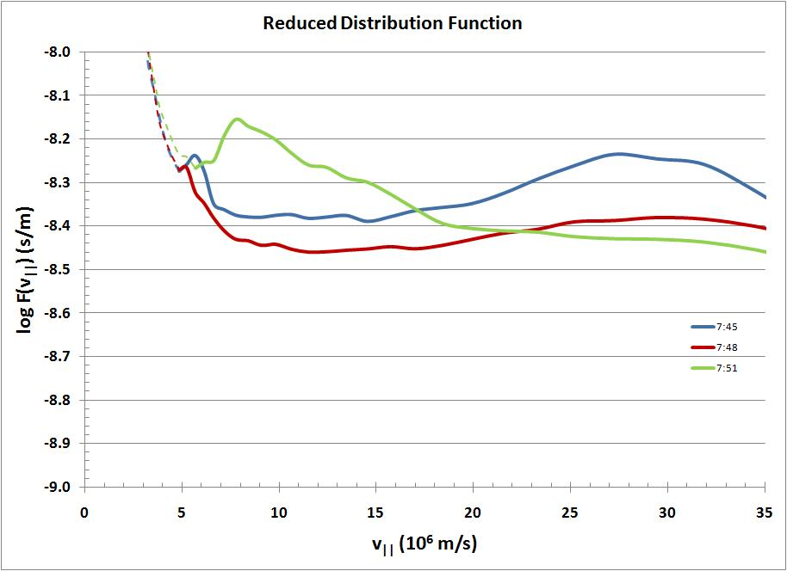

Slide 16
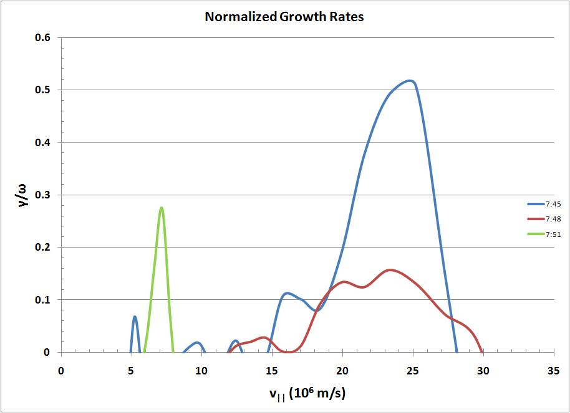

Slide 17


Slide 18
Conclusions
Multiple Day 291 beam events are significant enough to produce the auroral hiss emission.
Although analytical and numerical models produce different results for 8:35, both indicate very high growth rates.
Overly large growth rates in analytical results indicate breakdown in γ<<ω assumption.
Beams from other orbits are required to confirm and expand on these results.

