Slide 1
A Multi-Instrument Study of Auroral Hiss Emissions at Saturn Observed with Cassini
A.J. Kopf, D.A. Gurnett, G.B. Hospodarsky, W.S. Kurth, M.K. Dougherty, D.G. Mitchell, J.S. Leisner

Slide 2
AURORAL HISS
Auroral hiss is a whistler-mode emission observed in high-latitude regions of the magnetosphere
Was first observed at Earth in 1960s. Has since been detected on other planets
Emission is associated with electron beams which are propagating along magnetic field lines
Emission is believed to propagate near the resonance cone around field-aligned currents
Displays a characteristic funnel shape when plotted on a frequency-time spectrogram

Slide 3
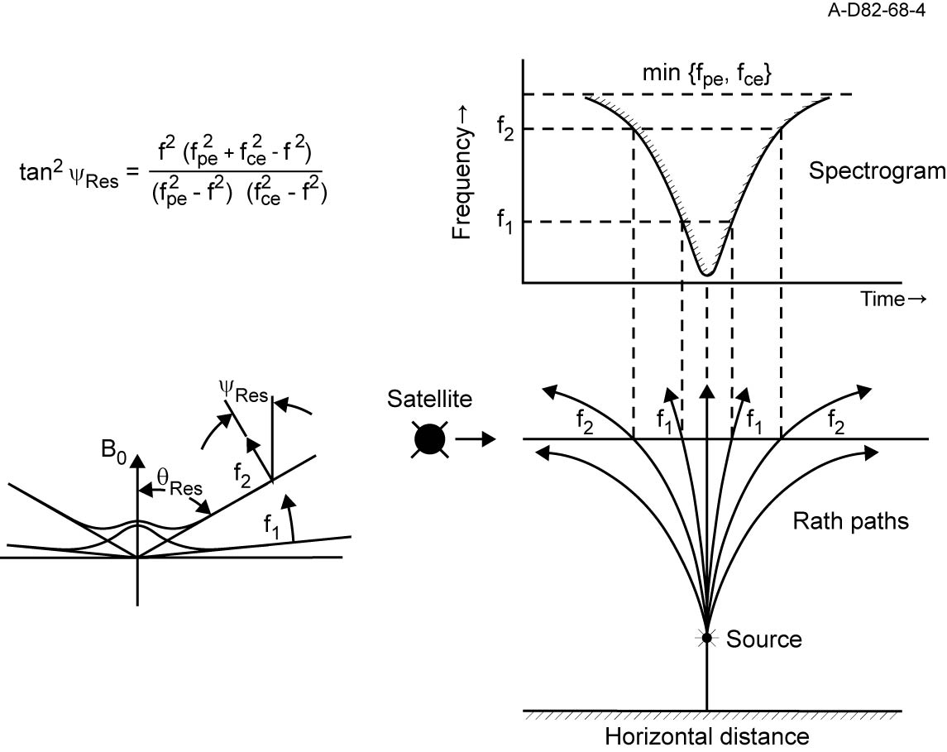
Resonance Cone & Funnel Shape

Slide 4
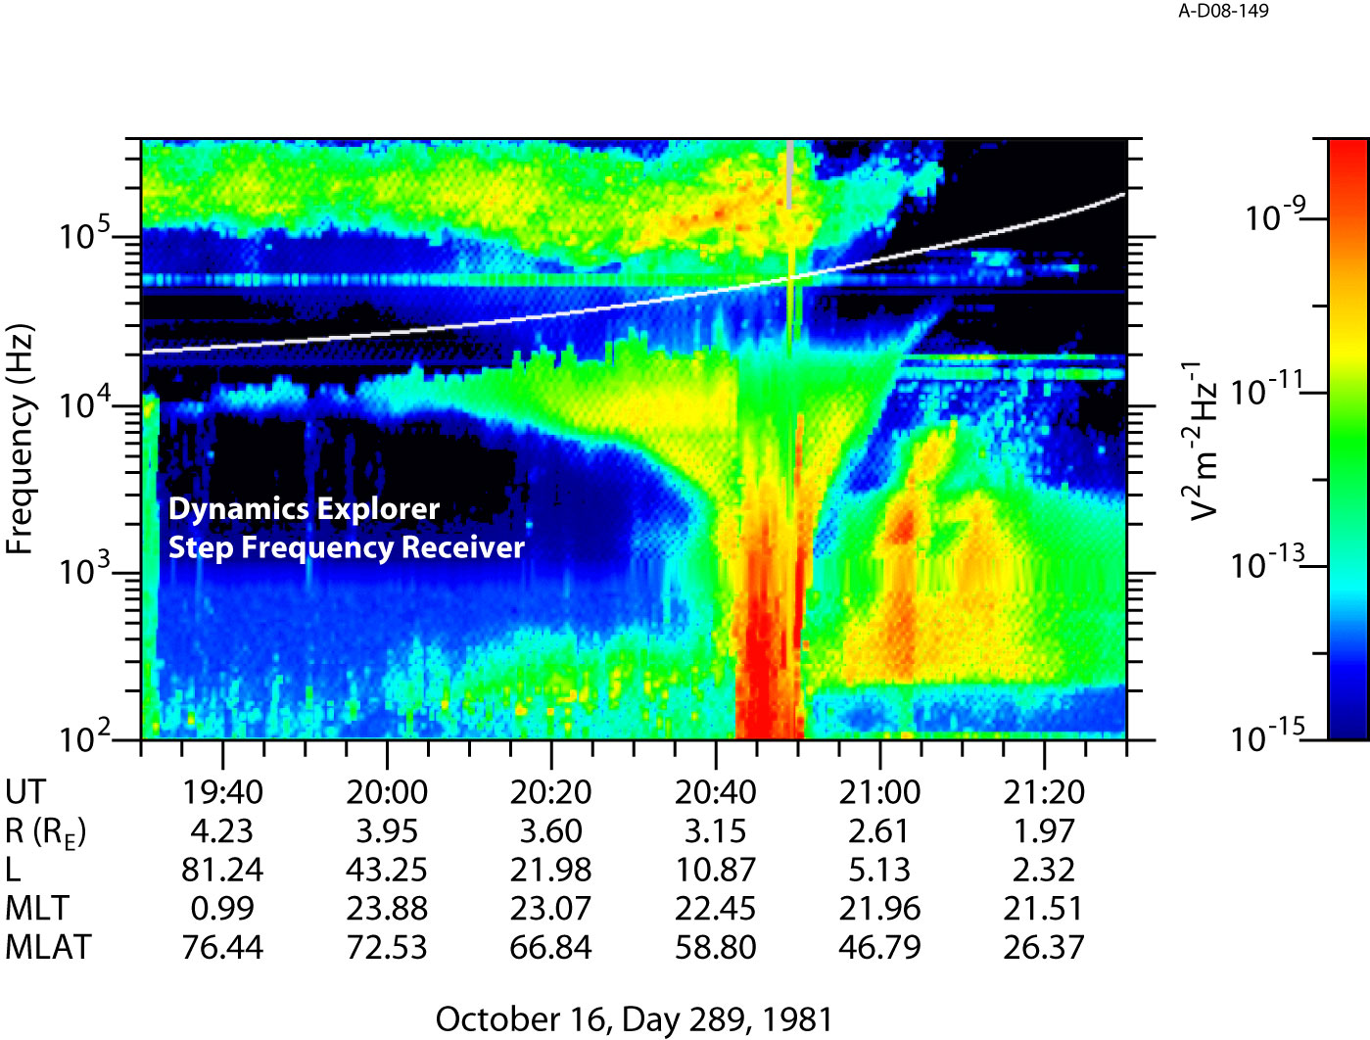
Auroral Hiss at Earth

Slide 5
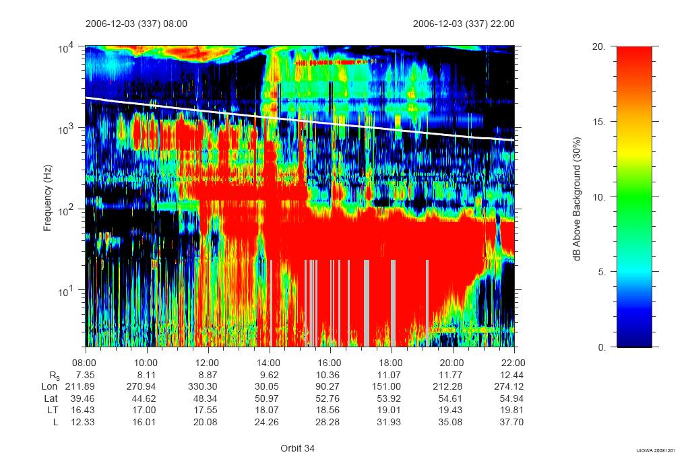
Auroral Hiss at Saturn

Slide 6
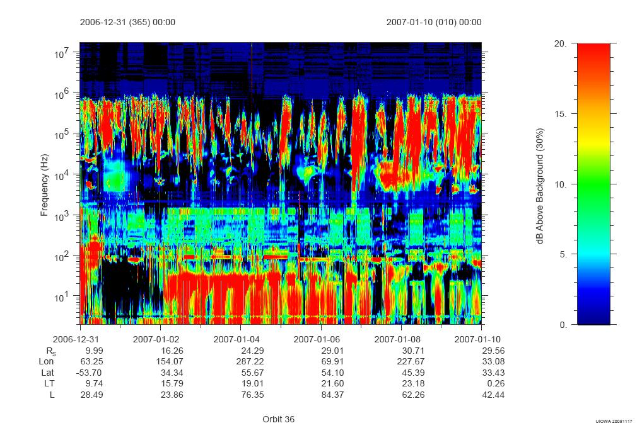
Periodic Nature

Slide 7
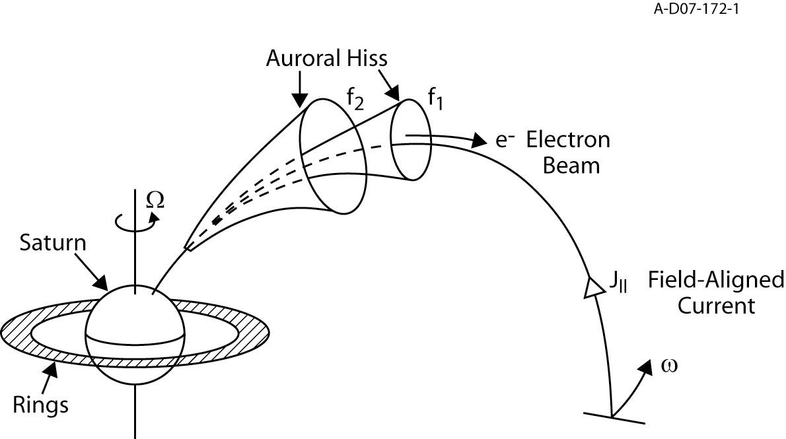
The Generation & Propagation of Auroral Hiss

Slide 8
Coverage and Detection

Slide 9
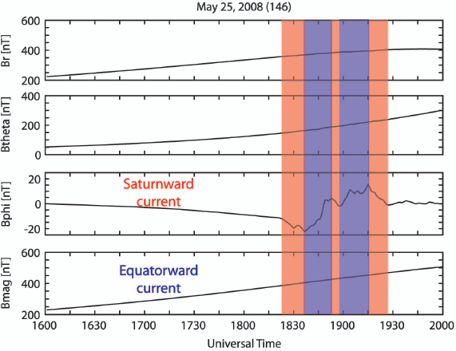
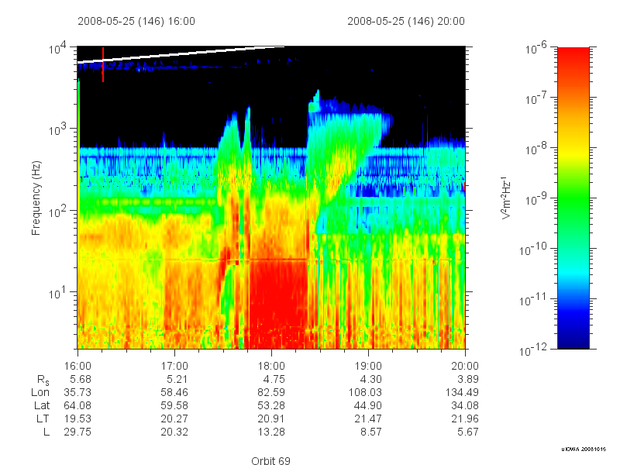

Slide 10
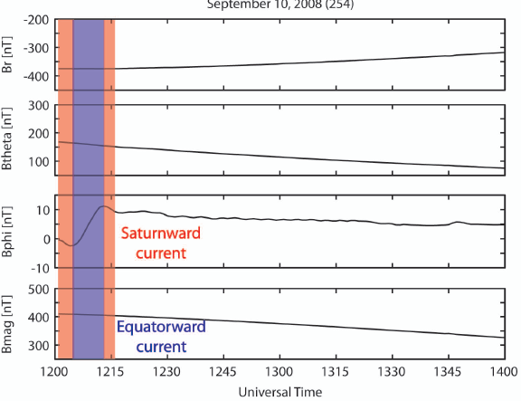
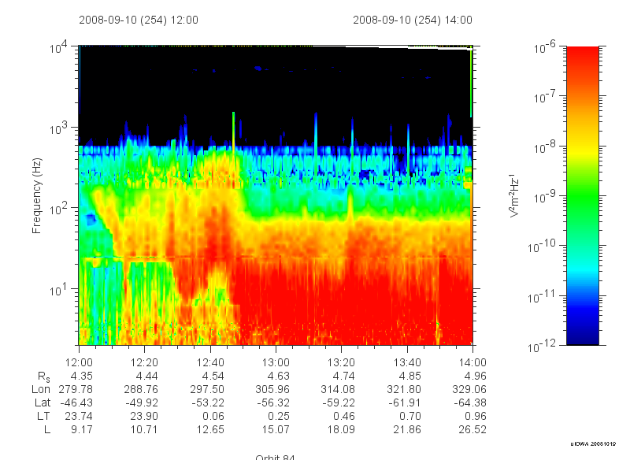

Slide 11
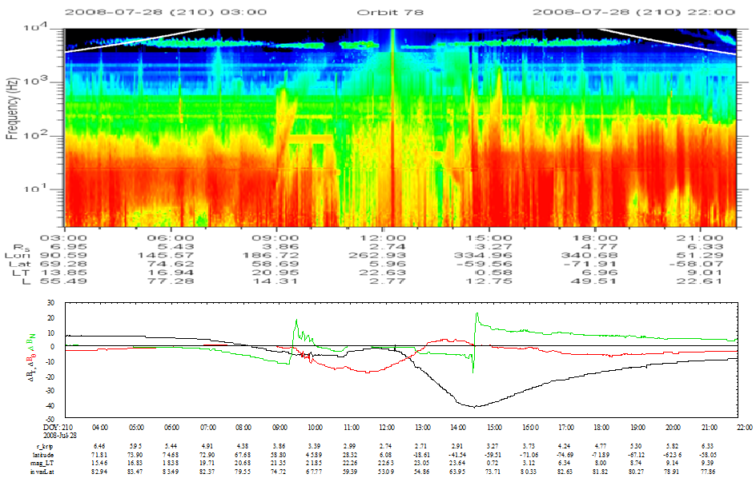

Slide 12
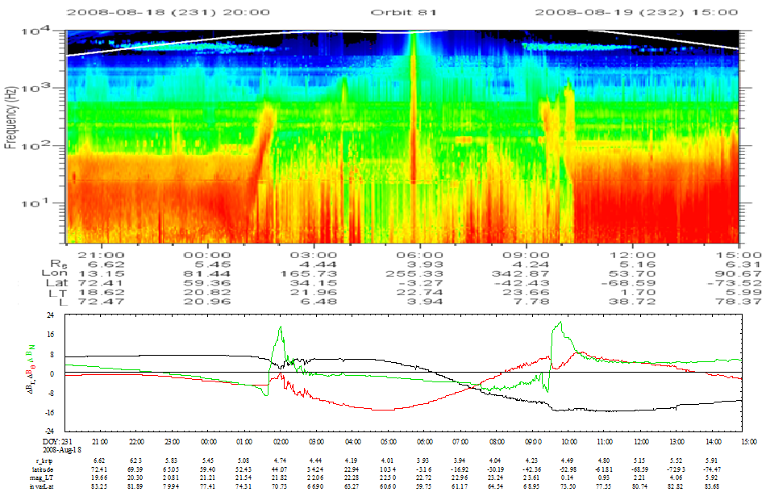

Slide 13
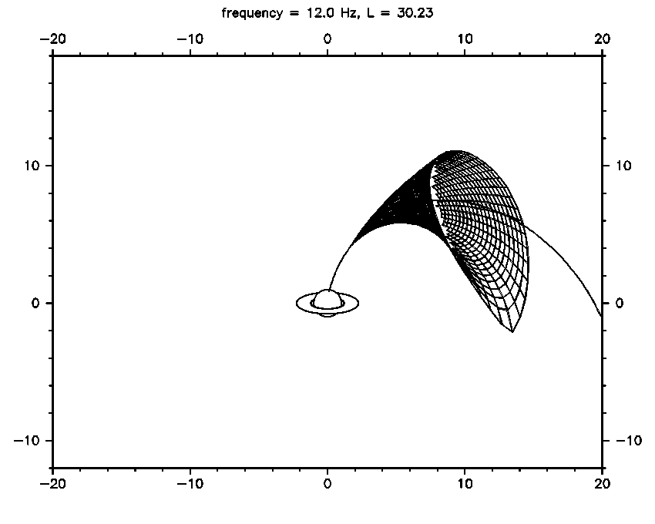
Ray Tracing

Slide 14
SUMMARY
Whistler mode auroral hiss events have been detected at Saturn, display the characteristic properties observed previously at Earth
Emission shows two periodicities
1 hour burst periodicity associated with ion conics
10.8 hour rotating beam source periodicity
Field-aligned current structures are commonly observed, but appear at equatorward edge of auroral hiss
Current work is focused on incorporating particle data and using ray tracing to map the emission back to a source region

